Slide 1

CS654: Digital Image Analysis
Lecture 32 (2): Image Morphology: Algorithms and Applications

Slide 2
Recap of Lecture 32
Opening
Closing
Hit-or-Miss Transform
Thinning
Thickening
Convex Hull

Slide 3
Outline of Lecture 32 (2)
Morphological Algorithms
Morphological Reconstruction
Segmentation (Watershadding)

Slide 4
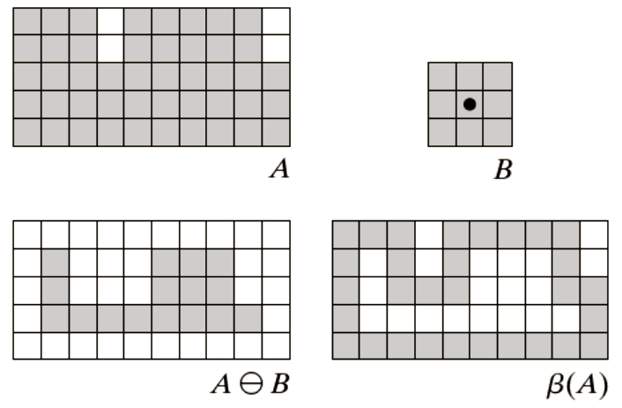

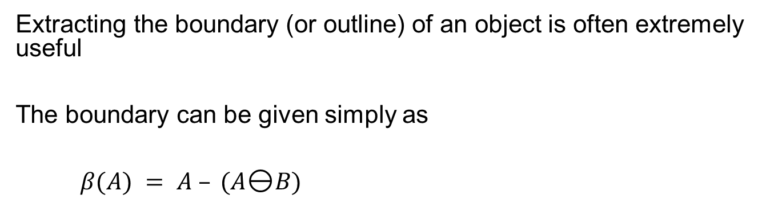
Boundary extraction
Extracting the boundary (or outline) of an object is often extremely useful
The boundary can be given simply as
$β(A) = A – (AB)$
$β(A)$= Boundary of a region $A$

Slide 5
Boundary extraction example
A simple image and the result of performing boundary extraction using a square 3*3 structuring element

Slide 6
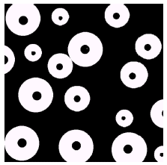
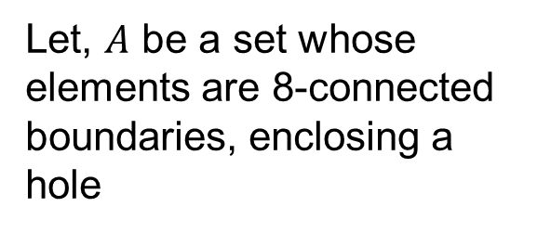
Hole Filling (Region Filling)
A hole is defined as a background region surrounded by a connected border of foreground pixels.
Let, $A$ be a set whose elements are 8-connected boundaries, enclosing a hole
Given a point inside here, can we fill the whole circle?

Slide 7
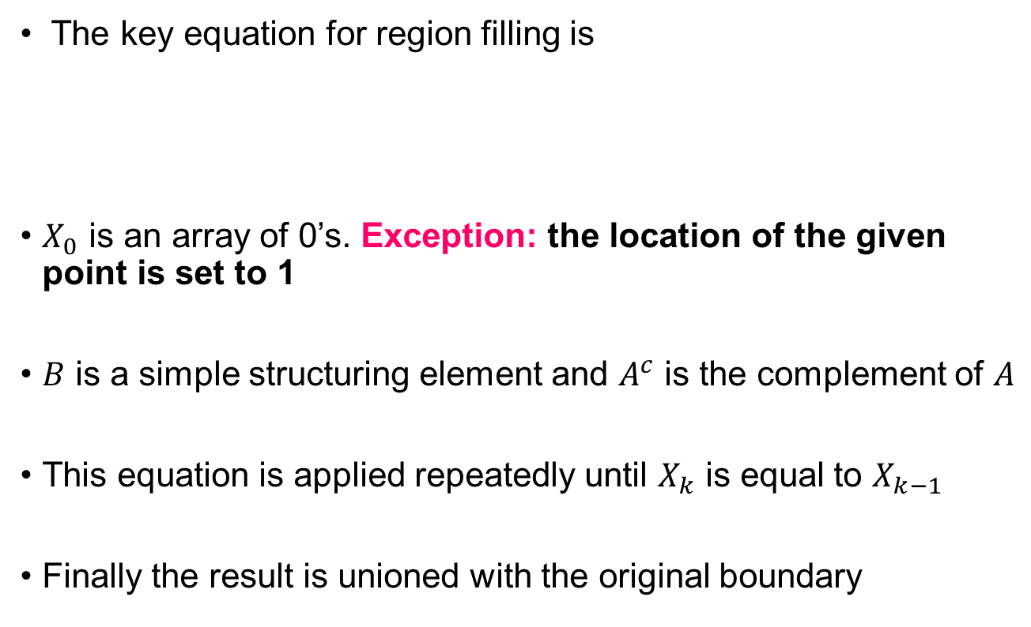
Morphological Region Filling
The key equation for region filling is
$X_{0}$ is an array of 0’s. Exception: the location of the given point is set to 1
$B$ is a simple structuring element and $A^{c}$ is the complement of $A$
This equation is applied repeatedly until $X_{k}$ is equal to $X_{k−1}$
Finally the result is unioned with the original boundary

Slide 8
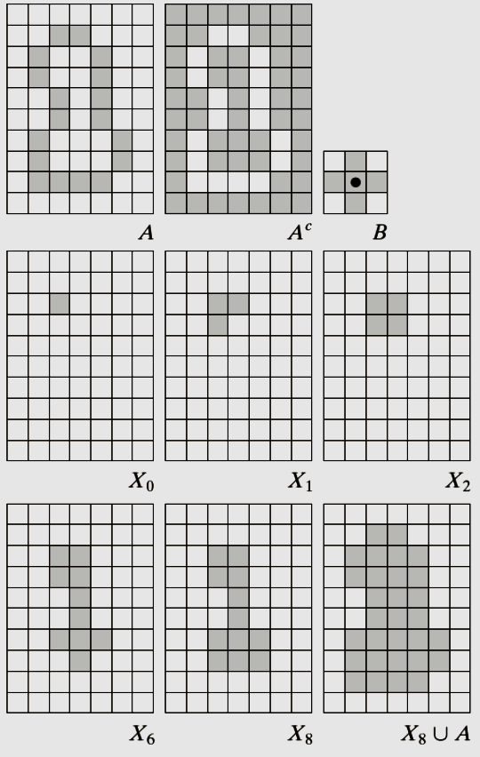
Region filling: Example

Slide 9
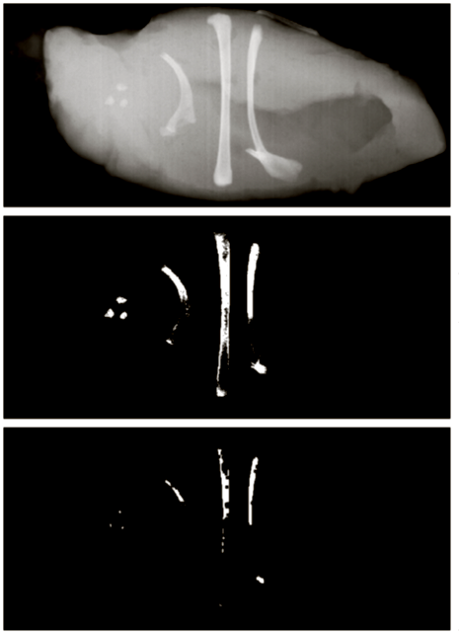

Extraction of Connected Component
Identifiers are of similar meaning to the ones used for boundary extraction
Note the change in $A$

Slide 10
Morphological Reconstruction
It is a morphological transformation involving two images and a structuring element
One image, the marker, is the starting point for the transformation
The other image, the mask, constrains the transformation.
The structuring element used defines connectivity.

Slide 11

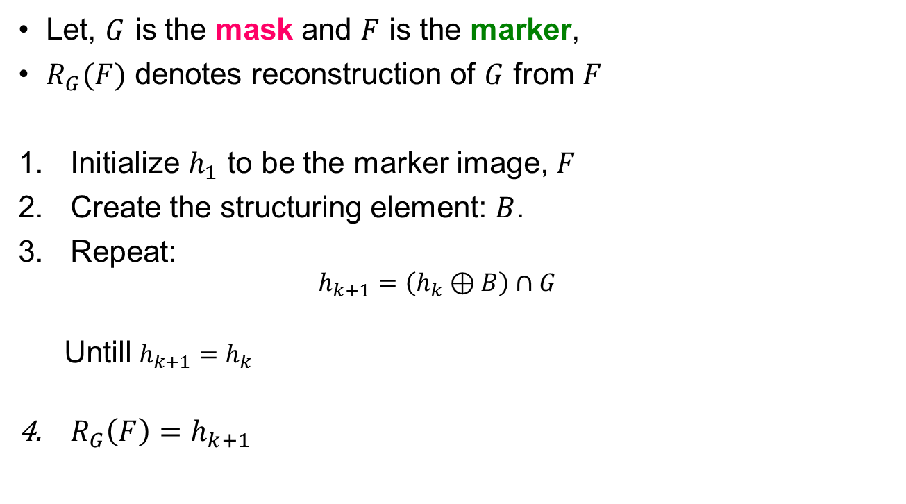
Reconstruction based on Dilation
Let, $G$ is the mask and $F$ is the marker,
$R_{G}(F)$ denotes reconstruction of $G$ from $F$
Initialize $h_{1}$ to be the marker image, $F$
Create the structuring element: $B$.
Repeat:
$$h_{k+1}=\left(h_{k}⊕B\right)∩G$$
Untill $h_{k+1}=h_{k}$
$R_{G}\left(F\right)=h_{k+1}$
Marker $F$ must be a subset of $G$

Slide 12

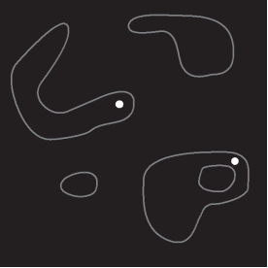
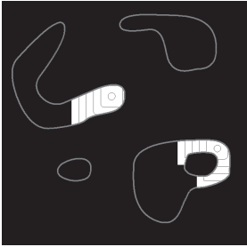
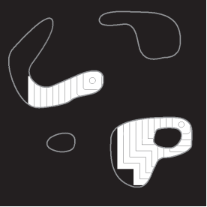
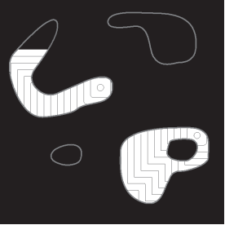

Morphological Reconstruction: Example
Original image (mask)
Marker Image
100 iteration
200 iteration
300 iteration
Final image

Slide 13
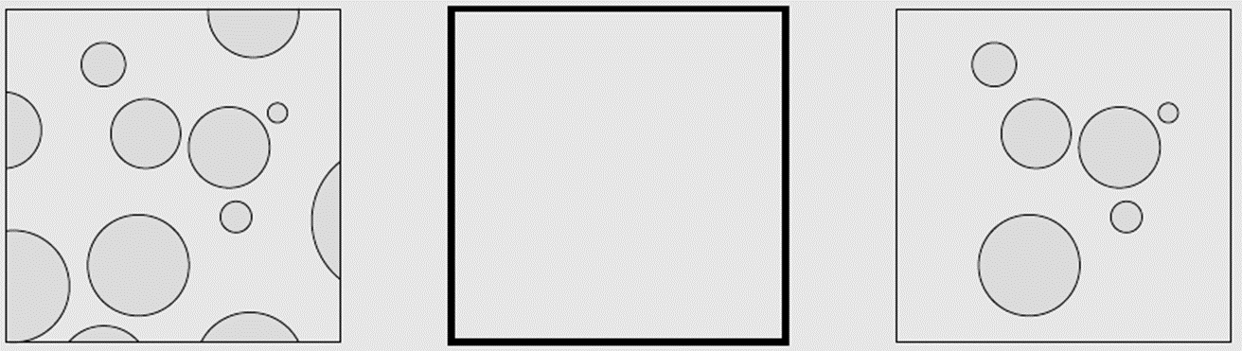
Clearing Border Objects
Original
reconstructed
Original
Mask

Slide 14
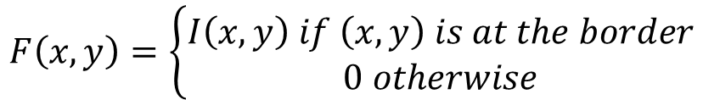
Clearing Border Objects
Removing objects that touch the border of an image
Key task is to select the appropriate marker to achieve the desired effect
$$F\left(x,y\right)=\left\{\begin{aligned}I\left(x,y\right) if \left(x,y\right) is at the border \\ 0 otherwise\end{aligned}\right.$$
$H=R_{I}(F)$ will contain object touching the border
$I−H$ will contain objects that do not touch the border

Slide 15
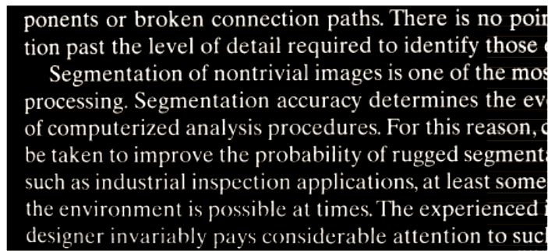
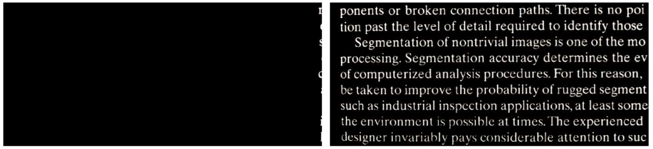
Border clearing example
Original image
Marker image
Resultant image

Slide 16
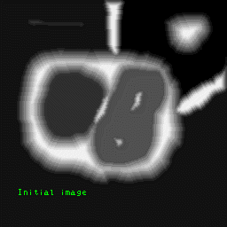
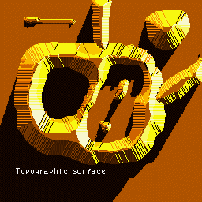
Image segmentation and mathematical morphology
Any gray-scale image can be considered as a topographic surface
The topography of an area could also mean the surface shape and features themselves.
Image source: Centre for Mathematical Morphology, MINES, France

Slide 17
Watershed Transformation principle
Flood this topological surface from its minima
Prevent the merging of the waters coming from different sources,
The image is partitioned into two different sets
The catchment basins and the watershed lines

