Slide 1

CS654: Digital Image Analysis
Lecture 32: Image Morphology: Open, Closing and Transforms

Slide 2
Recap of Lecture 31
Image morphology
Set operation on images
Dilation – translation, union
Erosion – translation, intersection
Structuring elements

Slide 3
Outline of Lecture 32
Opening
Closing
Morphological Algorithms
Morphological reconstruction

Slide 4
Opening & Closing
Opening and Closing are two important operators from mathematical morphology
They are both derived from the fundamental operations of erosion and dilation
They are normally applied to binary images

Slide 5





Open and Close
Close = Dilate followed by Erode
Open = Erode followed by Dilate
Original image
eroded
dilated
dilated
eroded
Open
Close

Slide 6
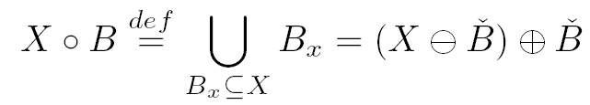

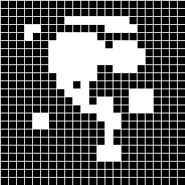
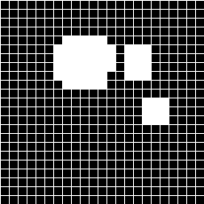
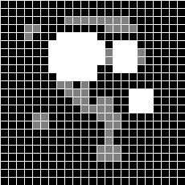

Opening
also
Supresses :
small islands
ithsmus (narrow unions)
narrow caps
difference

Slide 7
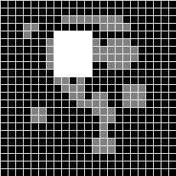
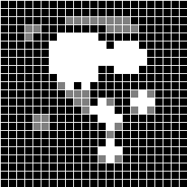


Opening with other structuring elements

Slide 8
Comparison of Opening and Erosion
Opening is defined as an erosion followed by a dilation using the same structuring element
The basic effect of an opening is similar to erosion
Tends to remove some of the foreground pixels from the edges of regions of foreground pixels
Less destructive than erosion
The exact operation is determined by a structuring element.

Slide 9
Opening Example
What combination of erosion and dilation gives:
cleaned binary image
object is the same size as in original
Original

Slide 10
Opening Example Cont
Erode original image.
Dilate eroded image.
Smooths object boundaries, eliminates noise (isolated pixels) and maintains object size.
Original
Erode
Dilate

Slide 11
One more example of Opening
Erosion can be used to eliminate small clumps of undesirable foreground pixels, e.g. “salt noise”
However, it affects all regions of foreground pixels indiscriminately
Opening gets around this by performing both an erosion and a dilation on the image

Slide 12
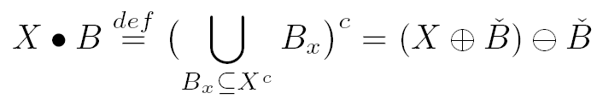

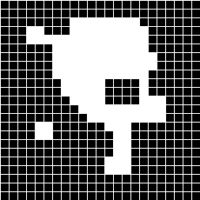
Closing
also
Supresses :
small lakes (holes)
channels (narrow separations)
narrow bays

Slide 13


Closing with other structuring elements
With bigger rectangle like this
With smaller cross like this

Slide 14
Close
Dilation followed by erosion
Serves to close up cracks in objects and holes due to pepper noise
Does not significantly change object size

Slide 15
More examples of Closing
What combination of erosion and dilation gives:
cleaned binary image
object is the same size as in original
Original

Slide 16
More examples of Closing cont
Dilate original image.
Erode dilated image.
Smooths object boundaries, eliminates noise (holes) and maintains object size.
Original
Dilate
Erode

Slide 17
Closing as dual to Opening
Closing, like its dual operator opening, is derived from the fundamental operations of erosion and dilation.
Normally applied to binary images
Tends to enlarge the boundaries of foreground regions
Less destructive of the original boundary shape
The exact operation is determined by a structuring element.

Slide 18
One more example of Closing

Slide 19
Mathematical Definitions of Opening and Closing
Opening and closing are iteratively applied dilation and erosion
Opening
Closing

Slide 20
Relation of Opening and Closing
Difference is only in corners

Slide 21
Opening and Closing are idempotent
Their reapplication has not further effects to the previously transformed result

Slide 22
Properties of Opening and Closing
Translation invariance
Antiextensivity of opening
Extensivity of closing
Duality

Slide 23
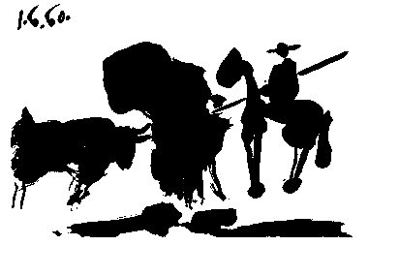



Example of Openings with various sizes of structuring elements
Structuring
Element
Pablo Picasso, Pass with the Cape, 1960

Slide 24

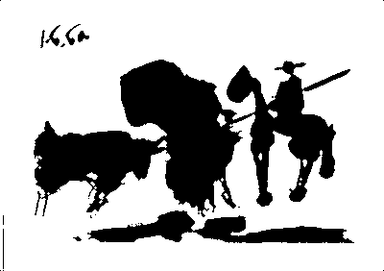

Example of Closings with various sizes of structuring elements
Structuring
Element

Slide 25

Extensive vs. Anti-extensive
Dilation and closing are extensive operations
Erosion and opening are anti-extensive operations

Slide 26










Application: Papilary lines recognition

Slide 27
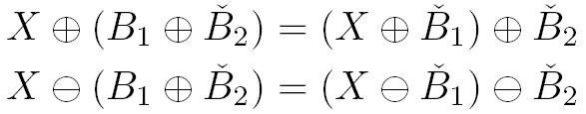
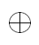
Decomposition of structuring elements
Big structuring elements can be splitted (seperated) into smaller structuring elements

Slide 28
Hit-and-Miss Transform
Binary morphological operation
Used to detect particular patterns of foreground and background pixels in an image
Input: a binary image and a structuring element
Output: another binary image

Slide 29
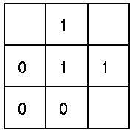
How it works
The structuring element is a slight extension to the type that has been used for dilation and erosion
It contains both 1’s and 0’s
FG
If the foreground and background pixels in the structuring element exactly match foreground and background pixels in the image, then
BG
The pixel underneath the origin of the structuring element is set to the foreground color.
DC
If it doesn't match, then that pixel is set to the background color.

Slide 30


Mathematical notation of Hit-or-Miss
Hit-or-miss :
Bi-phase structuring element
“Hit” part
(white)
“Miss” part
(black)

Slide 31


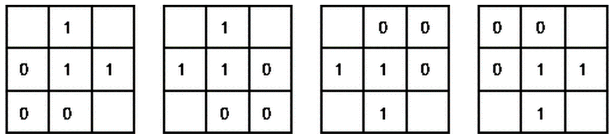
Hit-or-Miss: Example

Slide 32

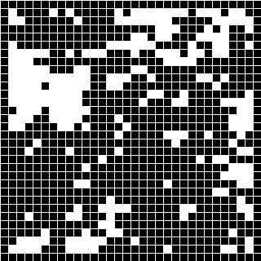
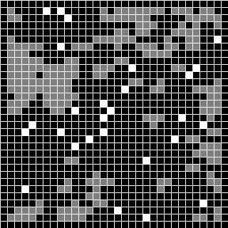
Hit-or-Miss: More example
isolated points at 4 connectivity

Slide 33
Morphological algorithms
Simple techniques can be combined to get more interesting morphological algorithms
Boundary extraction
Region filling
Extraction of connected components
Thinning/ thickening
Skeletonisation

Slide 34


Thickening and Thinning
Thinning :
Thickenning :
Depending on the structuring elements (actually, series of them), very different results can be achieved :
Prunning
Skeletons
Zone of influence
Convex hull
...

Slide 35

Thinning: Structuring elements
0 | 0 | 0
 | 1
1 | 1 | 1
 | 0 | 0
1 | 1 | 0
 | 1
0 |  | 1
0 | 1 | 1
0 |  | 1
0 | 0
0 | 1 | 1
 | 1
1 |  | 0
1 | 1 | 0
1 |  | 0
 | 1
1 | 1 | 0
 | 0 | 0
1 | 1 | 1
 | 1
0 | 0 | 0
 | 1
0 | 1 | 1
0 | 0

Slide 36
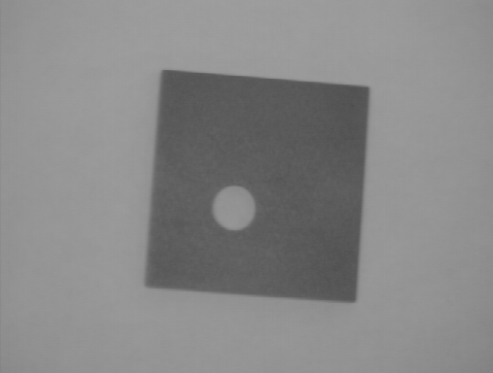
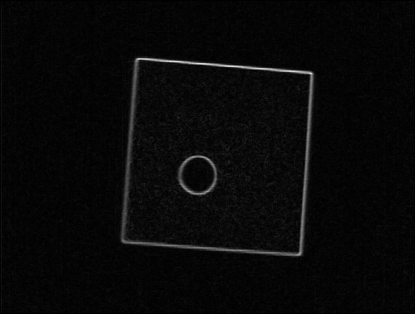
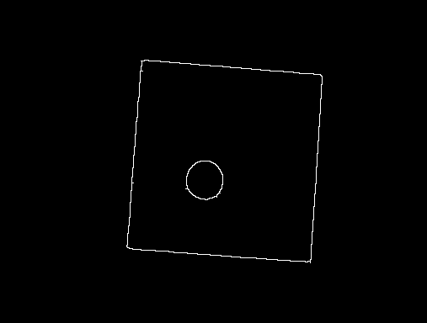
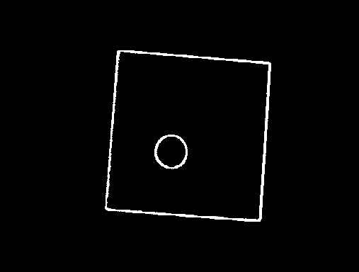
Application of thinning: Edge thinning
Sobel Edge Detection
Binary threshold
Iterative thinning

Slide 37

Application of thinning: Pruning
0 | 0 | 0
0 | 1 | 0
0
0 | 0 | 0
0 | 1 | 0
 |  | 0

Slide 38
Application of Thickening: Convex Hull
Imagine stretching an elastic band around the shape
1 | 1
1 | 0
1 |  | 0
 | 1 | 1
 | 0 | 1
0 |  | 1
1 |  | 0
1 | 0
1 | 1
1 | 1 | 1
1 | 0
 |  | 0
 | 1 | 1
 | 0 | 1
0 |  | 1
0
 | 0 | 1
1 | 1 | 1
0
 | 0 | 1
1 | 1 | 1
1 |  | 0
1 | 0
1 | 1

Slide 39




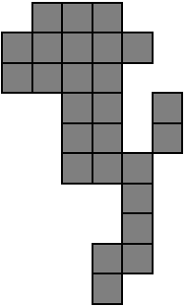
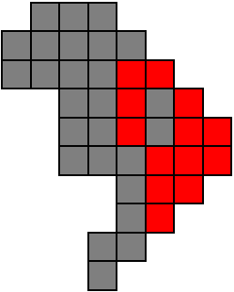
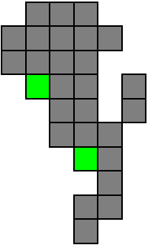
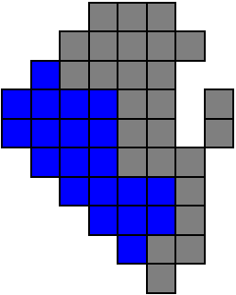
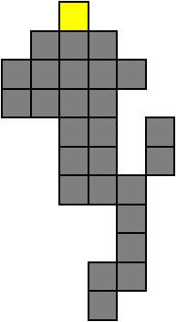
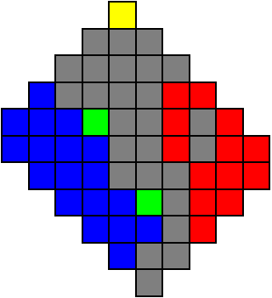
Convex Hull using thickening
Original shaper
Thickening with first mask
Union of four thickenings

Slide 40
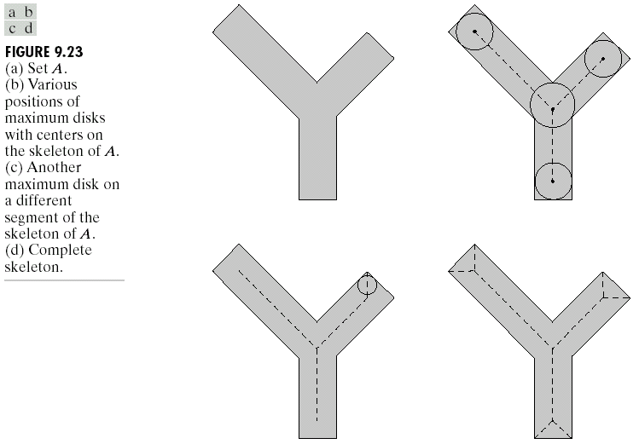
Skeletonization
Maximal disk :
Disk centered at x, D_{x}, such that D_{x} ⊆ X and no other D_{y} contains it .
Skeleton :
Union of centers of maximal disks.

Slide 41
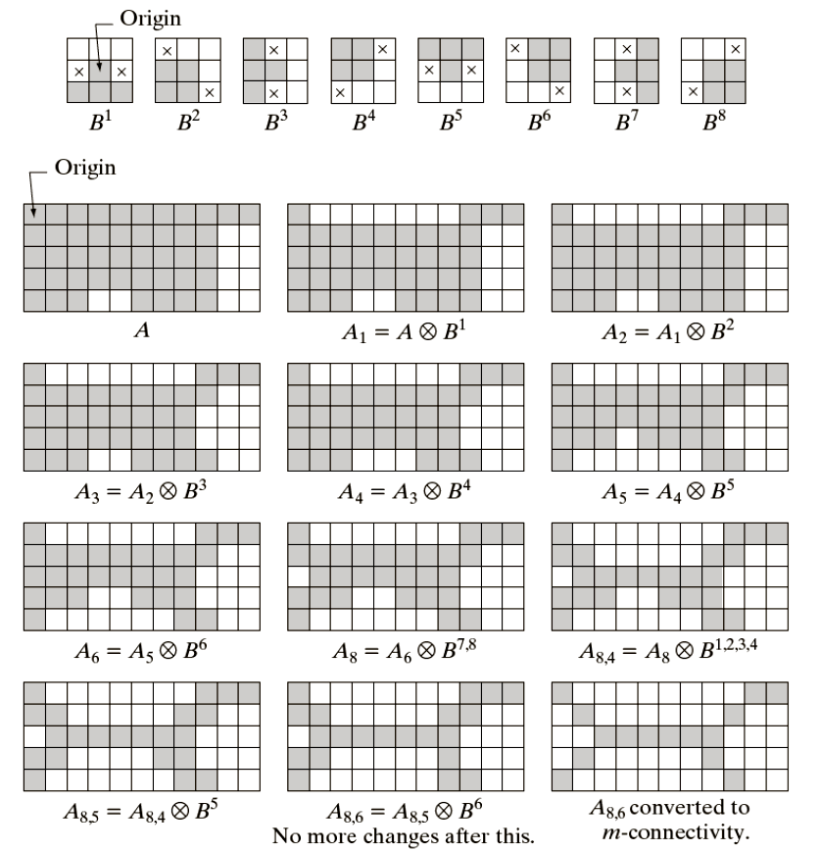
Example: Skeletonization using Thinning

Slide 42
Thank you
Next Lecture: DCT

