Slide 1

CS654: Digital Image Analysis
Lecture 33: Introduction to Image Compression and Coding

Slide 2
Outline of Lecture 33
Introduction to image compression
Measure of information content
Introduction to Coding
Redundancies
Image compression model

Slide 3
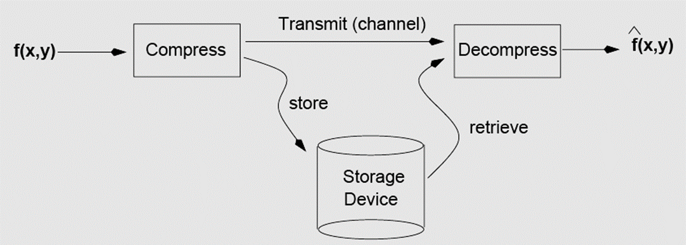
Goal of Image Compression
The goal of image compression is to reduce the amount of data required to represent a digital image

Slide 4
Approaches
Lossless
Information preserving
Lossy
Not information preserving
Low compression ratios
High compression ratios

Slide 5
Data ≠ Information
Data and information are NOT synonymous terms
Data is the means by which information is conveyed
Data compression aims to reduce the amount of data required to represent a given quantity of information
To preserve as much information as possible
The same amount of information can be represented by various amount of data

Slide 6
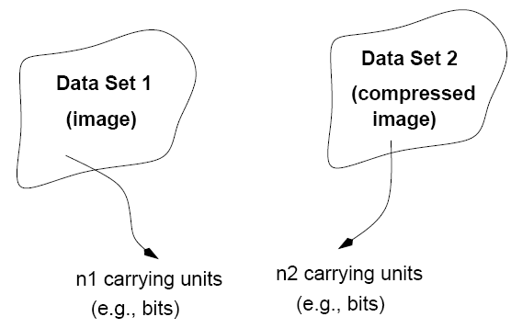
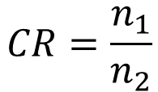
Compression Ratio (CR)
compression
Compression ratio:
$$CR=\frac{n_{1}}{n_{2}}$$

Slide 7


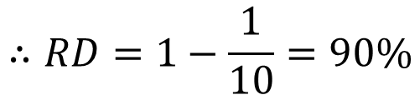
Data Redundancy
Relative data redundancy:
$$RD=1−\frac{1}{CR}$$
Example:
A compression engine represents 10 bits of information of the source data with only 1 bit. Calculate the data redundancy present in the source data.
$$CR=\frac{10}{1}$$
$$∴RD=1−\frac{1}{10}=90\%$$

Slide 8
Types of Data Redundancy
1
Coding Redundancy
Number of bits required to code
2
Interpixel Redundancy
similarity in the neighborhood.
3
Psychovisual Redundancy
irrelevant information for the human visual system
Compression attempts to reduce one or more of these redundancy types.

Slide 9
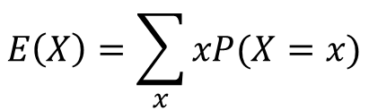
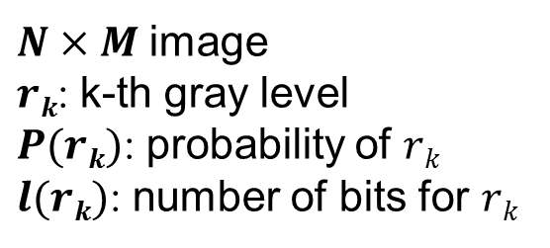

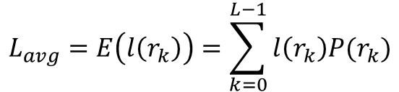
Coding Redundancy
Code: a list of symbols (letters, numbers, bits etc.)
Code word: a sequence of symbols used to represent a piece of information or an event (e.g., gray levels).
Code word length: number of symbols in each code word
$N×M$image
$rk$: k-th gray level
$P(rk)$: probability of $rk$
$l(rk)$: number of bits for $rk$
Expected value:
$$E\left(X\right)=\sum_{x}{xP(X=x)}$$
$$L_{avg}=E\left(l\left(r_{k}\right)\right)=\sum_{k=0}^{L−1}{l\left(r_{k}\right)P(r_{k})}$$
Average number of bits
Total number of bits
$${NML}_{avg}$$

Slide 10
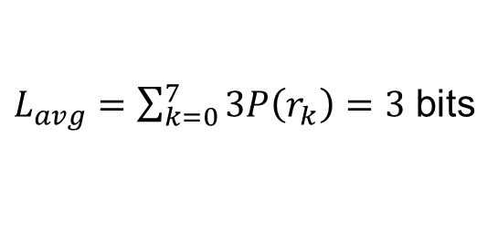
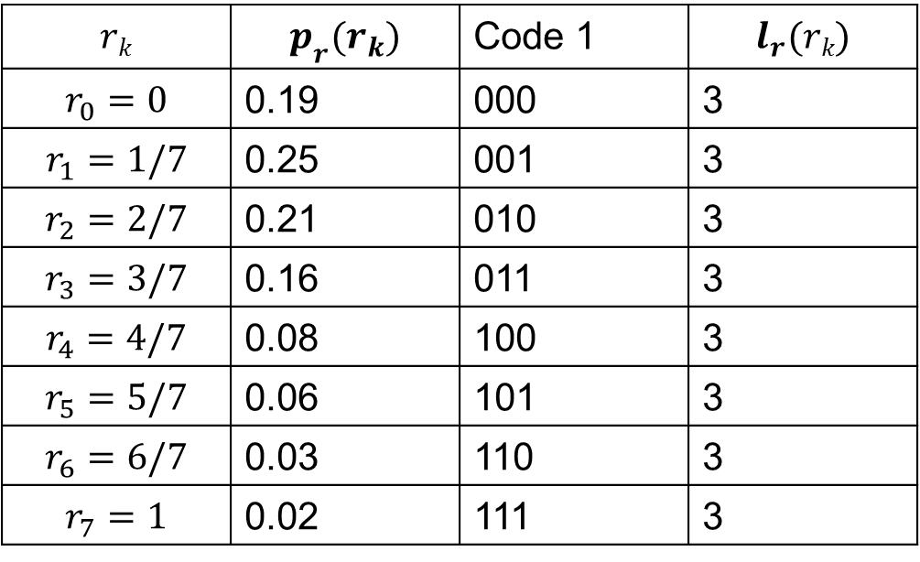

Coding Redundancy
Fixed length coding
$$rk$$ | $$p_{r}(r_{k})$$ | Code 1 | $$l_{r}(rk)$$
$$r_{0}=0$$ | 0.19 | 000 | 3
$$r_{1}=1/7$$ | 0.25 | 001 | 3
$$r_{2}=2/7$$ | 0.21 | 010 | 3
$$r_{3}=3/7$$ | 0.16 | 011 | 3
$$r_{4}=4/7$$ | 0.08 | 100 | 3
$$r_{5}=5/7$$ | 0.06 | 101 | 3
$$r_{6}=6/7$$ | 0.03 | 110 | 3
$$r_{7}=1$$ | 0.02 | 111 | 3
$L_{avg}=\sum_{k=0}^{7}{3P\left(r_{k}\right)=3}$ bits
Total number of bits
$$=3NM$$

Slide 11
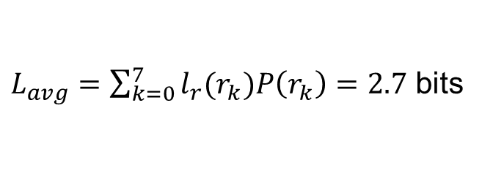
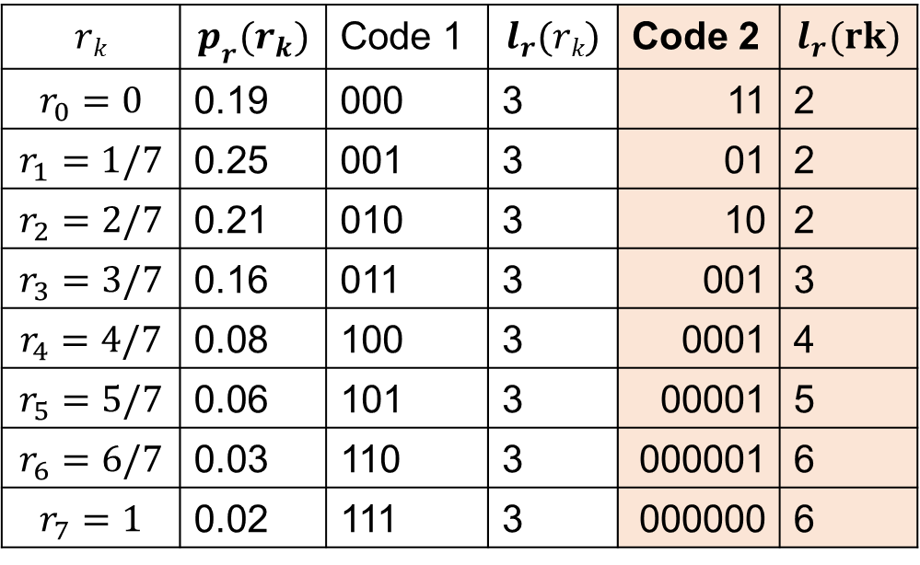


Coding Redundancy
Variable length coding
$$rk$$ | $$p_{r}(r_{k})$$ | Code 1 | $$l_{r}(rk)$$ | Code 2 | $$l_{r}(rk)$$
$$r_{0}=0$$ | 0.19 | 000 | 3 | 11 | 2
$$r_{1}=1/7$$ | 0.25 | 001 | 3 | 01 | 2
$$r_{2}=2/7$$ | 0.21 | 010 | 3 | 10 | 2
$$r_{3}=3/7$$ | 0.16 | 011 | 3 | 001 | 3
$$r_{4}=4/7$$ | 0.08 | 100 | 3 | 0001 | 4
$$r_{5}=5/7$$ | 0.06 | 101 | 3 | 00001 | 5
$$r_{6}=6/7$$ | 0.03 | 110 | 3 | 000001 | 6
$$r_{7}=1$$ | 0.02 | 111 | 3 | 000000 | 6
$L_{avg}=\sum_{k=0}^{7}{l_{r}(r_{k})P\left(r_{k}\right)=2.7}$ bits
$$CR=\frac{3}{2.7}=1.11≈10\%$$
$$RD=1−\frac{1}{1.11}=0.099$$

Slide 12
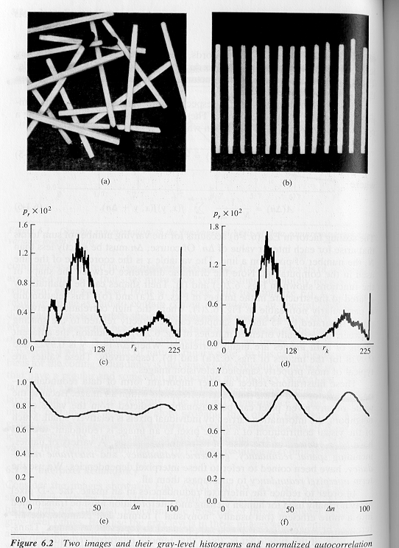
Inter-pixel redundancy
Inter-pixel redundancy implies that pixel values are correlated
A pixel value can be reasonably predicted by its neighbors
A
B

Slide 13
Psychovisual redundancy
The human eye does not respond with equal sensitivity to all visual information.
It is more sensitive to the lower frequencies than to the higher frequencies in the visual spectrum.
Discard data that is perceptually insignificant!

Slide 14
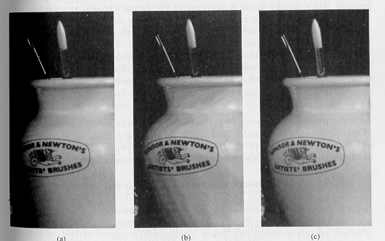
Example
256 gray levels
16 gray levels
16 gray levels/ random noise

Slide 15
Measuring Information
What is the minimum amount of data that is sufficient to describe completely an image without loss of information?
How do we measure the information content of a message/ image?

Slide 16

Modeling Information
We assume that information generation is a probabilistic process.
Associate information with probability!
A random event $E$ with probability $P(E)$ contains:
Note: $I(E)=0$when $P(E)=1$

Slide 17

How much information does a pixel contain?
Suppose that gray level values are generated by a random process, then $rk$ contains:
units of information!

Slide 18
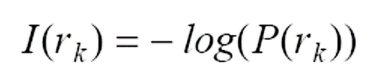
How much information does an image contain?
Average information content of an image:
using
units/pixel
(e.g., bits/pixel)
Entropy:
(assumes statistically independent random events)

Slide 19

Redundancy (revisited)
Redundancy:
where:
Note: if $Lavg= H$, then $R=0$ (no redundancy)

Slide 20


Image Compression Model
$$f(x,y)$$
Compression
Source Encoder
Channel encoder
Channel
Channel Decoder
Source decoder
Encoder
Noise tolerance
Decoder
$$f′(x,y)$$

Slide 21
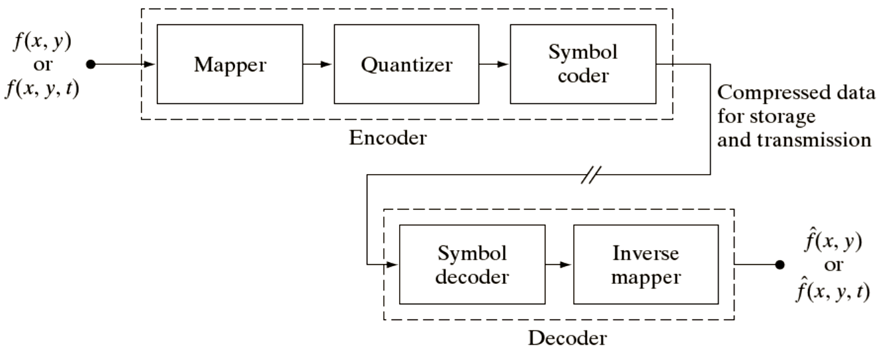
Functional blocks

Slide 22
Functional blocks
Mapper: transforms input data in a way that facilitates reduction of inter-pixel redundancies.

Slide 23
Functional blocks
Quantizer: reduces the accuracy of the mapper’s output in accordance with some pre-established fidelity criteria.

Slide 24
Functional blocks
Symbol encoder: assigns the shortest code to the most frequently occurring output values.

Slide 25
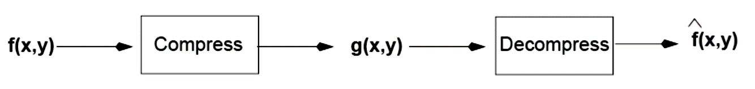



Fidelity Criteria
How close is to ?
Criteria
Subjective: based on human observers
Objective: mathematically defined criteria
Notes:
25

Slide 26
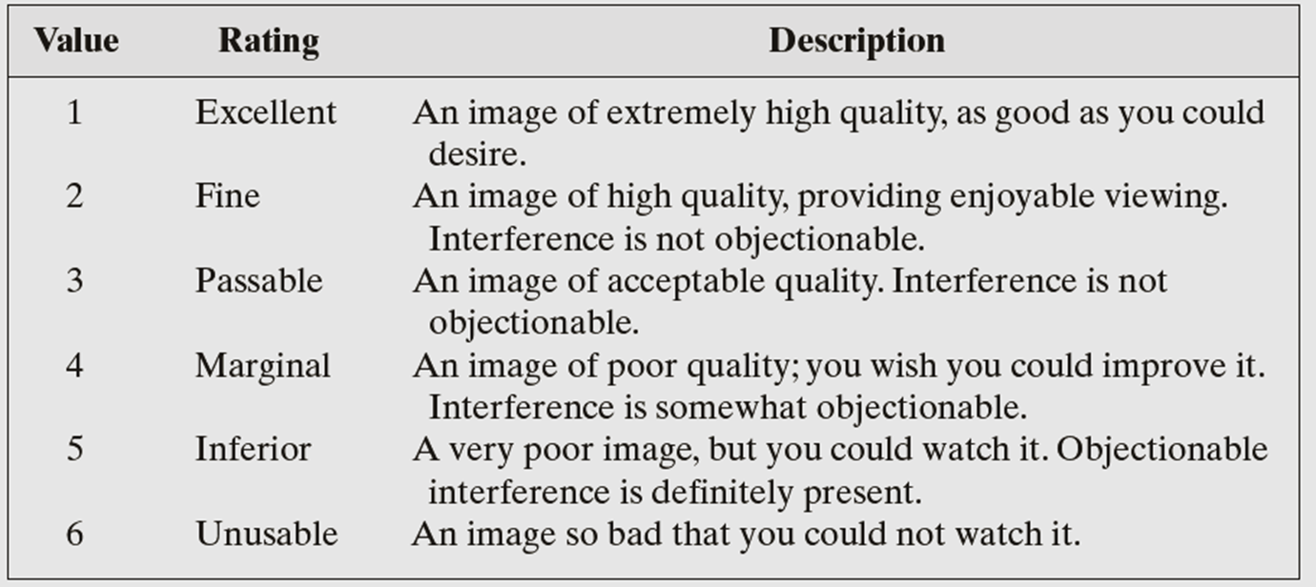
Subjective Fidelity Criteria

Slide 27
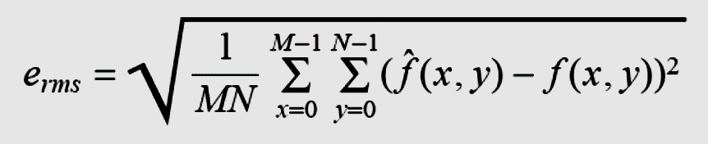
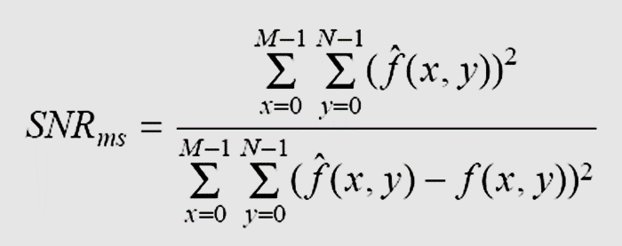
Objective Fidelity Criteria
Root mean square error (RMS)
Mean-square signal-to-noise ratio (SNR)
Notes:
27

Slide 28
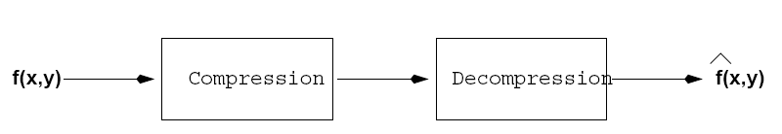
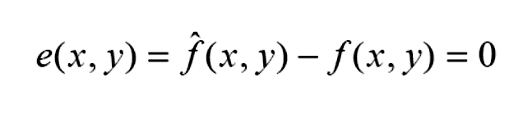
Lossless Compression
Types of coding
Repetitive Sequence Encoding
Statistical Encoding
Predictive Coding
Bitplane coding
RLE
Huffman
Arithmatic
LZW
DPCM

