Slide 1

CS654: Digital Image Analysis
Lecture 34: Different Coding Techniques

Slide 2
Recap of Lecture 33
Morphological Algorithms
Introduction to Image Compression
Data, Information
Measure of Information
Lossless and Lossy encryption

Slide 3
Outline of Lecture 34
Lossless Compression
Different Coding Techniques
RLE
Huffman
Arithmatic
LZW

Slide 4
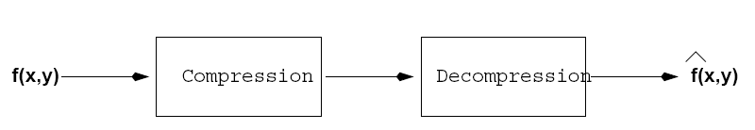
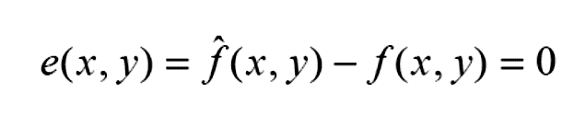
Lossless Compression
Types of coding
Repetitive Sequence Encoding
Statistical Encoding
Predictive Coding
Bitplane coding
RLE
Huffman
Arithmatic
LZW
DPCM

Slide 5
Run length Encoder - Algorithm
Start on the first element of input
Examine next value
If same as previous value
Keep a counter of consecutive values
Keep examining the next value until a different value or end of input then output the value followed by the counter. Repeat
If not same as previous value
Output the previous value followed by ‘1’ (run length). Repeat

Slide 6
Run-length coding (RLC) (inter-pixel redundancy)
Used to reduce the size of a repeating string of symbols (i.e., runs):
1 1 1 1 1 0 0 0 0 0 0 1 → (1,5) (0, 6) (1, 1)
Encodes a run of symbols into two bytes: (symbol, count)
Can compress any type of data but cannot achieve high compression ratios compared to other compression methods.
Notes:
6

Slide 7
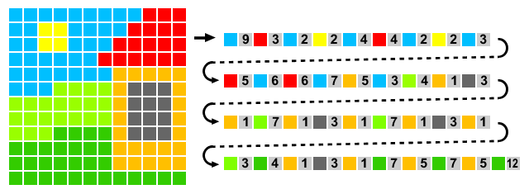
2D RLE

Slide 8
Differential Pulse Code Modulation (DPCM)
Encode the changes between consecutive samples
Example
The value of the differences between samples are much smaller than those of the original samples. Less bits are used to encode the signal (e.g. 7 bits instead of 8 bits)

Slide 9
DPCM
Input
Error
-
Entropy encoder
Predictor
Channel
Output
Error
+
Entropy decoder
Predictor
92 | 94
91 | 97

Slide 10
DPCM Example
Differential Pulse Code Modulation (DPCM)
Example:
change reference symbol if delta becomes too large
works better than RLE for many digital images (1.5-to-1)
A | A | A | B | B | C | D | D | D | D
A | 0 | 0 | 1 | 1 | 2 | 3 | 3 | 3 | 3

Slide 11
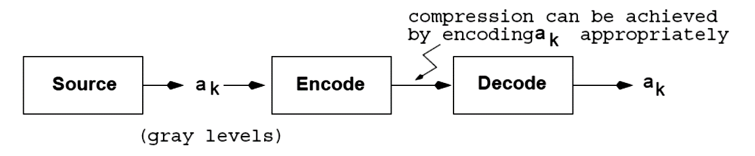
Huffman Coding (coding redundancy)
A variable-length coding technique.
Symbols are encoded one at a time!
There is a one-to-one correspondence between source symbols and code words
Optimal code (i.e., minimizes code word length per source symbol).

Slide 12
Huffman Code
Approach
Variable length encoding of symbols
Exploit statistical frequency of symbols
Efficient when symbol probabilities vary widely
Principle
Use fewer bits to represent frequent symbols
Use more bits to represent infrequent symbols
A
A
B
A
A
A
B
A

Slide 13
Huffman Code Example
Symbol | A | B | C | D
Frequency | 13% | 25% | 50% | 12%
Original Encoding | 00 | 01 | 10 | 11
 | 2 bits | 2 bits | 2 bits | 2 bits
Huffman Encoding | 110 | 10 | 0 | 111
 | 3 bits | 2 bits | 1 bit | 3 bits
Expected size
Original ⇒ 1/8×2 + 1/4×2 + 1/2×2 + 1/8×2 = 2 bits / symbol
Huffman ⇒ 1/8×3 + 1/4×2 + 1/2×1 + 1/8×3 = 1.75 bits / symbol

Slide 14
Huffman Code Data Structures
D
A
Binary (Huffman) tree
Represents Huffman code
Edge ⇒ code (0 or 1)
Leaf ⇒ symbol
Path to leaf ⇒ encoding
Example
A = “110”, B = “10”, C = “0”
Priority queue
To efficiently build binary tree
1
0
B
C
1
0
1
0

Slide 15
Huffman Code Algorithm Overview
Encoding
Calculate frequency of symbols in file
Create binary tree representing “best” encoding
Use binary tree to encode compressed file
For each symbol, output path from root to leaf
Size of encoding = length of path
Save binary tree

Slide 16
Huffman Code – Creating Tree
Place each symbol in leaf
Weight of leaf = symbol frequency
Select two trees L and R (initially leafs)
Such that L, R have lowest frequencies in tree
Create new (internal) node
Left child ⇒ L
Right child ⇒ R
New frequency ⇒ frequency( L ) + frequency( R )
Repeat until all nodes merged into one tree

Slide 17
Huffman Tree Construction 1
A
C
E
H
I
3
5
8
2
7

Slide 18
Huffman Tree Construction 2
A
H
C
E
I
3
2
5
8
7
5

Slide 19
Huffman Tree Construction 3
A
E
I
H
8
7
3
2
C
5
5
10

Slide 20
Huffman Tree Construction 4
E
I
A
H
8
7
3
2
C
5
15
5
10

Slide 21
Huffman Tree Construction 5
A
H
E = 01
I = 00
C = 10
A = 111
H = 110
3
2
C
E
I
1
0
5
8
7
5
1
0
1
0
10
15
1
0
25

Slide 22
Huffman Coding Example
Huffman code
Input
ACE
Output
(111)(10)(01) = 1111001
E = 01
I = 00
C = 10
A = 111
H = 110

Slide 23
Huffman Code Algorithm Overview
Decoding
Read compressed file & binary tree
Use binary tree to decode file
Follow path from root to leaf

Slide 24
Huffman Decoding 1
A
H
1111001
3
2
C
E
I
1
0
5
8
7
5
1
0
1
0
10
15
1
0
25

Slide 25
Huffman Decoding 2
A
H
1111001
3
2
C
E
I
1
0
5
8
7
5
1
0
1
0
10
15
1
0
25

Slide 26
Huffman Decoding 3
A
H
1111001
A
3
2
C
E
I
1
0
5
8
7
5
1
0
1
0
10
15
1
0
25

Slide 27
Huffman Decoding 4
A
H
1111001
A
3
2
C
E
I
1
0
5
8
7
5
1
0
1
0
10
15
1
0
25

Slide 28
Huffman Decoding 5
A
H
1111001
AC
3
2
C
E
I
1
0
5
8
7
5
1
0
1
0
10
15
1
0
25

Slide 29
Huffman Decoding 6
A
H
1111001
AC
3
2
C
E
I
1
0
5
8
7
5
1
0
1
0
10
15
1
0
25

Slide 30
Huffman Decoding 7
A
H
1111001
ACE
3
2
C
E
I
1
0
5
8
7
5
1
0
1
0
10
15
1
0
25

Slide 31

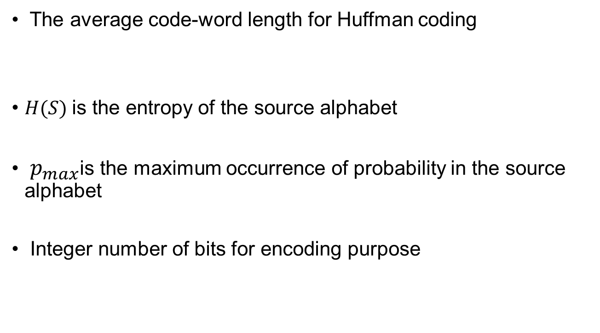
Limitation of Huffman Code
The average code-word length for Huffman coding
$H(S)$is the entropy of the source alphabet
$p_{max}$is the maximum occurrence of probability in the source alphabet
Integer number of bits for encoding purpose
$$H\left(S\right)≤L_{avg}<H\left(S\right)+p_{max}+k$$

Slide 32
Arithmetic (or Range) Coding
Instead of encoding source symbols one at a time, sequences of source symbols are encoded together.
There is no one-to-one correspondence between source symbols and code words.
Slower than Huffman coding but typically achieves better compression.

Slide 33
Arithmetic Coding (cont’d)
A sequence of source symbols is assigned to a sub-interval in [0,1) which corresponds to an arithmetic code, e.g.,
Start with the interval [0, 1)
As the number of symbols in the message increases, the interval used to represent the message becomes smaller.
arithmetic code
α₁ α₂ α₃ α₃ α₄
[0.06752, 0.0688)
0.068

Slide 34
Arithmatic Coding
We need a way to assign a code word to a particular sequence w/o having to generate codes for all possible sequences
Huffman requires keeping track of code words for all possible blocks
Each possible sequence gets mapped to a unique number in [0,1)
The mapping depends on the prob. of the symbols

Slide 35
Arithmatic Coding Example
Symbols | Probabilities
α1 | 0.2
α2 | 0.2
α3 | 0.4
α4 | 0.2
1.0
0.2
0.08
0.072
0.0688
α₄
0.8
0.16
0.06752
α₃
Encode message:
α₁ α₂ α₃ α₃ α₄
0.4
0.08
α₂
0.2
0.04
α₁
[0.06752, 0.0688)
or
0.068 (must be inside interval)
0.0
0.0
0.056
0.04
0.0644

Slide 36
Decoding
1.0
0.8
0.72
0.592
0.5728
α₄
0.8
0.72
0.688
0.5856
0.57152
Decode 0.572
α₃
0.4
0.56
0.624
0.5728
0.56896
α₂
α₃ α₃ α₁ α₂ α₄
0.2
0.48
0.592
0.5664
0.56768
α₁
0.0
0.4
0.56
0.56
0.5664

Slide 37


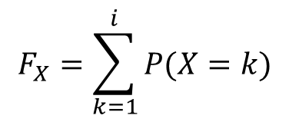

Arithmetic Encoding: Expression
Formula for dividing the interval
$$l\left(n\right)=\left(l\left(n−1\right)+u\left(n−1\right)\right)F_{X}(x_{n}−1)$$
$$u\left(n\right)=\left(l\left(n−1\right)+u\left(n−1\right)\right)F_{X}(x_{n})$$
$$F_{X}=\sum_{k=1}^{i}{P(X=k)}$$
$F_{X}$= Cumulative density function
$$tag=\frac{1}{2}(l\left(n\right)+u\left(n\right))$$

Slide 38




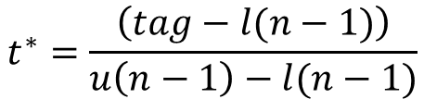
Arithmetic Decoding: Expression
1. Initial value
$$l\left(0\right)=0$$
$$u\left(0\right)=0$$
2. Calculate
$$t^{∗}=\frac{\left(tag−l(n−1)\right)}{u\left(n−1\right)−l(n−1)}$$
3. Find $x_{n}$, such that
$$F_{X}\left(x_{n}−l\right)≤t^{∗}<F_{X}(x_{k})$$
4. Update limits
5. Repeat until entire sequence is decoded

