Slide 1

CS654: Digital Image Analysis
Lecture 35: JPEG Compression

Slide 2
Outline of Lecture 35
DCT
JPEG Compression

Slide 3
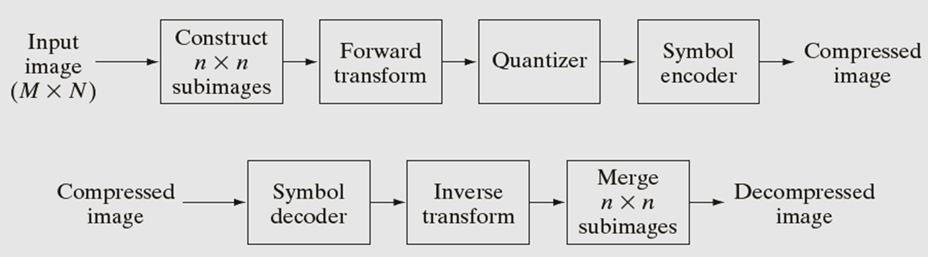
JPEG

Slide 4
Sub-image construction
n
n

Slide 5
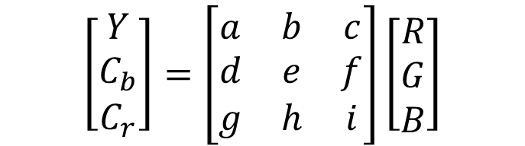
Compressing RGB images
B
C_{r}
G
C_{b}
R
Y
$$\left[\begin{matrix}Y \\ C_{b} \\ C_{r}\end{matrix}\right]=\left[\begin{matrix}a & b & c \\ d & e & f \\ g & h & i\end{matrix}\right]\left[\begin{matrix}R \\ G \\ B\end{matrix}\right]$$

Slide 6
JPEG

Slide 7
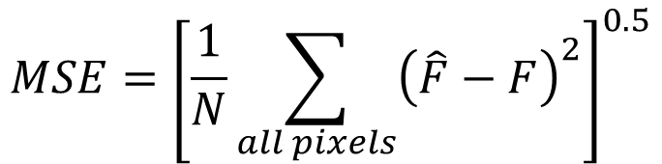
Why transform
Measurement of error in compression
Mean-square error
$$MSE={\left[\frac{1}{N}\sum_{all pixels}{{\left(\hat{F}−F\right)}^{2}}\right]}^{0.5}$$

Slide 8
Why transform
n
n

Slide 9
Why transform
Karhunen-Loeve Transform (KLT)
Image → KLT → Transformed image
Select one coefficient and discard others
Inverse KLT → Image
Ensures smallest MSE
Image dependent (coefficient of the matrix depends on the image), slow

Slide 10

Unitary transform
1-D input sequence
If $v=$ Transformed sequence

Slide 11


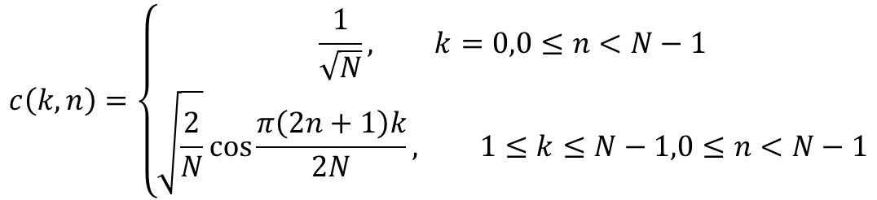
One-dimensional Discrete Cosine Transform (DCT)
Let n be a positive integer.
The one-dimensional DCT of order n is defined by an $N×N$ matrix $C$ whose entries are
$$C=\{c(k,n)\}$$
$$c\left(k,n\right)=\left\{\begin{aligned}\frac{1}{\sqrt{N}}, k=0,0≤n<N−1 \\ &\sqrt{\frac{2}{N}}\cos{\frac{π\left(2n+1\right)k}{2N}}, 1≤k≤N−1,0≤n<N−1\end{aligned}\right.$$

Slide 12
The Advantage of Orthogonality
C orthogonal: C^{T}C = I
Implies C⁻¹ = C^{T}
Makes solving matrix equations easy
Solve Y = CXC^{T} for X:
C^{T}Y = C^{T}CXC^{Y} = XC^{T}
C^{T}YC = XC^{T}C = X

Slide 13
One-dimensional DCT
The discrete cosine transform, C, has one basic characteristic: it is a real orthogonal matrix.

Slide 14
One-dimensional DCT
Suppose we are given a vector
The Discrete Cosine Transform of x is the n-dimensional vector
Where C is defined as

Slide 15
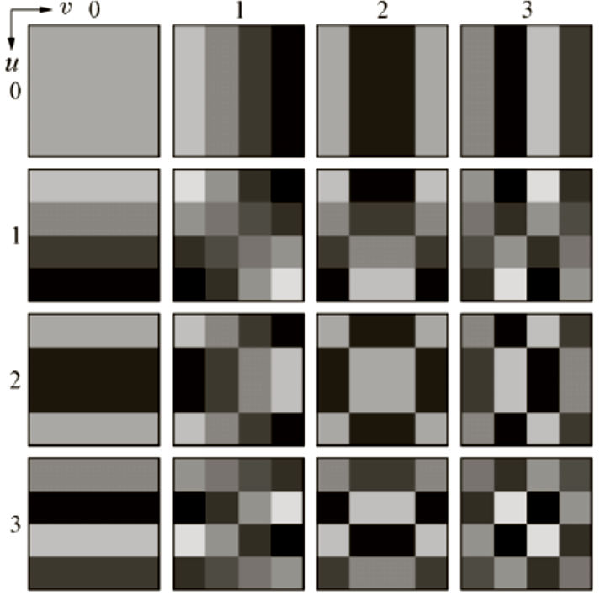
DCT Coefficient
An image is represented as a linear combination of the basis images
Basis images are fixed

Slide 16
Two-Dimensional DCT
Idea 2D-DCT: Interpolate the data with a set of basis functions
Organize information by order of importance to the human visual system
Used to compress small blocks of an image
(8 x 8 pixels in our case)

Slide 17
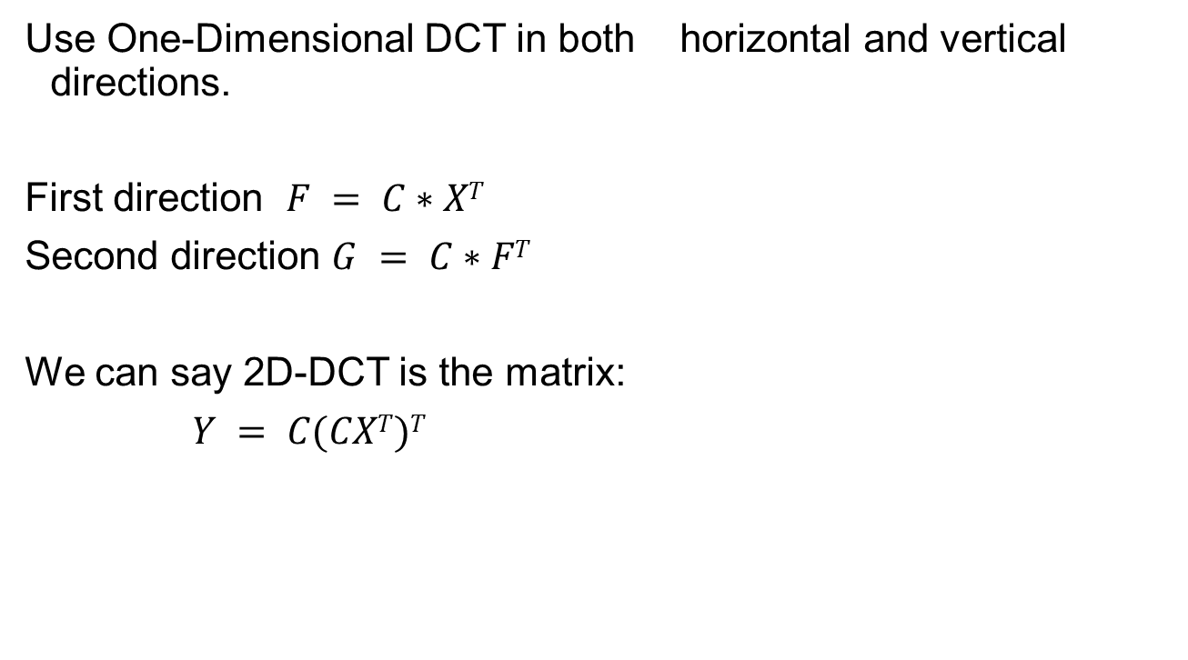
Two-Dimensional DCT
Use One-Dimensional DCT in both horizontal and vertical directions.
First direction $F = C∗XT$
Second direction $G = C∗FT$
We can say 2D-DCT is the matrix:
$Y = C(CXT)T$

Slide 18
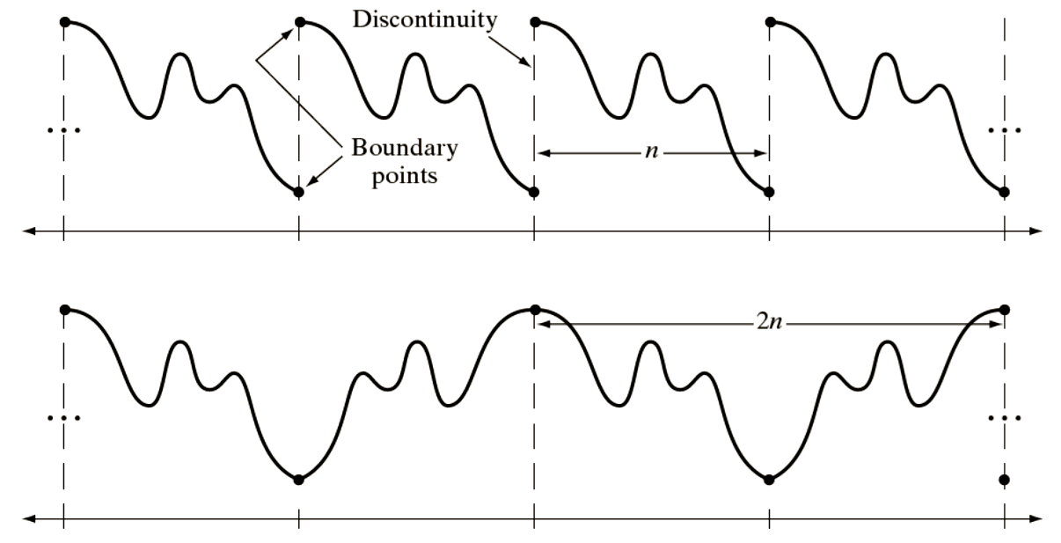
Why DCT?
Markovian Image (image pixel value at a location depends on its neighborhood)
Periodicity
DFT
DCT

Slide 19
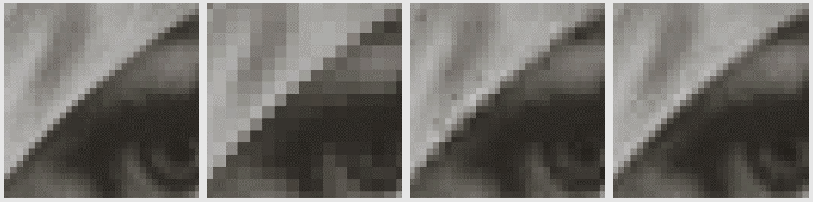


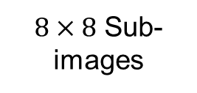
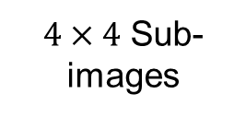
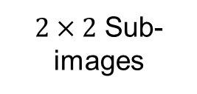
Why $8×8$ ?
25% of the DCT coefficient
$2×2$ Sub-images
$4×4$ Sub-images
$8×8$ Sub-images
Why to stop at $8×8$ ?
1. Computational
2. Markovian condition

Slide 20
JPEG

Slide 21

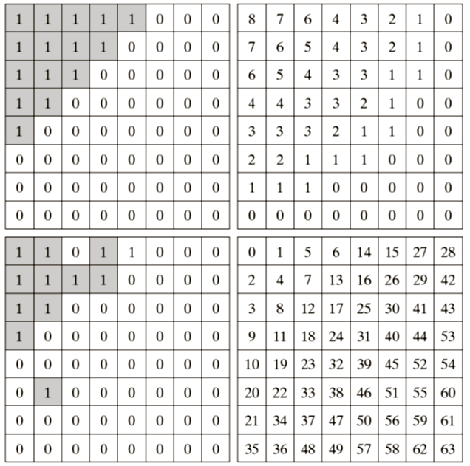
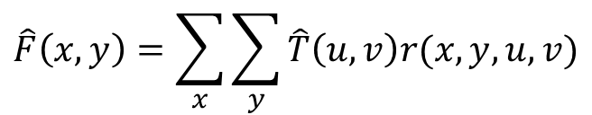
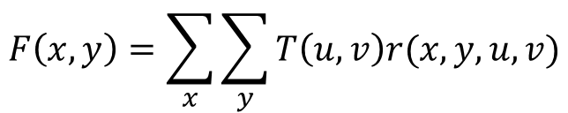
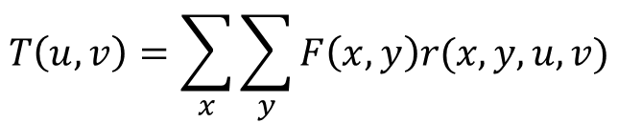
Quantization
$$T\left(u,v\right)=\sum_{x}{\sum_{y}{F\left(x,y\right)r(x,y,u,v)}}$$
$$F\left(x,y\right)=\sum_{x}{\sum_{y}{T\left(u,v\right)r(x,y,u,v)}}$$
$$\hat{F}\left(x,y\right)=\sum_{x}{\sum_{y}{\hat{T}\left(u,v\right)r(x,y,u,v)}}$$

Slide 22
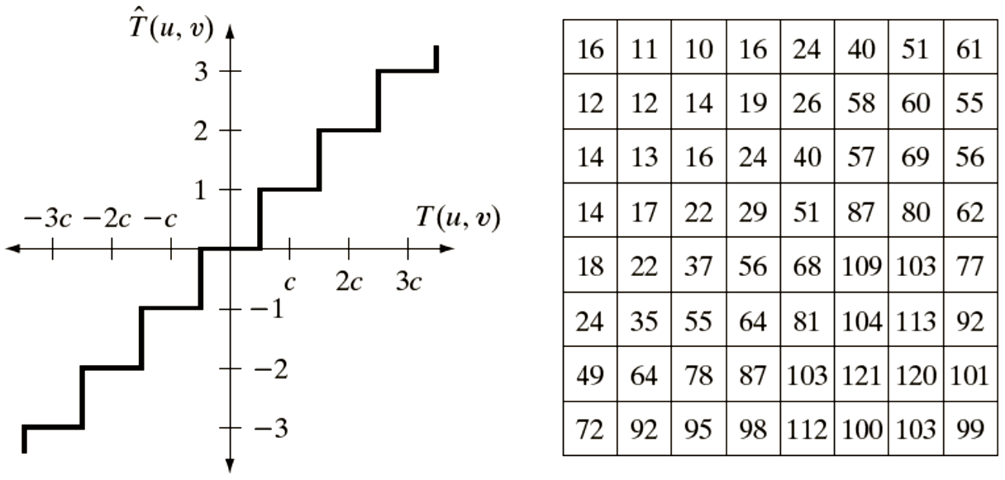
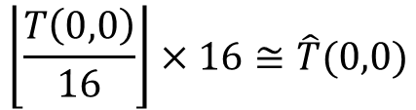
Uniform quantization
$$\left\lfloor \frac{T\left(0,0\right)}{16}\right\rfloor ×16≅\hat{T}(0,0)$$

Slide 23






Quantization: Example
$$Z$$
$$2Z$$
$$4Z$$
$$8Z$$
$$16Z$$
$$32Z$$

Slide 24
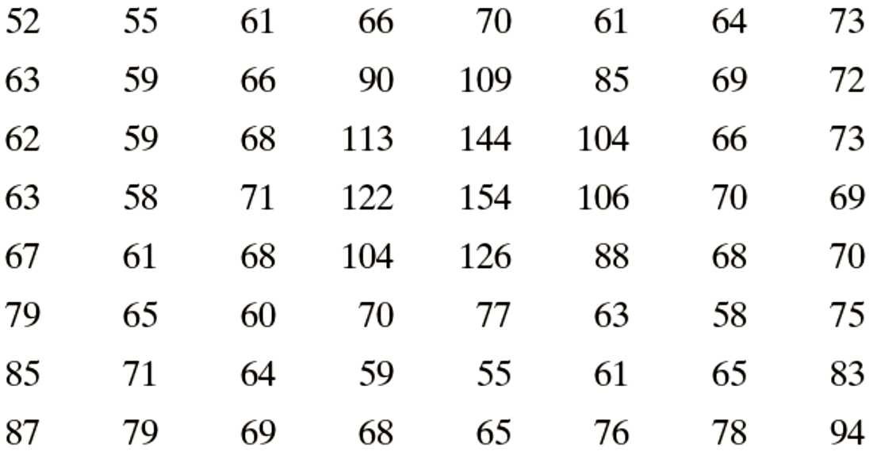
Default JPEG Quantization Table

Slide 25
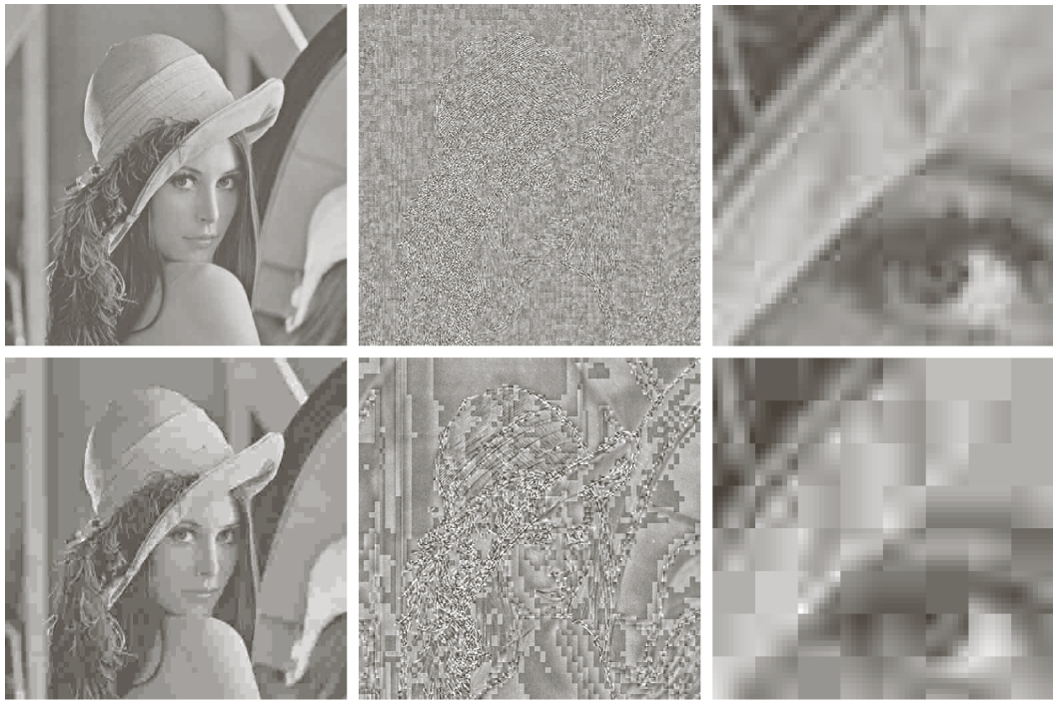
Example
Compressed image
Error
Zoomed area
With default quantization matrix
With scaled quantization matrix

Slide 26
JPEG Coding
Steps Involved:
Discrete Cosine Transform of each 8x8 pixel array f(x,y) →_{T} F(u,v)
Quantization using a table or using a constant
Zig-Zag scan to exploit redundancy
Differential Pulse Code Modulation(DPCM) on the DC component and Run length Coding of the AC components
Entropy coding (Huffman) of the final output
C_{r}
C_{b}
Y
f(i, j)
DCT
F(u, v)
Quantization
Fq(u, v)
8 x 8
8 x 8
Quant…
Tables
Coding
Tables
Zig Zag
Scan
Header
Tables
Data
Entropy
Coding
DPCM
RLC

Slide 27
2-D DCT
Images are two-dimensional; How do you perform 2-D DCT?
Two series of 1-D transforms result in a 2-D transform as demonstrated in the figure below
1-D
Row-
wise
1-D
Column-
wise
8x8
8x8
8x8
F(0,0) is called the DC component and the rest of F(i,j) are called AC components

Slide 28
2-D Transform Example
The following example will demonstrate the idea behind a 2-D transform by using our own cooked up transform: The transform computes a running cumulative sum.
1
1
1
1
1
1
1
1
1
1
1
1
1
1
1
1
My Transform:
1
1
1
1
1
1
1
1
1
1
1
1
1
1
1
1
1
1
1
1
1
1
1
1
8
7
6
5
4
3
2
1
1
1
1
1
1
1
1
1
8
7
6
5
4
3
2
1
1
1
1
1
1
1
1
1
8
7
6
5
4
3
2
1
1
1
1
1
1
1
1
1
1-D
Row-
wise
8x8
8
7
6
5
4
3
2
1
8
7
6
5
4
3
2
1
8
7
6
5
4
3
2
1
64
56
48
40
32
24
16
8
8
7
6
5
4
3
2
1
1-D
Column-
wise
56
49
42
35
28
21
14
7
8
7
6
5
4
3
2
1
48
42
36
30
24
18
12
6
8x8
40
35
30
25
20
15
10
5
32
28
24
20
16
12
8
4
Note that this is only a hypothetical transform. Do not confuse this with DCT
24
21
18
15
12
9
6
3
16
14
12
10
8
6
4
2
8
7
6
5
4
3
2
1
8x8

Slide 29
Zig-Zag Scan
Why? -- to group low frequency coefficients in top of vector and high frequency coefficients at the bottom
Maps 8 x 8 matrix to a 1 x 64 vector
8x8
. . .
1x64

Slide 30
DPCM on DC Components
The DC component value in each 8x8 block is large and varies across blocks.
Encode the difference between the current and previous 8x8 block. Remember, smaller number -> fewer bits
45
45
1x64
1x64
54
9
1x64
1x64
48
-6
.
.
.
1x64
.
.
.
1x64
32
12
1x64
1x64
36
4
1x64
1x64

Slide 31
RLE on AC Components
The 1x64 vectors have a lot of zeros in them, more so towards the end of the vector.
Higher up entries in the vector capture higher frequency (DCT) components which tend to be capture less of the content.
Could have been as a result of using a quantization table
Encode a series of 0s as a (skip,value) pair, where skip is the number of zeros and value is the next non-zero component.
Send (0,0) as end-of-block sentinel value.
. . .
0
0
0
0
0
1
1
0
0
0
0
0
0
0
0
2
. . .
1x64
5,1
7,2

Slide 32
Entropy Coding: DC Components
DC components are differentially coded as (SIZE,Value)
The code for a Value is derived from the following table
SIZE | Value | Code
0 | 0 | ---
1 | -1,1 | 0,1
2 | -3, -2, 2,3 | 00,01,10,11
3 | -7,…, -4, 4,…, 7 | 000,…, 011, 100,…111
4 | -15,…, -8, 8,…, 15 | 0000,…, 0111, 1000,…, 1111
. |  | .
. |  | .
11 | -2047,…, -1024, 1024,… 2047 | …
Size_and_Value Table

Slide 33
Entropy Coding: DC Components
DC components are differentially coded as (SIZE,Value)
The code for a SIZE is derived from the following table
SIZE | Code Length | Code
0 | 2 | 00
1 | 3 | 010
2 | 3 | 011
3 | 3 | 100
4 | 3 | 101
5 | 3 | 110
6 | 4 | 1110
7 | 5 | 11110
8 | 6 | 111110
9 | 7 | 1111110
10 | 8 | 11111110
11 | 9 | 111111110
Example: If a DC component is 40 and the previous DC component is 48. The difference is -8. Therefore it is coded as:
1010111
0111: The value for representing –8
(see Size_and_Value table)
101: The size from the same table reads 4. The corresponding code from the table at left is 101.
Huffman Table for DC component SIZE field

Slide 34
Entropy Coding: AC Components
AC components (range –1023..1023) are coded as (S1,S2 pairs):
S1: (RunLength/SIZE)
RunLength: The length of the consecutive zero values [0..15]
SIZE: The number of bits needed to code the next nonzero AC component’s value. [0-A]
(0,0) is the End_Of_Block for the 8x8 block.
S1 is Huffman coded (see AC code table below)
S2: (Value)
Value: Is the value of the AC component.(refer to size_and_value table)
Partial Huffman Table for AC Run/Size Pairs
Run/ SIZE | Code Length | Code
0/0 | 4 | 1010
0/1 | 2 | 00
0/2 | 2 | 01
0/3 | 3 | 100
0/4 | 4 | 1011
0/5 | 5 | 11010
0/6 | 7 | 1111000
0/7 | 8 | 11111000
0/8 | 10 | 1111110110
0/9 | 16 | 1111111110000010
0/A | 16 | 1111111110000011
Run/ SIZE | Code Length | Code
1/1 | 4 | 1100
1/2 | 5 | 11011
1/3 | 7 | 1111001
1/4 | 9 | 111110110
1/5 | 11 | 11111110110
1/6 | 16 | 1111111110000100
1/7 | 16 | 1111111110000101
1/8 | 16 | 1111111110000110
1/9 | 16 | 1111111110000111
1/A | 16 | 1111111110001000
… 15/A | More | Such rows

Slide 35
Entropy Coding: Example
Example: Consider encoding the AC components by arranging them in a zig-zag order -> 12,10, 1, -7 2 0s, -4, 56 zeros
12: read as zero 0s,12: (0/4)12 → 10111100
1011: The code for (0/4 from AC code table)
1100: The code for 12 from the Size_and_Value table.
10: (0/4)10 → 10111010
1: (0/1)1 → 001
-7: (0/3)-7 → 100000
2 0s, -4: (2/3)-4 → 1111110111011
1111110111: The 10-bit code for 2/3
011: representation of –4 from Size_and_Value table.
56 0s: (0,0) → 1010 (Rest of the components are zeros therefore we simply put the EOB to signify this fact)
40
12
0
0
0
0
0
0
10
-7
-4
0
0
0
0
0
1
0
0
0
0
0
0
0
0
0
0
0
0
0
0
0
0
0
0
0
0
0
0
0
0
0
0
0
0
0
0
0
0
0
0
0
0
0
0
0
0
0
0
0
0
0
0
0

