Slide 1

CS654: Digital Image Analysis
Lecture 36: Feature Extraction and Analysis

Slide 2
Recap of Lecture 35
JPEG
DCT

Slide 3
Outline of Lecture 36
Feature representation
Shape feature
Curvature
Curvature Scale Space
Other shape features

Slide 4
Introduction
The goal in digital image analysis is to extract useful information for solving application-based problems.
The first step to this is to reduce the amount of image data using methods that we have discussed before:
Image segmentation
Filtering in frequency domain
Morphology,
…

Slide 5
What next ??
The next step would be to extract features that are useful in solving computer imaging problems.
What features to be extracted are application dependent.
After the features have been extracted, then analysis can be done.

Slide 6
Shape features
Shape
Contour
Region
Structural
Non-Structural
Area
Euler Number
Eccentricity
Geometric Moments
Zernike Moments
Pseudo-Zernike Mmts
Legendre Moments
Grid Method
Syntactic
Graph
Tree
Model-driven
Data-driven
Shape context
Perimeter
Compactness
Eccentricity
Fourier Descriptors
Wavelet Descriptors
Curvature Scale Space
Shape Signature
Chain Code
Hausdorff Distance
Elastic Matching

Slide 7








Planer curves
Closed curve: $C\left(0\right)=C\left(1\right)$
$$C\left(0.1\right)$$
$$C\left(0.5\right)$$
$$C\left(0.8\right)$$
Parameterized curve
$$C\left(p\right)=\{x\left(p\right),y\left(p\right)\}$$
$$p∈[0,1]$$
y
$$C\left(x\right)=$$
$$\{x,F\left(x\right)\}$$
y
x
x

Slide 8
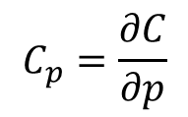


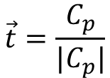







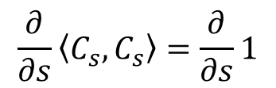
Planer curves: tangent, curvature
Parameterized curve
$$C\left(0.1\right)$$
$$C\left(p\right)=\{x\left(p\right),y\left(p\right)\}$$
$$p∈[0,1]$$
$$C\left(0.5\right)$$
$$C\left(0.8\right)$$
$$C_{ss}$$
Tangent
$$\vec{t}=\frac{C_{p}}{|C_{p}|}$$
$$=C_{s}$$
$s$ is a parameterization to get tangent of unit length
$$C_{p}=\frac{∂C}{∂p}$$
$$=[x_{p},y_{p}]$$
${|C}_{s}|=1,$magnitude of the derivative is unity
$$\left\langle C_{s},C_{s}\right\rangle =1$$
$$\frac{∂}{∂s}\left\langle C_{s},C_{s}\right\rangle =\frac{∂}{∂s}1$$
$$⇒\left\langle C_{s},C_{ss}\right\rangle =0$$
$$⇒2\left\langle C_{s},C_{ss}\right\rangle =0$$
Curvature: Magnitude of the second derivative, $κ$

Slide 9


Curvature
Magnitude of the second derivative → curvature
Change in the tangent between two successive point is more
Curvature is more → curve is curving a lot
$$κ=0$$
$$κ=\frac{1}{r}$$

Slide 10

Linear Transformation
Affine transformation:
${\left\{\tilde{x,}\tilde{y}\right\}}^{T}=A{\left\{x,y\right\}}^{T}+\vec{b}$
Euclidean transformation:
$$A=\left[\vec{u_{1}}, \vec{u_{2}}\right], where \left\langle \vec{u_{1}}, \vec{u_{2}}\right\rangle =0 and\left\langle \vec{u_{i}}, \vec{u_{i}}\right\rangle =1$$
Euclidean
Affine
Affine

Slide 11


Linear Transformation
Equi- Affine transformation:
${\left\{\tilde{x,}\tilde{y}\right\}}^{T}=A{\left\{x,y\right\}}^{T}+\vec{b}$
$$\det\left(A\right)=1$$
Euclidean
Equi- Affine
Equi-Affine

Slide 12



Differential Signature
Euclidean invariant signature
$$\{s,κ\left(s\right)\}$$
Starting point?
$$κ$$
$$s$$

Slide 13


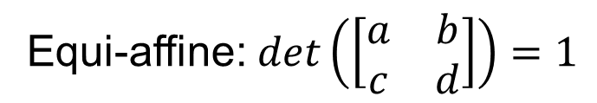
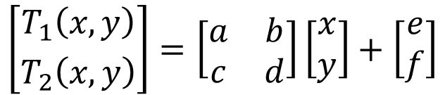
Affine transformation
$$I_{2}\left(x,y\right)=I_{1}(T_{1}\left(x,y\right),T_{2}\left(x,y\right))$$
$$\left[{T_{1}\left(x,y\right) \atop T_{2}\left(x,y\right)}\right]=\left[\begin{matrix}a & b \\ c & d\end{matrix}\right]\left[\begin{matrix}x \\ y\end{matrix}\right]+\left[\begin{matrix}e \\ f\end{matrix}\right]$$
Equi-affine: $det\left(\left[\begin{matrix}a & b \\ c & d\end{matrix}\right]\right)=1$
What would be the definition of arc length and curvature in case of affine transformation?

Slide 14
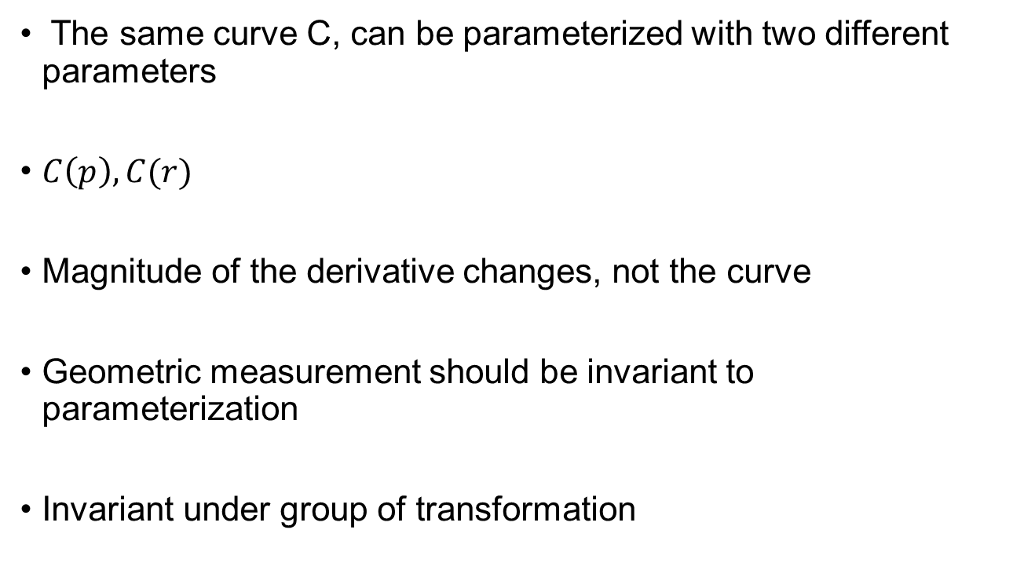
Re-parameterization
The same curve C, can be parameterized with two different parameters
$C\left(p\right), C(r)$
Magnitude of the derivative changes, not the curve
Geometric measurement should be invariant to parameterization
Invariant under group of transformation

Slide 15
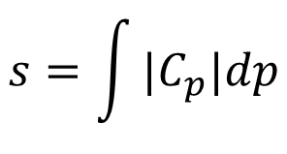

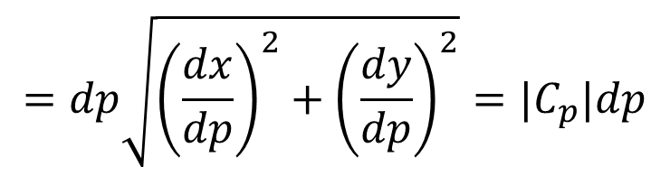

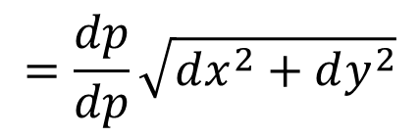


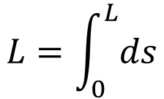
Euclidean arc-length
Only allows for rotation and translation
Length is preserved
$$ds=\sqrt{dx^{2}+dy^{2}}$$
$$=\frac{dp}{dp}\sqrt{dx^{2}+dy^{2}}$$
$$=dp\sqrt{{\left(\frac{dx}{dp}\right)}^{2}+{\left(\frac{dy}{dp}\right)}^{2}}=|C_{p}|dp$$
$$ds$$
$$dy$$
$$s=\int{|C_{p}|dp}$$
$$L=\int_{0}^{L}{ds}$$
$$dx$$

Slide 16


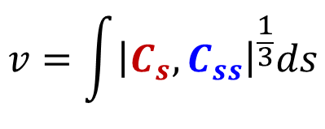

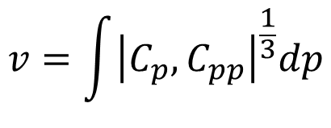


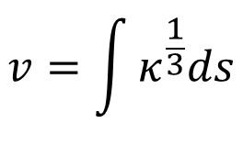


Equi-affine arclength
Length is not preserved any more, however area is preserved
$v$ = parameterization for affine transform
$$\left|C_{v},C_{vv}\right|=1$$
$$C_{v}$$
$$v=\int{{\left|C_{p},C_{pp}\right|}^{\frac{1}{3}}dp}$$
$$C_{vv}$$
$$v=\int{{\left|C_{s},C_{ss}\right|}^{\frac{1}{3}}ds}$$
$$1$$
$$v=\int{κ^{\frac{1}{3}}ds}$$
$$dv=κ^{\frac{1}{3}}ds$$
$$κ$$

Slide 17

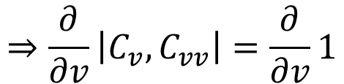





Equi-affine curvature
$$⇒\frac{∂}{∂v}\left|C_{v},C_{vv}\right|=\frac{∂}{∂v}1$$
$$\left|C_{v},C_{vv}\right|=1$$
$$⇒\left|C_{vv},C_{vv}\right|+\left|C_{v},C_{vvv}\right|=0$$
$$⇒\left|C_{v},C_{vvv}\right|=0$$
$$⇒C_{v}∥C_{vvv}$$
$$⇒C_{vvv}=μC_{v}$$
$μ=$ Affine invariant curvature

Slide 18

Differential signature
Affine invariant signature
$$\{v,μ\left(v\right)\}$$
$$κ$$
$$s$$

Slide 19
Curvature Scale Space
Defined a unique way of observing and studying 2-D closed shapes
Trace the outer most closed curve of the object and thus proceed
Mapping to a space which represents each point as a curvature w.r.t. the arc length.
Matching is performed using CSS image

Slide 20
CSS Image
It is a multi-scale organization of the inflection points (zero crossing points) of an evolving contour
Curvature is a local measure of how fast a planar contour is turning

Slide 21
Process
This method convolutes a path (arc length ) based parametric representation of a planar curve with a Gaussian function
As the Gaussian width varies from a small to a large value.
Plot the curvature vs. the normalized arc length of the planar curve.
As the Gaussian width is increased,
the scale of the image increases or
the image evolves and thus the amount of noise is reduced and the curve distortions smoothened.
The benefits of this representation are that it is invariant under rotation ,uniform scaling and translation of the curve.

Slide 22
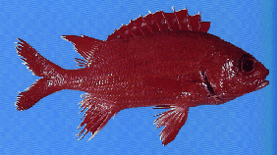
Illustration
Input image
CSS Image
Curvature zero-crossing segments
standard deviation of the Gaussian filter
arclength parameter on the original contour

Slide 23
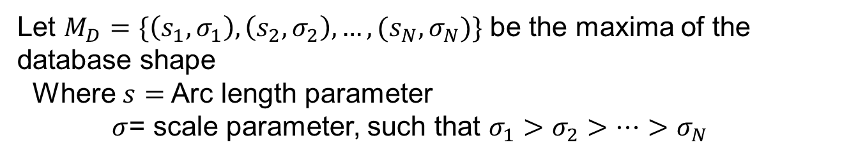
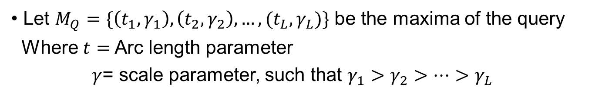
Matching
Let $M_{Q}=\{\left(t_{1},γ_{1}\right),\left(t_{2},γ_{2}\right),…,(t_{L},γ_{L})\}$ be the maxima of the query
Where $t=$ Arc length parameter
$γ$= scale parameter, such that $γ_{1}>γ_{2}>…>γ_{L}$
Let $M_{D}=\{\left(s_{1},σ_{1}\right),\left(s_{2},σ_{2}\right),…,(s_{N},σ_{N})\}$ be the maxima of the database shape
Where $s=$ Arc length parameter
$σ$= scale parameter, such that $σ_{1}>σ_{2}>…>σ_{N}$

Slide 24
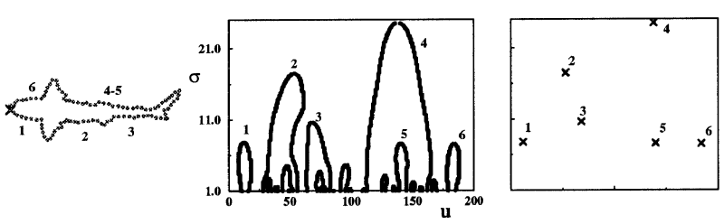
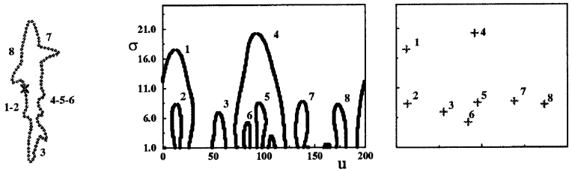
Illustration

Slide 25
Binary Object Features – Area
The area of the ith object is defined as follows:
The area A_{i} is measured in pixels and indicates the relative size of the object.

Slide 26
Binary Object Features – Center of Area
The center of area is defined as follows:
These correspond to the row and column coordinate of the center of the i-th object.

Slide 27
Binary Object Features – Axis of Least Second Moment
The Axis of Least Second Moment is expressed as θ - the angle of the axis relatives to the vertical axis.

Slide 28
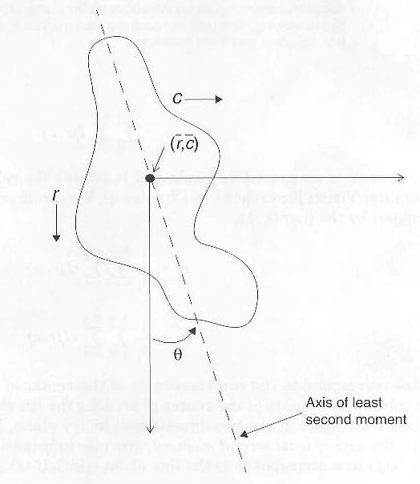
Binary Object Features – Axis of Least Second Moment
This assumes that the origin is as the center of area.
This feature provides information about the object’s orientation.
This axis corresponds to the line about which it takes the least amount of energy to spin an object.

Slide 29
Binary Object Features – Aspect Ratio
The equation for aspect ratio is as follows:
reveals how the object spread in both vertical and horizontal direction.
High aspect ratio indicates the object spread more towards horizontal direction.

