Slide 1

CS654: Digital Image Analysis
Lecture 39: Miscellaneous topics

Slide 2
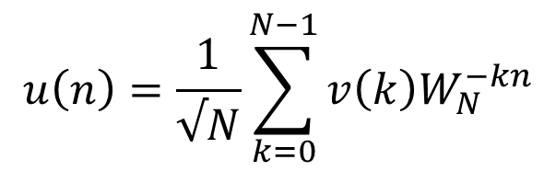
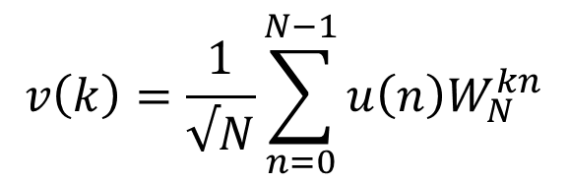

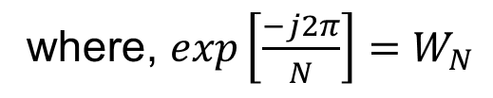
Image Transforms
Fourier Transform: intensity image → domain of spatial frequency
Unitary DFT (1-D case)
$u\left(n\right)$= Finite duration sequence
$$v\left(k\right)=\frac{1}{√N}\sum_{n=0}^{N−1}{u\left(n\right)W_{N}^{kn}}$$
where, $exp\left[\frac{−j2π}{N}\right]=W_{N}$
$$u\left(n\right)=\frac{1}{√N}\sum_{k=0}^{N−1}{v\left(k\right)W_{N}^{−kn}}$$

Slide 3

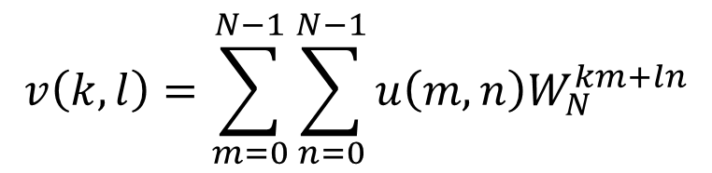
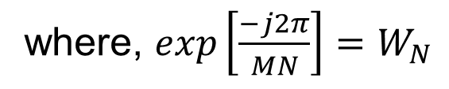

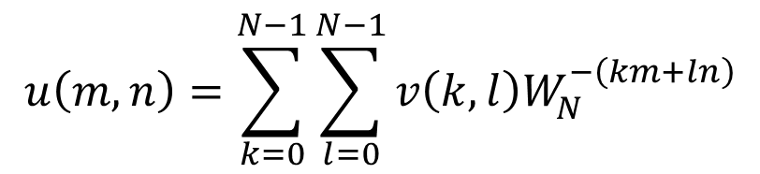
2-D DFT
Forward transformation
$$v\left(k,l\right)=\sum_{m=0}^{N−1}{\sum_{n=0}^{N−1}{u\left(m,n\right)W_{N}^{km+ln}}}$$
where, $0≤k,l≤N−1$
Reverse transformation
$$u\left(m,n\right)=\sum_{k=0}^{N−1}{\sum_{l=0}^{N−1}{v\left(k,l\right)W_{N}^{−\left(km+ln\right)}}}$$
where, $0≤m,n≤N−1$
where, $exp\left[\frac{−j2π}{MN}\right]=W_{N}$

Slide 4

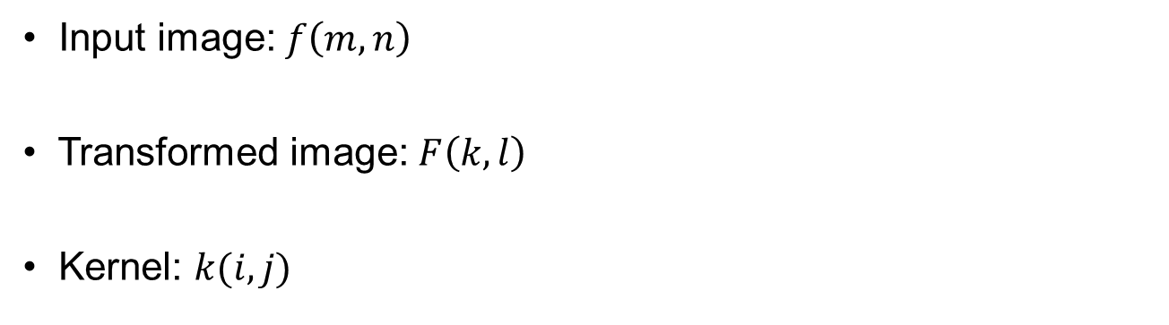
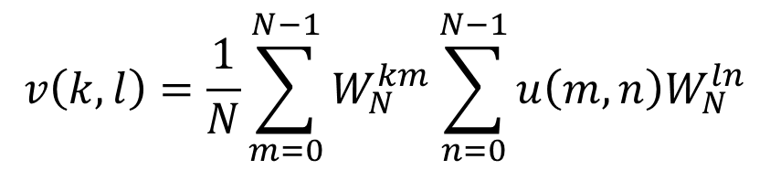
Separable 2-D DFT
$$v\left(k,l\right)=\frac{1}{N}\sum_{m=0}^{N−1}{W_{N}^{km}\sum_{n=0}^{N−1}{u\left(m,n\right)W_{N}^{ln}}}$$
Input image: $f\left(m,n\right)$
Transformed image: $F\left(k,l\right)$
Kernel: $k(i,j)$
$$F\left(k,l\right)=kernel×f\left(m,n\right)×kernel^{T}$$

Slide 5
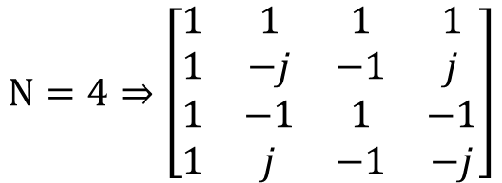
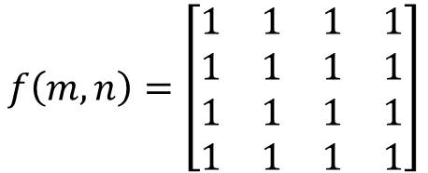
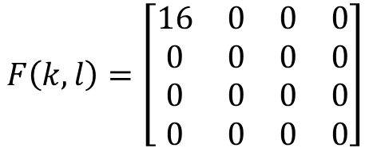
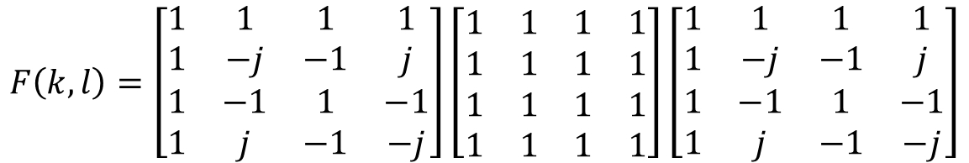
Numerical Problem
$$f\left(m,n\right)=\left[\begin{matrix}1 & 1 & 1 & 1 \\ 1 & 1 & 1 & 1 \\ 1 & 1 & 1 & 1 \\ 1 & 1 & 1 & 1\end{matrix}\right]$$
$$N=4⇒\left[\begin{matrix}1 & 1 & 1 & 1 \\ 1 & −j & −1 & j \\ 1 & −1 & 1 & −1 \\ 1 & j & −1 & −j\end{matrix}\right]$$
$$F\left(k,l\right)=\left[\begin{matrix}1 & 1 & 1 & 1 \\ 1 & −j & −1 & j \\ 1 & −1 & 1 & −1 \\ 1 & j & −1 & −j\end{matrix}\right]\left[\begin{matrix}1 & 1 & 1 & 1 \\ 1 & 1 & 1 & 1 \\ 1 & 1 & 1 & 1 \\ 1 & 1 & 1 & 1\end{matrix}\right]\left[\begin{matrix}1 & 1 & 1 & 1 \\ 1 & −j & −1 & j \\ 1 & −1 & 1 & −1 \\ 1 & j & −1 & −j\end{matrix}\right]$$
$$F\left(k,l\right)=\left[\begin{matrix}16 & 0 & 0 & 0 \\ 0 & 0 & 0 & 0 \\ 0 & 0 & 0 & 0 \\ 0 & 0 & 0 & 0\end{matrix}\right]$$

Slide 6



Singular Value Decomposition (SVD)
SVD of a rectangular matrix A is of the form
$$A=UDV^{T}$$
$A=m×n$matrix
$U,V=$orthonormal matrices
$D=$Diagonal matrices with the singular values of $A$
$σ_{1}≥σ_{2}…≥σ_{n}≥0$ are the Eigen values of $A^{T}A$ or $AA^{T}$

Slide 7







Numerical Problem
$$A=\left[\begin{matrix}5 & 5 \\ −1 & 7\end{matrix}\right]$$
$$A^{T}A=\left[\begin{matrix}5 & −1 \\ 5 & 7\end{matrix}\right]\left[\begin{matrix}5 & 5 \\ −1 & 7\end{matrix}\right]$$
$$=\left[\begin{matrix}26 & 18 \\ 18 & 74\end{matrix}\right]$$
Eigen analysis
$${det⁡(A}^{T}A−λI)=det⁡\left(\left[\begin{matrix}26−λ & 18 \\ 18 & 74−λ\end{matrix}\right]\right)$$
Characteristics equation:
$$λ^{2}−100λ+1600=0$$
$$⇒\left(λ−20\right)\left(λ−80\right)$$
$$⇒λ_{1}=20, λ_{2}=80$$

Slide 8


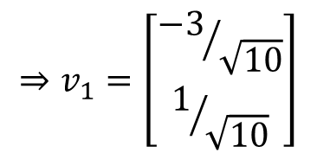


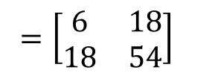
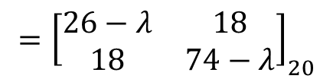
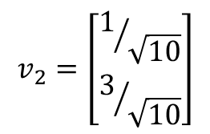
Numerical Problem: SVD
Eigen Vector for $λ=20$
$$={\left[\begin{matrix}26−λ & 18 \\ 18 & 74−λ\end{matrix}\right]}_{20}$$
$$={\left[\begin{matrix}6 & 18 \\ 18 & 54\end{matrix}\right]}_{}$$
$$A^{T}A−λI$$
$$⇒v_{1}=\left[\begin{matrix}{−3}/{\sqrt{10}} \\ 1/{\sqrt{10}}\end{matrix}\right]$$
$$v_{1}=\left[\begin{matrix}−3 \\ 1\end{matrix}\right]$$
Eigen Vector for $λ=80$
$$v_{2}=\left[\begin{matrix}1/{\sqrt{10}} \\ 3/{\sqrt{10}}\end{matrix}\right]$$

Slide 9
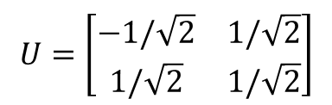
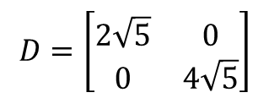
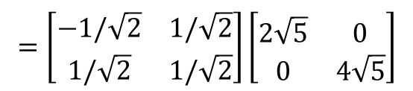
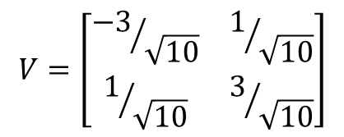
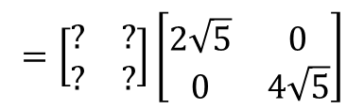
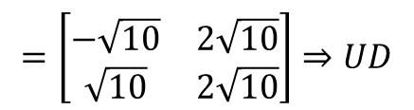
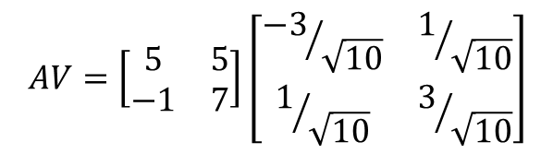
Constructing U, V, and D
$$V=\left[\begin{matrix}{−3}/{\sqrt{10}} & 1/{\sqrt{10}} \\ 1/{\sqrt{10}} & 3/{\sqrt{10}}\end{matrix}\right]$$
$$D=\left[\begin{matrix}2\sqrt{5} & 0 \\ 0 & 4\sqrt{5}\end{matrix}\right]$$
$$AV=\left[\begin{matrix}5 & 5 \\ −1 & 7\end{matrix}\right]\left[\begin{matrix}{−3}/{\sqrt{10}} & 1/{\sqrt{10}} \\ 1/{\sqrt{10}} & 3/{\sqrt{10}}\end{matrix}\right]$$
$$=\left[\begin{matrix}−\sqrt{10} & 2\sqrt{10} \\ \sqrt{10} & 2\sqrt{10}\end{matrix}\right]⇒UD$$
$$=\left[\begin{matrix}? & ? \\ ? & ?\end{matrix}\right]\left[\begin{matrix}2\sqrt{5} & 0 \\ 0 & 4\sqrt{5}\end{matrix}\right]$$
$$U=\left[\begin{matrix}−1/\sqrt{2} & 1/\sqrt{2} \\ 1/\sqrt{2} & 1/\sqrt{2}\end{matrix}\right]$$
$$=\left[\begin{matrix}−1/\sqrt{2} & 1/\sqrt{2} \\ 1/\sqrt{2} & 1/\sqrt{2}\end{matrix}\right]\left[\begin{matrix}2\sqrt{5} & 0 \\ 0 & 4\sqrt{5}\end{matrix}\right]$$

Slide 10






Inverse filtering (error minimization)
2D Discrete Domain Representation
$$g=Hf+η$$
Error function: $\hat{f}=g−(Hf+η)$
$$\hat{f}=g−Hf$$
Neglecting the noise component
Approximate least square error:
$$J(\hat{f})={\left\|g−H\hat{f}\right\|}^{2}$$
Unconstrained error minimization
$$J\left(\hat{f}\right)=g^{2}+H^{2}{\hat{f}}^{2}−2gH\hat{f}$$
Differentiate w.r.to $\hat{f}$ and equate to zero

Slide 11
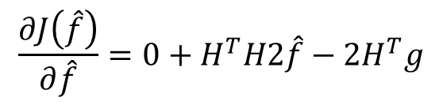
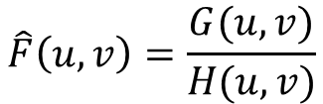



Inverse filtering (error minimization)
$$J\left(\hat{f}\right)=g^{2}+H^{2}{\hat{f}}^{2}−2gH\hat{f}$$
$$\frac{∂J\left(\hat{f}\right)}{∂\hat{f}}=0+H^{T}H2\hat{f}−2H^{T}g$$
Differentiate w.r.to $\hat{f}$
$$⇒ =−2H^{T}\left(g−H\hat{f}\right)$$
Equating to zero
$$H^{T}H\hat{f}=H^{T}g, ⇒\hat{f}={\left(H^{T}H\right)}^{−1}H^{T}g=H^{−1}g$$
$$\hat{F}\left(u,v\right)=\frac{G(u,v)}{H(u,v)}$$
In frequency domain
$1/H(u,v)$ does not necessarily exist. If $H(u,v)=0$or is close to zero, it may not be computationally possible to compute $1/H(u,v)$
It doesn't perform well when used on noisy images.

Slide 12

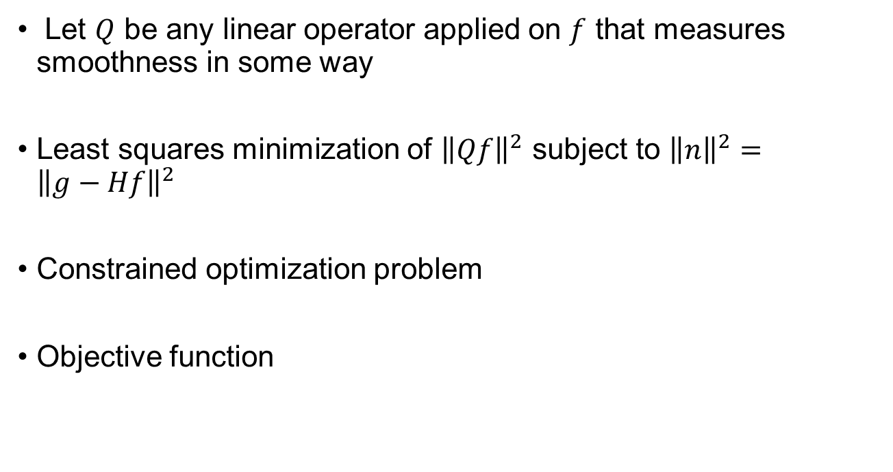

Constrained image restoration
Let $Q$ be any linear operator applied on $f$ that measures smoothness in some way
Least squares minimization of ${\left\|Qf\right\|}^{2}$ subject to ${\left\|n\right\|}^{2}={\left\|g−Hf\right\|}^{2}$
Constrained optimization problem
Objective function
$$α=Lagrange multiplier$$
$$J\left(f\right)={\left\|Qf\right\|}^{2}+α\left({\left\|g−Hf\right\|}^{2}−{\left\|n\right\|}^{2}\right)$$
Smoothness
Restoration

Slide 13

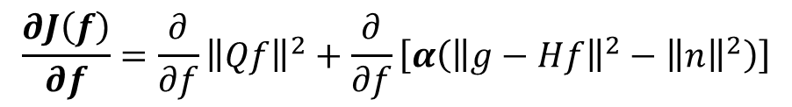



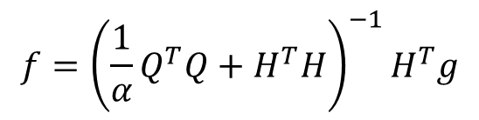
Minimization of error
$$J\left(f\right)={\left\|Qf\right\|}^{2}+α\left({\left\|g−Hf\right\|}^{2}−{\left\|n\right\|}^{2}\right)$$
$$\frac{∂J\left(f\right)}{∂f}={\frac{∂}{∂f}\left\|Qf\right\|}^{2}+\frac{∂}{∂f}\left[α\left({\left\|g−Hf\right\|}^{2}−{\left\|n\right\|}^{2}\right)\right]$$
$$=2Q^{T}Qf+2αH^{T}Hf−2αH^{T}g$$
$$f={\left({\frac{1}{α}Q}^{T}Q+H^{T}H\right)}^{−1}H^{T}g$$
Equating to zero
If $α$ is large
$$f≈{\left(H^{T}H\right)}^{−1}H^{T}g⇒H^{−1}g$$
Emphasize restoration
If $α$ is small
$$f≈{\left(Q^{T}Q\right)}^{−1}H^{T}g$$
Emphasize smoothness

Slide 14
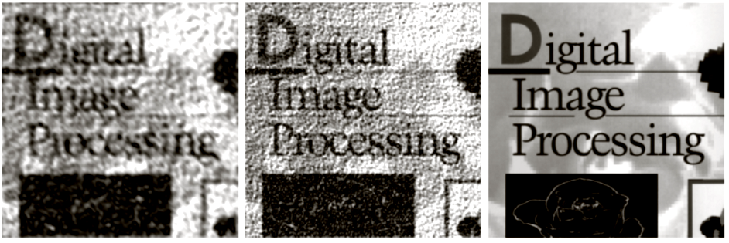

Constrained Restoration
By applying Fourier transform matrices to both sides
$$F\left(u,v\right)=\left[\frac{H^{∗}\left(u,v\right)}{{\left|H\left(u,v\right)\right|}^{2}+γ{\left|Q\left(u,v\right)\right|}^{2}}\right]G(u,v)$$
$$γ=\frac{1}{α}$$
$F, G, H and Q$are the Fourier transforms of $f, g, h and q$respectively
Constrained restoration results with Q = Laplacian and different γ values

Slide 15

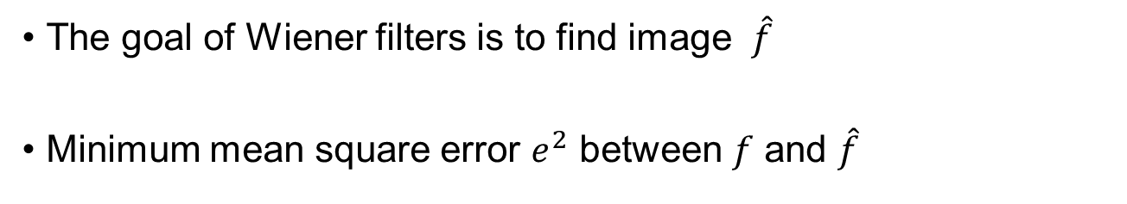
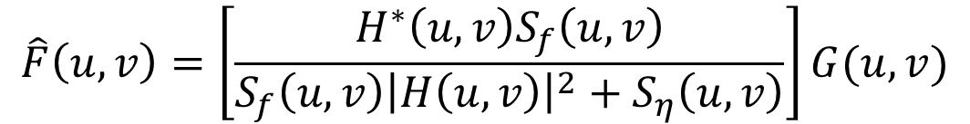
Wiener Filters
The goal of Wiener filters is to find image $\hat{f}$
Minimum mean square error $e^{2}$ between $f$ and $\hat{f}$
$$e^{2}=E\left\{{\left(f−\hat{f}\right)}^{2}\right\}$$
Assume: noise is zero mean and uncorrelated with the image
$$\hat{F}\left(u,v\right)=\left[\frac{H^{∗}\left(u,v\right)S_{f}\left(u,v\right)}{S_{f}\left(u,v\right){\left|H\left(u,v\right)\right|}^{2}+S_{η}\left(u,v\right)}\right]G(u,v)$$

Slide 16
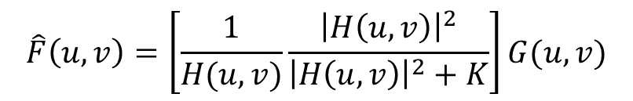

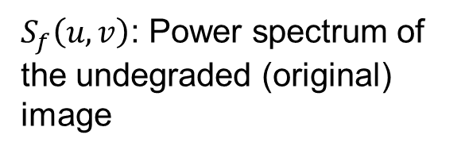
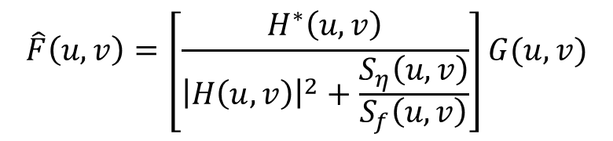
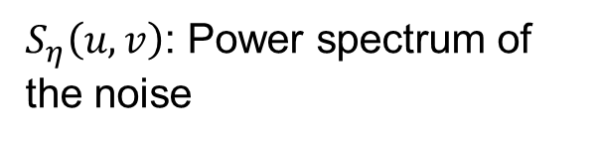


Weiner Filter
$$\hat{F}\left(u,v\right)=\left[\frac{H^{∗}\left(u,v\right)}{{\left|H\left(u,v\right)\right|}^{2}+\frac{S_{η}\left(u,v\right)}{S_{f}\left(u,v\right)}}\right]G(u,v)$$
$H\left(u,v\right)$: Degradation function
$S_{η}\left(u,v\right)$: Power spectrum of the noise
$H^{∗}\left(u,v\right)$: Complex conjugate of $H\left(u,v\right)$
$S_{f}\left(u,v\right)$: Power spectrum of the undegraded (original) image
${\left|H\left(u,v\right)\right|}^{2}$: $H^{∗}\left(u,v\right)H\left(u,v\right)$
$$\hat{F}\left(u,v\right)=\left[\frac{1}{H(u,v)}\frac{{\left|H\left(u,v\right)\right|}^{2}}{{\left|H\left(u,v\right)\right|}^{2}+K}\right]G(u,v)$$

Slide 17
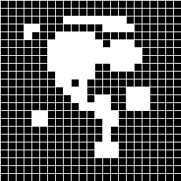

Image Morphology
x
-2 -1 0 1 2
-2 -1 0 1 2
B
y
A special set :
the structuring element
Origin at center in this case, but not necessarily centered nor symmetric
X
No necessarily compact
nor filled
3*3 structuring element

Slide 18
Dilation using Union Formula
Center of the circle
This circle will create one point
This circle will create no point

Slide 19
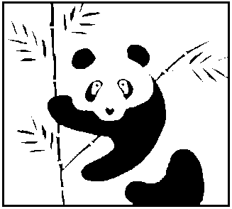




Open and Close
Close = Dilate followed by Erode
Open = Erode followed by Dilate
Original image
eroded
dilated
dilated
eroded
Open
Close

Slide 20
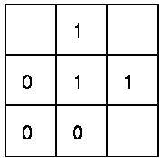
Hit-and-Miss Transform
The structuring element is a slight extension to the type that has been used for dilation and erosion
It contains both 1’s and 0’s
FG
If the foreground and background pixels in the structuring element exactly match foreground and background pixels in the image, then
BG
The pixel underneath the origin of the structuring element is set to the foreground color.
DC
If it doesn't match, then that pixel is set to the background color.

Slide 21
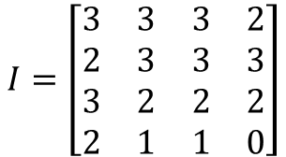
Compression: Numeric Problem
$$I=\left[\begin{matrix}3 & 3 & 3 & 2 \\ 2 & 3 & 3 & 3 \\ 3 & 2 & 2 & 2 \\ 2 & 1 & 1 & 0\end{matrix}\right]$$
Huffman Coding
Mean bits per symbol = 1.75
3→ 1
2 → 00
1 → 010
0 → 011
Compression ratio = 2/1.75 = 1.14
Efficiency = H(S)/1.75
Run-length Coding
(3,3), (2,2), (3,4), (2,4), (1,2), (0,1)
Compression ratio = 32 /24 = 1.33

Slide 22
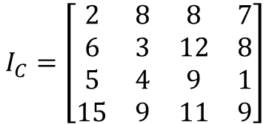
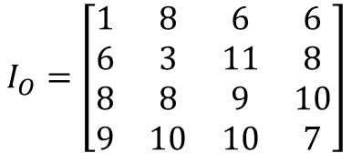
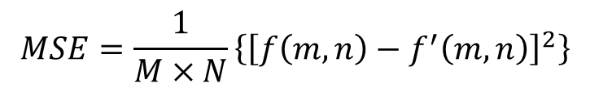
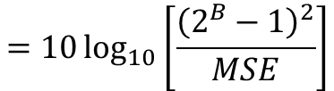
Compression: Numeric Problem
$$I_{O}=\left[\begin{matrix}1 & 8 & 6 & 6 \\ 6 & 3 & 11 & 8 \\ 8 & 8 & 9 & 10 \\ 9 & 10 & 10 & 7\end{matrix}\right]$$
$$I_{C}=\left[\begin{matrix}2 & 8 & 8 & 7 \\ 6 & 3 & 12 & 8 \\ 5 & 4 & 9 & 1 \\ 15 & 9 & 11 & 9\end{matrix}\right]$$
Peak Signal to Noise Ration (PSNR)
$$=10\log_{10}\left[\frac{{\left(2^{B}−1\right)}^{2}}{MSE}\right]$$
$$MSE=\frac{1}{M×N}\left\{{\left[f\left(m,n\right)−f^{′}\left(m,n\right)\right]}^{2}\right\}$$

