Slide 1

CS654: Digital Image Analysis
Lecture 40: Miscellaneous topics

Slide 2
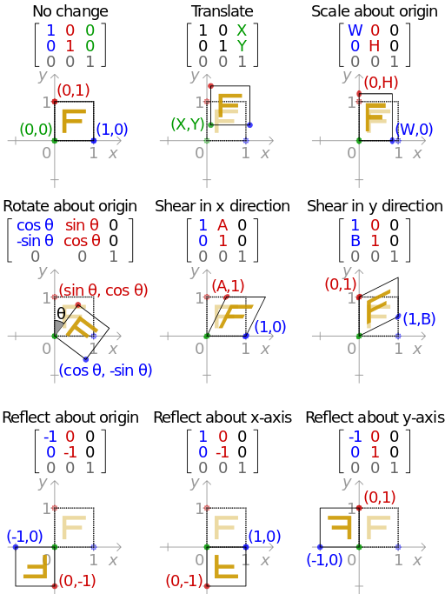
Geometric transformations
About origin
About an arbitrary point
About a line

Slide 3
Pixel arrangement

Slide 4
Invariance

Slide 5
Scaling and interpolation

Slide 6
Scaling and interpolation

Slide 7
Sampling

Slide 8
New image

Slide 9
6-Connectivity

Slide 10
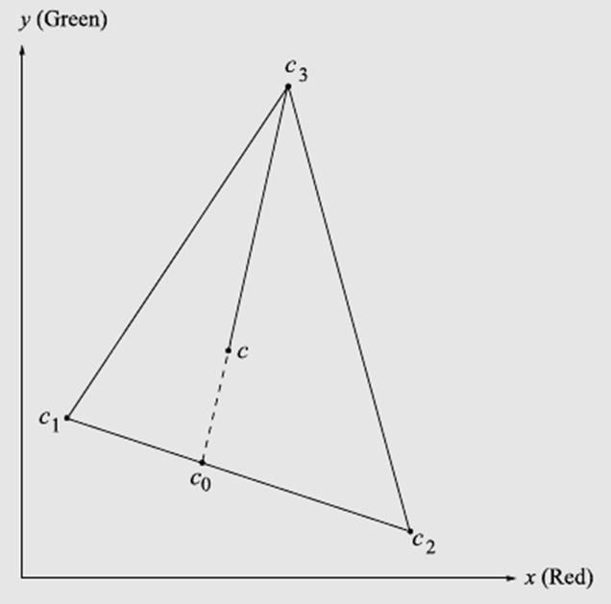
Color Model

Slide 11











Mask based edge detection
Smooth the input image $\hat{f}\left(x,y\right)=f\left(x,y\right)∗G\left(x,y\right)$
${\hat{f}}_{x}\left(x,y\right)=\hat{f}\left(x,y\right)∗M_{x}\left(x,y\right)$
${\hat{f}}_{y}\left(x,y\right)=\hat{f}\left(x,y\right)∗M_{y}\left(x,y\right)$
$|∇f|=\left|{\hat{f}}_{x}\left(x,y\right)\right|+|{\hat{f}}_{y}\left(x,y\right)|$
$θ=\tan^{−1}{\frac{{\hat{f}}_{x}\left(x,y\right)}{{\hat{f}}_{y}\left(x,y\right)}}$
$If magn(x, y)>T,then possible edge point$
$$f_{y}$$
$$∇f$$
$$y+1$$
38 | 66 | 65
14 | 35 | 64
12 | 15 | 42
$$θ$$
$$y$$
$$f_{x}$$
$$y−1$$
$$x−1$$
$$x$$
$$x+1$$

Slide 12
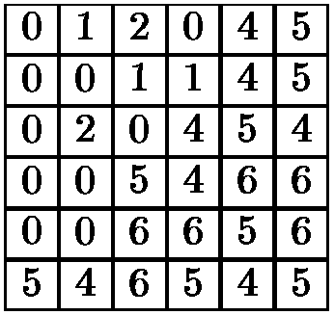
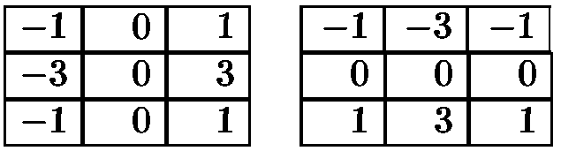
Numerical Example

Slide 13
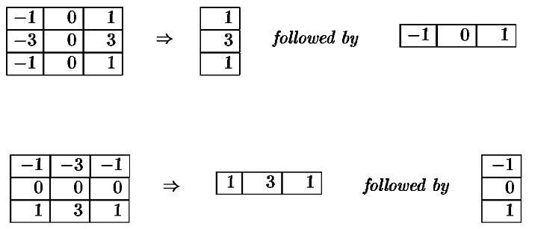
Numerical Example: Separable?

Slide 14
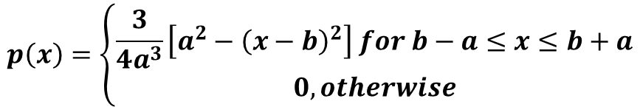
Segmentation
The grey level values of the object and the background pixels are distributed according to the probability density function:
$$p\left(x\right)=\left\{\begin{aligned}\frac{3}{4a^{3}}\left[a^{2}−{\left(x−b\right)}^{2}\right] for b−a≤x≤b+a \\ 0, otherwise\end{aligned}\right.$$
with a = 1, b = 5 for the background and a = 2, b = 7 for the object. Sketch the two distributions and determine the range of possible thresholds.

Slide 15
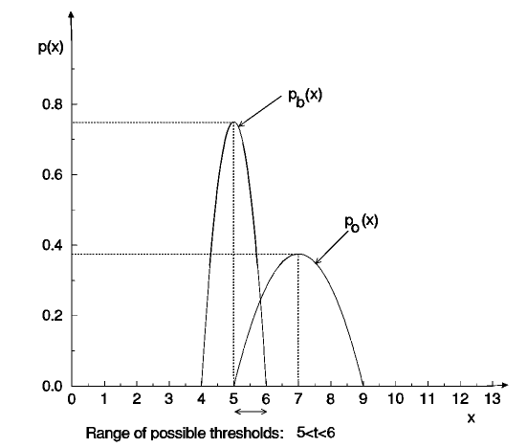
Segmentation

Slide 16
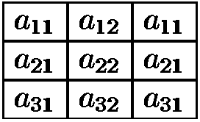
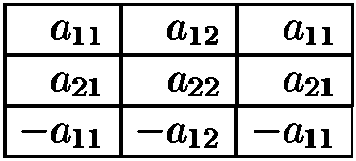
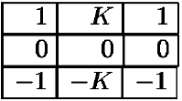


Weight of a $3×3$ matrix for edge detection

Slide 17
Mask design
Line detection kernels which respond maximally to horizontal, vertical and oblique single pixel wide lines
-1 | -1 | -1
2 | 2 | 2
-1 | -1 | -1
-1 | 2 | -1
-1 | 2 | -1
-1 | 2 | -1
-1 | -1 | 2
-1 | 2 | -1
2 | -1 | -1
2 | -1 | -1
-1 | 2 | -1
-1 | -1 | 2
Horizontal
Vertical
+45º
-45º

Slide 18
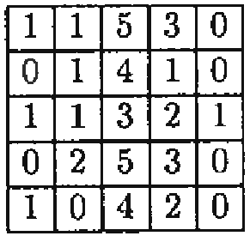
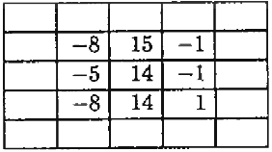

Mask processing
-1 | -1 | -1
2 | 2 | 2
-1 | -1 | -1
-1 | 2 | -1
-1 | 2 | -1
-1 | 2 | -1
-1 | -1 | -1
2 | 2 | 2
-1 | -1 | -1
$$⊗$$

