Slide 1

CS654: Digital Image Analysis
Lecture 4: Basic relationship between Pixels

Slide 2
Recap of Lecture 3
Issues with sampling and quantization
Quality and size trade-off
Data structure to store image information
Matrices – Integral image
Topological – Graph
Hierarchical – Pyramid, Quadtree

Slide 3
Highlights of Lecture 4
Relationship between image pixels
Neighbourhood
Connectivity
Adjacency
Path
Distance metric
Euclidean, City block, Chess board distance, Geodesic distance

Slide 4
Definitions
f(x,y): digital image
Pixels: q, p
Subset of pixels of f(x,y): S
 | p
 |  |  | q

Slide 5
Neighbors of a Pixel
A pixel p at coordinates (x,y) has four horizontal and vertical neighbors whose coordinates are given by:
(x+1,y), (x-1, y), (x, y+1), (x,y-1)
 | (x-1, y)
(x, y-1) | p (x, y) | (x, y+1)
 | (x+1, y)

Slide 6
Neighbourhood
This set of pixels, called the 4-neighbors or p, is denoted by N₄(p).
Each pixel is one unit distance from (x,y)
Some of the neighbors of p lie outside the digital image

Slide 7
Neighbors of a Pixel: Diagonal
The four diagonal neighbors of p have coordinates:
(x+1, y+1), (x+1, y-1), (x-1, y+1), (x-1, y-1)
and are denoted by N_{D} (p).
As before, if (x,y) is on the border of the image.
(x-1, y-1) |  | (x-1, y+1)
 | p (x,y)
(x+1, y-1) |  | (x+1, y+1)

Slide 8

Neighbourhood: 8-neighbours
Diagonal and the 4-neighbors, together are called the 8-neighbors of p
Denoted by N₈ (p).
$N_{8}\left(p\right)=N_{4}\left(p\right)∪N_{D}(p)$
(x-1, y-1) | (x-1, y) | (x-1, y+1)
(x, y-1) | p (x,y) | (x, y+1)
(x+1, y-1) | (x, y+1) | (x+1, y+1)
Some of the points in N_{D} (p) and N₈ (p) fall outside the image

Slide 9
Connectivity
It is used in establishing boundaries of objects and components of regions in an image
A pixel is connected to its neighbor when it has the same property
V is the set of gray-level values used to define adjacency
V set can be any subset of these 256 values.
For binary image ??

Slide 10
Different types of connectivity
V = { }
 |  | p
 |  | p
 |  | p
4-connected
8-connected
m-connected

Slide 11
Adjacency
A pixel p is adjacent to a pixel q, if they are connected.
4-adjacency: Two pixels p and q with values from V are 4-adjacent if q is in the set N₄(p).
8-adjacency: Two pixels p and q with values from V are 8-adjacent if q is in the set N₈(p).
m-adjacency =(mixed)
Depending upon the connectivity used

Slide 12
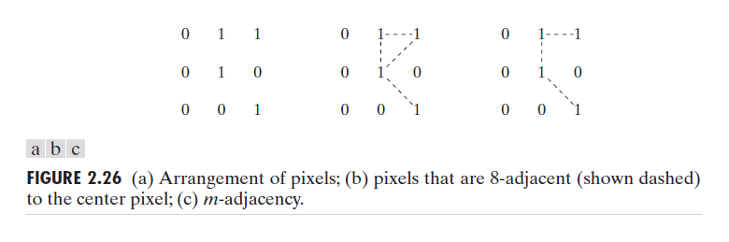
Types of Adjacency
Mixed adjacency is a modification of 8-adjacency. It is introduced to eliminate the ambiguities that often arise when 8-adjacency is used.
For example:

Slide 13
Types of Adjacency
In this example, we can note that to connect between two pixels (finding a path between two pixels):
In 8-adjacency way, you can find multiple paths between two pixels
While, in m-adjacency, you can find only one path between two pixels
So, m-adjacency has eliminated the multiple path connection that has been generated by the 8-adjacency.

Slide 14
Adjacent regions
Two subsets S1 and S2 are adjacent, if
some pixel in S1 is adjacent to some pixel in S2.
Adjacent means, either 4-, 8- or m-adjacency.
Region 1
Region 2

Slide 15
A Digital Path
A digital path from pixel p with coordinate (x,y) to pixel q with coordinate (s,t) is a sequence of distinct pixels
(x₀,y₀), (x₁,y₁), …, (x_{n}, y_{n})
where (x₀,y₀) = (x,y) and (x_{n}, y_{n}) = (s,t)
Pixels (x_{i}, y_{i}) and (x_{i-1}, y_{i-1}) are adjacent for 1 ≤ i ≤ n
n is the length of the path
If (x₀,y₀) = (x_{n}, y_{n}), the path is closed.

Slide 16
A Digital Path
Return to the previous example:
In figure (b) the paths between the top right and bottom right pixels are 8-paths. And the path between the same 2 pixels in figure (c) is m-path

Slide 17
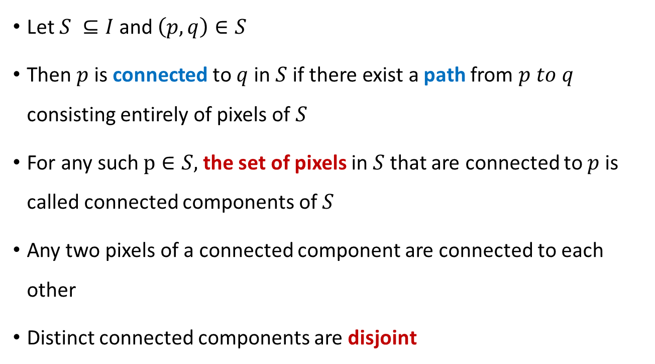
Connected component
Let $S ⊆I$ and $\left(p,q\right)∈S$
Then $p$ is connected to $q$ in $S$ if there exist a path from $p to q$ consisting entirely of pixels of $S$
For any such $p∈S,$ the set of pixels in $S$ that are connected to $p$ is called connected components of $S$
Any two pixels of a connected component are connected to each other
Distinct connected components are disjoint

Slide 18
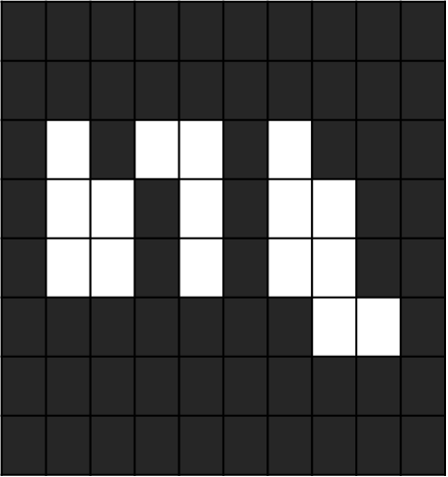

Connected component labeling (CCL)
Ability to assign different labels to various disjoint connected components
Connected-component analysis, Blob extraction, Region labeling, Blob discovery, or Region extraction
Connected-component labeling is not to be confused with segmentation.

Slide 19
Algorithm for CCL
Scan an image from left to right and from top to bottom
Assume 4-connectivity
P be a pixel at any step in the scanning process
 |  |  | p
r
t
Before pixel p, pixel r and t are scanned

Slide 20
Steps of CCL Algorithm: Pass 1
I(p) : pixel value at position p
L(p): Label assigned to pixel location p
If I(p) = 0, then move to next scanning position
If I(p) = 1 and I(r) = I(t) = 0, then
Assign a new label to position p
If I(p) = 1 and only one of the two neighbor is 1, then
Assign its label to p
If I(p) = 1 and both r and t are 1’s, then
If L(r) = L(t) then L(p) = L(r)
If L(r) != L(t) then
assign on of the labels to p and make a note that the two labels are quivalent

Slide 21
CCL: Pass 2
After all the pixels are processed once,
Pixels with value 1 are labeled
Some labels are equivalent
During 2nd pass (post-processing), process the equivalent pixels to form equivalent classes
Assign a different label to each class
Each pixel is labeled with the class label

Slide 22
CCL: Example
0 | 0 | 0 | 0 | 0 | 0 | 0 | 0 | 0 | 0 | 0 | 0 | 0 | 0 | 0 | 0 | 0
0 | 0 | 1 | 1 | 0 | 0 | 1 | 1 | 0 | 0 | 1 | 1 | 0 | 0 | 1 | 1 | 0
0 | 1 | 1 | 1 | 1 | 1 | 1 | 1 | 1 | 0 | 0 | 1 | 1 | 1 | 1 | 0 | 0
0 | 0 | 0 | 1 | 1 | 1 | 1 | 0 | 0 | 0 | 1 | 1 | 1 | 1 | 0 | 0 | 0
0 | 0 | 1 | 1 | 1 | 1 | 0 | 0 | 0 | 1 | 1 | 1 | 0 | 0 | 1 | 1 | 0
0 | 1 | 1 | 1 | 0 | 0 | 1 | 1 | 0 | 0 | 0 | 1 | 1 | 1 | 0 | 0 | 0
0 | 0 | 1 | 1 | 0 | 0 | 0 | 0 | 0 | 1 | 1 | 0 | 0 | 0 | 1 | 1 | 0
0 | 0 | 0 | 0 | 0 | 0 | 1 | 1 | 1 | 1 | 0 | 0 | 1 | 1 | 1 | 1 | 0
0 | 0 | 0 | 0 | 0 | 0 | 0 | 0 | 0 | 0 | 0 | 0 | 0 | 0 | 0 | 0 | 0

Slide 23
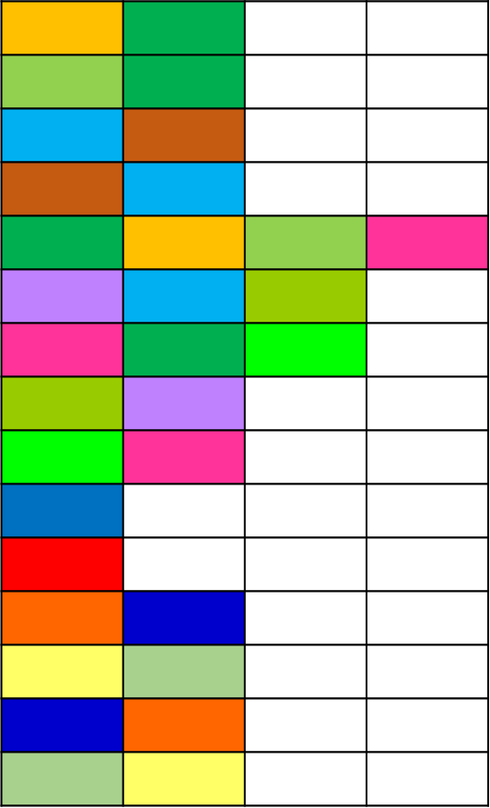
CCL: Example
0 | 0 | 0 | 0 | 0 | 0 | 0 | 0 | 0 | 0 | 0 | 0 | 0 | 0 | 0 | 0 | 0
0 | 0 | 1 | 1 | 0 | 0 | 1 | 1 | 0 | 0 | 1 | 1 | 0 | 0 | 1 | 1 | 0
0 | 1 | 1 | 1 | 1 | 1 | 1 | 1 | 1 | 0 | 0 | 1 | 1 | 1 | 1 | 0 | 0
0 | 0 | 0 | 1 | 1 | 1 | 1 | 0 | 0 | 0 | 1 | 1 | 1 | 1 | 0 | 0 | 0
0 | 0 | 1 | 1 | 1 | 1 | 0 | 0 | 0 | 1 | 1 | 1 | 0 | 0 | 1 | 1 | 0
0 | 1 | 1 | 1 | 0 | 0 | 1 | 1 | 0 | 0 | 0 | 1 | 1 | 1 | 0 | 0 | 0
0 | 0 | 1 | 1 | 0 | 0 | 0 | 0 | 0 | 1 | 1 | 0 | 0 | 0 | 1 | 1 | 0
0 | 0 | 0 | 0 | 0 | 0 | 1 | 1 | 1 | 1 | 0 | 0 | 1 | 1 | 1 | 1 | 0
0 | 0 | 0 | 0 | 0 | 0 | 0 | 0 | 0 | 0 | 0 | 0 | 0 | 0 | 0 | 0 | 0
Equivalent labels

Slide 24
CCL: Example
0 | 0 | 0 | 0 | 0 | 0 | 0 | 0 | 0 | 0 | 0 | 0 | 0 | 0 | 0 | 0 | 0
0 | 0 | 1 | 1 | 0 | 0 | 1 | 1 | 0 | 0 | 1 | 1 | 0 | 0 | 1 | 1 | 0
0 | 1 | 1 | 1 | 1 | 1 | 1 | 1 | 1 | 0 | 0 | 1 | 1 | 1 | 1 | 0 | 0
0 | 0 | 0 | 1 | 1 | 1 | 1 | 0 | 0 | 0 | 1 | 1 | 1 | 1 | 0 | 0 | 0
0 | 0 | 1 | 1 | 1 | 1 | 0 | 0 | 0 | 1 | 1 | 1 | 0 | 0 | 1 | 1 | 0
0 | 1 | 1 | 1 | 0 | 0 | 1 | 1 | 0 | 0 | 0 | 1 | 1 | 1 | 0 | 0 | 0
0 | 0 | 1 | 1 | 0 | 0 | 0 | 0 | 0 | 1 | 1 | 0 | 0 | 0 | 1 | 1 | 0
0 | 0 | 0 | 0 | 0 | 0 | 1 | 1 | 1 | 1 | 0 | 0 | 1 | 1 | 1 | 1 | 0
0 | 0 | 0 | 0 | 0 | 0 | 0 | 0 | 0 | 0 | 0 | 0 | 0 | 0 | 0 | 0 | 0

Slide 25
Thank you
Next Lecture: Neighbourhood Relationship (Contd.)

