Slide 1

CS654: Digital Image Analysis
Lecture 5: Pixels Relationships

Slide 2
Recap of Lecture 4
Different pixel relationships
Neighbourhood
Connectivity
Adjacency
Path
Connected component labelling

Slide 3
Outline
Different distance measures
Application of distance measures
Arithmetic and logical operations on images

Slide 4
Region and boundary
A region is a set of pixels in which there is a path between any pair of pixels
Points within a region are contiguous: reflexive, symmetric and transitive
Decomposition of set
Connected component labeling

Slide 5
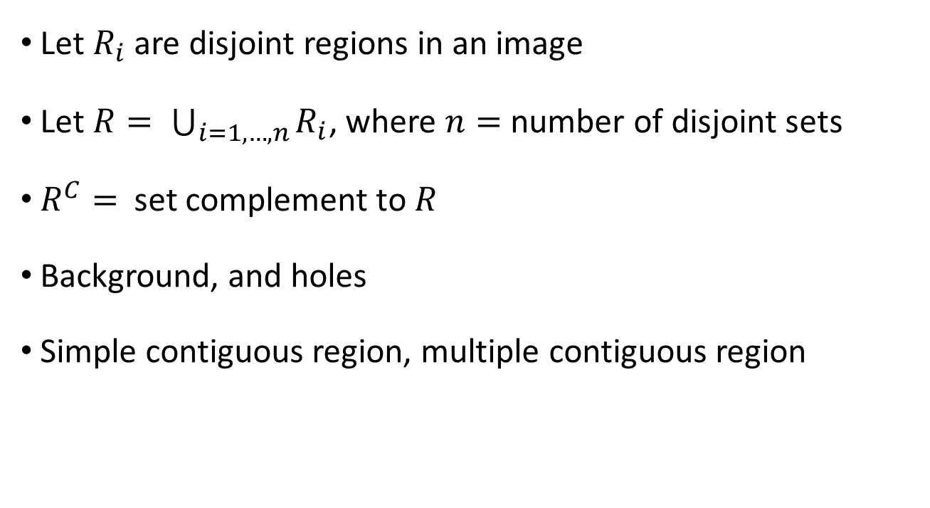
Foreground and background
Let $R_{i}$ are disjoint regions in an image
Let $R= \bigcup_{i=1,…, n}{R_{i}}$, where $n=$number of disjoint sets
$R^{C}=$ set complement to $R$
Background, and holes
Simple contiguous region, multiple contiguous region

Slide 6
Distance Measures
For pixels p, q and z, with coordinates (x,y), (s,t) and (v,w), respectively, D is a distance function if:
(a) D (p,q) ≥ 0 (D (p,q) = 0 iff p = q),
(b) D (p,q) = D (q, p), and
(c) D (p,z) ≤ D (p,q) + D (q,z).

Slide 7
Distance Measures
The Euclidean Distance between p and q is defined as:
D_{e} (p,q) = [(x – s)² + (y - t)²]^{1/2}
Pixels having a distance less than or equal to some value r from (x,y) are the points contained in a disk of
^{radius r centered at (x,y)}
q (s,t)
D_{e} (p,q)
p (x,y)

Slide 8
Distance Measures
The D₄ distance (also called city-block distance, Manhattan distance) between p and q is defined as:
D₄ (p,q) = | x – s | + | y – t |
Pixels having a D₄ distance from
(x,y), less than or equal to some
value r form a Diamond
centered at (x,y)
q (s,t)
D₄
p (x,y)

Slide 9
Distance Measures
Example:
The pixels with distance D₄ ≤ 2 from (x,y) form the following contours of constant distance.
The pixels with D₄ = 1 are
the 4-neighbors of (x,y)
 |  | 2
 | 2 | 1 | 2
2 | 1 | P | 1 | 2
 | 2 | 1 | 2
 |  | 2

Slide 10
Distance Measures
The D₈ distance (also called chessboard distance) between p and q is defined as:
D₈ (p,q) = max(| x – s |,| y – t |)
Pixels having a D₈ distance from
(x,y), less than or equal to some
value r form a square
Centered at (x,y)
q (s,t)
D_{8(b)}
p (x,y)
D_{8(a)}
D₈ = max(D_{8(a) ,} D_{8(b)})

Slide 11
Distance Measures
Example:
D₈ distance ≤ 2 from (x,y) form the following contours of constant distance.
2 | 2 | 2 | 2 | 2
2 | 1 | 1 | 1 | 2
2 | 1 | P | 1 | 2
2 | 1 | 1 | 1 | 2
2 | 2 | 2 | 2 | 2

Slide 12
Distance Measures
Dm distance:
is defined as the shortest m-path between the points.
In this case, the distance between two pixels will depend on the values of the pixels along the path, as well as the values of their neighbors.

Slide 13
Distance Measures
Example:
Consider the following arrangement of pixels and assume that p, p₂, and p₄ have value 1 and that p₁ and p₃ can have can have a value of 0 or 1
Suppose that we consider
the adjacency of pixels
values 1 (i.e. V = {1})
0 | s | t
q | r | 0
p | 0 | 0

Slide 14
Distance Measures
Cont. Example:
Now, to compute the D_{m} between points p and t
Here we have 4 cases:
Case1: If q =0 and s = 0
The length of the shortest m-path
(the D_{m} distance) is 2 (p, p₂, p₄)
0 | 0 | t
0 | r | 0
p | 0 | 0

Slide 15
Distance Measures
Cont. Example:
Case2: If q =1 and s = 0
now, q and p will no longer be adjacent (see m-adjacency definition)
then, the length of the shortest
path will be 3 (p, q, r, t)
0 | 0 | t
q | r | 0
p | 0 | 0

Slide 16
Distance Measures
Cont. Example:
Case3: If p₁ =0 and p₃ = 1
The same applies here, and the shortest –m-path will be 3 (p, p₂, p₃, p₄)
0 | s | t
0 | r | 0
p | 0 | 0

Slide 17
Distance Measures
Cont. Example:
Case4: If p₁ =1 and p₃ = 1
The length of the shortest m-path will be 4 (p, p₁ , p₂, p₃, p₄)
0 | s | t
q | r | 0
p | 0 | 0

Slide 18
Paradoxes
4- connectivity
Perpendicular lines not crossing each other

Slide 19
Paradoxes
 |  |  |  | a | B
 |  |  |  | d | C
8- connectivity
Perpendicular lines not crossing each other

Slide 20
Application of distance measure: Shape matching
Distance transform is an operator normally only applied to binary images.
The result of the transform is a gray-level image that looks similar to the input image
Except that the grey level intensities of points inside foreground regions are changed to show the distance to the closest boundary from each point.

Slide 21
Distance transform: Analogy
Imagine that foreground regions in the input binary image are made of some uniform slow burning inflammable material.
Starting a fire at all points on the boundary of a foreground region and letting the fire burn its way into the interior.
Label each point in the interior with the amount of time that the fire took to first reach that point
Chamfering algorithm or chamfering or distance function

Slide 22
Distance transform
The resulting image has pixel values
0 for elements of the relevant subset
Low values for close pixel
High values for pixels remote from it
The distance transform of a binary image
Distance from each pixel to the nearest non-zero pixel

Slide 23
Example
0 | 0 | 0 | 0 | 0 | 0 | 1 | 0
0 | 0 | 0 | 0 | 0 | 1 | 0 | 0
0 | 0 | 0 | 0 | 0 | 1 | 0 | 0
0 | 0 | 0 | 0 | 0 | 1 | 0 | 0
0 | 1 | 1 | 0 | 0 | 0 | 1 | 0
0 | 1 | 0 | 0 | 0 | 0 | 0 | 1
0 | 1 | 0 | 0 | 0 | 0 | 0 | 0
0 | 1 | 0 | 0 | 0 | 0 | 0 | 0
5 | 4 | 4 | 3 | 2 | 1 | 0 | 1
4 | 3 | 3 | 2 | 1 | 0 | 1 | 2
3 | 2 | 2 | 2 | 1 | 0 | 1 | 2
2 | 1 | 1 | 2 | 1 | 0 | 1 | 2
1 | 0 | 0 | 1 | 2 | 1 | 0 | 1
1 | 0 | 1 | 2 | 3 | 2 | 1 | 0
1 | 0 | 1 | 2 | 3 | 3 | 2 | 1
1 | 0 | 1 | 2 | 3 | 4 | 3 | 2
Distance transform for distance D₄

Slide 24
Two pass distance transform algorithm
Proposed by Rosenfeld and Pfaltz for distance D₄ and D₈
Idea: traverse the image by a small local mask
Pass 1:
Starts from top left corner of the image
Move horizontally left to right
Move vertically top to bottom
Pass 2:
Starts from bottom right corner of the image
Move horizontally right to left
Move vertically bottom to top

Slide 25
Masks use for distance transform calculation
AL | AL
AL | P
AL
 | BR
P | BR
BR | BR
Mask used for pass 1
Mask used for pass 2
Pixel neighbourhoods used in DT
P is the central pixel
The effectiveness comes from the propagation of values in a wave like manner

Slide 26
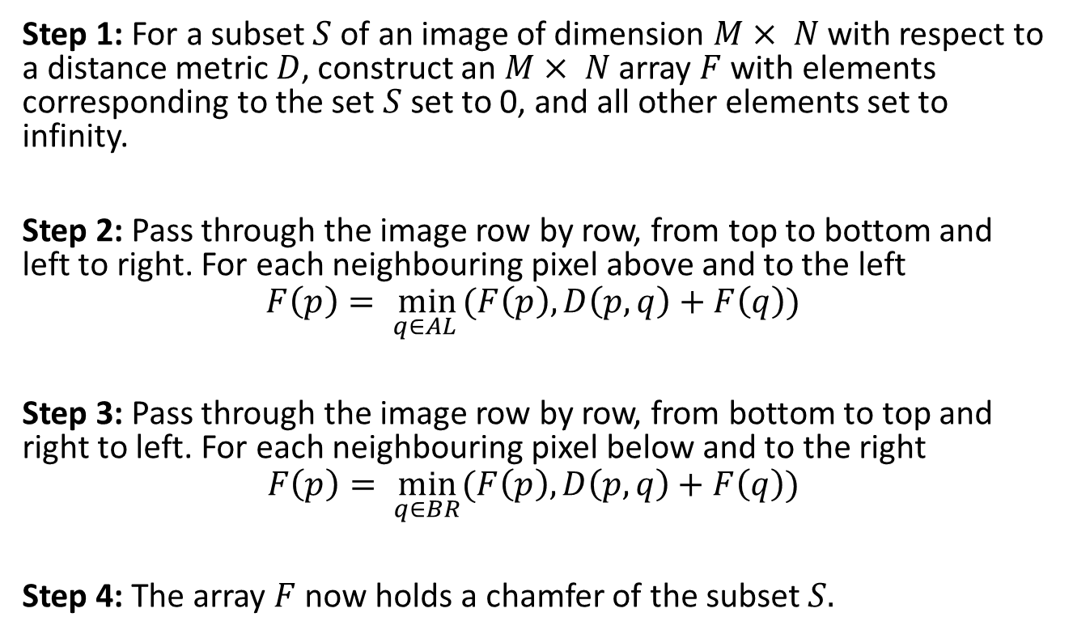
The DT Algorithm
Step 1: For a subset $S$ of an image of dimension $M× N$with respect to a distance metric $D$, construct an $M× N$array $F$with elements corresponding to the set $S$set to 0, and all other elements set to infinity.
Step 2: Pass through the image row by row, from top to bottom and left to right. For each neighbouring pixel above and to the left
$$F\left(p\right)= \min_{q∈AL }{(F\left(p\right),D\left(p,q\right)+F\left(q\right))}$$
Step 3: Pass through the image row by row, from bottom to top and right to left. For each neighbouring pixel below and to the right
$$F\left(p\right)= \min_{q∈BR}{(F\left(p\right),D\left(p,q\right)+F\left(q\right))}$$
Step 4: The array$F$now holds a chamfer of the subset $S.$

Slide 27
Arithmetic operations on Images
An image is represented in a matrix format.
To perform image arithmetic the size of the two matrices should be same.
The operation on two images results in a new image.
Consider two images A and B with same size.
Image Addition – add components from one image into other image
Image Subtraction – change detection
Image Multiplication – masking
Image Division

Slide 28
Logical operation on images
Logical operations are done on pixel by pixel basis.
The AND and OR operations are used for selecting sub-images in an image .
This masking operation is referred as Region Of Interest processing.
Isolate image parts
Logical AND
Logical OR

Slide 29
Thank you
Next Lecture: Basic transformations

