Slide 1

CS654: Digital Image Analysis
Lecture 6: Basic Transformations

Slide 2
Recap of Lecture 5
Different distance measures
D4, D8,Dm, Euclidean
Application of distance transform
Shape matching
Arithmetic and logical operations on images
Combining images

Slide 3
Today’s outline
Basic mathematical transformations in 2-D and 3-D
Translation
Rotation
Scaling
Inverse transformation
Perspective projection
Cartesian and homogeneous co-ordinate system

Slide 4
Basic transformations in 2-D
Translation
Rotation
Scaling
Concatenate transformations
Transformation about an arbitrary point

Slide 5
Rotation about a point other than the Origin
Translate the object so that the point of translation is moved to the origin
Rotate the relocated object as normal around the origin
Undo the translation in Step 1 to return the newly rotated object to its new rotated location.
Find the new end points of the line segment which connects the points (1,1) to (3,3) when it is rotated anti-clockwise about the point (1,1) through an angle of π/2.

Slide 6
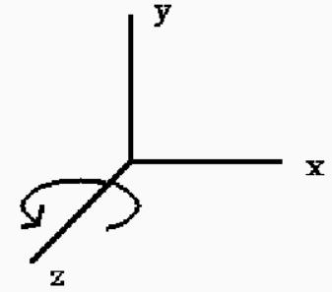
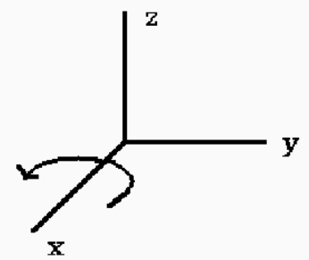
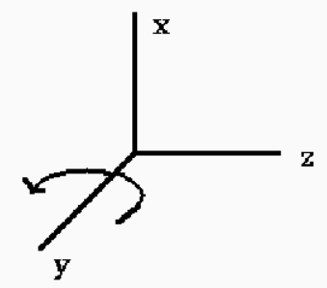
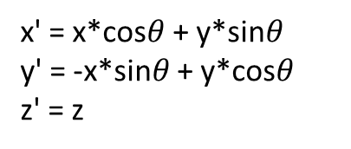
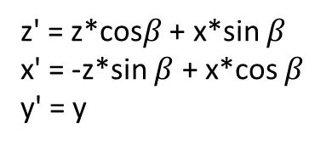
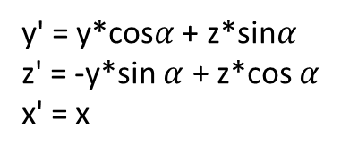
Basic transformation in 3D: Translation
Translation
Scaling
Rotation
About z-axis
About x-axis
About z-axis
x' = x*cos$θ$ + y*sin$θ$ y' = -x*sin$θ$ + y*cos$θ$
z' = z
y' = y*cos$α$ + z*sin$α$ z' = -y*sin $α$ + z*cos $α$ x' = x
z' = z*cos$β$ + x*sin $β$ x' = -z*sin $β$ + x*cos $β$ y' = y

Slide 7
Commutative and non-commutative transformation
Non-Commutative
Commutative
Non-uniform scale, rotate
Translate – scale
Rotate - translate
Translate – translate
Scale – scale
Rotate – rotate
Uniform scaling – rotate

Slide 8


Inverse transformation
Translation $T^{−1}=\left[\begin{matrix}1 & 0 & 0 & −tx \\ 0 & 1 & 0 & −ty \\ 0 & 0 & 1 & −tz \\ 0 & 0 & 0 & 1\end{matrix}\right]$
Scaling $S^{−1}=\left[\begin{matrix}\frac{1}{S_{x}} & 0 & 0 & 0 \\ 0 & \frac{1}{S_{y}} & 0 & 0 \\ 0 & 0 & \frac{1}{S_{z}} & 0 \\ 0 & 0 & 0 & 1\end{matrix}\right]$
Rotation
$$R_{θ}^{−1}=\left[\begin{matrix}cos(−θ) & sin(−θ) & 0 & 0 \\ −sin⁡(−θ) & cos⁡(−θ) & 0 & 0 \\ 0 & 0 & 1 & 0 \\ 0 & 0 & 0 & 1\end{matrix}\right]$$
$=\left[\begin{matrix}cos(θ) & −sin(θ) & 0 & 0 \\ sin⁡(θ) & cos⁡(θ) & 0 & 0 \\ 0 & 0 & 1 & 0 \\ 0 & 0 & 0 & 1\end{matrix}\right]$

Slide 9
Perspective transformation
Y
World co-ordinate
P(X,Y,Z)
X
Z
Given (X,Y,Z) and focal length of the camera can we determine the camera co-ordinate system?
P_{I}(x,y)
Image co-ordinate

Slide 10
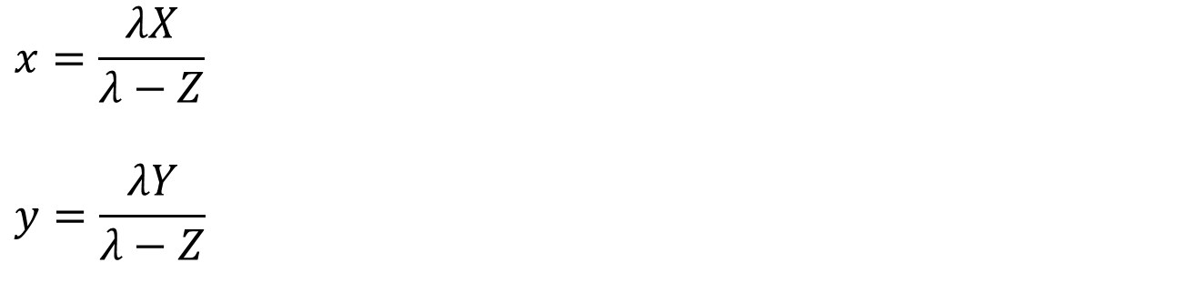
Relation between camera coordinate and world coordinate
Using similar triangle concept compute the relation between world coordinate and camera coordinate
$$x=\frac{λX}{λ−Z}$$
$$y=\frac{λY}{λ−Z}$$

Slide 11
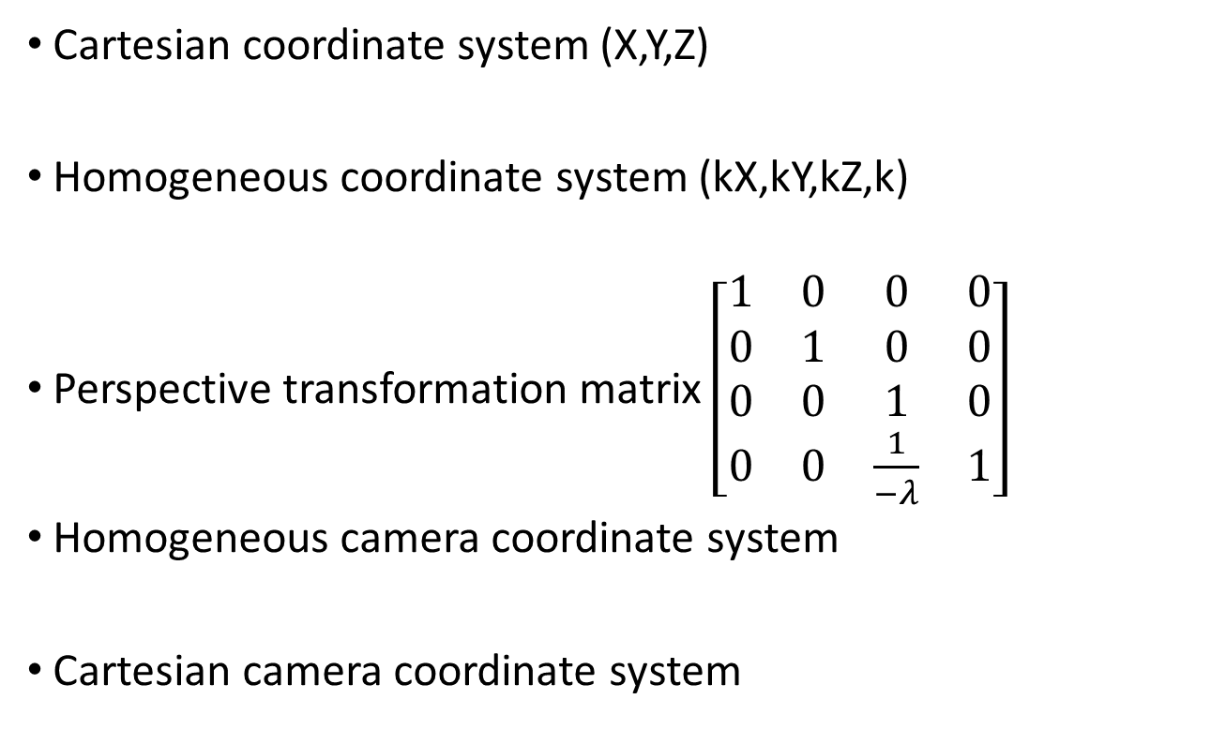
Homogeneous coordinate system
Cartesian coordinate system (X,Y,Z)
Homogeneous coordinate system (kX,kY,kZ,k)
Perspective transformation matrix $\left[\begin{matrix}1 & 0 & 0 & 0 \\ 0 & 1 & 0 & 0 \\ 0 & 0 & 1 & 0 \\ 0 & 0 & \frac{1}{−λ} & 1\end{matrix}\right]$
Homogeneous camera coordinate system
Cartesian camera coordinate system

Slide 12
Thank you
Next Lecture: Camera Model and Imaging Geometry

