Slide 1

CS654: Digital Image Analysis
Lecture 7: Camera Model and Imaging Geometry

Slide 2
Recap of lecture 6
Basic mathematical transformation
Translation, Rotation, Scaling
Transformation about origin and arbitrary point
Transformation in 2D and 3D
Perspective transformation – image formation

Slide 3
Outline of Lecture 7
Inverse perspective transformation
Generalized perspective transformation
Camera calibration

Slide 4
Perspective transformation: Recap
Y
World co-ordinate
P(X,Y,Z)
X
Z
Given (X,Y,Z) and focal length of the camera can we determine the camera co-ordinate system?
P_{I}(x,y)
Image co-ordinate

Slide 5


Mathematical relation
To obtain an image/ camera point in 2-D
$$c_{h}=Pw_{h}$$
Cartesian co-ordinate of the image point
$$x=\frac{λX}{λ−Z}$$
$$y=\frac{λY}{λ−Z}$$

Slide 6


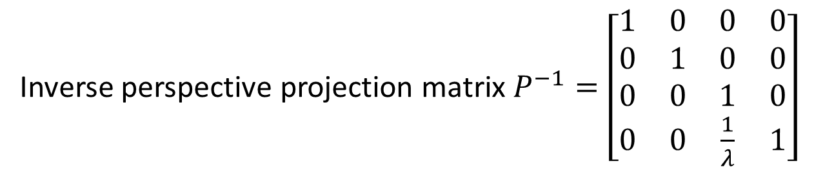

Inverse perspective projection
Given the camera coordinate $c_{h}=(x_{0},y_{0})$ can we obtain the 3-D world coordinate
$$c_{h}=Pw_{h}$$
$$w_{h}=P^{−1}c_{h}$$
Inverse perspective projection matrix $P^{−1}=\left[\begin{matrix}1 & 0 & 0 & 0 \\ 0 & 1 & 0 & 0 \\ 0 & 0 & 1 & 0 \\ 0 & 0 & \frac{1}{λ} & 1\end{matrix}\right]$

Slide 7
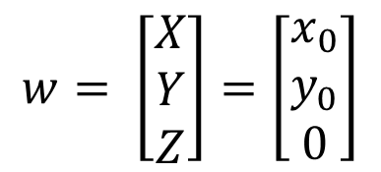
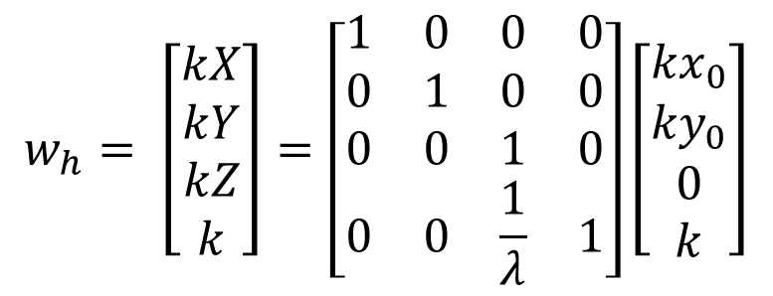
Inverse perspective projection
Homogeneous representation of the 3-D world coordinate
$$w_{h}= \left[\begin{matrix}kX \\ kY \\ kZ \\ k\end{matrix}\right]=\left[\begin{matrix}1 & 0 & 0 & 0 \\ 0 & 1 & 0 & 0 \\ 0 & 0 & 1 & 0 \\ 0 & 0 & \frac{1}{λ} & 1\end{matrix}\right]\left[\begin{matrix}{kx}_{0} \\ {ky}_{0} \\ 0 \\ k\end{matrix}\right]$$
Cartesian coordinate of the 3-D world coordinate
$$w= \left[\begin{matrix}X \\ Y \\ Z\end{matrix}\right]=\left[\begin{matrix}x_{0} \\ y_{0} \\ 0\end{matrix}\right]$$
3-D world coordinate is identical to 2-D image coordinate

Slide 8
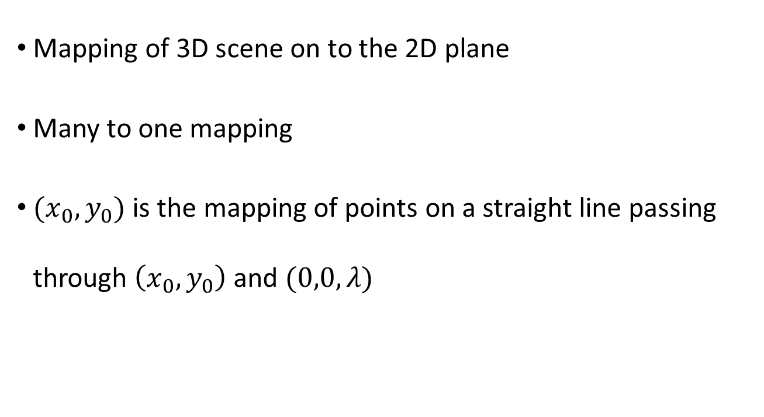
Problem of Inverse Perspective Transformation
Mapping of 3D scene on to the 2D plane
Many to one mapping
$(x_{0},y_{0})$ is the mapping of points on a straight line passing through $\left(x_{0},y_{0}\right)$ and $(0,0,λ)$

Slide 9
Inverse Perspective transformation → M:1 mapping
Y
World co-ordinate
P(X,Y,Z)
X
Z
P_{I}(x,y)
Image co-ordinate

Slide 10





Inverse perspective projection
Assume z-coordinate in $c_{h}$as a free variable
Apply inverse perspective transformation on this points
$$w_{h}= \left[\begin{matrix}kX \\ kY \\ kZ \\ k\end{matrix}\right]=\left[\begin{matrix}1 & 0 & 0 & 0 \\ 0 & 1 & 0 & 0 \\ 0 & 0 & 1 & 0 \\ 0 & 0 & \frac{1}{λ} & 1\end{matrix}\right]\left[\begin{matrix}{kx}_{0} \\ {ky}_{0} \\ kz \\ k\end{matrix}\right]$$
$$X= ?$$
$$Y= ?$$
$$Z= ?$$

Slide 11


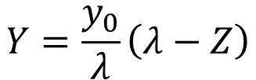
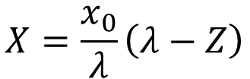
World coordinate after inverse perspective projection
Represent the free variable in terms of $λ$ and $Z$
Represent $X$ and $Y$
$$z=\frac{λZ}{λ−Z}$$
$$X=\frac{x_{0}}{λ}\left(λ−Z\right)$$
$$Y=\frac{y_{0}}{λ}\left(λ−Z\right)$$
To uniquely determine the point in 3-D to which an image point in 2-D is mapped to, we need to know the Z value

Slide 12
Generalized perspective transformation
We have assumed that image and world coordinate planes are aligned
Their origins are coinciding with each other
In a generalized scenario this doesn’t hold good
A set of things need to be taken into account

Slide 13
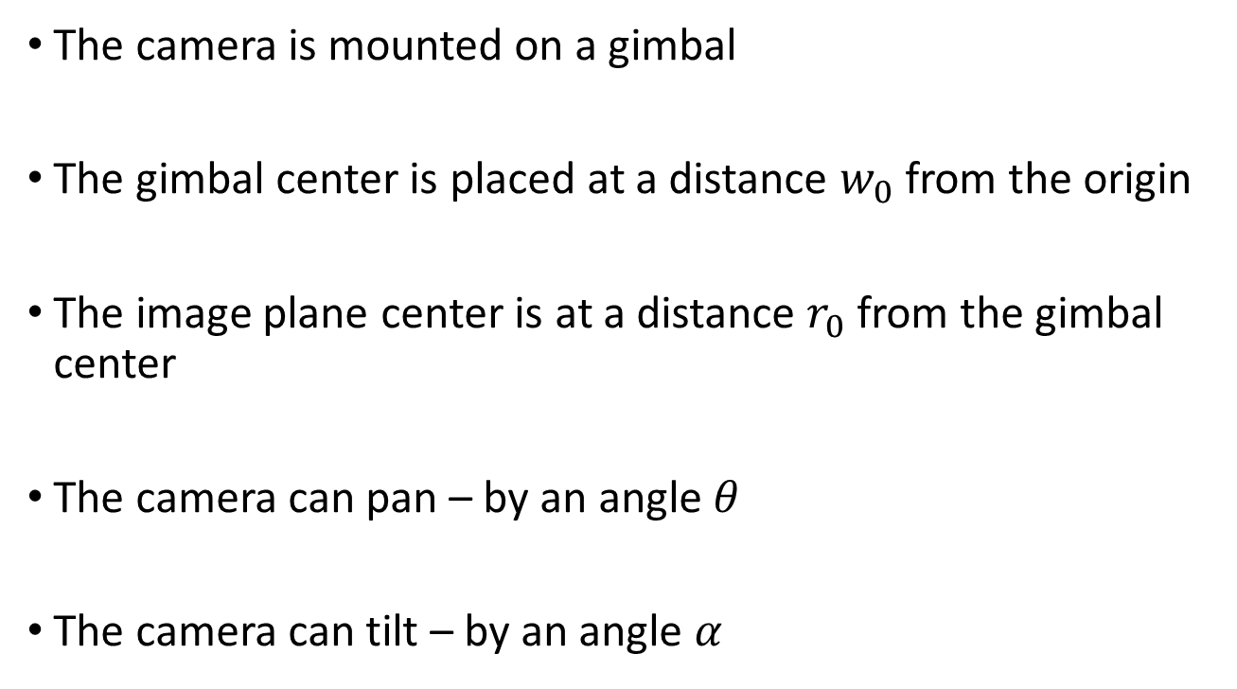
Generalized perspective transformation
The camera is mounted on a gimbal
The gimbal center is placed at a distance $w_{0}$ from the origin
The image plane center is at a distance $r_{0}$ from the gimbal center
The camera can pan – by an angle $θ$
The camera can tilt – by an angle $α$
Rotation around X axis, keeping Z axis fixed
Rotation around Z axis keeping X axis fixed

Slide 14

A series of transformations to be applied
Displacement of the gimbal center to the origin $(G)$
Pan ${(P}_{θ})$
Tilt ${(T}_{α})$
Displacement of the image plane to the origin $(C)$

Slide 15
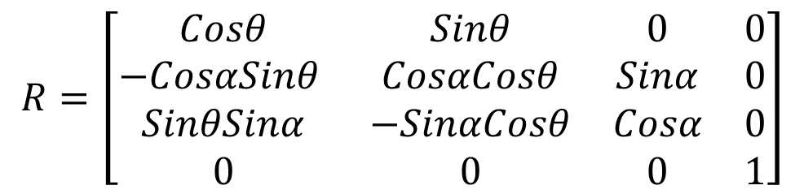
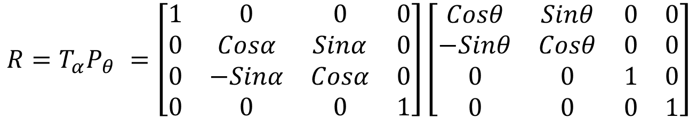
Combining pan and tilt
We can combine the two rotation matrix into one
$$R=T_{α}P_{θ} =\left[\begin{matrix}1 & 0 & 0 & 0 \\ 0 & Cosα & Sinα & 0 \\ 0 & −Sinα & Cosα & 0 \\ 0 & 0 & 0 & 1\end{matrix}\right]\left[\begin{matrix}Cosθ & Sinθ & 0 & 0 \\ −Sinθ & Cosθ & 0 & 0 \\ 0 & 0 & 1 & 0 \\ 0 & 0 & 0 & 1\end{matrix}\right]$$
$$R=\left[\begin{matrix}Cosθ & Sinθ & 0 & 0 \\ −CosαSinθ & CosαCosθ & Sinα & 0 \\ SinθSinα & −SinαCosθ & Cosα & 0 \\ 0 & 0 & 0 & 1\end{matrix}\right]$$

Slide 16



Combined transformation matrix
In simplified case
In generalized case
$$c_{h}=Pw_{h}$$
$$c_{h}=PAw_{h}$$
Combination of a series of transformations to be applied
$$A=CRG$$

Slide 17
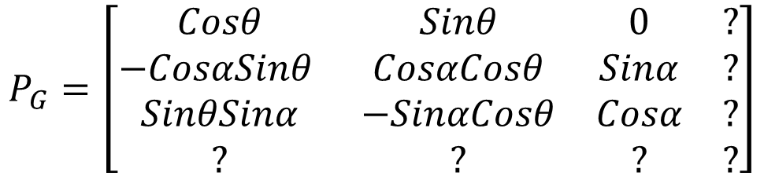

Final form of the generalized perspective transformation matrix
Let, the generalized perspective transformation matrix be denoted as $P_{G}=PA$
$$P_{G}=\left[\begin{matrix}Cosθ & Sinθ & 0 & ? \\ −CosαSinθ & CosαCosθ & Sinα & ? \\ SinθSinα & −SinαCosθ & Cosα & ? \\ ? & ? & ? & ?\end{matrix}\right]$$
$$c_{h}=P_{G}w_{h}$$
Homogeneous coordinate of the camera point after generalized perspective transformation

Slide 18

Cartesian coordinate of the image point
$$c={\left[x y\right]}^{T}$$
$$x=\frac{\left(X−x_{0}\right)Cosθ+\left(Y−y_{0}\right)Sinθ−r_{1}}{−\left(X−x_{0}\right)SinθSinα+\left(Y−y_{0}\right)SinαCosθ−\left(Z−z_{0}\right)Cosα+r_{3}+λ}$$
$$y=\frac{−\left(X−x_{0}\right)CosαSinθ+\left(Y−y_{0}\right)CosαCosθ+\left(Z−z_{0}\right)Sinα−r_{2}}{−\left(X−x_{0}\right)SinθSinα+\left(Y−y_{0}\right)SinαCosθ−\left(Z−z_{0}\right)Cosα+r_{3}+λ}$$

Slide 19
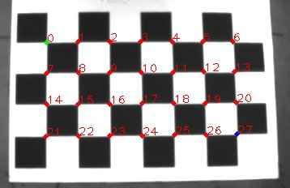
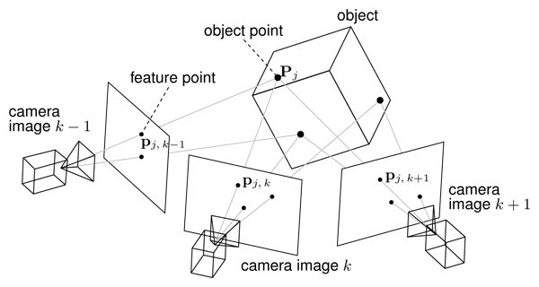
Reality

Slide 20
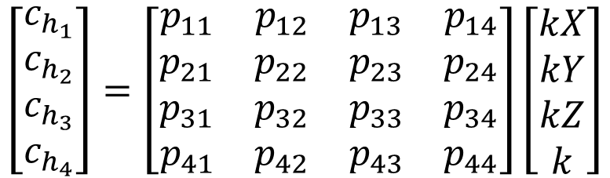

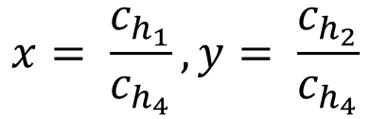
Camera calibration
Calculate the combined transformation matrix given the point correspondence
$$c_{h}=P_{G}w_{h}$$
$$\left[\begin{matrix}c_{h_{1}} \\ c_{h_{2}} \\ c_{h_{3}} \\ c_{h_{4}}\end{matrix}\right]=\left[\begin{matrix}p_{11} & p_{12} & p_{13} & p_{14} \\ p_{21} & p_{22} & p_{23} & p_{24} \\ p_{31} & p_{32} & p_{33} & p_{34} \\ p_{41} & p_{42} & p_{43} & p_{44}\end{matrix}\right]\left[\begin{matrix}kX \\ kY \\ kZ \\ k\end{matrix}\right]$$
$$x= \frac{c_{h_{1}}}{c_{h_{4}}},y= \frac{c_{h_{2}}}{c_{h_{4}}}$$

Slide 21
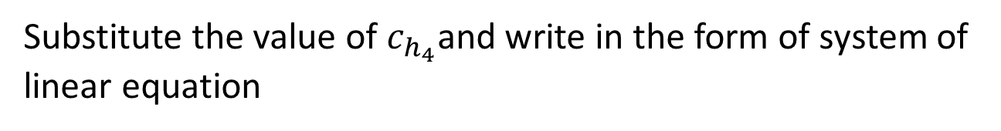






Camera coordinate representation
$$xc_{h4}=$$
$$p_{11}X+p_{12}Y+p_{13}Z+p_{14}$$
$$xc_{h4}=$$
$$p_{21}X+p_{22}Y+p_{23}Z+p_{24}$$
$$c_{h4}=$$
$$p_{41}X+p_{42}Y+p_{43}Z+p_{44}$$
Substitute the value of $c_{h_{4}}$and write in the form of system of linear equation

Slide 22
Relation between camera points and transformation matrix
$$p_{11}X+p_{12}Y+p_{13}Z+p_{14}−xXp_{41}−xYp_{42}−xZp_{43}−xp_{44}=0$$
$$p_{21}X+p_{22}Y+p_{23}Z+p_{24}−yXp_{41}−yYp_{42}−yZp_{43}−yp_{44}=0$$
What are the known variables?
What are the unknown variables?

Slide 23
Thank you
Next Lecture: Stereo Imaging

