Slide 1

CS654: Digital Image Analysis
Lecture 8: Stereo Imaging

Slide 2
Recap of Lecture 7
Inverse perspective transformation and its issues
Many to one mapping
Generalized perspective transformation
Fundamentals of camera calibration

Slide 3
Outline of Lecture 8
Fundamentals of stereo imaging
Calculation of disparity
Search space for point correspondence
Correlation based correspondence

Slide 4






Camera calibration
$$p_{11}X+p_{12}Y+p_{13}Z+p_{14}−xXp_{41}−xYp_{42}−xZp_{43}−xp_{44}=0$$
….. (1)
$$p_{21}X+p_{22}Y+p_{23}Z+p_{24}−yXp_{41}−yYp_{42}−yZp_{43}−yp_{44}=0$$
….. (2)
6 pairs of points are required
$1. (X_{1},Y_{1},Z_{1})$ and $(x_{1},y_{1})$
$3. (X_{3},Y_{3},Z_{3})$ and $(x_{3},y_{3})$
$5. (X_{5},Y_{5},Z_{5})$ and $(x_{5},y_{5})$
$2. (X_{2},Y_{2},Z_{2})$ and $(x_{2},y_{2})$
$4. (X_{4},Y_{4},Z_{4})$ and $(x_{4},y_{4})$
$6. (X_{6},Y_{6},Z_{6})$ and $(x_{6},y_{6})$

Slide 5
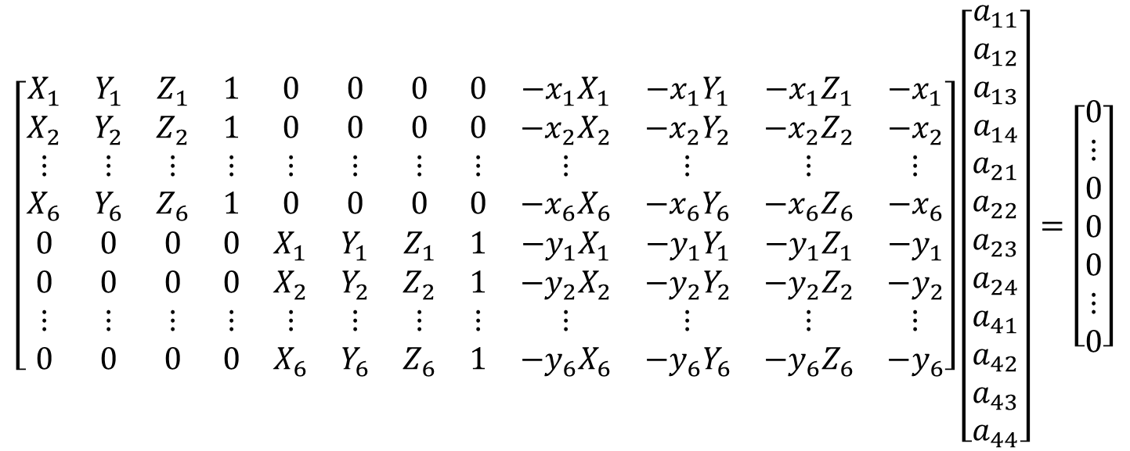




Solving for unknowns
$$CP=0$$
$$\left[\begin{matrix}X_{1} & Y_{1} & Z_{1} & 1 & 0 & 0 & 0 & 0 & −x_{1}X_{1} & −x_{1}Y_{1} & −x_{1}Z_{1} & −x_{1} \\ X_{2} & Y_{2} & Z_{2} & 1 & 0 & 0 & 0 & 0 & −x_{2}X_{2} & −x_{2}Y_{2} & −x_{2}Z_{2} & −x_{2} \\ ⋮ & ⋮ & ⋮ & ⋮ & ⋮ & ⋮ & ⋮ & ⋮ & ⋮ & ⋮ & ⋮ & ⋮ \\ X_{6} & Y_{6} & Z_{6} & 1 & 0 & 0 & 0 & 0 & −x_{6}X_{6} & −x_{6}Y_{6} & −x_{6}Z_{6} & −x_{6} \\ 0 & 0 & 0 & 0 & X_{1} & Y_{1} & Z_{1} & 1 & −y_{1}X_{1} & −y_{1}Y_{1} & −y_{1}Z_{1} & −y_{1} \\ 0 & 0 & 0 & 0 & X_{2} & Y_{2} & Z_{2} & 1 & −y_{2}X_{2} & −y_{2}Y_{2} & −y_{2}Z_{2} & −y_{2} \\ ⋮ & ⋮ & ⋮ & ⋮ & ⋮ & ⋮ & ⋮ & ⋮ & ⋮ & ⋮ & ⋮ & ⋮ \\ 0 & 0 & 0 & 0 & X_{6} & Y_{6} & Z_{6} & 1 & −y_{6}X_{6} & −y_{6}Y_{6} & −y_{6}Z_{6} & −y_{6}\end{matrix}\right]\left[\begin{matrix}a_{11} \\ a_{12} \\ a_{13} \\ a_{14} \\ a_{21} \\ a_{22} \\ a_{23} \\ a_{24} \\ a_{41} \\ a_{42} \\ a_{43} \\ a_{44}\end{matrix}\right]=\left[\begin{matrix}0 \\ ⋮ \\ 0 \\ 0 \\ 0 \\ ⋮ \\ 0\end{matrix}\right]$$
$$12×1$$
$$2n×12$$
$$12×1$$

Slide 6
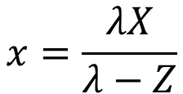






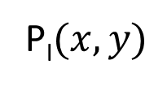
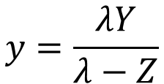
Perspective transformation
$$Y,y$$
World co-ordinate
P$(X,Y,Z)$
Image plane
$$X,x$$
$$Z,z$$
P_{I}$(x,y)$
$$x=\frac{λX}{λ−Z}$$
$$y=\frac{λY}{λ−Z}$$
$$X=\frac{x}{λ}(λ−Z)$$
$$Y=\frac{y}{λ}(λ−Z)$$
Two equations, three unknowns

Slide 7
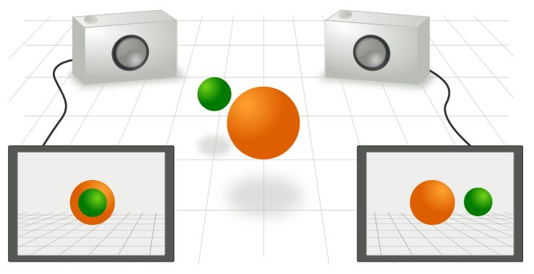
Stereo geometry
Image courtesy: https://en.wikipedia.org/wiki/Epipolar_geometry

Slide 8








Introducing a second imaging plane
$$P:(X,Y,Z)$$
Coordinate system for C1
Coordinate system for C2
Image point w.r.to C1
Image point w.r.to C2
Focal length of C1
Focal length of C2
$$z$$
$$z′$$
$$x$$
$$x′$$
$$y$$
$$y′$$
$$P_{I}′$$

Slide 9
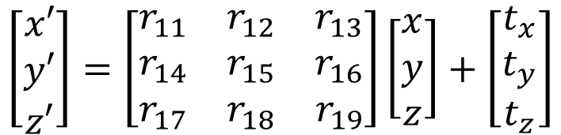
Relationship between coordinate systems
$$\left[\begin{matrix}x′ \\ y′ \\ z′\end{matrix}\right]=\left[\begin{matrix}r_{11} & r_{12} & r_{13} \\ r_{14} & r_{15} & r_{16} \\ r_{17} & r_{18} & r_{19}\end{matrix}\right]\left[\begin{matrix}x \\ y \\ z\end{matrix}\right]+\left[\begin{matrix}t_{x} \\ t_{y} \\ t_{z}\end{matrix}\right]$$
Translation matrix
Coordinates of Camera #2
Rotation matrix
Coordinates of Camera #1

Slide 10
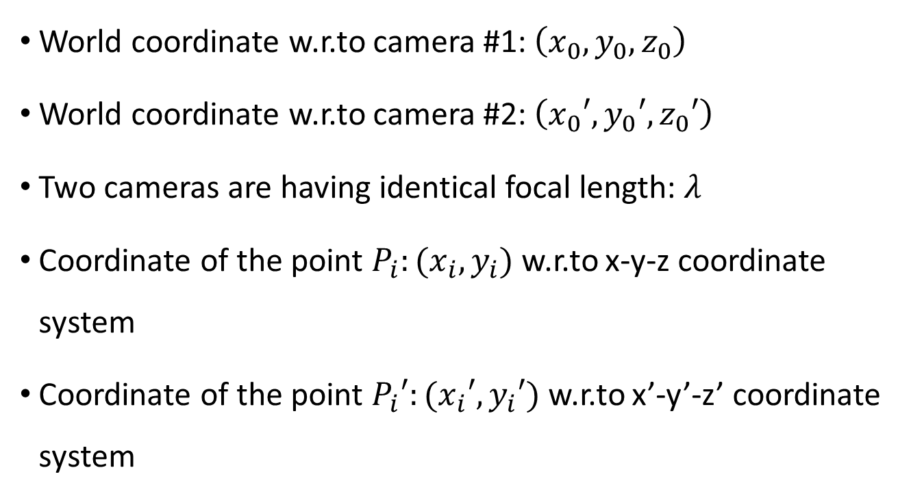
Assumptions
World coordinate w.r.to camera #1: $\left(x_{0},y_{0},z_{0}\right)$
World coordinate w.r.to camera #2: $\left(x_{0}′,y_{0}′,z_{0}′\right)$
Two cameras are having identical focal length: $λ$
Coordinate of the point $P_{i}:(x_{i},y_{i})$ w.r.to x-y-z coordinate system
Coordinate of the point $P_{i}′:(x_{i}′,y_{i}′)$ w.r.to x’-y’-z’ coordinate system

Slide 11
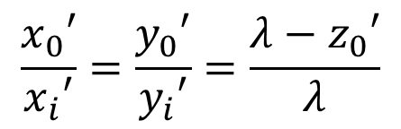

Mathematical relationship between points
For camera #1
For camera #2
$$\frac{x_{0}}{x_{i}}=\frac{y_{0}}{y_{i}}=\frac{λ−z_{0}}{λ}$$
$$\frac{x_{0}′}{x_{i}′}=\frac{y_{0}′}{y_{i}′}=\frac{λ−z_{0}′}{λ}$$
Coordinate transformation is required

Slide 12
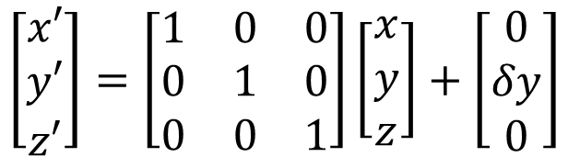
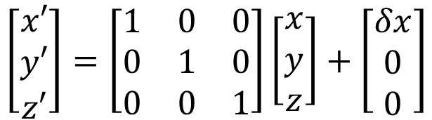
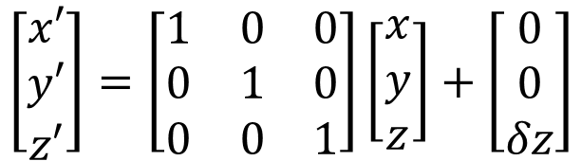
Rectified camera configuration
Assume pure translation, without any rotation
$$\left[\begin{matrix}x′ \\ y′ \\ z′\end{matrix}\right]=\left[\begin{matrix}1 & 0 & 0 \\ 0 & 1 & 0 \\ 0 & 0 & 1\end{matrix}\right]\left[\begin{matrix}x \\ y \\ z\end{matrix}\right]+\left[\begin{matrix}δx \\ 0 \\ 0\end{matrix}\right]$$
Lateral stereo geometry
$$\left[\begin{matrix}x′ \\ y′ \\ z′\end{matrix}\right]=\left[\begin{matrix}1 & 0 & 0 \\ 0 & 1 & 0 \\ 0 & 0 & 1\end{matrix}\right]\left[\begin{matrix}x \\ y \\ z\end{matrix}\right]+\left[\begin{matrix}0 \\ δy \\ 0\end{matrix}\right]$$
$$\left[\begin{matrix}x′ \\ y′ \\ z′\end{matrix}\right]=\left[\begin{matrix}1 & 0 & 0 \\ 0 & 1 & 0 \\ 0 & 0 & 1\end{matrix}\right]\left[\begin{matrix}x \\ y \\ z\end{matrix}\right]+\left[\begin{matrix}0 \\ 0 \\ δz\end{matrix}\right]$$
Axial stereo geometry

Slide 13
















Modified camera configuration after lateral shift along x-axis
$$P(x_{0},y_{0},z_{0})$$
$$z$$
$$δx$$
$$z′$$
$$P_{L}(x_{L},y_{L})$$
$$C_{L}$$
$$C_{R}$$
$$P_{R}(x_{R},y_{R})$$
$$x$$
$$λ$$
$$x′$$
$$λ$$
$$O_{L}$$
$$O_{R}$$
$$y$$
LEFT
$$y′$$
RIGHT

Slide 14
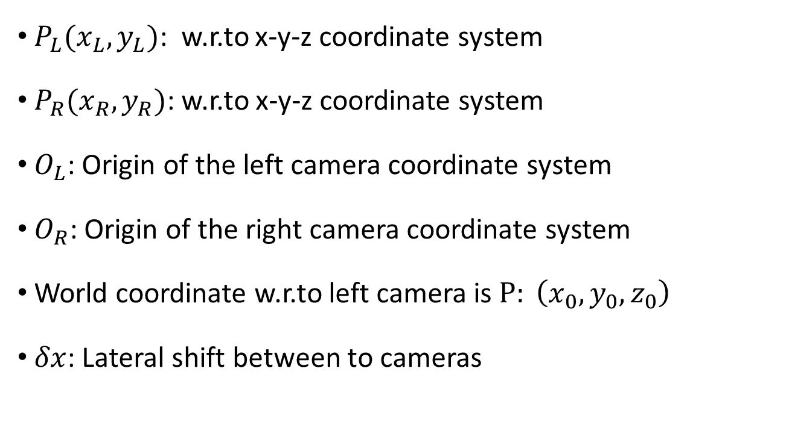
Assumption
$P_{L}(x_{L},y_{L})$: w.r.to x-y-z coordinate system
$P_{R}(x_{R},y_{R})$: w.r.to x-y-z coordinate system
$O_{L}$: Origin of the left camera coordinate system
$O_{R}$: Origin of the right camera coordinate system
World coordinate w.r.to left camera is $P: \left(x_{0},y_{0},z_{0}\right)$
$δx$: Lateral shift between to cameras

Slide 15


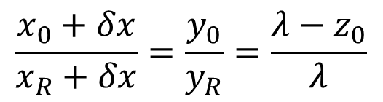
Mathematical relationship
For camera #1
For camera #2
$$\frac{x_{0}}{x_{L}}=\frac{y_{0}}{y_{L}}=\frac{λ−z_{0}}{λ}$$
$$\frac{x_{0}}{x_{R}}=\frac{y_{0}}{y_{R}}=\frac{λ−z_{0}}{λ}$$
Incorrect
$$\frac{x_{0}+δx}{x_{R}+δx}=\frac{y_{0}}{y_{R}}=\frac{λ−z_{0}}{λ}$$

Slide 16
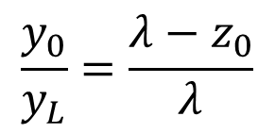
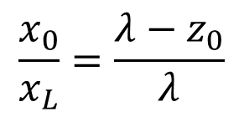
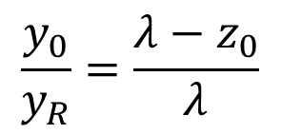
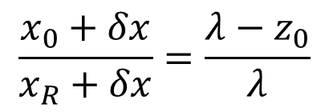
Solve for unknowns
$$\frac{x_{0}}{x_{L}}=\frac{λ−z_{0}}{λ}$$
…….. (1)
$$\frac{y_{0}}{y_{L}}=\frac{λ−z_{0}}{λ}$$
…….. (2)
$$\frac{x_{0}+δx}{x_{R}+δx}=\frac{λ−z_{0}}{λ}$$
…….. (3)
$$\frac{y_{0}}{y_{R}}=\frac{λ−z_{0}}{λ}$$
…….. (4)

Slide 17
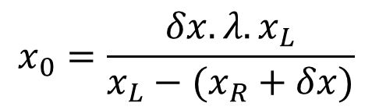
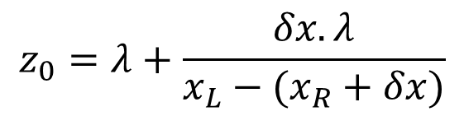
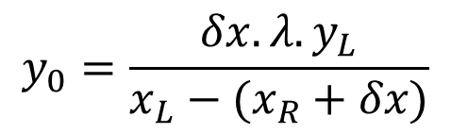
Coordinate of the 3D world point
$$z_{0}=λ+\frac{δx.λ}{x_{L}−(x_{R}+δx)}$$
Depth
$$x_{0}=\frac{δx.λ.x_{L}}{x_{L}−(x_{R}+δx)}$$
$$y_{0}=\frac{δx.λ.y_{L}}{x_{L}−(x_{R}+δx)}$$

Slide 18
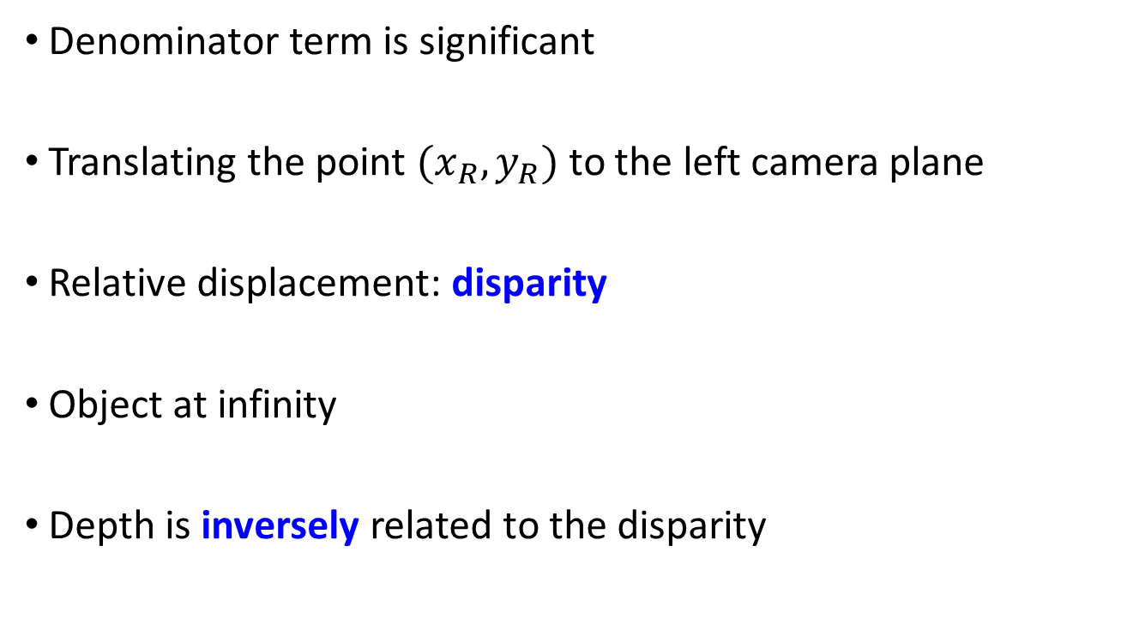
Disparity
Denominator term is significant
Translating the point $(x_{R},y_{R})$ to the left camera plane
Relative displacement: disparity
Object at infinity
Depth is inversely related to the disparity

Slide 19
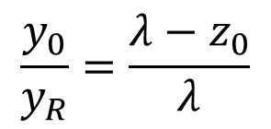
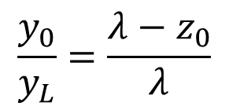
Search space for stereo matching
N
N
N
N
Left
Right
$$\frac{y_{0}}{y_{L}}=\frac{λ−z_{0}}{λ}$$
$$\frac{y_{0}}{y_{R}}=\frac{λ−z_{0}}{λ}$$

Slide 20
Token Based Stereo
Detect token
Corners, interest point, edges
Find correspondences
Interpolate surface

Slide 21
Correlation Based Stereo Methods
Depth is computed only at tokens and interpolated/ extrapolated to remaining pixel
Disparity map is constructed based on a correlation measure

Slide 22
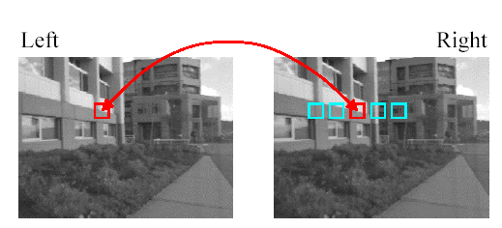



Correlation Based Stereo Methods
Once disparity is available compute depth using
$$Z=\frac{λB}{d}$$
$B=$Separation between the cameras
$d=$disparity
Error
Index of points

Slide 23
Thank you
Next Lecture: Image Interpolation

