Slide 1

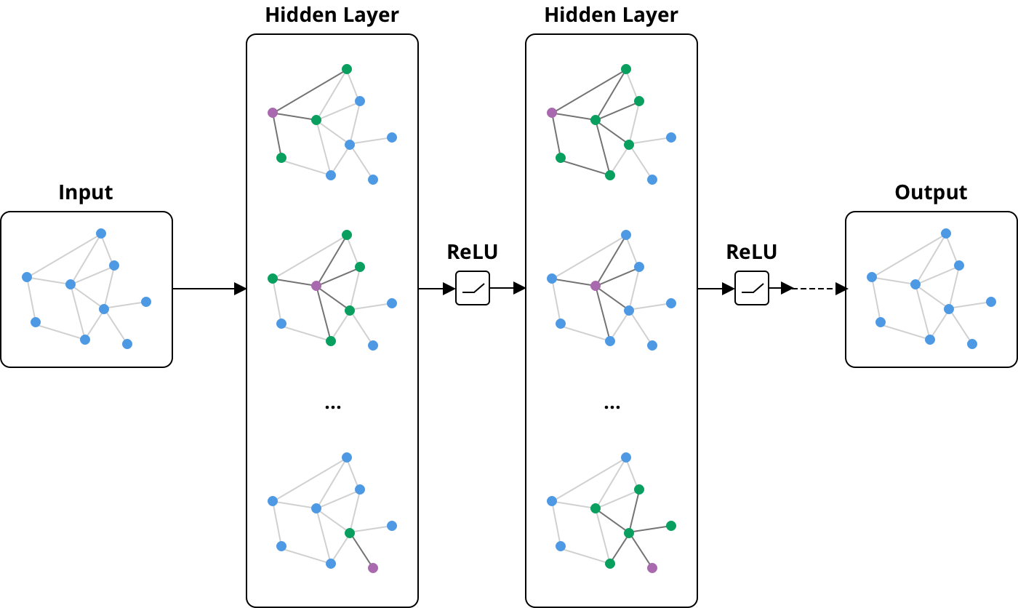
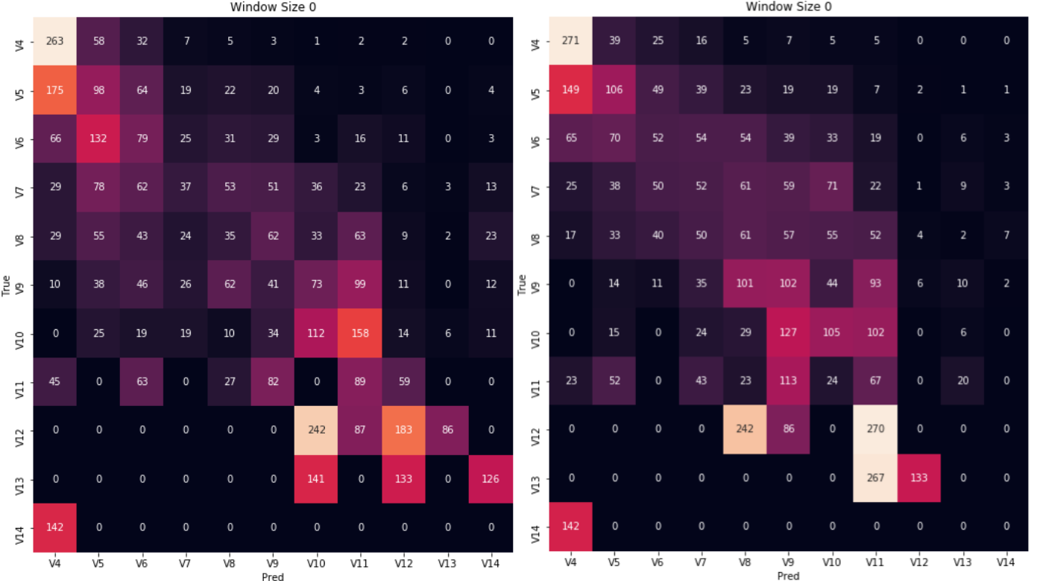
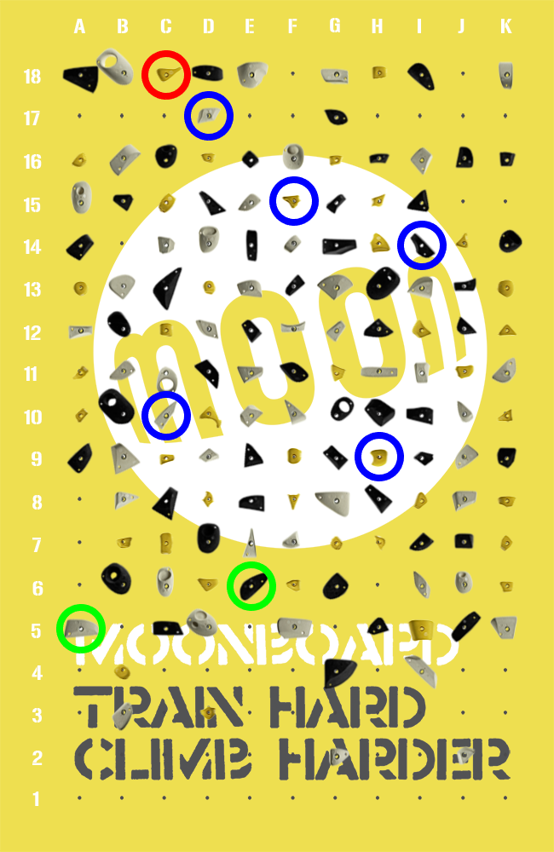
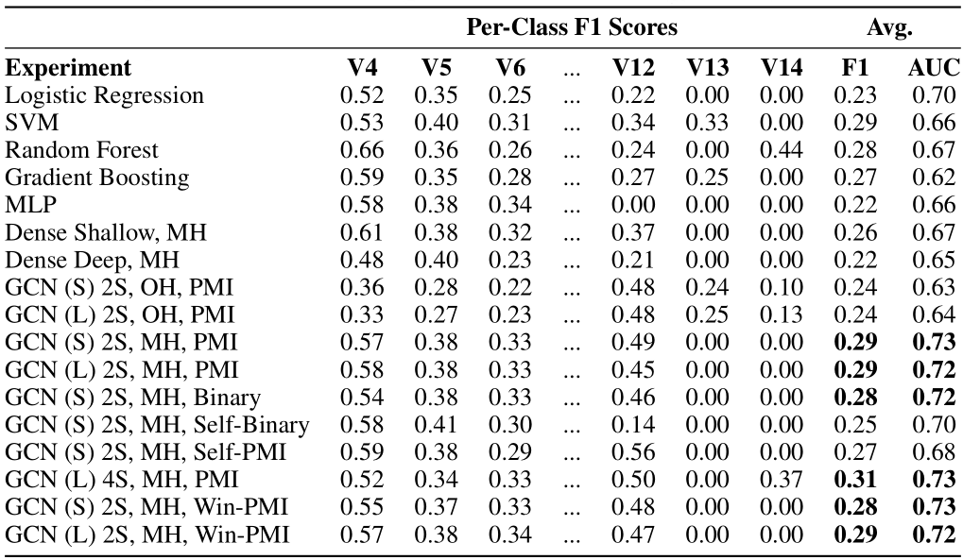
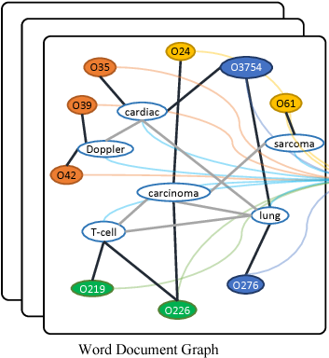
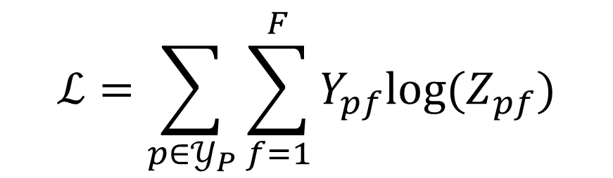
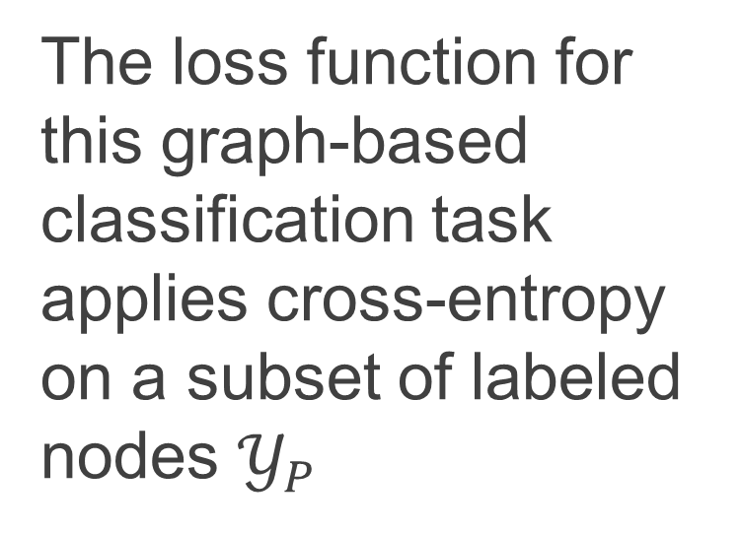
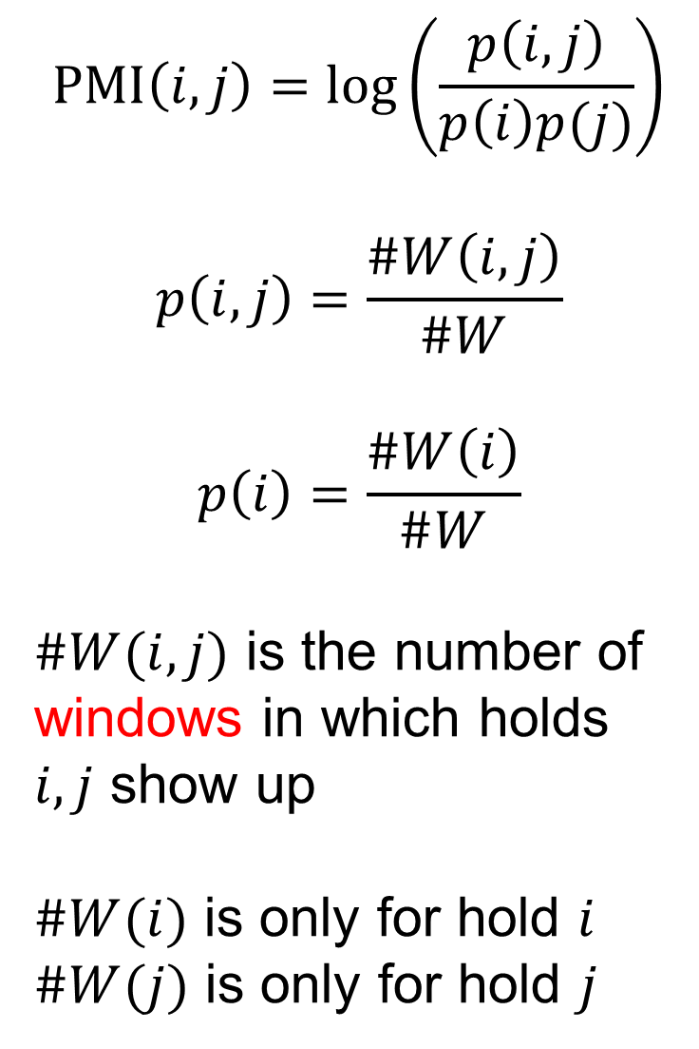
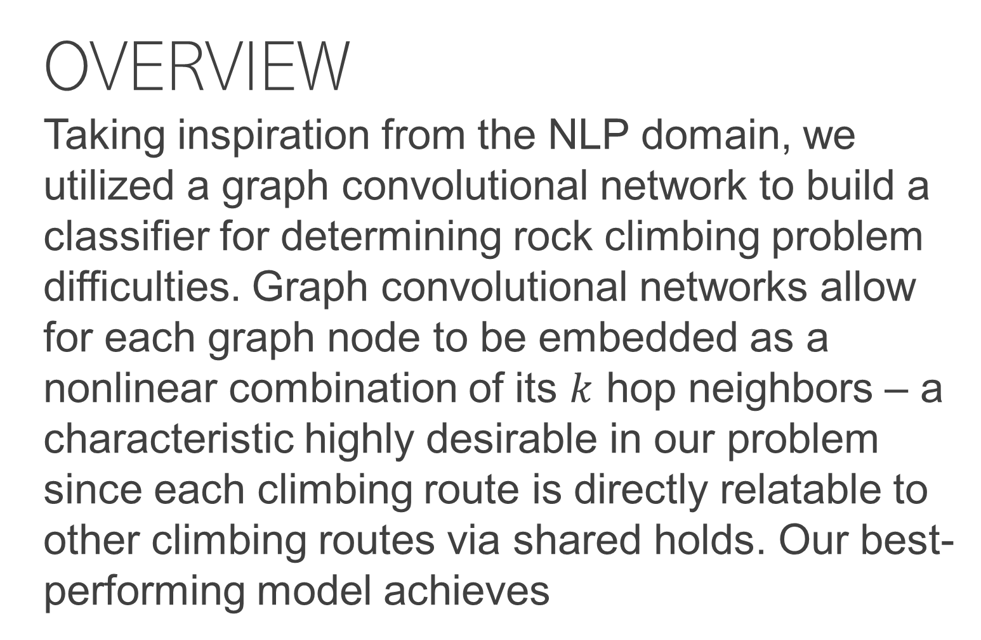
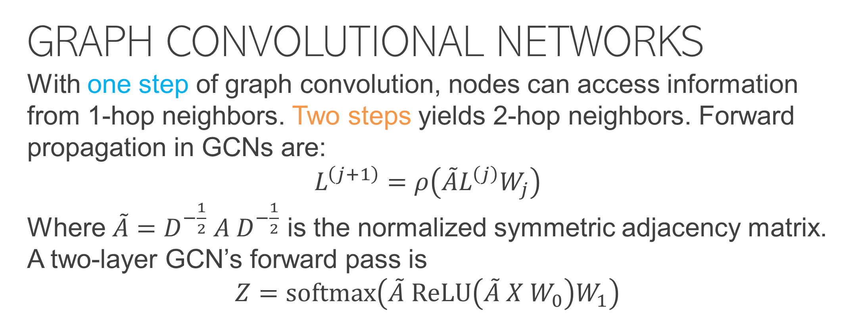
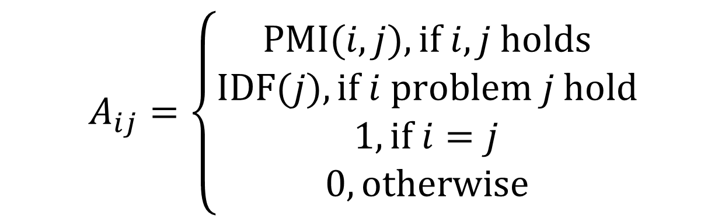
Graph Neural Networks in Rock-Climbing Classification
Cheng-Hao Tai (c2tai@Stanford.edu)
Aaron Wu (aaron@evisort.com)
Rafael Hinojosa (rahinojo@stanford.edu)
https://youtu.be/8cISaVsOqs0
OVERVIEW
Taking inspiration from the NLP domain, we utilized a graph convolutional network to build a classifier for determining rock climbing problem difficulties. Graph convolutional networks allow for each graph node to be embedded as a nonlinear combination of its $k$ hop neighbors – a characteristic highly desirable in our problem since each climbing route is directly relatable to other climbing routes via shared holds. Our best-performing model achieves
GRAPH CONVOLUTIONAL NETWORKS
With one step of graph convolution, nodes can access information from 1-hop neighbors. Two steps yields 2-hop neighbors. Forward propagation in GCNs are:
$$L^{\left(j+1\right)}=ρ\left(\tilde{A}L^{\left(j\right)}W_{j}\right)$$
Where $\tilde{A}=D^{−\frac{1}{2}} A D^{−\frac{1}{2}}$ is the normalized symmetric adjacency matrix. A two-layer GCN’s forward pass is
$$Z=\text{softmax}\left(\tilde{A} \text{ReLU}\left(\tilde{A} X W_{0}\right)W_{1}\right)$$
DISCUSSION
A total of 17 experiments were run to benchmark the GCN and evaluate its performance. We found that:
GCN with multi-hot features outperform all baseline models and fully-connected networks
GCN is less sensitive to extreme data imbalance and produces better predictions across the spectrum of difficulty classes
Confusion matrices – GCN (left), logistic reg. (right)
$$ℒ=\sum_{p∈𝒴_{P}}{\sum_{f=1}^{F}{Y_{pf}{\text{log}(Z}_{pf})}}$$
DATA
Data was sourced using Selenium from MoonBoard’s website. A total of 13,589 problems were collected and preprocessed into one-hot and multi-hot formats. For multi-hot, vectors are 140-dimensional long where each dimension encodes presence / absence of a hold. We used an 80/20 ratio for train-test split.
The loss function for this graph-based classification task applies cross-entropy on a subset of labeled nodes $𝒴_{P}$
RESULTS
Summary of experiments including baseline statistical models, fully-connected networks, and GCNs
BUILDING THE GRAPH
A heterogenous graph is used to model the corpus of MoonBoard problems. Adjacency between nodes are modeled as
$$\text{PMI}\left(i, j\right)=\log\left(\frac{p\left(i, j\right)}{p\left(i\right)p(j)}\right)$$
$$p\left(i, j\right)=\frac{\#W\left(i, j\right)}{\#W}$$
$$p\left(i\right)=\frac{\#W\left(i\right)}{\#W}$$
$\#W(i, j)$ is the number of windows in which holds $i, j$ show up
$\#W(i)$ is only for hold $i$
$\#W(j)$ is only for hold $j$
$$A_{ij}=\left\{\begin{aligned}\text{PMI}\text{(}i, j), \text{if} i, j \text{holds} \\ \text{IDF}\text{(}j), \text{if} i \text{problem} j \text{hold} \\ 1, \text{if} i=j \\ 0, \text{otherwise}\end{aligned}\right.$$
Both problems and holds are represented as nodes on the heterogenous graph – (right) sample for a heterogenous document / word graph

