Slide 1
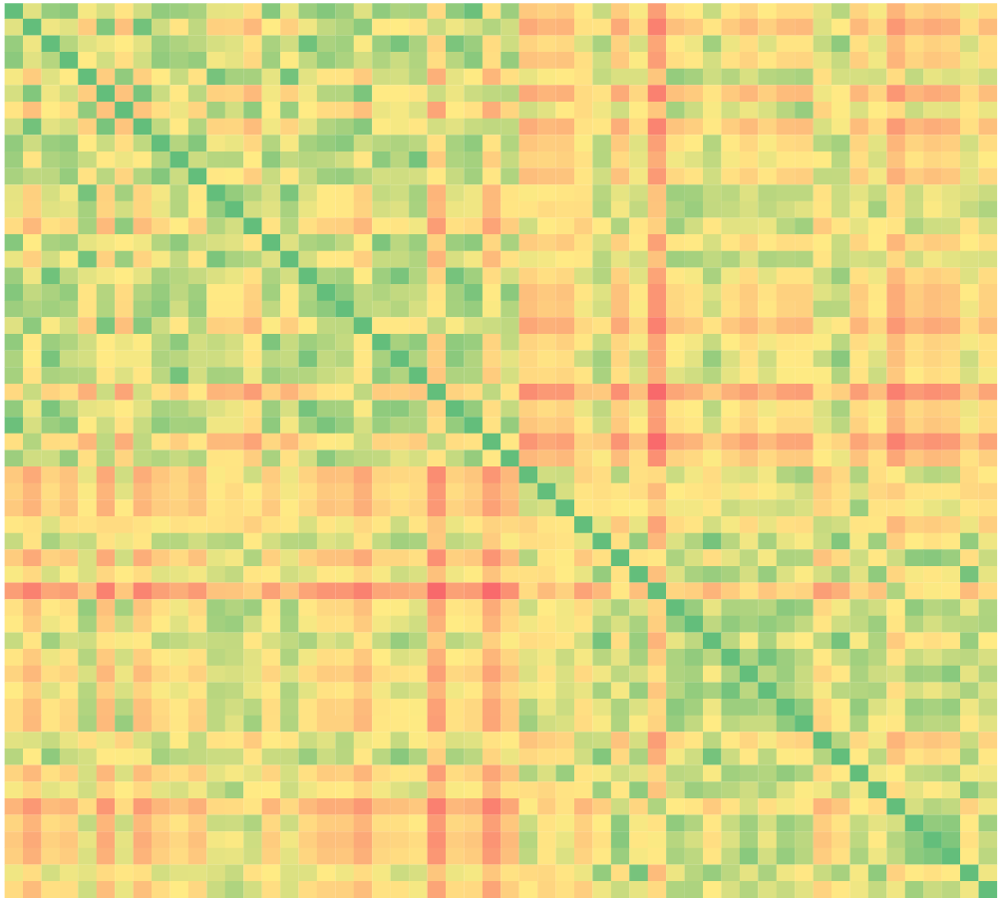
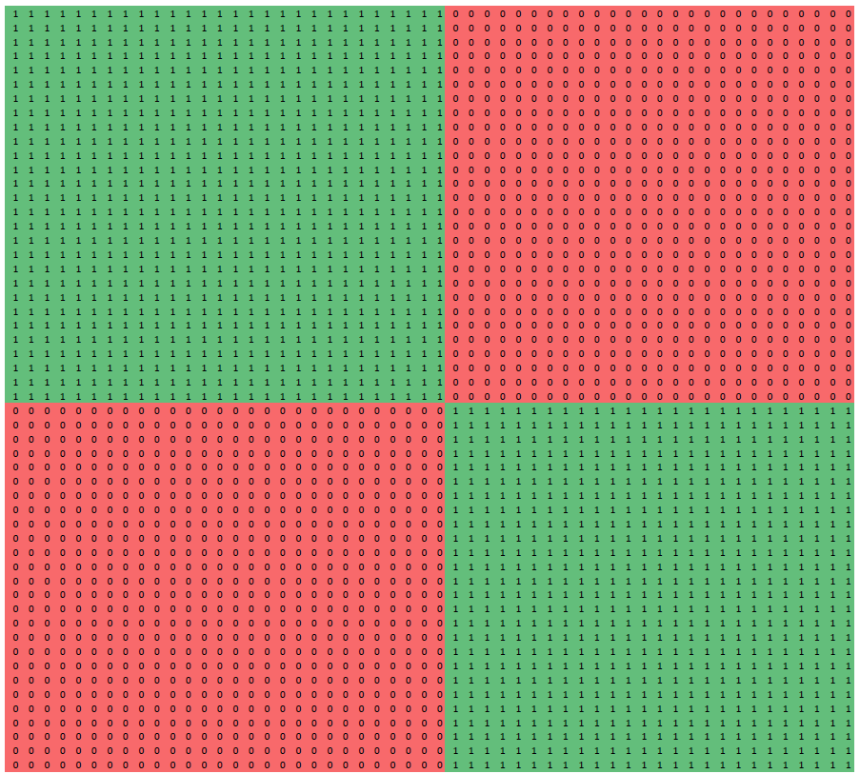
Incidence matrix
Instances sorted by cluster
SAME CLUSTER
OTHER CLUSTER
Correlation between
matrixes: negative
GOOD CLUSTERING
Euclidean distance matrix
Instances sorted by cluster
LOW DISTANCE
BIG DISTANCE

