Slide 1
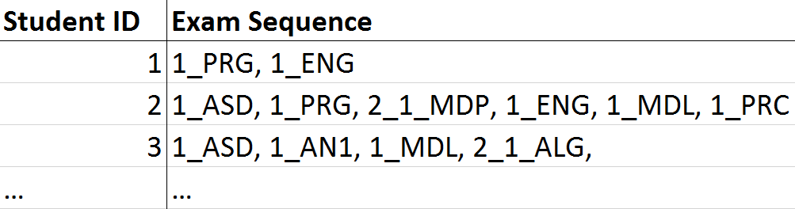


GSP Algotirhm
Frequent Pattern Analysis

