Slide 1
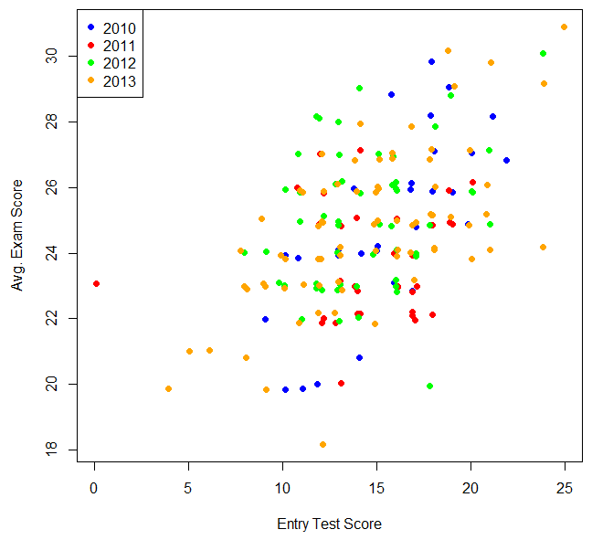
Direct correlation?

Slide 2
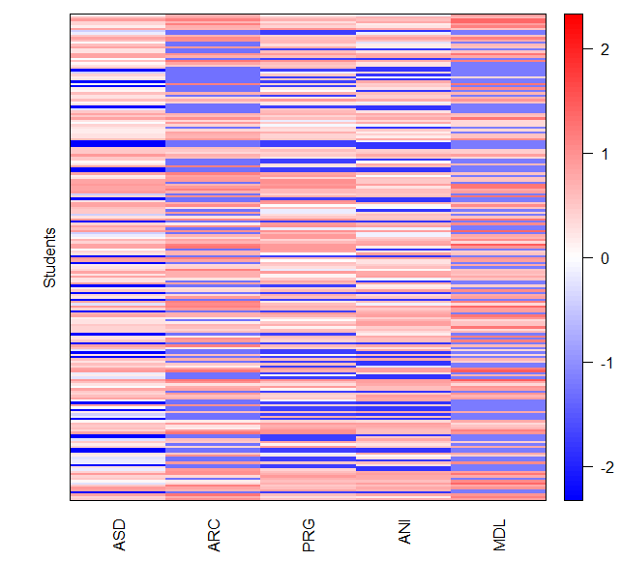
SCORE ABOVE AVERAGE
AVERAGE
SCORE BELOW AVERAGE

Slide 3
