Slide 1
S. NO. | GENERAL PURPOSE COMPUTING SYSTEMS | EMBEDDED SYSTEM
1 | A combination of generic hardware and general purpose operating system for executing variety of applications | Combination of special purpose hardware and embedded OS for executing a specific set of application
3 | Applications can be modified by user | Firmware of the embedded system is pre- programmed and it is non-modifiable by the end user
4 | Performance is a key deciding factor in the selection of the system. Always “Faster is better”. | Application specific requirements (like performance, power, memory, cost) are key deciding factor
5 | Personal computer, Laptops | DVD player, Digital camera

Slide 2
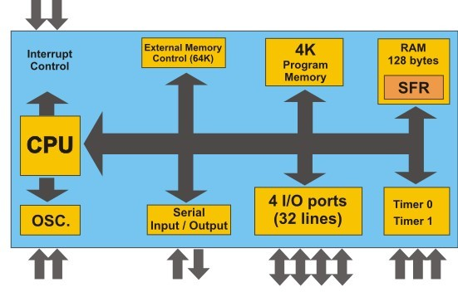
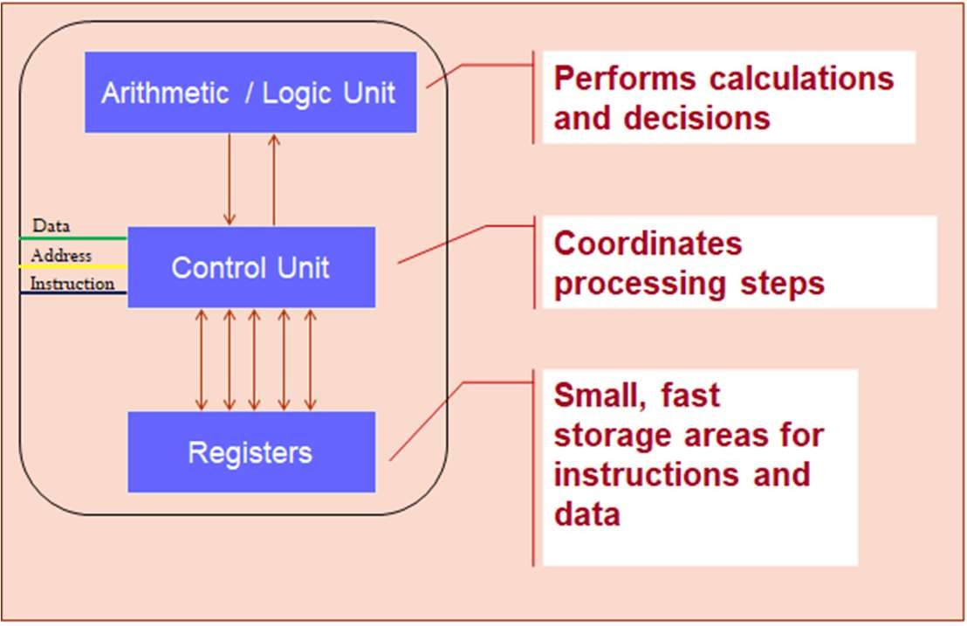
Feature
Microcontroller (µC)
Microprocessor (µP)
Purpose
Designed for specific embedded system applications
Designed for general-purpose computing applications
Single-chip computer system with on- board memory, peripherals, and I/O interfaces
CPU with on-board memory, peripherals, and I/O interfaces
Architecture
Cost & power
Lower cost+ power
Higher cost+ power
Instruction set
Fixed instruction set
More flexible
Harvard Architecture
Von Neuman Architecture

Slide 3
Classification of μP
General Purpose Processors (GPP)
Digital Signal Processor (DSP)
Micro Processors
Application Specific Processors
Application Specific Integrated Circuit (ASIC)
Application Specific Instruction Set Processor (ASIP)
37

Slide 4
Classification of μP
General Purpose Processors (GPP)
Classification of μP
Application Specific Processors (ASP)
perform multiple tasks
Pros - Flexible, easy to design, low cost, easy to reprogram
Cons - Poor performance, High power consumption
Contains only the components needed to execute a single program
Pros – Good performance, less power consumption, good overall cost
Cons – difficult to design, high design cost, difficult to reprogram
38

Slide 5
Feature | DSP (Digital Signal Processor) | ASIC (Application-Specific Integrated Circuit) | ASIP (Application-Specific Instruction Processor)
Overview | Specialized microprocessor for digital signal processing tasks and real time mathematical computations. | Custom-designed chip tailored for a specific application or task. Completely implemented in hardware. | Combines features of both DSP and ASIC, offering customizable hardware & instruction sets for specific tasks.
Advantages | Flexibility: Can be programmed for various applications. Real-time processing capability. Cost-effective for small volumes. | High performance: Optimized for specific tasks. Low power consumption – does only specific tasks | Programmable, like a DSP, but with specialized instructions. More flexible than ASIC, less than DSP. Custom instructions provide optimization.
Disadvantages | - Higher power consumption compared to ASICs. - Not as fast or efficient as ASICs. - Limited by general-purpose architecture. | Lack of flexibility: Cannot be reprogrammed for different tasks. functionality is hard-coded. - Expensive and time-consuming to design and manufacture. | Less efficient than ASICs for very specific tasks. Not as highly optimized as ASICs. More complex to design than DSPs. Higher cost than DSPs
Use Cases | Audio and video processing. Streaming platforms Telecommunications. Real-time data processing. | - High-volume, performance-critical applications. - Consumer electronics. - Networking devices. | - Custom applications requiring specific processing capabilities. - Embedded systems with specialized tasks.

Slide 6
ES : Design Process
Step 1: Requirements: Informal descriptions gathered from the customer are known as requirements
Product Name GPS Navigation System
Purpose Inputs Outputs Functions
Consumer grade moving map for driving use
Power button; two control button
Back-lit LCD Display 400x600
Uses 5-receiver GPS system; three user-selectable resolutions; always displays current latitude and longitude
Updates screen within 0.25 seconds upon movement 100mW
30 USD
2” x 6” and 250 grams
1kg
Performance Power
Cost
Size & Weight
59

Slide 7
ES : Design Process
Step 2: Specifications : serves as the contract between the customers and the architects.
Specification would include details for several components:
Data received from the GPS satellite
Map data
User interface
Operations that must be performed to satisfy customer requests
Background actions
Step 3: Architecture
Specification describes only the functions of the system
Implementation of the system is described by the Architecture
Architecture is a plan for the overall structure of the system.
It will be used later to design the components
60

Slide 8
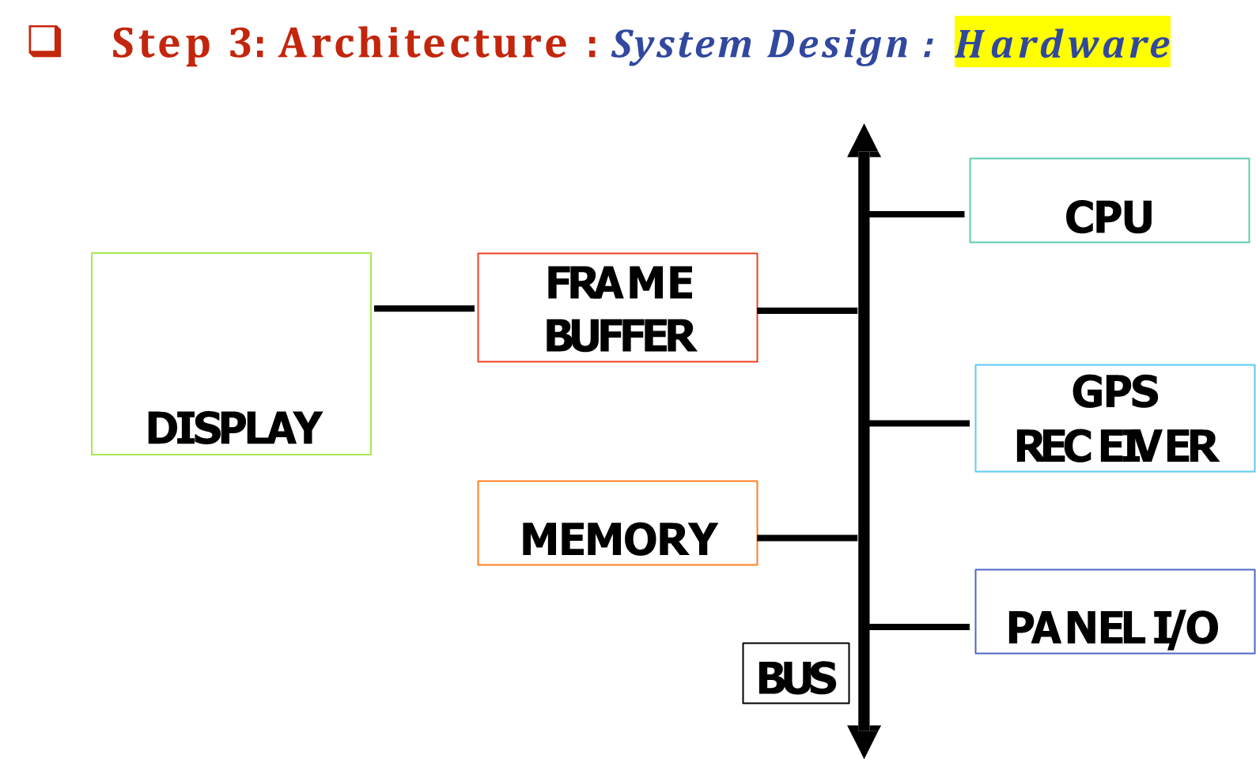
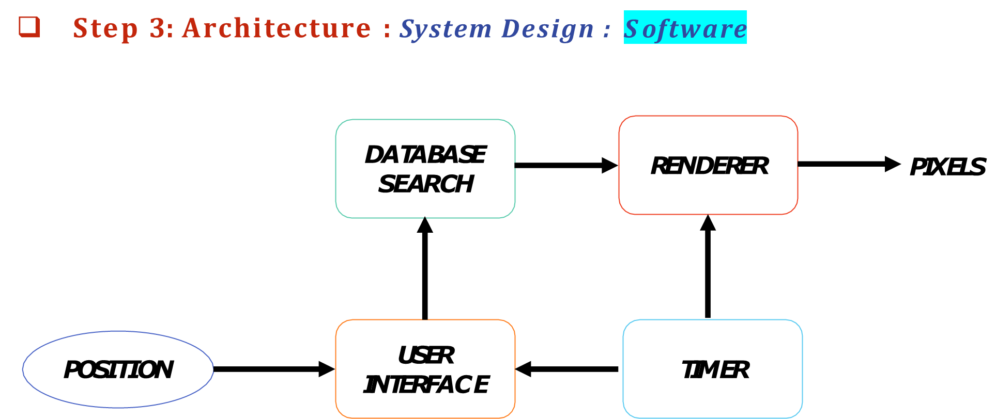
ES : Design Process

Slide 9
ES : Design Process
Step 4: Hardware & Software Components
In example GPS Reveiver
In the moving map, GPS receiver is a predesigned standard hardware component.
Topographic software is a standard software module which uses standard routines to access the database.
Printed circuit board are the components which needs to be designed.
When creating these embedded software modules, ensure the system runs properly in real time and that it does not take up more memory space than allowed.
65

Slide 10
ES : Design Process
Step 5: System Integration
After the components are built, they are integrated
Bugs are typically found during the system integration
By debugging a few modules at a time, simple bugs can be discovered
By fixing the simple bugs early, more complex bugs can be discovered
Appropriate debugging facilities during design which can help to ease system integration problems.
66

Slide 11
ES : Design Process Example:
Automatic Chocolate Vending Machine
Requirements
Purpose:
To sell chocolate through an ACVM from which children can
automatically purchase the chocolates.
The payment is by inserting the coins into a coin-slot.
Inputs:
Coins of different denominations through a coin slot.
User commands.
Outputs:
Chocolate and signal to the system that subtracts the cost from the
value of amount collected.
Display of the menus for GUIs, time and date, advertisements, welcome and thank messages.
68

Slide 12
ES : Design Process Example:
Automatic Chocolate Vending Machine
Requirements
A child sends commands to the system using a GUI.
It must consists of the LCD display and keypad units.
The child inserts the coins for cost of chocolate and the machine delivers the chocolate.
If the coins are not inserted as per the cost of chocolate in reasonable
times then all coins are refunded.
If the coin amount more, the excess amount is refunded along with chocolate.
The coins for the chocolates purchased collect inside the machine in a collector channel, so that owner can get the money, again through appropriate commands using the GUI.
USB wireless modem enables communication through Internet to the ACVM owner.
69

Slide 13
ES : Design Process Example:
Automatic Chocolate Vending Machine
Design Metrics
Power Dissipation: As required by mechanical units, display units and
computer system
Performance: One chocolate in two minutes and 256 chocolates before next filling of chocolates into the machine.[Assumed]
Process Deadlines: Machine waits for maximum 30 s for the coins and machine should deliver the chocolate within 60 s.
User Interfaces: Graphic at LCD or touch screen display on LCD and commands by children or machine owner through fingers on keypad or touch screen
Engineering Cost: US$ 50000 (assumed)
Manufacturing Cost: US$ 1000 (assumed)

Slide 14
ES : Design Process Example:
Automatic Chocolate Vending Machine
Specifications
Alphanumeric keypad on the top of the machine.
A child interaction with it when buying a chocolate. Owner commands
and interaction with the machine.
Three line LCD display unit on the top of the machine.
Displays menus, entered text, pictograms, and welcome, thank and
other messages, and time and date.
Child as well as the ACVM owner GUIs with the machine using keypad and display

Slide 15
ES : Design Process Example:
Automatic Chocolate Vending Machine
Specifications
Coin insertion slot:
So that the child can insert the coins to buy a chocolate.
Delivery slot
To collect the chocolate, and coins if refunded.
Internet connection port
So that owner can interact with ACVM from remote location.

Slide 16
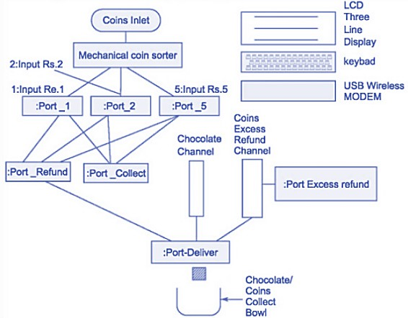
ES : Design Process Example:
Automatic Chocolate Vending Machine
Specifications : Overall System Architecture

Slide 17
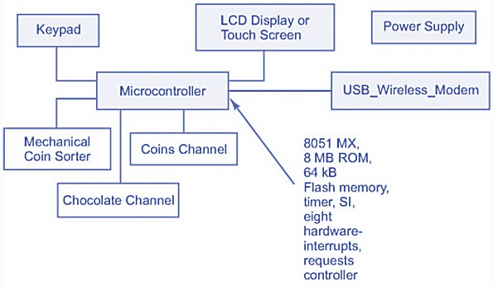
ES : Design Process Example:
Automatic Chocolate Vending Machine
Specifications : Hardware Design

Slide 18
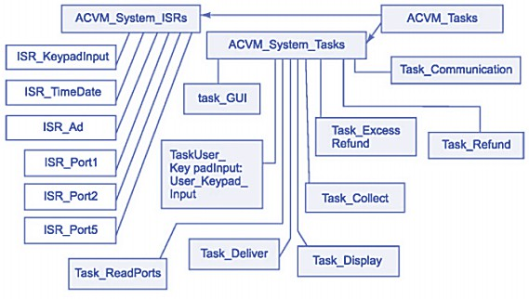
ES : Design Process Example:
Automatic Chocolate Vending Machine
Specifications : Software Design

Slide 19










ES : Design Process Example:
Digital Camera
Single-functioned -- always a digital camera
Tightly-constrained -- Low cost, low power, small, fast
Reactive and real-time -- only to a small extent
Digital camera chip
CCD
CCD preprocessor
Pixel coprocessor
D2A
A2D
lens
JPEG codec
Microcontroller
Multiplier/Accum
DMA controller
Display ctrl
Memory controller
ISA bus interface
UART
LCD ctrl

Slide 20
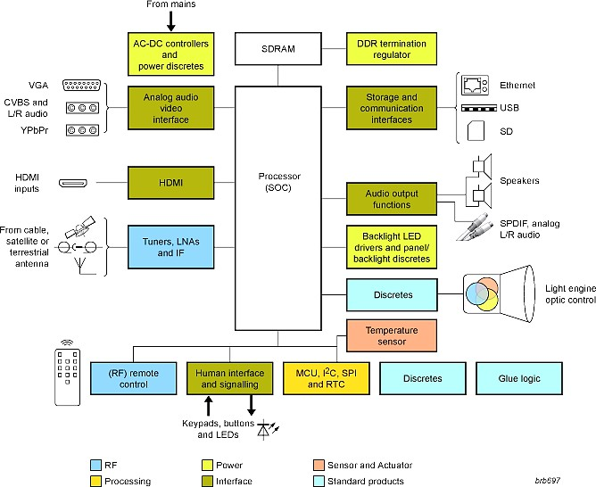
ES : Design Process Example:
Projector

Slide 21
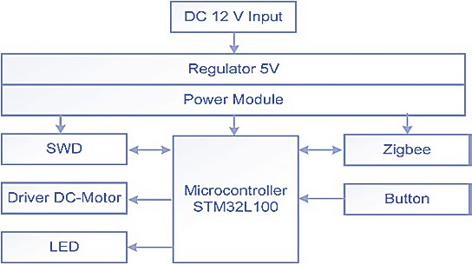
ES : Design Process Example:
Digital Fan

Slide 22
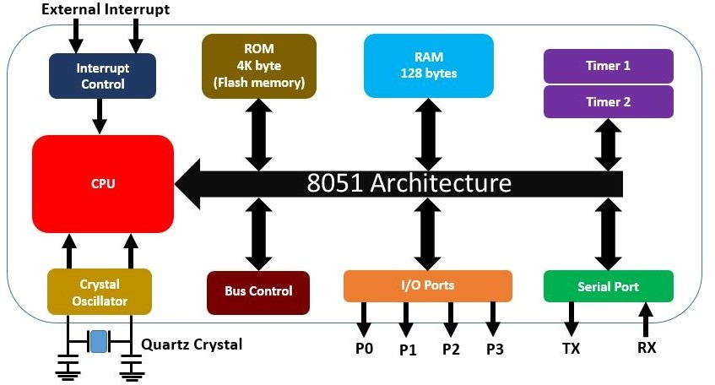
8051 Architecture
88

Slide 23
8051 Architecture
CPU: monitors and controls all operations performed
Interrupt Control: Two external interrupts (INT0 & INT1), Two timer (TF0 & TF1) interrupts and One serial port (RI / TI) interrupt.
ROM: The memory which is used to store the program of Microcontroller, is known as code memory or Program memory.
RAM: The memory to store data or operands temporarily. This memory is known as Data Memory.
Bus Control: collection of wires which work as a communication channel or medium for transfer of Data. 2 Type of Buses:
Address Bus: 16 bit address bus. It used to address memory locations.
Data Bus: 8 bits data bus. It is used to carry data.
Crystal Oscillator: works as a clock source.
I/O Ports: 32 I/O pins arranged as four 8-bit ports (P0 - P3)
90

Slide 24

PIC – Features
This powerful (200 nanosecond instruction execution) yet easy- to-program (RISC instructions).
PIC16F877A features
256 bytes of EEPROM data memory,
The synchronous serial port can be configured as either 3-wire Serial Peripheral Interface (SPI ) or the 2-wire Inter- Integrated Circuit (I²C ) bus and A Universal Asynchronous Receiver Transmitter (USART).
Self programming,
An ICD - In-Circuit Debugging
2 Comparators,
8 channels of 10-bit Analog-to- Digital (A/D) converter,
2 input capture/output
compare/PWM functions,

Slide 25
Timer 3
Parallel slave port
10 bit ADC ports
EEPROM
Synchronous serial port
Asynchronous serial port
(UART)

Slide 26
Special Functions of PIC16F877A I/O Pins
8 K ROM + 368 bytes RAM
“File Register” locations (8-bits wide) for temporary storage of data.
256 bytes nonvolatile EEROM for storage of calibration data, user-customized option settings, etc. Each of the 35 RISC instructions fits in just one location, permitting fast instruction execution time
Three hardware timers: Timer 0 (RA4/TOCK1 pin), Timer 1
(RC0/T1OSO/TICKI and RC1/T1OSI pins), and Timer 2 (no external pins are associated with this timer – this timer can be set to periodically interrupt via the PR2 period register).
10-bit, 8-channel analog-to-digital converter (analog inputs on Ports A and E)
8-bit parallel slave port (PSP) for making the PIC look like an addressable 8-bit peripheral register on a host computer’s bus.
Port D for the 8-bit data bus connection and
Port E for the RD\, WR\, and CS\ bus control lines).
Special Functions of PIC16F877A I/O Pins
Synchronous serial data port (SDA and SCL pins) used for implementing master and slave serial peripheral interface I2C serial interfaces.
Asynchronous serial data port (UART)

Slide 27
 | 8051 | PIC | ARM
Bus width | 8-bit | 8/16/32-bit | 32/64-bit
Speed | 12 Clock/instruction cycle | 4 Clock/instruction cycle | 1 clock/ instruction cycle
ISA | CISC | Some feature of RISC | RISC
Memory Architecture | Von Neumann architecture | Harvard architecture | Modified Harvard architecture
Power Consumption | Average | Low | Low
Cost | Very Low | Average | Low

Slide 28
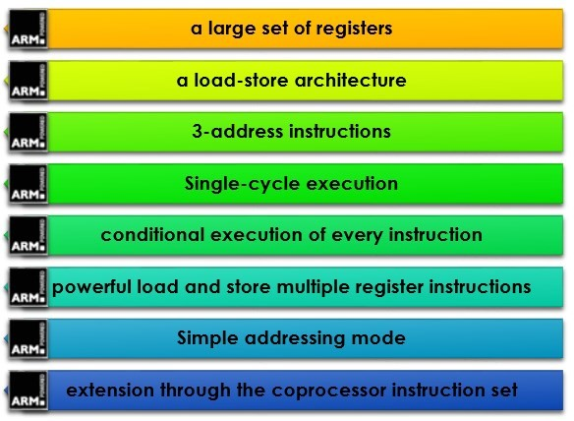
ARM Architecture : Features

Slide 29
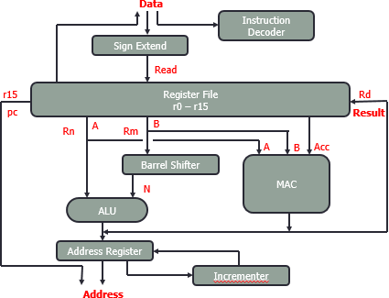
ARM Core Dataflow Model

Slide 30
ARM Core Dataflow Model
Instruction Decoder: It translates instructions before they are executed.
Register File: A storage bank made up of 32-bit registers.
Sign extend hardware: Converts signed 8-bit and 16-bit numbers to 32-bit values
Source Registers: two source registers, Rn & Rm, and a single result or destination register, Rd.
ALU & MAC:
Takes the register values Rn and Rm from the A and B buses and computes result.
Data processing instructions write the result in Rd directly
Load and store instructions use the ALU to generate an address to be held in the address register.
Address Register & Incrementor: For load and store instructions the incrementor updates the address register before the core reads or writes the next register value from or to the next sequential memory location.
Barrel Shifter: Provides five types of shift - Logic Shift left (LSL), Logic Shift Right (LSR), Arithmetic Shift Right (ASR), Rotate Right(ROR), Rotate Right Extended (RRX). After passing through the functional units, the result in Rd is written back to the register file using the Result bus.

Slide 31
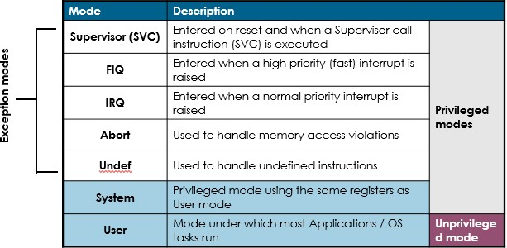
ARM Processor : Modes
Each processor has mode:
PRIVILEGED read-write access
NONPRIVILEGED only read access
109

Slide 32
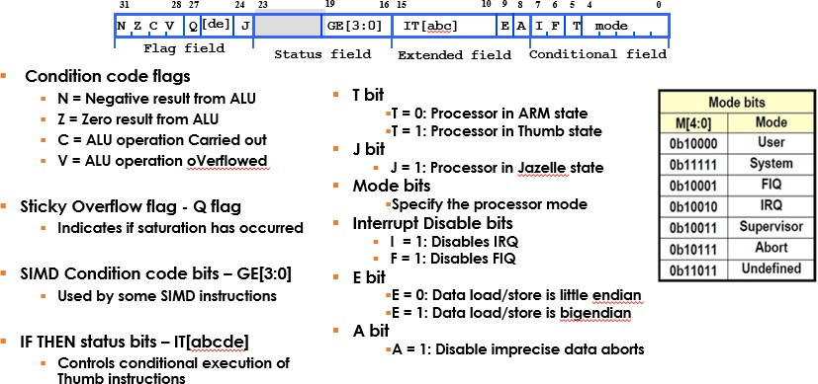
ARM Processor : CPSR Register

