Slide 1

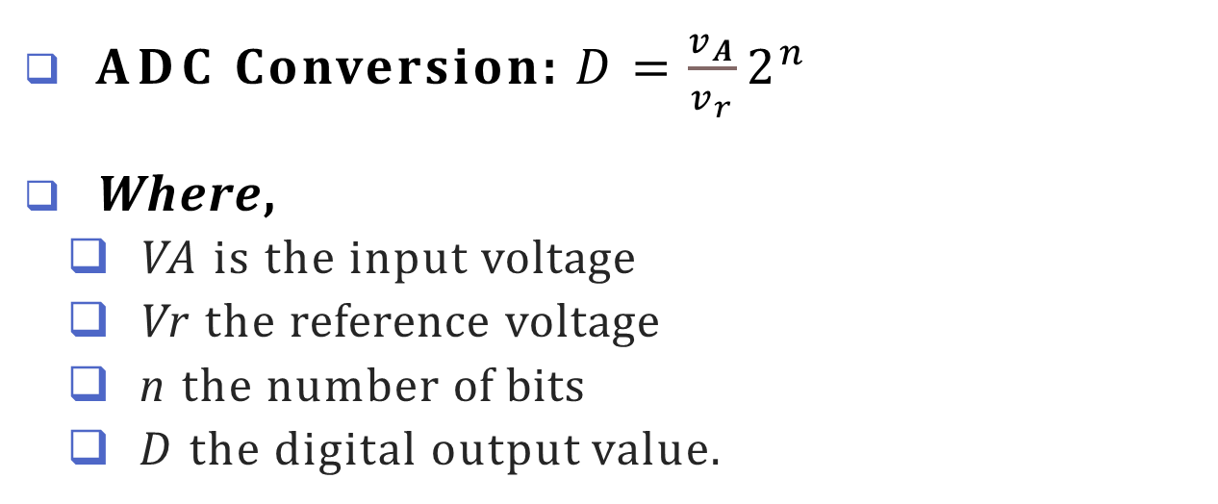
ADC (Analog to Digital) Convertor
analog pins have an ‘A’ in front of their label (A0 to A5).
ADC Conversion: $D=\frac{v_{A}}{v_{r}}2^{n}$
Where,
VA is the input voltage
Vr the reference voltage
n the number of bits
D the digital output value.
Resolution is a measure of how precisely an ADC can convert and represent a given input voltage.
Resolution = $\frac{Vr}{2^{n}}$
15

Slide 2
Analog I/O
analogReference(type)
Definition: reference other than 5 V.
Parameters type:
which type of reference to use (DEFAULT, INTERNAL, INTERNAL1V1, INTERNAL2V56, or EXTERNAL)
Returns
None
analogRead(pin)
Definition: Reads the value from a specified analog pins and 100 microseconds for one reading.
Parameters pin:
the number of the analog input pin to read from (0-5)
Returns
int(0 to 1023)
analogWrite(pin,value)
Definition: Write an analog output on a digital pin
Parameters pin: the number of the pin you want to write value: the duty cycle between 0 (always off 0%) and 255(always on 100%)
Returns
None

Slide 3
ADC Convertor
Program an Arduino board to read analog value from an analog input pin, convert the value into digital value and display it in a serial window.
int sensorValue = 0;
void setup()
{
//monitor output in serial port Serial.begin(9600); //intitating serial communication with 9600 baud rate
}
void loop()
{
sensorValue = analogRead(A0);
//analog input is read from A0 pin
Serial.println(sensorValue);
//printing the output in serial port
delay(100); // simple delay of 100ms
}

Slide 4
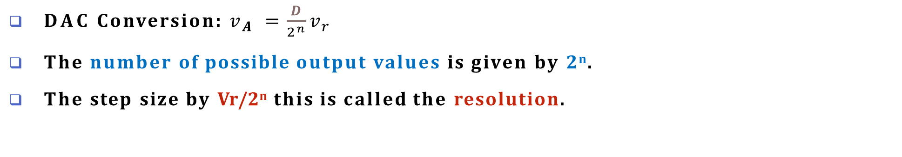
DAC(Digital/Binary to Analog) Convertor
DAC Conversion: $v_{A} =\frac{D}{2^{n}}v_{r}$
The number of possible output values is given by 2^{n}.
The step size by Vr/2^{n} this is called the resolution.
Code an Arduino board to control the speed of a DC motor using potentiometer.
int potvalue;
void setup()
{ pinMode(A0, INPUT); pinMode(6, OUTPUT);}
void loop()
{
potvalue=analogRead(A0)/4; //reads the analog value from the potentiometer (which ranges from 0 to 1023) and divides it by 4 to scale it down to a range of 0 to 255. This is because analogWrite expects a value between 0 and 255.
analogWrite (6, potvalue);
}
25

Slide 5
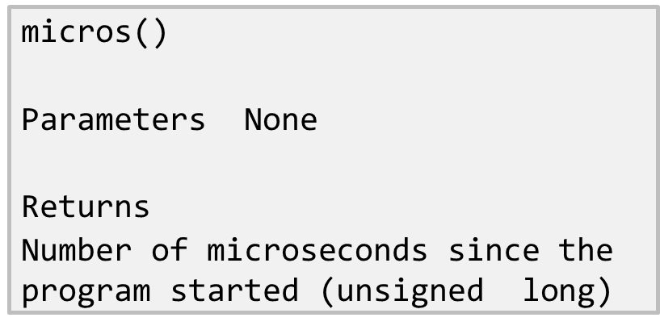
Timers on the Arduino
delay(ms)
Parameters
ms: the number of milliseconds to pause (unsigned long)
(1 s= 1000 ms )
Returns None
delayMicroseconds()
Parameters
us: the number of microseconds to pause (unsigned int)
(1 ms= 1000 µs )
Returns None

Slide 6
Timers on the Arduino
#define LED 13
int buttonState = 0;
void setup() {
Serial.begin(9600);
pinMode(LED, OUTPUT);
pinMode(7, INPUT);}
void loop() {
digitalWrite(LED, HIGH);
delay(500);
digitalWrite(LED, LOW);
delay(500);
buttonState = digitalRead(7);
if(buttonState==LOW) {
Serial.write("micros()=");
Serial.println(micros());
}
else {
Serial.write("millis()=");
Serial.println(millis());
}}
Example Code an Arduino board to read a pushbutton connected to a digital input to display millis() when ON and display micros() when OFF. Blink an LED connected to a digital output with 500 ms delay.

Slide 7

Pulse Width Modulation (PWM)
PWM create simple square wave by varying the duty cycle and pulse width
The pulse width (also called a period) is a short duration of time in which the duty cycle will operate.
The duty cycle is the proportion of time that the pulse is
“on” or “high” and is expressed as a percentage.
100% duty cycle - continuously on
0% duty cycle - continuously off
Used in a variety of applications, ranging from telecommunications to robotic control.

Slide 8
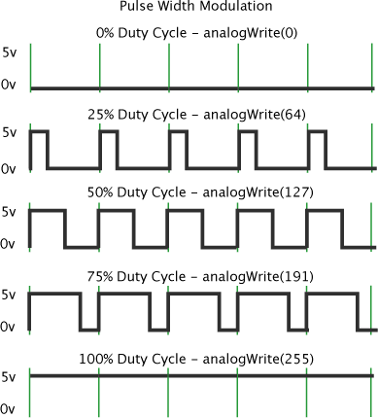
Pulse Width Modulation (PWM)
Speed of DC motor is proportional to the applied DC voltage.
If Conventional DAC output is used,
drive it through an expensive and bulky power amplifier
use the amplifier output to drive the motor
Alternatively, a PWM signal can be used to drive a power transistor directly

Slide 9
Pulse Width Modulation (PWM)
Example
Code an Arduino board to control the brightness of an LED. Monitor the PWM waveform in an oscilloscope and interface a buzzer to listen to different tones.
int brilho = 0;
void setup()
{ pinMode(3, OUTPUT); }
void loop()
{
for (brilho = 0; brilho <= 255; brilho += 5) { analogWrite(3, brilho);
delay(30); // increases the brightness from 0 to 255
}
for (brilho = 255; brilho >= 0; brilho -= 5) { analogWrite(3, brilho);
delay(30); // decreases the brightness from 255 to 0
}
}

Slide 10
Watch Dog Timer in Arduino
The ATmega328P in the Arduino UNO board has a Watchdog Timer which helps the system recover from scenarios where the system hangs/freezes due to errors.
When enabled, it starts counting from 0 to a value selected by the user.
If the watchdog timer is not reset by the time it reaches the user-selected value, the watchdog resets the microcontroller.
ATmega328P watchdog timer can be configured for 10 different time settings (16ms, 32ms, 64ms, 0.125s, 0.25s, 0.5s, 1s, 2s, 4s and 8s).
Example: A simple example of LED blinking.
The LEDs are blinked for a certain time before entering a while(1) loop.
Since the watchdog timer is not reset when in the while(1) loop, the watchdog causes a system reset and the LEDs start blinking again before the system hangs and restarts again. This continues in a loop.
Here, we will be using the on-board LED connected to the pin 13 of the Arduino UNO board.

Slide 11
Watch Dog Timer in Arduino
void setup() {
Serial.begin(9600); /* Define baud rate for serial communication */
pinMode(13,OUTPUT);
wdt_disable(); delay(3000);
/* Disable the watchdog and wait for more than 2 seconds */
/* Done so that the Arduino doesn't keep resetting infinitely in case of wrong configuration */
wdt_enable(WDTO_2S); /* Enable the watchdog with a timeout of 2 seconds */
}
void loop()
{
for(int i = 0; i<20; i++)
{
digitalWrite(13, HIGH); delay(100); digitalWrite(13, LOW); delay(100); wdt_reset();
}
while(1);
system reset. */
}
/* Blink LED for some time */
/* | Reset the watchdog */
/* | Infinite loop. Will cause | watchdog | timeout | and
107

Slide 12
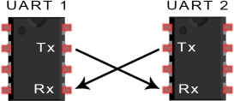
UART (Universal Asynchronous Receiver/ Transmitter)
It is used to transmit & receive serially via Tx and Rx Pin/wires
UARTs has no clock signal and follows asynchronous data communication.
Start and stop bits are added to data packet for identifying beginning and end of data packet
Baud rate is expressed as bits per second (bps). It is a measure of speed of data transfer. Both receiving and transmitting UART should work in same baud rate
UART: Working
In UART, data is transmitted in serial from data bus to transmitting UART
Transmitting UART adds a start bit, stop bit and a parity bit
Data packet is transmitted serially from Tx to Rx pin
Rx pin reads the data and converts parallelly by removing other bits.

Slide 13
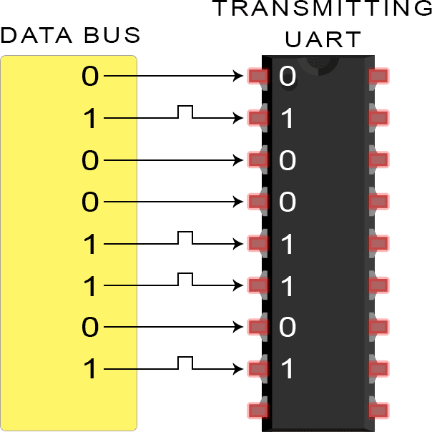
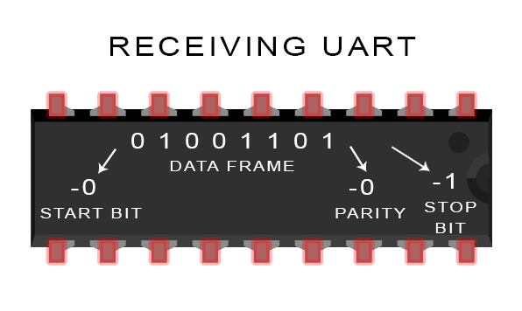
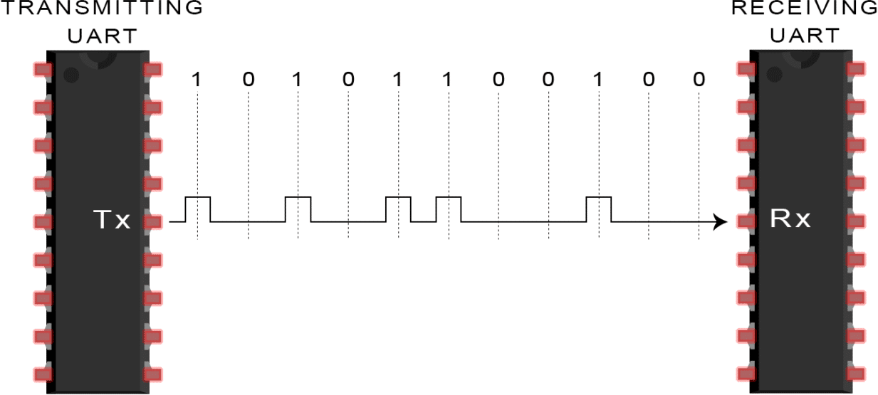
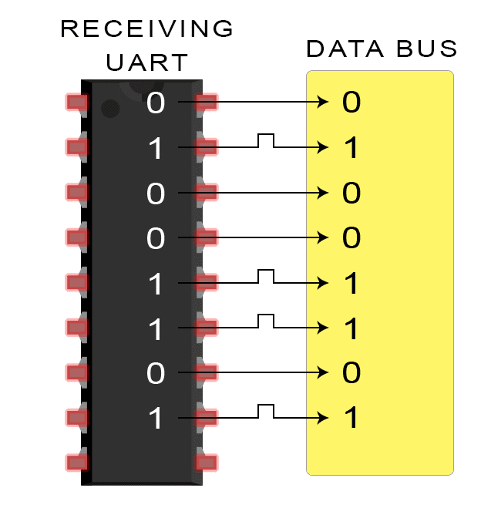
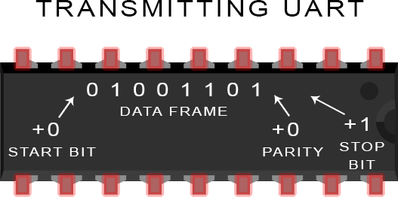
UART: Working
Frame Format:
1 start bit | 5 to 9 data bit | 0 or 1 parity bit | 1 to 2 stop bits

Slide 14
UART: In Arduino
All Arduino boards have at least one serial port (UART)
Serial is used for communication between the Arduino board and other devices.
It communicates on digital pins 0 (RX) and 1 (TX) as well as with the computer via USB. Thus, if you use these functions, you cannot also use pins 0 and 1 for digital input or output.
56

Slide 15
UART: Arduino Functions
if (Serial)
indicates whether or not the USB serial connection is open
Get the number of bytes available for reading from the serial port.
Serial.available()
Sets the data rate in bits per second (baud) for serial data transmission.
Serial.begin()
Disables serial communication, allowing the RX,TX to be used for input & output.
Serial.end()
Serial.find()
reads data from the serial buffer until the target is found.
Prints data as ASCII text followed by a carriage return and newline character.
Serial.println()
Serial.read()
Serial.readString()
Reads incoming serial data.
reads characters from the serial buffer into a String.
Writes binary data to serial port. This data is sent as a byte or series of bytes
Serial.write()
57

Slide 16
UART: In Arduino
Example-1: Print data received through serial communication on to the serial monitor of Arduino
void setup() {
Serial.begin(9600); //set up serial library baud rate to 9600
}
void loop() { if(Serial.available())
//if number of bytes (characters) available
// for reading from serial port
{
Serial.write(Serial.read()); //print what you read
}
}
58

Slide 17
UART: In Arduino
Example-2: Arduino code for serial interface to blink switch ON LED when “a” is received on serial port
int inByte;
void setup() {
Serial.begin(9600); pinMode(13, OUTPUT);
}
void loop() {
// Stores incoming command
// Led pin
// Ready to receive commands
If(Serial.available() > 0) {
inByte = Serial.read(); if(inByte = = 'a') {
digitalWrite(13, HIGH); Serial.println("LED - On");
// A byte is ready to receive
// byte is 'a’
}
else {
// byte isn't 'a’
digitalWrite(13, LOW); Serial.println("LED - off");
} } }
59

Slide 18
UART: In Arduino
Arduino Software Serial Library
SoftwareSerial library has been developed to allow serial communication on other digital pins of the Arduino
Uses software to replicate the functionality of the hardwired RX and
TX lines hence the name "SoftwareSerial".
This can be extremely helpful when the need arises to communicate
with two or more serial enabled devices
Limitations:
Maximum RX speed is 57600bps
RX doesn't work on Pin 13
If using multiple software serial ports, only one receive data at a time.
60

Slide 19
UART: In Arduino
Arduino Software Serial Library
SoftwareSerial()
Need to enable serial communication
gets the no of bits available for reading from serial port
avaialble()
begin()
overflow()
peek()
sets the speed of serial communication
checks the serial buffer overflow has occurred
returns the character received in the serial port
returns the character that was received on the Rx
pin of serial port
read()
Print()
Listen() Write()
works same as serial.print
enables the selected serial port to listen
print data to transmit pin of software serial
61

Slide 20
UART: In Arduino
Example-3: Arduino code to
Receives from the hardware serial
,
sends to
software serial
and
Receives from software serial
,
sends to hardware serial
.
#include <SoftwareSerial.h>
SoftwareSerial mySerial(10, 11); // RX, TX
void setup() { Serial.begin(57600); while (!Serial) {
;
}
// Open serial communications and wait for port to open:
// wait for serial port to connect. Needed for native USB port only
mySerial.begin(4800);
mySerial.println("Hello, world?");
// set the data rate for the SoftwareSerial port
}
void loop() {
// run over and over
if (mySerial.available()) {
Serial.write(mySerial.read());
}
if (Serial.available()) {
mySerial.write(Serial.read());
} }
62

Slide 21
Sensor
Electrical devices. Convert physical quantity/ measurements into electrical signals. Can be analog or digital. Types: Temperature, Humidity, Light, Sound, etc.
Digital Humidity and Temperature Sensor (DHT)
measures humidity (in %) and temperature (in °C) values serially over a single wire. 4 Pins {1 … 4, from Left to Right}
Pin 1 : Power Supply
Pin 2 : Data
Pin 3 : Null
Pin 4 : Ground
DHT Sensor Library
dht.readHumidity()
dht.readTemperature()
#include<dht.h>;
DHT dht(2,DHT11);
float humidity; float temperature;
void setup()
{ Serial.begin(9600); dht.begin(); }
void loop()
{
// read data from sensor and store in variables
humidity = dht.readHumidity();
temperature dht.readTemperature();
// print values
Serial.print(humidity)
Serial.print(temperature)
Delay(2000);
}
64

Slide 22
Actuators
Converts Energy to Motion
Types of Motor Actuators: Servo motor, Stepper motor, Hydraulic, AC motor,

Slide 23
Actuators : Servo Motor
Arduino provides a separate library – SERVO, to operate the servo motor.
#include<Servo.h>; // include servo lib.
int servoPin = 12;
Servo myServo; create a servo object
void setup()
{
myServo.attach(servoPin) // attaches the servo on pin servoPin (12) to Servo object
}
void loop()
{
myServo.write(0); | // | Move | servo | motor | by | 0 deg.
delay(1000);
myServo.write(90); | // | Move | servo | motor | by | 90 deg.
delay(1000)
myServo.write(180); | // | Move | servo | motor | by | 180 deg.
delay(1000)
}
71

Slide 24
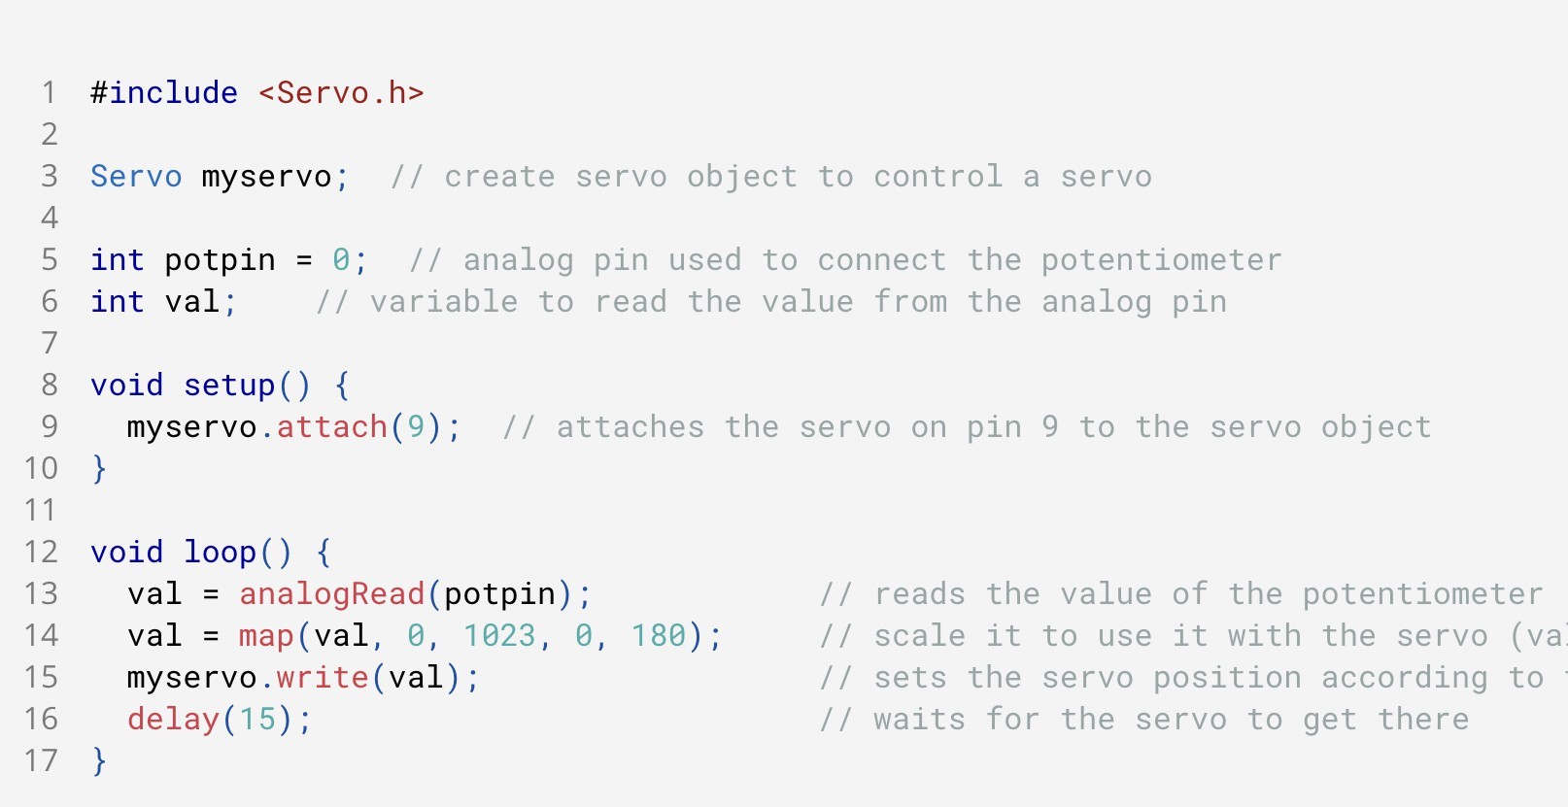
Actuators : Servo Motor
Knob Circuit

Slide 25
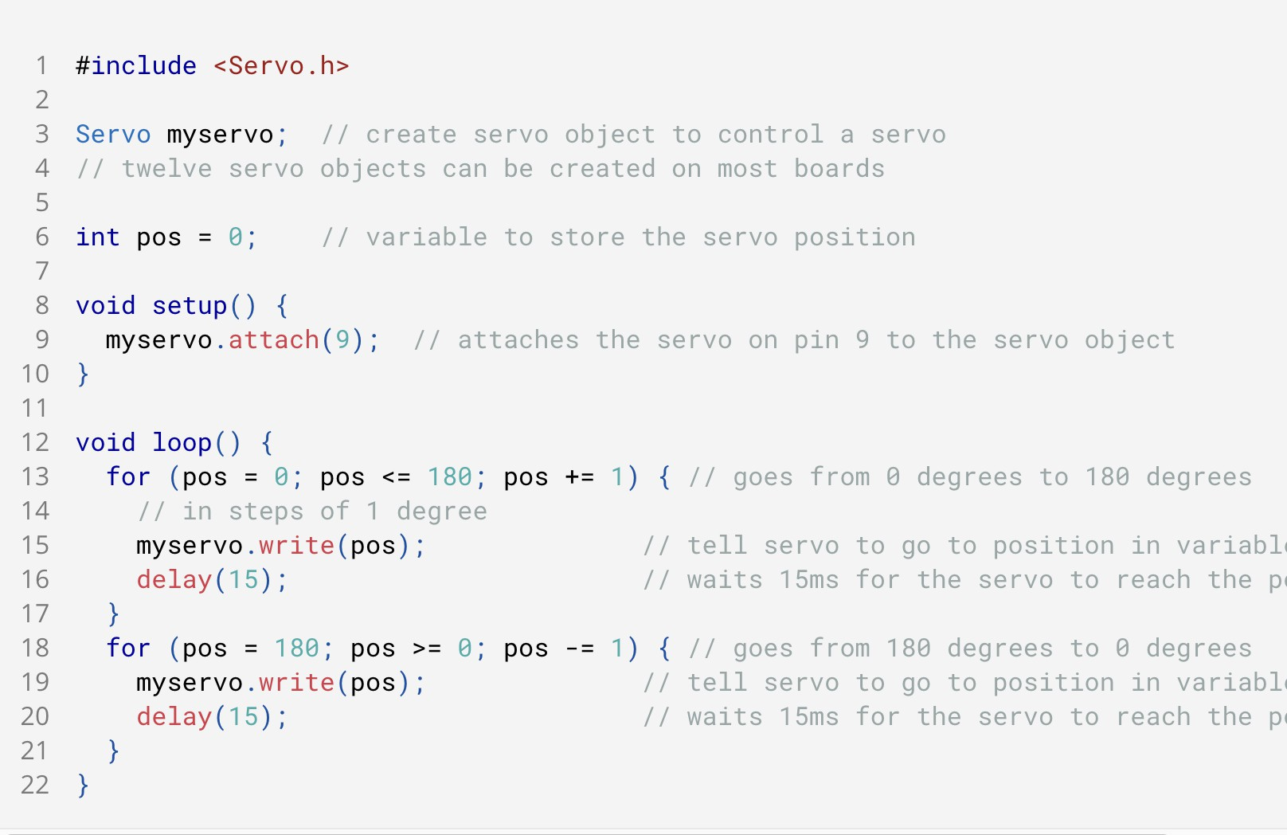
Actuators : Servo Motor
Sweep Circuit

Slide 26
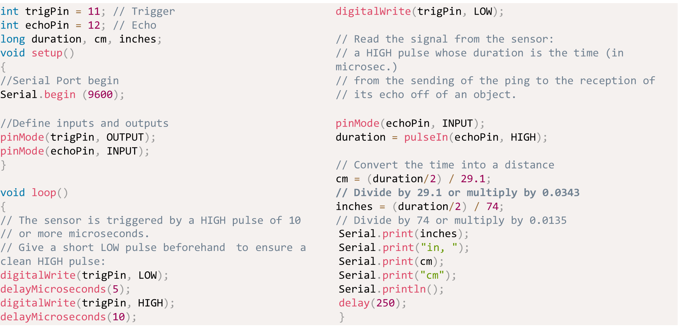
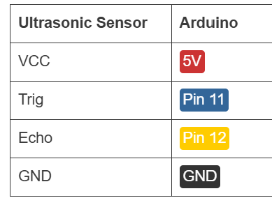
Sensor : Ultrasonic Sensor
An electronic sensor that measures the distance of a target object by emitting ultrasonic sound waves, and converts the reflected sound into an electrical signal.
Ultrasonic sensors have two main components: transmitter and receiver.
Ultrasonic waves travel faster than the speed of audible sound (i.e. the sound that humans can hear).
Formula: 𝑫 = ½ 𝑻 ∗ 𝑪 🞄 where D is the distance, T is the time, and C is the speed of sound ~ 343 meters/second).

Slide 27
Use a DHT11 temperature sensor to monitor the ambient temperature. If the temperature exceeds 50°C, an LED will light up as an alert.
#include <DHT.h> #define DHTPIN 2
// Pin connected to the DHT11 sensor
#define DHTTYPE DHT11
// DHT11 sensor type #define LEDPIN 3
// Pin connected to the LED DHT dht(DHTPIN, DHTTYPE);
void setup()
{
pinMode(LEDPIN, OUTPUT);
dht.begin(); Serial.begin(9600);
}
void loop()
{
float temperature = dht.readTemperature();
Serial.print(temperature);
if (temperature > 50)
{
digitalWrite(LEDPIN, HIGH); //Turn on LED
}
else
{
digitalWrite(LEDPIN, LOW); //Turn off LED
}
delay(2000);
// Wait for 2 seconds before taking the next reading
}

Slide 28
Design a vending machine using an Arduino. Two buttons allow the user to select either tea or coffee. Each selection triggers a servo motor to "dispense" the chosen drink, while an LED lights up during the dispensing process.
int teaState = digitalRead(teaButton);
int coffeeState = digitalRead(coffeeButton);
#include <Servo.h>
Servo teaServo; Servo coffeeServo;
int teaButton = 2; int coffeeButton = 3; int ledPin = 11;
void setup() { pinMode(teaButton, INPUT); pinMode(coffeeButton, INPUT); pinMode(ledPin, OUTPUT);
teaServo.attach(9); coffeeServo.attach(10);
teaServo.write(0);
// Initial position for tea dispenser coffeeServo.write(0);
// Initial position for coffee dispenser
Serial.begin(9600);
}
void loop() {
if (teaState == HIGH) { Serial.println("Tea selected"); digitalWrite(ledPin, HIGH);
// Turn on LED to indicate selection
teaServo.write(90); delay(2000); teaServo.write(0);
// Rotate servo to dispense tea
// Dispense time
// Return to initial position
digitalWrite(ledPin, LOW); // Turn off LED
if (coffeeState == HIGH) { Serial.println("Coffee selected"); digitalWrite(ledPin, HIGH); // Turn on LED to
indicate selection
coffeeServo.write(90); // Rotate servo to dispense coffee
}
delay(2000); coffeeServo.write(0);
// Dispense time
// Return to initial position
digitalWrite(ledPin, LOW); // Turn off LED
delay(100); // Small delay to debounce the button
}
}

Slide 29
Design a simple robot project for obstacle detection using an ultrasonic sensor and two servo motors. When the ultrasonic sensor detects an obstacle within a certain distance, the robot will turn 90 degrees.
// Clear the trigger pin digitalWrite(TRIG_PIN, LOW); delayMicroseconds(2);
delay(500); // Wait for 0.5 seconds
#include <Servo.h>
#define TRIG_PIN 9
#define ECHO_PIN 10
#define LEFT_SERVO_PIN 5
#define RIGHT_SERVO_PIN 6
// Turn 90 degrees leftServo.write(0); // Turn left rightServo.write(180); // Turn
right
delay(1000); // Turn for 1 second
// Set the trigger pin high for 10 microseconds
digitalWrite(TRIG_PIN, HIGH); delayMicroseconds(10); digitalWrite(TRIG_PIN, LOW);
Servo leftServo; Servo rightServo;
// Move forward again leftServo.write(90); // Forward rightServo.write(90); // Forward
void setup() { pinMode(TRIG_PIN, OUTPUT); pinMode(ECHO_PIN, INPUT);
// Read the echo pin
duration = pulseIn(ECHO_PIN, HIGH);
delay(1000); // Continue moving forward for 1 second
} else {
// Move forward leftServo.write(90); // Forward rightServo.write(90); // Forward
}
leftServo.attach(LEFT_SERVO_PIN); rightServo.attach(RIGHT_SERVO_PIN);
// Calculate the distance in centimeters
distance = duration * 0.0344 / 2;
// Initialize servos to move forward leftServo.write(90); // Forward rightServo.write(90); // Forward
Serial.print("Distance: "); Serial.print(distance); Serial.println(" cm");
Serial.begin(9600);
delay(100); // Small delay before next reading
}
}
if (distance < 20) { // Obstacle
detected within 20 cm
// Stop the robot leftServo.write(90); // Stop rightServo.write(90); // Stop
void loop() { long duration; int distance;

Slide 30
Monitor the amount of rainwater collected in a storage tank. A water level sensor (analog) is used to measure the water level, and every time the water level reaches a certain height (threshold), the system increments a counter. This counter could represent the number of times the tank fills up to a specific level, helping in tracking water usage or collection efficiency.
int sensorPin = A0; // water level sensor pin
int counter = 0;
// Initialize counter
void setup()
{ Serial.begin(9600); }
void loop()
{
int sensorValue = analogRead(sensorPin);
if (sensorValue > threshold) {
counter++; // Increment the counter Serial.print("Tank Filled Count: "); Serial.println(counter);
// Display the counter value on the Serial Monitor
displayCounter(counter);
delay(2000);
// Delay to prevent multiple counts for a single fill
}
delay(500);
// Small delay before the next reading

Slide 31
In certain environments, such as greenhouses, server rooms, or even home attics, maintaining an optimal temperature is crucial. Manually adjusting vents or windows to control the temperature can be inefficient. Automate the process by using an analog temperature sensor to monitor the temperature and a servo motor to open or close a vent or window based on the detected temperature. A timer is also used to ensure the vent or window adjusts only after a certain period, preventing frequent unnecessary adjustments.
#include <Servo.h>
// Start serial communication
if (temperature > thresholdTemp)
Servo ventServo;
int tempSensorPin = A0;
// Analog pin for temperature sensor int thresholdTemp = 30;
// Threshold temperature in Celsius
int ventOpenAngle = 90;
// Angle to open the vent int ventClosedAngle = 0;
// Angle to close the vent unsigned long previousMillis = 0; unsigned long interval = 60000;
// 1 minute interval for checking
}
{
ventServo.write(ventOpenAngle);
// Open vent
Serial.println("Vent Opened");
} else {
void loop() {
unsigned long currentMillis =
millis();
if (currentMillis - previousMillis
>= interval) {
previousMillis = currentMillis;
ventServo.write(ventClosedAngle); // Close vent
Serial.println("Vent Closed");
}
int tempValue =
analogRead(tempSensorPin);
// Read the temperature sensor value float temperature = (tempValue /
1024.0) * 5.0 * 100.0;
// Convert to Celsius (for LM35)
}
delay(1000);
// Small delay before the next loop iteration
}
void setup() { ventServo.attach(9);
// Attach servo motor to pin 9 ventServo.write(ventClosedAngle);
// Start with vent closed
Serial.print("Temperature: "); Serial.print(temperature); Serial.println(" C");
Serial.begin(9600);

