Slide 1
Criteria for Processor Selection
Sequence of analysis to be made selecting an appropriate processor for
embedded system applications as follows,
Application requirement analysis:
understand the purpose of application and arrive specific requirement
Processor Architecture analysis:
MCS51, ARM, PIC, PowerPC, MIPS etc.,
Peripheral set analysis:
Includes on-chip (RAM, ROM ,I/O Ports, ADC) and specialized processing units (FPU, MMU, DMA)
Technical analysis:
Execution speed, operating voltage, power consumption, and data & address bus size etc.,
Non-technical analysis:
Cost, software tools, package type, vendor reputation, support etc.,
9

Slide 2
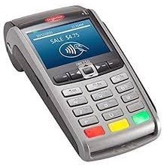
Criteria for Processor Selection Case Study 1 : Handheld Device
Wireless Spot Billing Machine
The device is compact and lightweight (less than 500grms).
The device is WEB/USB enabled which helps the operator to get instant bill remotely and update transactions back to the server.
Features:
Billing Machine is easy to operate and user-friendly.
It is highly secured with Password protection.
It is accessible to the remote application via GPRS.
It holds the Customer Data in memory.
Accurate data Import and Export Settings

Slide 3
Specifications:
Processor : ARM 32-bit with Adaptive real-time accelerator (ART Accelerator), capable of In-System Programming. Cortex-M3 processor is specifically developed for high-performance, low-cost platforms for a broad range of devices including Microcontrollers, Automotive body systems, Industrial control systems and Wireless networking and sensor.
Memory : 8 MB of Non-volatile data memory is provided with the units data retention is minimum 10 years without any power being applied. Optional - It also has micro SD card slot for large memory backup
Real Time Clock : In-built Real time clock with battery backup.
Key-Board : A 35 key multi function key board is provided on the front panel.
LC Display : 132*64 pixels graphical LCD display with back light provided for user interaction. It has various graphical icons for indication of battery status, signal status etc.
Printer : High Speed 24 Column Impact Printer With 2.7 Lines/Sec
Paper Roll Communication : RS232C Ports-1 Nos (Option of second port) with flexible baud rates.
Built-in GSM/GPRS modem optional.
Battery : The units are powered by 7.4v 2600 mAH LI-ION Rechargeable Battery pack.
Weight : 655grams~(without paper roll).
.
14

Slide 4
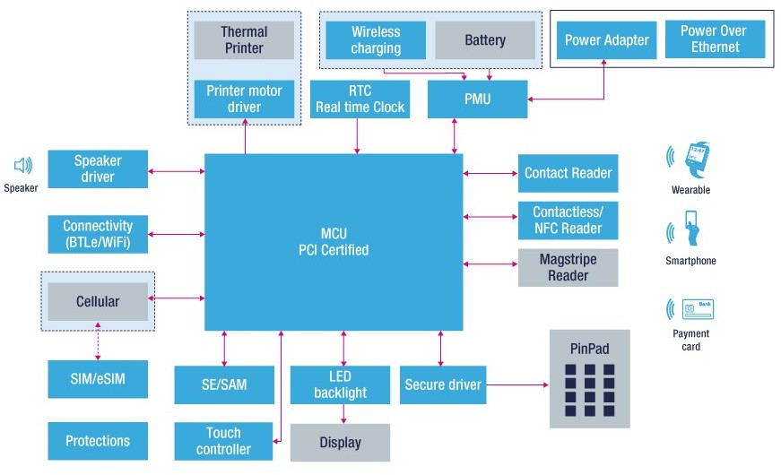
Criteria for Processor Selection Case Study 1 : Handheld Device
Block Diagram

Slide 5
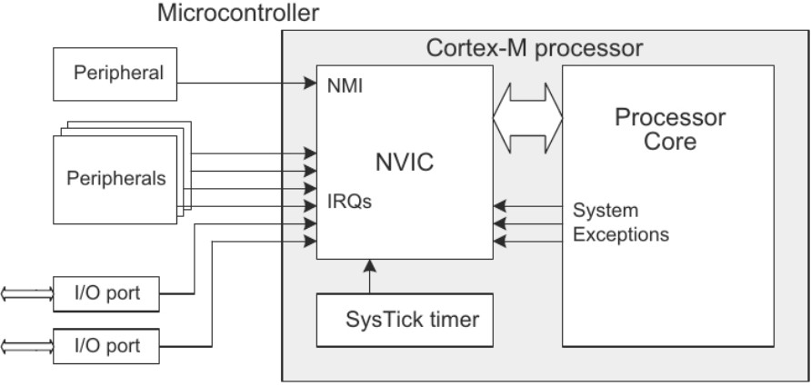
Nested Vector Interrupt
Nested vector interrupt control (NVIC) is a method of prioritizing interrupts,
improving the MCU’s performance and reducing interrupt latency.
NVIC also provides
implementation schemes
for handling interrupts that
occur when other interrupts are being executed or when the CPU is in the
process of restoring its previous state and resuming its suspended process.

Slide 6
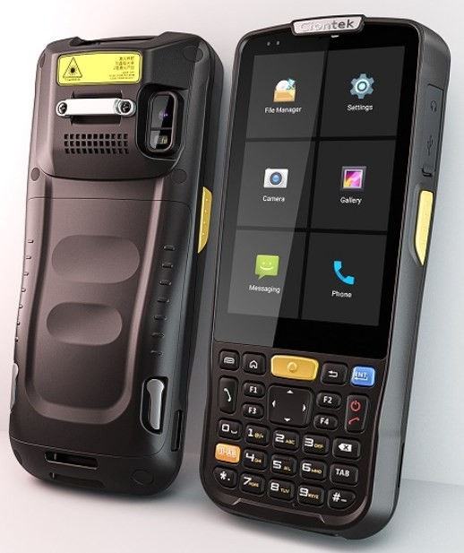
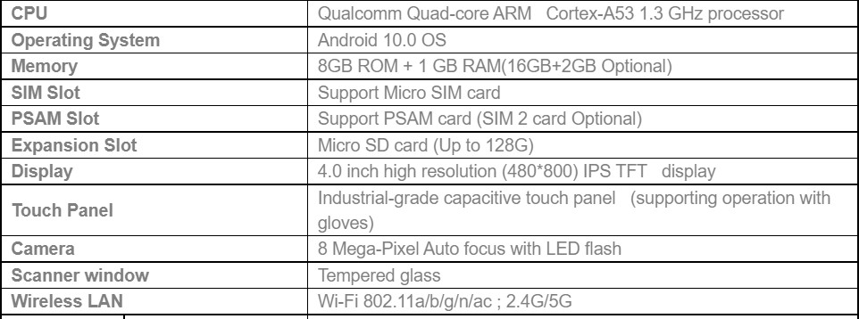
Rugged Handheld Data Terminal
It is built for life out in the field, integrates Corning Gorilla glass for display, able to handle drops, bumps, spills, dust, vibration.
Stable wireless connections and accurate efficient data capture options
Specifictaions:

Slide 7
Processor
Cortex-A53 processor is a high efficiency processor that implements the Armv8-A architecture.
The Cortex-A53 processor has one to four cores, each with an L1 memory system and a single shared L2 cache.
It can be combined with other Cortex-A CPUs in a big.LITTLE configuration
Big.LITTLE configuration refers to a CPU design that features two core clusters with differently-designed cores
High performance cores: These cores are designed for demanding tasks.
Power-efficient cores: These cores handle more conventional tasks.
21

Slide 8
Digital Camera
Digital still cameras require a significant amount of silicon contents, including the sensor (CCD or CMOS), the analog components (ADC, NTSC encoder, …) and the engine (Digital Signal Processor).
DSP - is the brain of the camera and is responsible for performing all the computations needed to process and compress the image.
Most DSCs use a CCD imager to sense the images. The driver electronics and the Timing Generator circuitry generate the necessary signal to clock the CCD.
Correlated Double Sampling and Automatic Gain Control electronics are used to get a good-quality image signal from the CCD sensor.
This CCD data is then digitized and fed into the DSC engine. All the image-processing and image-compression operations are performed in the DSC engine.
On most DSCs, the user has the ability to view the image to be captured on the LCD display. The current DSCs also provide ways to connect to the external PC or printer through an RS-232 or a USB port.
The compressed images are stored in Flash memory for later use.

Slide 9
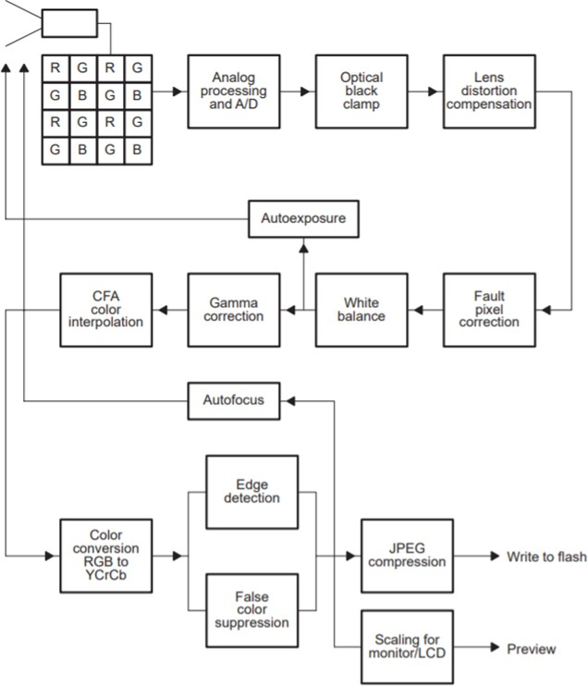
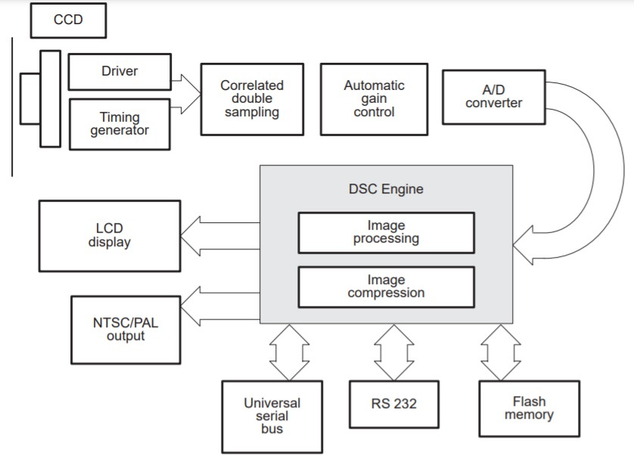

Slide 10
Image Pipeline
The Colour Filtered Array (CFA) data needs to undergo significant amount of image processing before the image can be finally presented in a usable format for compression. All these processing stages are collectively called the “image pipeline.”
The TMS320C54x DSP is well suited to perform these tasks efficiently and generate a high-quality image that is close to the image quality offered by traditional film from the raw CCD data.
On TMS320C54x DSP processor, all image pipeline operations can be executed on chip since only a small 16 x 16 block of the image is used.
TMS320C549 is well suited due to its large on-chip memory (32K x 16-bit RAM and 16K x 16-bit ROM). In this way, the processing time is kept short, because there is no need for external high-speed memory.
This device offers high performance and efficiency (100 MIPS) at low power consumption (0.45mA/MIPS)

Slide 11
Case Study 3 : ATM
ATM is a computerized telecommunications device that provides customers a secure method of performing financial transactions in a public space without the need for a human clerk or bank teller.
Hardware
CPU (to control the user interface and transaction devices)
Magnetic and/or Chip card reader (to identify the customer)
PIN Pad (similar in layout to a Touch tone or Calculator keypad), often
manufactured as part of a secure enclosure.
Secure crypto-processor, generally within a secure enclosure.
Display (used by the customer for performing the transaction)
Function key buttons (usually close to the display) or a Touchscreen (used to
select the various aspects of the transaction)
Record Printer (to provide the customer with a record of their transaction)
Vault (to store the parts of the machinery requiring restricted access)
Housing (for aesthetics)

Slide 12
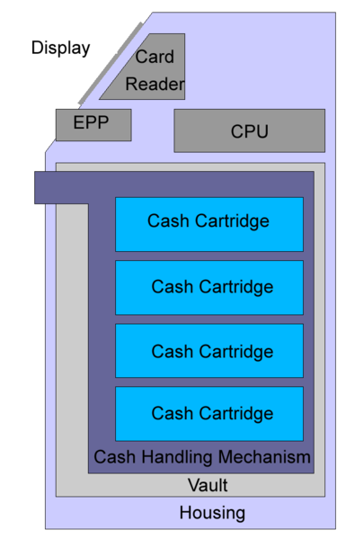
Vaults
Dispensing mechanism (to provide cash or other items of value)
Deposit mechanism (to take items of value
from the customer)
Security sensors (Magnetic, Thermal, Seismic)
Locks (to ensure controlled access to the contents of the vault)

Slide 13
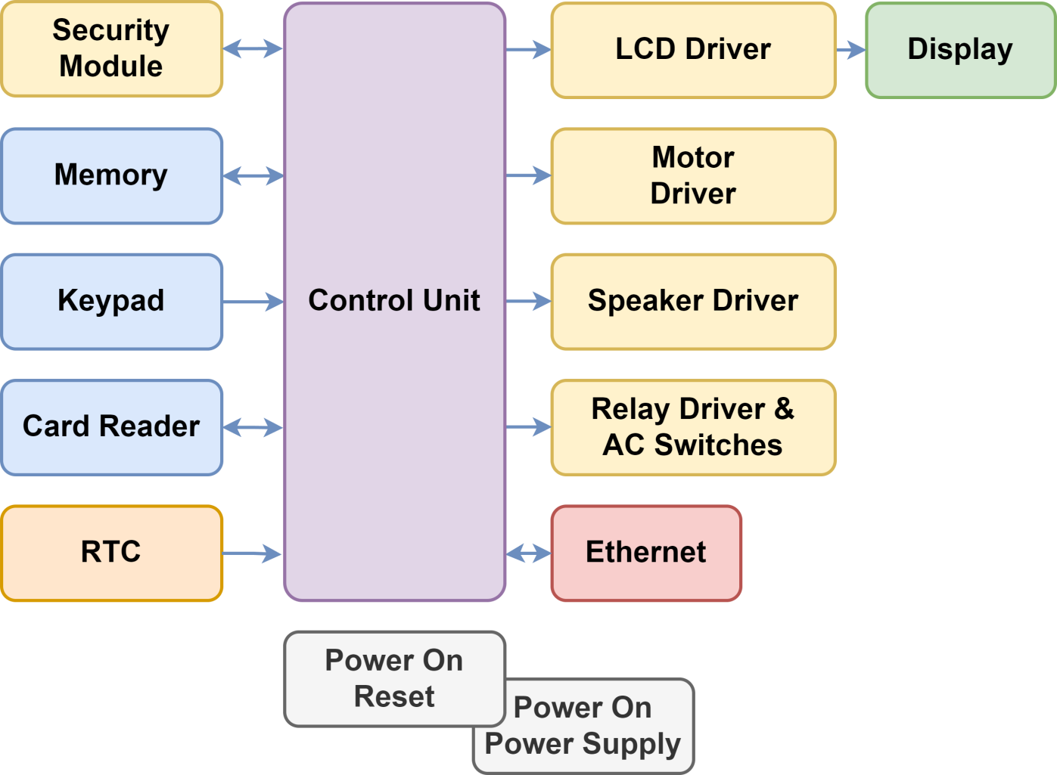

Slide 14
Network
Internet service provider (ISP) provides communication between ATM and host processors.
When the transaction is made, the details are input by the cardholder. This information is passed on to the host processor by the ATM.
The host processor checks these details with an authorized bank. If the details are matched, the host processor sends the approval code to the machine so that the cash can be transferred.)
Special Purpose Processor
Using a single-purpose processor in an embedded system results in several design metric benefits and drawbacks, which are essentially the inverse of those for general purpose processors.
Performance may be fast, size and power may be small, and unit-cost may be low
While design time and NRE costs may be high, flexibility is low, unit cost may be high for small quantities, and performance may not match general-purpose processors for some applications.

Slide 15
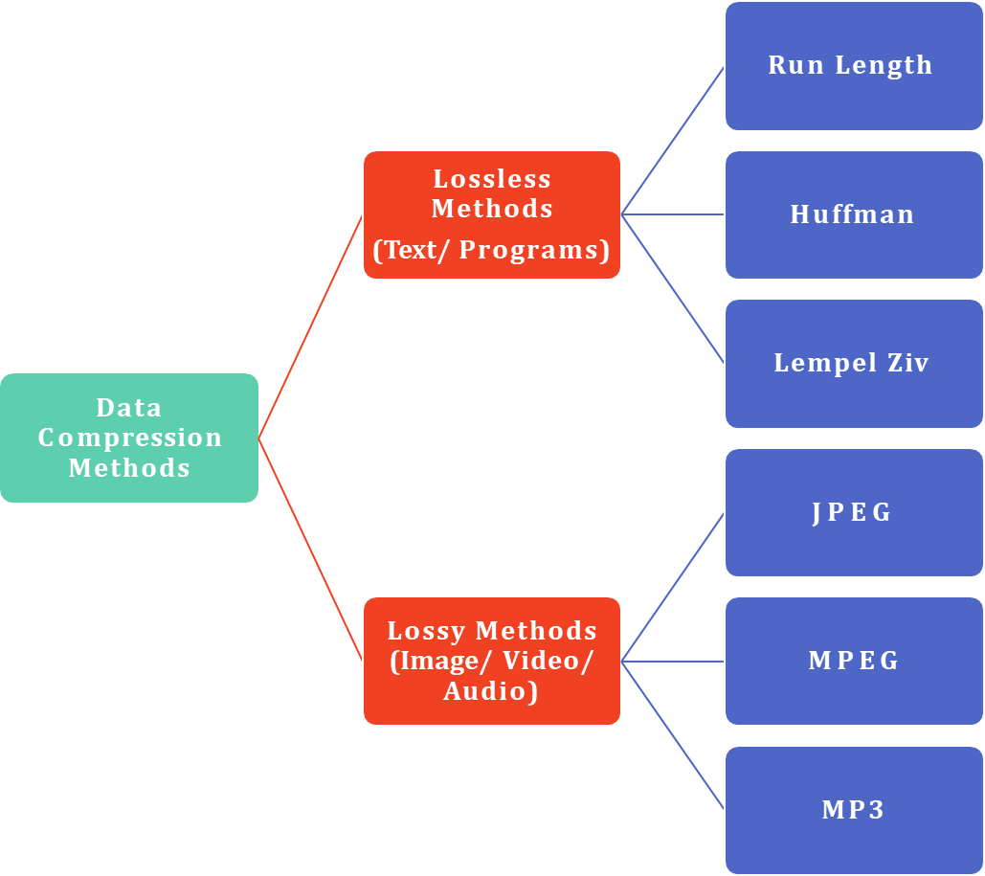
Data Compression – Methods

Slide 16
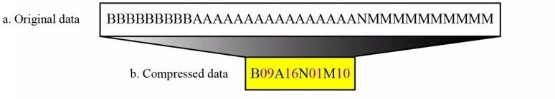
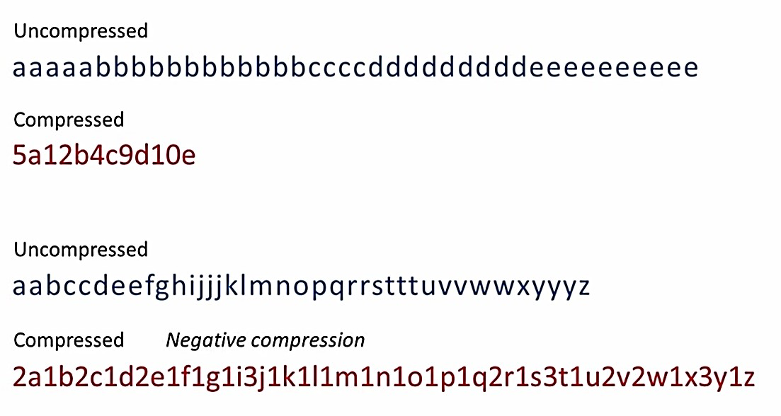
Run Length Encoding
Occurrence of the symbols itself followed by the no. of occurrences.
The process could be made efficient if the data uses only 2 symbols (0’s and 1’s )
00000 1111111111 00000000000000 111111 00 11111 [42 Bits]
0 : 5; 1 : 10 ; 0 : 14 ; 1 : 6 ; 0 : 2 ; 1 : 5
0 101 1 1010 0 1110 1 110 0 10 1 101
[26 Bits]

Slide 17
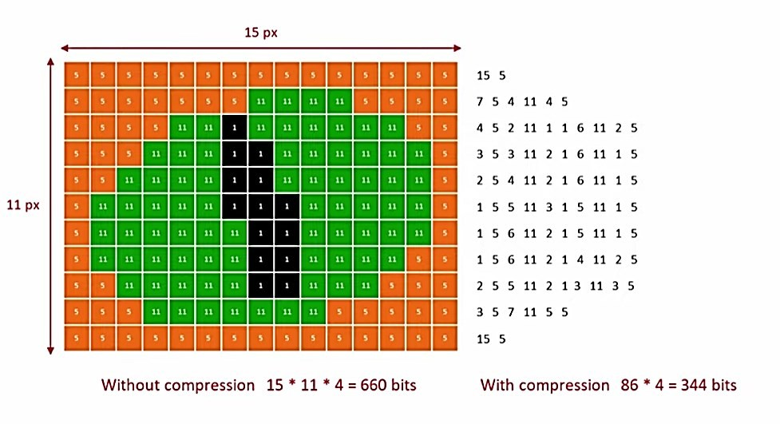
Run Length Encoding

Slide 18
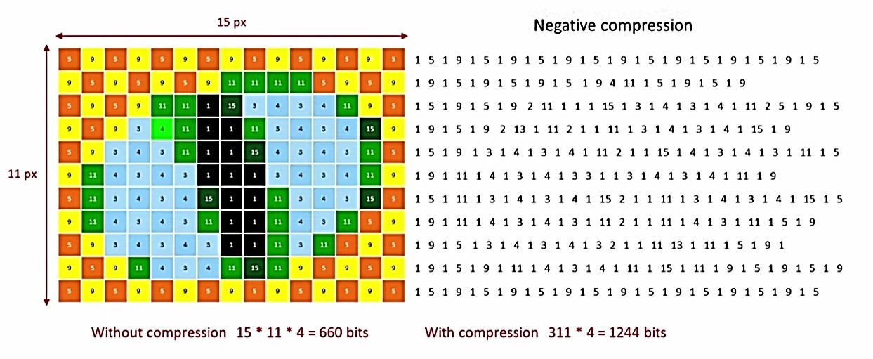
Run Length Encoding

Slide 19
Huffman Coding
Assign fewer bits to symbols that occur more frequently.
More bits to symbols that appear less often.
There is no unique Huffman Code and every Huffman Code has the same average code length.
Algorithm:
Make a leaf node for each code symbol
Add a generation probability of each symbol to leaf node
Take 2 leaf nodes with smallest probability and connect them to a new node
Add 1 & 0 to each of the two branches
Probability of new node is the sum of the probabilities of two connecting nodes
51

Slide 20
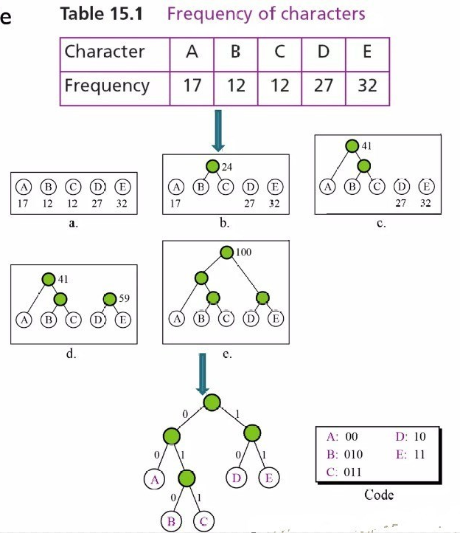
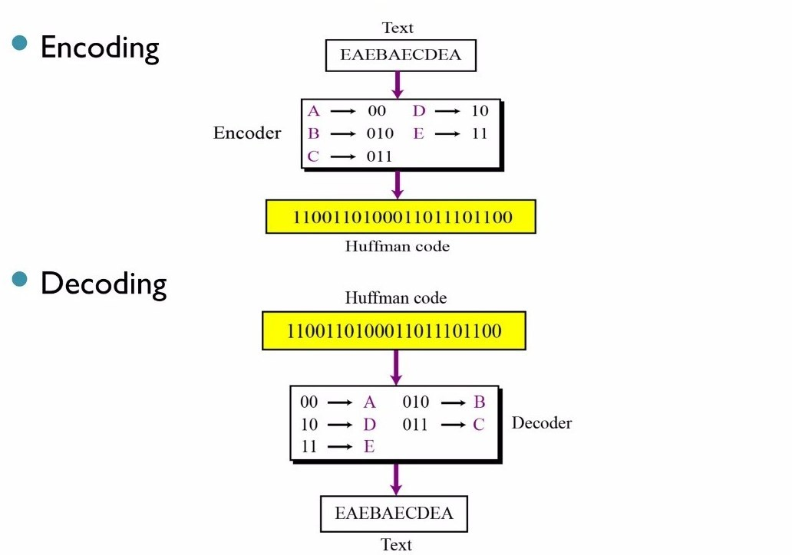


Huffman Coding

Slide 21
Lempel Ziv Coding
It is a dictionary based encoding.
Create a dictionary (a table) of strings used during the communication.
If both sender and receiver have a copy of the dictionary, then the previously- encountered strings can be substituted by their index in the dictionary.
2 Phases of Operation - Building an indexed dictionary and Compressing a string of symbols.
Algorithm:
Extract the smallest substring that cannot be found in the remaining uncompressed string.
Store that substring in the dictionary as a new entry and assign it an index value.
Substring is replaced with the index found in the dictionary.
Insert the index and the last character of the substring into the compressed string.

Slide 22
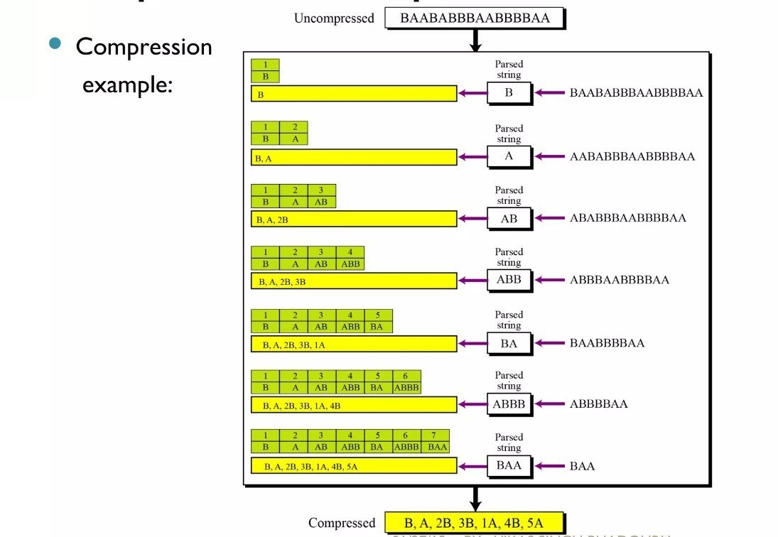
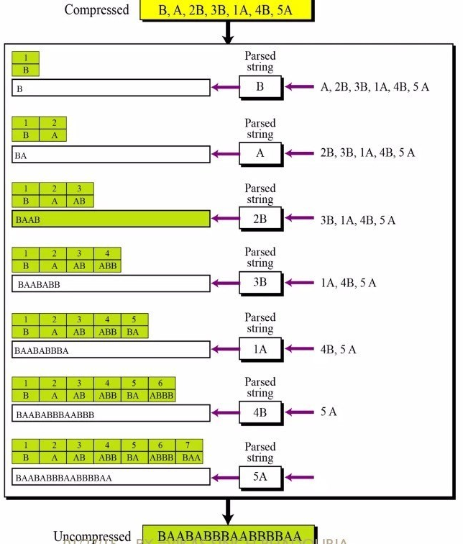
Compression
De-compression
https://youtu.be/EgreLYa-81Y?si=6Tm_UJSaFZKSyJ-t

Slide 23
JGEG Encoding
Step 1: Isolation of Color Information
Image’s brightness information is spread evenly through the R, G, B channels.
Convert the image’s colour space from RGB to YCbCr. It stores all of the brightness information in one channel (Y) while splitting the colour information between the other two (Cb and Cr).
Step 2: Reduce Color Information
scaling down just the Cb & Cr (colour) channels while keeping the important Y (brightness) channel full size.
Step 3: Conversion to Freq. Domain
Start by dividing each of the Y, Cb, and Cr channels up into 8×8 blocks of pixels.
The spatial domain is what we have now: the value in the upper-left corner represents the brightness (Y-value) of the pixel in the upper-left corner of that block.
Domain transformation is accomplished using 2D Discrete Cosine Transform (DCT)

Slide 24
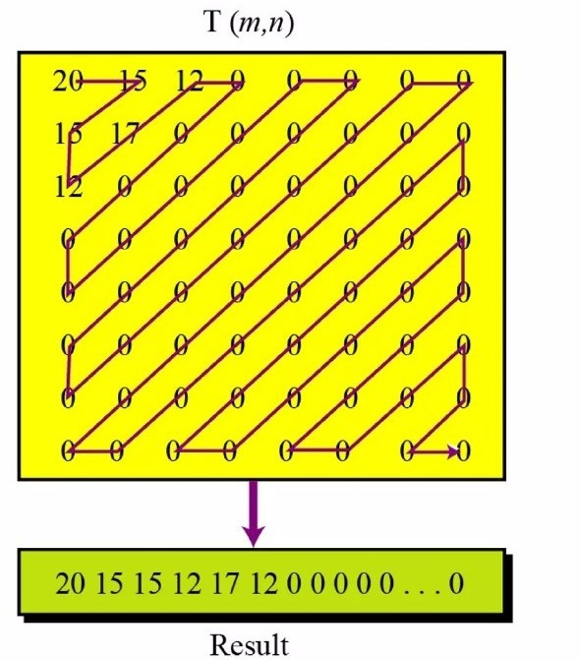
JPEG Encoding
JPEG has one last trick for making the data more compressible:
It lists the values for each 8×8 block in a zig-zag pattern that puts the numbers in order from lowest frequency to highest.
That means that the most heavily quantized parts (with the largest divisors) are next to each other to make nice, repetitive patterns of small
numbers.
Block data is compressed in zig-zag order, grouping similar frequencies together.
66

Slide 25
MPEG Encoding
Used for compressing video files.
Each video is a rapid sequence of a set of frames.
Spatial Compression - Each frame is spatially compressed by JPEG
Temporal Compression - Redundant frames are removed. For Example: In a static scene in which someone is talking, most frames are the same expect for the sequence/ segment when the lips are moving, which change from one frame to other
Compressed Video = Spatial Compression of Each Frame + Temporally compressing a set of frames

