Slide 1
Building Process for Embedded Systems
In embedded software development, the build tools run on a host computer that differs from the target hardware platform.
Compiler, Assembler, Linker, Locator, Debugger
Produces executable binary image that will run on target embedded system
To develop software for an Embedded System
Create source file (on Host)
Compile/Assemble: translate into machine code (on Host)
Link: combine all object files and libraries, resolve all symbols (on Host)
Locate: assign memory addresses to code and data (on Host)
Download: copy executable image into Target processor memory
Execute: reset Target processor
1

Slide 2
Compiler:
translate programs written in human-readable language into binary-object that contains set of machine-language instructions (opcodes) and data resulting from language translation.
Symbol table in the object file contains names and locations of all variables and functions referenced within the source file.
Linker:
Object files themselves are individually incomplete, some of the internal variable and function references not yet been resolved.
The job of the linker is to combine these object files and resolve all of the unresolved symbols and form a new complete relocatable object file.
the program is complete except for one thing: no memory addresses have yet been assigned to the code and data sections within.
Locator:
The locator assigns physical memory addresses to each of the code and data sections within the relocatable program and produces an output file that contains a binary memory image that can be loaded into the target.
14

Slide 3
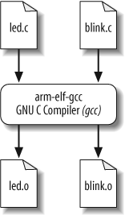

Build Procedure Arcom Viper-lite Development Board
COMPILE
The basic structure for the gcc compiler command is:
The command-line options we’ll need are:
-g
-c
-Wall
-I../include
To generate debugging info in default format
To compile and assemble but not link
To enable most warning messages
To look in the directory include for header files
Here are the actual commands for compiling:
So if all goes well, there will now be two additional object files — led.o and blink.o—in the working directory.

Slide 4
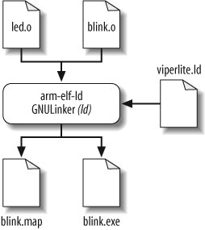
LINK AND LOCATE
GNU linker performs the linking and locating of the object files.
For locating, there is a linker script file named viperlite.ld that we input to ld in order to establish the location of each section in the Arcom board’s memory.
The structure for the linker and locater ld command is:
The command-line options we’ll need for this step are:
-Map blink.map
-T viperlite.ld
-N
-o blink.exe
To generate a map file and use the given filename
To read the linker script
To set the text and data sections to be readable and writable
To set the output filename (if this option is not included, will use the default output filename a.out)
The actual command for linking and locating is:
The order of the object files determines their placement in memory.
Result of this command is the creation of two files— blink.map and blink.exe
Linker script and memory map section contains a breakdown of the memory contribution of each and every file that was linked into the final image.

Slide 5
Loading on the Target
Two ways of downloading the binary image on the embedded system:
Using a Device Programmer:
Step 1: Once the binary image is ready on the computer, the device programmer is connected to the computer.
Step 2: Device programmer contains a software interface through which the user selects the target uP/uC for which the binary image has to be downloaded.
Step 3: Device programmer then transfers the binary image bit by bit to the chip.
Using In System Programmer(ISP):
Is the ability of programming the embedded processor/controller while it is installed in a complete system, rather than requiring the chip to be programmed prior to installing it into the system.
Allows firmware updates to be delivered to the on-chip memory of microcontrollers and related processors without requiring specialist programming circuitry on the circuit board, and simplifies design work
User through the ISP’s software interface sends the binary image to the target board.
This avoids the requirement of frequently removing the microprocessor / microcontroller or ROM for downloading the code if a device programmer had to be used.

Slide 6
Debugging Tools
SIMULATOR
Disadvantage - it only simulates the processor, and not the peripherals.
REMOTE DEBUGGER
It is used to monitor/control/download/execute and debug embedded SW over a comm. link.
The front-end of the GUI debuggers contain several windows to show the active part of the source code, current register contents, information about the executing program.
Backend provides low-level control of target processor, runs on target processor and communicates to the front-end over a communication link.
Debugger and software being debugged are executing on two different computer systems.
Disadvantage: inability to debug startup code, code must execute from RAM, requires a target processor to run the final software package
IN-CIRCUIT EMULATOR (ICE)
Emulation refers to the ability of a computer program or electronic device to imitate another program or device
Contains a copy of target processor, plus RAM, ROM, and its own embedded software.
It allows you to examine the state of the processor while the program is running.
ICE provides greater flexibility, ease for developing various applications on a single system in place of testing that multiple targeted systems.
Disadvantage of this method is that, it is expensive.

Slide 7
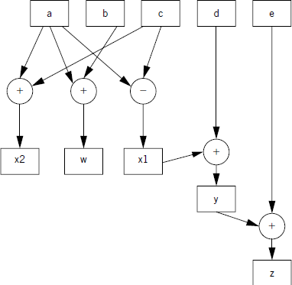
DFG
Round nodes: Represents or denotes operators.
Square nodes: Represents values.
Advantages of DFG:
It orders the way operations can be performed in a program.

Slide 8
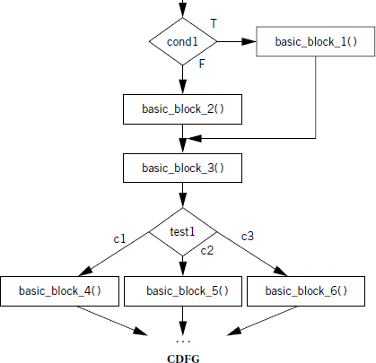
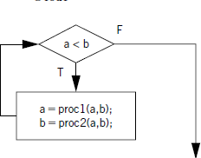
Control DFG
if (cond1) basic_block_1( );
else basic_block_2();
basic_block_3( );
switch (test1) {
case c1: basic_block_4( ); break;
case c2: basic_block_5( ); break;
case c3: basic_block_6( ): break;
}
Constructs a model for decision and data flow of a program.
Consists of - decision nodes and edges labelled with possible outcomes
Conditional Blocks in Control DFG:
while (a < b)
{
a = proc1(a,b);
b= proc2(a,b);
}
Building Loop in Control DFG:

Slide 9
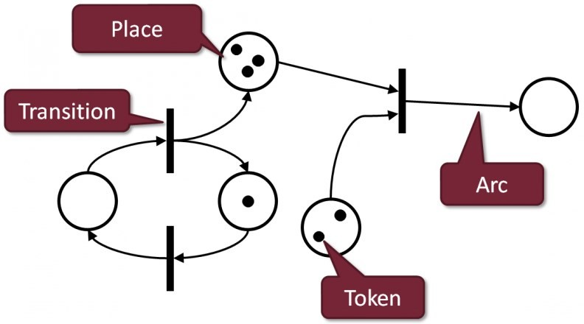
Petri Net Model/ Place Transition Net Model
Interaction between asynchronous and concurrent processes. In asynchronous process, start and sequence of processes may vary during the execution
Petri Net(PN) is very similar to State Transition Diagrams which model the system behavior
COMPONENTS OF PETRINET MODEL
Places (circles) : possible states of the system;
Transitions (rectangles) : events which cause the changes of state (firing)
Arcs (arrows) : Every arc simply connects a place with a transition or a transition with a place.
Tokens(black dot): Change of state is denoted by a movement of token(s) from place(s) to place(s). Once firing is initiated, tokens will be transferred from input to output places

Slide 10
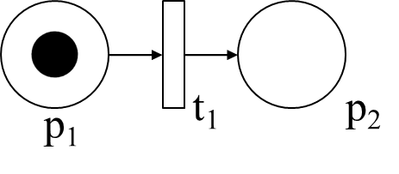


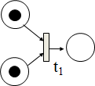
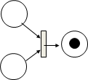
Petri net with two places and one transaction.
Sequential Execution:
Transition t2 can take place only after t1.
Concurrency:
t1 and t2 are concurrent process
Merging:
When several tokens are arrived at same transition merging will take place
Synchronization:
Transition t1 will be enabled only when at least one token is available at each of its input places
p₁: input place
p₂: output place

Slide 11
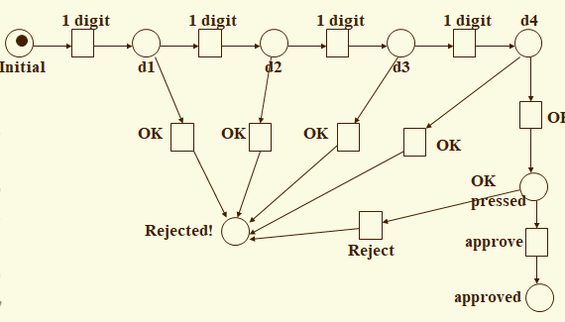
POS terminal generally does the following:
Validate the user using 4-digit PIN number
Checks whether the funds in a customer’s bank account are sufficient
Transfers the funds from the customer’s account to the seller’s account
Records the transaction and prints a receipt
Scenario 1: Normal: Enters all 4 digits and press OK.
Scenario 2: Exceptional: Enters only 3 or less digits and press OK
EXAMPLE – 1: POINT OF SALE (POS) MACHINE

Slide 12
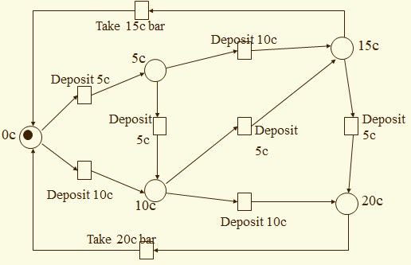
EXAMPLE – 2 : VENDING MACHINE
Machine dispenses two kinds of snack bars 20c and 15c.
Constraint: 10c and 5c coins can only be used
Scenario 1: Deposit four 5c, take 20c snack bar.
Scenario 2: Deposit 10 + 5c, take 15c snack bar.
Scenario 3: Deposit 5 + 10 + 5c, take 20c snack bar.

Slide 13
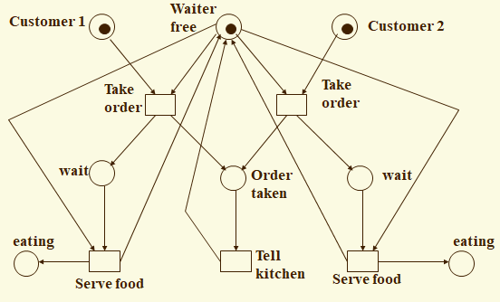
EXAMPLE – 3 : ORDER MANAGEMENT IN A RESTAURANT
Scenario 1:
Waiter takes order from customer 1
Serves customer 1
Takes order from customer 2
Serves customer 2.
Scenario 2:
Waiter takes order from customer 1
Takes order from customer 2
Serves customer 2
Serves customer 1

Slide 14
Unified Modelling Language
Use Case Diagram: Shows functional requirements and user interactions. Components: Actors, use cases, system boundary.
Class Diagram: Represents the static structure of the system architecture(classes, attributes, relationships). Components: Classes, attributes, methods, associations.
Sequence Diagram: Illustrates object interactions in a time sequence and operation flow. Components: Objects, lifelines, messages, activations.
State Diagram: Shows object states and transitions due to events. Components: States, transitions, events, initial/final states.
Activity Diagram: Depicts the flow of activities and control flow. Components: Activities, control flows, decision points.
System Requirement
Use case diagrams
System Structure
Class diagram
System
characteristics
Sequence, state and activity diagram

Slide 15
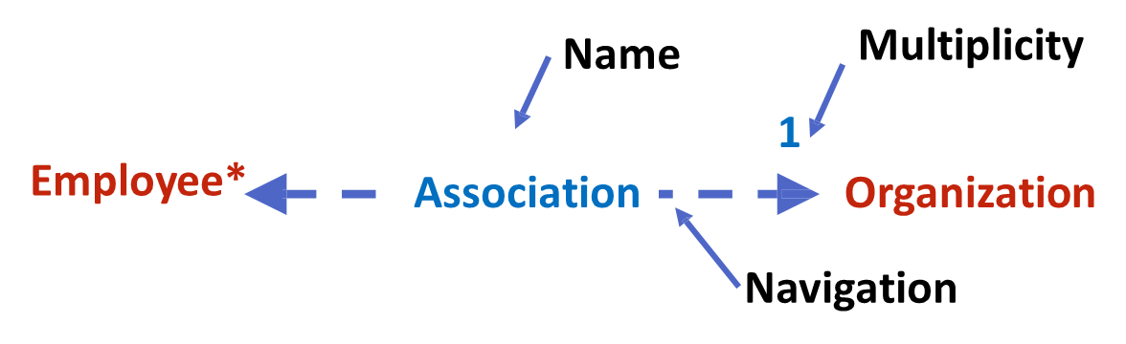

USE CASE DIAGRAM
Shows different ways a user can interact with the system. Extensibility makes UML more powerful and flexible.
Dependency: Relationship between two elements of a system
Association: describes how the elements are associated. The multiplicity (1, *, etc.) to show how many objects are associated
Generalization: inheritance relationship / parent-child relationship
Dependent
Independent

Slide 16
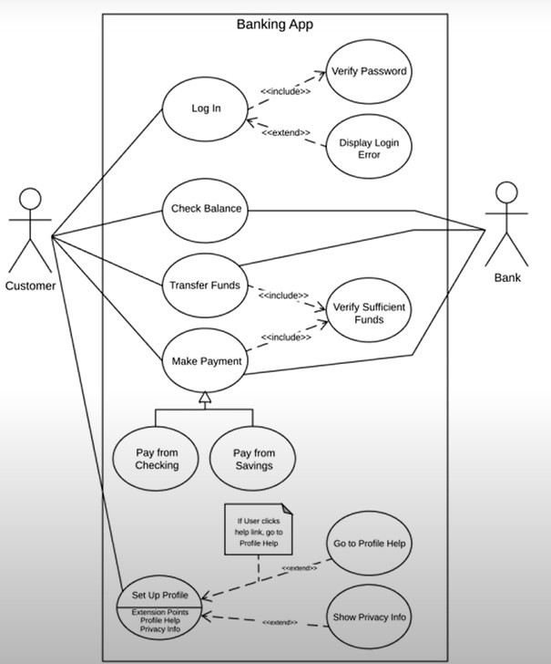
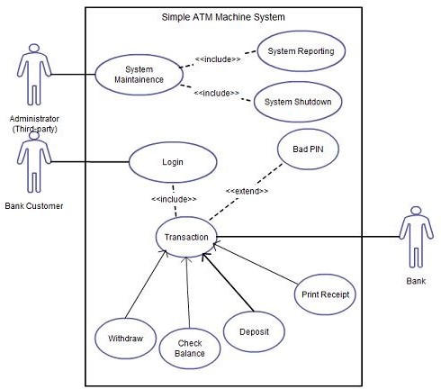
Example: ATM System
UML

Slide 17
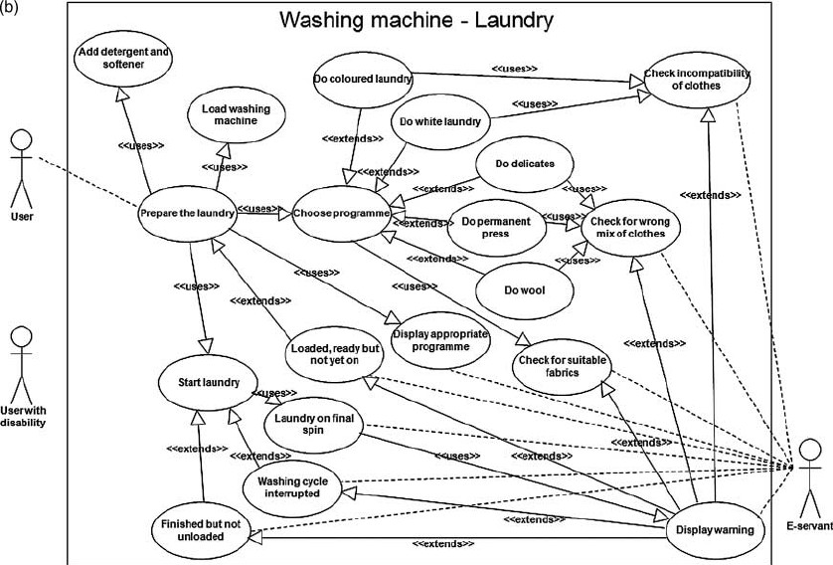
Example: Washing Machine
UML

Slide 18
Class Diagram
Student
+ name: String #Roll: Int -Section: String
+ display () -Add () -Edit () # Delete ()
Visibility
Class
+ Public
Set of interrelated classes
Collection of classes, interfaces, associations, collaborations and constraints.
Classes can be “is-a” or "has-a" relationship
- Private
# protected
Attributes
Relationships
Inheritance
Methods
Association
Aggregation
Anil
Sunil

Slide 19
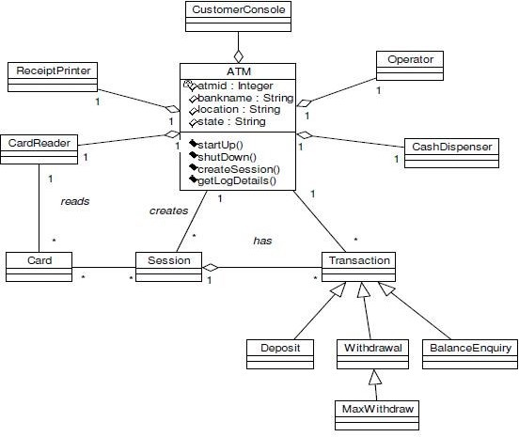
ATM - Diagram

Slide 20
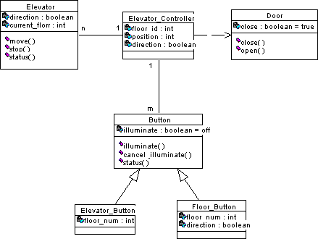
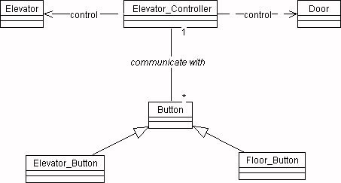
Elevator – Class Diagram

Slide 21
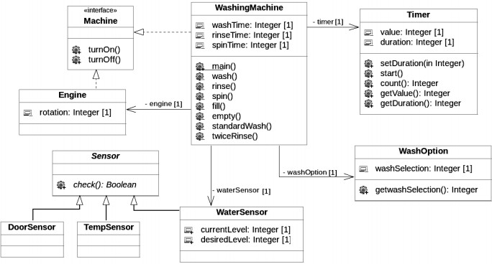
Class Diagram Example Washing Machine

Slide 22
Sequence Diagram
Interactions among the different elements in the model
Describes the dynamic behavior of the system
It emphasizes on the time sequence of messages
Used in planning and understanding the functionality of existing and future scenario
Alternate frame
Object
Activation Bar
Alt
If it is valid
Else
Synchronous message
Lifeline Notation
Return message

Slide 23
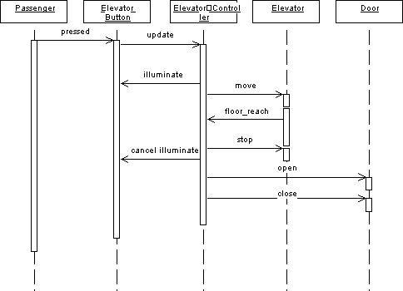
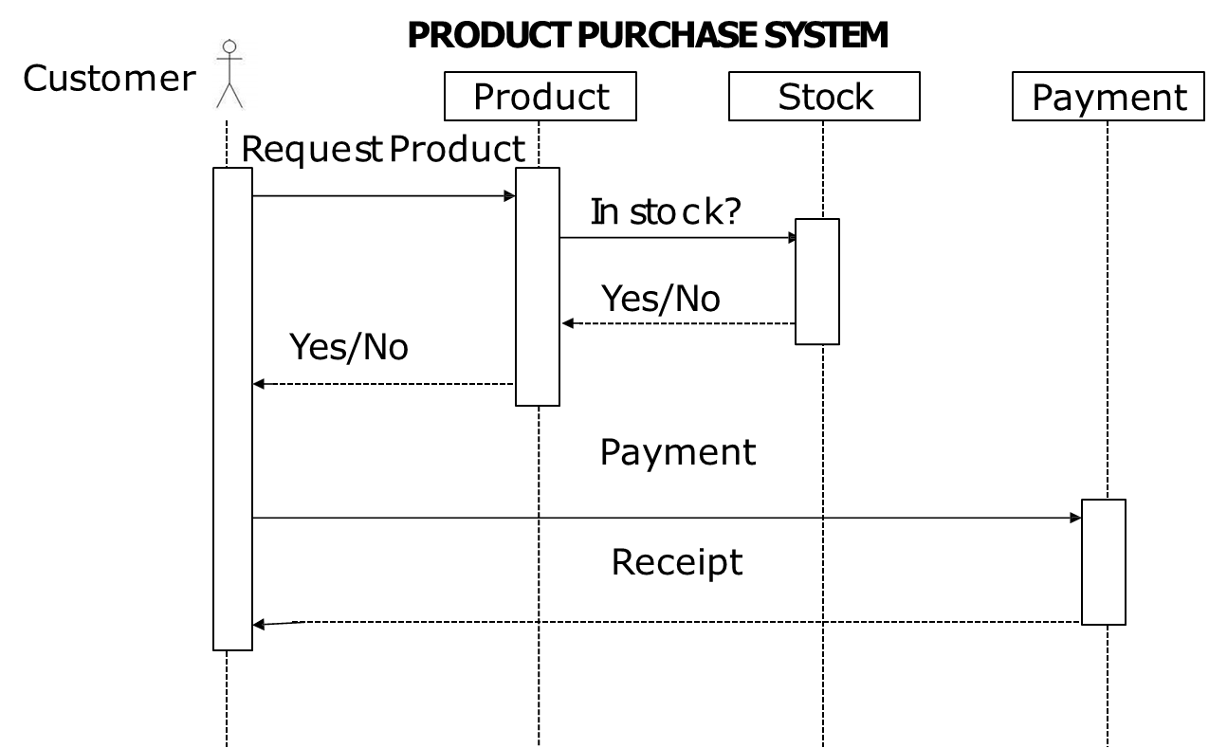
ELEVATOR SYSTEM
Sequence Diagram

Slide 24
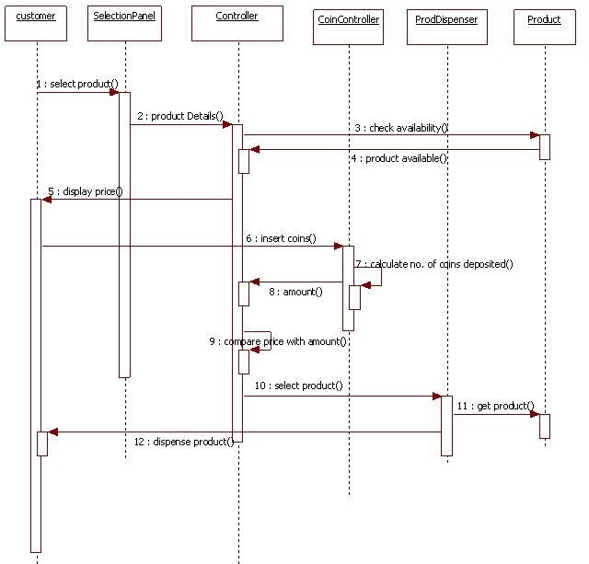
Sequence Diagram
Vending Machine

Slide 25
State Diagram
State diagram stores the status of object
It’s a
behavioral diagram
It explains the dynamic behavior of a class
State diagrams an be used to understand the reaction of
objects on receiving external stimuli
Initial state
Transition Symbol
Final state
State
Composite State
Self Transition

Slide 26
State Diagram
ONLINE ORDER MANAGEMENT
Transition
Send order request
Special or Normal order
Idle
Initial state
Abnormal exit state
Final state
Order confirmation
Dispatch order

Slide 27
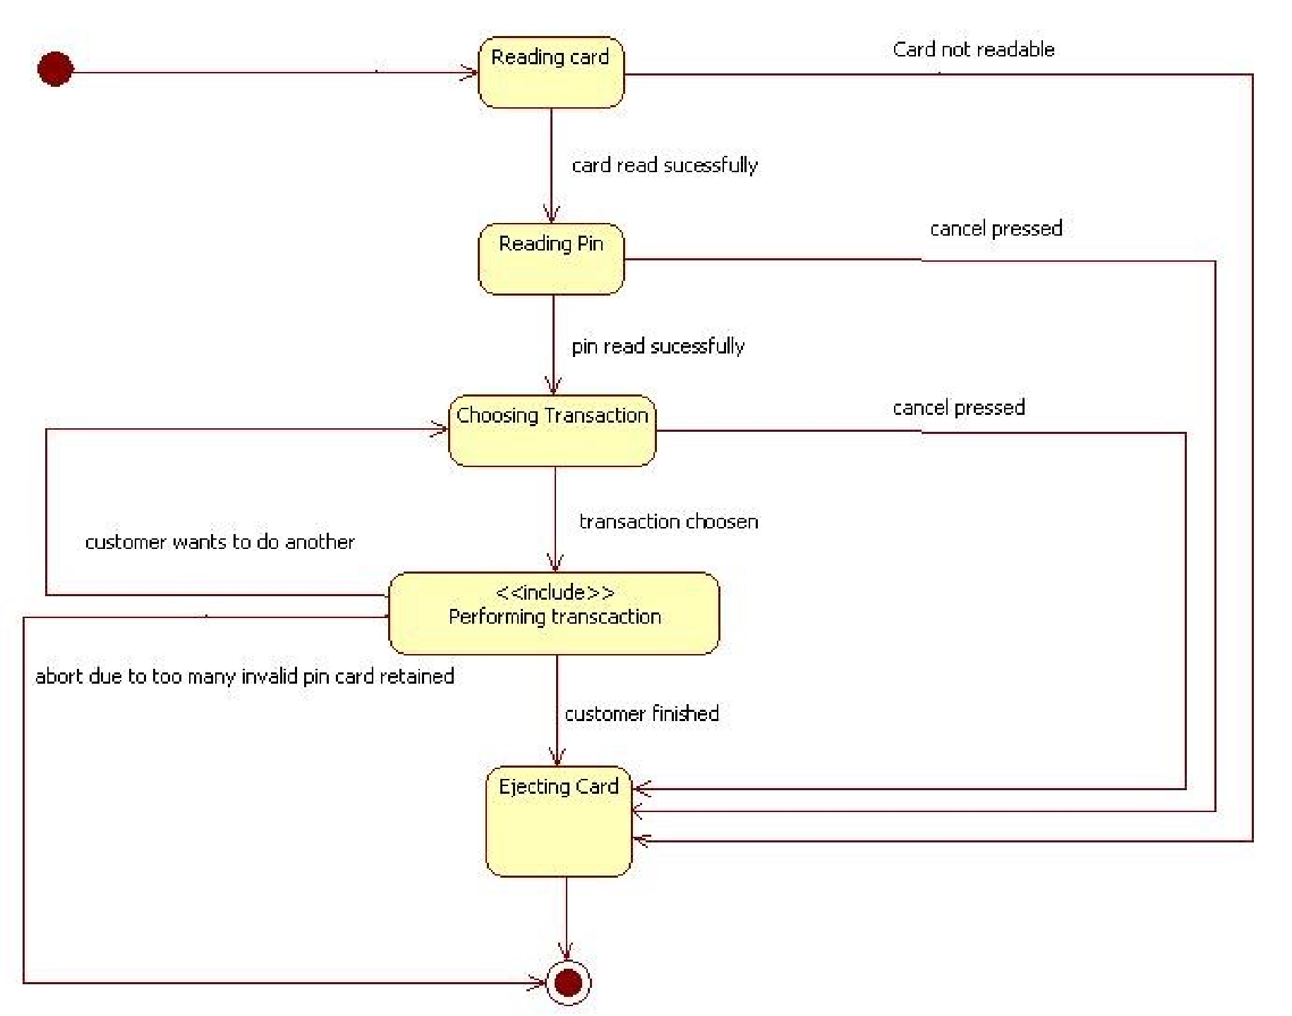
State Diagram
ATM machine

Slide 28
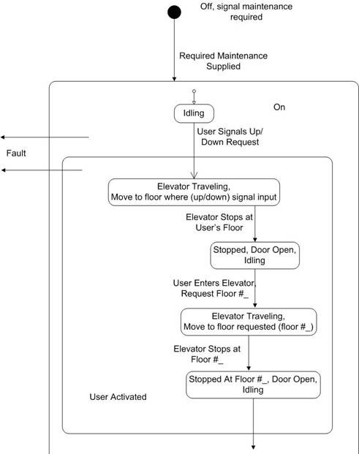
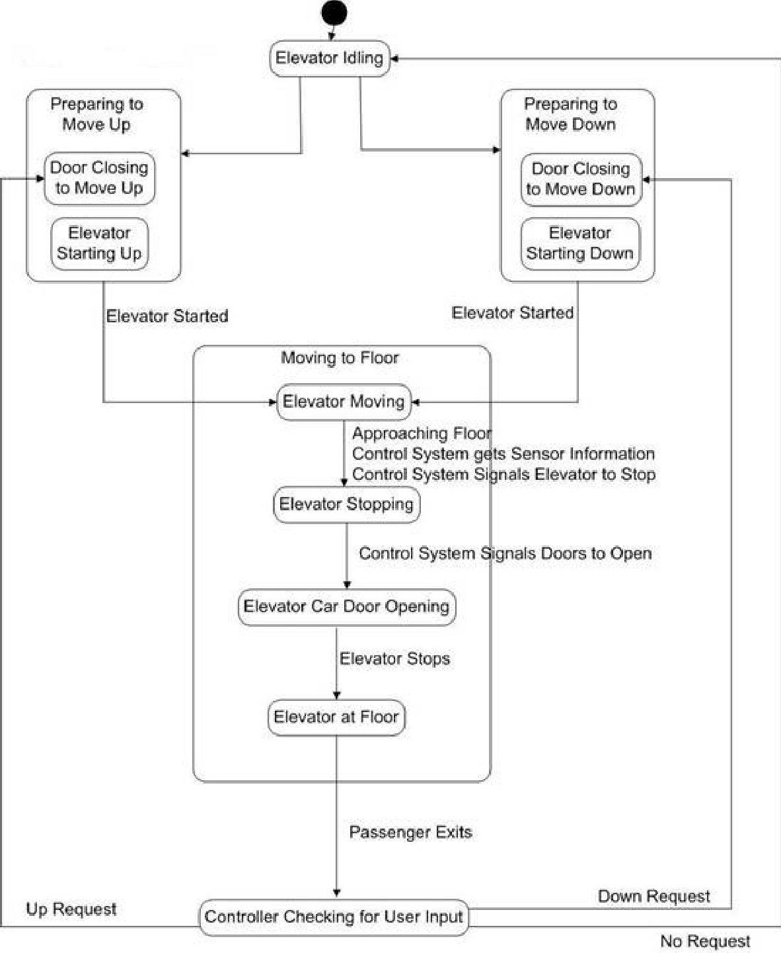
State Diagram
"User" Behavior for Elevator System”
“Elevator Control System"

Slide 29
Activity Diagram
Behavioral diagram
Shows the control flow from start to finish point including other decisions paths that is being executed
It can explain both sequential and concurrent processing
Activity
Action
Control flow
Object flow
Initial node
Final node
Object node
Decision node
Merge node
Fork node
Join node

Slide 30
Activity Diagram
Activity Diagram of an Order Management System
Customer sends an order request
Order request system
confirms the order
Condition check
Start of process
[No]
[Yes]
[Yes]
Confirm order
[No]
Termination
Dispatch order

Slide 31
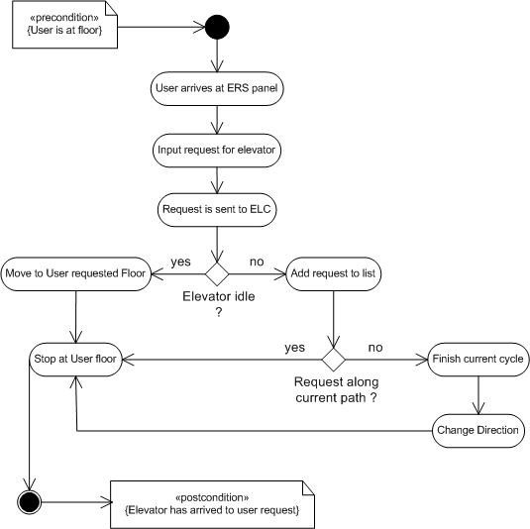
Activity Diagram
Elevator
ELC – Elevator Logic Control ERS – Elevator Request Service

Slide 32
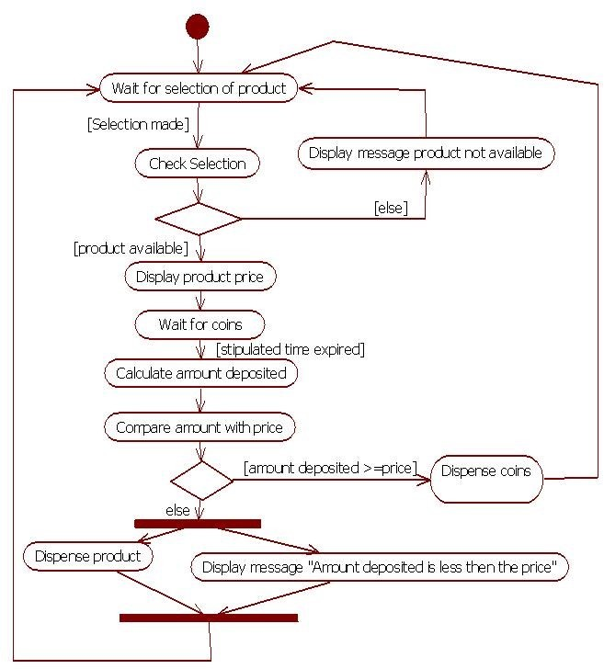
Activity Diagram
Vending Machine

Slide 33
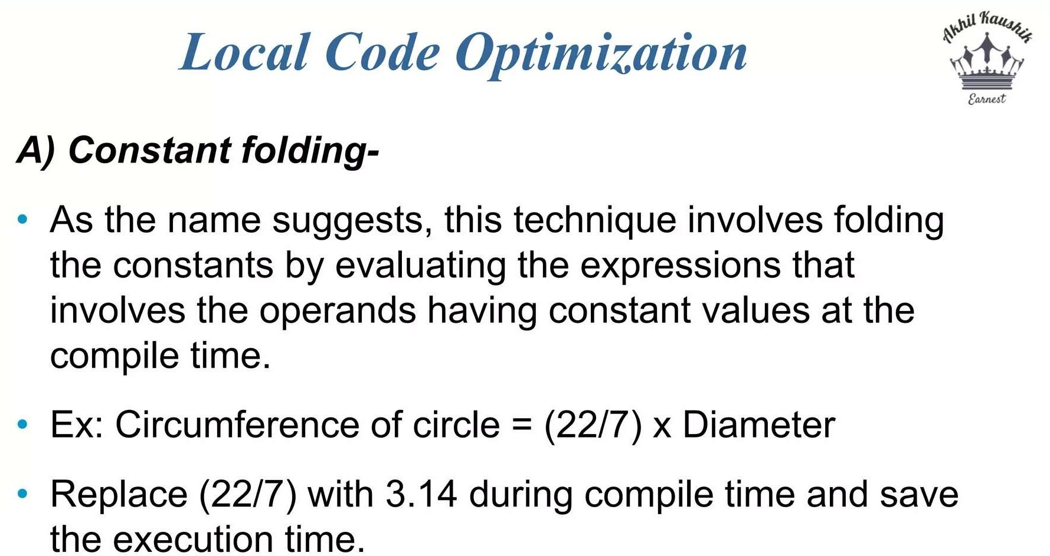

Slide 34
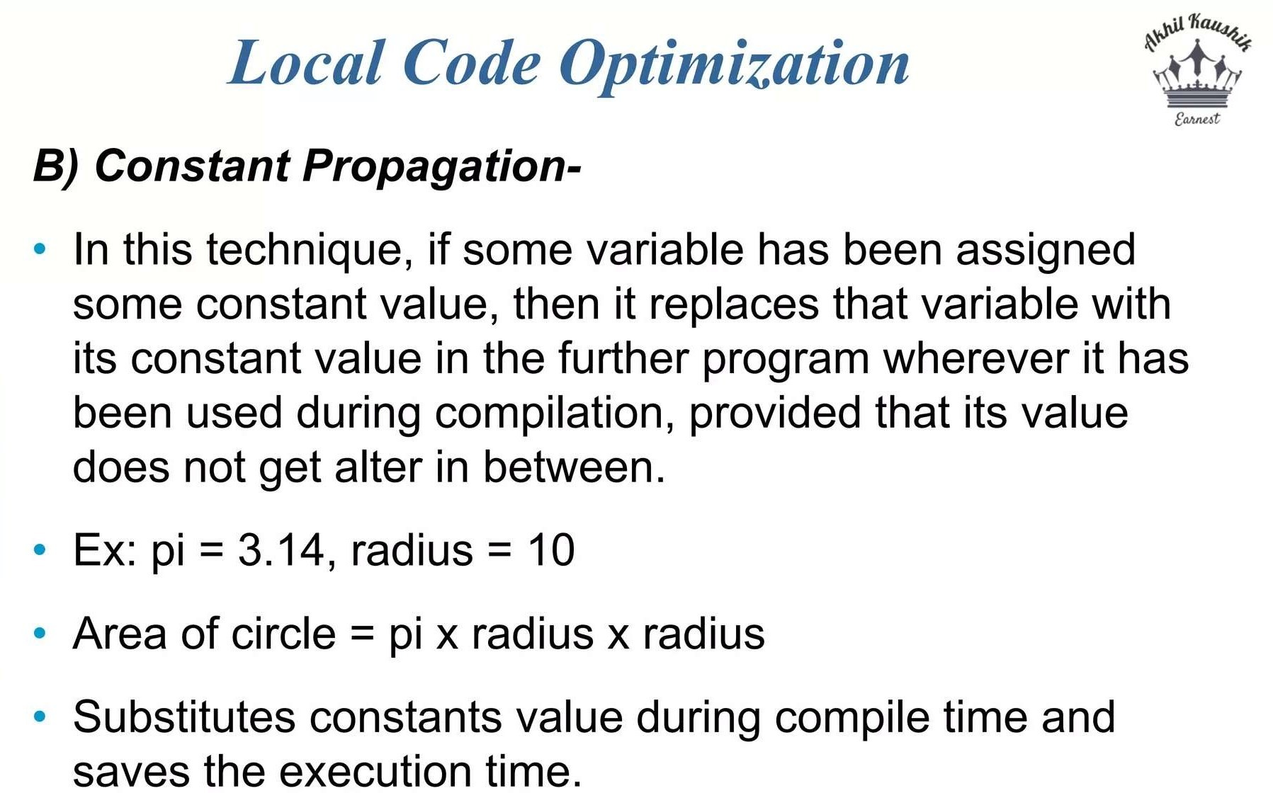

Slide 35
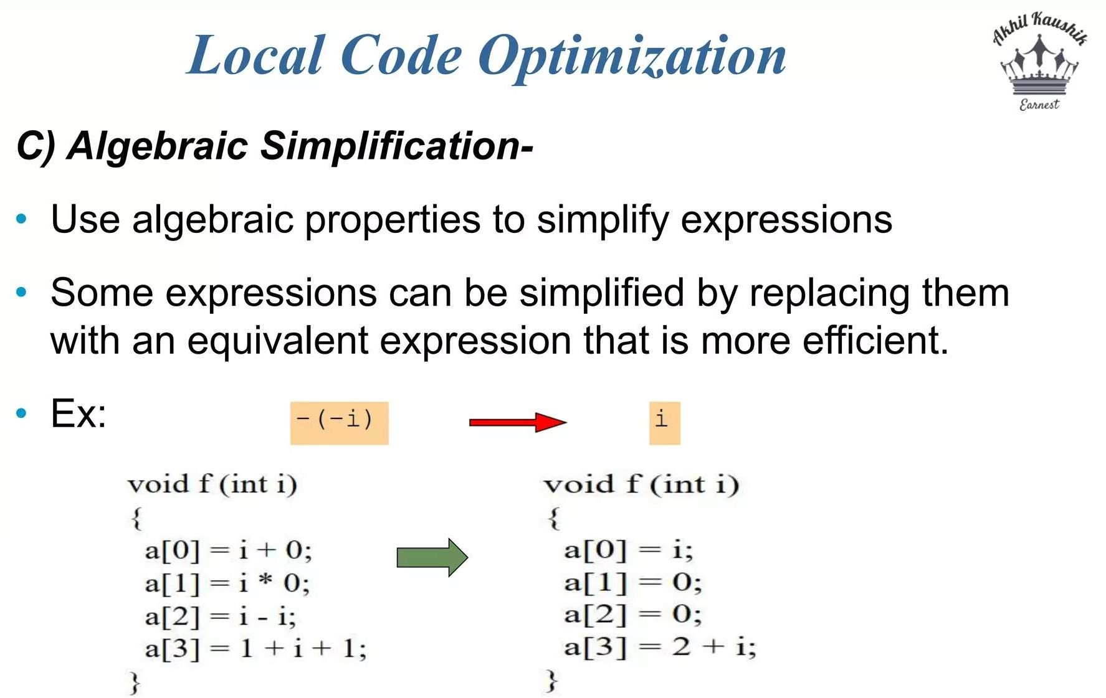

Slide 36
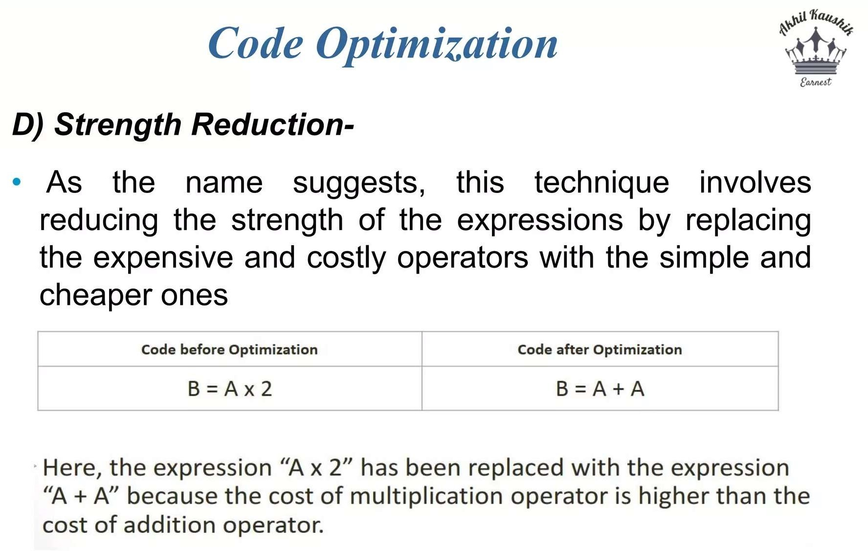

Slide 37
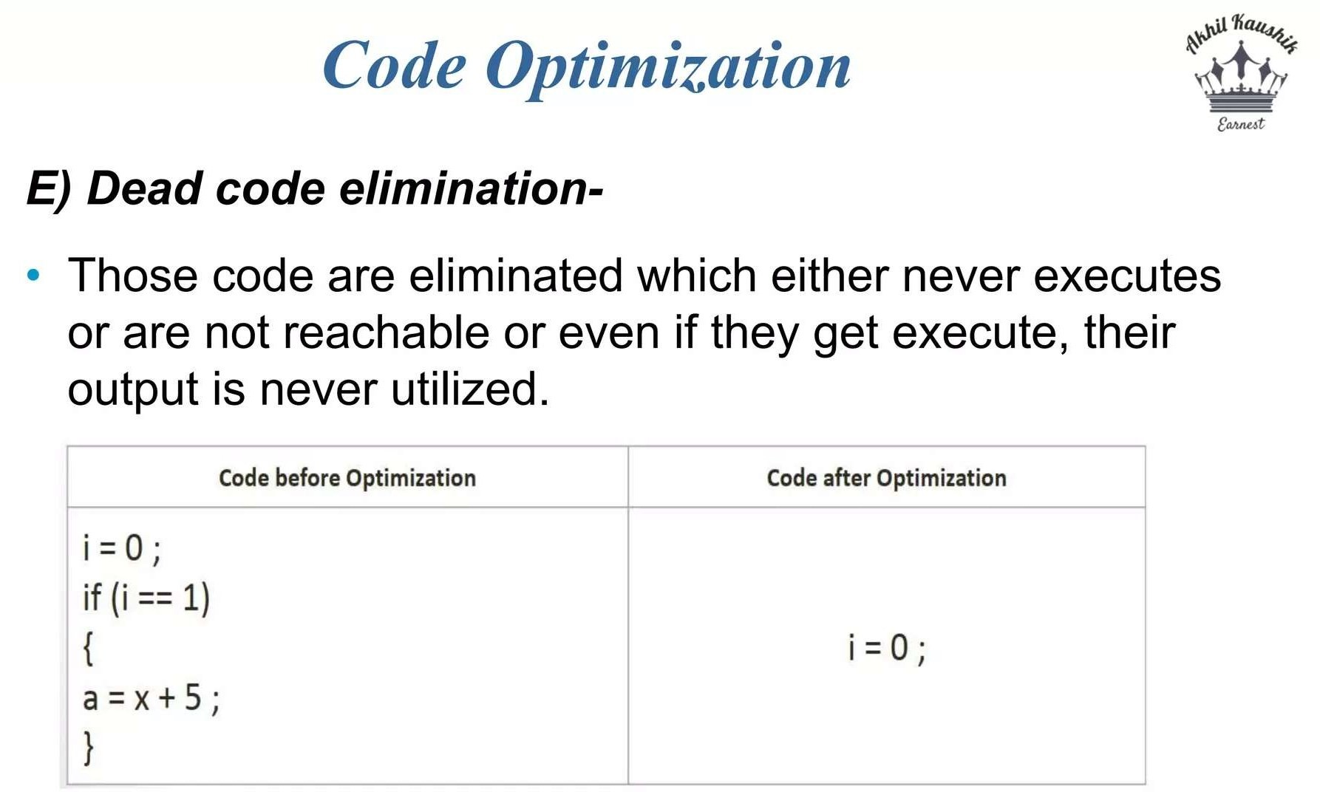

Slide 38
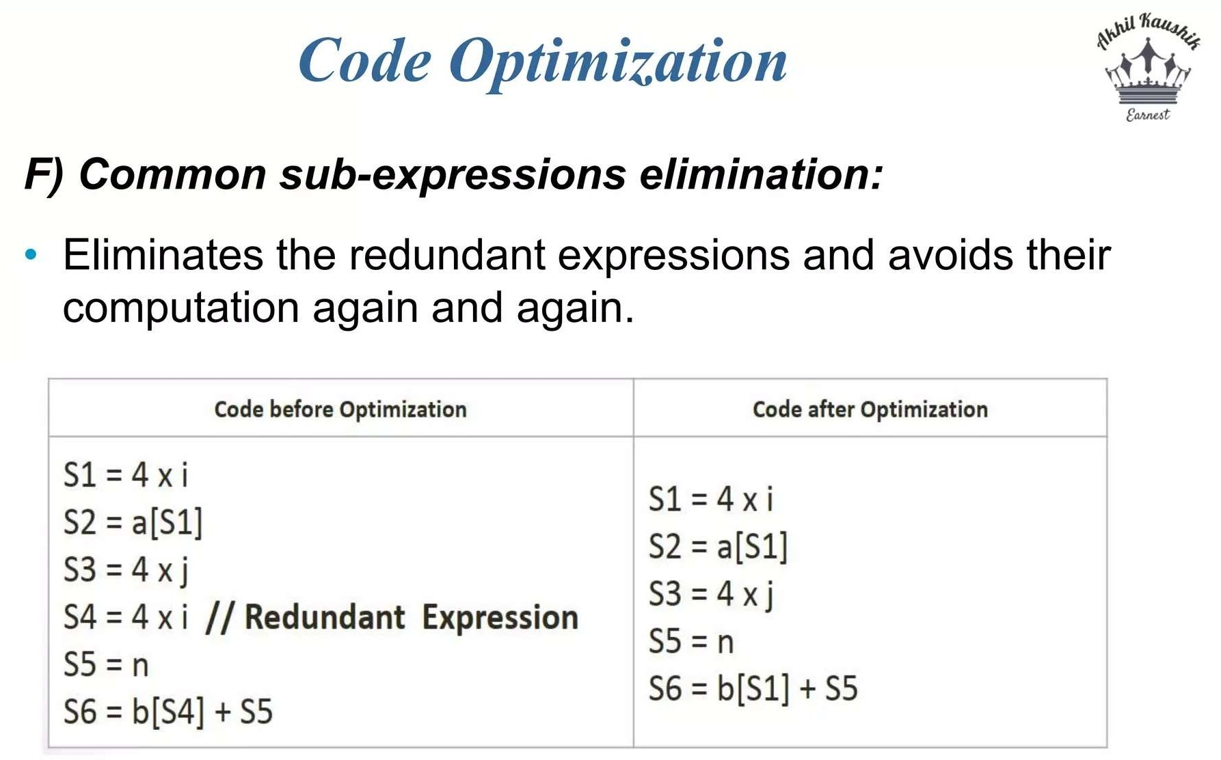

Slide 39
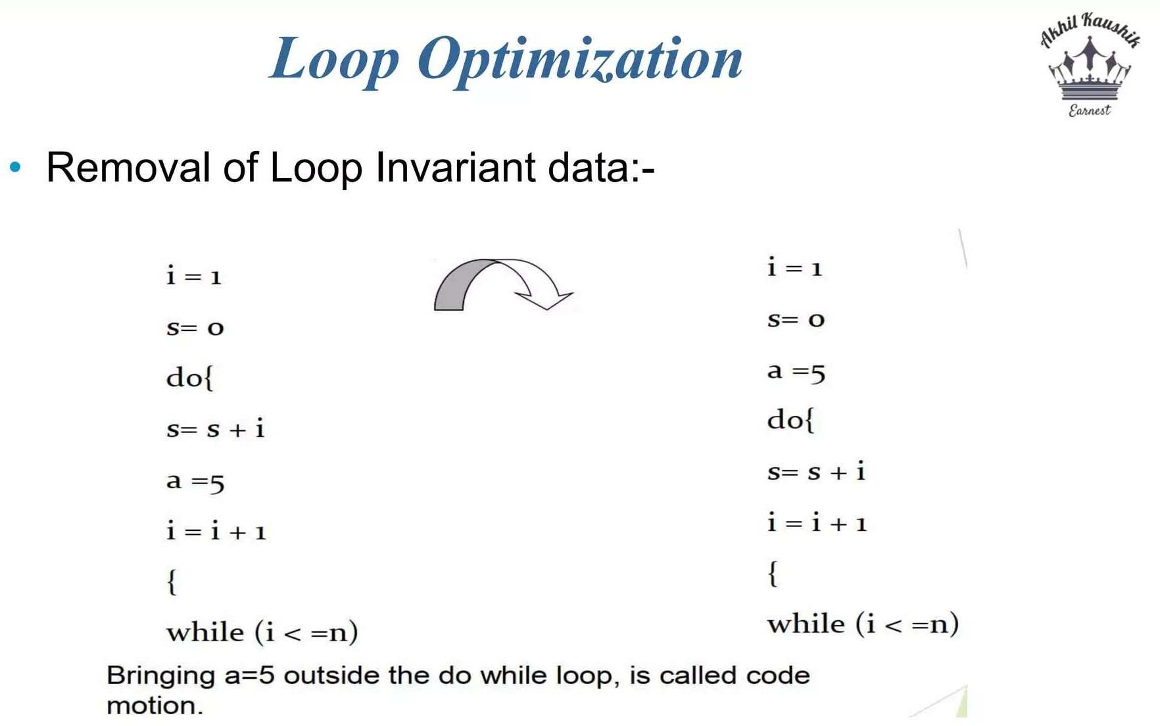

Slide 40
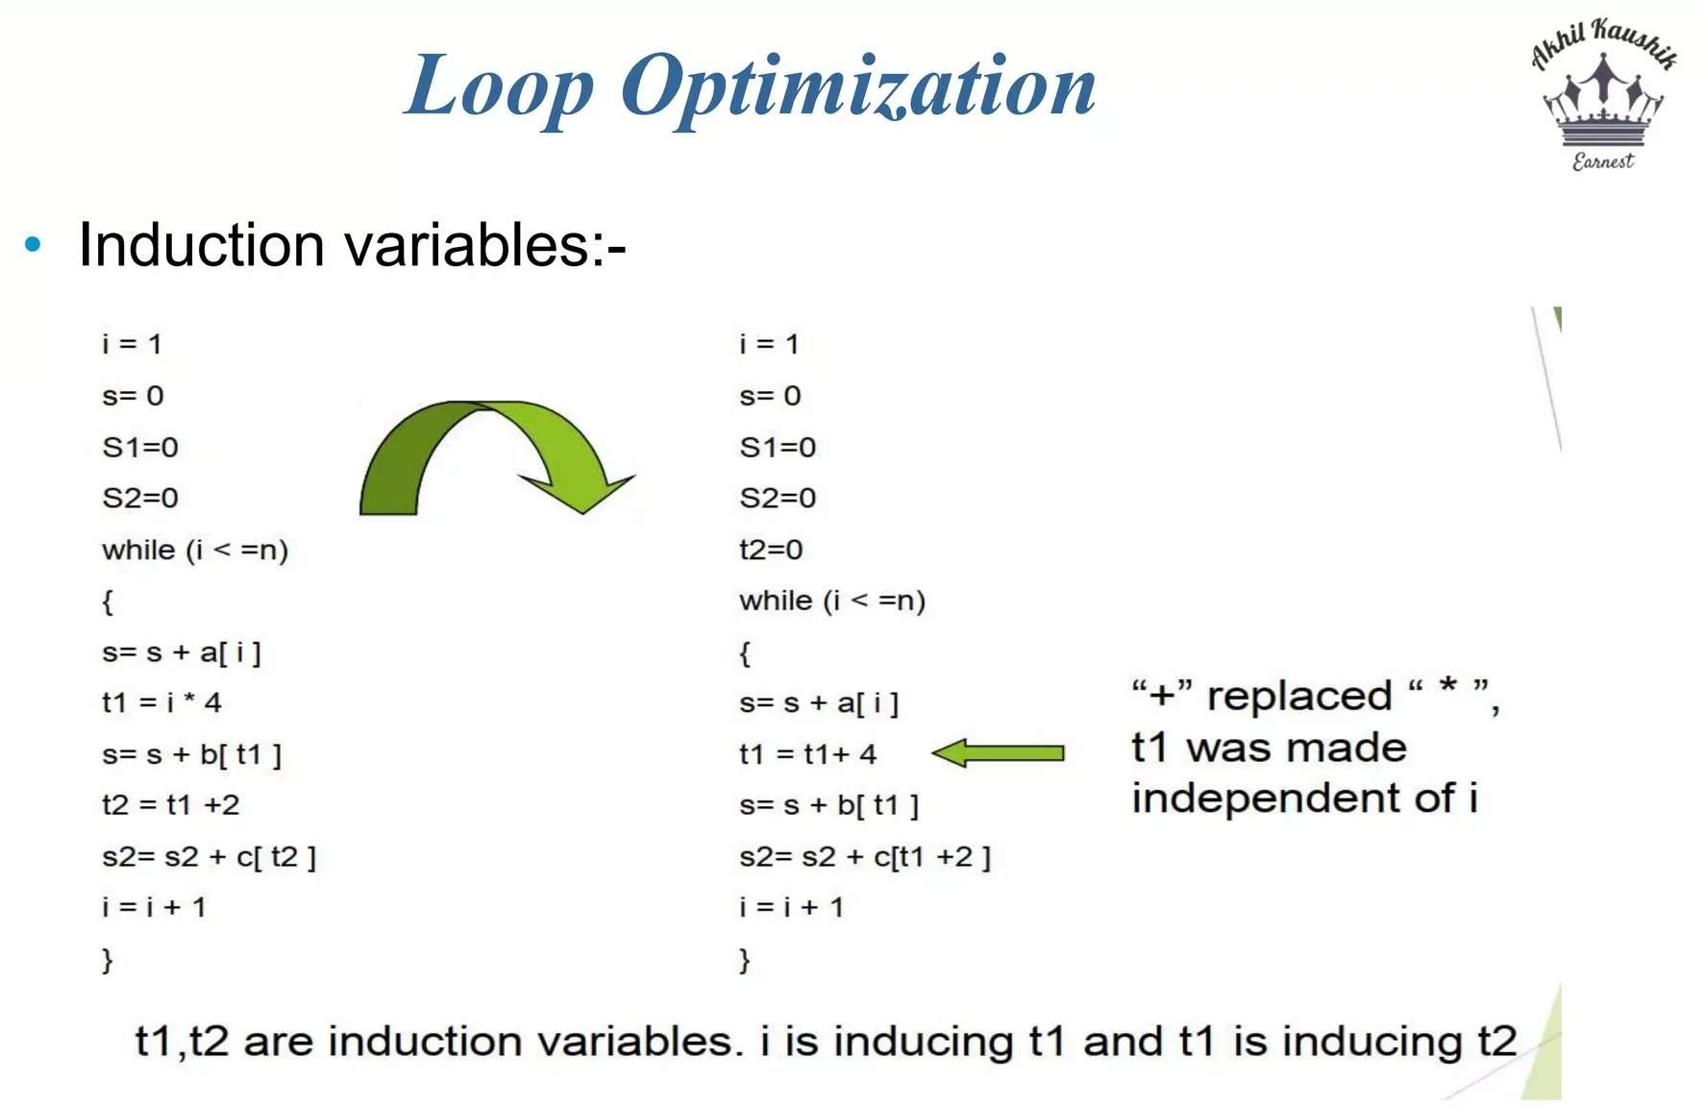

Slide 41
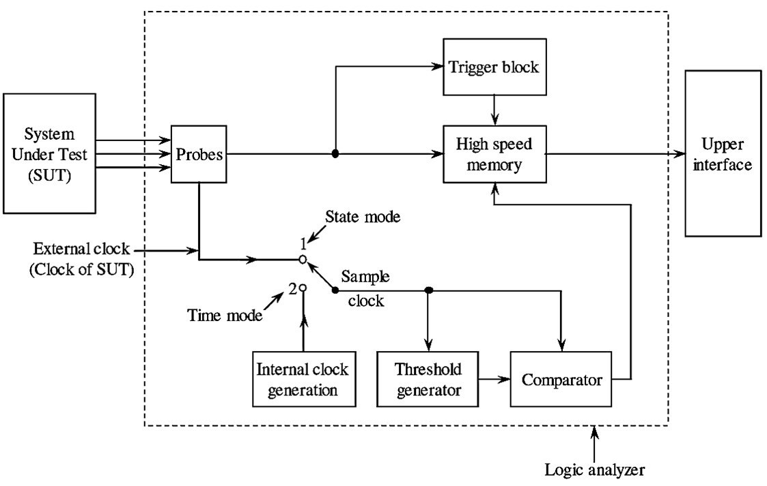
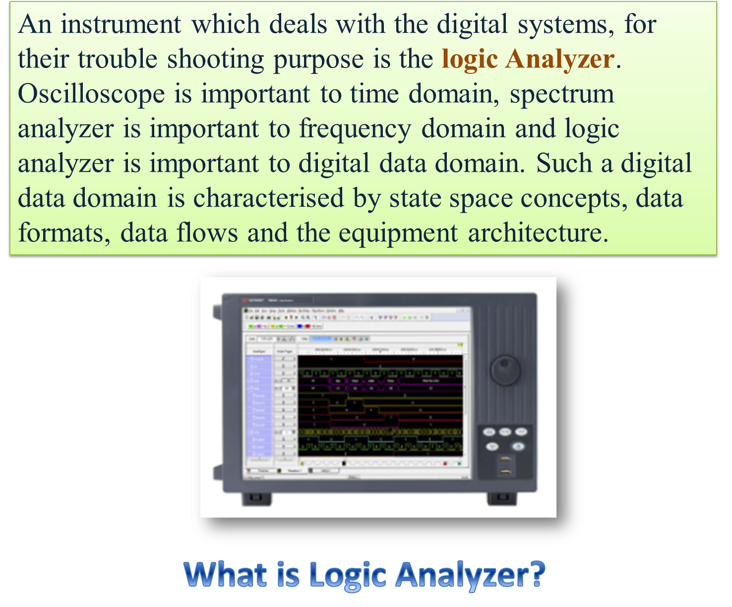
LOGIC ANALYZER
The main elements of a logic analyzer are probes, internal clock generator, threshold generator, comparator, memory, trigger block. Appropriate probes are used to connect the data lines of a digital system (i.e., System Under Test (SUT)) to the logic analyzer. The internal clock generator generates the clock pulses which are used for sampling the input data, The comparator block compares the sampled data and a specified threshold voltage generated by threshold generator. The memory of the logic analyzer is used to store the data captured by logic analyzer.

Slide 42
WORKING OF LOGIC ANALYZER
After receiving the signal from the SUT, it samples the input signal at certain clock frequency.
In the sampling process, it compares the input signal with a certain threshold voltage at each sample point and depending upon the result of comparison it converts the input signal at that sampling instant into a logic 1 (High) or logic 0 (low) state.
Thus, by sampling process the input signal gets converted into a pattern of 0’s and l’s.
The sampled data is then stored in the memory of logic analyzer
with each sample point occupying a single memory location.
Types of Logic Analysers:
Logic Timing Analyzer (Asynchronous Measurements)
This Analyzer “samples” the waveform at each edge of the internal clock generated at regular intervals of time stores them in memory and displays the same in a timing waveform. This is called as “asynchronous” measurement since the internal clock runs asynchronous to the logic system being tested.

Slide 43
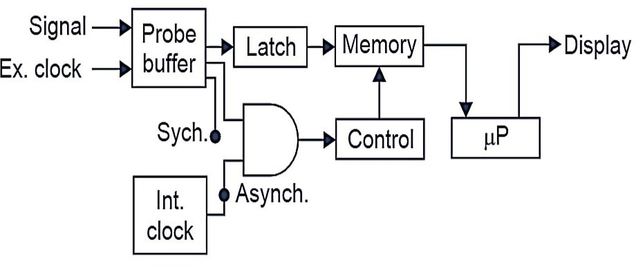
2) Logic Analyzer (Synchronous Measurement)
This uses a signal from the circuit under test, external clock determines when the logic signal is to be stored. This is called as “synchronous” measurement since the external clock runs synchronous to the logic system being tested. Modern logic analyzer combines both the above functions in one unit.
The Fig. 1. shows block diagram of a logic analyzer. It combines both functions i.e., asychronous and synchronous. The logic signal data to be measured enters the Analyzer through “Probe Buffer”. The output from the buffer is clocked into a latch at regular intervals. The latched data is stored in the memory and is displayed by the microprocessor (µP).
The signal data used to latch can be obtained from two different sources. For asynchronous operation an internal clock is used and for synchronous operation, an external clock is used.

Slide 44
Applications of Logic Analyzer
A logic analyzer has the ability to capture and display the data of multiple digital signals (usually more than eight) at a time. Hence, a logic analyzer can be used to examine a large number of digital signal lines of a digital system.
Note: The logic probe can view only one signal at a time and also it cannot store it. When it is required to have a record of more than one signal simultaneously e.g., when it is necessary to look at the logic levels of all the lines of a microprocessor bus, we use a “logic Analyzer”.
Characteristics:
Multiple channels
Provide a time display of logic states
Does not display analog information

