Slide 1
RTOS FEATURES:
Multitasking and Pre-emptibility, Task Priority, Inter Task Communication, Synchronization
RTOS TYPES:
Hard RTOS: degree of tolerance for missed deadlines is negligible. Examples: Missile Navigation Systems, Vehicle Air Bags Control
Firm RTOS: Tolerates a low occurrence of missing a deadline. Missing deadline however may occur in reduction of quality of product but not total failure. Examples: Food processing control system, Weather monitoring system
Soft RTOS: Allows for frequently missed deadlines, and as long as tasks are timely executed. Examples: Digital cameras & mobile phones
RTS Task Specifications:
A periodic task is one that repeats after a certain fixed time interval.
An aperiodic task can arise at random instants. Two or more instances might occur at the same time instant because minimum separation 𝒈𝒊, between two consecutive instances can be 0. A sporadic task is a subtype of aperiodic task.
7

Slide 2
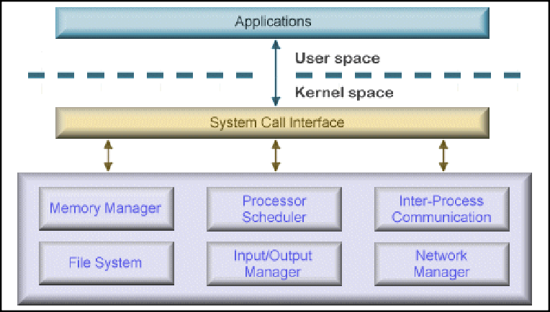
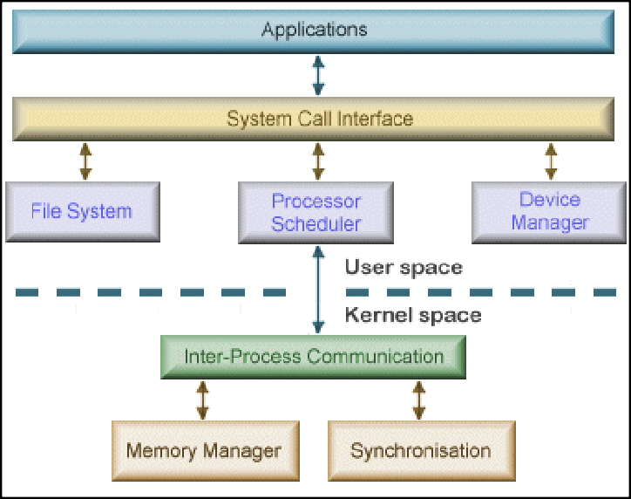
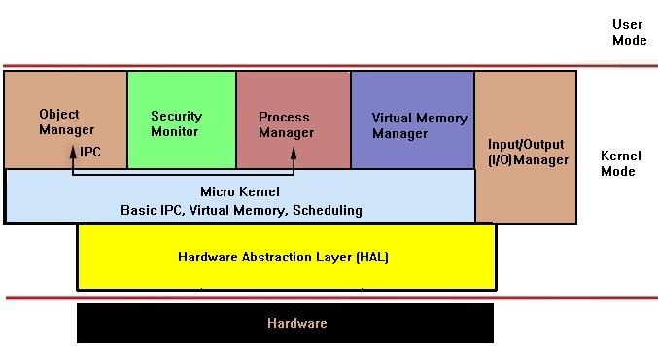
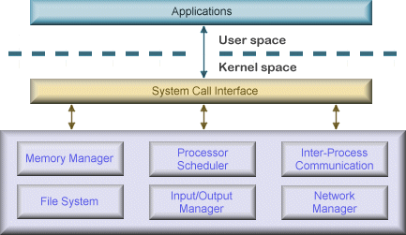
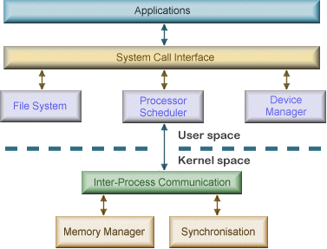
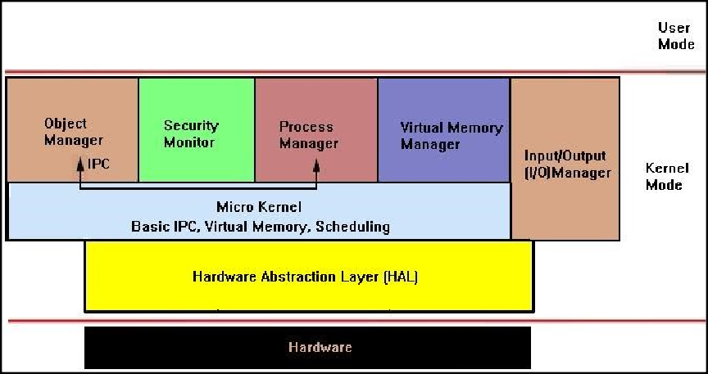
RTOS : Kernal
 | MONOLITHIC KERNEL | MICROKERNEL | HYBRID KERNEL
Basic | Both user services and kernel services are kept in the same address space. | User services and kernel services are kept in separate address space. | Kernel combining aspects from both Monolithic and Microkernel designs
Size | Larger | Smaller | Smaller than monolithic kernel
Execution | Fast | Slow | Moderate
Extendible | Hard to extend. | Easily extendible. | Dynamically loadable
Security | If a service crashes, the whole system crashes | If a service crashes, it does effect on working of microkernel. | It depends on service called
Code | More code is required. | Less code is required. | Moderate code size
Example | Linux, Unix, Windows NT and older ver., DOS. | QNX, Minix, GNU | Windows NT and above, Mac OS, ReactOS

Slide 3
Scheduling Criteria
CPU utilization: CPU should be working most of the time (Ideally 100% all the time)
Throughput: total number of processes completed per unit time(10 tasks/sec.)
Turnaround time (TAT): amount of time taken to execute a particular process, Completion Time - Arrival Time
Waiting time(WT): time periods spent waiting in the ready queue by a process to acquire get control on the CPU, Turnaround time - CPU burst time
Load average: average number of processes residing in the ready queue waiting for their turn to get into the CPU
Response time: Amount of time it takes from when a request was submitted
until the first response is produced
SCHEDULING OBJECTIVE: Max →CPU utilization, Throughput
Min → Turnaround time, Waiting time, Load average, Response time
40

Slide 4
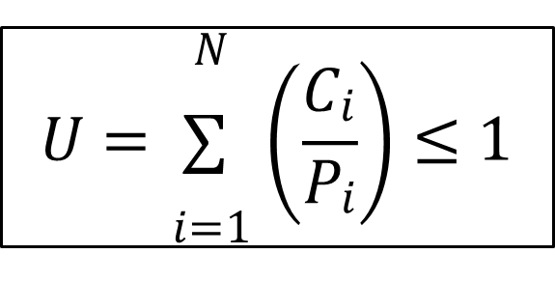
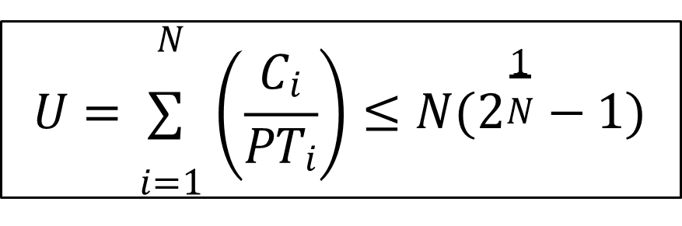
Schedulability Test
Necessary test:
If test is passed, tasks may be schedulable but not necessarily
If test is not passed, tasks are definitely not schedulable
Sufficient test:
If test is passed, then task are definitely schedulable
If test is not passed, tasks may be schedulable but not necessarily
Exact test: (Necessary test + Sufficient test)
The task set is schedulable if and only if it passes the test
 | Rate Monotonic Scheduling (RMS) | Earliest Deadline First (EDF)
Type of Scheduling | Static priority scheduling (Pre-emptive) | Dynamic priority scheduling (Pre-emptive)
Priority Assignment | Fixed; tasks with shorter periods have higher priority | Dynamic; tasks with closer deadlines have higher priority
System Utilization and Complexity | Lower utilization but simpler to implement | Higher utilization but more complex to implement
Behaviour | Predictable but less flexible | Less predictable but flexible
D=T | (Requires D=T) and works with only periodic task | Works with both periodic and aperiodic tasks
Necessity Test | Need to check for both necessity and sufficient test | Need to check only for necessity test
Use Cases | predictable periodic tasks (e.g., control systems) | mix of periodic and aperiodic tasks (e.g., multimedia)
42

Slide 5
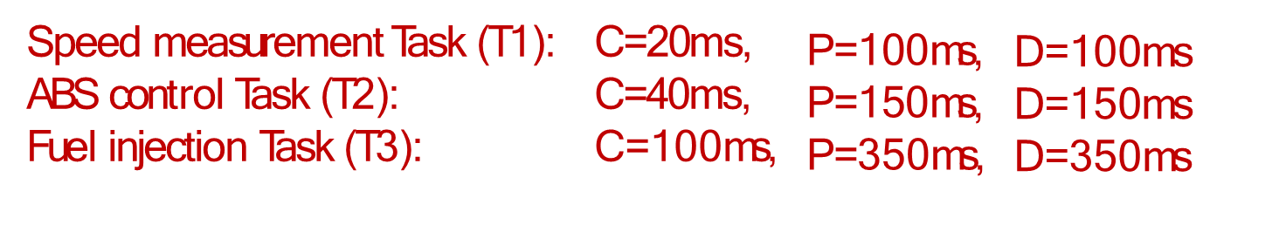
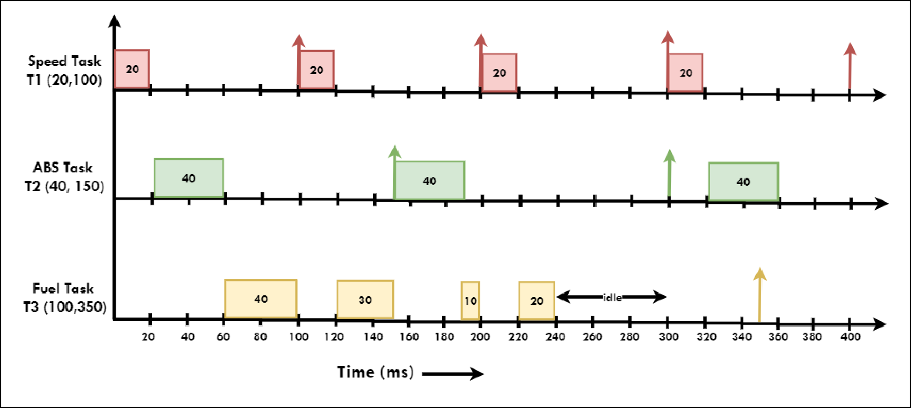
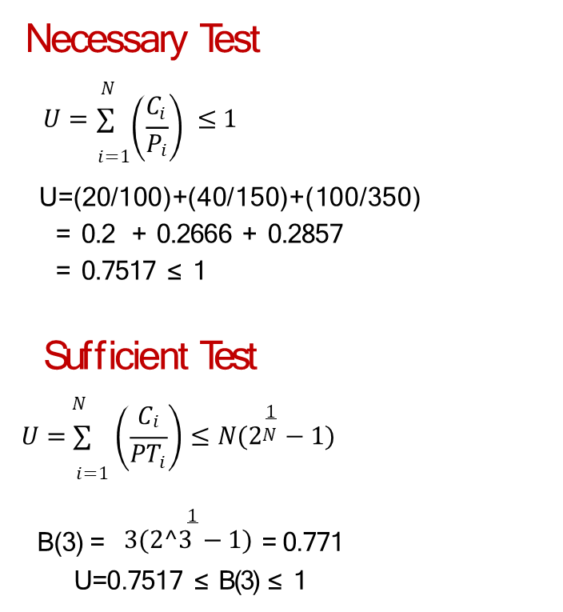
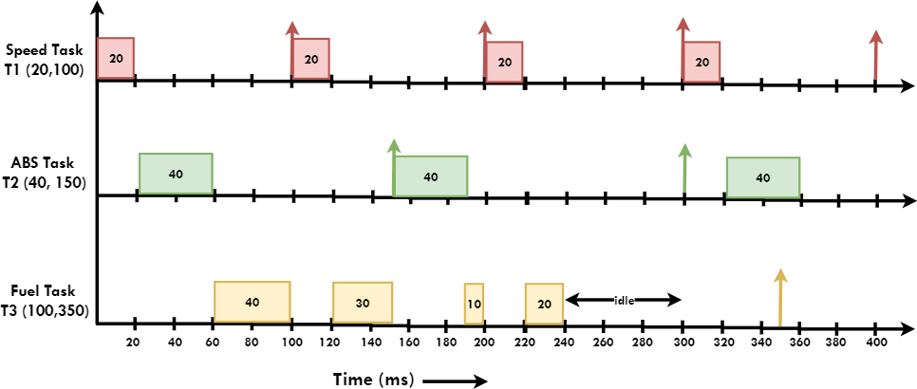
RATE MONOTONIC SCHEDULING (RMS)
https://youtu.be/a3XqpyEW3ns?si=oMkmYzXskNgIZf_U
Once you’ve finished executing all tasks at least once to its fullest C, be idle until next P

Slide 6
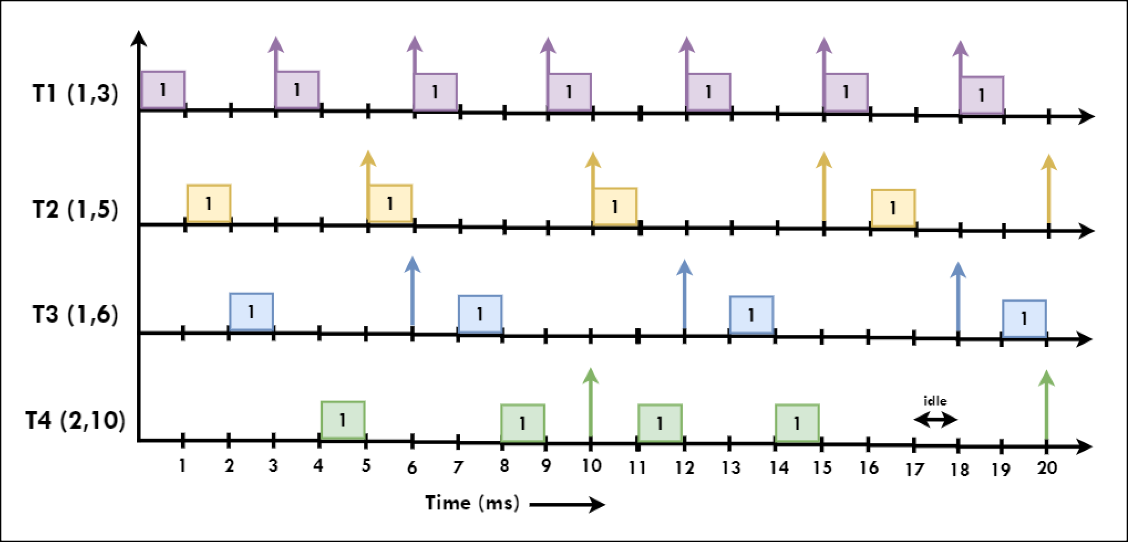
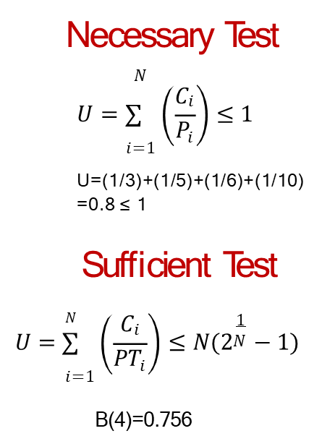
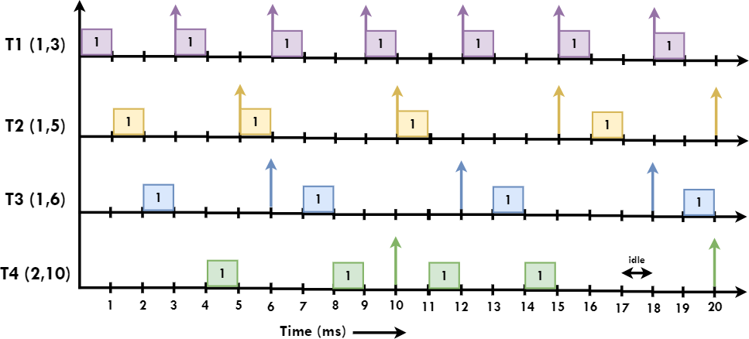
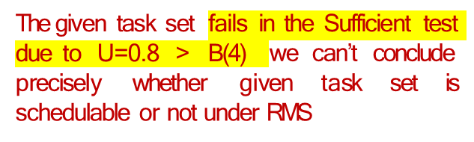
Consider set of four task (Ci, Pi) running on embedded system as follows, T1= (1, 3) , T2= (1, 5) , T3= (1, 6) , T4= (1, 10)

Slide 7
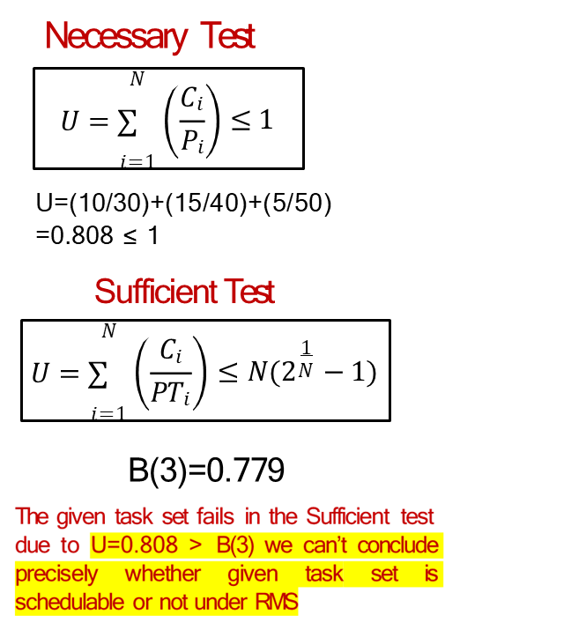
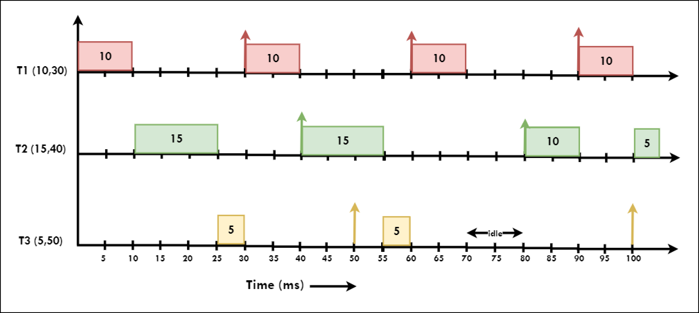
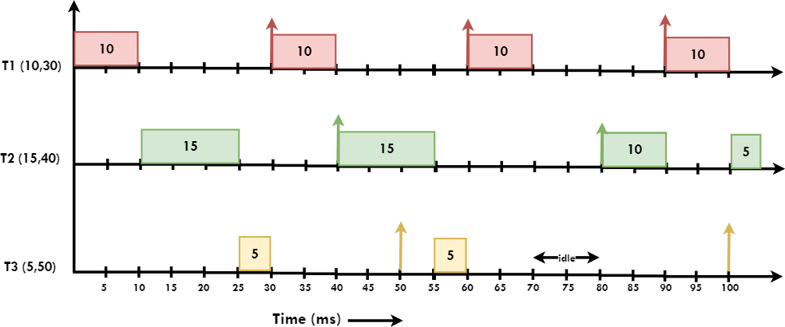
Consider set of three task (Ci, Pi) running on embedded system as follows, T1= (10, 30) , T2= (15, 40) , T3= (5, 50)

Slide 8
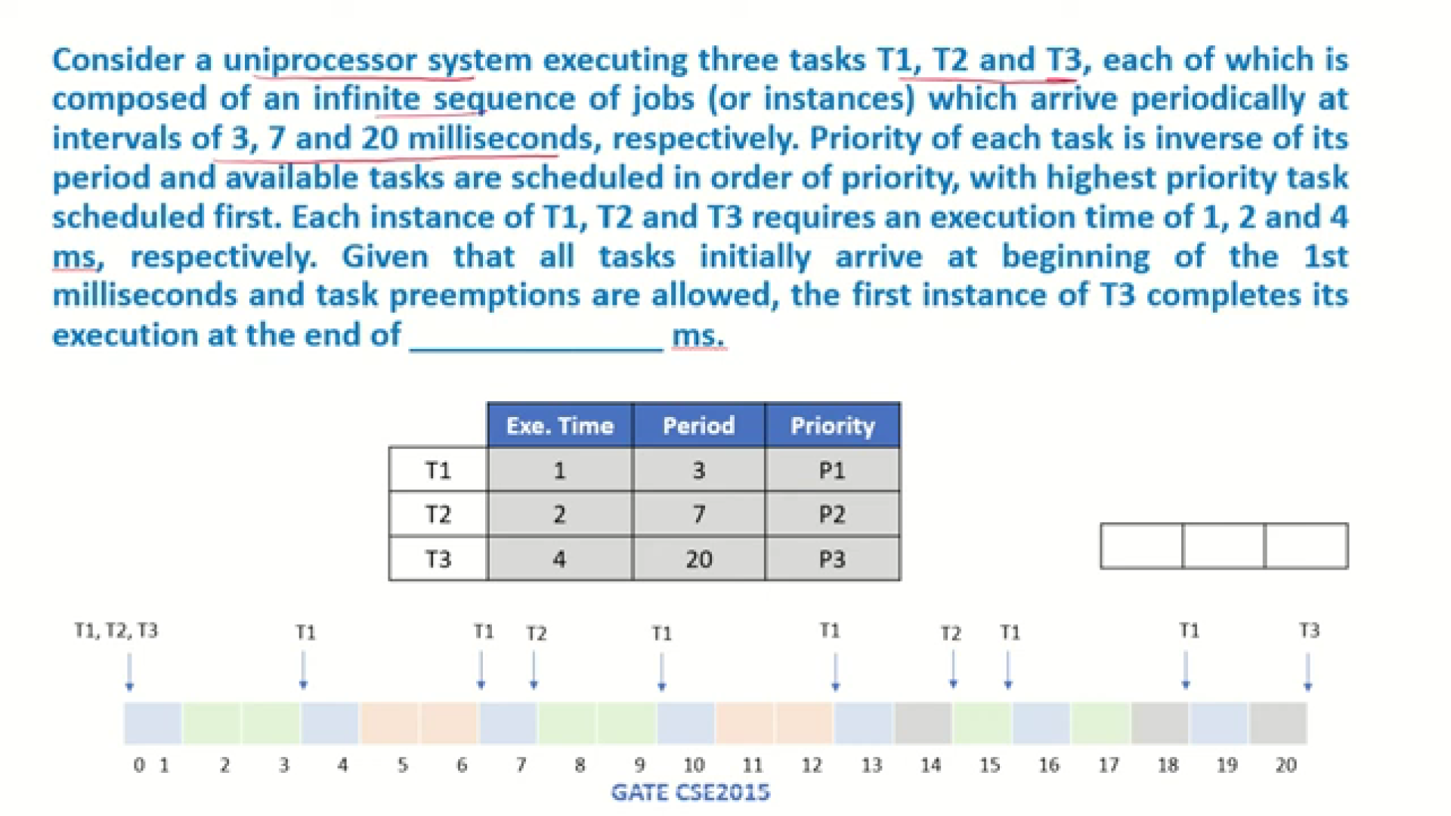

Slide 9
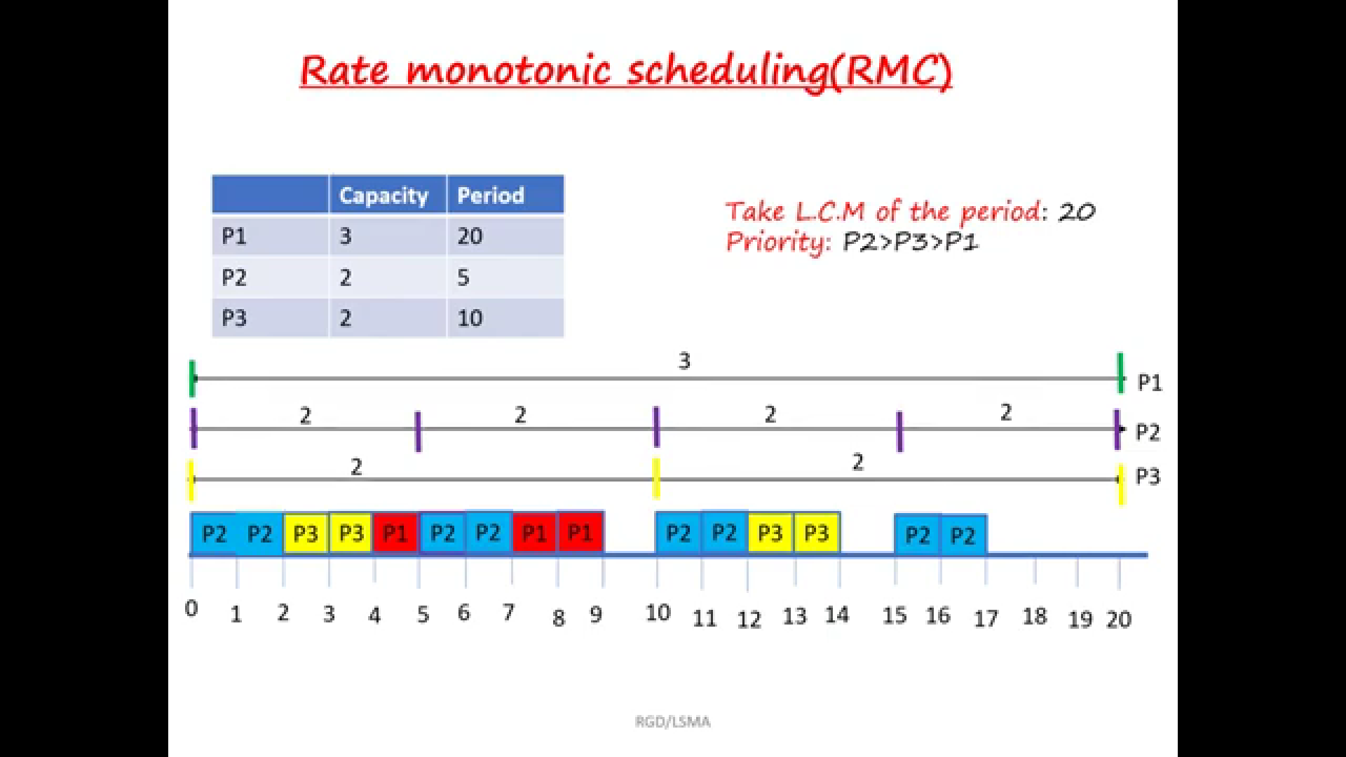

Slide 10
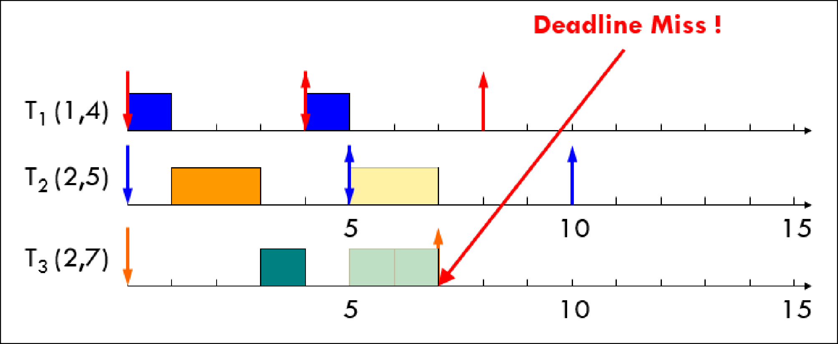
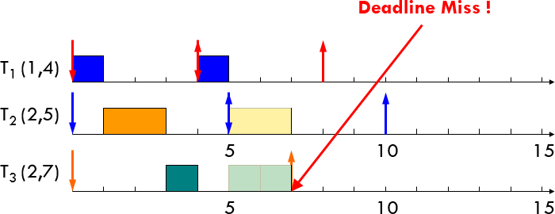
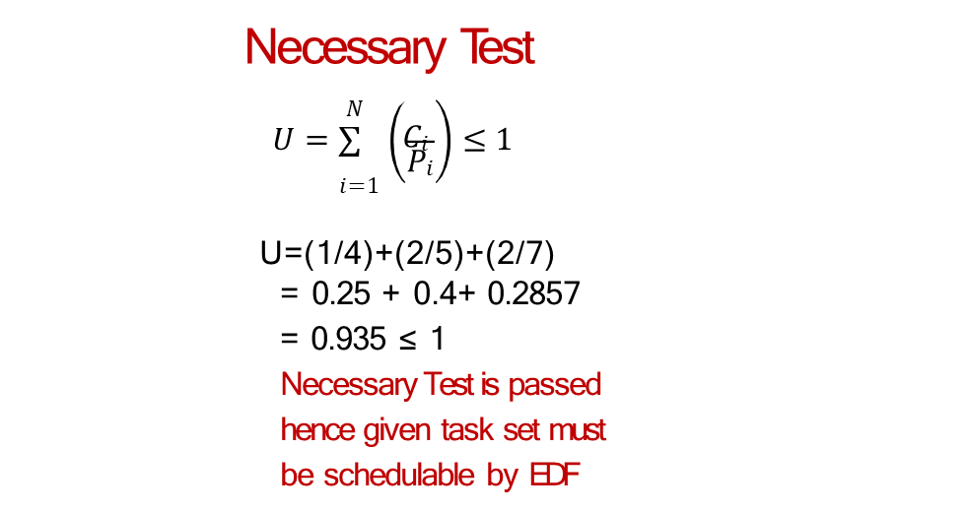
EARLIEST DEADLINE FIRST (EDF)
Temperature measurement Task (T1): | C=1ms, | P=4ms
Humidity measurement Task (T2): | C=2ms, | P=5ms
Co2 measurement Task (T3): | C=2ms, | P=7ms
https://youtu.be/4Sfn1dUh01E?si=Zb3nFgGNt-m8V-nA
Let’s first try with RMS
T3 should have executed another 1 time to complete 2 before start of next cycle at 7 but failed
T3 executed ½ because preempted by T1

Slide 11
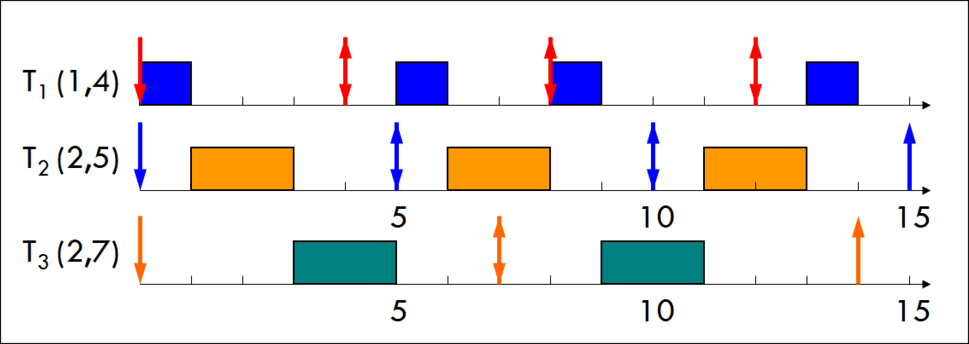
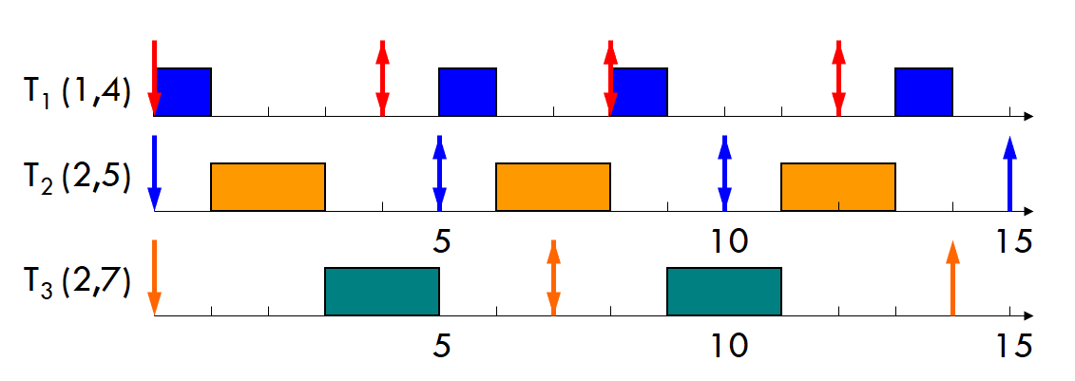
Real Time Scheduling
EARLIEST DEADLINE FIRST (EDF) – EXAMPLE-1
T3 is allowed to execute fully and not get preempted by T1’s current deadline which is at 4 because nearest deadline of T3 is at 7 which is closer than next deadline of T1 which is 8.
Although given task set failed to schedule under RMS, it can scheduled by EDF

Slide 12
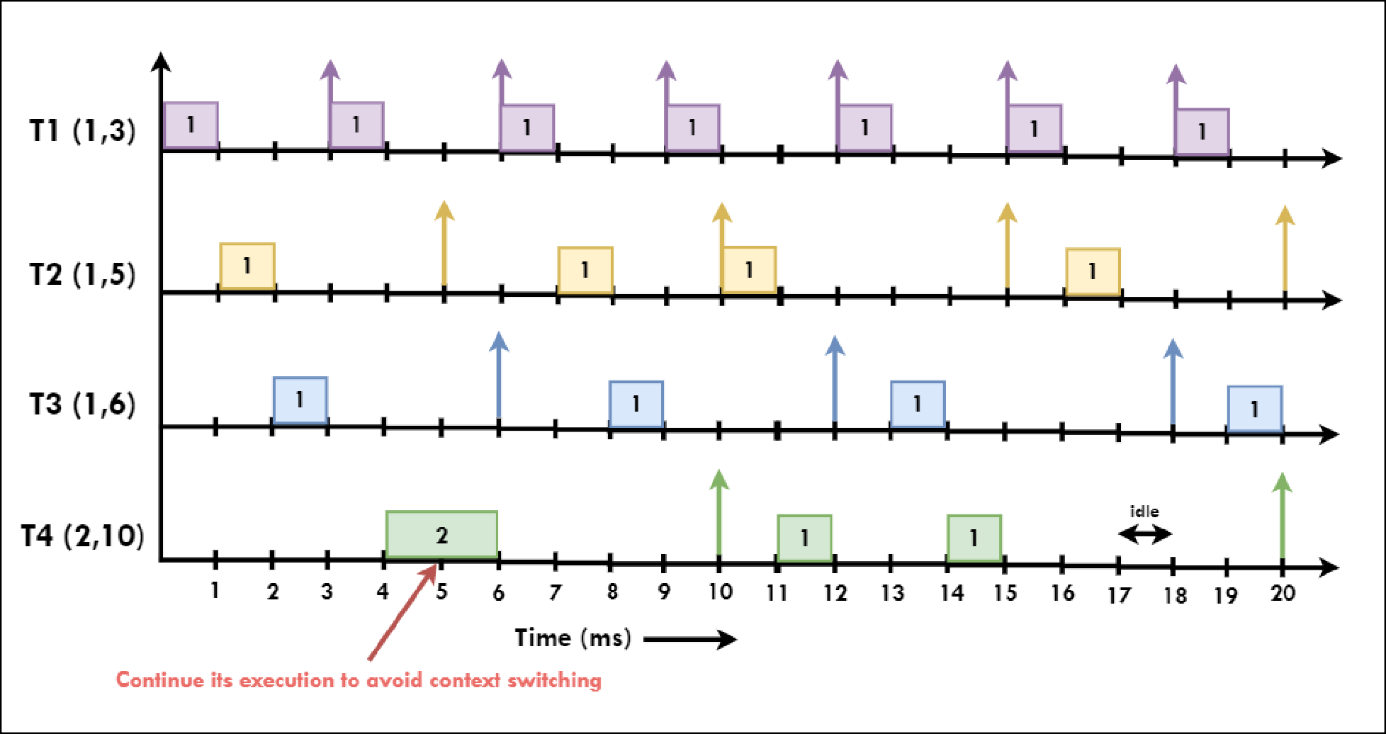
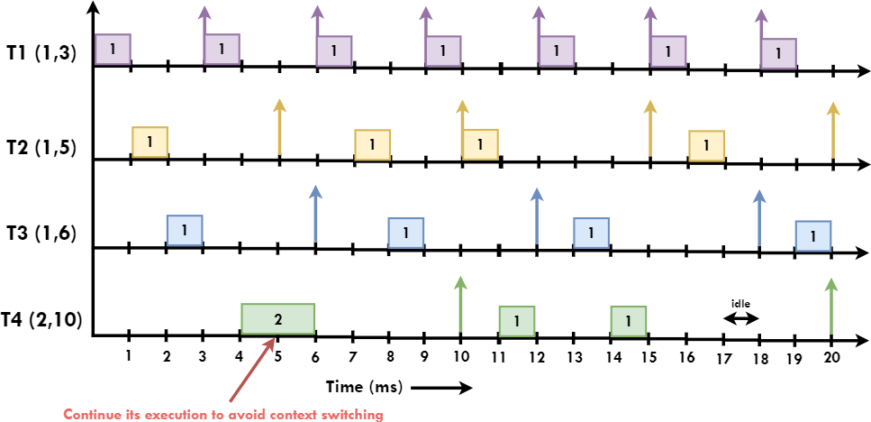
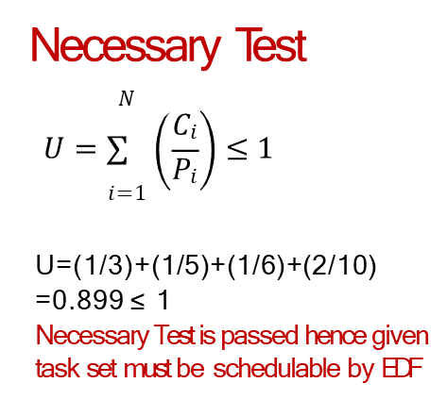
Consider set of four task (Ci, Pi) running on embedded system as follows, T1= (1, 3) , T2= (1, 5) , T3= (1, 6) , T4= (2, 10)

Slide 13
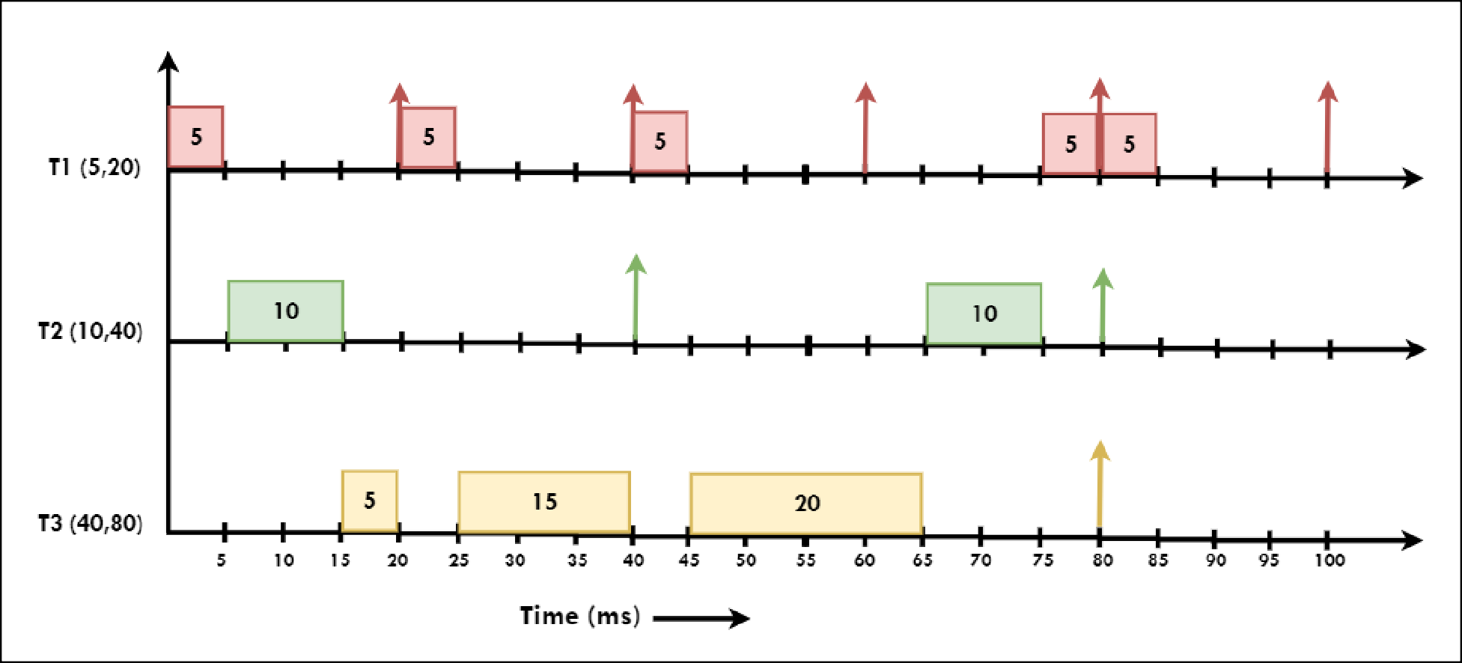
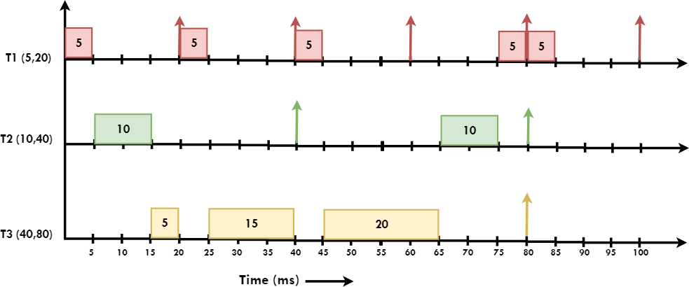
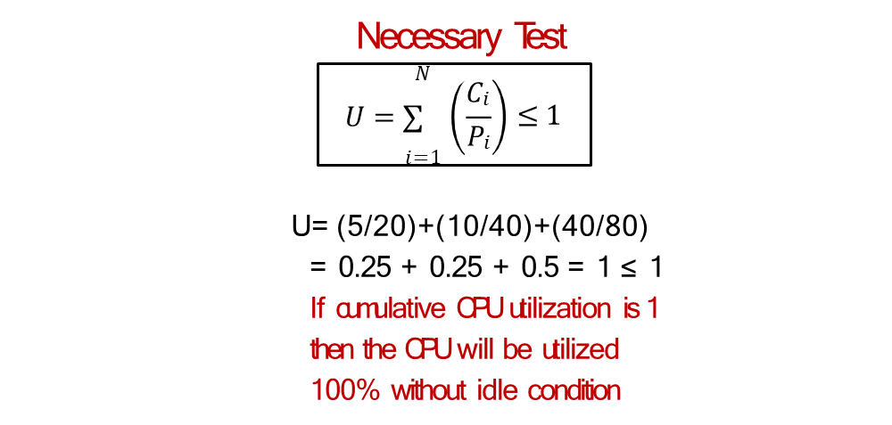
Consider set of three task (Ci, Pi) running on embedded system as follows, T1= (5, 20) , T2= (10, 40) , T3= (40, 80)
At time instance 80ms all 3 tasks are having same deadline.
When multiple tasks having deadline at same instance of a time then one of the task will be chosen randomly and get executed.
63

Slide 14
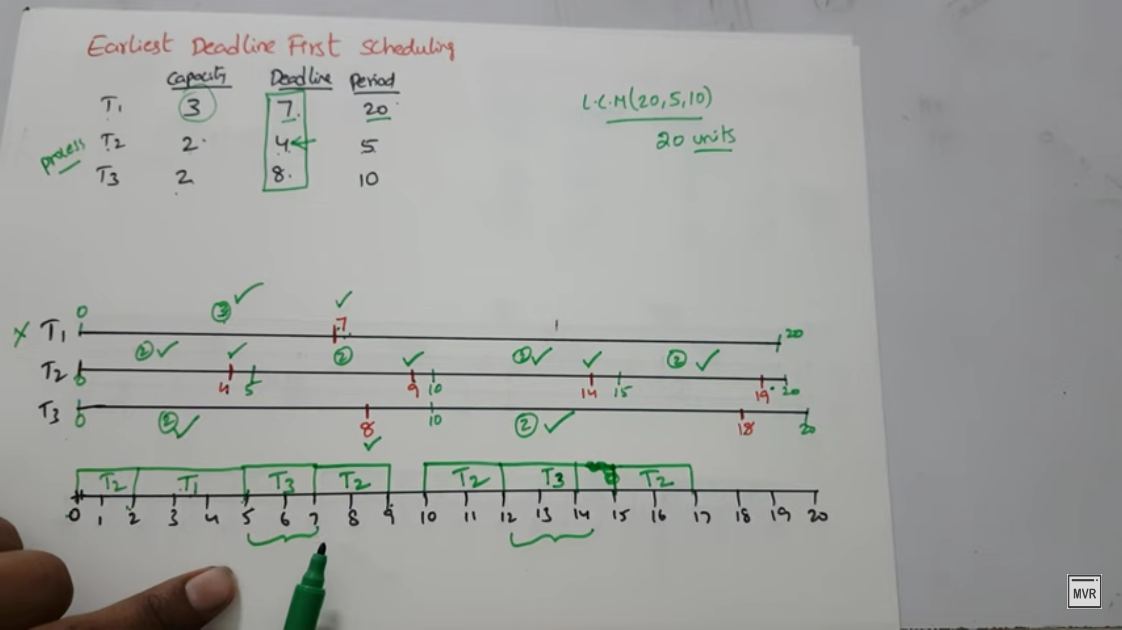
Here Deadline != Period
https://youtu.be/ejPXTOcMRPA?si=Cb81EtJKfp9W16dF

Slide 15
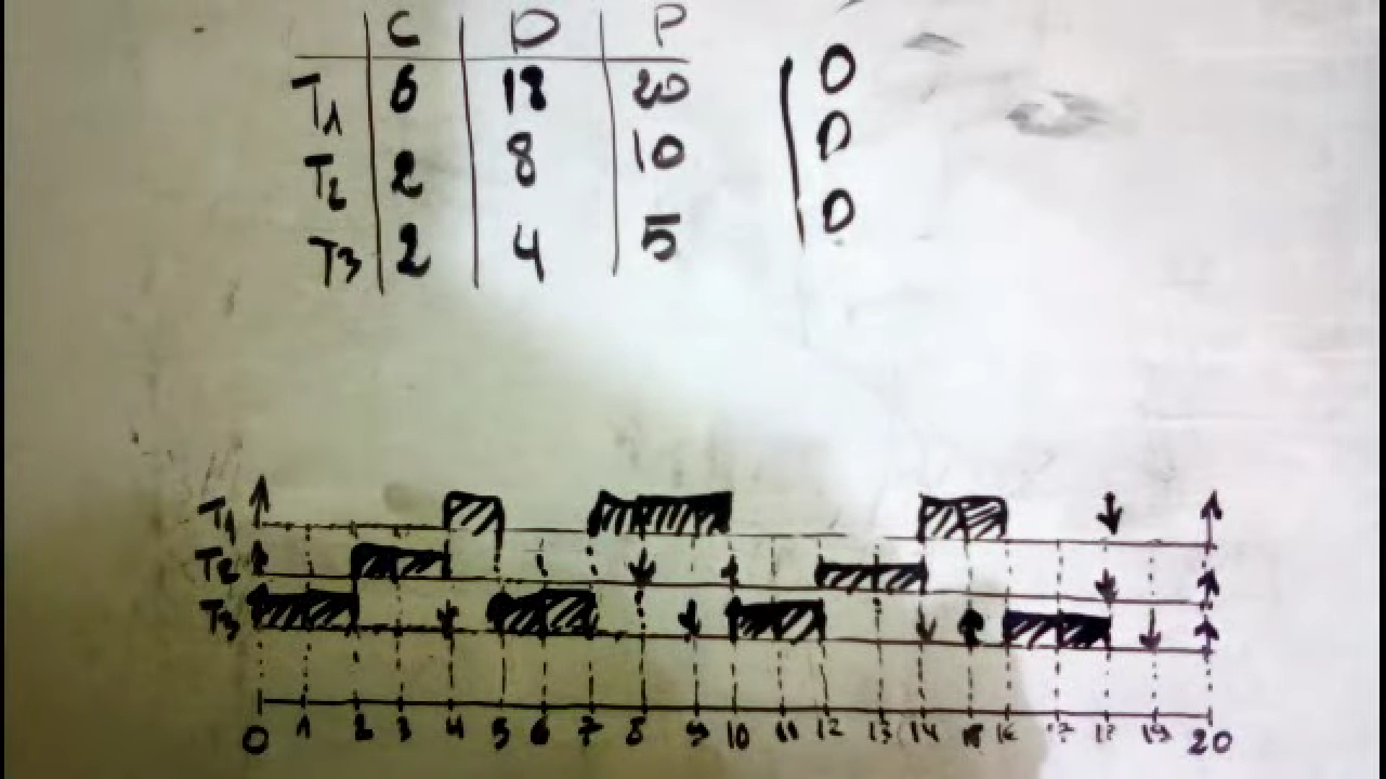

Slide 16
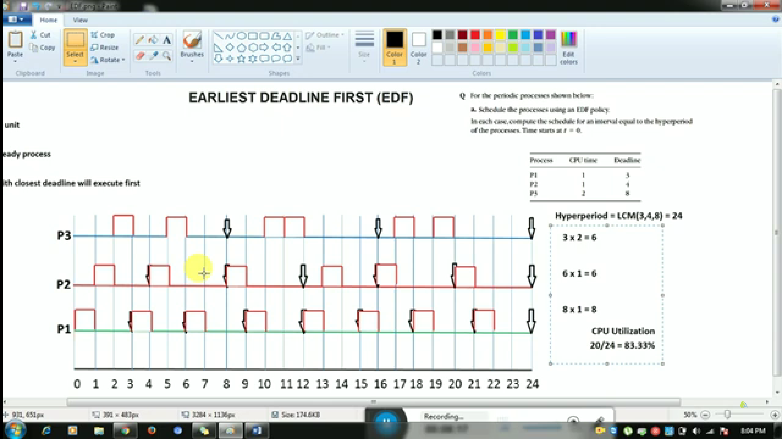

Slide 17
POSIX
Describes a Portable Operating System Interface based on UNIX
Defines application programming interface (API), command line shells, and utility interfaces for software compatibility with variants of UNIX and other OS
Benefits:
Avoid Vendor Lock-In
Using any software API creates dependency - ties applications to vendor's (OS)
Makes changing vendors difficult or, in some cases, impossible
APIs are Valuable, Stable, & Publicly Available
No need to rely on proprietary documentation from a single-source vendor
Expertly designed and widely standardized to promote portability.

Slide 18
Tutorials & Examples can be Found Online
POSIX-based OSs are by far the most popular and widely deployed
Online tutorials, examples, and explanations of when you might want to use certain
Reduces Total Cost of Ownership
If you find the TCO of an opensource OS is too high, then having written your applications with POSIX will enable you to easily switch to better OS.
Reduced Time-to-Market
A proven set of APIs speed development, reduces engineering costs.
If an engineer get stick on a program, you can refer to a vast pool of available resources to help solve the problem.
A greater degree of freedom and flexibility to switch Oss and vendors at your discretion, and available vast documentation, and reduced TTM and TCO are why POSIX is so useful for builders of large and complex safety and security critical embedded

Slide 19
Protothreads
Feature | Threads | Protothreads
Control structures | Yes | Yes
Debug stack retained | Yes | Yes
Implicit locking | No | Yes
Preemption | Yes | No
Automatic variables | Yes | No
Extremely light weight
All protothreads run on the same stack and content switching is done by stack rewinding
Protothread only requires only 2 bytes of memory per protothread
Are implemented in pure C and do not require any machine-specific assembler code.
Local variables should be used with utmost care - if in doubt, don’t use local variables inside a protothread!.
A protothread is driven by repeated calls to the function in which protothread is running. Each time the function is called, the protothread will run until it blocks or exits.

Slide 20
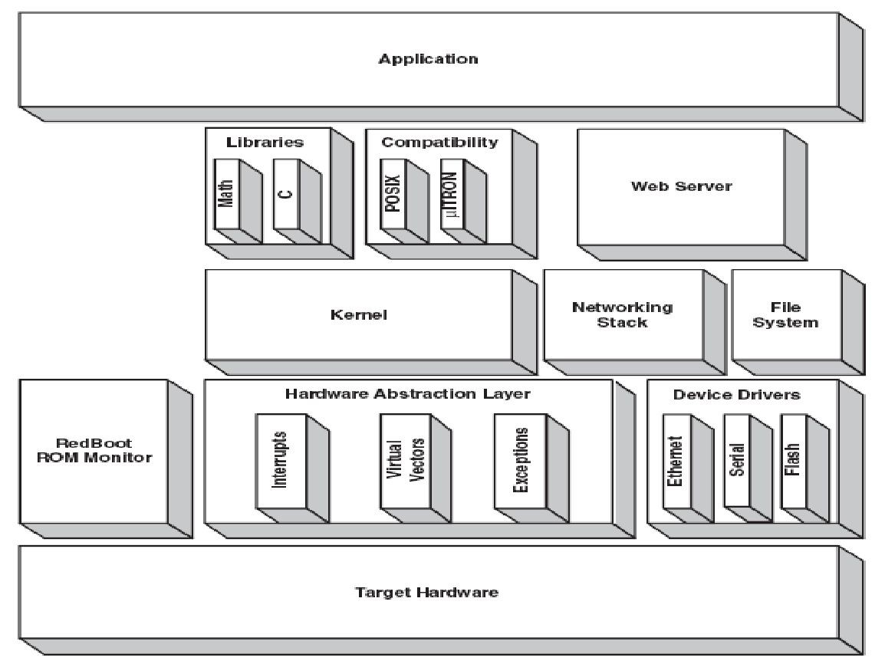
eCos real-time operating systeman open source tool to create embedded kernels and applications
eCos supports the following standard API: µitron, POSIX, Embedded Linux API, it’s own native API.

Slide 21
Hardware Abstraction Layer (HAL)
The HAL is a software layer.
It provides a platform independent API for platform specific functionality.
Enhances portability of code.
Example Implementation for ARM architecture
#define HAL_ENABLE_INTERRUPTS() \
asm volatile { \ “mrs r3,cpsr;” \ “bic r3,r3,#0xc0;” \
:
:
: “r3”
\
\
\
};

Slide 22
The Kernel
core to the eCos system.
Provides standard functionality like interrupt and exception handling, scheduling, threads, synchronization
Assertions available
CYG_FAIL (diag_message): Does not accept a condition as its first argument.
CYG_ASSERT (condition, diag_message) : Accepts a condition as it’s first argument.
CYG_ASSERTC (condition) : Compact version of the above assertion
CYG_FAIL() outputs the messages irrespective of any conditions.
CYG_ASSERTC() macro does not output any diagnostic messages.

Slide 23
Exception Handling
Exception handling can be done in two ways :
HAL + Kernel Exception Handling (default)
Uses a Vector Service Routine (VSR).
It is an array of pointers to exception handler routines.
HAL does basic interrupt processing like saving the context etc
Then control goes to kernel for further processing if required.
Application Exception Handling
Applications can provide their own VSR when an exception occurs.
VSR’s must be written in assembly language.
HAL_VSR_GET and HAL_VSR_SET are macros provided to give access to VSR table.

Slide 24
Interrupt Processing
Provides ISR’s and DSR’s
ISR’s perform most common tasks. They are small and execute quickly.
DSR’s perform additional processing if necessary.
Synchronization primitives are not allowed inside the ISR’s because ISR’s must be fast and bounded by time. Synchronization primitive causes the task to wait or sleep. They are allowed in DSR.
Multilevel Queue Scheduler
Allows multiple threads at same priority level.
Allows pre-emption between different priority levels.
Timeslicing within a priority level allowed.
Bitmap Scheduler
Only single thread at each priority level.
Pre-emption between different priority levels allowed.
Makes the scheduling algorithm simple and hence efficient.
Schedulers

Slide 25
Threads
Synchronization Mechanisms
eCos kernel provides API functions for controlling threads within a function.
Various thread controlling functions exist to
create and exit threads
kill or delete threads
yield a thread.
delay, suspend and resume threads.
The synchronization mechanisms provided by eCos are :
mutexes
semaphores
condition variables
flags
message Boxes
spinlocks (For SMP systems)

Slide 26
Mutexes
Mutexes allow multiple threads to share resources serially.
eCos provides Priority Ceiling Protocol and Priority Inheritance protocol as solutions to above problem.
Priority Ceiling Protocol - priority of the owner of mutex is raised to some predefined value.
Priority Inheritance - priority of owner of thread is raised to highest level of all threads waiting for the mutex.
Condition Variables
Condition variables are used with mutexes to allow multiple threads to access shared data.

Slide 27
Condition Variables API
Kernel API to control condition variables: cyg_cond_init(), cyg_cond_destroy(), cyg_cond_wait(), cyg_cond_timed_wait(), cyg_cond_signal(), cyg_cond_broadcast
Kernel Mutex controlling API: cyg_mutex_init(), cyg_mutex_destroy() , cyg_mutex_lock() , cyg_mutex_trylock(), cyg_mutex_unlock(), cyg_mutex_release(), cyg_mutex_set_ceiling(), cyg_mutex_set_protocol()
Kernel Semaphore controlling API: cyg_semaphore_init(), cyg_sempahore_destroy(), cyg_semaphore_wait(), cyg_semaphore_trywait(), cyg_semaphore_timed_wait(), cyg_semaphore_post(), cyg_semaphore_peek()

