Slide 1
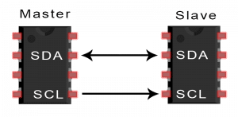
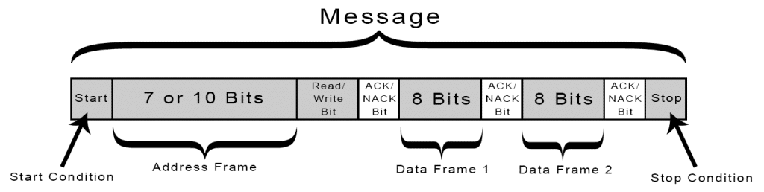
INTER-INTEGRATED CIRCUIT (I2C)
Widely used for short distance and intra-board communication
It can support multi-master and multi-slave configuration
SDA pin (Serial Data) – Bidirectional, bit by bit connection between master and slave
SCL pin (Serial Clock) – Master device addresses the slave devices via SCL and output is synchronized using clock signal

Slide 2
HOW I2C WORKS
Start Condition: SDA pin switches from high to low voltage level before the SCL pin switches from high to low
Stop Condition: SDA pin switches from low to high voltage after SCL pin switches from low to high
Address Frame: 7 or 10 bit unique address is assigned to each slave for identifying when master wants to connect to it
Read/Write Bit: This bit defines the state of master, whether it is sending data (low) or receiving data (high)
ACK/NACK Bit: Each frame is followed by an ACK bit. If message is successfully received, an ACK bit is returned

Slide 3
STEPS OF I2C DATA TRANSMISSION
Steps of IC2 data transmission:
The master sends 7/10 b address to each slave with which it wants to connect along with a r/w b
Slave compares the address with its own address and if it matches, ACK b is sent and SDA pin is set to low
ADVANTAGES:
Only uses two wires
Supports multiple masters and slaves
ACK/NACK bit for successful transmission
DISADVANTAGES:
Clock speed limitation & power dissipation because of pull-up resistor
hardware complexity increases with multi master/slave configuration
Frame overhead due to ack bits and device address bits

Slide 4
INTER-INTEGRATED CIRCUIT
Arduino function for I2C protocol (Wire Library)
Wire.begin() //Initialize the I2C bus Wire.requestFrom(address, quantity)
//address- 7 bit address of the device to request bytes
//quantity- The number of bytes to request
Wire.receive() Wire.send()
//receives a byte of data transmitted from slave to master
//sends data to master from slave on request
Wire.onRequest(handler)
//register a function to call when master request data
//from slave
Wire.onReceive(handler) - //Registers a function to be called when a slave device
//receives a transmission from a master
Wire.read() Wire.write() Wire.setClock()
//reads a byte transmitted form slave to master
//writes data to slave on request from master
//modifies the clock frequency of I2C

Slide 5
I2C – Arduino Interface
Slave sender
#include <Wire.h>
void setup()
{ Wire.begin(8);
// join i2c bus with address #8
Master read
include <Wire.h> void setup()
{ Wire.begin();
Serial.begin(9600); } void loop(){
Wire.onRequest(requestEvent); }
// register event
void loop() { delay(100); }
Wire.requestFrom(8, 6);
// request 6 bytes from slavedevice #8
while (Wire.available()){
// function that executes whenever data is requested by master
// this function is registered as an event, see setup()
void requestEvent()
char c = Wire.read();
Serial.print(c); }
slave may send less than requested; receive a byte as a char
delay(500);
}
{ Wire.write("hello "); }
// respond with message of 6 bytes as expected by master

Slide 6
CONTROL AREA NETWORK
set of rules for transmitting and receiving messages in a network of electronic devices.
Every electronic device is connected using a single common serial bus to receive and transmit data using CAN protocol
Use cases - gear control, lighting control, air conditioning, central locking etc.
NEED FOR CAN:
Simple and low cost – Communicate via one single bus
Fully centralized – one point of entry
Flexibility: can be easily connected / disconnected
Good Speed
Multi-master communication

Slide 7
CAN ARCHITECTURE
CAN protocol uses lower two layers of OSI: physical layer and data link layer. Host controller uses application layer
System designer defined the functionality of remaining five layers according to needs
CAN controller incorporate logical link control (LLC) and MAC medium access control of data link layer.
LLC allows filtering of messages by using unique ID.
Once, framing is done it is followed by arbitration, error detection handled by MAC layer
CAN trans-receiver takes care of encoding and decoding and then synchronizes with CAN bus for transmission

Slide 8
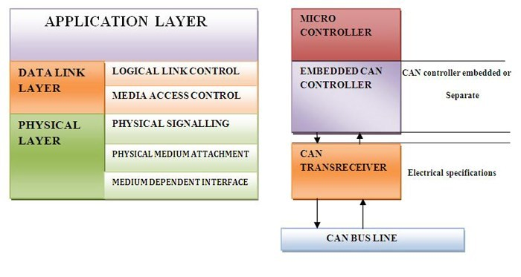
CONTROL AREA NETWORK

Slide 9
HOW CAN PROTOCOL WORKS?
Master-slave configuration is not supported
Each node cannot access every other node for reading and writing data on CAN bus
In CAN protocol predefined unique ID is used instead of destination address
Based on the availability of bus and priority of message, CAN bus writes the CAN frame
Frame is defined structure, carrying sequence of bit or bytes of data. Framing is done by MAC sub layer of Data Link Layer.
Binary values in CAN protocol are termed as dominant (logic 0) and recessive (logic 1)
SOF | 11 bit identifier | RTR | IDE | r0 | DLC | 0…8 byte data | CRC | ACK | EOF | IFS

Slide 10
SOF - Start of Frame bit. A dominant bit (logic 0)
IDENTIFIER-It serves dual purpose, one to determine which node has access to the bus and second to identify the type of message.
RTR - Remote Transmission Request. dominant when it is a data frame and recessive when it is a remote frame
IDE – Identifier Extension. Dominant bit is for standard and recessive for extended frame.
DLC – Data Length Code. It is 4-bit data length code that contains the number of bytes being transmitted.
DATA – Used to store up to 64 data bits of application data to be transmitted.
CRC– Cyclic Redundancy Check. contains the checksum for error detection.
ACK – Acknowledge (ACK) field. When the data is received correctly the recessive bit in ACK slot is overwritten as dominant bit by the receiver.
EOF– End of Frame (EOF). The 7-bit field marks the end of a CAN frame (message)
IFS - Inter Frame Space specifies minimum number of bits separating consecutive messages

Slide 11
MESSAGE FRAME - TYPES
Data frames- most commonly used frame for data transmission from one node to another node.
Remote frames – seeks permission for data transmission from another node. Similar to data frame without data field & RTR bit is recessive.
Error frames – If transmitting/receiving node detect an error, it will immediately abort transmission and send error frame
Overload frame-It is similar to error frame but used for providing extra delay between the messages. An Overload frame is generated by a node when it becomes too busy and is not ready to receive.

Slide 12
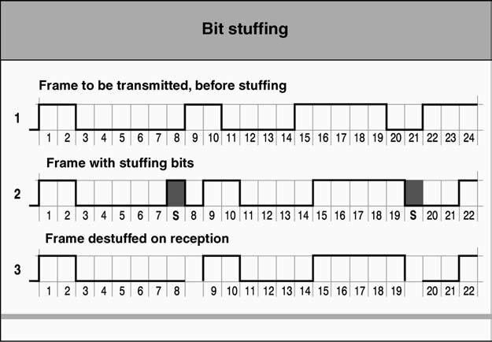
BIT STUFFING METHOD
After 5 bits of identical value (either dominant / recessive), a supplementary bit having an intentionally opposite value.
To ‘break the rhythm’, indicate that everything is all right, despite appearances.

Slide 13
TYPES OF ERRORS IN CAN
In Physical Layer
Bit Error - bit itself is affected by errors
Bit Stuffing Error - involuntary (parasites, transmissions, forgotten elements)
In Frame Layer
CRC delimiter error
ACKnowledgement delimiter error
end of frame error
overload delimiter error
CONFINEMENT ERRORS: determining whether a node is:
not disturbed at all,
slightly disturbed
rather more seriously disturbed by errors
too disturbed and must switch to bus off

Slide 14
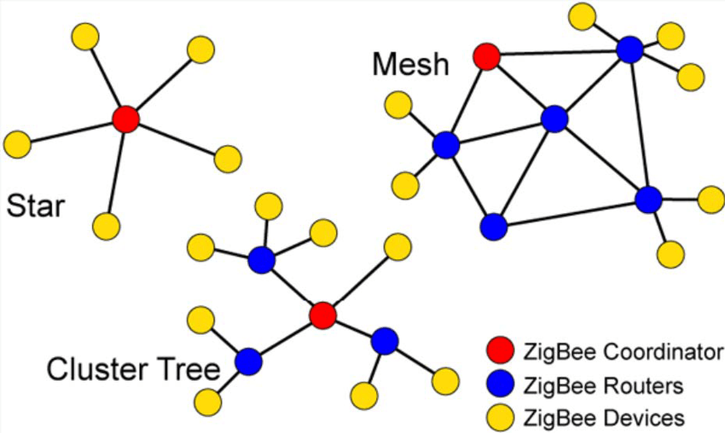
ZIGBEE
ZigBee is specially built for control and sensor applications
ZigBee is a standard with very low cost, low power device, low data rate and short range communications
Open-source standard developed by ZigBee Alliance
It works on IEEE 802.15.4 standard for WPAN
It supports master-slave configuration or master-master configuration
ZigBee supports star, tree and mesh topologies
Coordinator (Root of network) - Performs channel selection, assigning node ID, allocation of unique address
Routers (Intermediate node between coordinator and end node) - Route traffic between different nodes
End Node (All traffic to end device is first routed to parent node) - sleep mode to increase battery efficiency

Slide 15
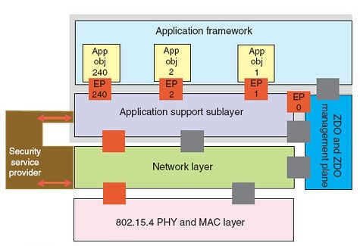
Methods of channel access
Contention based - need not synchronized and used CSMA - Channel goes to receive mode and check for any signal, if no signal is detected then it will start data transmission or else wait for a random period of time
Contention free - Allocates specific time slot to each device GTS (Guaranteed Time Slot)
Low power consumption – extended battery life
Low data rate – 200-250 kbps where as Wi-Fi- 11 Mbps, Bluetooth – 1 Mbps
Short range - 75-100 meter indoor, Up to 300 meters outdoor
Low latency
Low cost
Uses AES encryption for security
Simple setup and maintenance
Zigbee protocol stack

Slide 16
ZIGBEE
IEEE 802.15.4 MAC frame format
Data frame
Beacon frame
Acknowledgement frame
Command frame
General MAC Frame Format
Octets : 2 | 1 | 0/2 | 0/2/8 | 0/2 | 0/2/8 | Variable | 2
Frame Control | Sequence number | Destination PAN identifier | Destination Address | Source PAN Identifier | Source Address | Frame payload | Frame Check Sequence
MAC header |  |  |  |  |  | MAC Payload | MAC footer

Slide 17
ZIGBEE
IEEE 802.15.4 MAC frame format - Beacon Frame Format
Octets : 2 | 1 | 4 or10 | 2 | Variable | variable | Variable | 2
Frame control | Beacon sequence number | Source address information | Super frame specification | GTS field | Pending address field | Beacon payload | Frame check sequence
MAC header |  |  | MAC payload |  |  |  | MAC Footer
The beacon frame is transmitted periodically by the PAN coordinator.
It provides information about the network management through the super frame and GTS fields.
It also synchronizes the network devices and indicates the proper communication period for them.

Slide 18
ZIGBEE
IEEE 802.15.4 MAC frame format Command Frame Format
Octets: 2 | 1 | 4 to 20 | 1 | Variable | 2
Frame control | Data Sequence number | Address information | Command type | Command payload | Frame Check sequence
 | MAC header |  | MAC payload |  | MAC Footer
Useful for communication between the network devices.
The command identifier specifies actions like association, disassociation, and data, GTS or beacon request.

Slide 19
Arduino Coding for Zigbee interface
#include <SoftwareSerial.h>
SoftwareSerial XBee(2, 3); void setup()
{
XBee.begin(9600); Serial.begin(9600);
}
void loop()
{
if (Serial.available())
{
XBee.write(Serial.read());
}
if (XBee.available())
{
Serial.write(XBee.read());
}
}

Slide 20
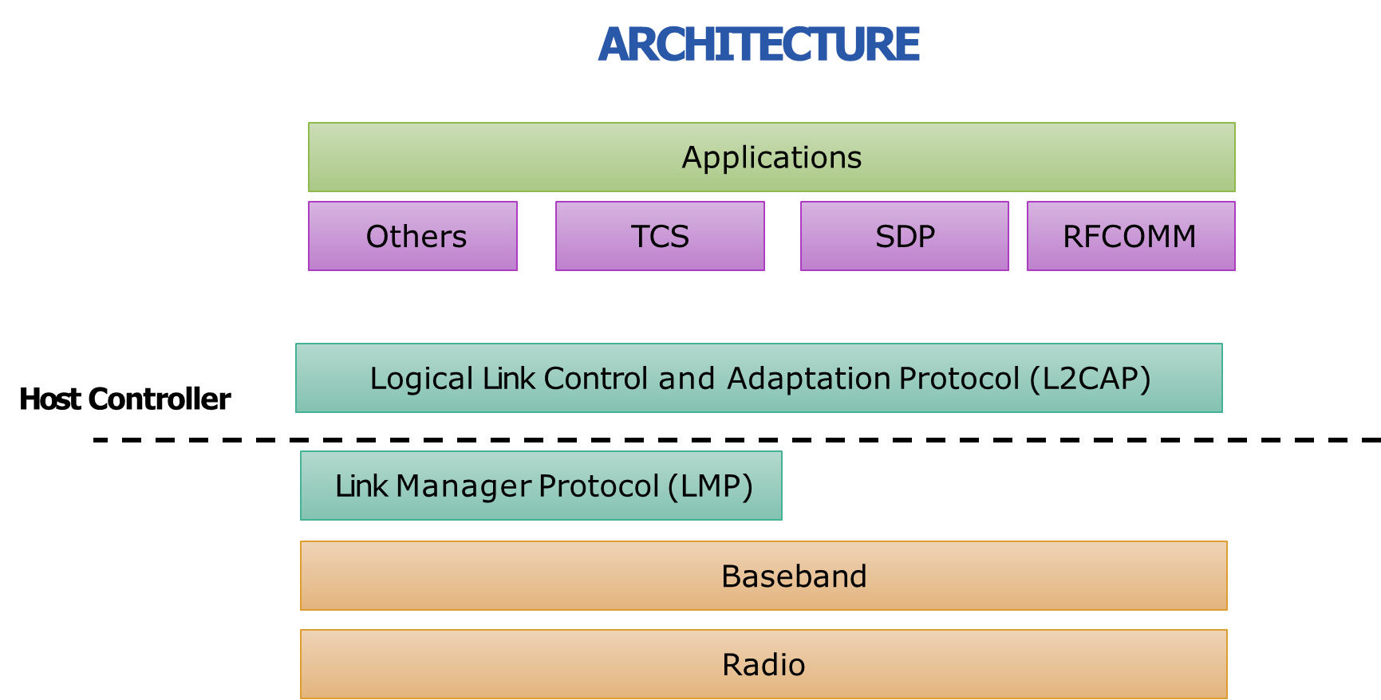
BLUETOOTH
It’s a secure protocol, and it’s perfect for short-range, low- power, low-cost, wireless transmissions
Bluetooth is a dynamic standard where devices can automatically find each other & establish connections
Bluetooth networks can be referred as piconet and scatternet
It use a master/slave model – Slaves are only allowed to transmit to and receive from their master. They can’t talk to other slaves in the piconet.

Slide 21
BLUETOOTH: ARCHITECTURE
Radio: This layer defines the requirements for a transceiver to operate such as frequency bands and modulation techniques.
Baseband: describes the specification of the Bluetooth Link Controller (LC). Defines addressing scheme & packet frame. 2 types of link are ACL and SCO.
LMP: for link set-up and control, device authentication & message encryption
Host Controller Interface (HCI): Provides a command interface to access hardware and control registers.
L2CAP: supports higher level packet segmentation and reassembly
RFCOMM: emulation of serial ports over L2CAP protocol.
SDP: Service Discovery Protocol (SDP) - Provides a means for applications to discover which services are provided/available through a Bluetooth device
TCS: telephony control protocol for telephony service

Slide 22
BLUETOOTH
Two types of link between master and slave
Asynchronous Connection Less (ACL)
Packet switched data
Slave can have only one ACL link to master
Used for correct delivery over fast delivery
Maximum data rate of 721 kbps
Synchronous Connection Oriented (SCO)
Real time data transmission
Damaged packet cannot be retransmitted
Data rate of 64 kbps

Slide 23
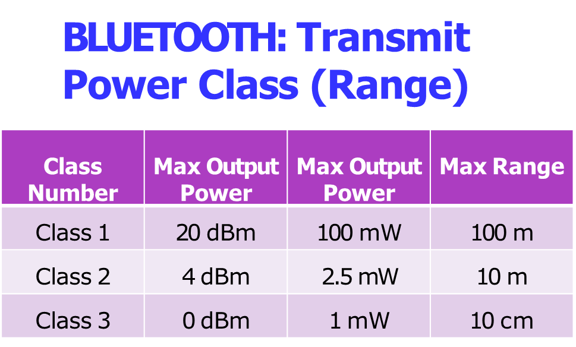
BLUETOOTH: Frame Format
72 bits
54 bits
0-2744 bits
Access Code
Header
Data
Preamble (4)
Synchronisation (64)
Trailer (4)
Header
Payload body CRC
Access code (AC) - Used for packet identification
Once packet is received, receiver in piconet will compare the incoming signal with AC, if any mismatch is found packet will be ignored
It is used for synchronization
Three types
Channel AC – targets piconet ID
Device AC – individual devices
Inquiry AC – used during pairing
Data - contains information from upper layer
Payload body – contains user data CRC- 16 bit checksum

Slide 24
BLUETOOTH: Connection Process
Step-1 Inquiry:
If 2 Bluetooth devices know absolutely nothing about each other, one must run an inquiry to try to discover the other
On receiving the inquiry, the device which listens to such a request will send back address, name and other information
Step-2 Paging (Connecting) – process of forming a connection between two Bluetooth devices.
Step-3 Connection – The mode of operation of device is decided in connection phase
BLUETOOTH: Connection Modes
Active Mode – Regular mode, where device sends and receives data (connection up-to 7 devices)
Sniff Mode – Power saving mode, (frees slave for predetermined period of time, recurring fixed time slot)
Hold Mode – Temporary mode, (frees slave for predetermined period of time, one time slot)
Park Mode – Sleep mode with infinite time, slave will wake only if master tells it to wake up (maximum of 255 devices can be added)

Slide 25
BLUETOOTH: HC05 – BLUETOOTH MODULE
Bluetooth SPP (Wireless Serial Port Protocol)
Can be used in a Master or Slave configuration (default=SLAVE)
Master module can initiate a connection to other devices.
Role of the module (Master / Slave) can be configured only by AT COMMANDS.
Hardware Features
3.3 to 5 V I/O.
PIO (Programmable Input/Output) control.
UART interface with programmable baud rate.
With integrated antenna.
Software Features
Slave default Baud rate: 9600,
Data bits:8, Stop bit:1,Parity:No parity.
Auto‐connect to the last device on power as default.
Permit pairing device to connect as default.

Slide 26
BLUETOOTH: HC05 – BLUETOOTH MODULE
Arduino
Write a program to control a LED connected at Pin 7 of Arduino through command send by Bluetooth supported mobile device.
#define ledPin 7 int state = 0; void setup() {
pinMode(ledPin, OUTPUT);
digitalWrite(ledPin, LOW); Serial.begin(38400);
}
void loop() {
if(Serial.available() > 0){
// Checks whether data is comming from the serial port
state = Serial.read();
// Reads the data from the serial port
}
if (state == '0’) {
digitalWrite(ledPin, LOW); // Turn LED OFF
Serial.println("LED: OFF"); // Send back, to the
phone, the String "LED: ON"
state = 0;
}
else if (state == '1') { digitalWrite(ledPin, HIGH); Serial.println("LED: ON");; state = 0;
}
}

Slide 27
Wi-Fi: Elements of Network
WIFI uses radio technology to transmit and receive data at high speed.
Access Point (AP) –wireless LAN transceiver or “base station” that can connect one or many wireless devices simultaneously to the Internet.
Safeguards – Firewalls and anti-virus protect networks
SSID (Service Set Identifier) : It is a 32-character name which identifies each unique Wi-Fi network.
WPA-PSK (Wi-Fi Protected Access- Pre-Shared Key Authentication) : It is a way of encrypting Wi-Fi signal to protect from unwanted users.
Wi-Fi uses Ad-Hoc networks to transmit.
It is a point-to-point network without any interface.

Slide 28
Wi-Fi Topologies
Peer-to-peer Topology: Client devices within a cell can communicate with each other directly without using AP. It is useful for setting up a wireless network quickly and easily.
Infrastructure network: I f a Mobile Station (MS), like a computer, phone, wants to communicate with another MS, it needs to send the information to AP first, then AP sends it to the destination MS.
Hotspot:
Wi-Fi hotspot is created by installing an access point (base station)to an internet connection.
When Wi-Fi enabled device encounters a hotspot the device can then connect to that network wirelessly.

Slide 29
Wi-Fi
Limitations
Interference
Degradation in performance
High power consumption
Limited range
Advantages:
Ease of Installation
Flexibility
Cost
Reliability
Security
Use unlicensed part of the radio spectrum
Roaming
Speed

Slide 30
Interface with Arduino
#include <SoftwareSerial.h> SoftwareSerial ESPserial(2, 3); // RX | TX void setup()
{
Serial.begin(115200); // communication with the host computer
//while (!Serial) { ; }
// Start the software serial for communication with the ESP8266
ESPserial.begin(115200);
Serial.println("");
Serial.println("Remember to set Both NL & CR in the serial monitor."); Serial.println("Ready");
Serial.println("");
}
void loop()
{
// listen for communication from the ESP8266 and then write it to the serial
monitor
if ( ESPserial.available() ) { Serial.write( ESPserial.read() ); }
// listen for user input and send it to the ESP8266
if ( Serial.available() ) { ESPserial.write( Serial.read() ); }
}

Slide 31
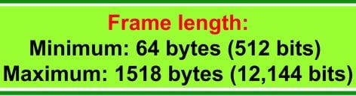
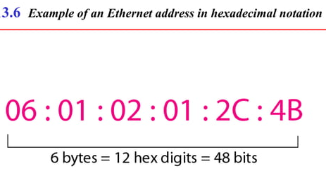
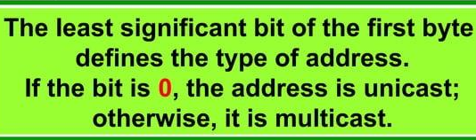
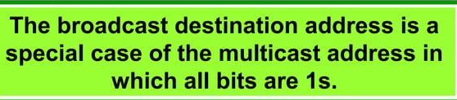


Slide 32
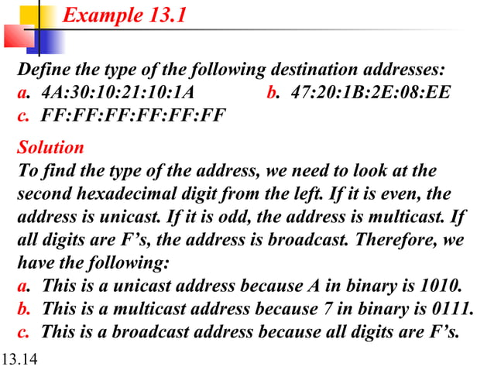

Slide 33
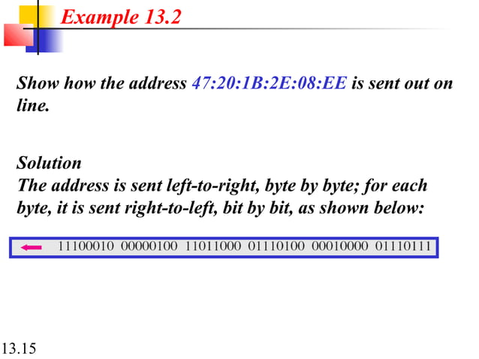

Slide 34
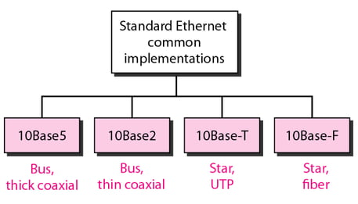
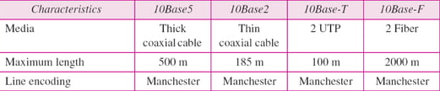

Slide 35
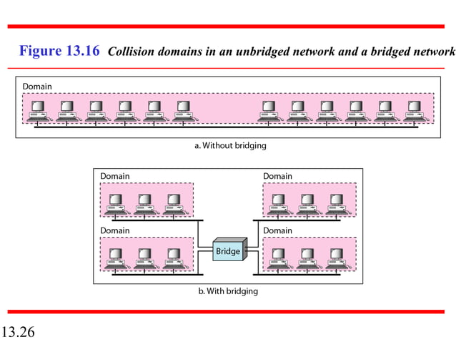

Slide 36
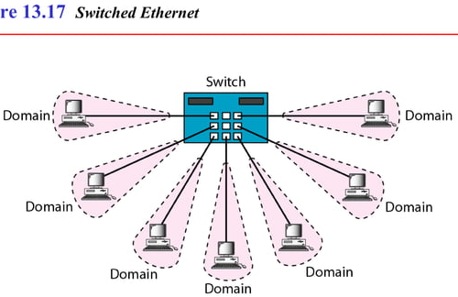
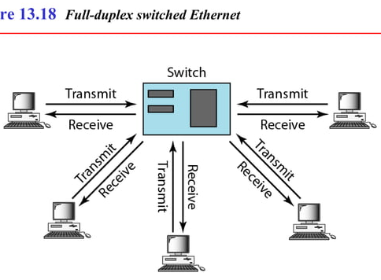

Slide 37
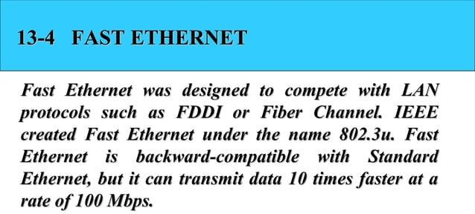
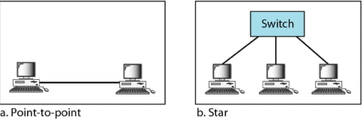

Slide 38
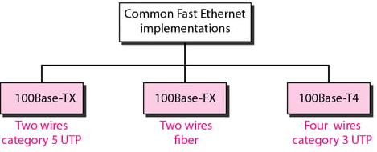
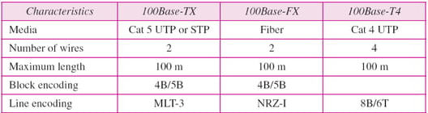

Slide 39
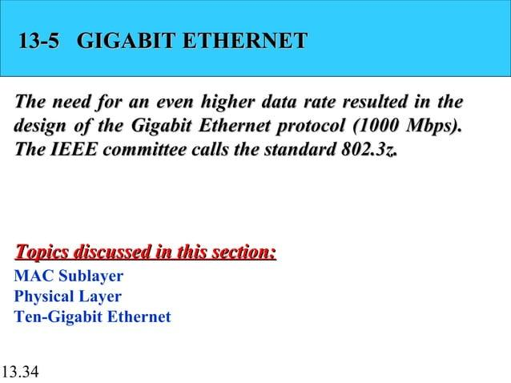
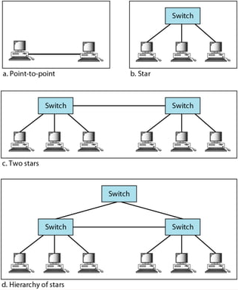
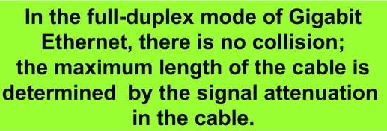

Slide 40
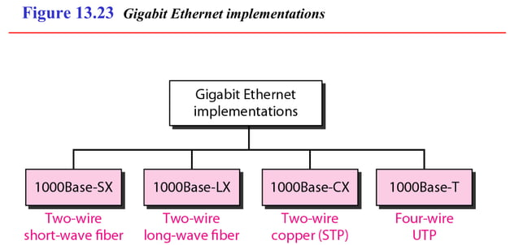
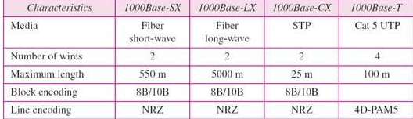

Slide 41
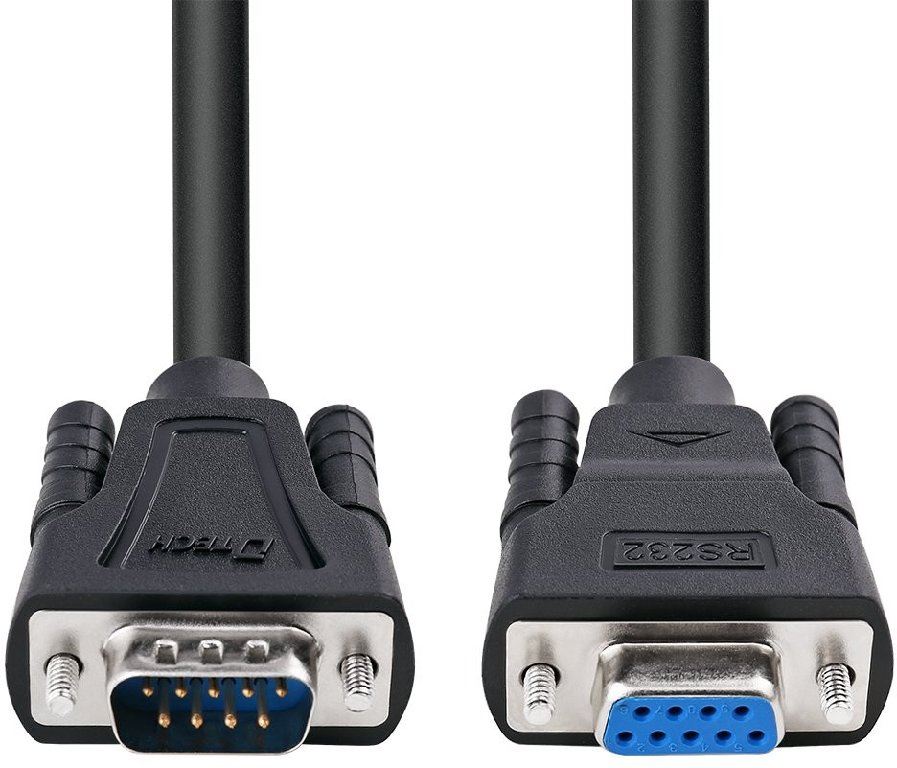
RS-232 (Recommended Standard 232)
Interference Standard for serial communication
Both synchronous and async. transmissions are supported
RS232 devices can be classified as Data Terminal Equipment (DTE) or Data Communication Terminal (DCE), defines that each device which wires will be sending and receiving each signal.
DTE : Refers to the terminals and computers that send and receive the data
DCE : Refers to the communication equipment, such as modems, responsible for transmitting the data.
Limitations
Limited transmission speed,
Relatively large voltage swing,
Big standard connectors
multi-drop have limitations in speed and compatibility.
Handshaking in RS-232 - To ensure reliable data transmission between two devices, the data transmission must be coordinated.

Slide 42
PINs
Data Carrier Detect – a signal is sent to the data set that is going to be transmitted to the terminal.
Received Data – The data set receives the initial signal via the receive data line (RxD).
Transmitted Data – The data terminal gets a signal from the data set, a confirmation that there is a connection between the data terminal and the data set.
Data Terminal Ready – A sign that the data terminal is prepared for the transmission of data.
Signal Ground – A return for all the signals on a single interface
Data Set Ready – A positive voltage is applied to the data set ready (DSR) line, which ensures the serial communications between a data terminal and a data set can be completed.
Request to Send – A positive voltage indicates the request to send (RTS) can be performed, which means the data set is able to send information to the data terminal without interference.
Clear to Send – After a connection has been established between a data terminal and a distant modem, a clear to send (CS) signal ensures the data terminal recognizes that communications can be performed.
Ring Indicator – The ring indicator (RI) signal will be activated if a modem that operates as a data set detects low frequency. When this occurs, the data terminal is alerted, but the RI will not stop the flow of serial data between devices.

