Slide 1
Smart Farming using Embedded Systems
Refers to the integration of advanced electronic devices and technologies within agricultural practices to enhance efficiency & productivity.
Challenges in traditional agriculture: Labor shortages, inefficient resource utilization.
How embedded systems can help:
Increased Productivity and reduced costs: Optimized resource utilization, reduced labor costs.
Improved Quality: Precise control of environmental factors.
Sustainable Agriculture: Eco-friendly practices, conservation of resources.
Challenges:
Power Constraints: Limited battery life in remote areas.
Sol: A solar-powered sensor node.
Environmental Factors: Harsh conditions can affect sensor and actuator performance.
Data Security: Protect sensitive data from unauthorized access.

Slide 2
Sensor Applications in Agriculture
Soil Sensors: Monitor soil moisture, pH, and nutrient levels.
Climate Sensors: Measure temperature, humidity, and rainfall.
Light Sensors: Detect light intensity for optimal plant growth.
Gas Sensors: Detect harmful gases in the environment.
Actuator Applications in Agriculture
Irrigation Systems: Precise water distribution based on sensor data.
Ventilation Systems: Adjust airflow to regulate temperature and humidity.
Lighting Systems: Control artificial lighting for optimal plant growth.
Fertilization Systems: Precise application of fertilizers based on plant needs.
Communication in Agriculture
Wireless Communication: Wi-Fi, Bluetooth, and cellular networks for remote monitoring and control.
Wired Communication: Ethernet and RS-485 for reliable data transmission.
IoT Connectivity: Connect devices to the internet for real-time data analysis and remote management.

Slide 3
Automotive Electronics
CAN (Controller Area Network)
Airbag System
Electronic Data Recorders (EDR)
Anti-lock Braking System (ABS)
Traction Control System
Vehicle Stability Control (VSC)
Advanced Driver Assistance Systems (ADAS)
Blind Spot Monitoring System
Tyre Pressure Monitoring
Multimedia System
Fuel Control System

Slide 4
Controller Area Network (CAN): Allows microcontrollers and devices to communicate without a host computer. Reduces wiring & enables faster data exchange. Used in ABS, airbags, etc.
Airbag System: Microcontrollers analyze impact data and deploy airbags within seconds.
Electronic Data Recorders (EDRs) / Black Box: Records critical data before and during crashes (e.g., speed, braking, seatbelt use). Assist in crash analysis & insurance.
Anti-lock Braking System (ABS): Monitors wheel speed sensors & adjusts braking pressure preventing wheels from locking up during braking. Improves vehicle control during emergency braking, enhances safety on slippery roads.
Traction Control System: Monitors wheel speeds, reduces engine power or applies brakes to control wheel spin when accelerating, especially on slippery surfaces.
Vehicle Stability Control: Uses sensors to detect loss of control and applies brakes or reduces engine power. Reduces the risk of rollover during extreme maneuvers.
Cruise Control System: Sensors monitor speed to maintain desired speed.
ADAS: Collection of systems designed to assist drivers, including lane-keeping, collision avoidance, and parking assistance using multiple sensors (cameras, radar, LIDAR) and real-time data processing.

Slide 5
Consumer Electronics: Embedded Systems in Washing Machines
Fully Automated Mode:
Senses the requirement of water, water temperature, detergent, fabric quality, load, wash cycle time and perform operations.
Once the system is started it performs the task independenly without any user interference.
Semi Automatic Mode:
Once the predefined mode is started the system perform its job.
Washing conditions are predefined
After completion it informs the user about the completion of work.
Manual Mode:
User specify which operation, they want to do, provide related information of the control system. Example: Only wash mode, or only dry mode.
User defines the wash cycle and time, amount of water and load. User start the machine.
Components - Display Panel, Sensor, Water level sensor, Door sensor, Driving motor, Controller, Pump

Slide 6
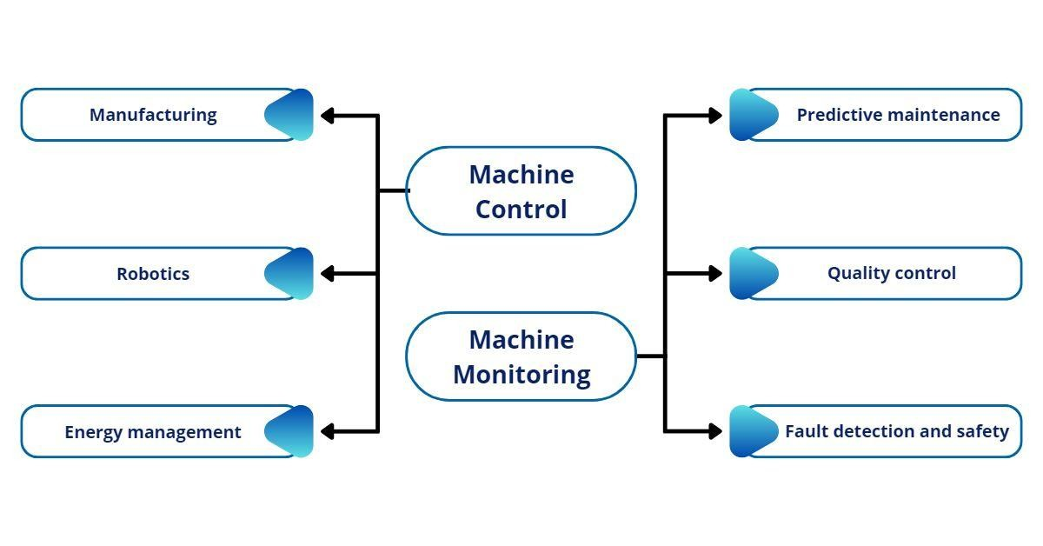
Industrial controls

Slide 7
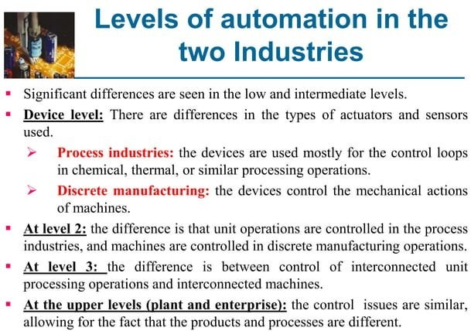
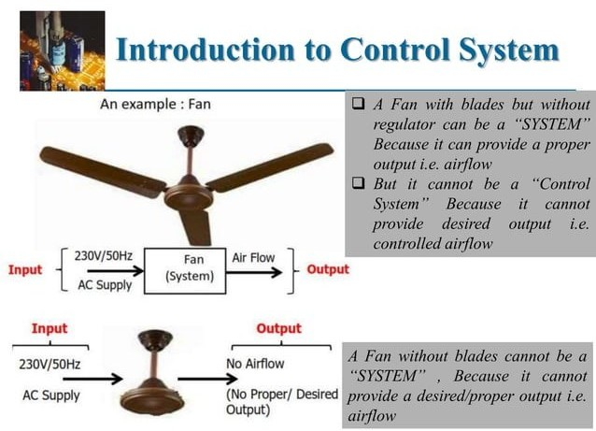

Slide 8
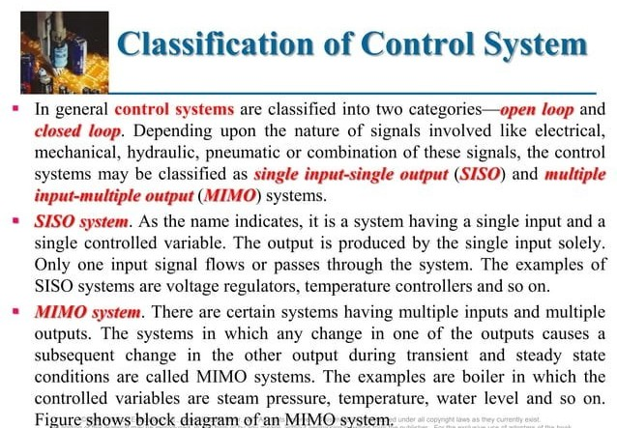

Slide 9
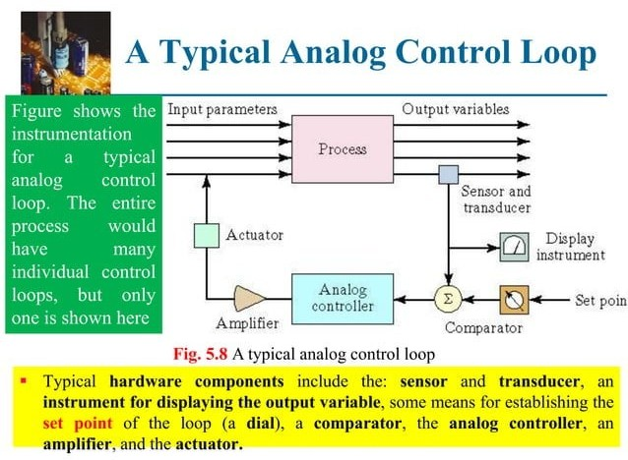

Slide 10
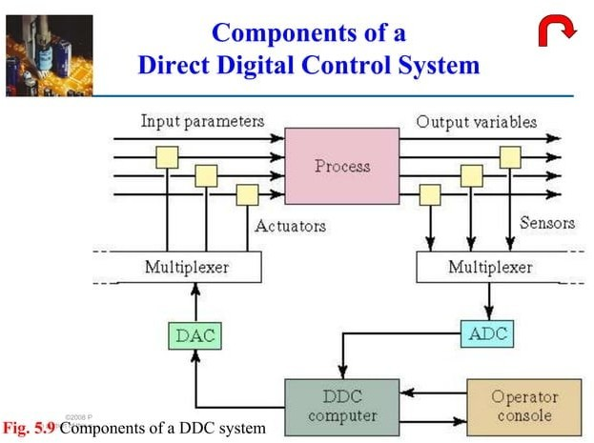

Slide 11
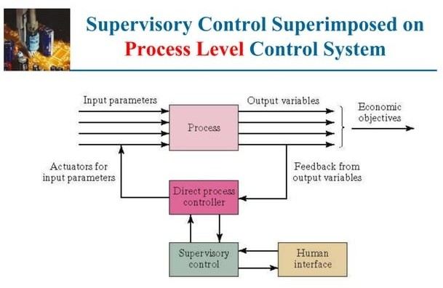

Slide 12
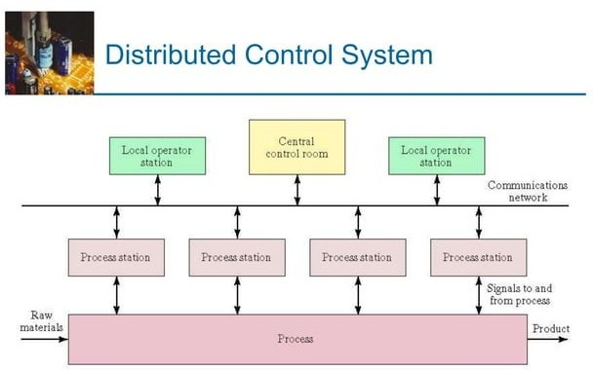

Slide 13
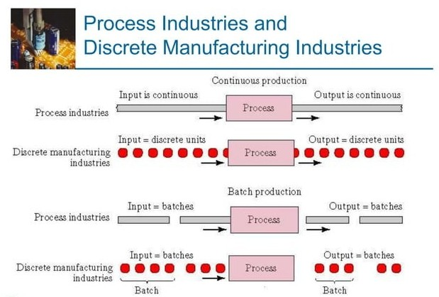

Slide 14
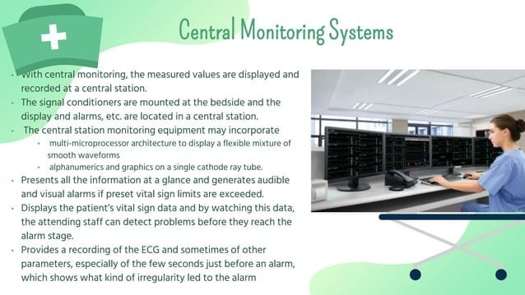

Slide 15
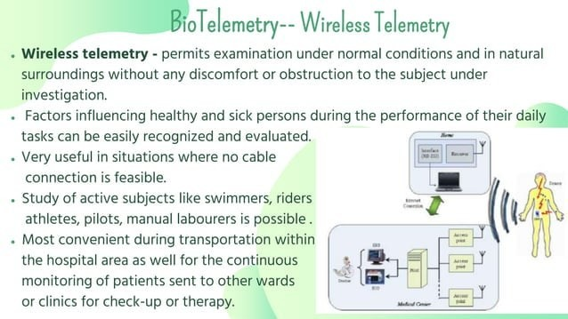
Major components of Wireless telemetry systems are : Modulation system, radio carrier, transmitter and receiver

Slide 16
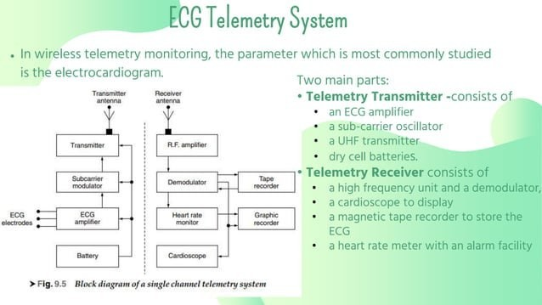
Single Channel Telemetry Systems

Slide 17
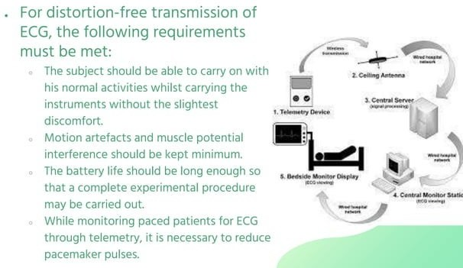

Slide 18
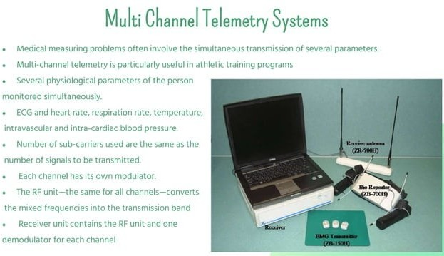

Slide 19
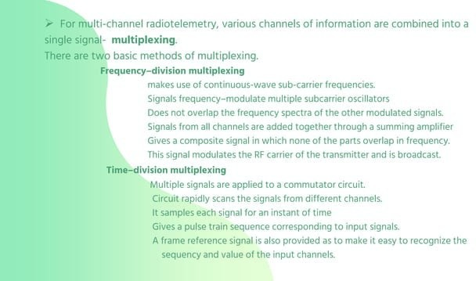

Slide 20
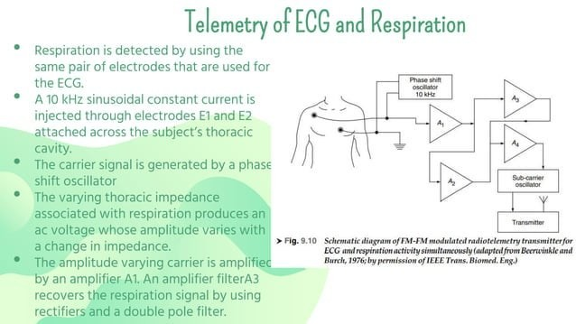
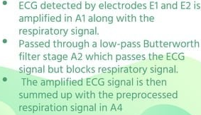

Slide 21
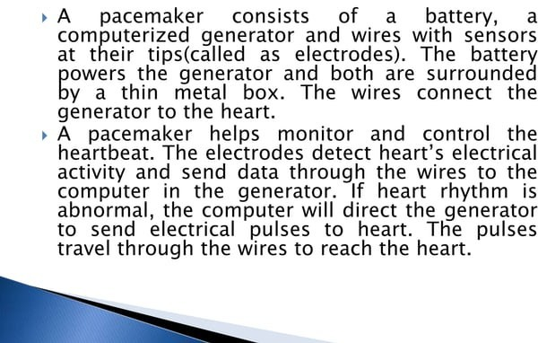
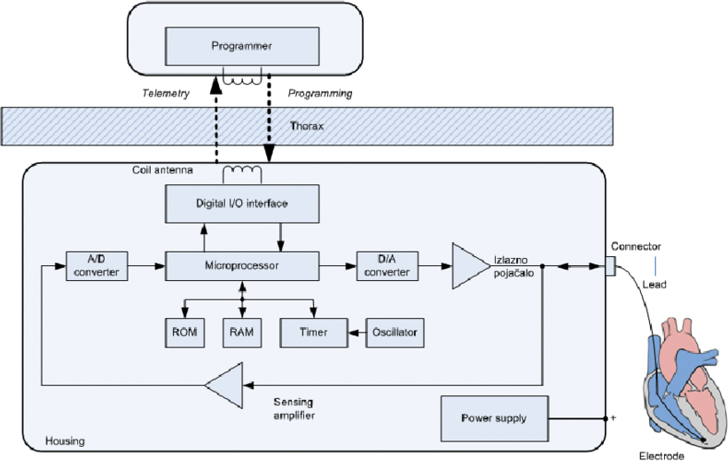
Pacemaker Block diagram

Slide 22
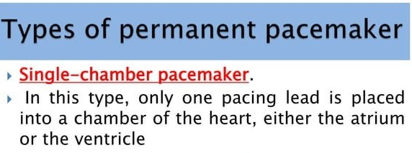
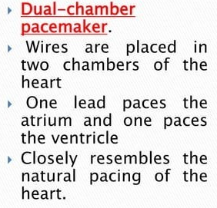
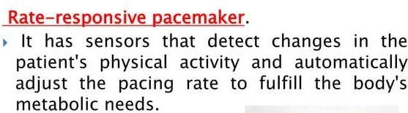

Slide 23
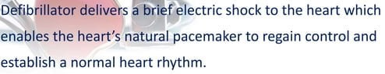
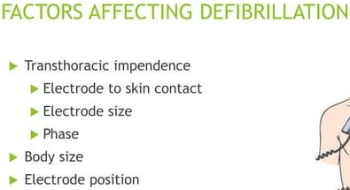

Slide 24
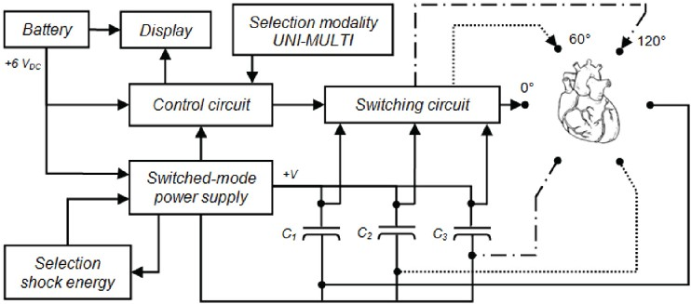
Defibrillator block diagram

Slide 25
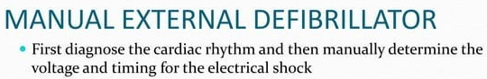
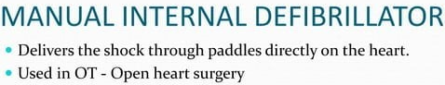
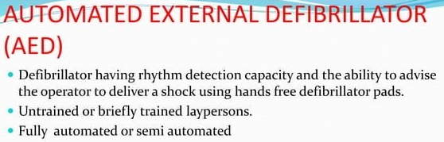

Slide 26
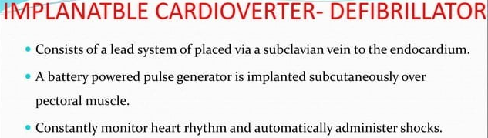
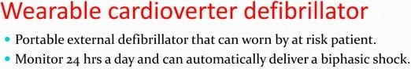
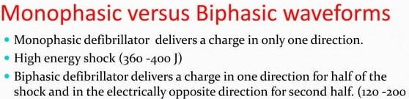

Slide 27
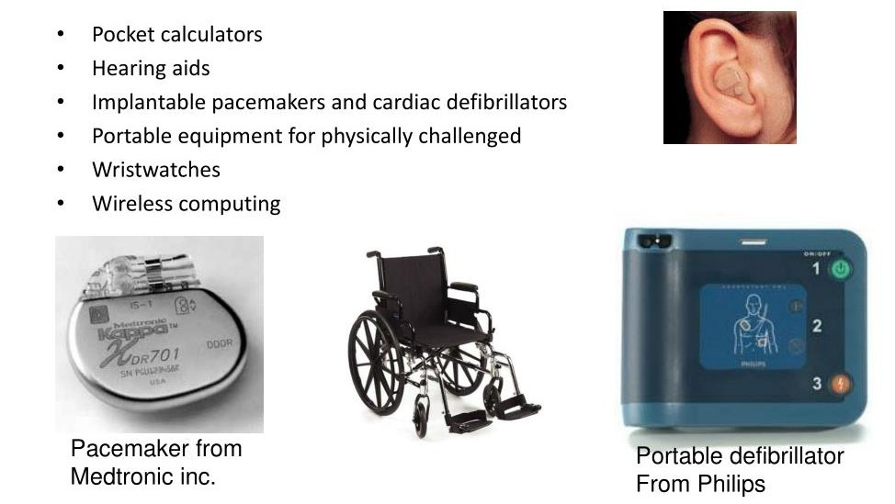
MEDICAL ELECTRONICS

