Slide 1
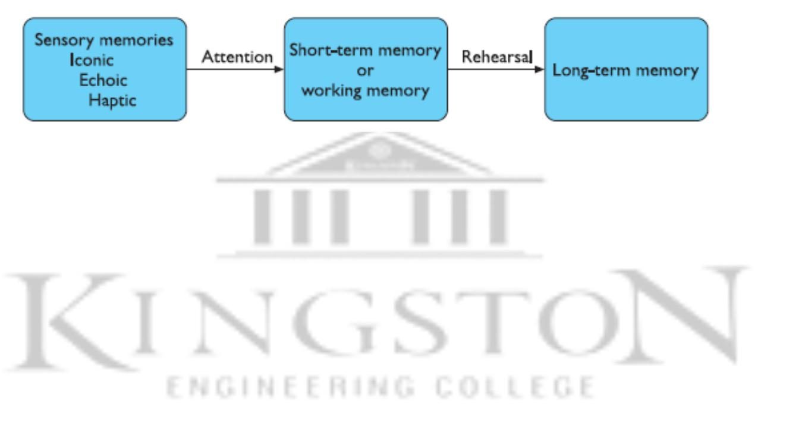
HUMAN MEMORY
Sensory memory
These memories are constantly overwritten by new information coming in on these channels.
A sensory memory exists for each sensory channel: iconic memory for visual stimuli, echoic memory (sound) for aural stimuli and haptic memory for touch.
Short-term memory
Acts as a scratch-pad‘ for temporary recall of information quickly.
Long-term memory
slow access , slow decay, huge or unlimited capacity
There are two types of long-term memory:
episodic – serial memory of events
semantic – structured memory of facts, concepts, skills

Slide 2
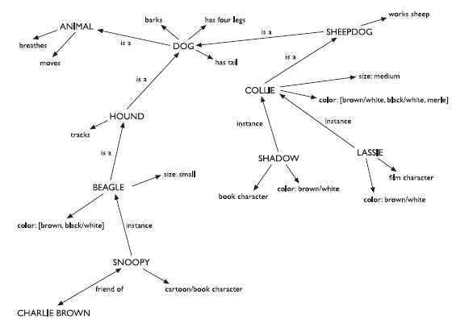
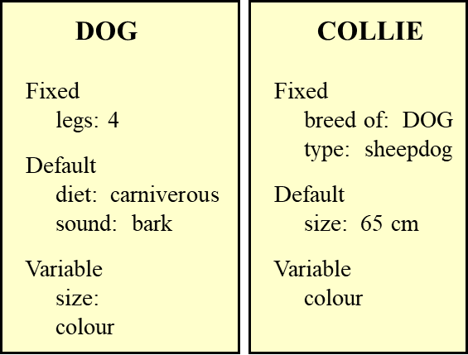
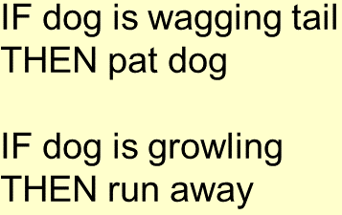
Long-term memory
Semantic network; Frames; Scripts; Production Rules
Semantic network: Items are associated to each other in classes and may inherit attributes from parent classes.
Frames: extend semantic networks to include structured hierarchical information.
Production Rules: Condition/action rules (if condition is matched then use rule to determine action)

Slide 3
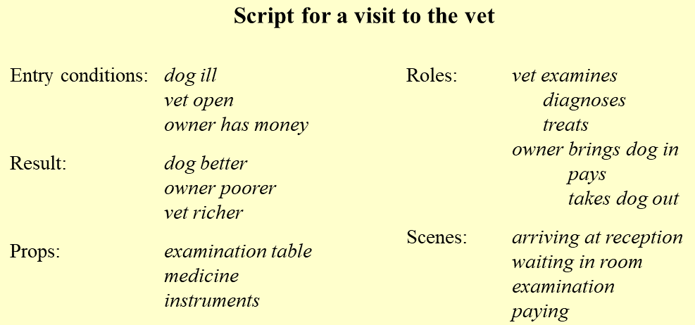
Scripts- attempt to model the representation of stereotypical knowledge about situations.
1.Entry conditions - Conditions that must be satisfied for the script to be activated.
2.Result -Conditions that will be true after the script is terminated.
3.Props -Objects involved in the events described in the script.
4.Roles -Actions performed by particular participants.
5.Scenes- The sequences of events that occur.

Slide 4
Thinking – Reasoning + Problem Solving
Types of reasoning: Deductive, Inductive, Abductive
Deductive reasoning : derive logically necessary conclusion from given premises. Like algebra a=b & b=c then a=c.
e.g. If it is Friday then she will go to work. It is Friday.
Therefore she will go to work.
Inductive reasoning : generalizing from cases we have seen to infer information about cases we have not seen.
e.g. all elephants we have seen have trunks therefore all elephants have trunks.
Abductive reasoning : when you take a set of observations and use a theory to explain them. This is very similar to how doctors work on patients by taking symptoms to make a diagnosis
e.g. Sam drives fast when drunk.
If I see Sam driving fast, assume drunk.

Slide 5
Problem solving: If reasoning is a means of inferring new information from what is already known, problem solving is the process of finding a solution to an unfamiliar task, using the knowledge we have.
Gestalt theory
Problem solving is both productive and reproductive.
Reproductive problem solving draws on previous experience but productive problem solving involves insight and restructuring of the problem.
Problem space theory
The problem has an initial state and a goal state and people use the operators to move from the former to the latter.
Such problem spaces may be huge, and so heuristics are employed to select appropriate operators to reach the goal.
Eg: Solving puzzles

Slide 6


Design of interactive systems Norman’s Execution-Evaluation Cycle
Gulf of Execution
Define goals
Gather knowledge
Develop action plan
Execute plan
Gulf of Evaluation
Observe results
Interpret results
Evaluate goals
Gulf of Execution: “How do I do it?”
Execution: Taking action to accomplish a specific goal
Commands and mechanisms need to match the goals, intention, and expectations of a person
Gulf of Evaluation: “What does it mean?”
Evaluation: Understanding the state of the system
Output needs to present a view of the system that is easily perceived, interpreted, and evaluated in terms of the user's goals and intentions?

Slide 7
Positioning, pointing and drawing
Text entry devices
QWERTY keyboard
Dvorak Layout
Special keyboards – kinetic keyboard, one hand keyboard
Numeric keypad
Chord keyboards
The mouse
Touchpads
Trackball – upside down mouse
Stylus
Joystick
Touch sensitive screen
Display devices
Bitmap displays – resolution and color
Virtually all computer displays are based on some sort of bitmap. That is the display is made of vast numbers of colored dots or pixels in a rectangular grid. These pixels may be limited to black and white, in grayscale, or full color.

Slide 8
Devices for virtual reality and 3D interaction
Positioning in 3D space: 3D virtual world. Users need to navigate and orient themselves through these spaces and manipulate the virtual objects they find there.
The 3D mouse: Rather than just moving the mouse on a tabletop, you can pick it up, move it in three dimensions, rotate the mouse and tip it forward and backward, left and right.
Seeing in 3D: To be able to look at a special 3D screen and see 3D images just as one does with a hologram.
VR motion: In real life when we move our head the image our eyes see changes accordingly. VR systems produce the same effect by using sensors in the goggles or helmet and then using the position of the head to determine the right image to show.

