Slide 1
Principle 1 : Recognize User Diversity
Novice or first-time users - The number of actions should be small, so they can carry out simple tasks successfully and thus reduce anxiety and build confidence. Informative feedback and step-by-step online tutorials may be effective.
Knowledgeable intermittent users - They have stable task concepts and broad knowledge of interface but have difficulty retaining the structure or location of features. Online help screens to fill in missing pieces of task or interface knowledge will benefit.
Expert frequent users - Familiar with the task and interface concepts and seek to get their work done quickly. Demand rapid response times, non-distracting feedback, and the shortcuts to carry out actions.

Slide 2
Interaction Styles
Command-Line Interface (CLI): Users interact with the computer by typing commands in a text-based interface.
Graphical User Interface (GUI): Users interact with the computer using graphical elements such as icons, buttons, and menus.
Menu-Based Interaction: Users navigate through a series of menus to access various functionalities. Menus can be hierarchical or linear.
Form-Based Interaction: Interaction involves filling out forms with fields, checkboxes, and buttons.
Natural Language Interaction: Users communicate with the computer using natural language, either spoken or written.
Gesture-Based Interaction: Users interact with the system through physical gestures, often using touchscreens or motion-sensing devices.
Voice-Based Interaction: Users interact with the system using spoken commands or queries.

Slide 3
Shneiderman's Eight Golden Rules of Interface Design (PROPOSED)
Permit Easy Reversal of Actions: Immediately discovering that it is easy to choose "Cancel" after making an error. They will feel less anxious and more willing to explore the options.
Reduce Short-Term Memory Load: Avoid overloading your site with information. You have to deduce which ones should be placed first or you will lose the user's attention.
Offer Informative Feedback: When a user submits a form online, provide immediate feedback indicating the success or failure of the submission. Displaying a message like "Your form has been submitted successfully" or "Please complete all required fields".
Offer Simple Error Handling: If something goes wrong, your system should make it easy for users to understand and resolve the problem.Eg: clear error notifications and descriptive hints.
Strive for Consistency: Whether it is the layout, the size of the button, the color code or the tone used when writing the page, it is important to be consistent throughout the site.
Support Internal Locus of Control: YouTube lets us choose how much notification we want to see, by doing this, YouTube is giving freedom to the users and making them feel like they have control over what they will receive.
Enable Frequent Users to Use Shortcuts: Allow your users to access all parts of the website with minimum of clicks. Eg: keyboard shortcuts which allows users to copy and paste.
Design Dialog to Yield Closure: In an e-commerce checkout process, break the payment into clear and sequential steps with a progress bar. At the completion of each step, provide a summary and a clear indication before moving to the next step.

Slide 4
Norman’s 7 Principles
Use Both Knowledge in the World and Knowledge in the Head – balances both the information that users can recall (knowledge in the head) and the information provided by the environment (knowledge in the world). This balance reduces cognitive load, making systems more user-friendly. Example: A web form that auto-fills common fields (like the user’s name and address) uses knowledge in the world to reduce effort. At the same time, it allows users to recall and input their less common details.
Simplify Task Structures - reduces the complexity of user interactions, leading to quicker and more efficient task completion without errors. Example: A one-click purchase option in online shopping simplifies the buying process by reducing the steps needed to complete a transaction.
Make Things Visible - ensures that users can easily find the functions and information they need minimizing errors. Example: A toolbar in a word processor that shows all the formatting options (bold, italic, underline) makes these functions visible, so users can access them quickly without needing to recall specific commands.
Get the Mapping Right - aligns the user’s expectations with the actual system design. This reduces confusion, enhances usability, and leads to more intuitive interactions. Example: Turning the wheel right makes the car go right, aligning the user's mental model with the car’s design.
Convert Constraints into Advantages - help users make fewer mistakes by restricting their actions to only what is possible or culturally acceptable. Example: In a software installation process, the "Next" button may be disabled until all required fields are filled, using technological constraints to ensure users complete necessary steps before proceeding.
Design for Error – predicting potential mistakes users might make and creating systems that help prevent or recover from them easily. This improves user satisfaction and reduces frustration. Example: An email application that asks for confirmation before sending a message without a subject line or attachment (when mentioned) helps users avoid common errors, such as sending incomplete emails.
When All Else Fails − Standardize - creates consistency across similar systems or interfaces, reducing the learning curve for users. Example: The use of Ctrl+C and Ctrl+V for copy and paste functions across most software applications is a standardized practice.

Slide 5
Web page distractions
Numerous visual and auditory interruptions.
Extensive visual clutter.
Poor information readability.
Confusing and inefficient navigation.
Excessive or inefficient page scrolling.
Information overload.
Design inconsistency.
Poor search facilities.

Slide 6
Consistency – Ensure same conventions and rules apply for all aspects of an interface.
Ordering of content - Divide information into units that are logical and meaningful by frequency of use, function and importance. Place critical information near the top of the Web site.
Navigation and Flow – place the most important and most frequently used elements or controls at the top left. Maintain a top-to-bottom, left-to-right flow.
Focus and Emphasis – Blinking, Line rulings, Color, Larger size, Animation, Positioning, Distinctive or unusual shape, Isolation. The fewer elements you have on a page, the easier it is to understand what you intended to communicate.
Typography - In screen design, different fonts and font sizes are used to organize information, establish importance, establish a reading order, and create a particular mood.
Visually pleasing composition - Balance, Symmetry, Regularity, Predictability, Sequentiality, Economy, Unity, Proportion, Simplicity, Groupings

Slide 7
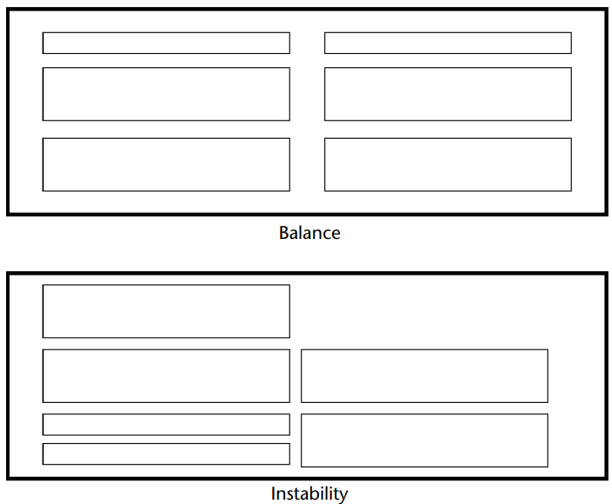
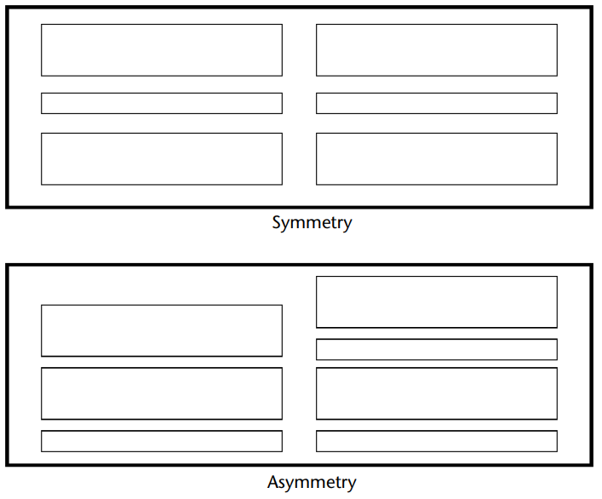
Balance/Symmetry
Create screen balance by providing an equal weight of screen elements, left and right, top and bottom.

Slide 8
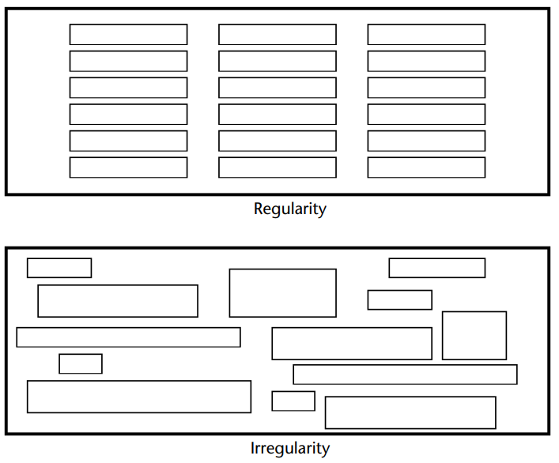
Regularity
Create regularity by establishing standard and consistently spaced horizontal and vertical alignment points.
Also, use similar element sizes, shapes, colors, and spacing.

Slide 9
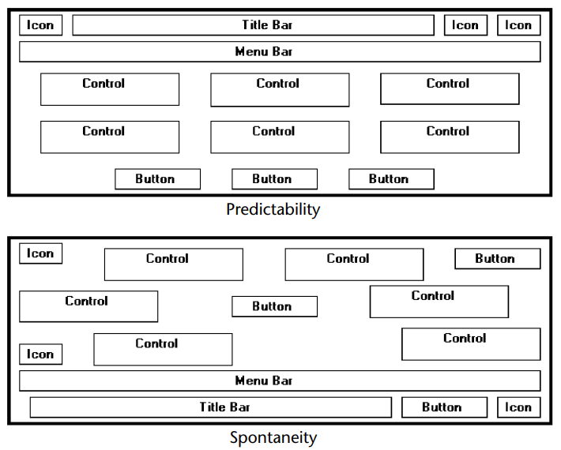
Predictability
Create predictability by being consistent and following conventional orders or arrangements

Slide 10
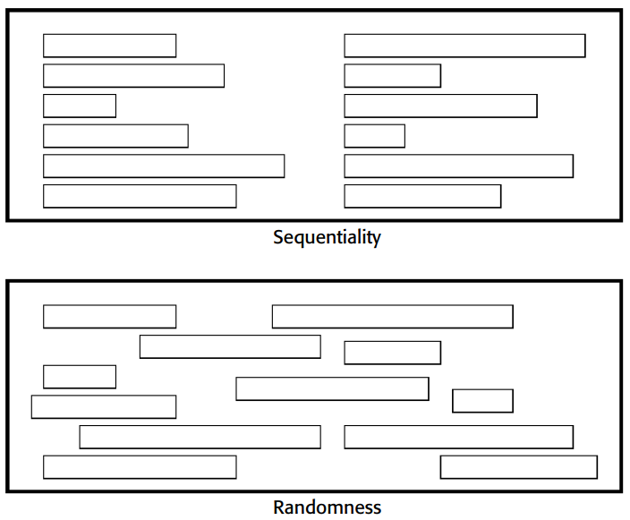
Sequentiality
Provide sequentiality by arranging elements to guide the eye through the screen in an obvious, logical, rhythmic, and efficient manner.
The eye tends to be attracted to
A brighter element before one less bright.
Graphics before text.
Color before black and white.
A big element before a small one.
An unusual shape before a usual one.

Slide 11
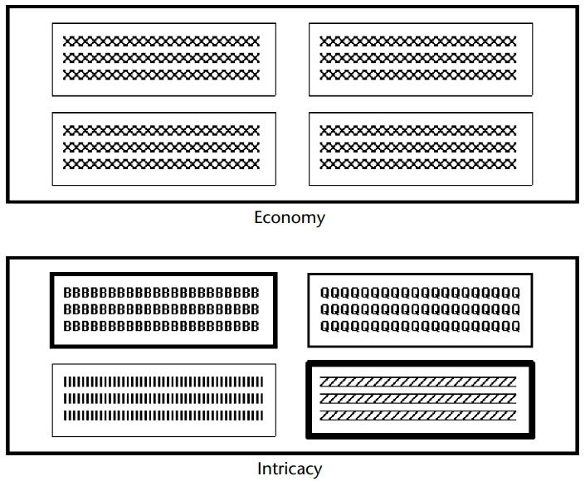
Economy
Provide economy by using as few styles, display techniques, and colors as possible

Slide 12
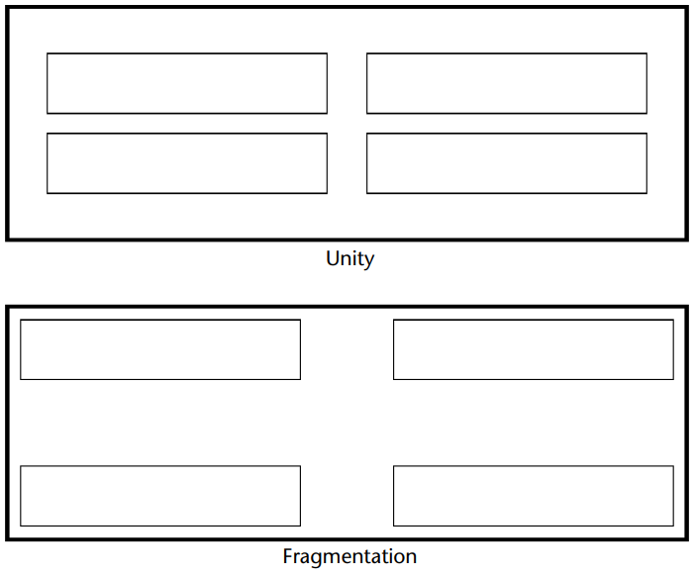
Unity
Create unity by
Using similar sizes, shapes, or colors for related information.
Leaving less space between elements of a screen than the space left at the margins.

Slide 13
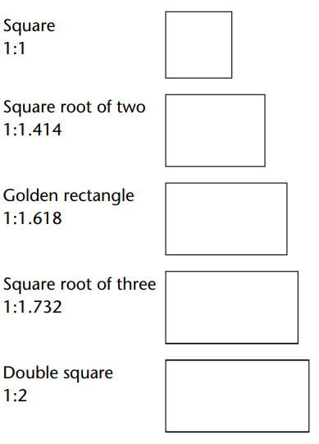
Proportion
Create windows and groupings of data or text with aesthetically pleasing proportions.

Slide 14
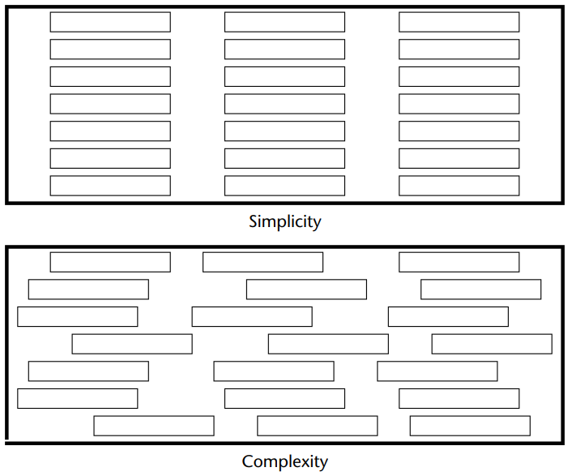
Simplicity (Complexity)
Optimize the number of elements on a screen, within limits of clarity.
Minimize the alignment points, especially horizontal or columnar.
Provide standard grids of horizontal and vertical lines to position elements.

Slide 15
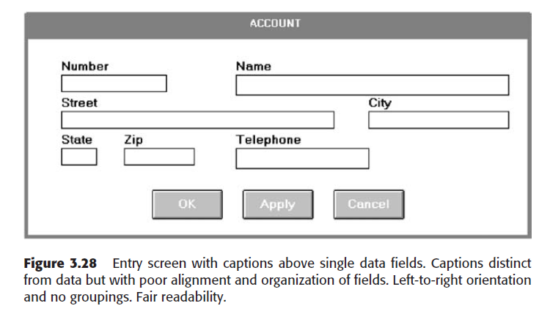
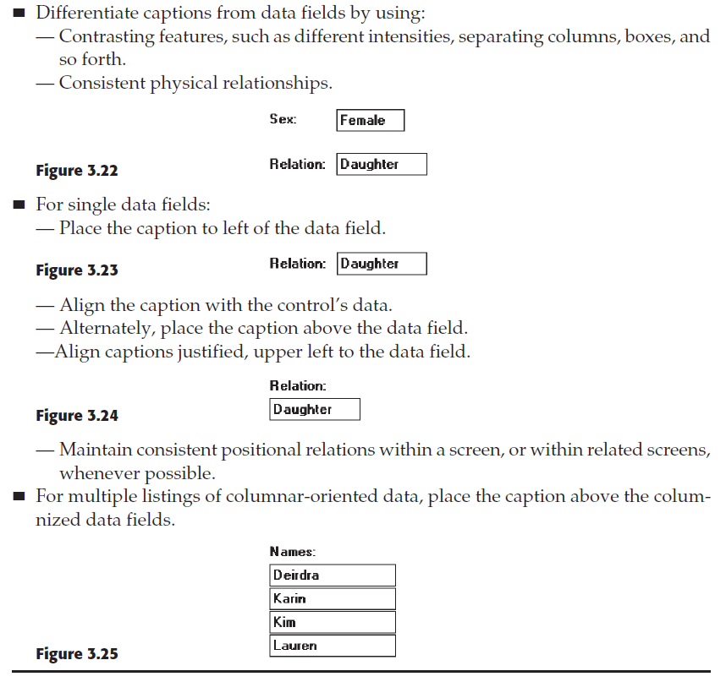
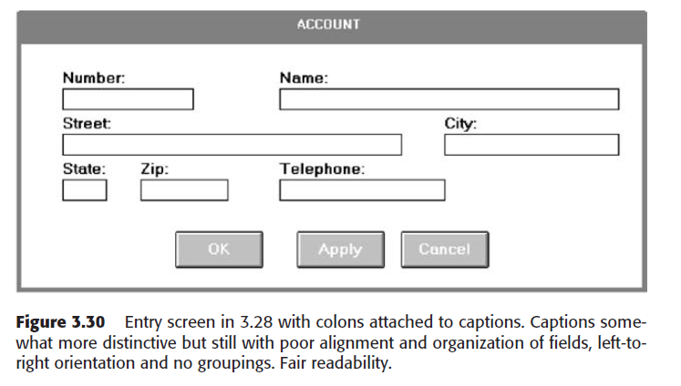
Screen elements - Control Captions &Data Fields

Slide 16
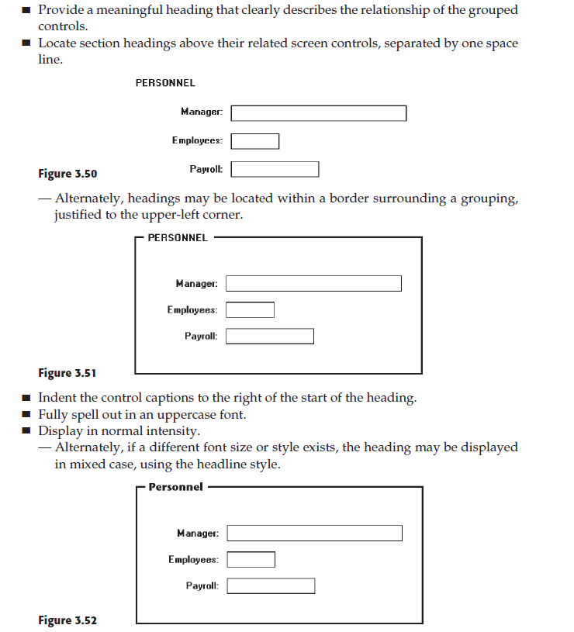
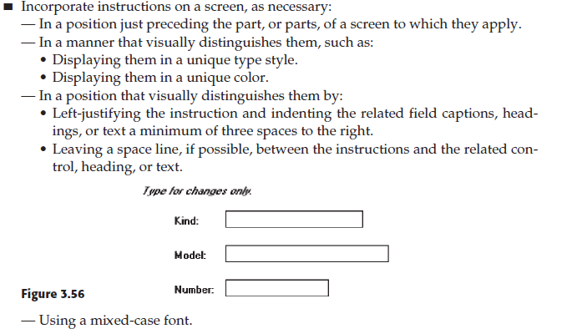
Section Headings
Instructions

Slide 17
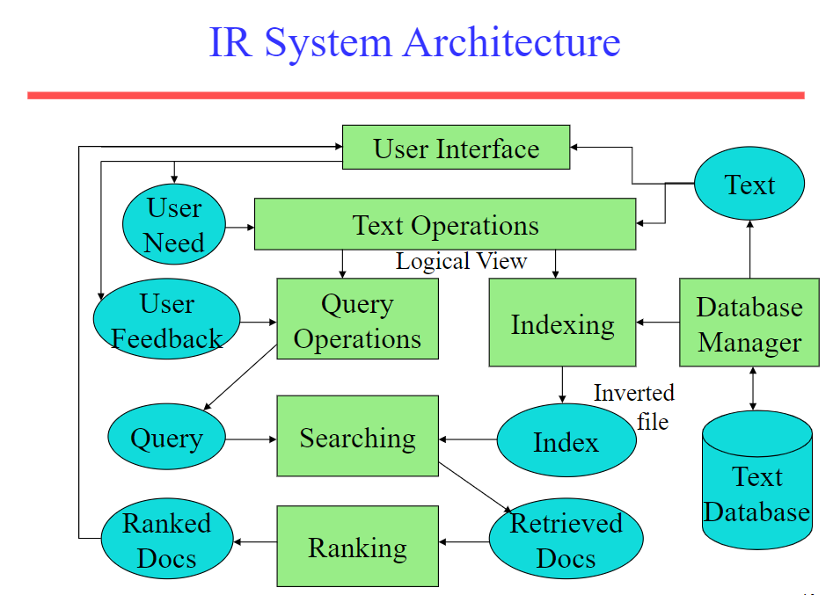

Slide 18
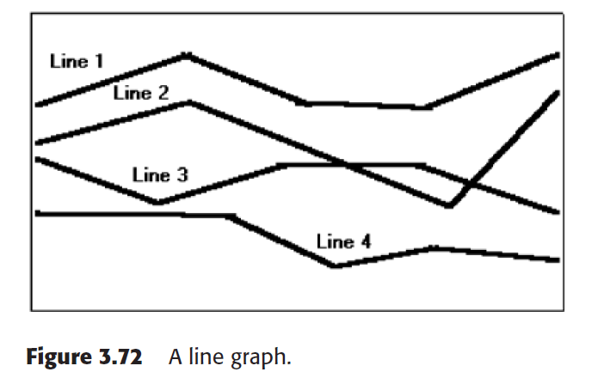
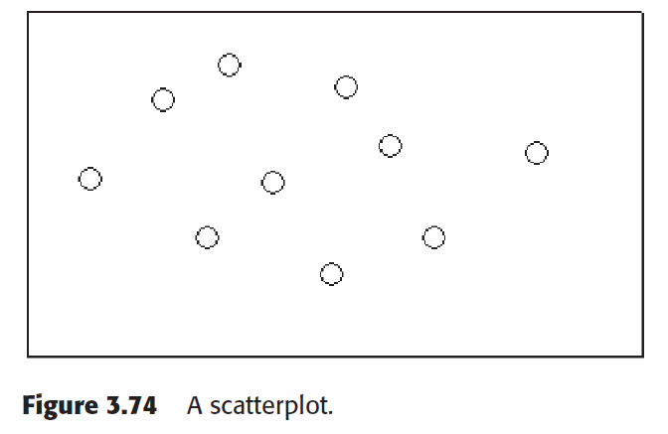
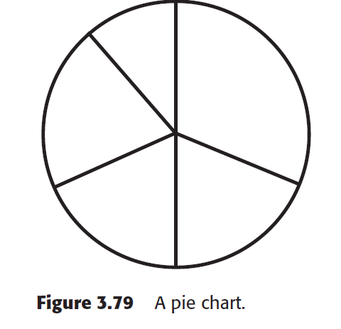
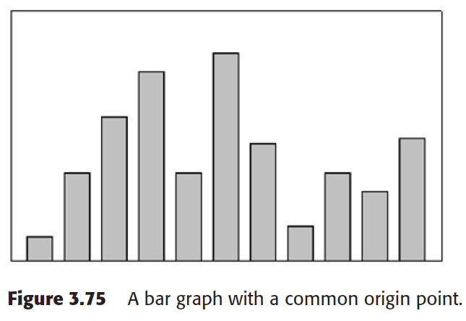
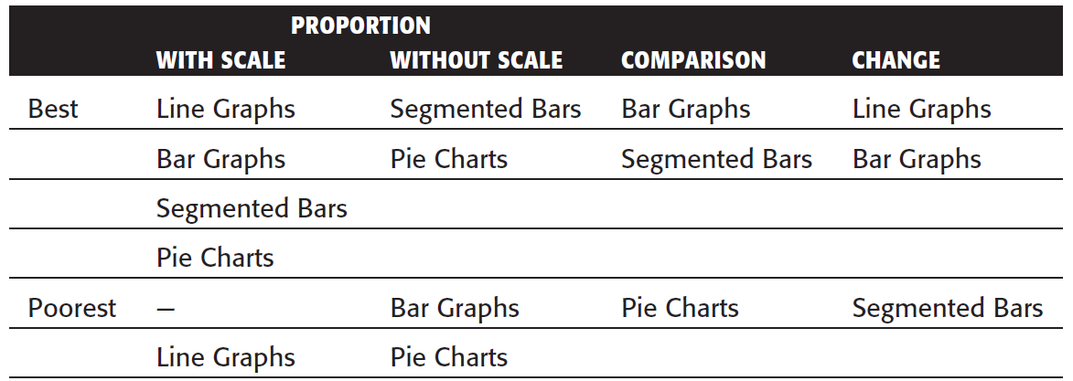
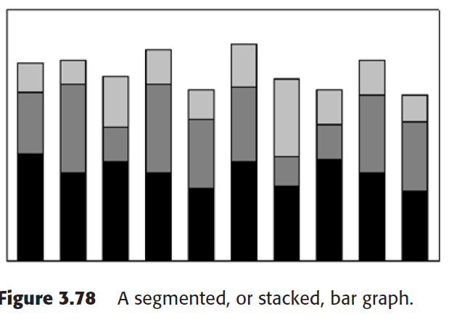
Statistical graphics
Curves and line graphs can be used to show relationships between sets of data defined by two continuous variables. They are especially useful showing data changes over time.
Scatterplots can be used to show relationships among individual data points in a two-dimensional array.
Bar graphs can be used to show a few differences between separate entities or to show differences in a variable at a few discrete intervals.
Segmented or Stacked Bars If both the total measure of a value and its component portions are of interest
Flowchart If the data to be displayed flows in a complex, yet sequential

Slide 19
Graphical Systems
■ Screen design must be compatible with the capabilities of the system, including:
— System power.
— Screen size.
— Screen resolution.
— Display colors.
— Other display features.
■ Screen design must be compatible with the capabilities of the:
— System platform being used.
— Development and implementation tools being used.
— Platform style guide being used.

Slide 20
Browsers
■ Compatibility:
— Make the Web site accessible to all users’ browsers.
— Use browser defaults as much as possible.
■ Monitor size and resolution:
— Design within the boundaries of an image-safe area for all browsers.
— Present images at a resolution appropriate for all users’ monitors.
■ Fonts:
— Use fonts that can be displayed on a variety of browsers.
■ Colors:
— Use colors that succeed on a variety of browsers and platforms.
• A palette of 216 colors.
■ Bandwidth:
— Design for the most commonly used bandwidth.
• A 56-kbps modem is most common for home users.
■ Versions
— Create multiple versions that support multiple browsers.
• Always provide a text-only version.
• Make use of browser sniffers.

Slide 21
Other Web Considerations
■ Downloading:
— Provide fast page download times, no more than 8 to 10 seconds per page.
• Minimize the use of design techniques that cause longer download times.
– Long pages.
– Large chunky headings.
– Numerous or large graphics and images.
– Animation.
– Excessive amount of color.
– Excess use of frames.
— Provide enough information to the user so that whether or not to request a download
can be determined, including:
• Program or document description.
• Type of download.
• Size of download.
• Download version.
• Estimated loading time.
• Special operating requirements.
■ Currency:
— Keep Web site information current.
■ Page printing:
— Provide a means to print:
• Groups of related pages.
• Individual pages.
• Sections of pages.
■ Maintainability:
— Ensure easy Web site maintainability.

Slide 22
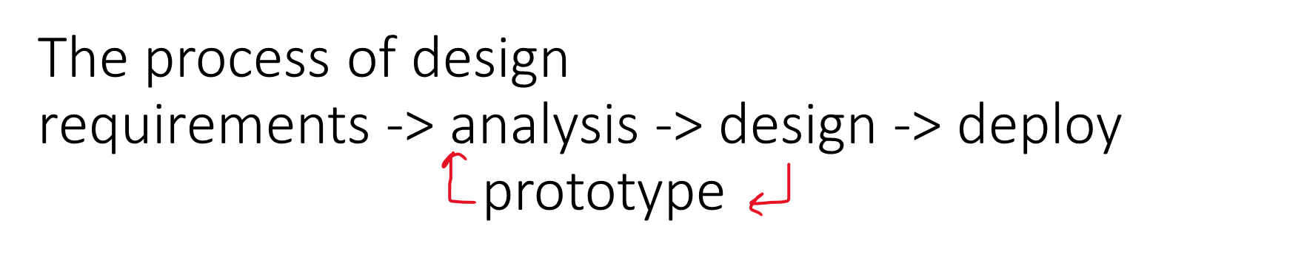
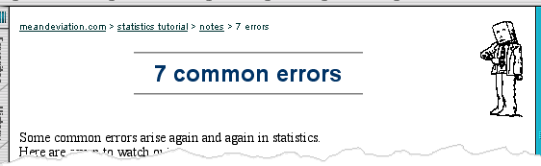
Where you are
shows path through web site hierarchy
top level category
sub-category
web site
this page
live links
to higher
levels

Slide 23
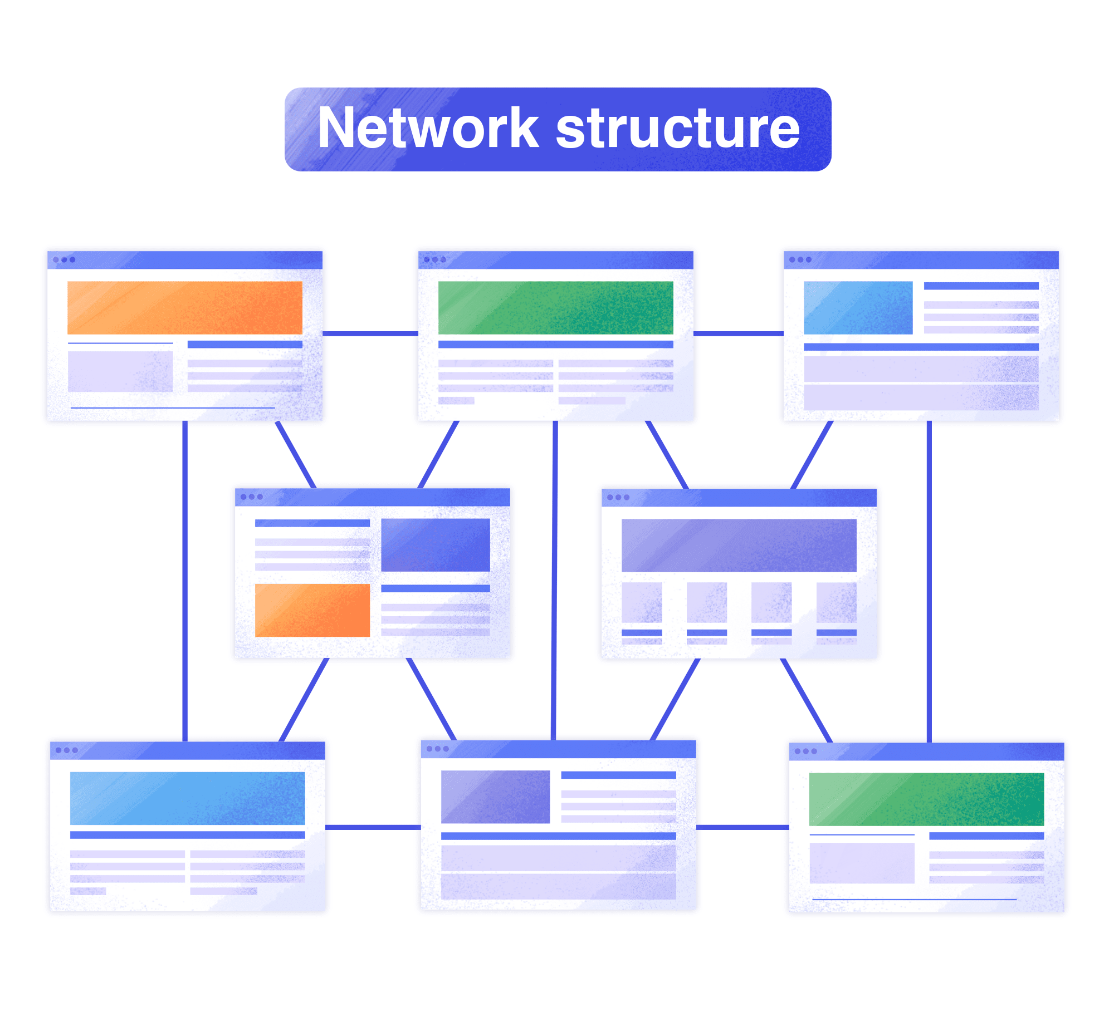
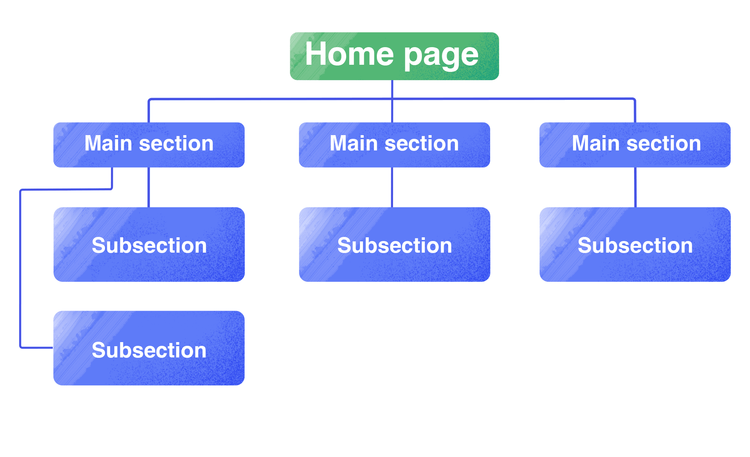
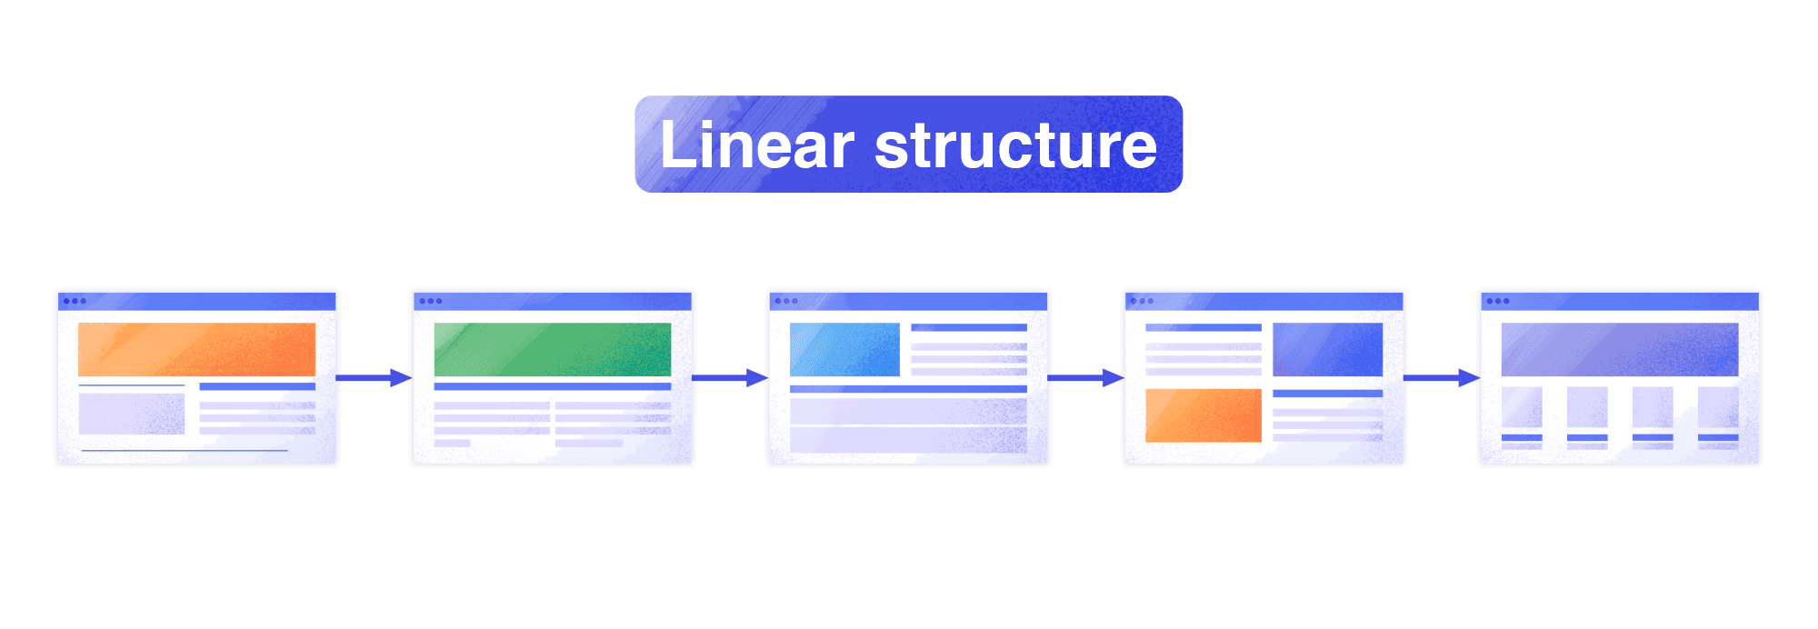
Hierarchical Diagrams
Network Diagrams
show different paths through system
what leads to what
what happens when
including branches
more task oriented then hierarchy

Slide 24
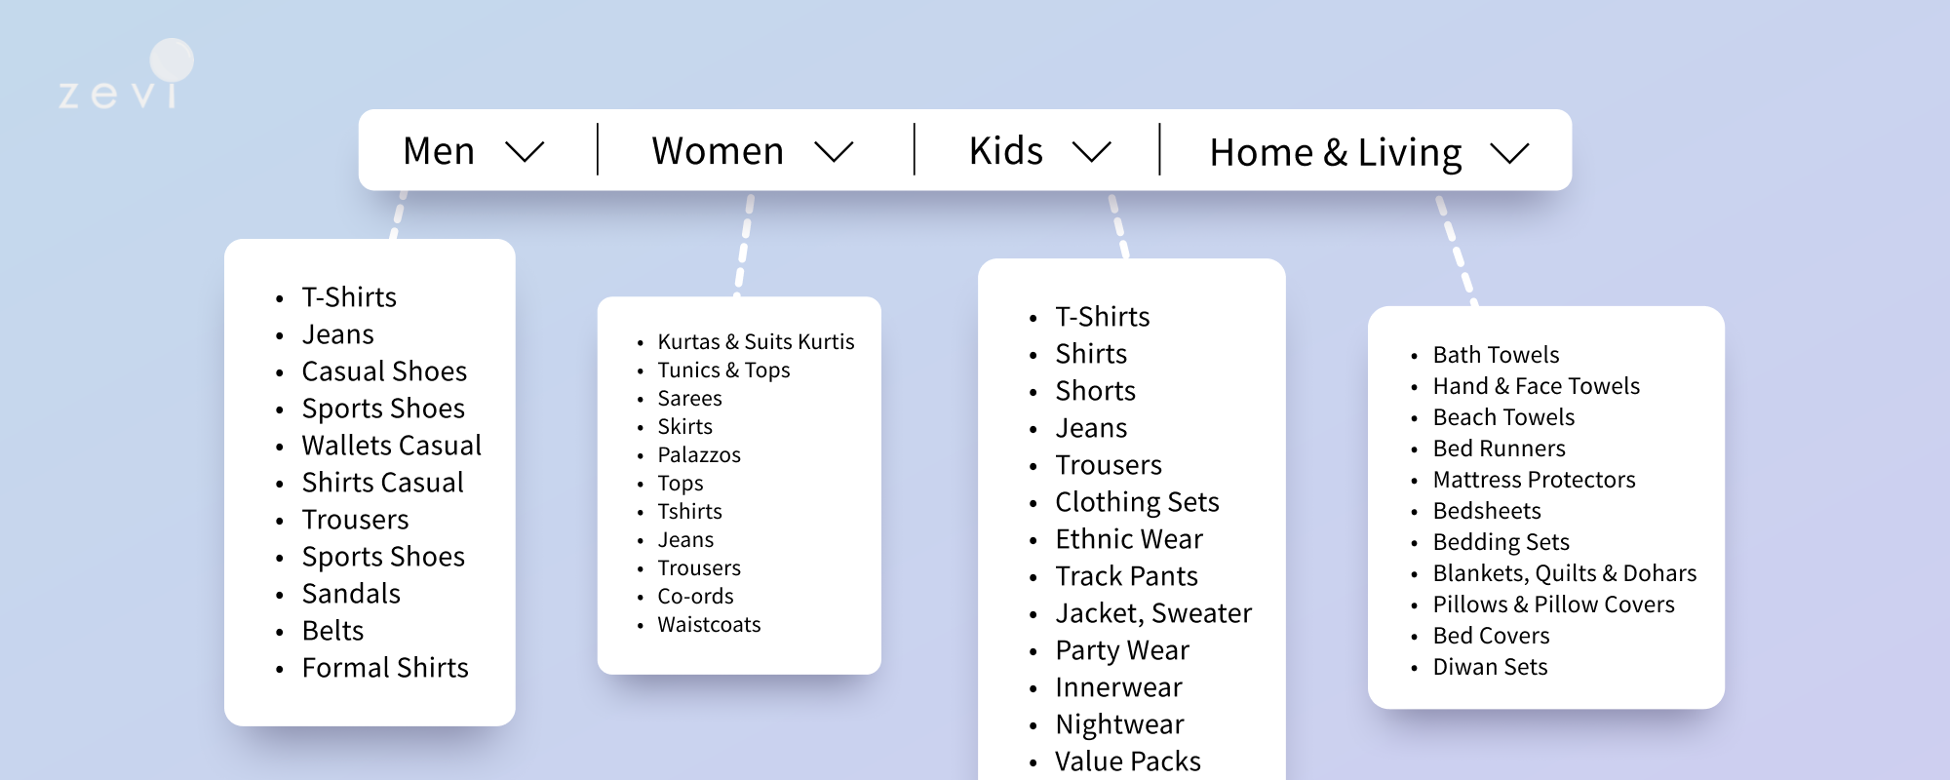
Order of groups and items

Slide 25
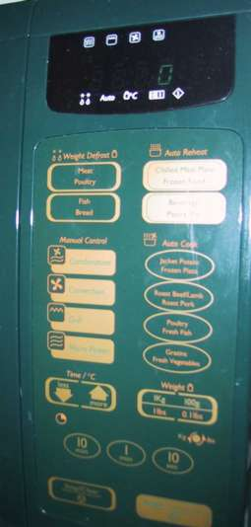
Physical Controls
grouping of items
defrost settings
type of food
time to cook

Slide 26
Physical Controls
grouping of items
Order of Items
1) type of heating
1
2) temperature
2
3) time to cook
3
4) start
4

Slide 27
Physical Controls
grouping of items
order of items
decoration
different colours for different functions
lines around related buttons (temp up/down)

Slide 28
Physical Controls
grouping of items
order of items
decoration
alignment
centered text in buttons - easy to scan

Slide 29
Physical Controls
grouping of items
order of items
decoration
alignment
white space
gaps to aid grouping

Slide 30
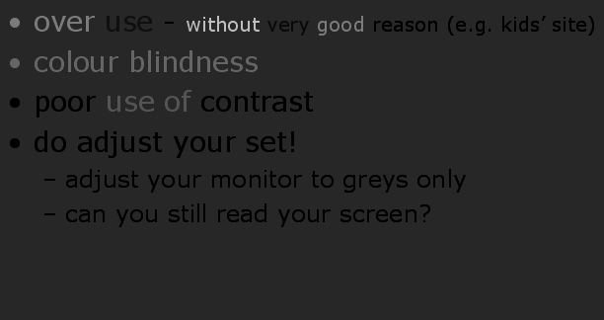
bad use of colour
over use - without very good reason (e.g. kids’ site)
colour blindness
poor use of contrast
do adjust your set!
adjust your monitor to greys only
can you still read your screen?

Slide 31
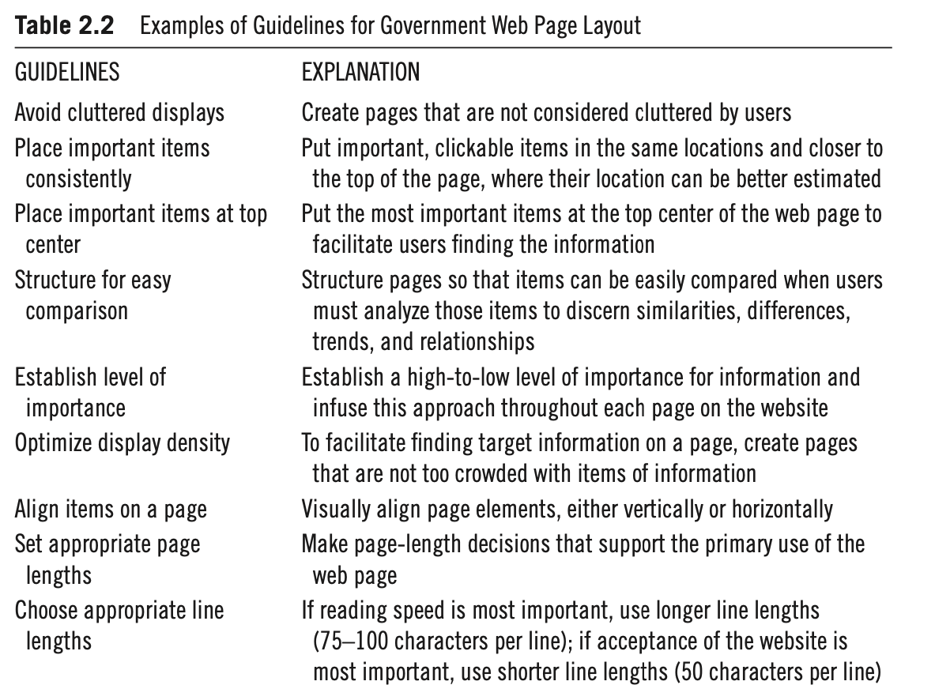

Slide 32
Input methods to facilitate data entry
Consistency of data-entry transactions:
Minimal input actions by user
Minimal memory load on users
Compatibility of data entry with data display
Clear and effective labeling of buttons and data-entry fields
Match and place the sequence of data-entry and selection fields in a natural scanning and hand-movement direction
Design of form and dialog boxes
Flexibility for user control of data entry

Slide 33

Comparison of two mobile game interfaces (the initial entry screen): (a) information and object density is needlessly high and distracting (left), (b) simple and minimal layout, and object sizes fitted to ergonomic usage (right).

Slide 34
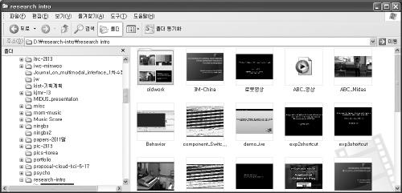
The use of a two-panel selector, a design pattern for information structuring and facilitated navigation.

Slide 35
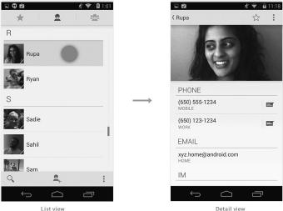
Android design guideline promoting the use of list views and detailed views (multiple panels) to efficiently use the screen size of mobile devices.

Slide 36
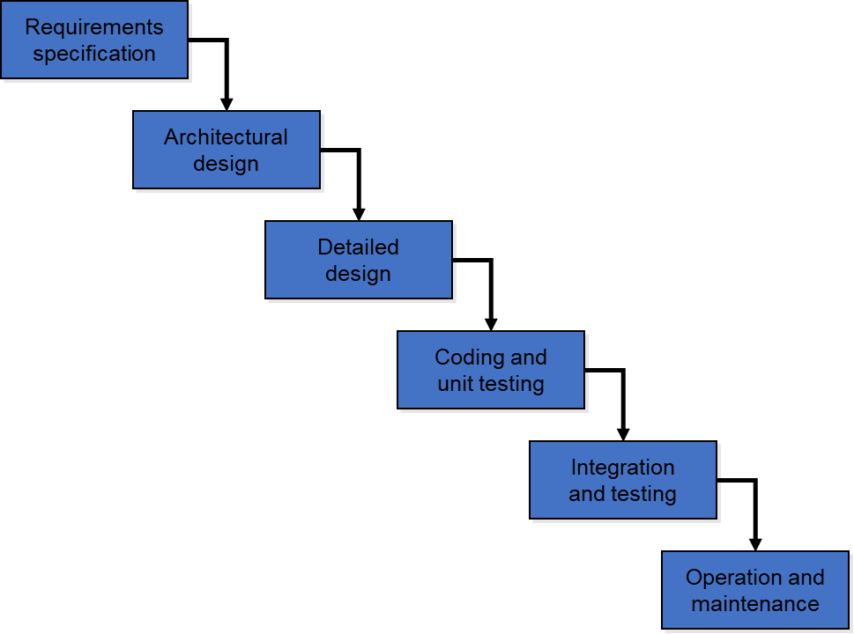
Software Life Cycle - Waterfall Model
Iterative design and prototyping

Slide 37
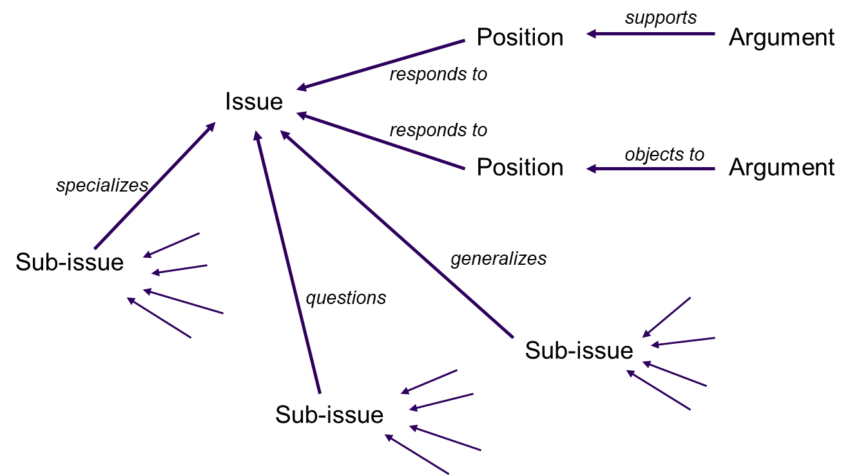
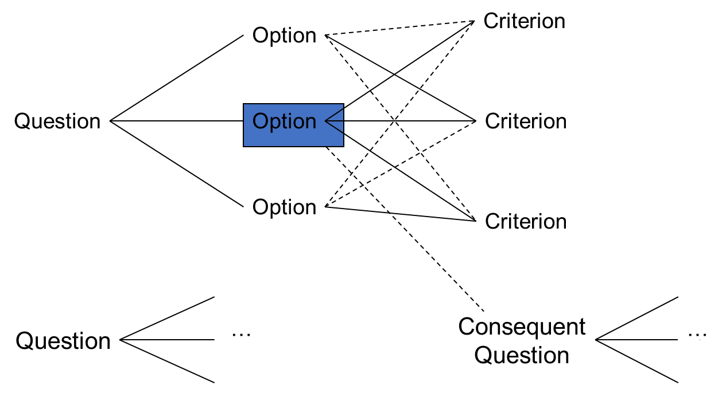
Issue-based information system (IBIS)
Design rationale
communication throughout life cycle, reuse of design knowledge across products, organizes potentially large design spaces
QOC
process-oriented - preserves order of deliberation and decision-making
Issues – hierarchical structure with one ‘root’ issue
Positions – potential resolutions of an issue
Arguments – modify the relationship between positions and issues
structure-oriented - emphasizes post hoc structuring of considered design alternatives
Questions (and sub-questions) – represent major issues of a design
Options - provide alternative solutions to the question
Criteria – the means to assess the options in order to make a choice

