Slide 1
Validation Techniques
Usability Testing
User Interviews
Surveys
Expert Evaluations
Heuristic Evaluation
Cognitive Walkthrough
Prototype Testing
Field Studies

Slide 2
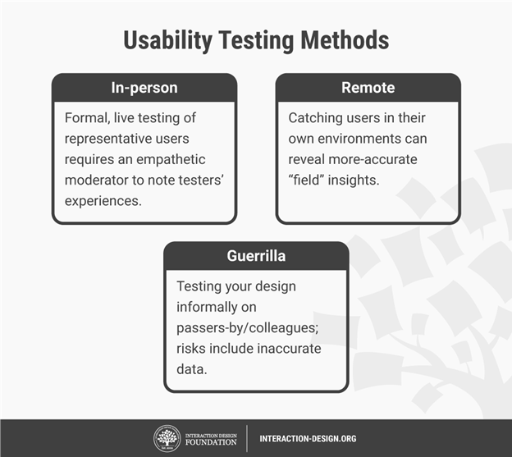
Usability Testing Process
Plan – Define what you want to test and how to conduct your test
Set user tasks – Prioritize the most important tasks, Clearly define tasks with realistic goals.
Recruit testers – Use screening questionnaires (e.g., Google Forms) to find suitable candidates or advertise and offer incentives. You can also find contacts through community groups, etc.
Facilitate testing – Set up testing in a suitable environment.
Assess user behaviour – Quantitative – time users take on a task, success and failure rates, effort and Qualitative – users’ stress responses, subjective satisfaction and perceived level of effort/difficulty
Create a test report – Review video footage and analyzed data. Clearly define design issues and best practices.

Slide 3
Interface Testing Process
Usability Testing: Evaluate how easily users can navigate the site, search for products, and complete purchases by observing their interactions and gathering feedback.
Navigation Testing: Ensure users can efficiently browse and access information pages, with clear and intuitive navigation labels.
Functionality Testing: Verify that all website features, like product search, filtering, and checkout, work correctly without errors.
Compatibility Testing: Test the website across various devices and browsers to ensure consistent functionality and appearance. Check how well the site adapts to different screen sizes and orientations for seamless use across devices.
Accessibility Testing: Ensure the website is accessible to users with disabilities
Performance Testing: Measure site speed, responsiveness, and stability
Security Testing: Assess and mitigate security risks, ensuring data protection
User Feedback Collection: Gather feedback from users through surveys or interviews to identify areas for improvement.
Iterative Testing and Improvement: Continuously refine the website based on testing results and feedback to enhance usability, performance, and security.

Slide 4
User Acceptance Testing
Unlike other forms of testing, which focus on technical aspects such as functionality and performance, UAT specifically assesses the system from the perspective of the end users. (Similar to usability testing)
Define Acceptance Criteria: Set clear success criteria based on user feedback and usability goals.
Select Test Participants: Choose a diverse group of end users who represent target audience.
Develop Test Scenarios: Create realistic tasks that reflect typical user activities.
Observe and Document: Track user performance, noting any issues or challenges.
Collect User Feedback: Gather opinions and suggestions for improvements from participants.
Iterate and Improve: Make iterative changes based on feedback to enhance the platform.
Final Acceptance Decision: Approve the platform for release once it meets user expectations.

Slide 5
Heuristic evaluation
Here are examples for each of Jakob Nielsen's 10 Usability Heuristics: (C H H A U F E R V M)
Consistency and Standards - In a word processor, using standard icons like a disk for "Save" and a pencil for "Edit" aligns with common user expectations across different applications.
Help Users Recognize, Diagnose, and Recover from Errors - When an incorrect password is entered, a system shows an error message like "Incorrect password. Please try again," and provides a link to reset the password.
Help and Documentation - A help icon or "?" button is present on each screen of an app, leading to relevant documentation or tips for using that feature.
Aesthetic and Minimalist Design - A weather app displays only the essential information, such as temperature and weather conditions, without overwhelming users with unnecessary details.
User Control and Freedom - A "Cancel" button in a form submission allows users to back out of the process if they change their mind, providing an easy way to undo actions.
Flexibility and Efficiency of Use - A photo editing software allows expert users to use keyboard shortcuts while still providing a menu interface for beginners.
Error Prevention - A form provides dropdown menus for selecting dates to prevent invalid entries, reducing the chances of error
Recognition Rather than Recall - When writing an email, the system suggests email addresses as the user types, reducing the need for the user to remember exact addresses.
Visibility of System Status - A file upload progress bar showing the percentage completed informs users about the ongoing process, helping them understand how much time remains.
Match Between the System and the Real World - An e-commerce app uses a shopping cart icon and terminology like "Add to Cart" and "Checkout," which match the real-world concept of shopping.

Slide 6
Types Of Evaluation
1. Field Studies: To understand real-world usage, gather insights about how users interact with the system in their daily routine in the user's natural environment, such as a workplace or home, where they typically interact with the system.
Advantages: Provides authentic data, captures environmental influences, and identifies real-world problems.
Limitations: Less control over variables, potential distractions, and difficulty in replicating conditions for consistency.
Example: Observing how a user interacts with a navigation app while driving in the city.
2. Laboratory Studies: Evaluations conducted in a controlled environment where conditions are manipulated to test specific aspects.
Advantages: Allows control over variables, easy replication of conditions, and in-depth monitoring using tools like eye-tracking.
Limitations: May not reflect real-world use, users can feel self-conscious.
Example: Testing the usability of a website by asking users to complete tasks in a usability lab while tracking their mouse movements and facial expressions.
3. Experimental Evaluation: A more formal and structured evaluation conducted under controlled conditions, often comparing different interfaces or versions, to test hypotheses about specific design features, and measure objective metrics (e.g., task completion time, error rate).
Advantages: Provides statistical data for validating hypotheses and allows precise measurement of variables.
Limitations: Time and resources, results can be influenced by laboratory effects, and findings might not always translate to real-world contexts.
Example: Comparing the effectiveness of two navigation menu designs on a website by measuring the time users take to find specific information.

Slide 7
Evaluation Design
Cognitive Walkthrough: usually performed by expert in cognitive psychology. expert ‘walks though’ design to identify potential problems using psychological principles
For each task walkthrough considers
what impact will interaction have on user?
what cognitive processes are required?
what learning problems may occur?
how well design supports user in learning task?
Heuristic Evaluation: design examined by experts to see if usability criteria (heuristics) are violated: Example heuristics-
system behaviour is predictable
system behaviour is consistent
feedback is provided
Review-based evaluation: Results used to support or change parts of design. e.g. GOMS prediction of user performance.

Slide 8
Observational Methods
Think Aloud: Users verbalize their thoughts while performing tasks, revealing their cognitive processes. Useful for understanding how users interact with a system and identifying usability issues.
Cooperative Evaluation: The evaluator and user collaborate during testing. The evaluator can ask questions and clarify user actions, allowing for deeper exploration of user behavior.
Protocol Analysis: User actions and thoughts are recorded and systematically analyzed to understand decision-making and task performance.
Automated Analysis: Software tools track and analyze user behavior, providing objective data such as click patterns, time on tasks, and navigation paths. Ideal for large-scale, quantitative analysis.
Post-task Walkthroughs: After task completion, users reflect on their actions and decisions, providing additional insights into usability challenges and their thought process.

Slide 9
Interviews:
analyst questions user on one-to -one basis usually based on prepared questions
Advantages
can be varied to suit context
issues can be explored more fully
informal, subjective and relatively cheap
Disadvantages
very subjective
time consuming
Questionnaires
Set of fixed questions given to users
Advantages
quick and reaches large user group
can be analysed more rigorously
Disadvantages
less flexible
less subjective
Physiological measurements: emotional response linked to physical changes like:
heart activity, including blood pressure, volume and pulse.
Eye-tracking (fixations, scan paths, REM)
activity of sweat glands
electrical activity in muscle
electrical activity in brain

