Slide 1
Sensors: Temperature sensors, Pressure sensor, Proximity sensor, Air quality sensor , Humidity sensor
Actuators: Converts some form of energy into motion such as linear, rotary, and oscillatory.
Electric Actuator: converts electrical energy of AC or DC form into kinetic energy of mechanical motion. Eg: AC motor
Pneumatic actuators: uses compressed air at high pressure and convert this energy into motion. Eg: Air brake
Hydraulic actuator: uses the liquid for generating motion. Eg: hydraulic cranes
Thermal Actuator: converts thermal energy into kinetic energy. Eg: Thermostatic valves

Slide 2
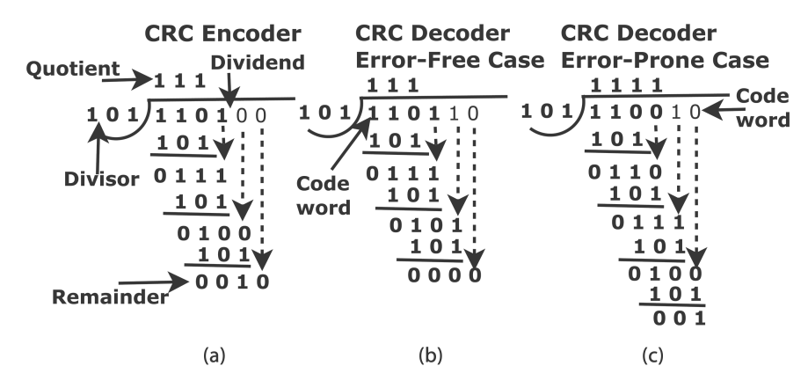
Error control in Data Link Layer- Cyclic Redundancy Check: Example
Let data length k_{b}=4 and code word length be n_{b}=6
No. of bits to be appended = n_{b}-k_{b}=2
Let data be x³+x²+1=1101, generator polynomial be x²+1=101

Slide 3
Repeater
A repeater operates at the physical layer. It is a 2 port device.
Its job is to amplify/regenerate the signal over the same network before the signal becomes too weak or corrupted
Hub
A hub is a basically multi-port repeater.
A hub connects multiple wires coming from different branches, eg: in star topology
Hubs cannot filter data, so data packets are sent to all connected devices.
Also, they do not have the intelligence to find out the best path for data packets which leads to inefficiencies and wastage.
Modem
Operates in physical layer.
converts digital signals generated by the computer into analog signals which are transmitted over cable line and transforms incoming analog signals into digital equivalents.
Bridge
A bridge operates at the data link layer.
A bridge is a repeater, with add on functionality of filtering content by reading the MAC addresses of the source and destination.
It has a single input and single output port, thus making it a 2 port device.
Switch
A switch is a data link layer device.
A switch is a multiport bridge that can boost its efficiency and performance. (a large number of ports imply less traffic)
The switch can perform error checking before forwarding data, which makes it very efficient as it does not forward packets that have errors and forward good packets selectively to the correct port only.
Routers
The router is mainly a Network Layer device.
A router is like a switch that routes data packets based on their IP addresses.
Routers have a dynamically updating routing table based on which they make decisions on routing the data packets.
Gateway
Gateways operate at Network layer.
Connect two networks that may work upon different networking models.
An Internet of Things (IoT) gateway is a physical device or software program that serves as the connection point between the cloud and controllers, sensors and intelligent devices. It can provide additional security.

Slide 4
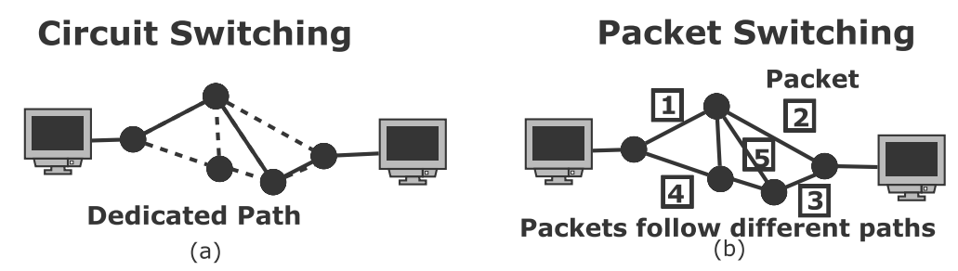
Circuit Switching and Packet Switching
Circuit switching is a communication method where a dedicated communication path, or circuit, is established between two devices before data transmission begins. The circuit remains dedicated to the communication for the duration of the session, and no other devices can use it while the session is in progress.
Packet switching is a communication method where data is divided into smaller units called packets and transmitted over the network. Each packet contains the source and destination addresses, as well as other information needed for routing. The packets may take different paths to reach their destination, and they may be transmitted out of order or delayed due to network congestion.

Slide 5
IPv4 Addresses
The IPv4 address consists of two parts, namely, network ID and host ID.
Subnet mask is used to separate IP address into network address and host address.
The IPv4 address has 32 bits or 4 octets in total. In each octet, the value could be between 0 and 255 in decimal.

Slide 6
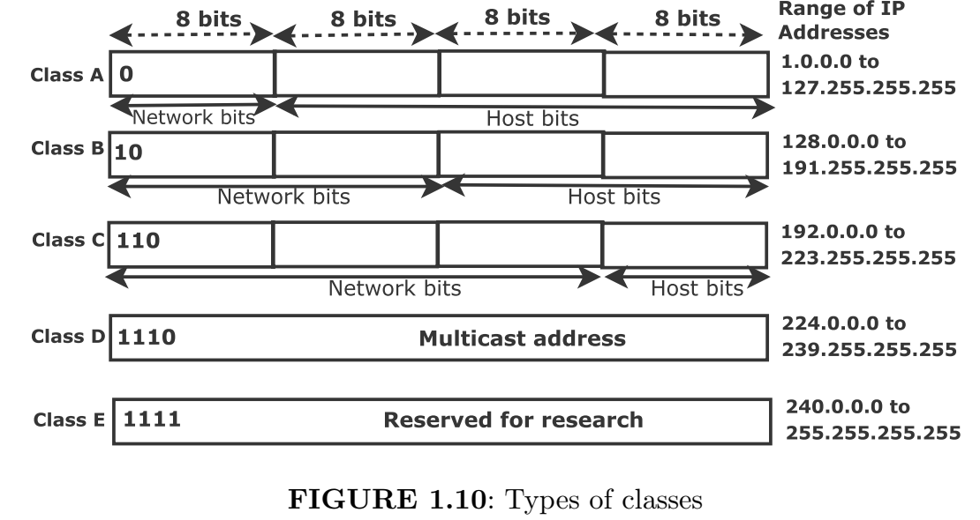
Subnet Mask
Class A: The first one octet is of network and rest three octets are of host. Therefore, subnet mask for this class is 1111 1111.0000 0000.0000 0000.0000 0000 in binary, that is, 255.0.0.0 in decimal.
Class B: The first two octets are of network and the rest two octets are of the host. Therefore, the subnet mask for this class is 1111 1111.1111 1111.0000 0000.0000 0000 in binary, that is, 255.255.0.0 in decimal.
Class C : The first three octets are of network and the rest one octet is of the host. Therefore, the subnet mask for this class is 1111 1111.1111 1111.1111 1111.0000 0000 in binary, that is, 255.255.255.0 in decimal.

Slide 7
Number of Network IDs and Host IDs:
However, the actual number of hosts is equal to 2^{host bits}−2.
We subtract 2 because we cannot use the first ID which is a network ID and the last ID which is a broadcast ID.
For example, IP 130.5.10.15 belongs to class B. Therefore, the first 16 bits are of the network and the next 16 bits are of the host.
In this example, the network ID is 130.5.0.0. and the broadcast ID 130.5.255.255 cannot be used.

Slide 8
Number of Network IDs and Host IDs:
The number of usable hosts in:
class A: 2²⁴ − 2 = 1,67,77,214
class B: 2¹⁶ − 2 = 65534
class C: 2⁸ − 2 = 254
number of networks for
class A: 2⁷ = 128,
class B: 2¹⁴ = 16384
class C: 2²¹ = 20,97,152
Therefore, class A supports a large number of hosts for a large organization, class B for a medium sized organization, and class C for a small number of hosts in a small organization.

Slide 9
Identify the classes of the IPs: 110.10.20.30, 150.10.20.30, and 200.10.20.30, and find the network IDs, broadcast IDs, and the number of actual hosts for the given IP.
110.10.20.30
Class: A (since it falls within 1.0.0.0 to 126.255.255.255)
Default Subnet Mask: 255.0.0.0, Network ID: 110.0.0.0, Broadcast ID: 110.255.255.255
Number of Hosts: 2²⁴ − 2 = 1,67,77,214 (total hosts in the network, excluding network and broadcast addresses)
150.10.20.30
Class: B (since it falls within 128.0.0.0 to 191.255.255.255)
Default Subnet Mask: 255.255.0.0. Network ID: 150.10.0.0, Broadcast ID: 150.10.255.255
Number of Hosts: 2¹⁶ − 2 = 65534 (total hosts in the network, excluding network and broadcast addresses)
200.10.20.30
Class: C (since it falls within 192.0.0.0 to 223.255.255.255)
Default Subnet Mask: 255.255.255.0, Network ID: 200.10.20.0, Broadcast ID: 200.10.20.255
Number of Hosts: 2⁸ − 2 = 254 (total hosts in the network, excluding network and broadcast addresses)

Slide 10
Subnet
It is a network within the network or division of IP address. A network can connect several computers, say 254 computers in class C. However, if we connect only 10 computers, then 254 − 10 = 244 IPs are wasted.
First Approach: Make a large routing table of 254 entries in the main
router. When some packets arrive, direct them to an appropriate subnet. This approach is highly complex if we use class A or B.
Second Approach: Say for class C, we have 24 bits for the network and 8 bits for the host. We can borrow some bits from the host to network. Let us consider the following example to illustrate it.

Slide 11
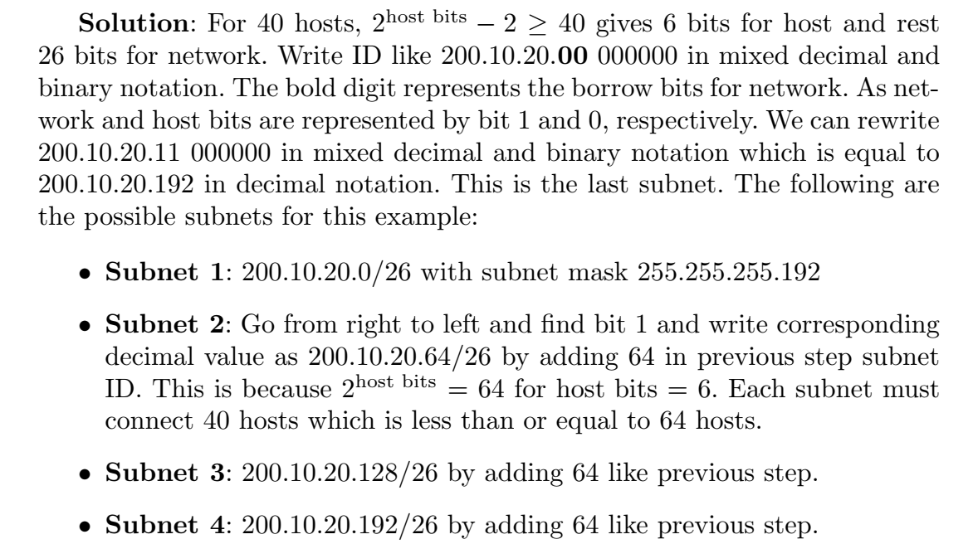

Example of Subnet: Consider a class C network ID 200.10.20.0/24 with subnet mask 255.255.255.0. Make different possible subnets for 40 hosts in each subnet.

Slide 12
Classless Interdomain Routing
Classful addressing, namely, class A, B, and C are not flexible.
This is because the number of hosts in class B is too high which is equal to 2¹⁶ − 2 = 65534.
On the contrary, the number of hosts in class C is too low which is equal to 2⁸ − 2 = 254.
In Classless Interdomain Routing (CIDR) notation, IP address 200.10.20.0/20 means that there are 20 bits for the network and 12 bits (=total 32 bits − 20 bits) for the host.
The network mask is equal to 1111 1111. 1111 1111. 1111 0000. 0000 0000 = 255.255.1111 0000. 0000 0000 in mixed decimal and binary notation. (First 20 bits are 1’s for network bits). This is simplified to 255.255.240.0 in decimal notation.

Slide 13
Supernet
This is used to aggregate routes to reduce the size of a routing table.
For example, IP addresses 200.10.0.0 and 200.10.2.0 are aggregated by performing binary AND operation of these two addresses.
In binary notation, the first and second IP addresses are:
11001000.00001010.00000000.00000000 and
11001000.00001010.00000010.00000000.
The binary AND of these two addresses is 11001000.00001010.00000000.00000000 = 200.10.0.0 in decimal notation.

Slide 14
IPv6 Addresses
The limitation of IPv4 addressing:
IPv4 address is 32 bits long. Therefore, it can provide the addresses to only 2^32 devices. This motivates us to use IPv6 address which is 128 bits = 16 bytes long. This can provide 2¹²⁸ unique addresses.
We use hexadecimal colon notation and there are 8 sections. Each section is of length 2 bytes and requires 4 hexadecimal digits. For example, ABCD:0034:12AB:4821:BAC2:0000:0000:FFFF.
Since it is very long, the leading zeros can be discarded as ABCD:34:12AB:4821:BAC2:0:0:FFFF in simplified notation. Furthermore, consecutive zeros can be replaced with double semi-colon only once as ABCD:34:12AB:4821:BAC2::FFFF.

Slide 15
Routing at Network Layer
The router uses the routing table to send the IP packets from one hop to another. In the beginning, the entire route from source to destination is not known. Instead, the route is calculated after each hop.
Static Routing : path is precomputed manually beforehand.
Dynamic Routing: path is automatically updated based on the speed or failure of the links.
Autonomous System: collection of networks under single administration having a common routing scheme.
Interior Routing Protocol (IRP) is for routing within the autonomous system.
Exterior Routing Protocol (ERP) is for routing between autonomous systems to exchange the information between exterior routers.

Slide 16
Distance Vector Routing (Bellman-Ford)
Preferred for directed graphs and both +ve and –ve weights
Routers exchange routing tables with only immediate neighbors. This, in turn, propagated to the entire network. Routing table consists of distance and direction (node).
Initially, the cost is set to infinity if the node is not directly reachable.
After sharing of routing tables by immediate neighbors, the cost is updated then and the intermediate node is also updated.
Numerical -https://youtu.be/m2Hx0QbG-2M?si=HEaNAEkK6cVqm562
https://youtu.be/gYG2eWzS_6E?si=WPcWo_mgvkLCoYDL

Slide 17
Link State Routing (Dijkstra)
Preferred for non-directed graphs and only positive weights
First, each node makes a link-state packet which consists of the node ID, list of links, sequence number, and age. (Sequence number helps in identifying new packets and discarding old packets at a particular node).
The Dijkstra algorithm is used to find the shortest route between any two nodes, and the best route is determined. Finally, we have the routing tables for each node like distance vector protocol.
For N number of routers and K number of neighbors for each router, the memory requirement is NK.
https://youtu.be/Rv2RzVu9S9k?si=ta8-JC6KhFKeqkEU
https://youtu.be/U5W8-gGblXs?si=Al9AU0aXZPW21__V

Slide 18
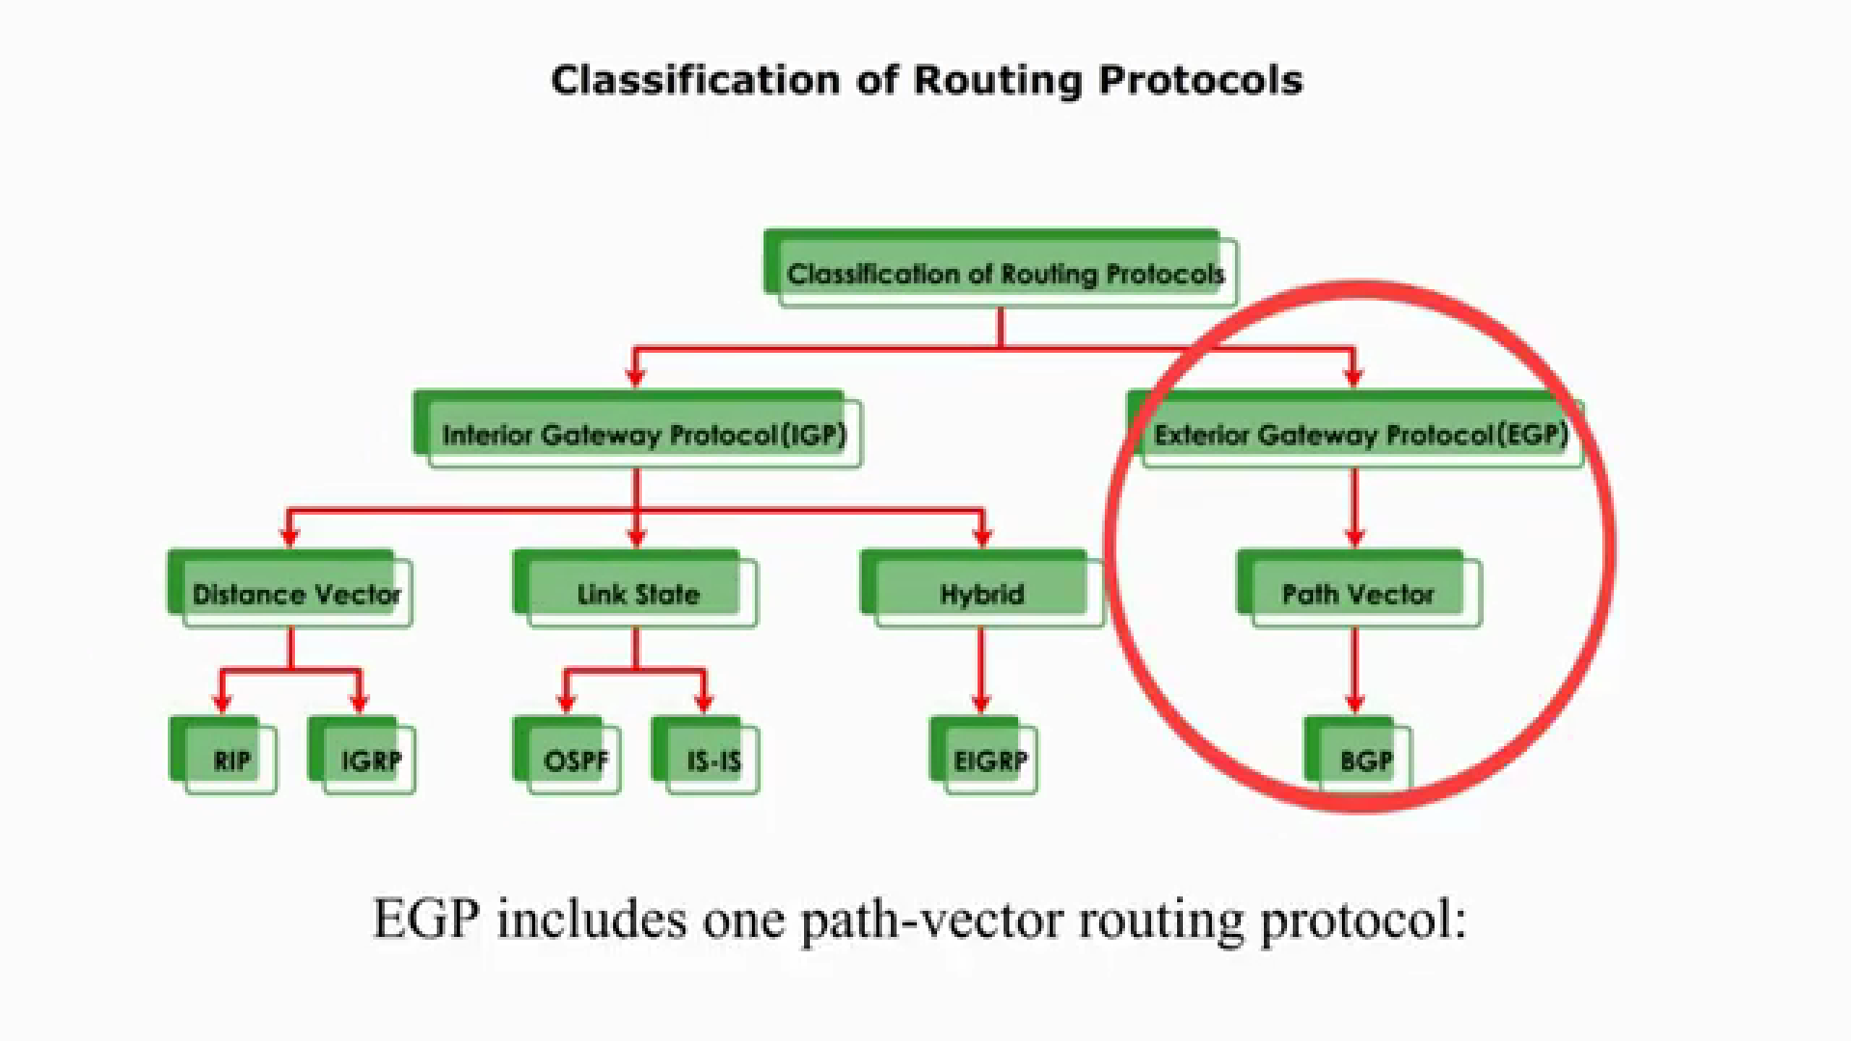

Slide 19
Feature | Interior Gateway Protocol (IGP) | Exterior Gateway Protocol (EGP)
Purpose | Exchange routing information within a single Autonomous System (AS) | Exchange routing information between different Autonomous Systems (ASes)
Examples | RIP, OSPF | BGP
Metric | Typically based on hop count, delay, load, or bandwidth. | Primarily based on policy, with considerations for path length, reliability, and administrative preferences.
Scalability | Generally suitable for smaller to medium-sized networks. | Designed for large-scale, complex networks, including the internet.
Complexity | Relatively simpler to configure and manage. | More complex due to policy-based routing and the need to coordinate between different ASes.
Routing Algorithm | Distance-vector or link-state. | Path-vector.

Slide 20
Criteria | RIP | OSPF | BGP
Interior/Exterior | IGP | IGP | EGP
Protocol Type | Distance Vector | Link-State | Path Vector
Algorithm Used | Bellman-Ford | Dijkstra's Shortest Path First | Best path selection based on attributes
Routing Metric | Hop count | Cost (bandwidth) | Path attributes (AS path, next hop, etc.)
Convergence Time | Slow | Fast | Slow
Scalability | Poor (15 hops) | Highly scalable | Extremely scalable
Network Size | Small to medium | Medium to large | Large-scale networks and Internet
Routing Updates | Periodic | Triggered | Triggered
Protocol Complexity | Simple | Moderately complex | Complex

Slide 21
Interior Gateway Routing Protocol
https://youtu.be/V1PsmExNw6k?si=VJuW2kAUGtZHan5t
The oldest interior gateway routing protocol within an (intra) autonomous system is based on distance vector routing- Routing Information Protocol (RIP).
RIP uses hop count as a metric and it is measured from the source router to the destination subnet. Hop = no. of networks travelled
In distance vector routing, each router exchanges distance vector with neighboring routers. The distance vector is the current shortest path from that router to the subnet.
Routing information is exchanged between routers every 30 seconds. The router does not listen to anything from the neighboring router once every 180 seconds in case of neighbor is down or failed.
Subsequently, routing table is updated by sending advertisements to neighboring routers.
A router can also send a RIP request message to know its neighbor’s cost to the destination.

Slide 22
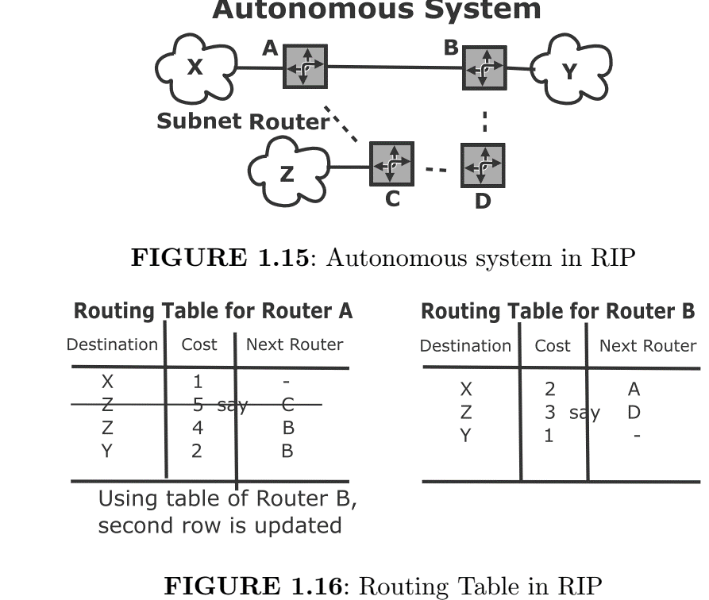
RIP
The RIP table consists of three columns: destination subnet, number of hops to destination subnet (cost), and the next router
First, the routing table for router A is created, and then for router B.
Next, when router A receives the advertisement from router B, router A comes to know the shorter path to destination subnet Z is via router D.
Hence, the routing table for router A is updated by adding a 1 hop count via router B to subnet Z.
Limitation: works only for small system and suffers from count-to-infinity problem and convergence.
This motivates us to use OSPF which is based on link-state routing.
https://youtu.be/wk6h929RBYU?si=hUUBQDHSt8aoiKVs

Slide 23
Open Shortest Path First (OSPF)
Open Shortest Path First (OSPF) is an interior gateway routing protocol for within an (intra) autonomous system.
It uses link-state routing for flooding the link state packets (neighbors and costs) and Dijkstra’s shortest path algorithm.
The sequence number is used to keep track of the latest information.
The router in OSPF broadcasts link-state information to all the routers in the Autonomous System (AS) periodically every 30 minutes or when the link goes down/up.
This is unlike the distance vector where broadcasting is done for only immediate neighbors.
Each router creates a topology for its area and then the Dijkstra algorithm is used to find the shortest path between the backbone router and other routers.

Slide 24
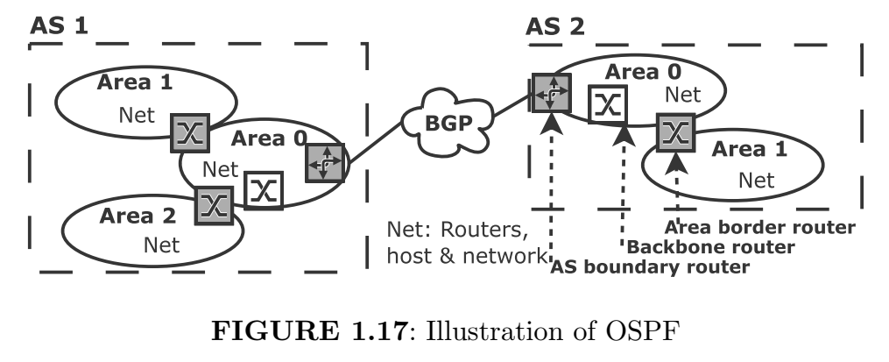
OSPF Terminologies
Area is a generalized subnet which consists of networks, routers and hosts. The router in an area broadcasts link-state packets to other routers of that area. Each area runs its link-state routing using the shortest-path algorithm. It may be noted that the areas do not overlap.
Area border router sends the packets to other areas. Backbone router is the router inside the primary area zero. The backbone area connects all the normal areas of an autonomous system. The traffic goes from one area to another area via the backbone area.
The packets are first sent to the area border router (intra-area routing) and then to the backbone router (inter-area routing) of the AS (autonomous system) and finally to AS boundary router (inter-AS) for other ASes.

Slide 25
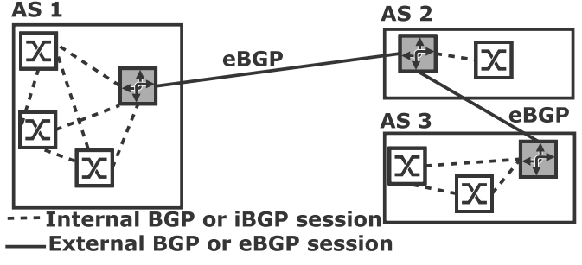
Exterior Gateway Routing Protocol
Border Gateway Protocol (BGP) is used as a routing protocol among multiple autonomous systems.
BGP reliably communicates by establishing TCP connections.
BGP is a distance-vector protocol, however, it is different from RIP as it considers only the cost to destination.
BGP routing table consists of the exact path being used in addition to the cost to reach the destination.
BGP chooses the shortest path if the degree of local preferences for the two routes are similar. If both degrees of local preferences and costs are the same, then the route with the closest next-hop router is selected.
https://youtu.be/p6wJzS-VXiU?si=1YQJgEylVxvo_NRL

Slide 26
As shown in Figure 1.19, TCP connections inside an AS is called internal BGP or iBGP session.
The TCP connection between two BGP is called external BGP or eBGP session.
The traffic goes from source AS to destination AS via neighboring AS.
AS 1 sends the reachability information to AS2 through eBGP and vice versa.
On similar lines, AS 2 and AS 3 do.
Now, a gateway of AS 2 sends the reachability information of AS 1 to AS 3.
The routing/forwarding table of AS 3 is updated with the reachability information of AS 1.
Thus, there are three steps in BGP, namely, neighbor agreement, neighbor reachability, and network reachability.

Slide 27
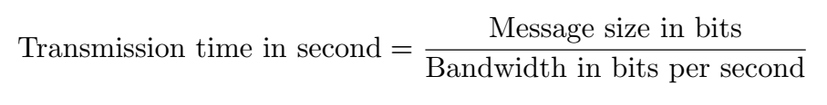
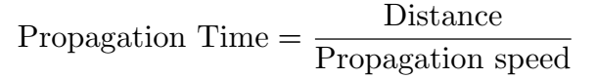
Performance Metrics
Total delay = Processing time + Queuing time + Transmission time + Propagation time
Processing Time: time needed for examining the packet header, determining the next stop, and checking bit-level errors.
Queuing Time: waiting time needed before transmission. It depends on the number of packets that are already in the queue.
Transmission Time: time required for transmitting all the packet’s bits onto the communication link. This is given by
Propagation Time: The amount of time required for bits to travel between the source and destination. It is given by
The propagation speed of an electromagnetic signal in the air is 3 × 10⁸m/s.
Throughput is defined as the ratio of number of bits at the receiver and time elapsed.
Bandwidth-delay product is the number of bits that can fit in the link.

Slide 28

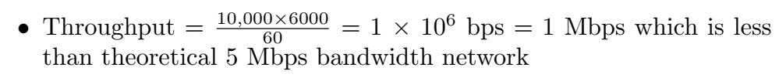
Examples of Delay and Throughput:
Determine the transmission time and propagation time for a 10 kb message over a bandwidth of 100 Mbps. The distance between source and destination is 2000 km and propagation speed in cable is 2 × 10⁸ m/s.
We can send on an average 10,000 frames per minute with each frame is made of 6000 bits. Determine the throughput of this 5 Mbps bandwidth network.

