Slide 1
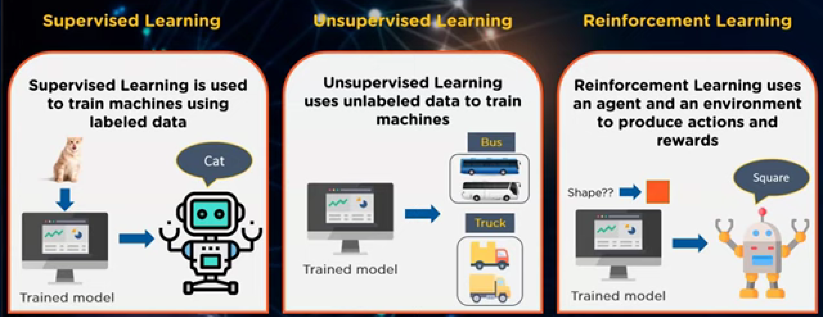
Labeled data = output already known to you. The model just needs to map the labeled inputs to the known outputs
The model learns from the data, identifies patterns in the input and returns corresponding output
There might be diff paths to reach the end state and the robot is trained to find the best path via reward system. AKA it follows trial and error method to find the desired sol.
Classification and Regression Cluster and Association Reward based

Slide 2
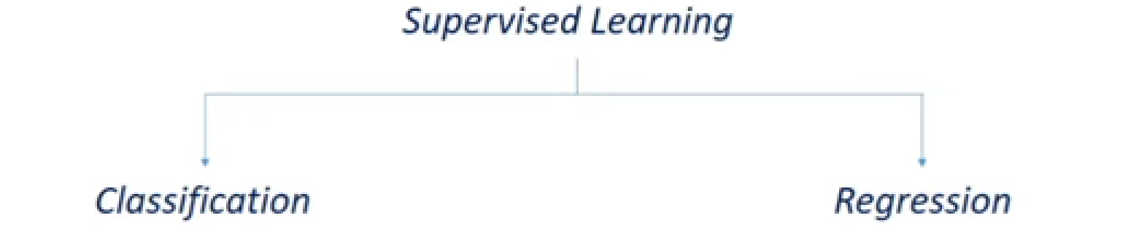
Supervised learning
Unsupervised learning
Examples of supervised learning:
Weather prediction
Sales forecast
Stock price analysis
Examples of unsupervised learning:
Computing clusters
Market segmentation
Genomics – grping ppl by genetic similarity
target variables are discrete. | target variables are continuous.
Problems like Spam Email Classification, Disease prediction | Problems like House Price Prediction, Rainfall Prediction

Slide 3
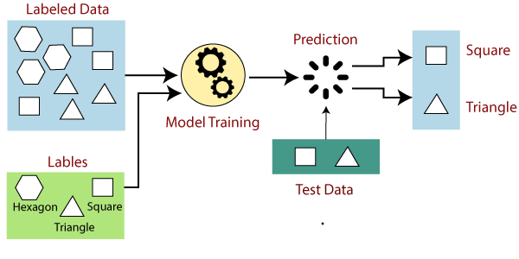
What is Supervised Machine Learning?
Learning an input and output map.
Labels
If the output happens to be a categorical one, then the supervised learning paradigm is called `classification'.
If the output is a continuous value, then the learning paradigm is called `regression'.

Slide 4
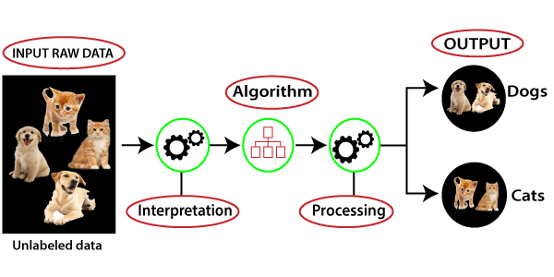
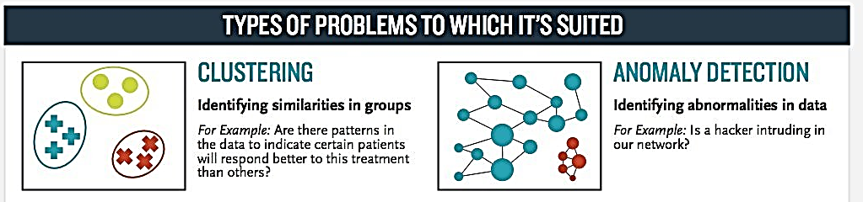
What is Unsupervised Machine Learning?
Discovering patterns in the data.

Slide 5
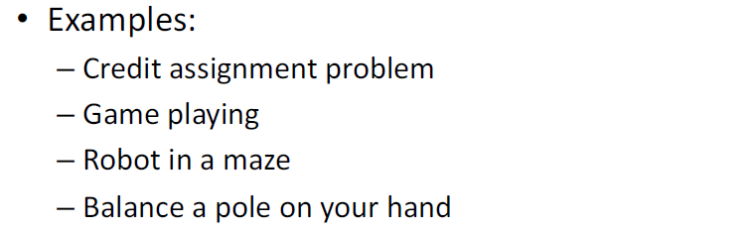

Reinforcement Learning
Reinforcement learning is learning which maps situations to actions—The learner is not told which actions to take, but instead must discover which actions yield the most reward by trying them.
There is no fixed training dataset, rather a goal or set of goals that an agent is required to achieve.

Slide 6
Which method of ML will use for the given problems?
Spam Email Detection: Supervised Learning - Classification
Grade History of Students: Supervised Learning - Regression
Product Recommendation: Unsupervised learning
Suggestion of Friends in Facebook: Unsupervised Learning
Sales Report Generation: Unsupervised Learning
Predict Next Year's Sale Based on History Data: Supervised Learning – regression
Updating Facebook User Profiles: Reinforcement Learning

Slide 7
Suppose you are a business analyst of an online food ordering system.
How will you identify customers for advertising new products?
Customer Segmentation using Unsupervised learning (clustering)
How will you know whether a customer buys a product or not?
Supervised Learning : Classification (class1: Buys_yes , class2: Buys_no)
(Age, Income, Credit_card, employed, Buys)
C. How will you determine the sales (in Rupees) of certain products?
Supervised Learning : Regression
(Advertisement, product_rating, Sales)

Slide 8
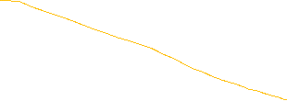

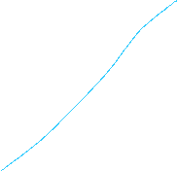
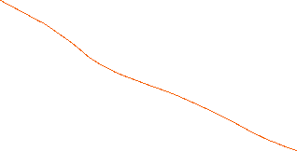
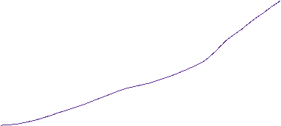
Match the following
A. Face Recognition | P. Reinforcement Learning
B. Malware detection | Q. Regression
C. Group similar gene profiles | R. Classification
D. Gaming | S. Unsupervised learning
E. Predicting the remaining useful time of batteries | T. Anomaly detection

Slide 9
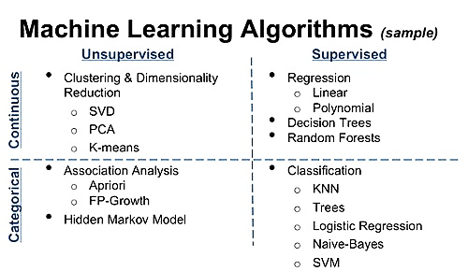
Supervised and Unsupervised Algorithms

Slide 10
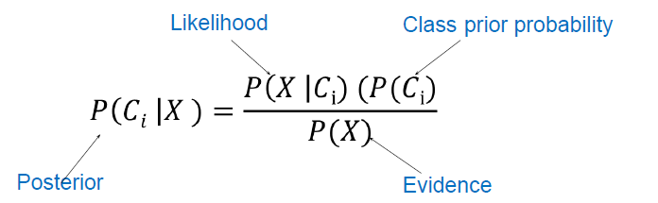
An Example of Bayes Theorem
A doctor knows that meningitis causes stiff neck 50% of the time
Prior probability of any patient having meningitis is 1/50,000
Prior probability of any patient having stiff neck is 1/20
If a patient has stiff neck, what’s the probability he/she has meningitis?

Slide 11
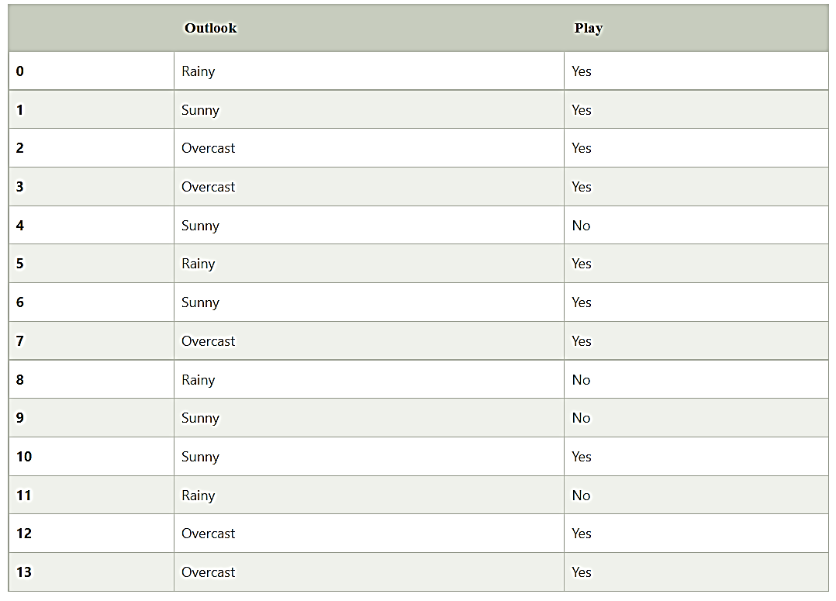
Naïve Bayes Classification model Solved Example#1
If the weather is sunny, then the Player should play or not?

Slide 12
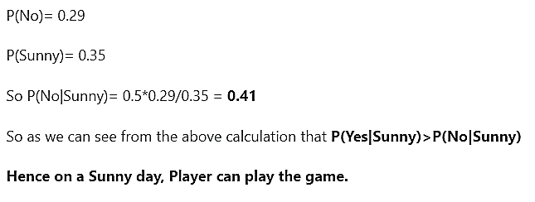
Prior Probabilities:
P(Play = Yes): Total number of days when the player played / Total number of days = 10/14 ≈ 0.71
P(Play = No): Total number of days when the player didn't play / Total number of days = 4/14 ≈ 0.29
Likelihood Probabilities:
P(Weather = Sunny | Play = Yes): Number of sunny days when the player played / Total number of days when the player played = 3/10 ≈ 0.3
P(Weather = Sunny | Play = No): Number of sunny days when the player didn't play / Total number of days when the player didn't play = 2/4 ≈ 0.5
Posterior Probabilities (Using Bayes' Theorem):
P(Play = Yes | Weather = Sunny) = (P(Weather = Sunny | Play = Yes) * P(Play = Yes)) / P(Weather = Sunny)
P(Play = No | Weather = Sunny) = (P(Weather = Sunny | Play = No) * P(Play = No)) / P(Weather = Sunny)
Note: Since we're only comparing the probabilities for "Yes" and "No" given the same weather condition, we can ignore the denominator (P(Weather = Sunny)) as it will be the same for both calculations.
Comparison:
P(Play = Yes | Weather = Sunny) ≈ 0.3 * 0.71 ≈ 0.213
P(Play = No | Weather = Sunny) ≈ 0.5 * 0.29 ≈ 0.145

Slide 13
Example-1
Here all features are discrete
Predict whether a person buys computer or not based on attributes such as age, income, student and credit_rating.
Test Data instance
<=30 | medium | yes | fair | ?

Slide 14
Class prior probabilities P(C_{i}):
P(buys_computer = “yes”) = 9/14 = 0.643 P(buys_computer = “no”) = 5/14= 0.357
Test Data instance : X = (age <=30, Income = medium, Student = yes, Credit_rating = fair)
Only calculate P(X|Ci) for above mentioned criteria
Class conditional probabilities P(X|C_{i}):
P(age = “<=30” | buys_computer = “yes”) = 2/9 = 0.222
P(age = “<= 30” | buys_computer = “no”) = 3/5 = 0.6
P(income = “medium” | buys_computer = “yes”) = 4/9 = 0.444
P(income = “medium” | buys_computer = “no”) = 2/5 = 0.4
P(student = “yes” | buys_computer = “yes) = 6/9 = 0.667
P(student = “yes” | buys_computer = “no”) = 1/5 = 0.2
P(credit_rating = “fair” | buys_computer = “yes”) = 6/9 = 0.667
P(credit_rating = “fair” | buys_computer = “no”) = 2/5 = 0.4
Posterior probabilities
P(Ci |X) = P(X|Ci)*P(Ci) :
P(X|buys_computer = “yes”) * P(buys_computer = “yes”)
= 0.222 x 0.444 x 0.667 x 0.667 x 0.643 = 0.028
P(X|buys_computer = “no”) * P(buys_computer = “no”)
= 0.6 x 0.4 x 0.2 x 0.4 x 0.357 = 0.007
Therefore, X belongs to class (“buys_computer = yes”

Slide 15
1. Consider the following Employee dataset. In the given dataset Status is the target variable and it indicates whether an Employee is Lazy or Diligent.
Using Naïve Bayes Learning predict the class of an instance with the feature values: < Weight : Normal, Eye Color : Black, IQ level: Excellent>
Weight | Eye Color | IQ level | Status
Normal | Black | Average | Lazy
Normal | Black | Average | Lazy
Normal | Amber | Average | Lazy
Underweight | Black | Good | Lazy
Underweight | Amber | Good | Lazy
Normal | Black | Good | Diligent
Underweight | Black | Excellent | Diligent
Normal | Black | Excellent | Diligent
Normal | Amber | Excellent | Diligent
Underweight | Amber | Good | Diligent
Normal | Amber | Average | Diligent
Underweight | Black | Good | Diligent

Slide 16
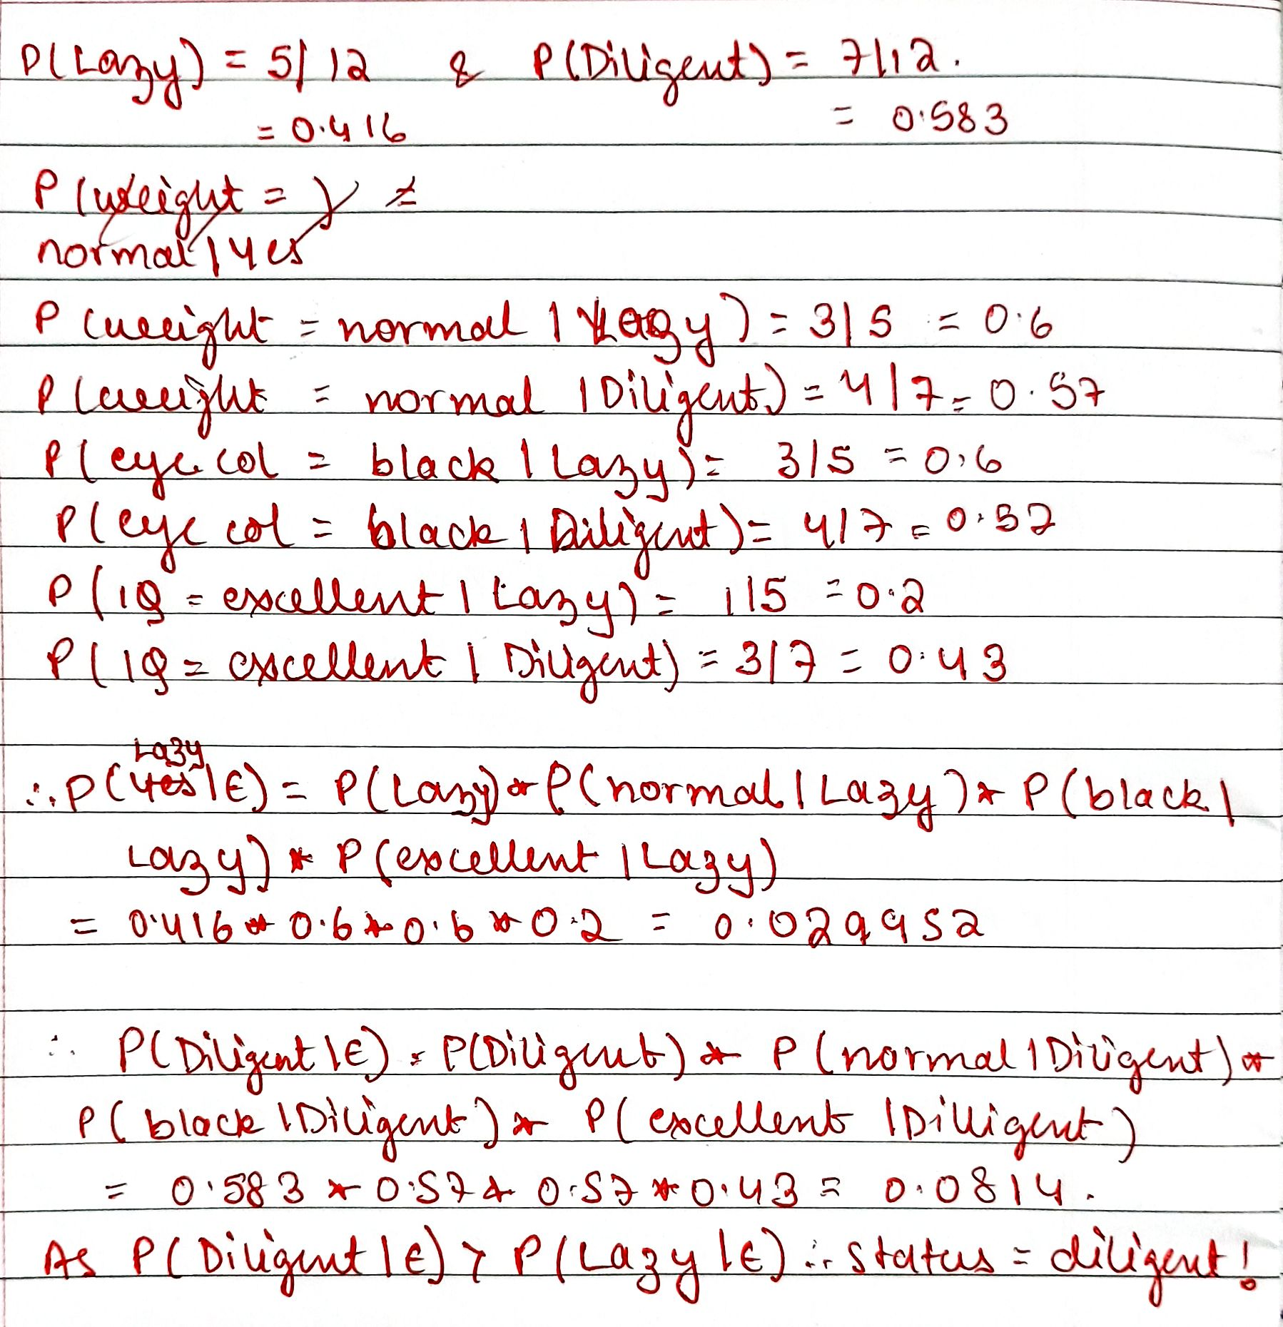

Slide 17
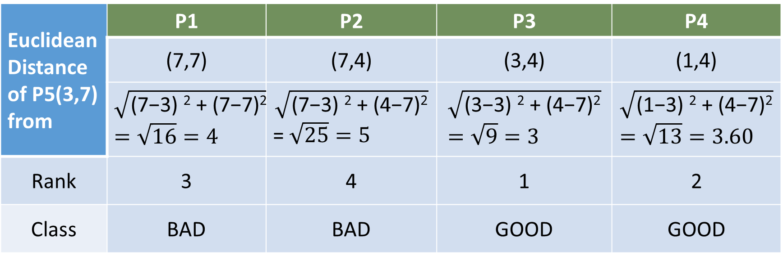
Points | X1 | X2 | Y
P1 | 7 | 7 | BAD
P2 | 7 | 4 | BAD
P3 | 3 | 4 | GOOD
P4 | 1 | 4 | GOOD
P5 | 3 | 7 | ?
KNN Example (3 Nearest NeighBour)
Advantages
It is simple to implement.
It can be more effective if the training data is large.
Disadvantages:
Always needs to determine the value of K which is complex.
The computation cost is high because of calculating the distance for all the training samples.
Euclidean Distance of P5(3,7) from | P1 | P2 | P3 | P4
 | (7,7) | (7,4) | (3,4) | (1,4)
 | $$\sqrt{\text{(7−3) }\text{2}\text{ + (7−7)}\text{2}}=\sqrt{16}=4$$ | $$\sqrt{\text{(7−3) }\text{2}\text{ + (}\text{4}\text{−7)}\text{2}}$$ =$\sqrt{25}=5$ | $$\sqrt{\text{(}\text{3}\text{−3) }\text{2}\text{ + (}\text{4}\text{−7)}\text{2}}=\sqrt{9}=3$$ | $$\sqrt{\text{(}\text{1}\text{−3) }\text{2}\text{ + (}\text{4}\text{−7)}\text{2}}=\sqrt{13}=3.60$$
Rank | 3 | 4 | 1 | 2
Class | BAD | BAD | GOOD | GOOD
2 Good, 1 BAD -- so GOOD (majority voting)

Slide 18
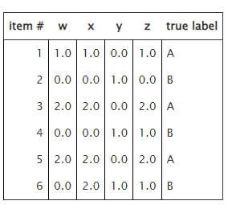
KNN Classification
Classify the data point: (<1, 0, 1, 2> using KNN with K=2 on the following dataset.
For k=2: k=rank=1, label=B
k=rank=2, label=B
class=B
Similarly:
For k=4:
k=rank=1, label=B
k=rank=2, label=B
k=rank=3, label=A
k=rank=4, label=B
As B’s occurrence is max, class=B

Slide 19
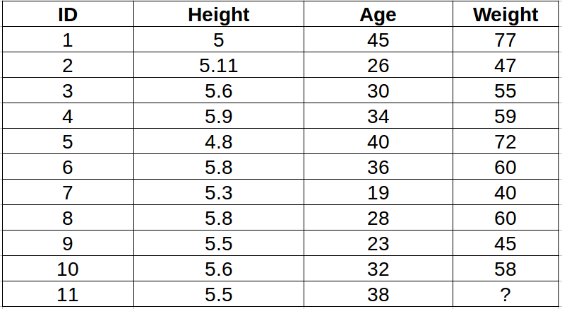
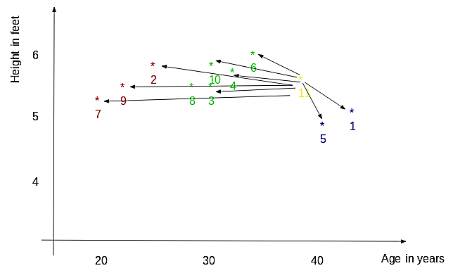
K-Nearest Neighbor(KNN) Algorithm-Solved Example
The distance between the new point and each training point is calculated.

Slide 20
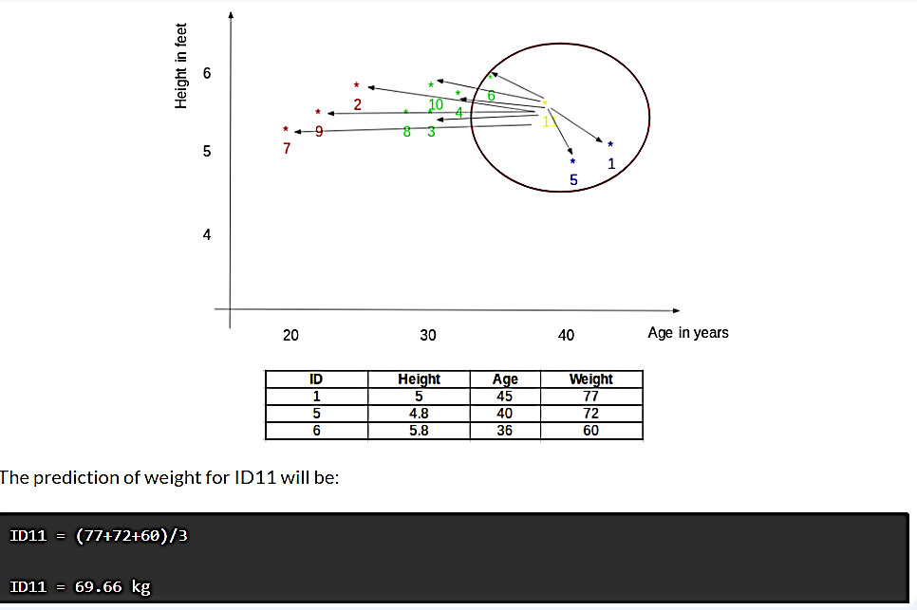
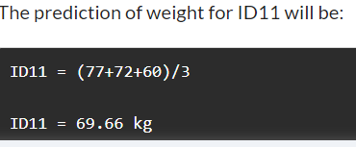
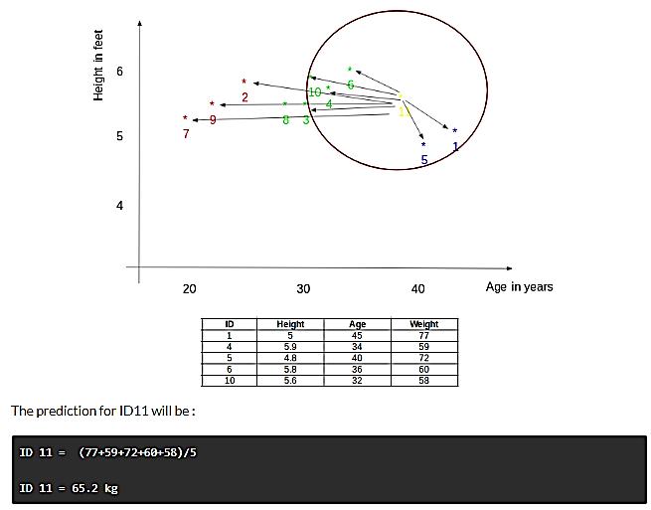
The closest k data points are selected (based on the distance). In this example, points 1, 5, 6 will be selected if the value of k is 3.
In our example, for a value k = 5, the closest points are ID1, ID4, ID5, ID6 and ID10.

Slide 21
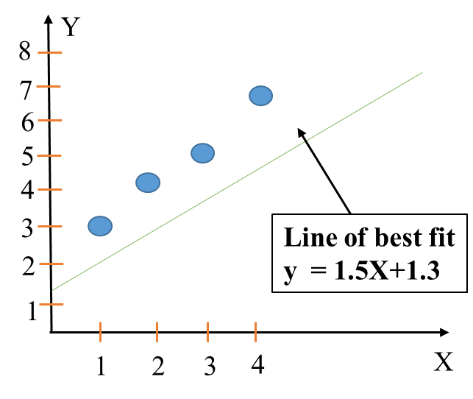
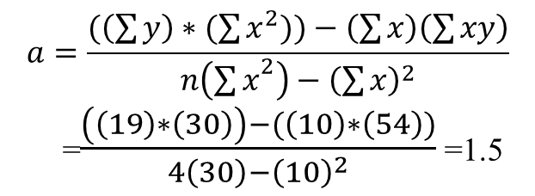
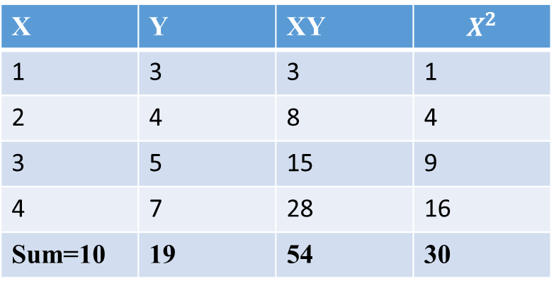
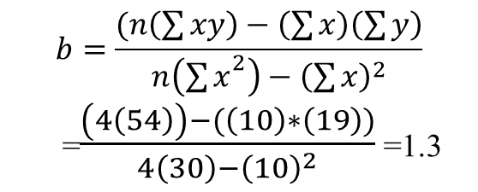
Regression analysis is a statistical method to model the relationship/correlation between a dependent (target) and independent (predictor) variables with one or more independent variables.
X | Y | XY | $$X^{2}$$
1 | 3 | 3 | 1
2 | 4 | 8 | 4
3 | 5 | 15 | 9
4 | 7 | 28 | 16
Sum=10 | 19 | 54 | 30
$$a=\frac{(\left(\sum{y}\right)∗(\sum{x^{2}))−\left(\sum{x}\right)\left(\sum{xy}\right)}}{n\left({\sum{x}}^{2}\right)−{\left(\sum{x}\right)}^{2}}$$
=$\frac{\left(\left(19\right)∗\left(30\right)\right)−(\left(10\right)∗\left(54\right))}{4\left(30\right)−{\left(10\right)}^{2}}$ =1.5
$$b=\frac{(n\left(\sum{xy}\right)−\left(\sum{x}\right)\left(\sum{y}\right)}{n\left({\sum{x}}^{2}\right)−{\left(\sum{x}\right)}^{2}}$$
=$\frac{\left(4\left(54\right)\right)−(\left(10\right)∗\left(19\right))}{4\left(30\right)−{\left(10\right)}^{2}}$ =1.3
y = ax + b
y = 1.5X+1.3

Slide 22
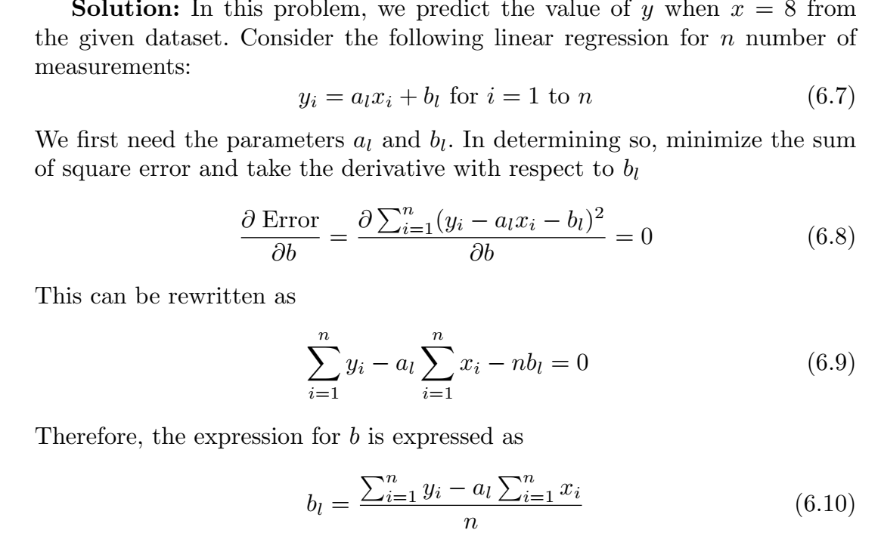

Slide 23
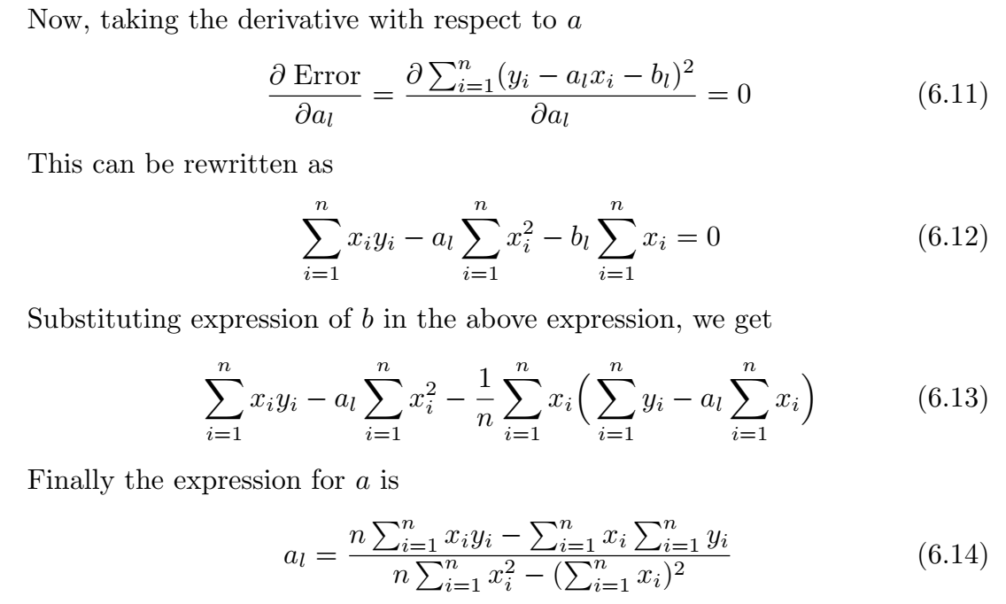

Slide 24
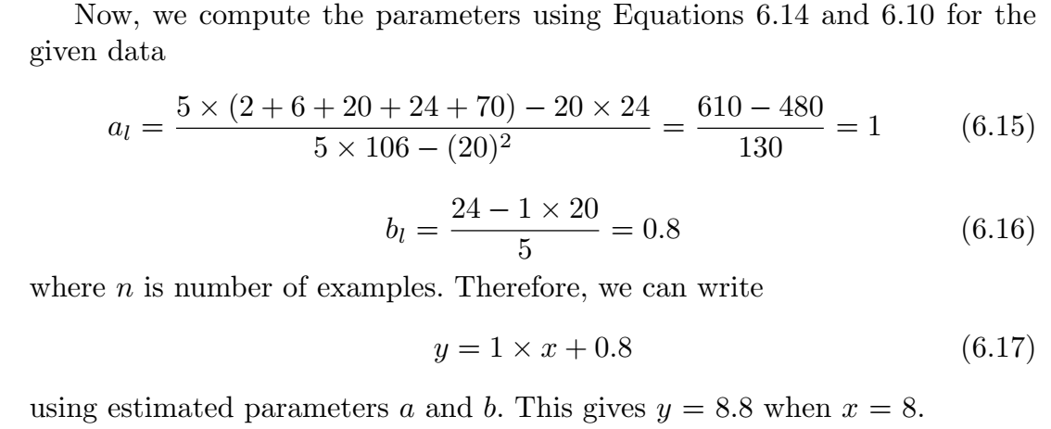

Slide 25
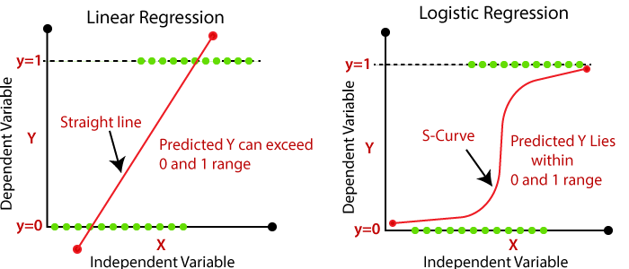
Logistic Regression
Logistic regression estimates the probability of a certain event occurring using the odds ratio by calculating the logarithm of the odds.
Uses Maximum likelihood estimation (MLE) to transform the probability of an event occurring into its odds, a nonlinear model.
Odds ratio is the probability of occurrence of a particular event over the probability of non occurrence and providing an estimate of the magnitude of the relationship between binary variables. i.e. probability of success divided by the probability of failure

Slide 26
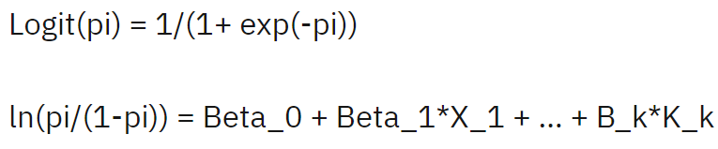
What Logistic Regression predicts?
Probability of Y occurring given known values for X(s).
In Logistic Regression, the Dependent Variable is transformed into the natural log of the odds. This is called logit (short for logistic probability unit).
The probabilities which ranged between 0.0 and 1.0 are transformed into odds ratios that range between 0 and infinity and approximated as a sigmoid function applied to a linear combination of input features in the range 0 to 1.
If the probability for group membership in the modeled category is above some cut point (the default is 0.50), the subject is predicted to be a member of the modeled group. Example: Default their payment.
If the probability is below the cut point, the subject is predicted to be a member of the other group. Example: No Default their payment.
For any given case, logistic regression computes the probability that a case with a particular set of values for the independent variable is a member of the modeled category.

Slide 27

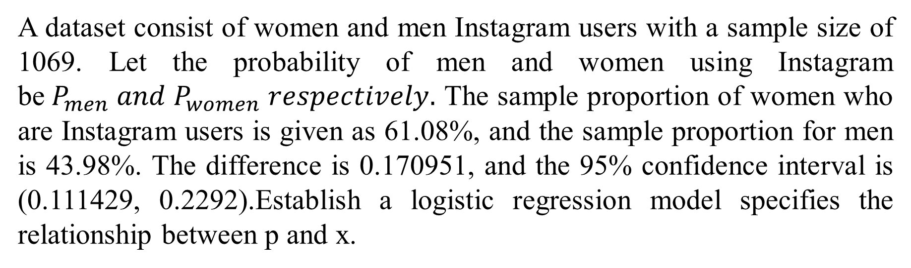
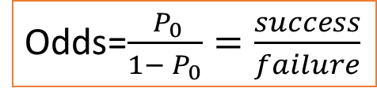
Logistic Regression-Solved Example#1
A dataset consist of women and men Instagram users with a sample size of 1069. Let the probability of men and women using Instagram be${ P}_{men} and{ P}_{women} respectively.$ The sample proportion of women who are Instagram users is given as 61.08%, and the sample proportion for men is 43.98%. The difference is 0.170951, and the 95% confidence interval is (0.111429, 0.2292).Establish a logistic regression model specifies the relationship between p and x.
Odds=$\frac{{ P}_{0}}{1−{ P}_{0}}=\frac{success}{failure}$
Solution
Logistic regression equation for women log ($\frac{{ P}_{women}}{1−{ P}_{women}})=β_{0}$+ $β_{1}$
Logistic regression equation for men log ($\frac{{ P}_{men}}{1−{ P}_{men}})=β_{0}$

Slide 28

Logistic Regression-Solved Example#1 (Contd.)
Odds for women=$\frac{{ P}_{0}}{1−{ P}_{0}}=\frac{\text{0.}\text{6108}}{1−\text{0.}\text{6}\text{1}\text{08}}$=1.5694
Odds for men=$\frac{{ P}_{0}}{1−{ P}_{0}}=\frac{\text{0.}\text{439}\text{8}}{1−\text{0.}\text{4398}}$=0.7851
Log of Odds for women=log ($\frac{{ P}_{women}}{1−{ P}_{women}})$=log(1.5694)=0.4507=$β_{0}\text{+ }β_{1}$
Log of Odds for men=log ($\frac{{ P}_{men}}{1−{ P}_{men}})$=log(0.7851)=-0.2419=$β_{0}$
$$b_{0}=−0.2419$$
Slope $b_{1}$= Log (odds for women)-Log(odds for men)=$\text{0.4507}$-(- 0.2419)=0.6926
Best fit regression equation y$=b_{0}\text{+}b_{1}x\text{=−0.2419+0.6926}x$

Slide 29
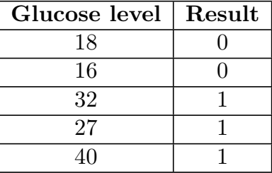
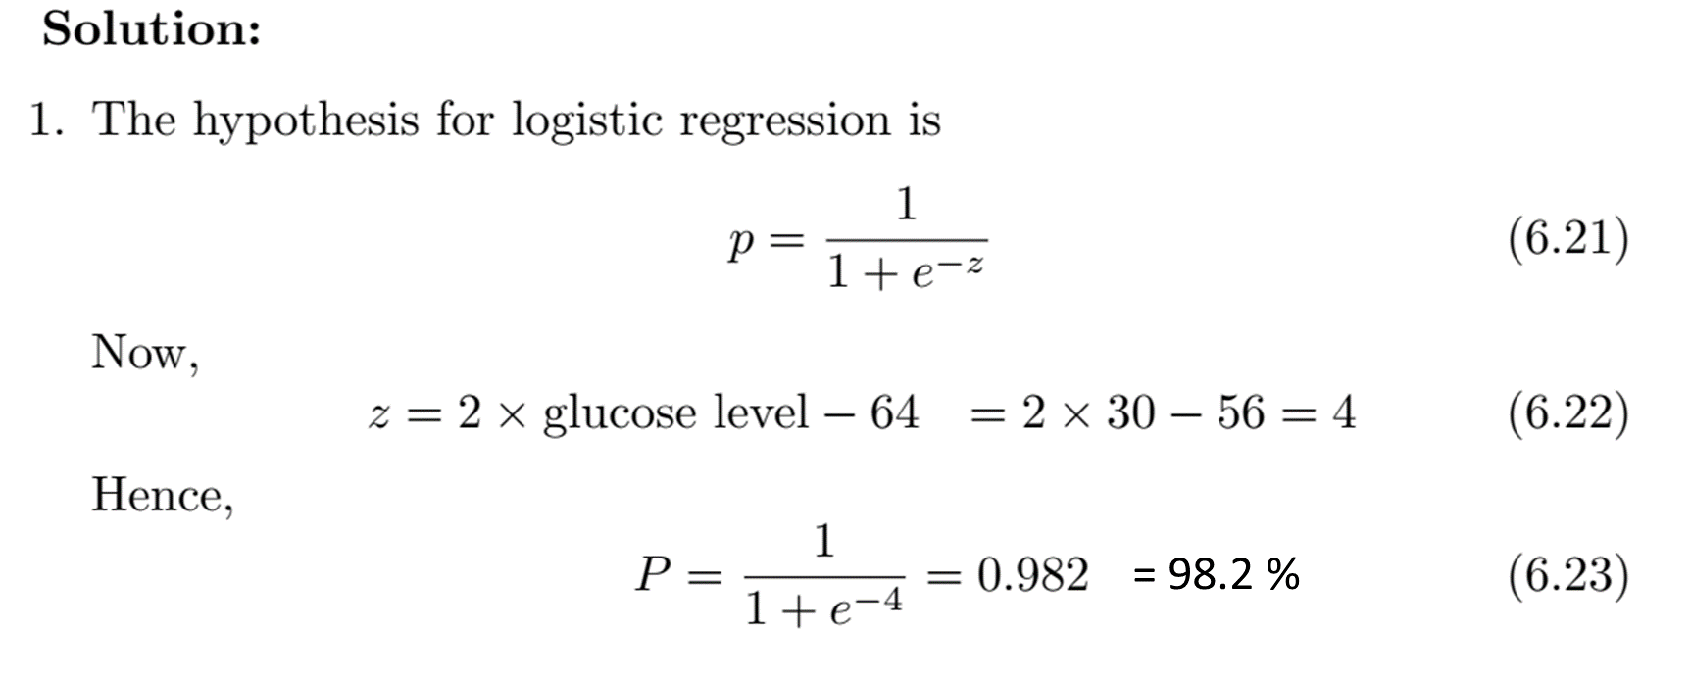
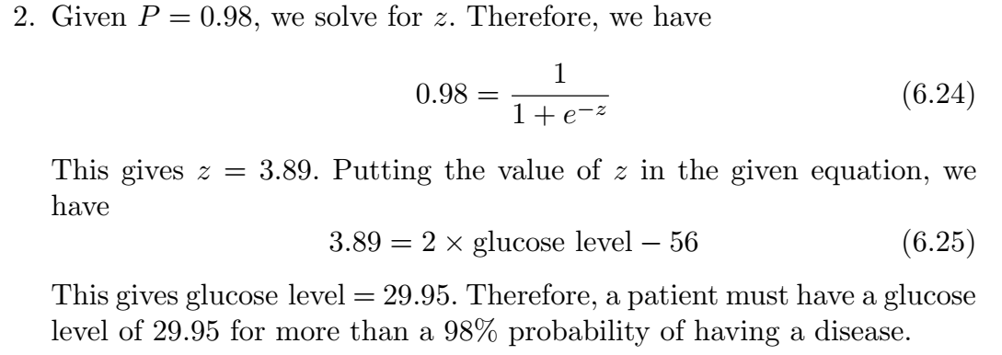
Example: The dataset of disease or disease-free for five patients is given in Table 6.4. Use logistic regression as the classifier. Assume the hypothesis for linear regression is : 2 × glucose level − 56.
1. Determine the probability of having a disease who has glucose level 30.
2. At least how much glucose level ensures disease case with a probability of more than 98%?

