Slide 1
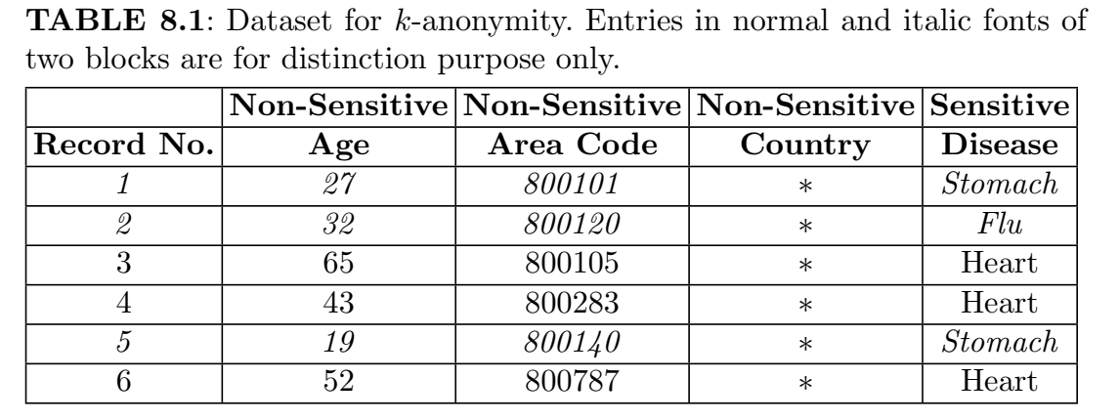
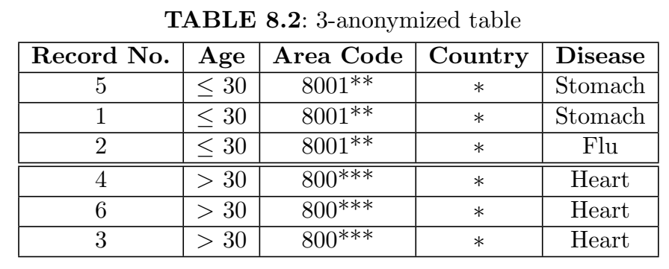
Privacy using k-anonymity

Slide 2
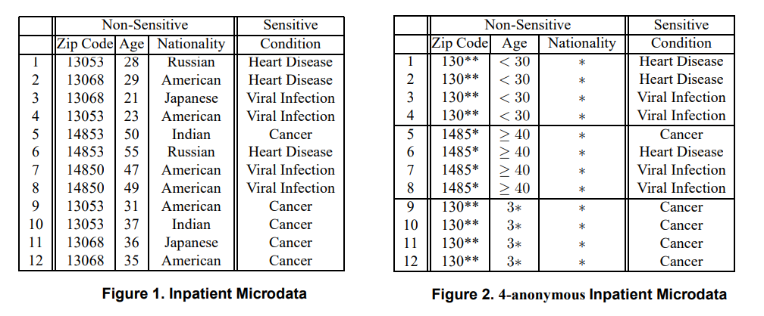
Privacy using k-anonymity
We do generalization to anonymize the data.
For example, if there are three records in each group, the non-sensitive attributes are generalized by > or < or are suppressed by asterisks. The name of the country is completely suppressed.
The name of the person is suppressed to provide a first level of anonymization.
In the 3-anonymized table, at least 2 records are not distinguishable with each record in each block.

Slide 3
Drawbacks of k-anonymity
1. Homogeneity Attack: When all records share the same sensitive attribute, an attacker who knows a person's quasi-identifiers (like age and ZIP code) can infer their sensitive information. Example: If all records in a 2-anonymized group have "heart disease" as the medical condition, anyone who knows a person belongs to this group can deduce their health status.
2. Background Knowledge Attack: k-Anonymity does not protect against attackers using external knowledge to make inferences. If an attacker knows a person's demographics and background information, they can narrow down possibilities and deduce sensitive data. Example: If an attacker knows that Japanese people have a low incidence of heart disease, they might infer that a 21-year-old Japanese female in the dataset likely has a viral infection instead.
K-Anonymity can create groups that leak information due to lack of diversity in the sensitive attribute. L-diversity safeguards sensitive information by ensuring diversity in the data values of sensitive attributes within anonymized groups.

Slide 4
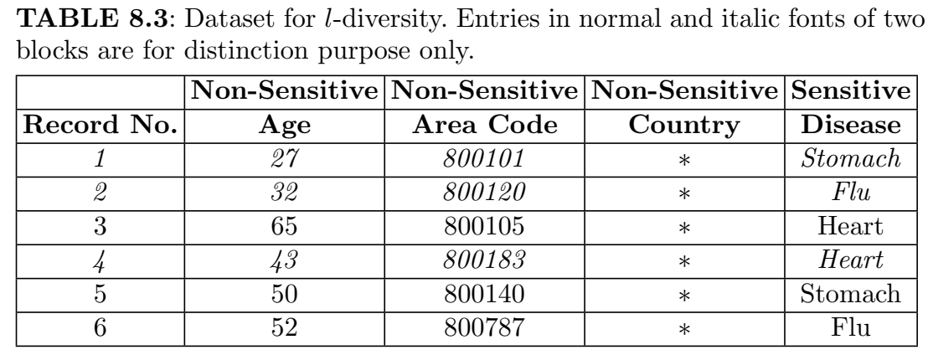
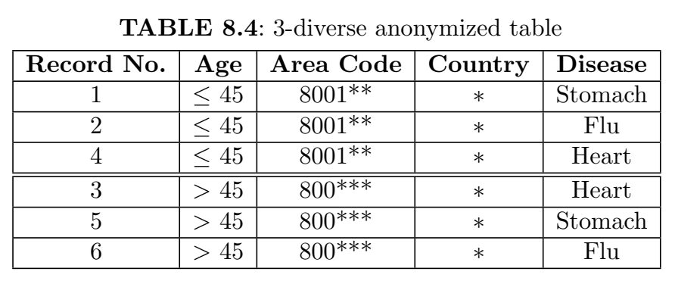








Privacy using l-diversity
https://youtu.be/GNhb3PcmjmA?si=8o5QglRR4ZtUjU-O
3 diversity
2 diversity
No diversity
3 diversity

Slide 5
Drawbacks of l-diversity:
Similarity Attacks: l-Diversity may not protect against inferences if sensitive attribute values are different but closely related. Example: In a dataset, "cold," "flu," and "viral infection" are distinct but similar illnesses.
Difficulty with Imbalanced Data: When sensitive attributes are unevenly distributed, achieving l-diversity can be impossible. Example: If most records have "diabetes," ensuring diversity in every group is challenging without distorting the data.
Reduced Data Utility: To meet l-diversity, significant generalization may reduce the dataset's usefulness for analysis. Example: Generalizing age ranges to broader categories can limit the insights available.

Slide 6
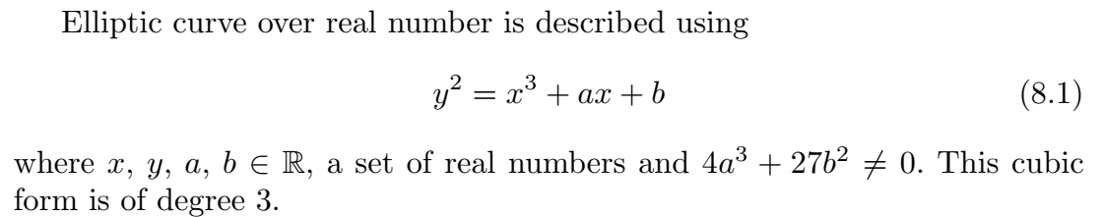
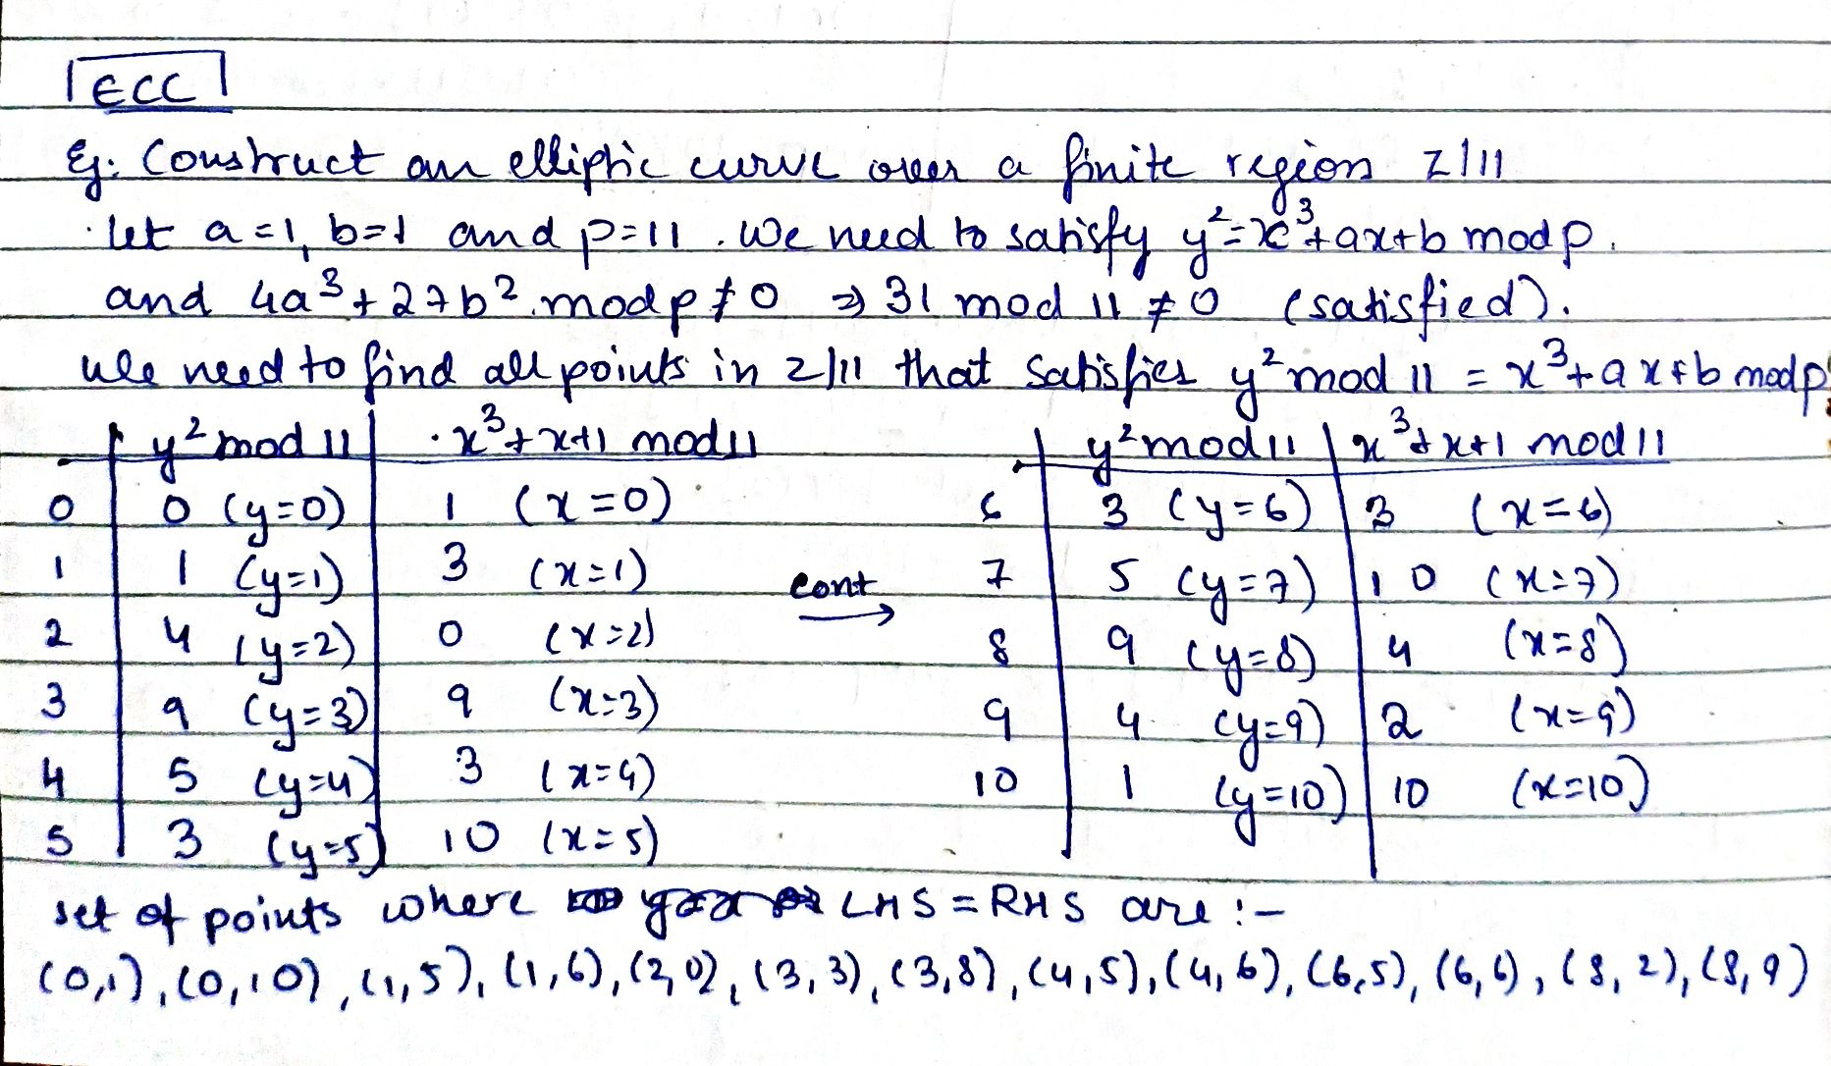

Slide 7
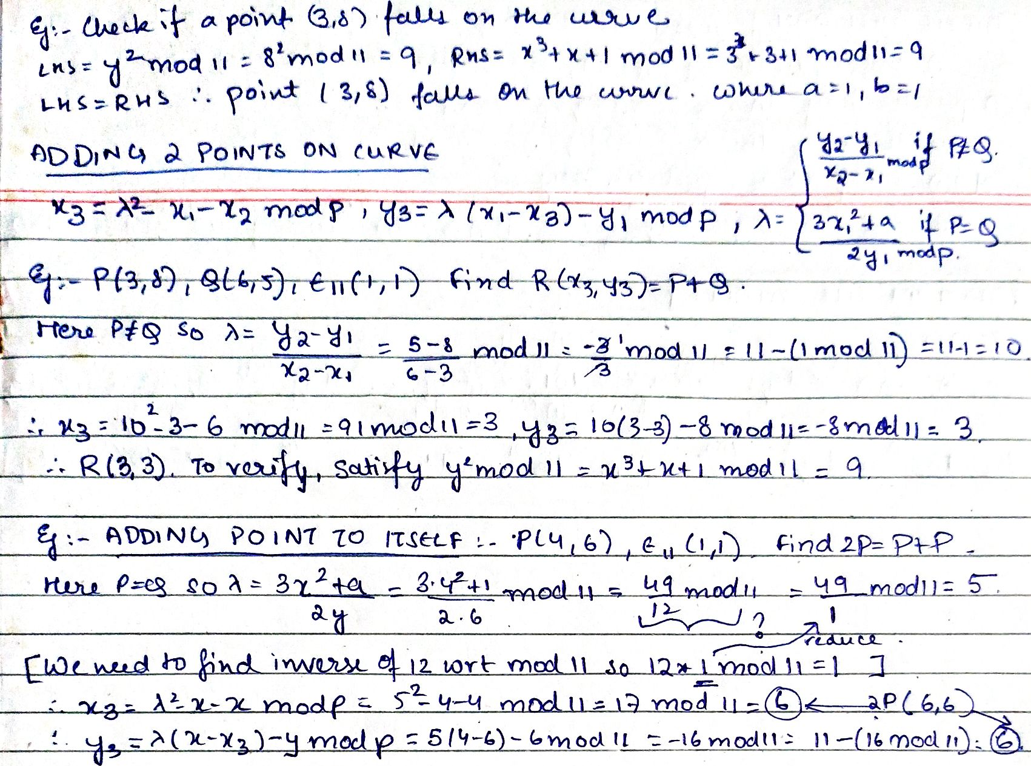

Slide 8
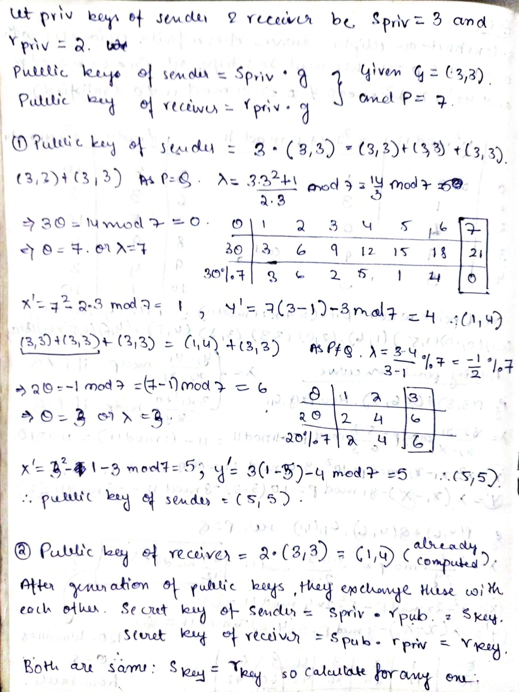
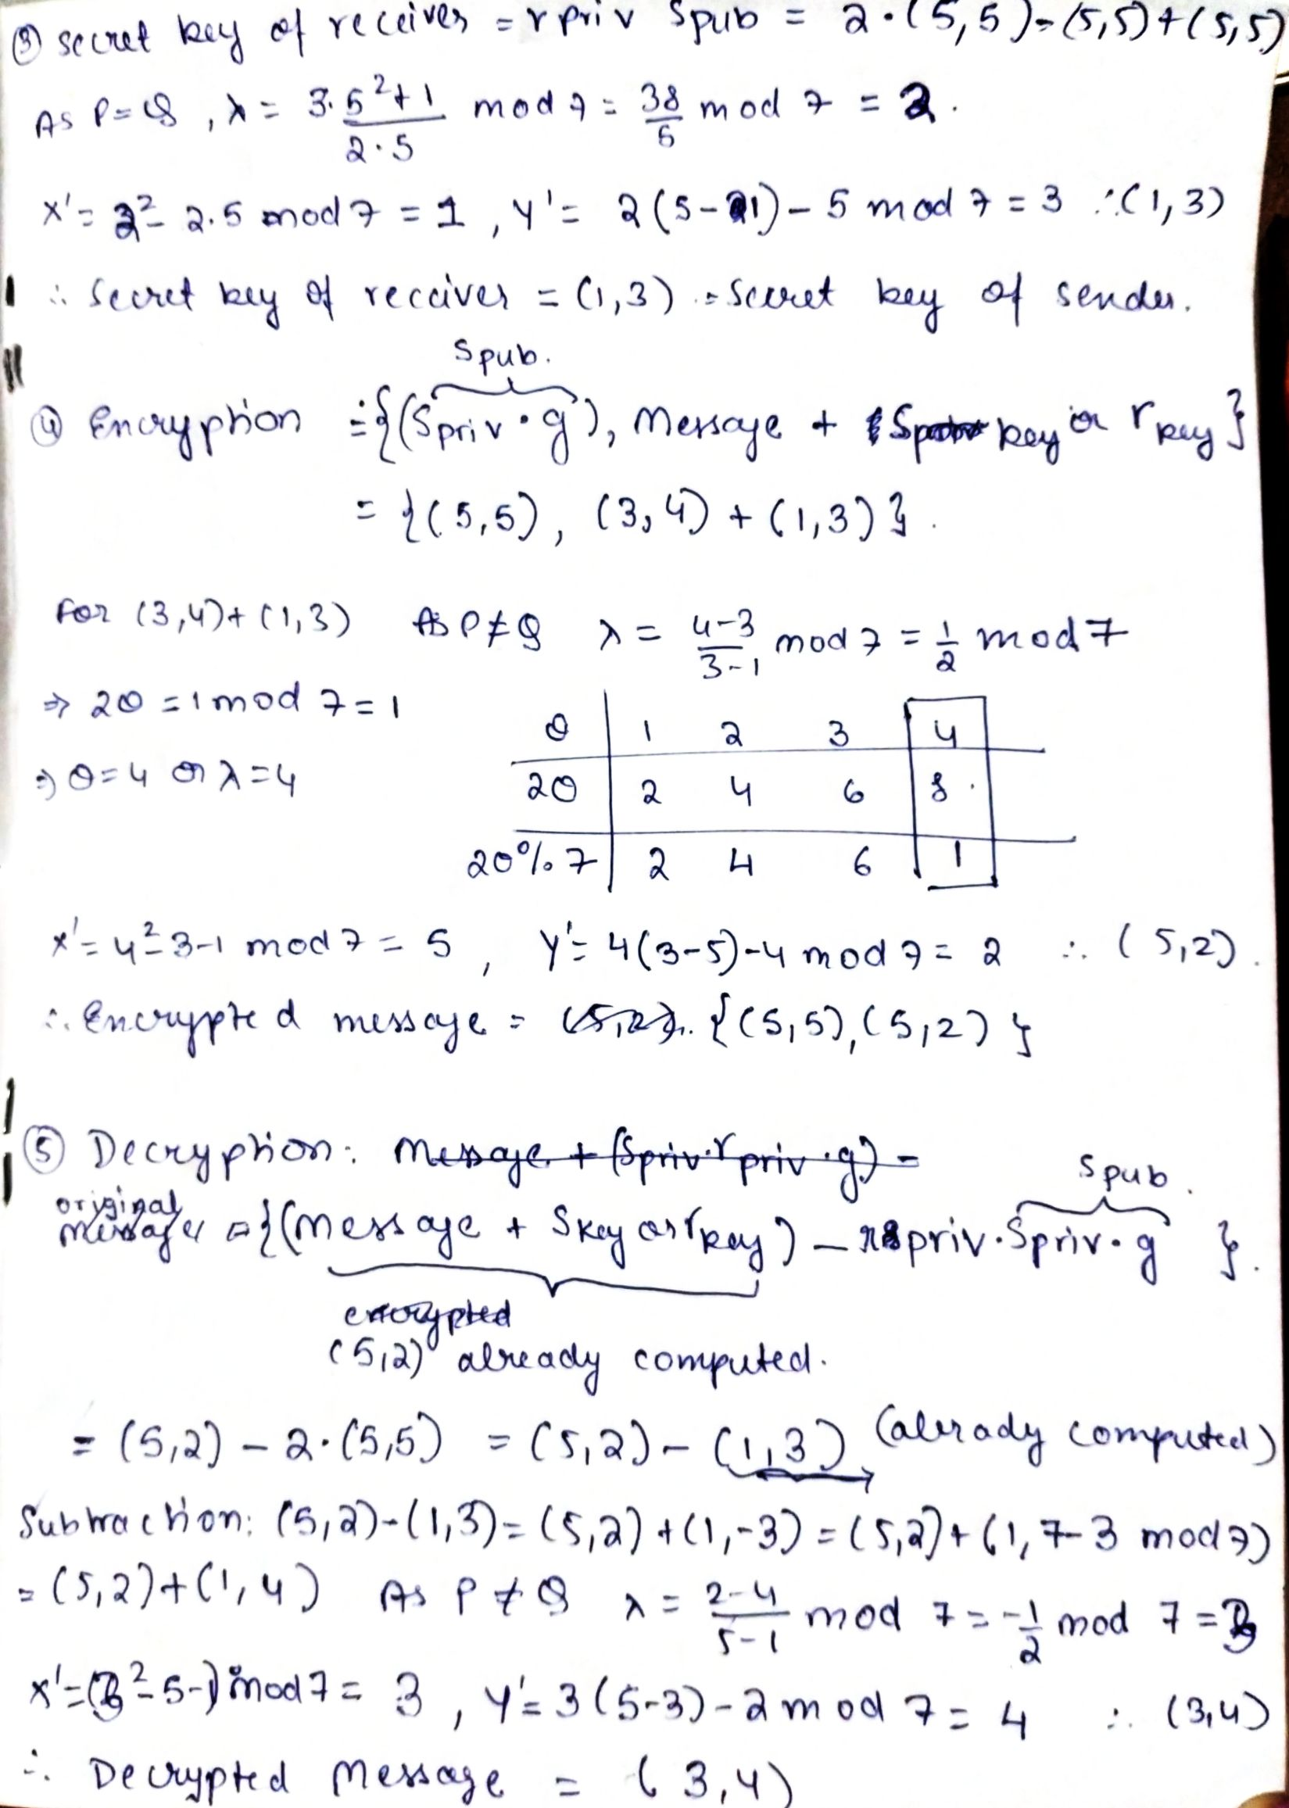

Slide 9
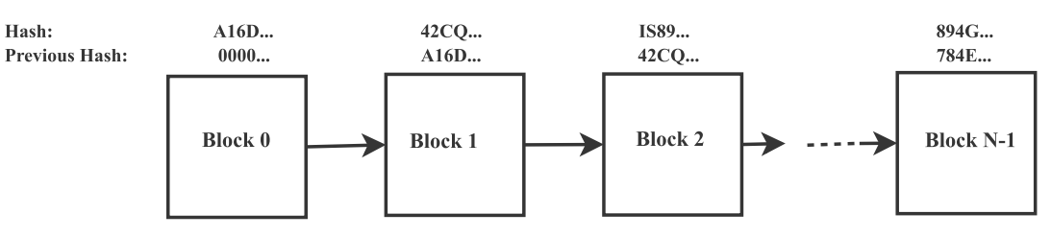
Blockchain
Blockchain is a chain of blocks in chronological order., linked blocks like a linked list of a data structure and hash as a pointer.
Hash represents each block uniquely.
The “previous hash" of the current block is the “Hash" of the previous block. The first block has the previous hash “0000...." as there is no preceding block to it.
It is a one-way function, that is, given the input, the hash value can be computed easily. However, given the hash value, it is very difficult to produce the input back.
It is deterministic, that is, for the same input, the output is also the same.
There are 64 digits in hexadecimal representation or 32 bytes in binary representation. Each digit is mapped to 4 bits in binary representation. Therefore, the total size is 64 × 4 equal to 256 bits for the SHA-256 hashing algorithm.

Slide 10
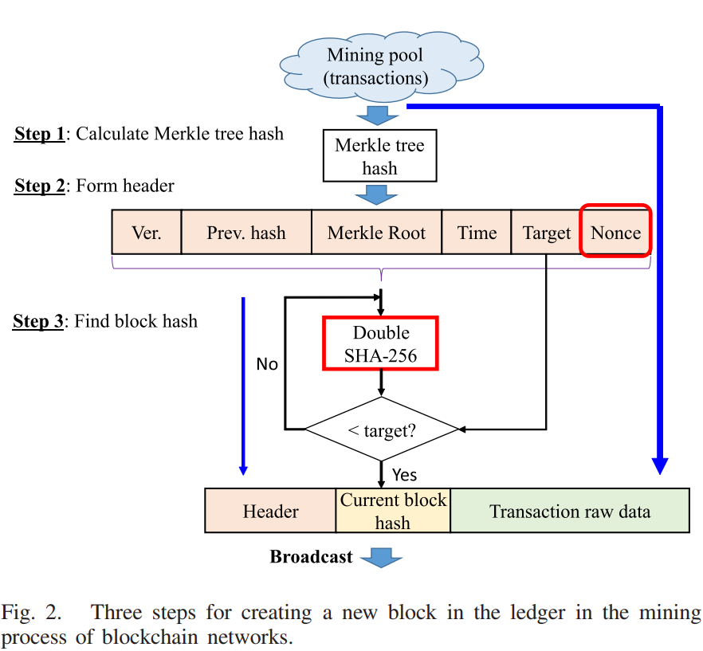
Steps for creating new block in a ledger
Step 1 selects a set of transaction data that the miner plans to write into the current block and calculates the Merkle tree hash value of this set of data.
Step 2 forms the block header, including the version, hash value of the previous block, Merkle root hash value, timestamp, target, and nonce fields.
Step 3 This step hashes the block header by utilizing Double SHA-256 with all possible values of the nonce field until a valid hash smaller than a predefined target is found.

Slide 11
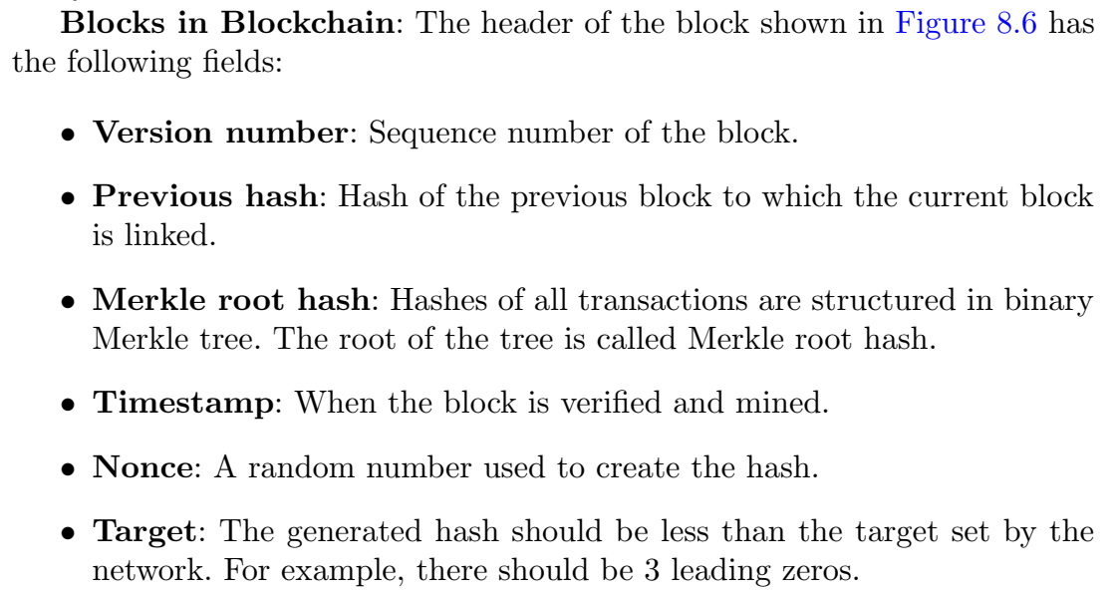
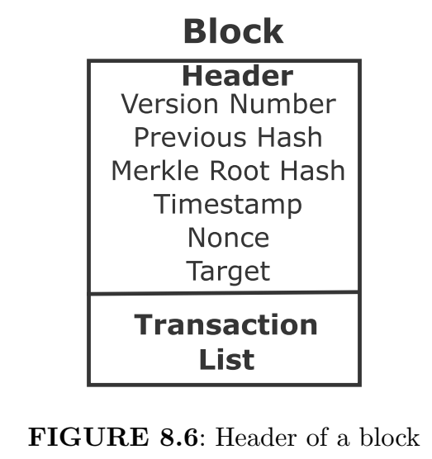

Slide 12
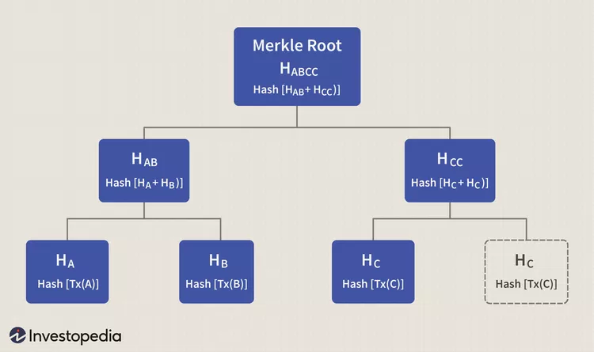
Merkle Root
A hash tree, or the Merkle tree, encodes the blockchain data in an efficient and secure manner. It enables the quick verification of blockchain data, as well as quick movement of large amounts of data from one computer node to the other on the peer-to-peer blockchain network.
Every transaction occurring on the blockchain network has a hash associated with it. However, these hashes are not stored in a sequential order on the block, rather in the form of a tree-like structure such that each hash is linked to its parent following a parent-child tree-like relation.
Since there are numerous transactions stored on a particular block, all the transaction hashes in the block are also hashed, which results in a Merkle root.
This root hash is called the Merkle root, and due to the tree-like linkage of hashes, it contains all the information about every single transaction hash that exists on the block. It offers a single-point hash value that enables validating everything present on that block.

Slide 13
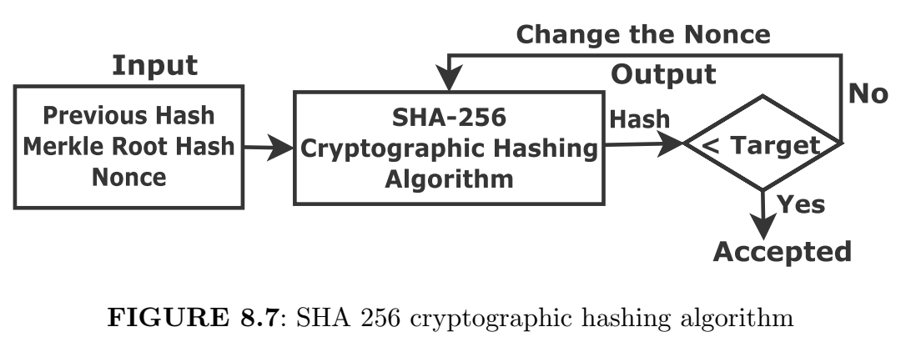
Miner
There are three input, namely, previous hash, Merkle root hash and the nonce to SHA-256 cryptographic hashing algorithm as shown in Figure 8.7.
The miner varies the nonce, while the previous hash and Merkle root remain the same, to generate a hash value lower than the target.
If the hash value meets the target set by the networks, then we stop. Otherwise, the process is repeated and this is called proof of work consensus algorithm.
The miner verifies and validates the transactions and adds the block.
The first miner who gets the hash that meets the target is rewarded.
Since the miner invests resources and computing power, he or she is rewarded for the same in terms of bitcoin or other forms of remuneration.

Slide 14
Tamper–proof Block chain
Let us consider that the attacker tampers the data of block number 3 of Figure 8.5.
Subsequently, the hash value of this block changes.
However, the previous hash value of block 4 remains intact as there is no tampering in block number 4.
Consequently, the changed hash value of block number 3 due to tampering and the previous hash value of block number 4 do not match.
This makes the following blocks invalid. Hence, tampering can be detected in a blockchain network.

Slide 15
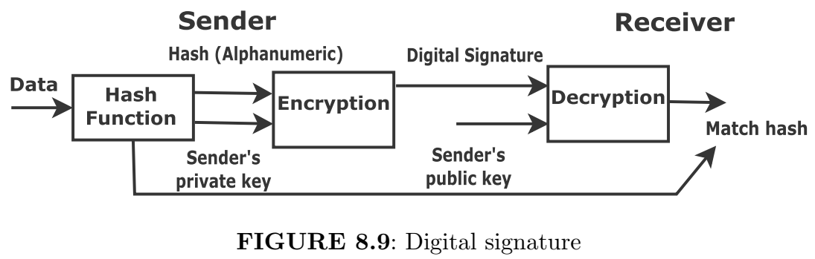
Digital Signature
We can also use the SHA-256 hash function in the blockchain. First the original message is passed through an SHA-256 hash function, which gives alphanumeric characters. Subsequently, both hash message and private key of the sender is used for encryption to get a digital signature as shown in Figure 8.9. At the receiver, both the digital signature and sender’s public key are used to get the hash message. If this hash message and the hash message after directly applying the hash function to the data are the same, then the message is not altered during transmission and coming from the legitimate sender.

Slide 16
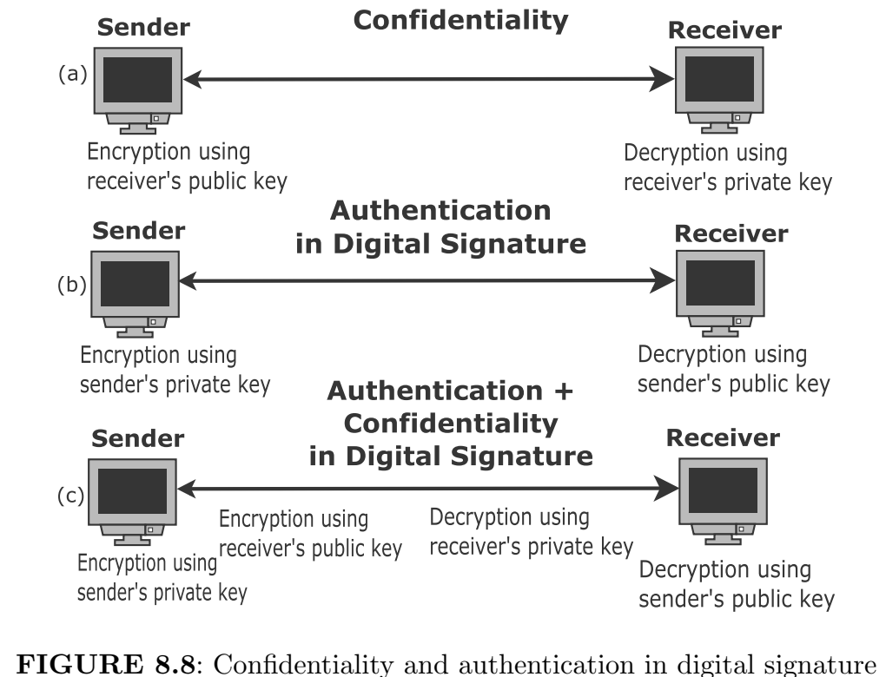
Role of Digital Signature in Blockchain
Confidentiality is defined as the state of keeping secret or private. This is carried out using public key for encryption and private keys for decryption
Authentication is defined as the process of showing something legitimate. This is achieved using digital signature as shown. In authentication, we need public key, not private key, to decrypt. We make sure that received message is from the authentic sender.
We can achieve both confidentiality and authentication. We do double encryption and decryption at both sender and receiver ends.

Slide 17
Transaction in Blockchain
The transaction details are deducted amount for the sender and credited amount for the receiver.
There is no actual transfer of digital currency. Only the transaction is recorded in the ledger of blockchain.
The transaction detail is passed through the SHA-256 cryptographic hashing function.
We know that the private key is secret with the user, while the public key is shared with all the Bitcoin users.
The transaction detail is signed using the user’s private key.
The sender broadcasts the encrypted transactions with amount of bitcoin network to be transferred.
The miner receives the transaction, verifies, and validates it.
The miner then includes it in a block and propagates it to other Bitcoin users.

Slide 18
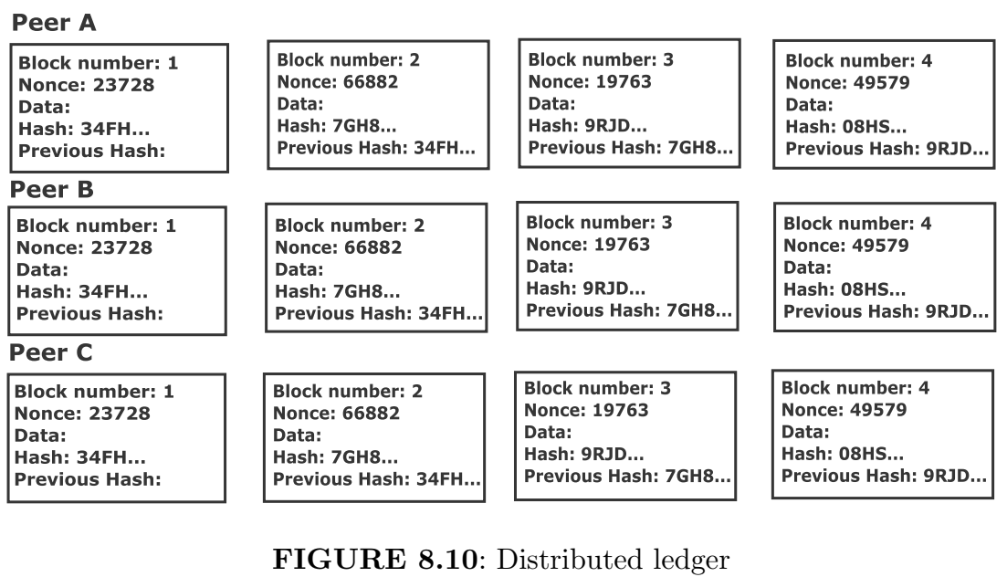
Distributed Ledger

Slide 19
Distributed Ledger
All users have the same copy of a ledger. A blank ledger with no data input also has some hash.
Each row is a blockchain, where the “previous hash" of the current block is the “hash" of the previous block.
If we write something in any block of some peer, all subsequent blocks turn pink.
This leads to a change in “hash" and “previous hash“ like a linked list. Now, clicking on mine of that block changes the nonce and regenerates the hash such that it has 4 leading zeros to meet the target. This makes that block green and the process is repeated for subsequent blocks of that row.
Notably, modification of a block makes all subsequent blocks invalid and these are re-mined.
For example, when we write in the data field of block 3 (say) of Peer A, this generates a hash value that is different from block 3 of peer B or C.
Note that the hash values of block 3 of peer B and C are the same as we have not modified their data fields. Hence, the data modification of a block can be easily detected. This was not possible if we have a single copy of the ledger.
If a node (computer) gets corrupted, we do not lose the data because the same copy is with other nodes.

Slide 20
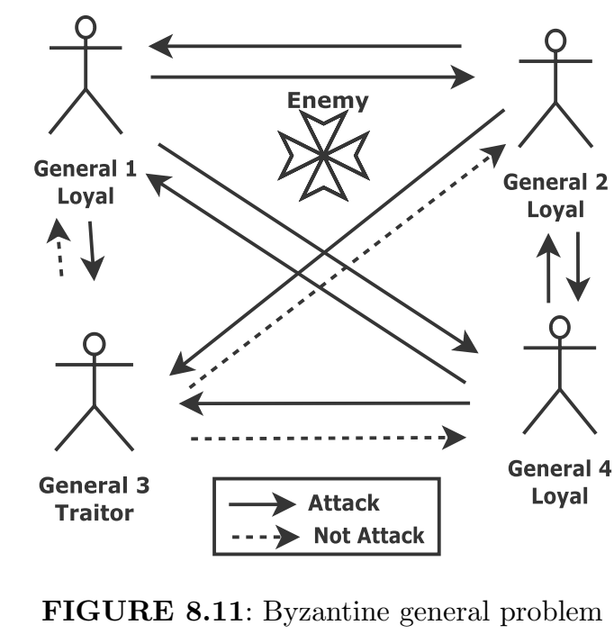
Byzantine Generals Problem
Let us assume that there are four generals, out of them, three are loyal and one is a traitor as shown in Figure 8.11.
The loyal general gives the command to attack, while the traitor to not attack.
The generals are not at one place, they communicate among themselves.
The goal is victory even if a minority of the generals are traitors.
In this scenario, the loyal general receives the 2 commands for attack and 1 command to not attack.
The majority of commands are to attack, therefore, they attack the enemy. This is called Byzantine fault tolerance.
On similar lines, in blockchain networks, the generals are the nodes and the messages are the transactions.
Attack command is the legitimate transaction, while to not attack command is the invalid transaction. We arrive at the consensus in the presence of some malicious nodes.

Slide 21
Transaction Pool and Candidate Block
Transaction pool stores all the unverified transactions before getting included in a new block.
Candidate block is a temporary current block that does not have valid proof of work. It is made up of transactions selected from the transaction pool.
The miner picks block number 5 (say) and starts validating.
However, in meantime, some other miners might get the satisfactory hash that meets the target.
The block number 5 does not have a valid proof of work which is mined by miner 2 before miner 1 completes and gets the reward.
Now, miner 1 starts competing for block number 6 by picking the unverified transaction from the transaction pool.

Slide 22
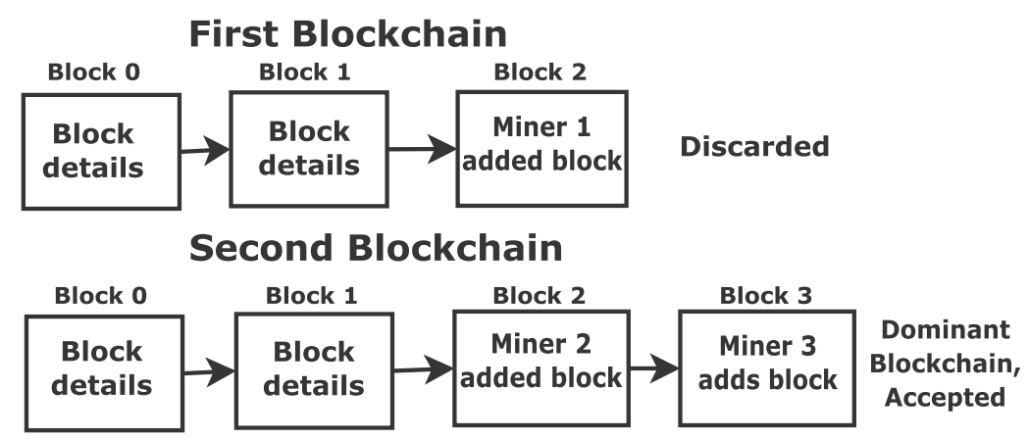
Tie in Generating Hashes or Adding Blocks by Miners
A tie is a rare event, however, we choose the one who finds the hash that meets the target first.
If two miners get the hashes that meet the target at the same time, both add his or her block. However, two blockchains must not run and only one blockchain needs to be allowed.
We choose the blockchain in which the other miner has added a block first and gets verified by other users in the network. Say, miner 3 adds the block in the second blockchain, then it is accepted as the dominant blockchain. The first blockchain is discarded.

Slide 23
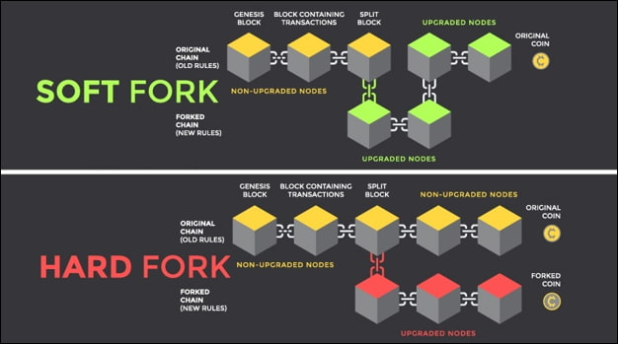
Fork
A fork happens whenever a community makes a change to the blockchain’s protocol, or basic set of rules. When this happens, the chain splits — producing a second blockchain that shares all of its history with the original, but is headed off in a new direction with different rules or protocols.
Soft fork: The new version works well with the old version, that is there is backward compatibility. Hence, there is flexibility.
Hard fork: This is rigid as there are different rules for different chains and the users have to choose one. Both chains are valid and cannot be discarded. Some users support the old chain, while others the new chain.
Example: We have different versions of the same coin, for instance, bitcoin (BTC) and bitcoin cash (B cash or BCH). Initially, we had a block size of 1 MB with a lesser number of transactions. With the popularity of Bitcoin, the number of transactions has been increased. Therefore, we need a larger block size of 8 MB for bitcoin cash since August 2017.

Slide 24
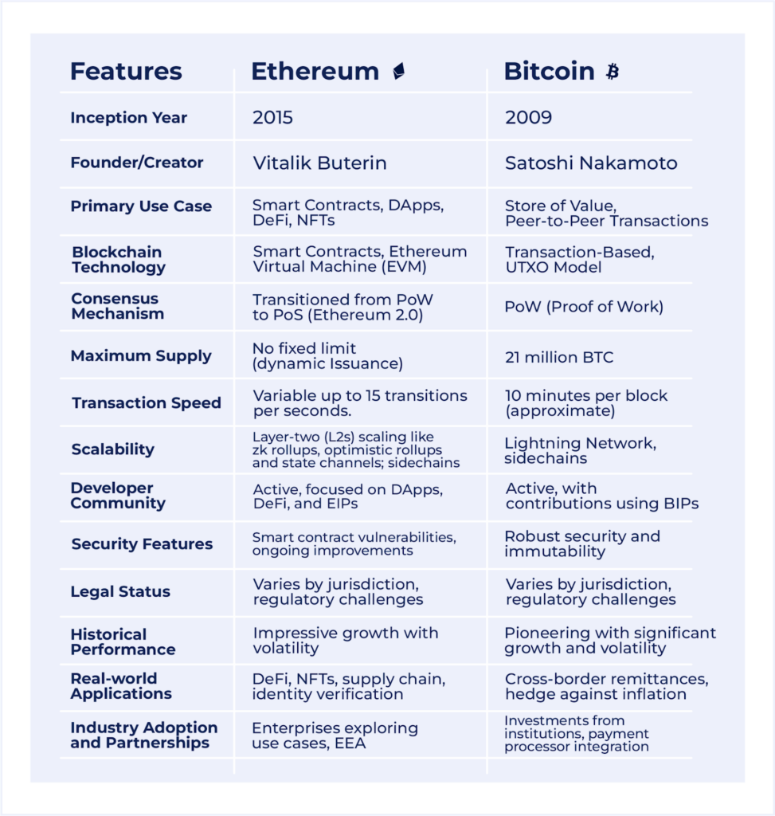
Bitcoin vs Ethereum

Slide 25
Applications of Blockchain
Money transaction: We know the drawback of a bank and steps for transactions between sender and receiver.
Know your customer (KYC): We do not need to submit the KYC form to each bank separately. Once KYC is recorded in a blockchain network, we can allow accessing the KYC form to each bank.
Voting system: Single vote casting by an electorate; electorate identity information and votes cannot be tampered with and stored permanently.
Insurance claim: The medical history of a patient can be stored in immutable records. This prevents the false claim made by the patient.
Retail Management: The sensors collect the conditions of the product. The product can be automatically tracked, and conditions at generation, shipment, and arrival can be verified through history. The contract can be executed between two vendors.
Government Organizations: All the data can be secured, tamper-proof and transparent among stakeholders eliminating paper-based records.

Slide 26
Disadvantages of Blockchain
Private keys: It is a password that allows you to withdraw funds from your wallet. If you lose this key, you cannot withdraw funds from your account. So, you need to store multiple copies of it. Somebody might access one of these copies. Changing a private key once generated is impossible.
Possibility of disruption of network security: The validation process in a blockchain is done through miners having a lot of computing power. If you are a miner with enough computing power to control more than 50% of a blockchain's mining hash rate, you can launch a 51% attack. You can prevent transactions from gaining confirmations and even pause payments between users.
High costs of implementation: You have to hire core blockchain developers and then create blockchain-based applications. Plus, there are hardware requirements too.
Inefficient mining process : Each miner needs a high-powered computer to compete in the mining process but only one gets the block rewards. There is a massive waste of energy and resources.
Environmental impacts: Mining, minting and validating transactions require high-powered systems to run 24/7. This can lead to serious environmental consequences.
Storage problems: all the data on a particular blockchain is stored on the hard drive of a miner's system which might require an upgrade as data increases.
Anonymity: Anonymity is the main selling point of blockchain technology. Cybercriminals were using blockchains as money laundering platforms.
Immutability: Once you enter information on a blockchain, it becomes unchangeable.
Hard forks: Hard forks occur when most blockchain members want to implement new rules/cryptocurrency. In this case, the old and new cryptocurrencies operate as separate entities. Many users face difficulties as the new coin is not readily available on exchange platforms upon its release.

