Slide 1
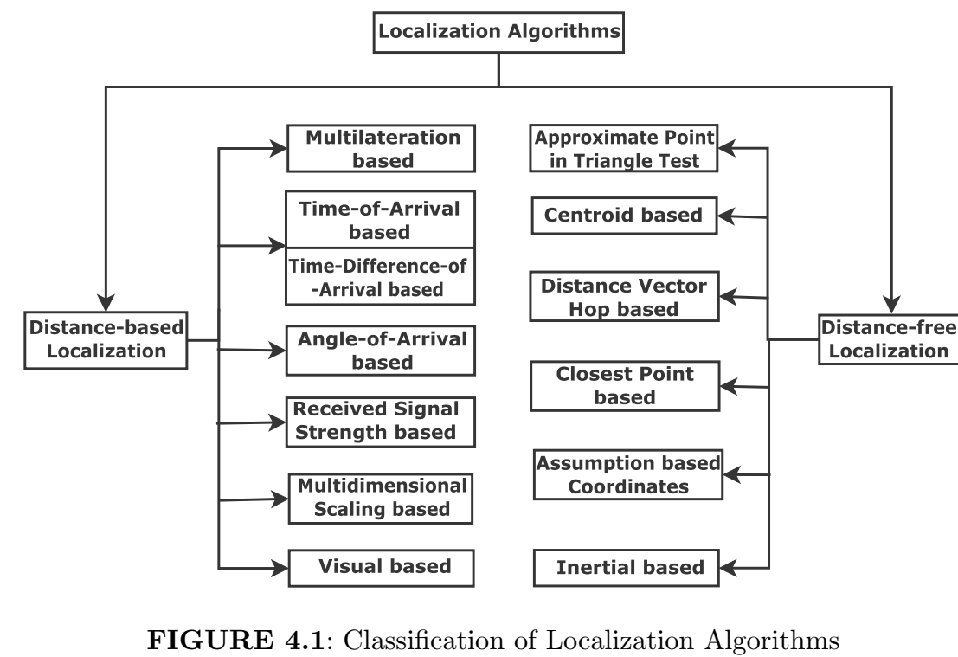
Localization methods utilize the knowledge of the locations of a small subset of nodes. The node that is aware of its location is known as an anchor, beacon, source, or landmark.
Distance-based localization methods utilize the distance between the anchor and unknown node. Distance-free methods utilize only connectivity information.
Distance-based methods are fine-grained (± 10cm) localization methods, whereas, distance-free methods are coarse-grained (± 5m).
The distance-free based localization has low complexity

Slide 2
Distance-based localization methods
AOA and DOA-based algorithms need special hardware to estimate the angle at which the signal arrives at the antenna array.
The time of arrival (TOA) method performs localization using the information about the time of arrival of the signal from different anchors. However, TOA requires a reference timestamp to synchronize the local clock of the nodes.
To overcome this issue of reference offset, a time difference of arrival (TDOA) method is used. TDOA is based on the principle of the time difference of arrival of the anchor signals at a pair of nodes.
In this method, one of the anchors is generally taken as a reference node. The TDOA method does not require synchronization between anchors and the unknown node.

Slide 3
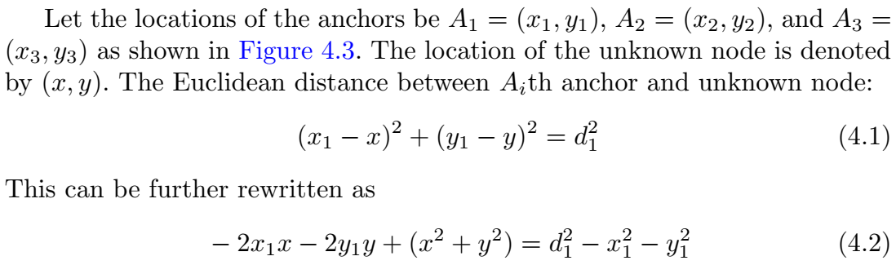
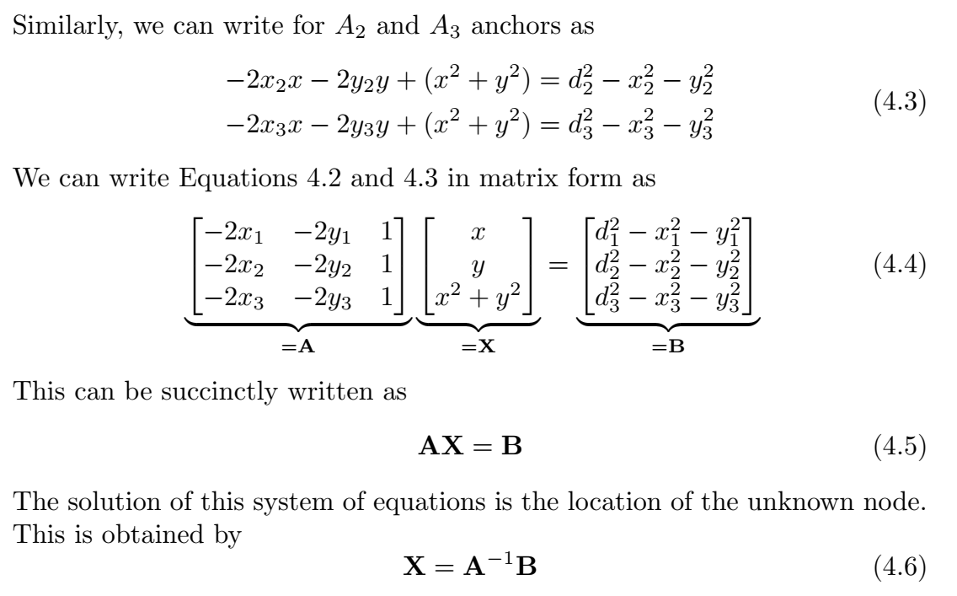
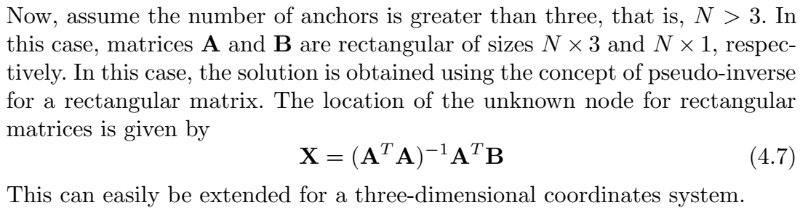
Multilateration based localization
Q. Let's assume the following anchor locations: A1 = (1, 2) , A2 = (4, 5) , A3 = (7, 8) and the measured distances to the unknown node are: d1 = 3 , d2 = 4 , d3 = 5
1. Calculate the matrix A = [[ -2*1, -2*2, 1 ], [ -2*4, -2*5, 1 ], [ -2*7, -2*8, 1 ]] = [[-2, -4, 1], [-8, -10, 1], [-14, -16, 1]]
Calculate the matrix B = [[ 3^2 - 1^2 - 2^2 ], [ 4^2 - 4^2 - 5^2 ], [ 5^2 - 7^2 - 8^2 ]] = [[4], [-25], [-84]]
Calculate the matrix X = A^-1 * B = [[0.5, -0.5, 0], [-0.5, 0.5, 0], [1, 1, 1]] * [[4], [-25], [-84]] = [[24], [29], [105]]
For matrices of greater/complex sizes:

Slide 4
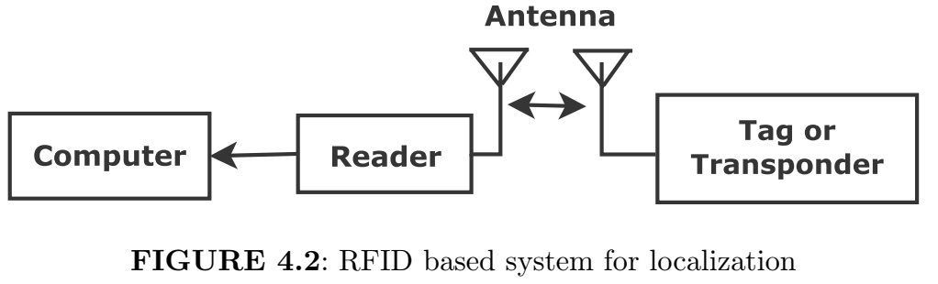
Received Signal Strength (RSS)
The RFID reader detects and receives the RF wave originating from the RFID tag (transponder).
The energy of RF signals decreases exponentially with the distance.
The RFID reader is then connected to computing devices. The computing devices estimate the location of the objects using RSS signals.
The RSS-based algorithm is marginally inaccurate, however, RSS measurements are easily accessible and low-cost. Hence it is used in Radio Frequency Identification (RFID) based positioning, which is suitable for IoT networks.

Slide 5
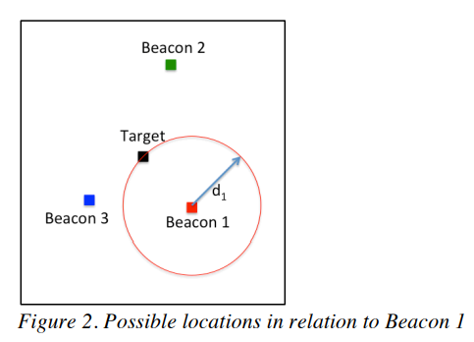
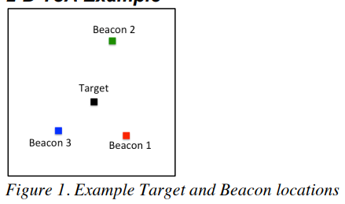
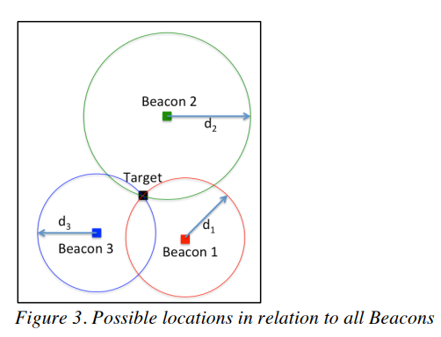


Basics of Time of Arrival based Localization

Slide 6
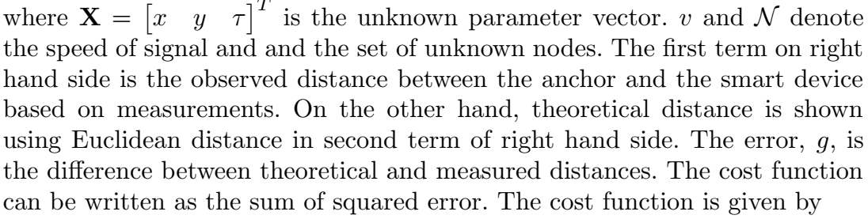

Time-of-Arrival based localization
We know that speed multiplied with time elapsed gives the distance between transmitter and receiver. The difference between theoretical and observed distances is given by:
where w is the confidence parameter between 0 and 1. The expression is the function of the unknown node location. The wi is the weight of the ith anchor and the smart device.

Slide 7
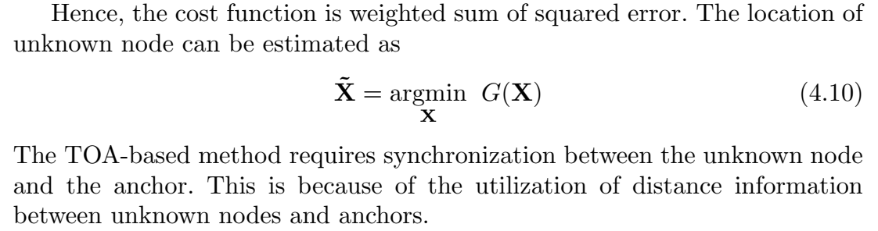
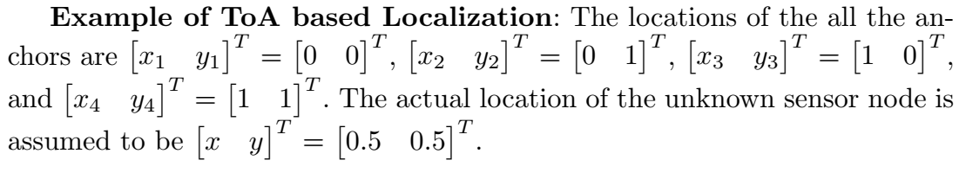

Slide 8
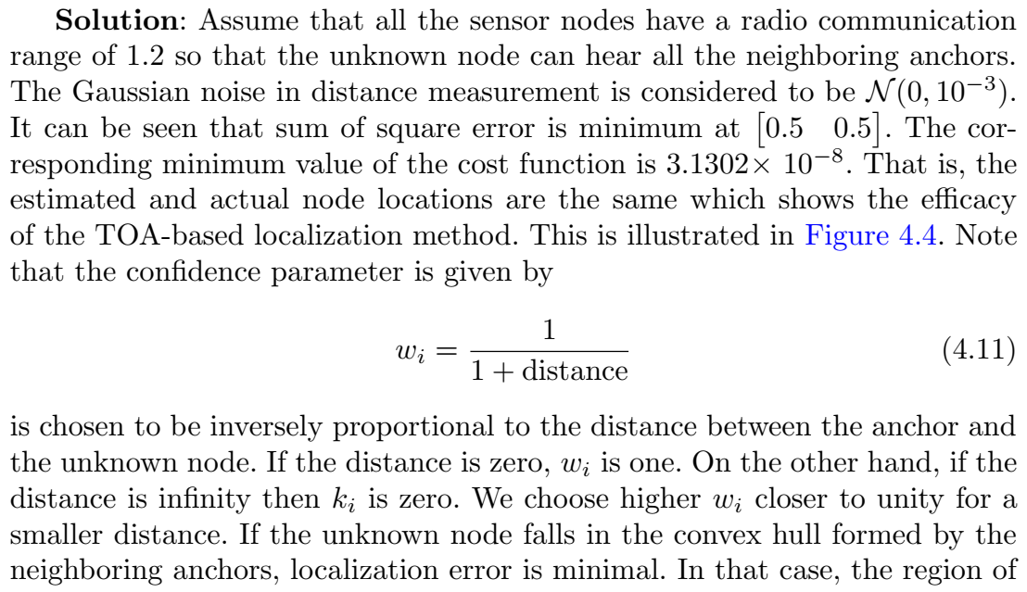

Slide 9
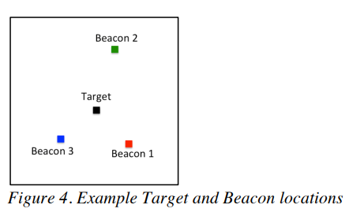

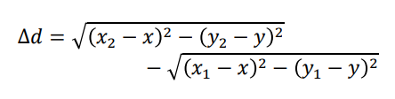
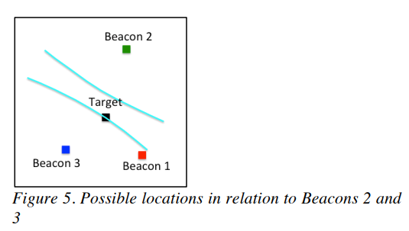
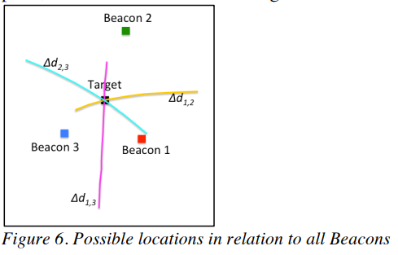
Time Difference of Arrival based localization (TDoA)
hyperbola

Slide 10
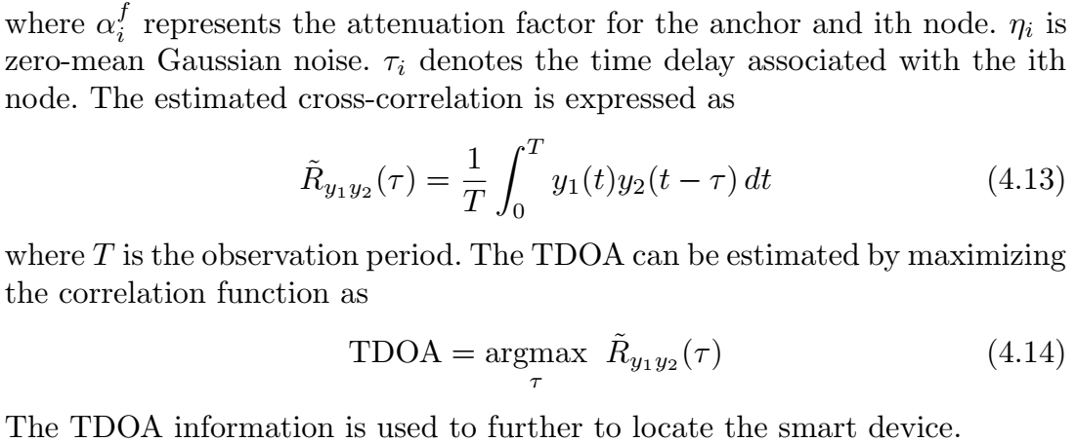
Time difference of arrival based localization
We explain Time-difference-of-arrival (TDOA) based localization now. The received signals at ith unknown node is given by:

Slide 11

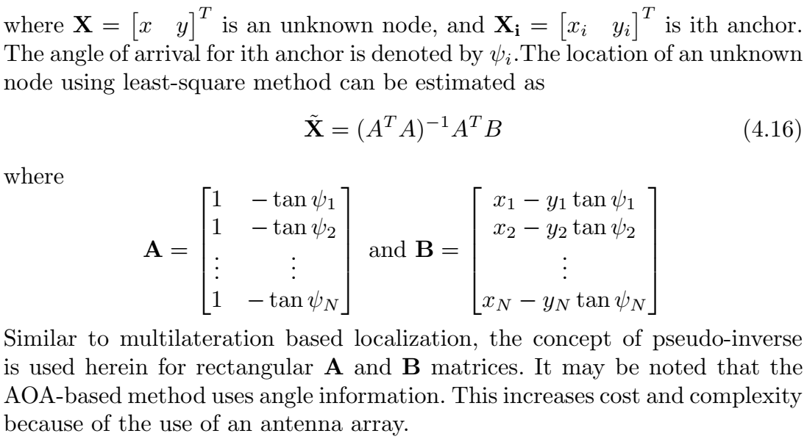
Angle of Arrival based localization
We first use trigonometry and geometry in Angle-of-Arrival (AOA) based localization. The angle and location relationship between the unknown node and anchor can be expressed as:

Slide 12
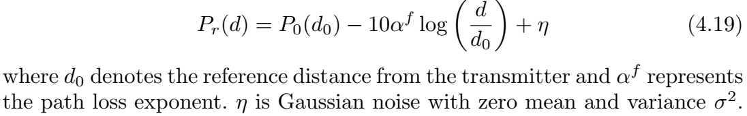
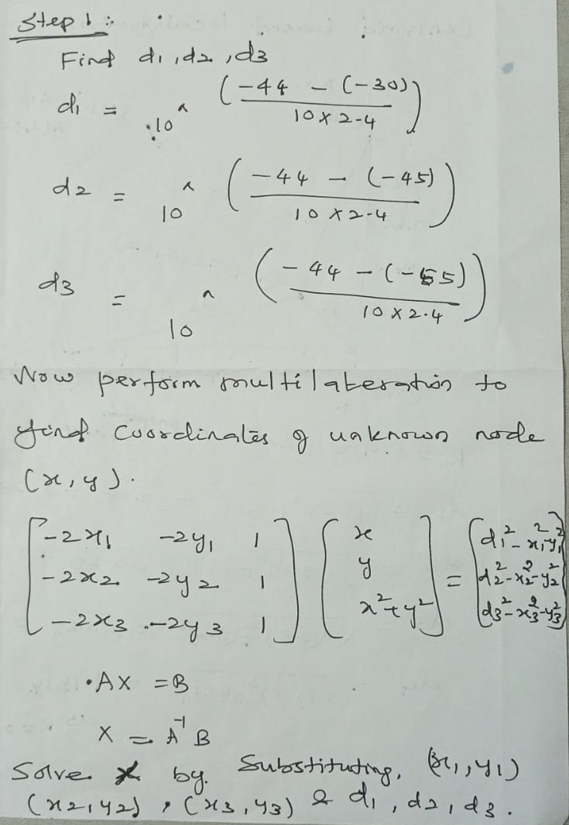
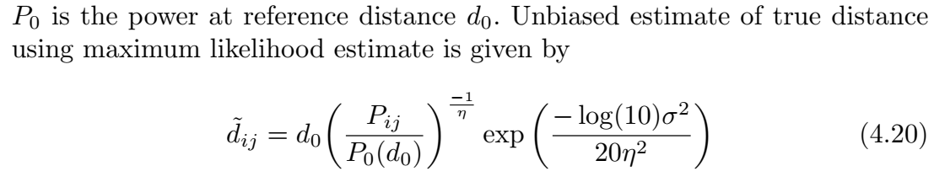
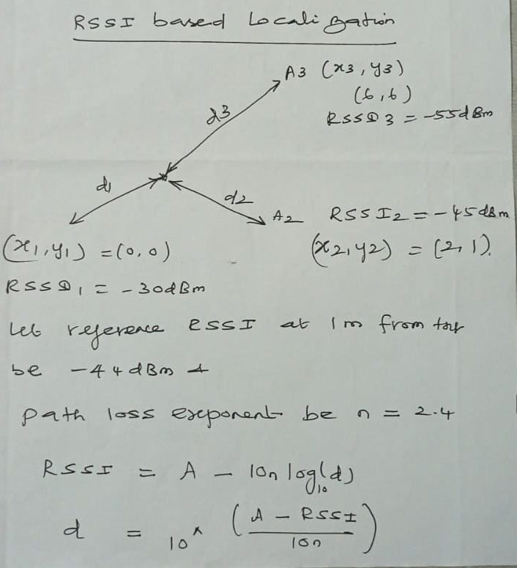
Received Signal Strength based localization
RSS is a low-cost measurement and it depends upon the wireless channel. It may yield large errors because of the requirement of an accurate propagation model. We can also use the least-square method to estimate distance.

Slide 13
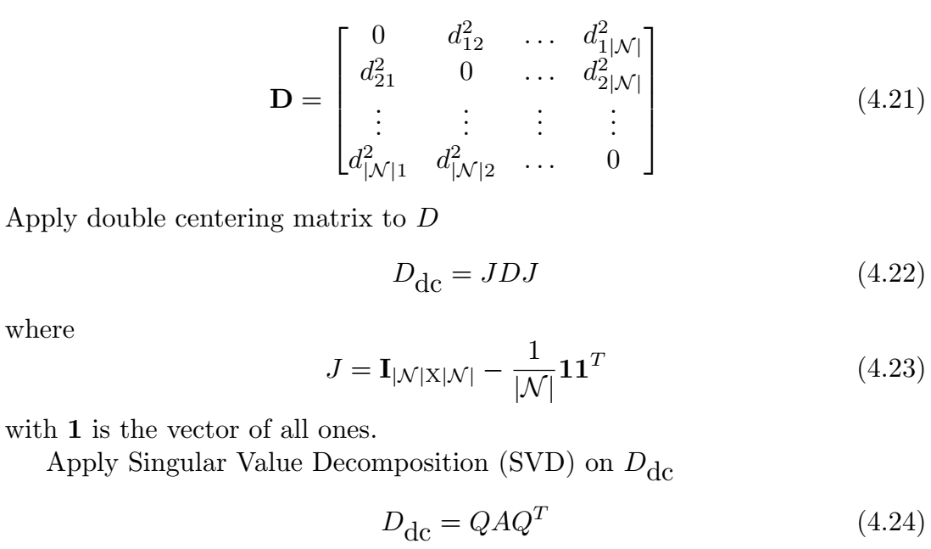
Multi Dimensional Scaling Based Localization
The algorithm based on the MDS computes the location of the unknown node, given the set of distances between each pair of nodes. The squared distance matrix is given by

Slide 14
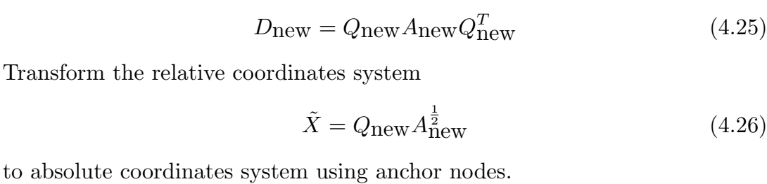
where A is the diagonal matrix having each element as eigenvalue and Q a matrix corresponding to the eigenvector. Choosing the first two eigenvalues and the corresponding eigenvectors for two-dimensional coordinates system

Slide 15
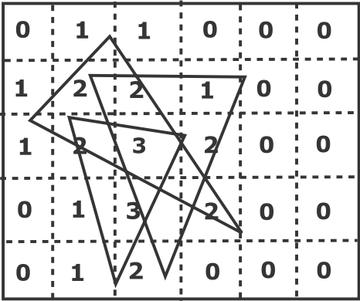
Approximate Point in Triangle Test
Nodes that are equipped with high-powered transmitters are called anchors. The unknown node can obtain its location based on the information from the anchors. Example:
First, a grid array is formed and all the grids are initially assigned a zero value as shown in Figure 4.9.
It is then scanned using a grid scan algorithm. If the node lies inside the triangle, it is incremented by one.
It is worth mentioning that the number of grids can be increased by decreasing the size for better accuracy.
APIT is a cost-effective approach and it has good localization accuracy, even in the presence of irregular radio patterns, and with the random node deployment.

Slide 16
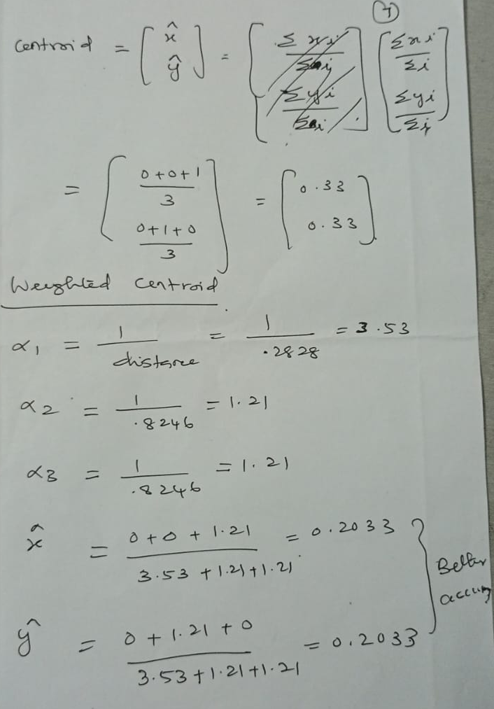
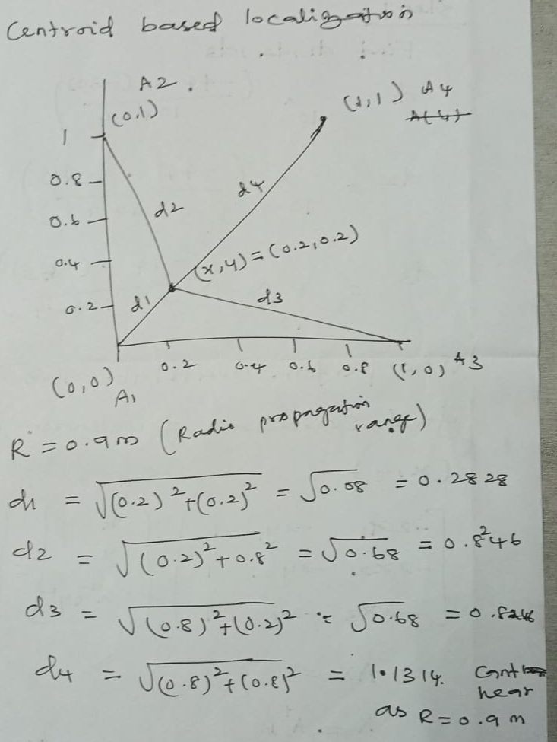
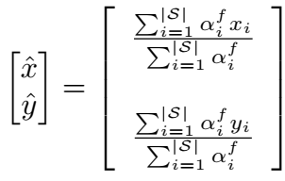
Centroid-based Localization

Slide 17
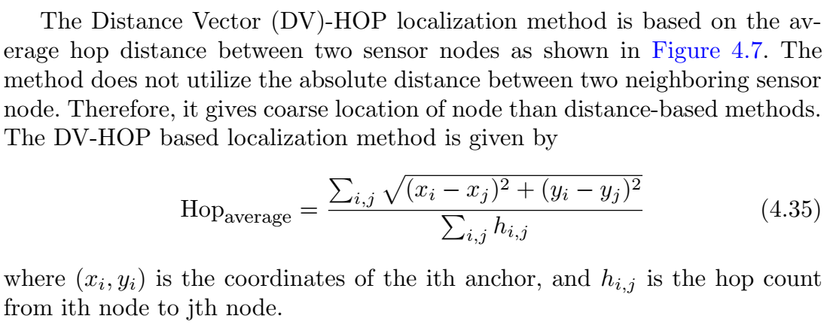
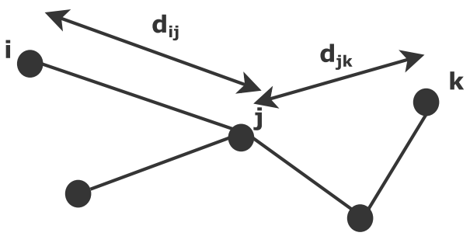
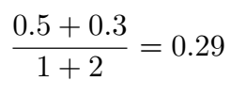
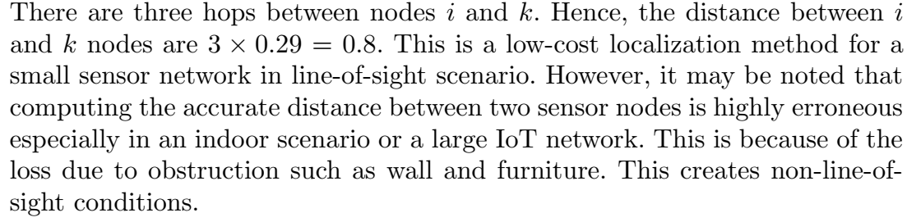
Distance vector hop based localization
Example:Let d_{ij} = 0.5 and d_{jk} = 0.3.
The average hop distance =

Slide 18
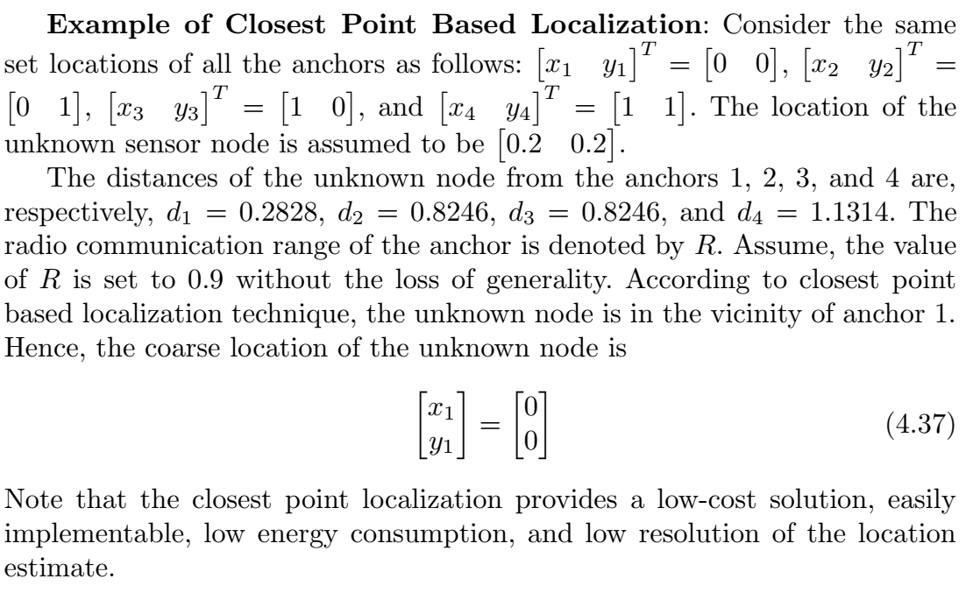
Closest Point Based Localization
The coarse location of the unknown sensor node may be decided based on:
Which anchor is the closest to node receiving maximum power?
Direction at which nth node receives maximum energy?

Slide 19
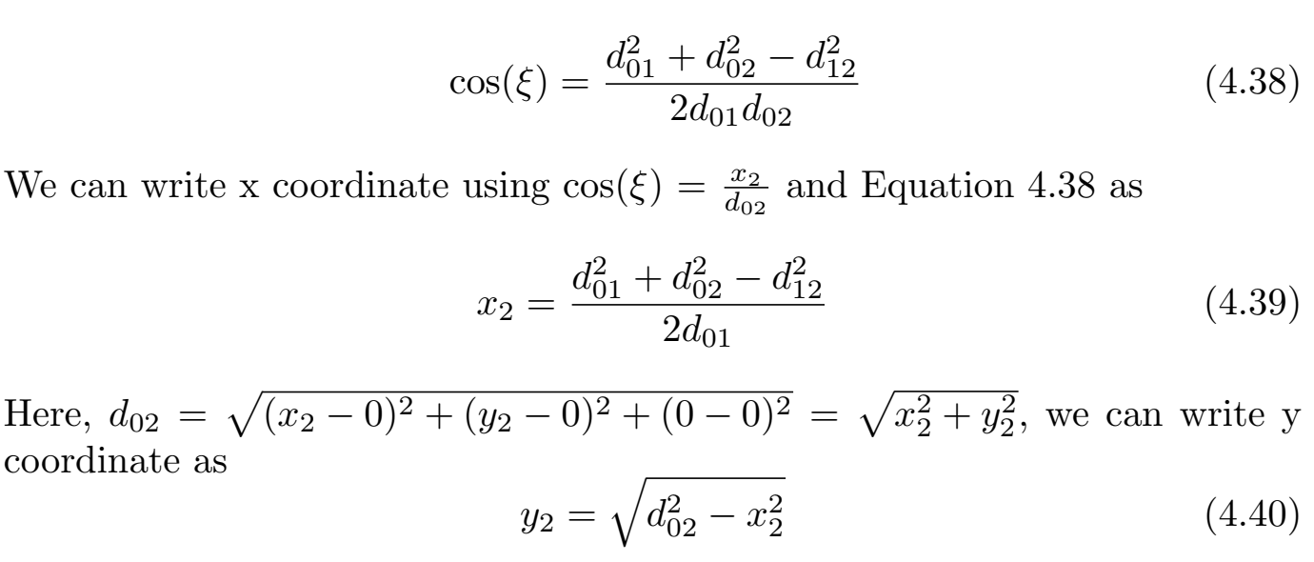
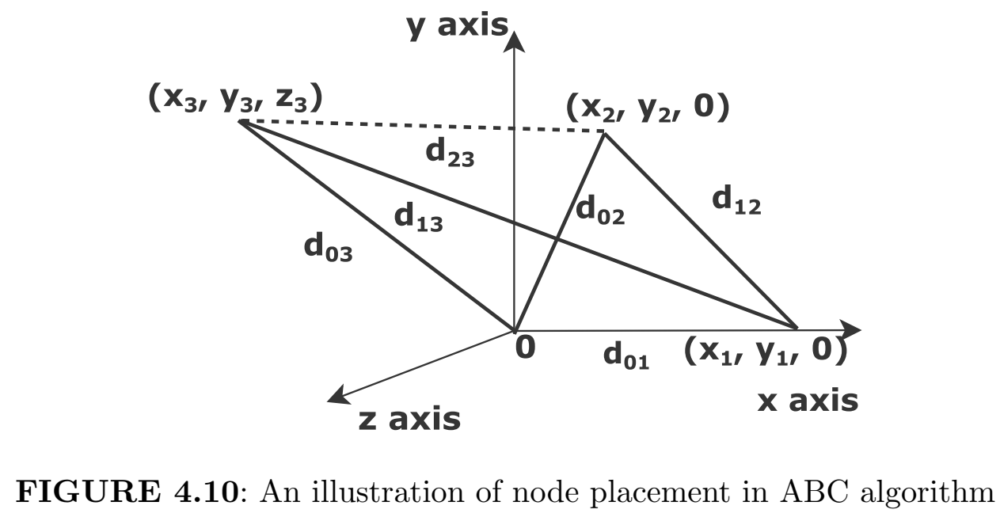
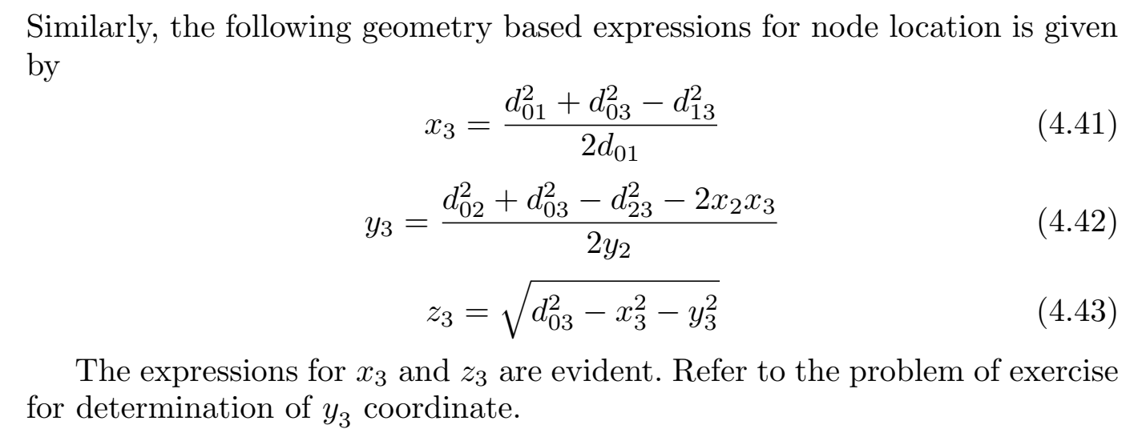
Assumption Based Coordinates (ABC) Localization
Initially, it is difficult to get the range measurements from more than three anchors for a 2D coordinate system. Therefore, a map based on the neighboring ranges is generated at the beginning of the network operation. ABC is a distributed localization method.

Slide 20
