Slide 1
CLUSTERING
Please refer problem we did in class and the handwritten note for this topic.

Slide 2
Sensor Data Fusion
In the data fusion technique, we combine data of homogeneous or heterogeneous sensor data from IoT networks.
Fused data provides complementary information than the individual sensor data. We estimate or predict some aspect of an observed event in the fusion process.
The data fusion technique helps us in making more accurate decisions.

Slide 3
Motivation and Pointers for Data Fusion
There may be a loss of individual sensor data during data collection, communication, or reception.
Further, some sensors may not provide a large number of observations or measurements due to their hardware specification.
Hence, it limits the higher sampling rate.
Finally, some sensors may not be accurate.
This motivates us to study the data fusion technique.

Slide 4
Motivation and Pointers for Data Fusion
Some of the pointers of the data fusion technique are as follows:
First, there is no replacement for good sensor data. Even a sophisticated fusion algorithm cannot address the challenge if sensor data are not collected properly.
Second, the error in one stage propagates to the next stage. We must do the best possible processing at every stage right from the data collection stage.
Third, the results using fused data may not be better than the best sensor. Poor optimization of parameters such as weight during the fusion process may provide poor accuracy.
Fourth, a fusion algorithm may not be universally accepted. An algorithm is chosen based on the characteristics of the data.
Fifth, getting sufficient training data is not possible in a practical scenario. Hybrid algorithms that extract and use implicit and explicit features may help.
Sixth, because of the dynamic fusion process, the refinement of the estimate does not end.

Slide 5
Fusion Architecture
There are three types of architecture of fusion, namely, centralized fusion, distributed fusion and hybrid fusion.
Centralized fusion is used for homogeneous sensors. Temporal alignment and transformation of data are carried out appropriately herein. It uses estimation theory.
Distributed fusion is used for heterogeneous sensors. Local decision is made or information is extracted by each sensor using estimation theory. Then it is fused. The fusion architecture is suitable for a large network.
Hybrid fusion combines both centralized and distributed fusion methods. The distributed scheme is preferred to reduce computational overhead.
The centralized scheme is used for high accuracy.

Slide 6
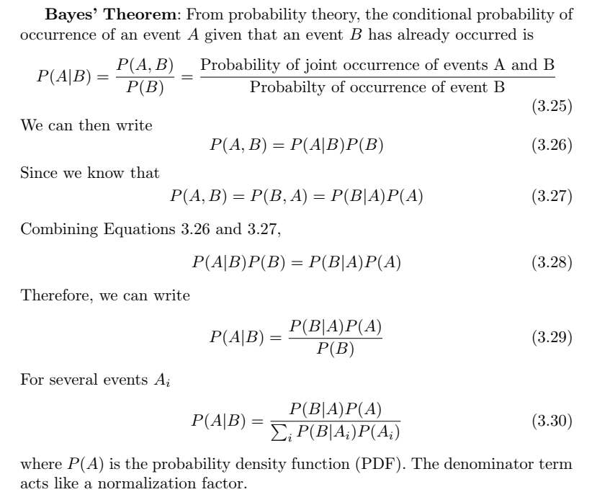
Bayesian Fusion

Slide 7
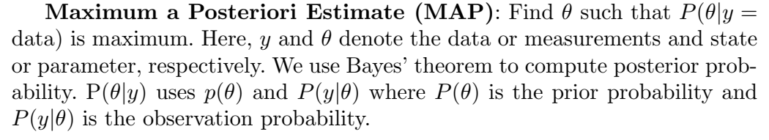
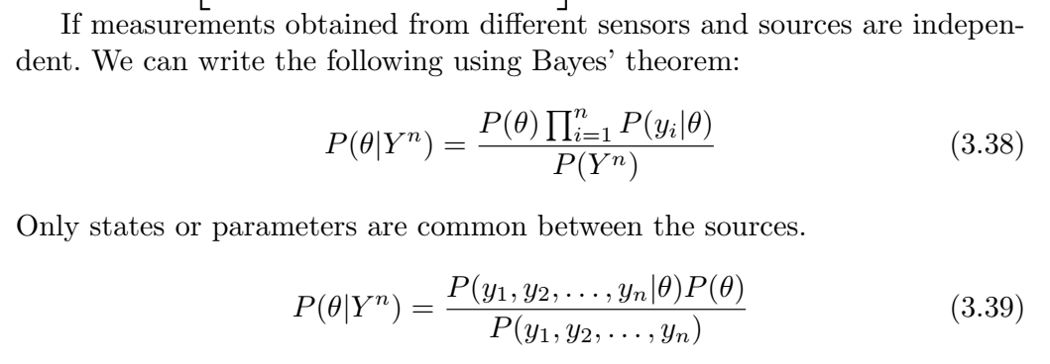

Slide 8
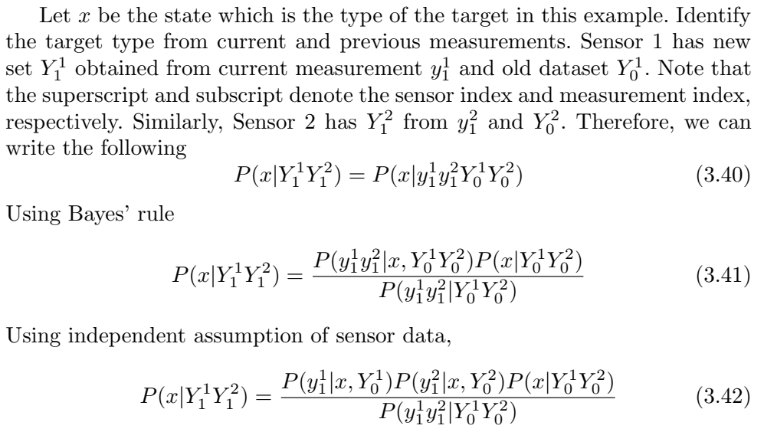
Fusion of Data from Two Sensors

Slide 9
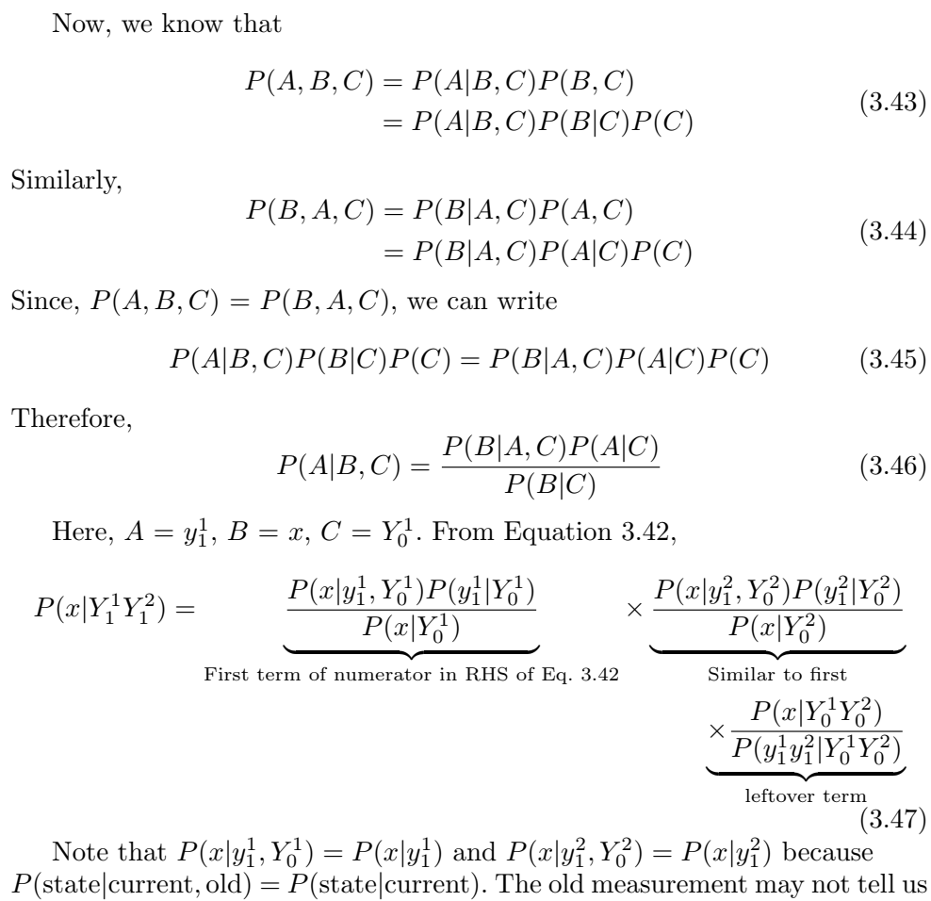

Slide 10
