Slide 1
Cloud and Fog Computing.
Cloud computing is a shared pool of dedicated computing resources provided to all users. The features of cloud computing are as follows:
Resource pooling: Multiple users use same resources and services like storage, processing and bandwidth.
Scalability: On-demand resources and services can be changed based on the user demand.
On the other hand, fog computing is a platform that provides distributed storage, computing, and networking services.
The computing is implemented on IoT devices themselves or gateways at the edge of the networks. This brings the computations closer to the things, sensors, or devices where the data is generated.

Slide 2
Motivation for Fog Computing
Billions of devices are connected to the Internet.
Multipath fading and interference leads to loss of packets even in cloud computing architecture.
As we move, there is a need for the physical movement of computing and storage facilities.
Sensing and actuating devices are resource-constrained devices. Thus, all data cannot be processed by those devices themselves.
Hence, there is a requirement to offload the storage and compute functions to fog nodes.
The applications of fog computing include real-time analytics, and distributed and hierarchical data management.

Slide 3
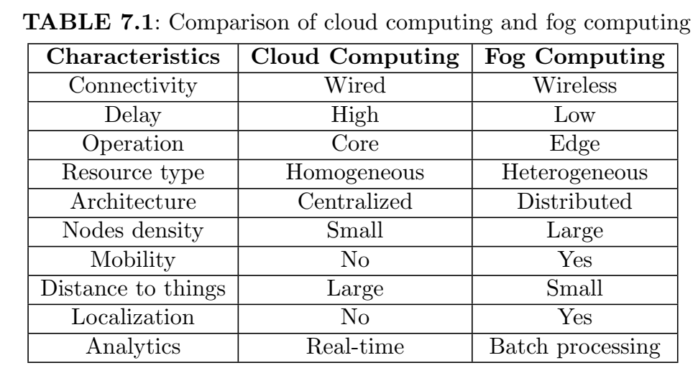
Cloud Computing vs Fog Computing

Slide 4
Technologies for Fog Computing- Virtualization Technology
The fog node processes the data near the source.
This is carried out using lightweight virtualization technology which combines or partitions the computing resources to provide multiple operating environments. The advantages are:-
1. Reduces overhead of underutilized infrastructure.
2. Provides the application with isolated execution environments
3. Supports multiple operating systems over the same hardware infrastructure.
4. Easy movement of applications from physical location (hardware) to another

Slide 5
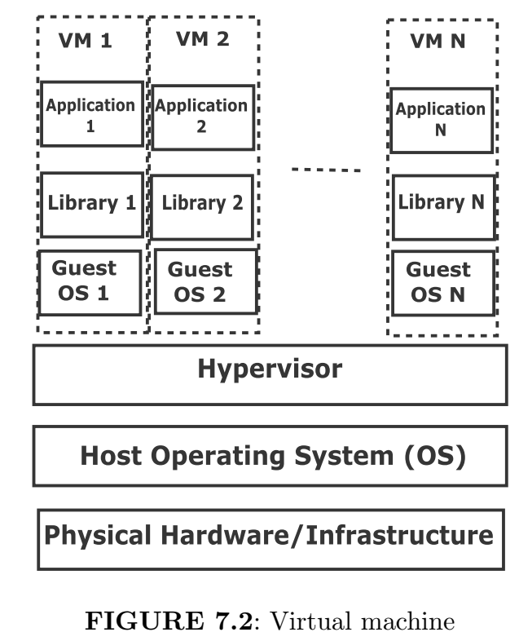
Virtualization Technology
Virtualization at CPU Instruction Level: Gives the illusion of running on one processor architecture. However, the actual hardware belongs to a different architecture.
Virtualization at Hardware Abstraction Level: The hardware abstraction layer uses a virtual machine manager or hypervisor, which is a software layer that sits above the physical hardware. The hypervisor creates multiple VMs which run on different operating systems. The applications are unaware of the underlying virtualization.
Virtualization at Operating System Level: This provides an abstraction of the kernel-space system calls to user-space applications. Also, it provides security and isolation capabilities to prevent one application from causing damage to another.

Slide 6
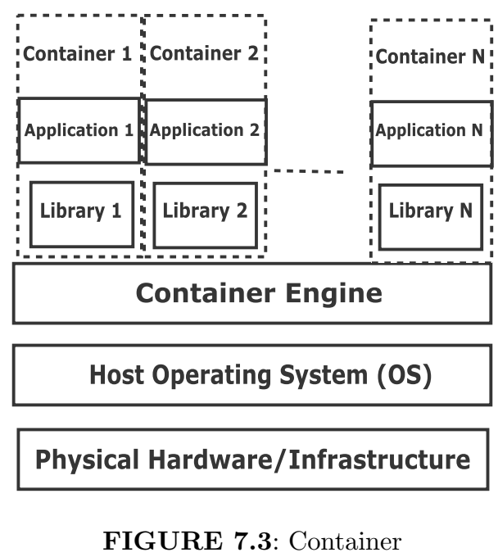
Containers in Cloud Computing
These are minimal components to run an application. Containers share the same operating system and common libraries.
Advantages of Containers over VM :
The containers are lightweight in terms of memory and processing.
A large number of containers can be supported for the given resources than VMs. Therefore, the container provides scalability for both cloud computing and fog computing.
Containers can be migrated faster from one host to another.
Limitations of Containers:
The containers cannot be used for applications that require different OS versions or environments. This is because it shares the OS unlike VM.
There is a security issue since containers use the same OS, unlike VM.

Slide 7
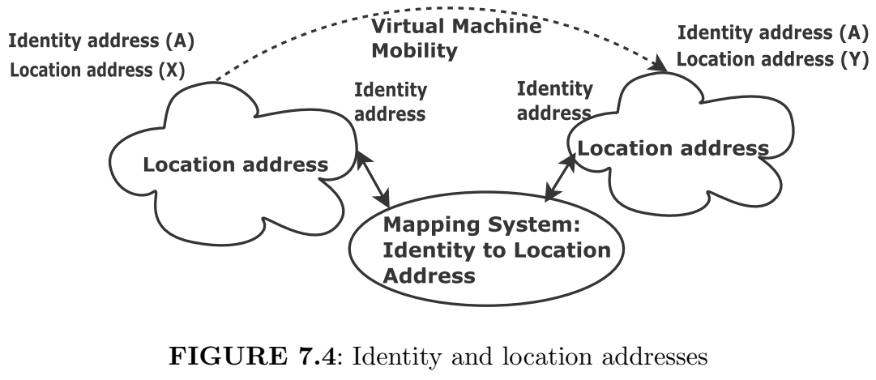
Mobility in Fog Network
There are two types of addresses of end devices for message delivery.
Media Access Control (MAC) address: This is used for unique identification over the network. (identity address)
Internet Protocol (IP) address: This is the geographical location of the end device. (location address)
We use identity and location addresses, respectively, at the edge and core of the network for scalability and mapping.

Slide 8
Ethernet Virtual Private Network (EVPN)
Only network elements at the edge of the network are supported by EVPN because EVPN is an overlay technology. (Fog Computing)
EVPN uses Border Gateway Protocol (BGP) to build the forwarding table.
How does EVPN work?
The Provider Edge (PE) learns the MAC address of host which is the Customer Edge (CE)
PE sends MAC advertisement route messages to other network elements in case of learning a new MAC address. There are two route messages for the MAC address: an old (wrong) one and a new (correct) one.
EVPN decides the correct MAC route based on the highest sequence number
The old PE withdraws the PE route and installs a new one directing to the new PE.

Slide 9
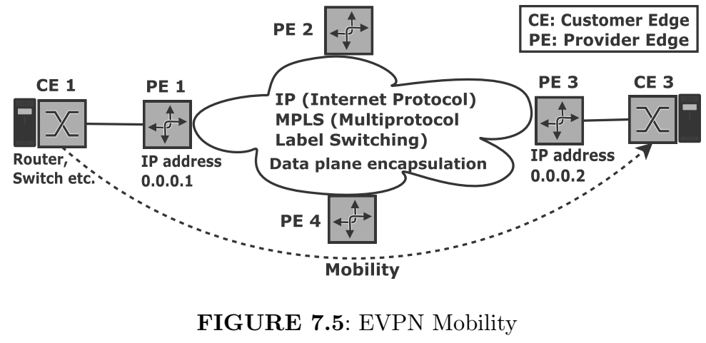
EVPN Mobility
MAC advertisement route message is sent by PE 1.
MAC address is moved to a new server from PE 1 to PE 3.
Then, PE 3 learns a new local MAC address and sends a new advertisement route message.
In case of different sequence numbers: If PE 1 and PE 3 have MAC address with a sequence numbers 4 and 5, then PE 3 advertises the local MAC route because it has a higher sequence number. PE 1, PE 2, and PE 4 install the remote MAC advertisement route from PE 3.
In case of the same sequence numbers: If PE 1 and PE 3 have MAC address with same sequence numbers, then PE 1 will advertise the local MAC route because PE1 has the lower IP address (0.0.0.1). PE 2, PE 3, and PE 4 will install the remote MAC advertisement route from PE1.

Slide 10
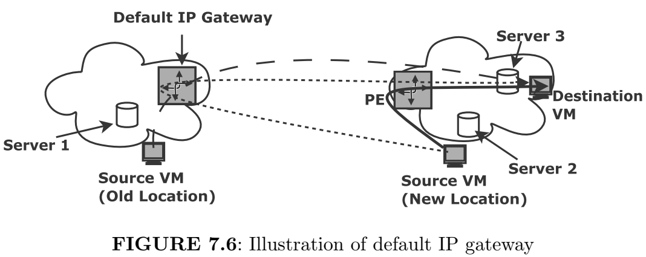
Default IP Gateway
In the event of mobility, VM’s configurations like RAM, disk image, and address of default IP gateway remain unchanged.
A default IP gateway is needed for forwarding the traffic to the remote server.
This must be in the vicinity of the host server which ensures optimal forwarding of traffic. EVPN declares PE which is at the edge of the network to act as a default IP gateway.
Example of Default IP Gateway: As shown in Figure 7.6,
The source VM on server 1 communicates to destination VM using optimal forwarding path via default IP gateway.
After mobility, the VM on server 2 communicates to destination VM via same default IP gateway.
Finally, the communications happen through PE. This is shown using a solid line.

Slide 11
Locator/Identifier Separation Protocol (LISP)
LISP dynamically maps between EIDs and RLOCs.
Endpoint Identifiers (EIDs) are the identity addresses of an end device. (Fog computing) & Routing Locators (RLOCs) are the location addresses of routers.
RLOCs are fixed with the network topology and are contactable by routing. EID is mobile without changing the routing that interconnects the locator IP space.

Slide 12
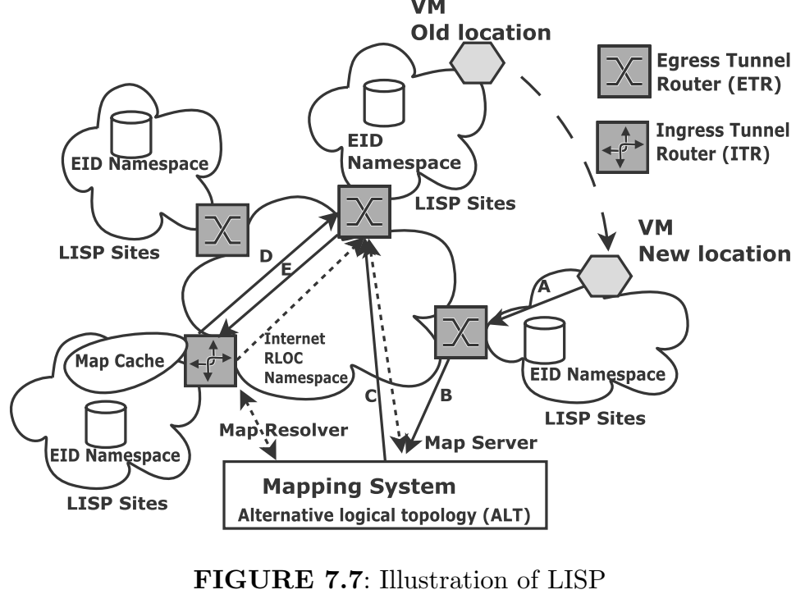
The steps involved in LISP are summarized below:
• The traffic of VM is sent from a new location to a new nearby ETR. (A)
• The MAP server is updated with new EID-ETR mapping. This is shown (B)
• The de-registration of EID from old ETR takes place. This is shown (C)
• If the ITR sends traffic to EID via old ETR, it is shown with D
• Then the old ETR responds with solicit-map-request to ITR to update
map-cache. (E)

Slide 13
Architecture of LISP
Ingress Tunnel Routers (ITRs) receive and encapsulate traffic of end device for transporting over the LISP network.
Egress Tunnel Routers (ETRs) decapsulate the tunneled traffic and forward to their destinations.
Identification of ITRs and ETRs are based on their RLOCs.
To forward traffic, ITR uses a map resolver to determine the RLOC of the ETR of the destination EID.
The map server has all EID-ETR mapping.
This destination ETR responds to source ETR the list of RLOCs associated with EID.

Slide 14
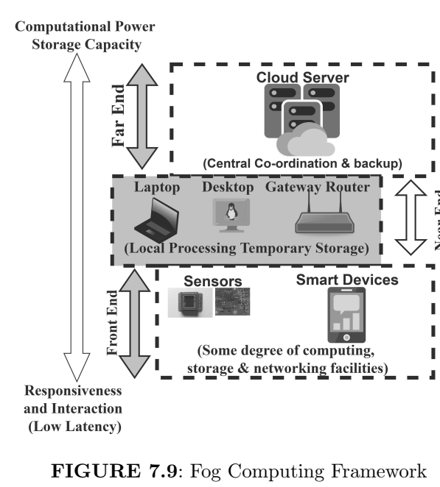
Fog Orchestration
Fog orchestration provisions and manages compute, storage and network facilities.
deploying, debug, patch, and update applications or OS, setting up network connectivity between applications, reserving bandwidth, and allocating and expanding disk space.
In contrast to cloud orchestration, fog orchestration does topology management, things connectivity, and network performance guarantees.

Slide 15
Localization in Fog Computing Framework
Wi-Fi-based localization is widely used than inertial based methods such as accelerometer, gyroscope, and magnetometer.
Further, fingerprinting based localization performs better than path loss model in terms of localization accuracy.
In fingerprinting-based localization, there are two steps: training and testing. In the training phase, we collect RSS and corresponding location information at reference points. In the testing phase, given a new RSS at the smart device, we estimate the corresponding location.
If the available computational power is less than a set threshold, then a nearby device is requested for computations. This is also called device-to-device communication using Wi-Fi direct.
If the nearby device is not available, the local processing unit or cloud server is requested. Note that the fog computing framework saves energy and extends the lifetime of a resource-constrained smart device.
In offloading, we move the computational load from the local device to the fog device.
The fog node in the vicinity may be powerful than the local node.
In the fog computing framework, we move the cloud computing capabilities toward the edge of the network. This is also called edge computing.
The benefits of task offloading are lower latency, lower energy consumption and sharing of computations among several devices.

Slide 16
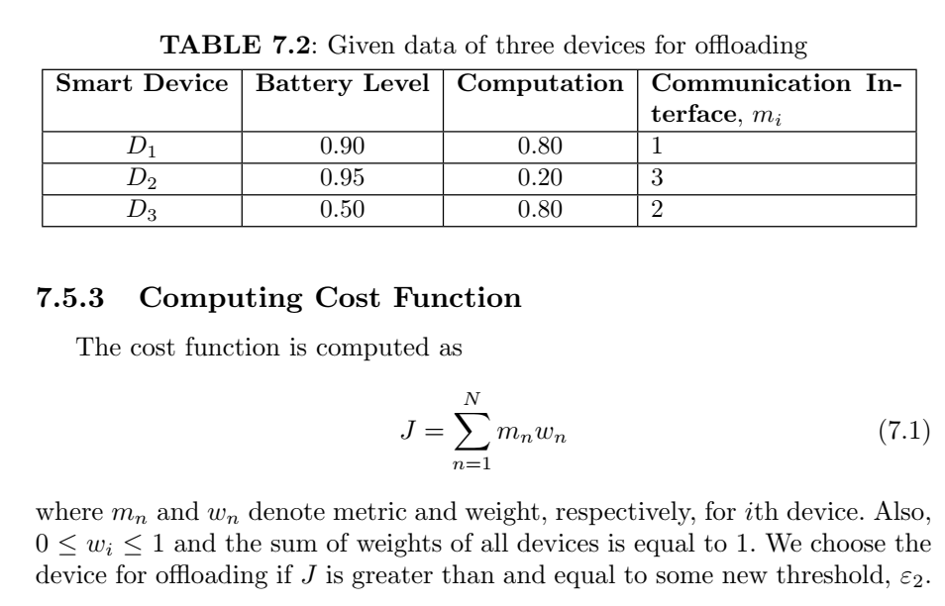

Slide 17
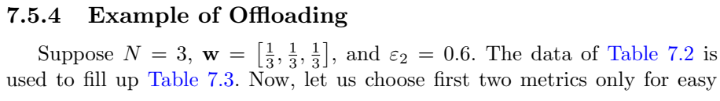
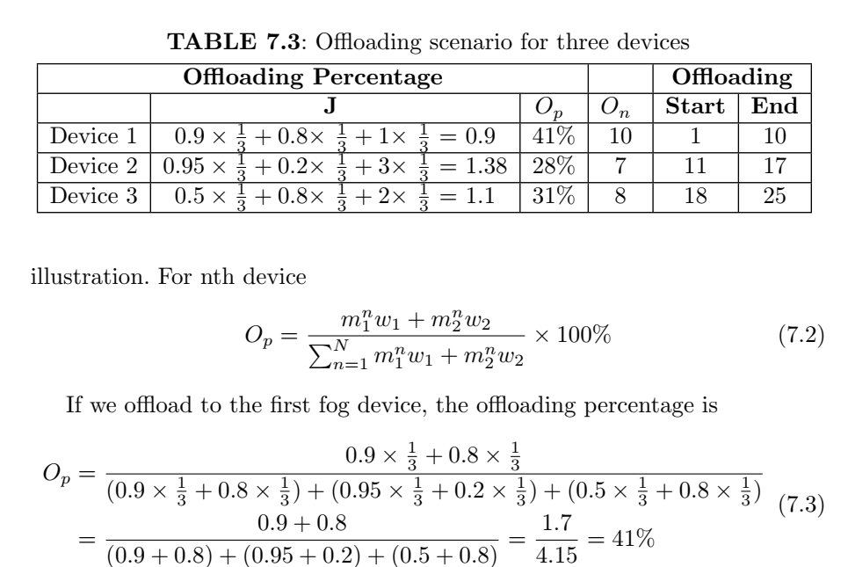

Slide 18
