Slide 1
Introduction
In a smart environment, heterogeneous things send data to the gateway, fog node, or cloud using wireless protocols.
Encryption of data is carried out in a secured smart environment. Further, things data analytic is used for automated decisions and making our life easier.
The channel state information provides a device-free solution and hence, better than wearable sensors and image/video-based.
The image and video-based approach breach the privacy of the user and require a large transmit bandwidth.
Three applications are presented herein for a smart healthcare system: human activity recognition using wearable sensors, Channel State Information (CSI) based human activity recognition, and human health monitoring.

Slide 2
Human Activity Recognition using Wearable Sensors
The applications of HAR include remote patient monitoring and transportation amongst others. The wearable biomedical sensors are :
Electromyography (EMG): To assess the health of muscles.
Electro-encephalograph (EEG): To detect abnormalities in the brain waves.
Electrocardiogram (ECG): To record electrical activity of the heart.
Accelerometer (ACC): To measure acceleration of the body.
Electrodermal Activity (EDA): To measure changes in the electrical properties of the skin.
Respiration (RESP): To measures breathing rate.
Force (FSR): To detect numbness of the body.
Temperature (TEMP): To measure body temperature.
The other biomedical sensors are blood pressure sensor, airflow sensor, sound generator, body position sensor, snore sensor, alert patient button, glucometer, and pulse oximeter.
The data from the things are sent using wireless technology such as Bluetooth, Wi-Fi, LoRaWAN to the gateway, fog node or cloud for computational purpose securely.
The activities that can be detected are classified into several categories. Those can be (a) sitting, (b) lying on a bed, (c) standing, (d) walking, (e) jogging, and (f) running to name a few.

Slide 3
Human Activity Recognition using Wearable Sensors
- Select a biomedical kit based on signal requirements, sampling rate, etc.
- Utilize wearable sensor data for activity recognition using data analytic techniques.
- Employ machine learning algorithms to extract features from the data.
- Features can include mean, variance, standard deviation, etc.
- Deep learning algorithms can automatically extract features.
- Use windowing to create overlapping segments of the time-series data.
- Compute features for each windowed segment.
- Input features into classifiers like kNN, naive Bayes, or SVM.
- Recognize activities based on the sensor data.
- Multiple sensors enhance accuracy but increase computational complexity.

Slide 4
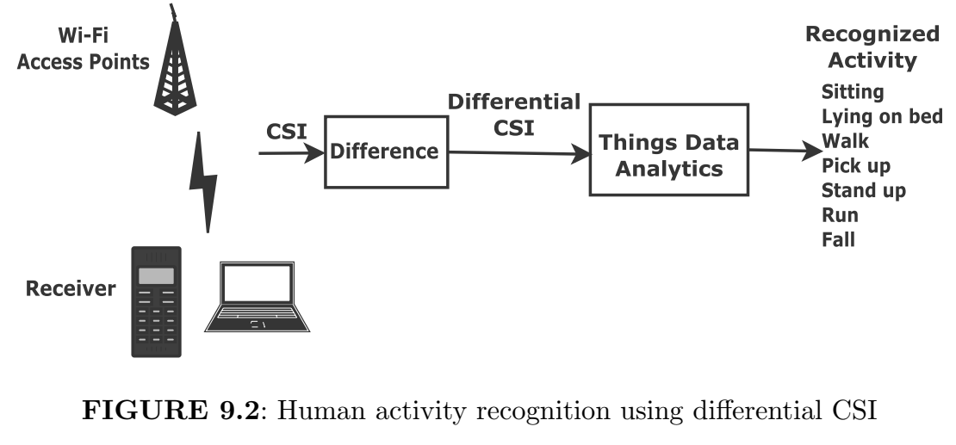
Human Activity Recognition using WiFi Channel State Information
HAR algorithms may be classified into three categories: wearable sensor based, image/video-based and wireless link based.
However, wearable sensors may cause discomfort to humans and Image/video-based HAR consumes a lot of bandwidth during transmission and breaches the privacy of users. Therefore, we discuss wireless link-based HAR in this section

Slide 5
Human Activity Recognition using WiFi Channel State Information
- Channel State Information (CSI) is utilized between a Wi-Fi access point (transmitter) and a smart device (receiver) to recognize human activities.
- The medium between transmitter and receiver is termed as the channel.
- CSI, being a complex number, consists of both magnitude and phase.
- Typically, CSI includes carrier frequency offset and sampling frequency offset, as per existing literature.
- Taking the difference of two CSI samples for the same activity enables easy cancellation of offsets.
- This soft computing approach boosts activity recognition performance.
- The differential CSI is then analyzed using data analytics for the classification of various activities.
- Classified activities include sitting, lying on the bed, walking, picking up objects, standing up, running, and falling.
- One potential application of these sensed activities is in a pacemaker to maintain the required heart rate using a controller.

Slide 6
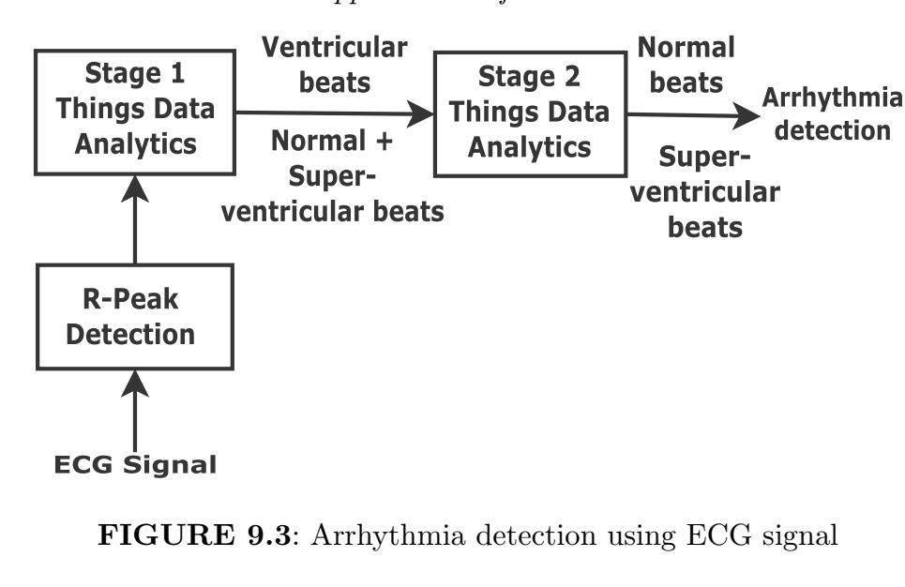
Human Health Monitoring
- ECG signals consist of P wave, QRS complex, and T wave, representing atrial depolarization, ventricular depolarization, and ventricular repolarization, respectively.
- QRS complex provides information about cardiac arrhythmias, detected using the Pan-Tompkins algorithm.
- Classification of normal, ventricular, and super-ventricular beats is performed, with a challenge in distinguishing normal and super-ventricular beats.
- A 2-stage data analytic approach is used to address this challenge.
- Class imbalance is tackled by upsampling abnormal beat data to balance the number of samples between classes.

Slide 7
Smart City- Smart Parking Application
- Smart parking system provides real-time vacant slot information via smartphone app.
- Occupancy detection via pressure or infrared sensors, with low-cost infrared sensors transmitting data using IoT protocols.
Upon arrival, vehicles are automatically guided to the nearest available slot.
Location info aids navigation in large underground parking areas.
- Location tracking in GPS-challenged areas (like underground) uses RSS-based localization algorithms.
- On exit, the system updates the number of free slots.
- Blockchain technology facilitates secure parking fee negotiation and payment without human intervention.

Slide 8
Smart Farming
for data collection & data processing. This helps in enhancing crop productivity, measuring climate change, and animal health monitoring in real-time. Uses rechargeable battery and an external solar panel. The smart agriculture kit measures the following: Temperature, Humidity, Pressure, Soil temperature, Soil moisture. Wind speed using anenometer, wind vane, and pluviometer, Solar radiation
We can also make use of a drone for data gathering for a large agriculture field. The collected data is further sent to the gateway, fog node or cloud using IoT protocols for processing. Things data analytic is used for decision-making purposes. The location of animals grazing in the field is tracked using a localization algorithm. The overall cost reduces and the productivity increases in smart farming.

Slide 9
Smart Air Pollution Monitoring System
Air pollution is caused by urbanization, transportation, industrial emission, dust, wildfire, and burning of fossil fuels. The solid and liquid particles of gases are suspended in air pollution like Ozone, Particulate Matter (PM), Nitric dioxide, Sulphur dioxide and Carbon monoxide
We use a smart pollution monitoring system for pollution control measures. We use air quality index to check whether it is safe to live or not.
The power option is provided rechargeable battery and external solar panel. The air quality indices are estimated on hourly, day wise and week wise basis. The data are sent to the gateway, fog node or cloud node using IoT protocols.
Subsequently, the following values are computed and mapped are
1. Excellent, range: 0 to 50
2. Fine, range: 51 to 100
3. Moderate, range: 101 to 150
4. Poor, range: 151 to 200
5. Very poor, range: 201 to 300 and
6. Hazardous, range: 301 to 500.

