Slide 1
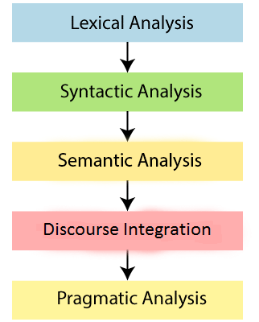
Phases of NLP

Slide 2
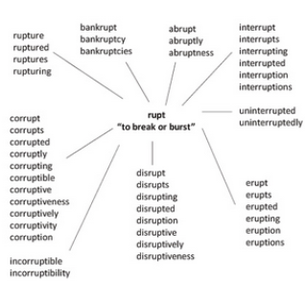
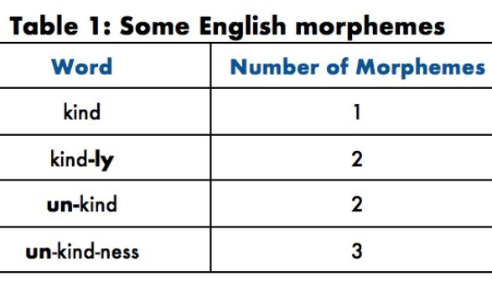
1) Lexical/Morphological Analysis
A morpheme is the smallest linguistic unit that has meaning/function.
These can be either a free morpheme (e.g. walk) or a bound morpheme (e.g. -ing, -ed). The latter cannot stand on it’s own and should be assigned to a free morpheme to attach meaning.

Slide 3
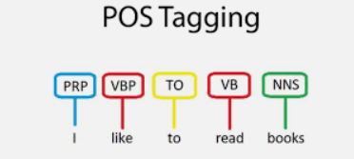
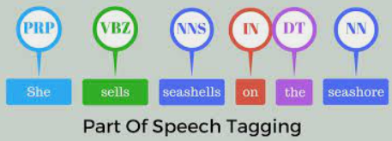
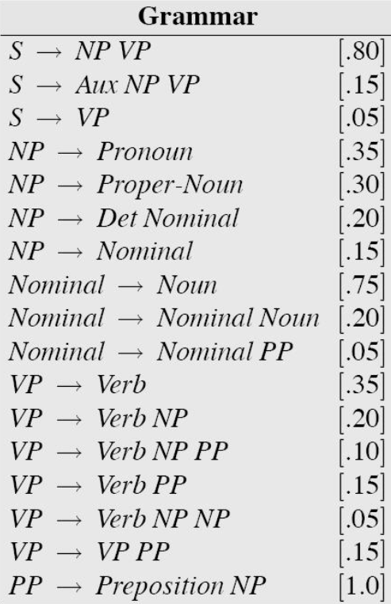
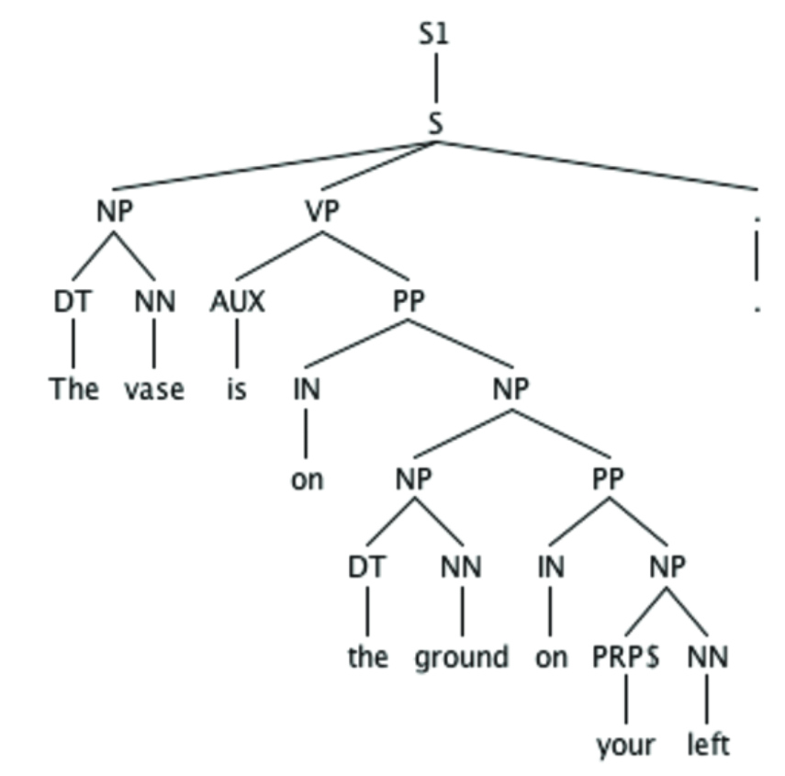
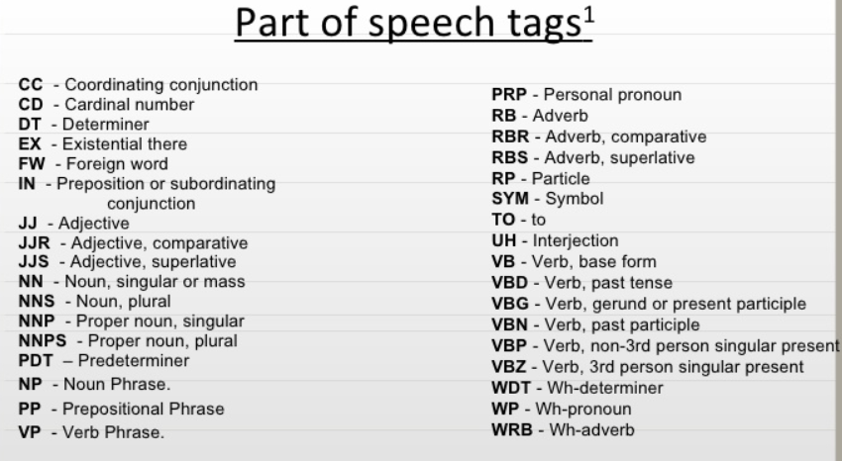
2) Syntax Analysis/Parsing
Syntax concerns the proper ordering of words and its affect on meaning

Slide 4
3) Semantic Analysis
Unlike syntactic analysis, which deals with grammatical structure, semantic analysis is concerned with the literal and contextual meaning of words, phrases, and sentences.
Semantic analysis aims to understand the dictionary definitions of words and their usage in context. It determines whether the arrangement of words in a sentence makes logical sense.
Syntactically Correct but Semantically Incorrect: “Apple eats a John.” This sentence is grammatically correct but does not make sense semantically.

Slide 5
4) Discourse Analysis
This phase deals with comprehending the relationship between the current sentence and earlier sentences or the larger context. Discourse integration is crucial for contextualizing text and understanding the overall message conveyed.
Contextual Reference: “This is unfair!” To understand what “this” refers to, we need to examine the preceding or following sentences. Without context, the statement’s meaning remains unclear.

Slide 6
5) Pragmatic Analysis
When Semantic Analysis overthinks
Pragmatic analysis goes beyond the literal meanings examined in semantic analysis, aiming to understand what the writer or speaker truly intends to convey. In natural language, words and phrases can carry different meanings depending on context, tone, and the situation in which they are used.
“I’m falling for you.”
The word “falling” literally means collapsing, but in this context, it means the speaker is expressing love for someone.

Slide 7
Ambiguity
Lexical Ambiguity: A word has multiple meanings.
Example: "I went to the bank." (Bank could mean a financial institution or a riverbank.)
Resolution: Context clarifies the intended meaning.
Syntactic Ambiguity: A sentence's structure allows multiple interpretations.
Example: "I saw the man with a telescope." (Did I use a telescope, or did the man have it?)
Resolution: Context or parsing resolves the interpretation.
Semantic Ambiguity: The sentence’s meaning is unclear despite correct words and syntax.
Example: "Visiting relatives can be boring." (Relatives visiting vs. the act of visiting relatives.)
Resolution: Context or rephrasing helps.
Discourse Ambiguity: Unclear references or relationships across sentences.
Example: "He never keeps his promises." (Who is he?)
Resolution: Co-reference resolution or broader context clarifies.
Pragmatic Ambiguity: The speaker's intent is unclear.
Example: "Can you pass the salt?" (Literal capability vs. a polite request.)
Resolution: Social context or conventions clarify intent.

Slide 8
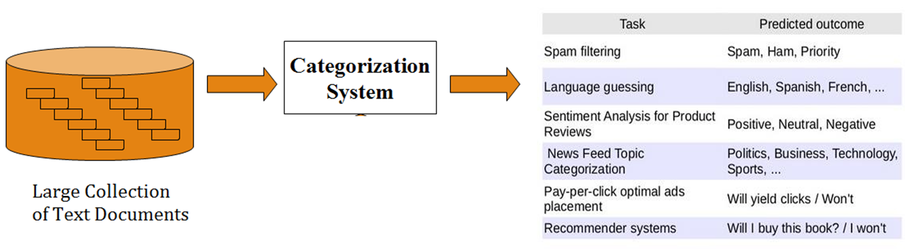

Real Life Applications of NLP
Spell Check
Grammar Check
Text rewriter
Chatbots
Automatic Lyrics Generation
Plagiarism Detection
Information Extraction
Text Categorization and Summarization

Slide 9
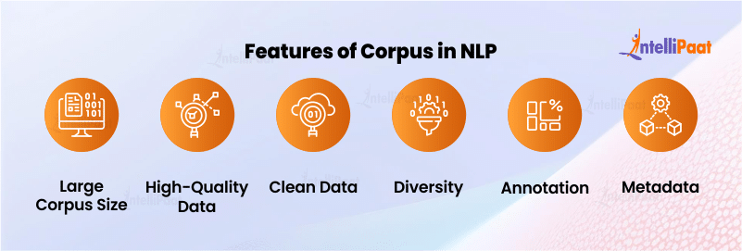
Why Do We Need Corpus in NLP?
Training Machine Learning Models: corpora are used to train and refine machine learning models. The massive amount of text data in the corpus is used to teach these models patterns, correlations, and complexities.
Language Understanding: Corpora gives a complete picture of the structure, grammar, vocabulary, and usage of a language. To generate new languages, NLP models utilize corpora.
Rule-Based Systems: Corpora are used by linguists and NLP experts to develop and test linguistic rules and patterns.
Statistical Analysis: They give information that is necessary for probabilistic NLP approaches to examine word frequency distributions, co-occurrence patterns, word relationships, etc.

Slide 10
Types of Corpora in NLP
Text Corpora
General-Purpose Corpora: variety of texts from different genres and domains.
Specialized Corpora: concentrate on certain domains or subjects
Comparable Corpora: cross-lingual or cross-domain research
Multimodal Corpora
Text-Image Corpora: These corpora contain both textual and visual information, making them appropriate for jobs like captioning pictures and answering visual questions.
Text-Speech Corpora: These databases combine textual information with related audio or speech recordings for jobs like automatic speech recognition.
Time-Series Corpora
They preserve texts over time, which makes them valuable for observing linguistic evolution and researching the current trends and state of the language.
Annotated Corpora
Linguistically Annotated Corpora: contain linguistic annotations such as part-of-speech tags, grammatical parse and are necessary for developing and testing NLP models.
Sentiment-Annotated Corpora: have sentiment or emotion information labeled, which makes sentiment analysis and emotion detection tasks easier.

Slide 11
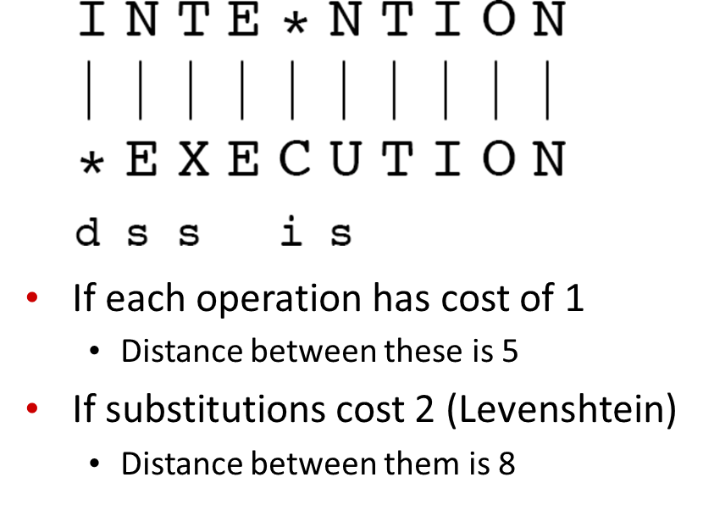

How similar are two strings?
Dan Jurafsky
Edit Distance : The minimum edit distance between two strings is the minimum number of editing operations (Insertion, Deletion, Substitution) needed to transform one into the other
Computational Biology
Align two sequences of nucleotides
AGGCTATCACCTGACCTCCAGGCCGATGCCC TAGCTATCACGACCGCGGTCGATTTGCCCGAC
Resulting alignment:
-AGGCTATCACCTGACCTCCAGGCCGA--TGCCC---
TAG-CTATCAC--GACCGC--GGTCGATTTGCCCGAC
Spell correction
The user typed “graﬀe” Which is closest?
graf, graft, grail, giraﬀe

Slide 12
Adding Backtrace to Minimum Edit Distance
Dan Jurafsky
https://youtu.be/xWGav6hhM8A?si=gT1MdAl-5gKuEpuk
https://youtu.be/wCnaHQebRzU?si=cW8V8vQNt8X0CTcB
For each i = 1…M
For each j
= 1…N
D(i-1,j) + 1
min D(i,j-1) + 1
+
deletion
D(i,j)=
insertion
D(i-1,j-1)
2; if X(i) ≠ Y(j)
0; if X(i) = Y(j)
substitution
LEFT
UP DIAG
insertion
ptr(i,j)=
deletion
substitution

Slide 13
 | # | E | X | E | C | U | T | I | O | N
# | 0 | 1 | 2 | 3 | 4 | 5 | 6 | 7 | 8 | 9
I | 1 | 2 | 3 | 4 | 5 | 6 | 7 | 6 | 7 | 8
N | 2 | 3 | 4 | 5 | 6 | 7 | 8 | 7 | 8 | 7
T | 3 | 4 | 5 | 6 | 7 | 8 | 7 | 8 | 9 | 8
E | 4 | 3 | 4 | 5 | 6 | 7 | 8 | 9 | 10 | 9
N | 5 | 4 | 5 | 6 | 7 | 8 | 9 | 10 | 11 | 10
T | 6 | 5 | 6 | 7 | 8 | 9 | 8 | 9 | 10 | 11
I | 7 | 6 | 7 | 8 | 9 | 10 | 9 | 8 | 9 | 10
O | 8 | 7 | 8 | 9 | 10 | 11 | 10 | 9 | 8 | 9
N | 9 | 8 | 9 | 10 | 11 | 12 | 11 | 10 | 9 | 8

Slide 14
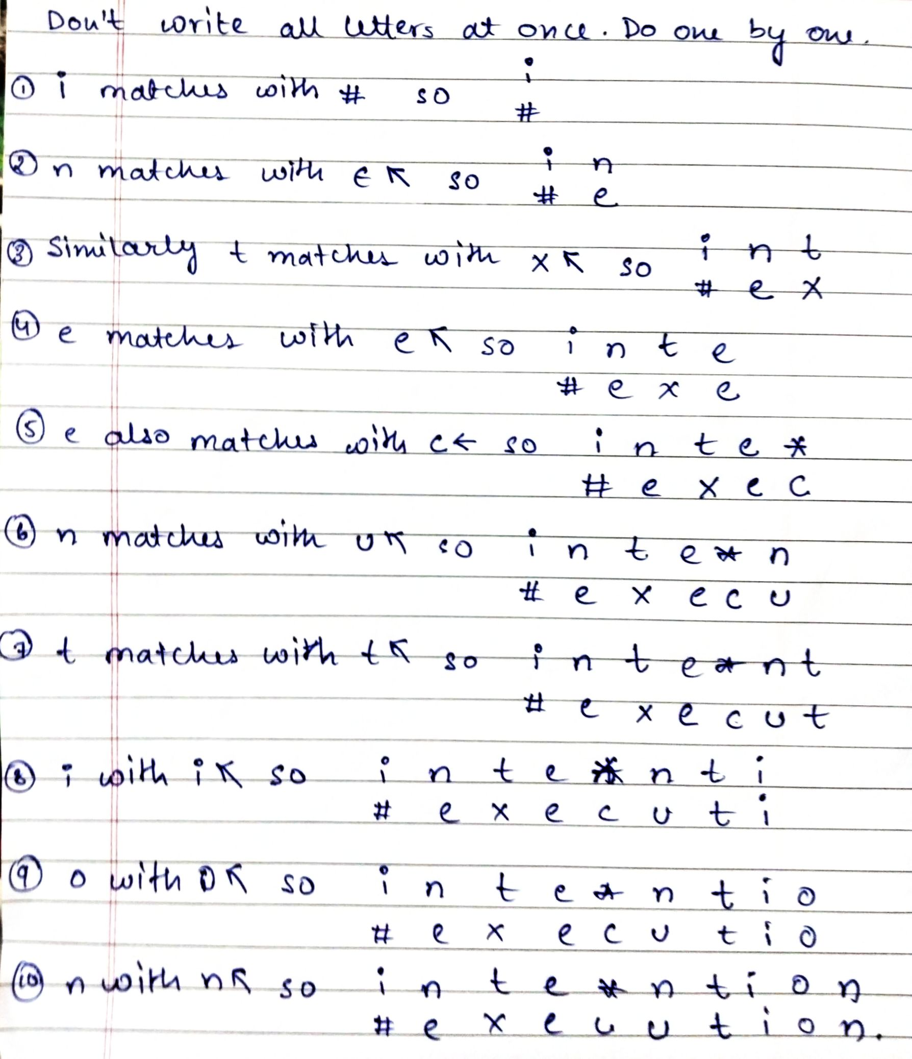

Result of Backtrace
Dan Jurafsky
Two strings and their alignment:
Performance
Time: O(nm)
Space: O(nm)
Backtrace: O(n+m)

