Slide 1
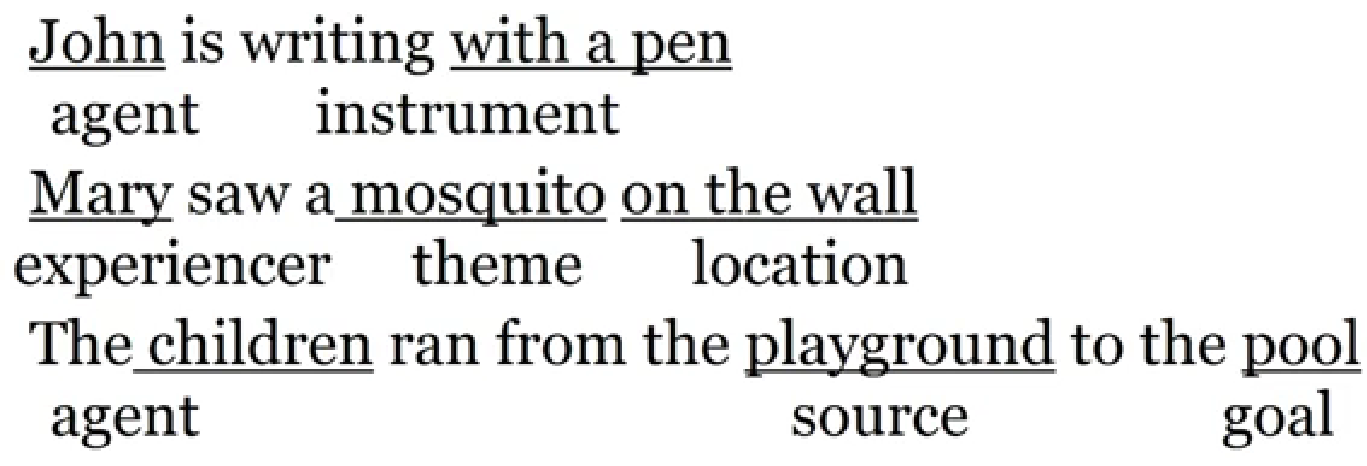
Thematic Role | Definition | Example
AGENT | The volitional causer of an event | The waiter spilled the soup.
EXPERIENCER | The experiencer of an event | John has a headache.
FORCE | The non-volitional causer of the event | The wind blows debris from the mall into our yards.
THEME | The participant most directly affected by an event | Only after Benjamin Franklin broke the ice...
RESULT | The end product of an event | The city built a regulation-size baseball diamond...
CONTENT | The proposition or content of a propositional event | Mona asked “You met Mary Ann at a supermarket?”
INSTRUMENT | An instrument used in an event | He poached catfish, stunning them with a shocking device...
BENEFICIARY | The beneficiary of an event | Whenever Ann Callahan makes hotel reservations for her boss...
SOURCE | The origin of the object of a transfer event | I flew in from Boston.
GOAL | The destination of an object of a transfer event | I drove to Portland.

Slide 2
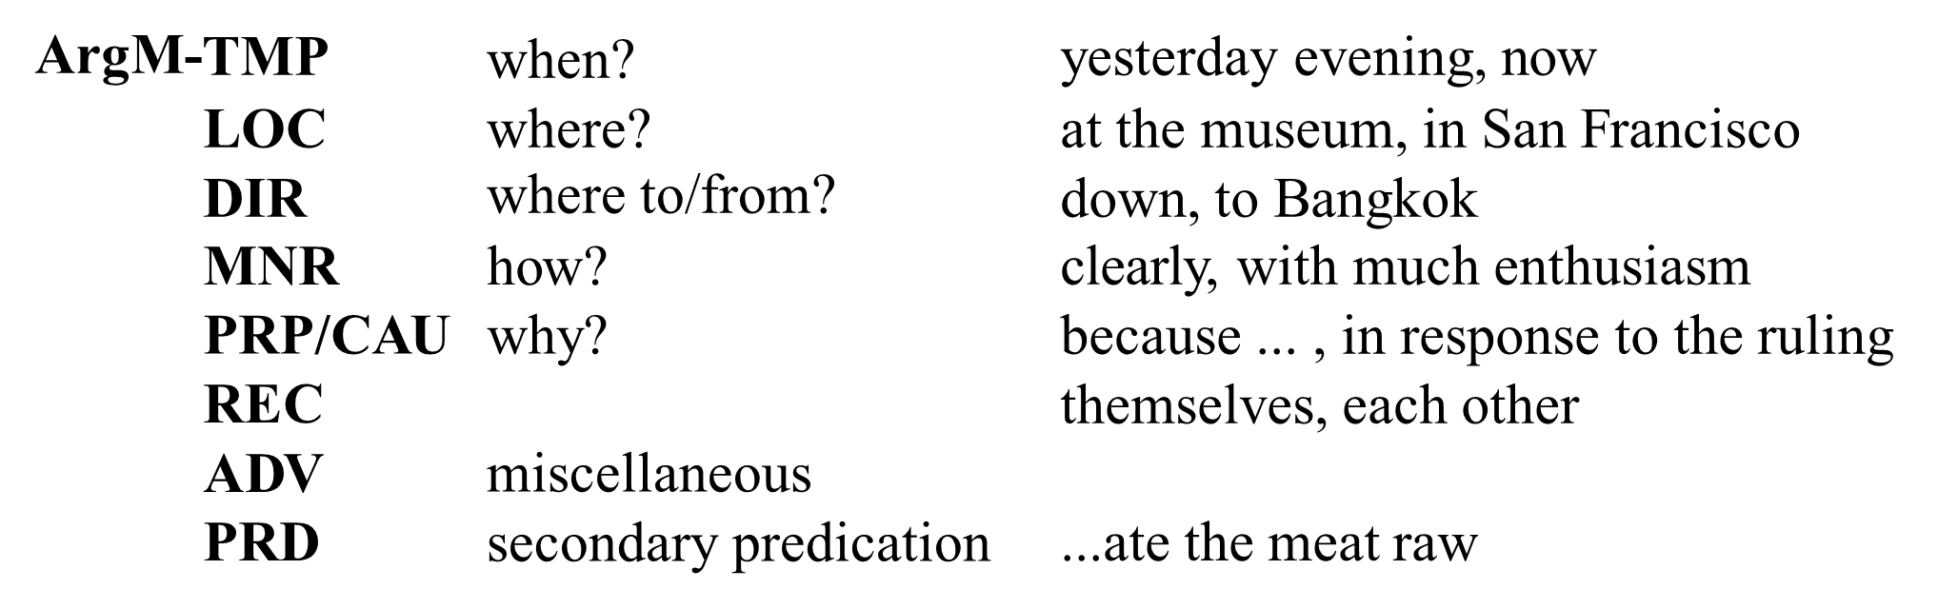
The Proposition Bank (PropBank)
PropBank Roles
Proto-­‐Agent: Causes an event or change of state in another participant
Proto-­‐Patient: Undergoes change of state, affected by another participant

Slide 3
PropBank Roles
Semantic roles in PropBank are verb-­‐sense specific because roles are determined verb by verb, with respect to the other roles
Each verb sense has numbered argument: Arg0, Arg1, Arg2,…
Arg0: PROTO-­‐AGENT Arg1: PROTO-­‐PATIENT
Arg2: usually: benefactive, instrument, attribute, or end state Arg3: usually: start point, benefactive, instrument, or attribute Arg4 the end point
(Arg2-­‐Arg5 are not really that consistent, causes a problem for labeling)

Slide 4
PropBank Frame Files
agree.01
Arg0: Agreer Arg1: Proposition
Arg2: Other entity agreeing
Ex1: Ex2:
[_{Arg0} The group] agreed [_{Arg1} it wouldn’t make an offer]. [_{ArgM-TMP} Usually] [_{Arg0} John] agrees [_{Arg2} with Mary] [_{Arg1} on everything].
)
fall.01
Arg1: Logical subject, patient, thing falling
Arg2: Extent, amount fallen Arg3: start point
Arg4: end point, end state of arg1
Ex1: Ex2:
[_{Arg1} Sales] fell [_{Arg4} to $25 million] [_{Arg3} from $27 million]. [_{Arg1} The average junk bond] fell [_{Arg2} by 4.2%].

Slide 5
PropBanking a Sentence
(S (NP-SBJ Analysts) (VP have
(VP been
(VP expecting
(NP (NP a GM-Jaguar pact)
(SBAR (WHNP-1 that) (S (NP-SBJ *T*-1)
(VP would
(VP give
(NP the U.S. car maker)
(NP (NP an eventual (ADJP 30 %) stake)
(PP-LOC in (NP the British company))))))))))))
S
A sample parse tree
VP
have ^{VP}
been
NP-SBJ
Analysts
VP
ctingNP
SBAR
S
HNP-1 VP
that
expe
NP
a GM-Jaguar _{W}
pact
NP-SBJ
VP
*T*-1
would
give
NP
the US car maker
NP
Analysts have been expecting a GM-Jaguar pact that would give the U.S. car maker an eventual 30% stake in the British company.
PP-LOC
NP
an eventual 30% stake
NP
the British company
in

Slide 6
The same parse tree PropBanked
have been expecting
(S Arg0 (NP-SBJ Analysts) (VP have
(VP been
(VP expecting
Arg1 (NP (NP a GM-Jaguar pact)
(SBAR (WHNP-1 that)
(S Arg0 (NP-SBJ *T*-1)
(VP would
(VP give
Arg2 (NP the U.S. car maker)
Arg0
Arg1
Analysts
a GM-Jag
pact
uar
Arg1 (NP (NP an eventual (ADJP 30 %) stake) (PP-LOC in (NP the British
Arg0
that would give company))))))))))))
Arg1
*T*-1
Arg2
an eventual 30% stake in the British company
the US car maker
expect(Analysts, GM-J pact)
give(GM-J pact, US car maker, 30% stake)

Slide 7
FrameNet
Roles in PropBank are specific to a verb
Role in FrameNet are specific to a frame: a background knowledge structure that defines a set of frame-­‐specific semantic roles, called frame elements,
includes a set of predicates that use these roles
each word evokes a frame and profiles some aspect of the frame

Slide 8
The “Change position on a scale” Frame
This frame consists of words that indicate the change of an ITEM’s position on a scale (the ATTRIBUTE) from a starting point (INITIAL VALUE) to an end point (FINAL VALUE)
[_{ITEM} Oil] rose [_{ATTRIBUTE} in price] [_{DIFFERENCE} by 2%].
[_{ITEM} It] has increased [_{FINAL STATE} to having them 1 day a month]. [_{ITEM} Microsoft shares] fell [_{FINAL VALUE} to 7 5/8].
[_{ITEM} Colon cancer incidence] fell [_{DIFFERENCE} by 50%] [_{GROUP} among men].
a steady increase [_{INITIAL VALUE} from 9.5] [_{FINAL VALUE} to 14.3] [_{ITEM} in dividends]
0)
1)
2)
3)
4)
5)
a [_{DIFFERENCE} 5%] [_{ITEM} dividend] increase...

Slide 9
The “Change position on a scale” Frame
Core Roles
ATTRIBUTE The ATTRIBUTE is a scalar property that the ITEM possesses. DIFFERENCE The distance by which an ITEM changes its position on the scale. FINAL STATE A description that presents the ITEM’s state after the change in the ATTRIBUTE’s value as an independent predication. FINAL VALUE The position on the scale where the ITEM ends up. INITIAL STATE A description that presents the ITEM’s state before the change in the AT- TRIBUTE’s value as an independent predication. INITIAL VALUE The initial position on the scale from which the ITEM moves away. ITEM The entity that has a position on the scale. VALUE RANGE A portion of the scale, typically identified by its end points, along which the values of the ATTRIBUTE fluctuate.
Some Non-Core Roles
DURATION The length of time over which the change takes place. SPEED The rate of change of the VALUE. GROUP The GROUP in which an ITEM changes the value of an ATTRIBUTE in a specified way.

Slide 10
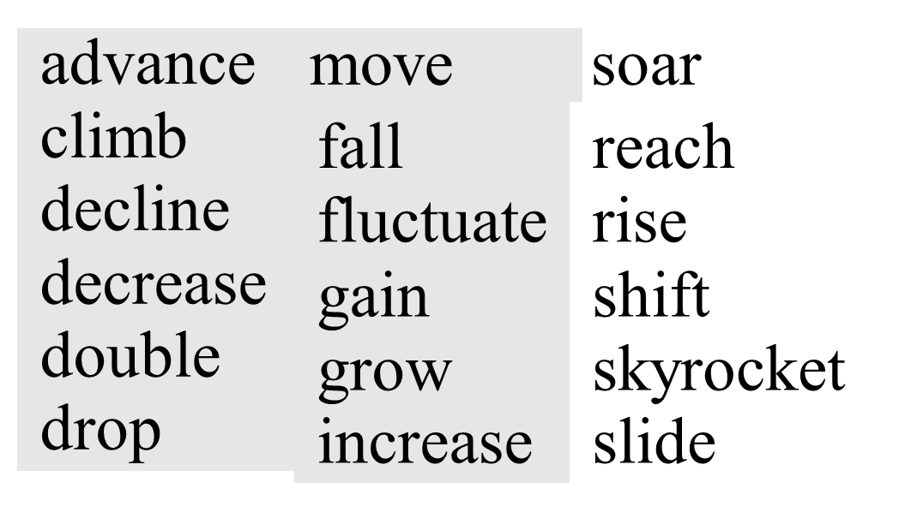
Relation between frames
Inherits from: Is Inherited by: Perspective on:
Is Perspectivized in: Uses:
Is Used by:
Subframe of: Has Subframe(s): Precedes:
Is Preceded by:
Is Inchoative of: Is Causative of:

Slide 11
Semantic Role Labeling
[The San Francisco Examiner] issued
[a special edition] [yesterday]
ARG1 ARGM-TMP
ARG0
TARGET
S
Path in the parse tree : NP"S#VP#VBD
NP-SBJ = ARG0
DT NNP NNP
San Francisco
VP
NNP
The
Examiner
VBD = TARGET
NP = ARG1
JJ NN
special edition
PP-TMP = ARGM-TMP
IN NP
around NN NP-TMP noon yesterday
issued
DT
a
44

Slide 12
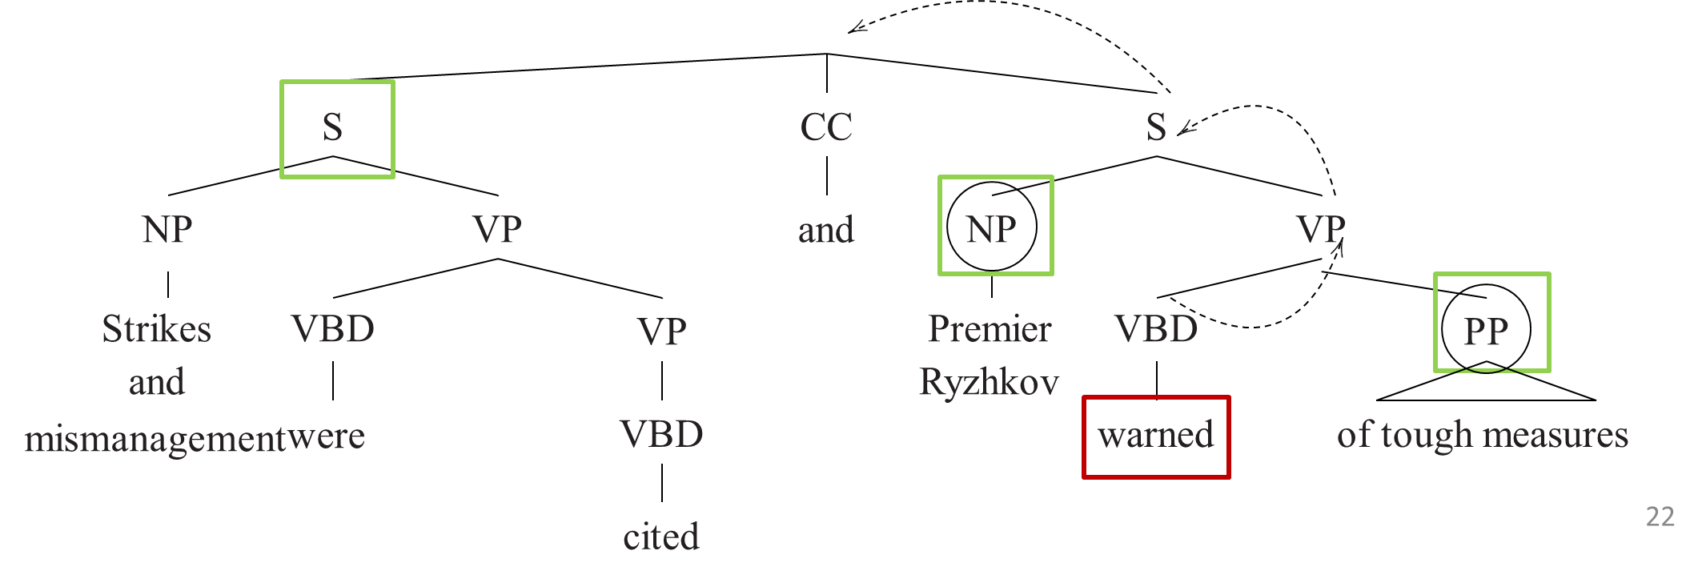
Why add Pruning and Identification steps?
Very few of the nodes in the tree could possible be arguments
So we prune the very unlikely constituents

Slide 13

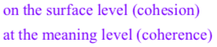
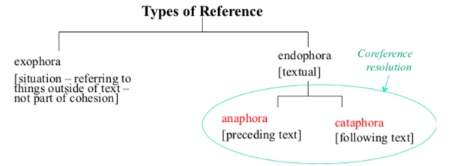
Coreference resolution is the task of finding all expressions that refer to the same entity in a text. Use case - document summarization, question answering, and information extraction.
Cohesion - Cohesion is the grammatical and lexical linking within a text or sentence that holds a text together and gives it meaning
Coherence - Coherence is defined as the quality of being logical, consistent and able to be understood.

Slide 14
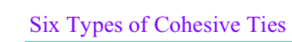
Reference: Words or phrases refer back to something mentioned earlier or anticipate something that will be mentioned later. This includes pronouns, demonstratives, and definite articles.
Example: "Aastha bought a book. She loved it.“ Here, "she" refers back to "Aastha," and "it" refers to "book."
Substitution: A word or phrase is replaced with another term to avoid repetition and maintain cohesion.
Example: "John prefers coffee, but I prefer tea.” Here, "I" substitutes the person who is speaking to avoid repeating the name.
Ellipsis: Parts of a sentence are omitted when they are understood from the context, thus avoiding redundancy.
Example: "Aastha can dance, and Parul can too.“ The word "dance" is omitted after "can" because it's understood from the context.
Conjunction: Connective words like "and," "but," "because," etc., are used to link sentences or clauses, indicating the relationship between them. Example: "She went to the library, and she found a quiet place to study."
Lexical Cohesion: This involves the use of related vocabulary to maintain the continuity of a text. It includes repetition, synonyms, and collocations. Example: "The car was speeding down the road. The vehicle nearly hit a pedestrian.“ Here, "car" and "vehicle" are synonyms, creating cohesion.
Substitution by Repetition (Reiteration): It involves the repetition of the same word or a different form of the word for emphasis or to maintain cohesion. Example: "It was a beautiful day. Indeed, it was a beautiful moment to go outside.“ The word "beautiful" is repeated to emphasize the idea.

Slide 15
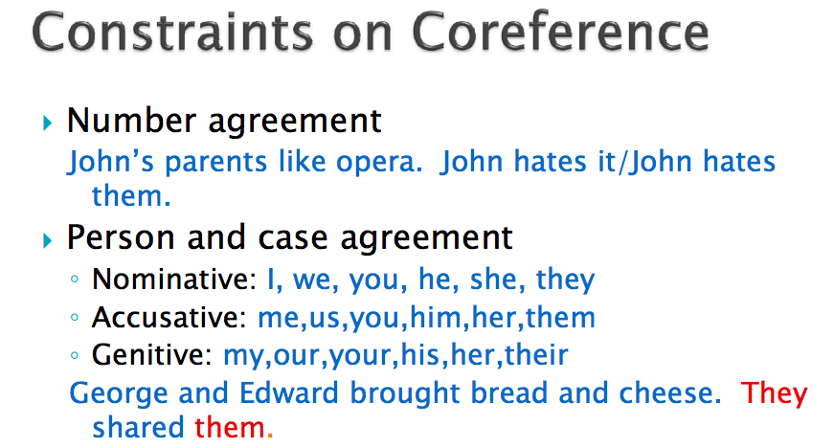
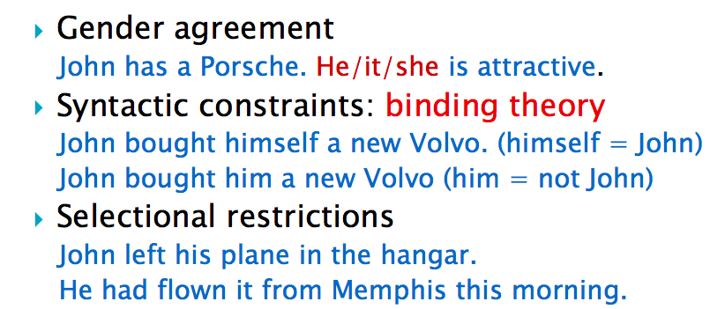
Coreference, is said to occur whenever two noun phrases refer to the same entity.
Coreference/Pronominal anaphora resolution
identifying the anaphors
finding the possible candidates for antecedent
filtering out those that are impossible based on various criteria and identifying the most likely antecedent.

