Slide 1
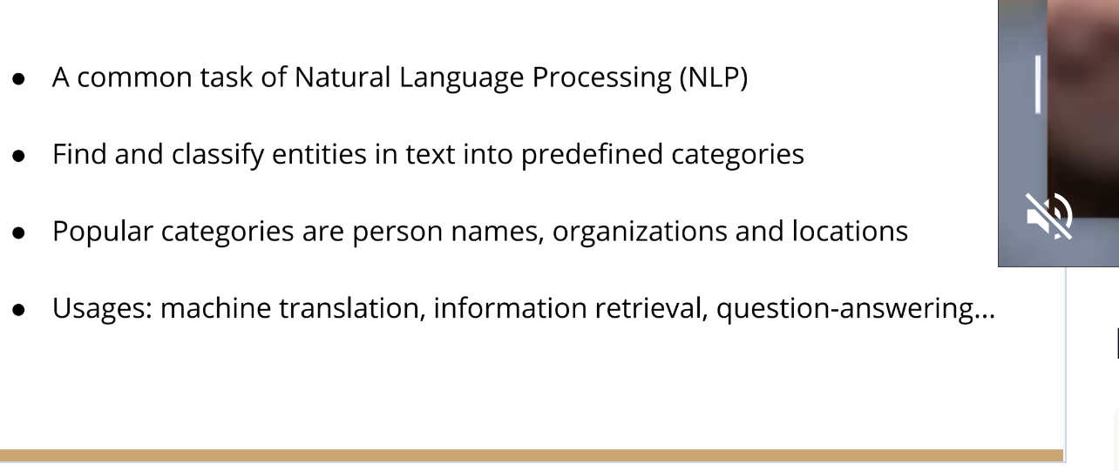
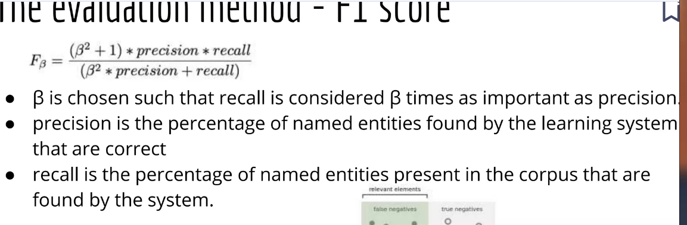
Named-entity recognition (NER) — is a subtask of information extraction that seeks to locate and classify named entities into pre-defined categories such as person names, organizations, locations, time expressions, quantities, etc.
… NER is also known simply as entity identification, entity chunking and entity extraction.

Slide 2
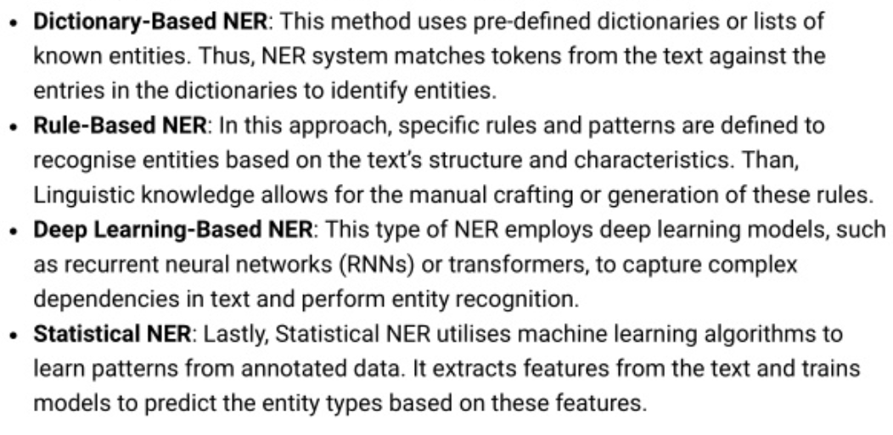

Slide 3
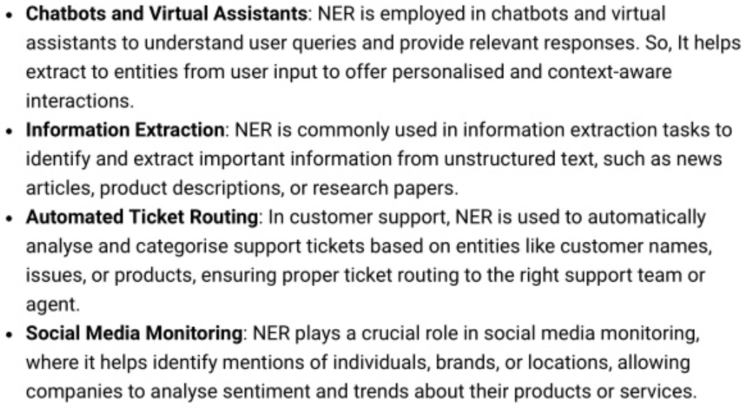

Slide 4
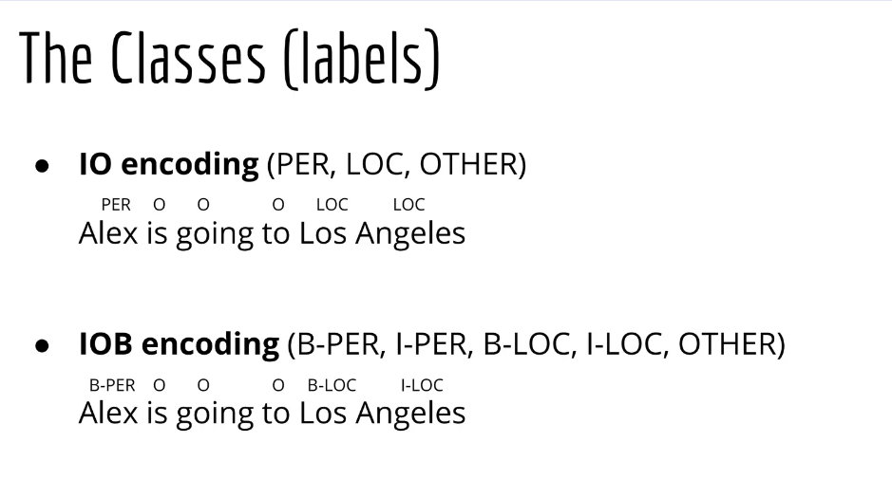
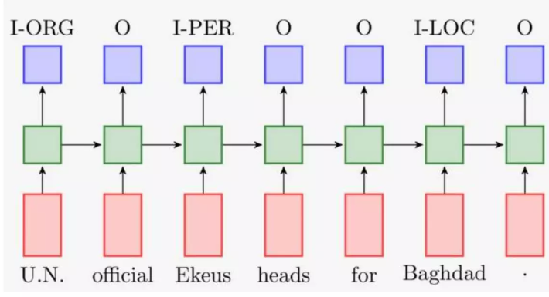
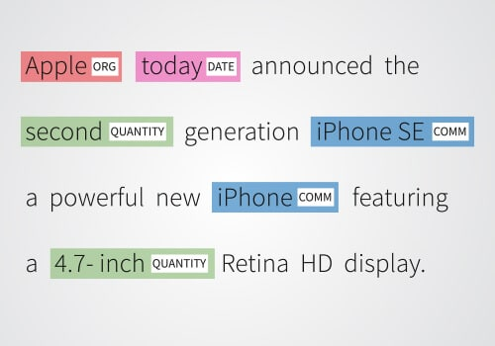
NER Entity Types
Person (PER): Example: Nelson Mandela, Dr. Jane Doe
Organization (ORG): Example: Google, World Health Organization, United Nations
Location (LOC): Example: London, Mount Everest
Date (DATE): Example: January 1, 2024, 2024-01-01
Time (TIME): Identifies time expressions. Example: 3:00 PM, 15:00
Quantity (QUANTITY): Example: 10 kilograms, 2 liters
Percentage (PERCENT): Example: 50%, 0.5
Money (MONEY): Example: $100, €50
Other (MISC): Example: Nobel Prize, iPhone 15″

