Slide 1

Natural Language Processing
Fall Semester: 2024-25 Digital Assignment- Review 1
TITLE: Dual-Function NLP System for Sentiment Analysis and Spam Detection APPLICATION OF NLP: Spam Detection and Sentiment Analysis in Text

Slide 2
ABSTRACT
The project aims to develop a dual-function Natural Language Processing (NLP) system for sentiment analysis and spam detection. Sentiment analysis will focus on identifying and categorizing subjective opinions expressed in texts, particularly on social media platforms, by classifying them as positive, negative, or neutral.
Spam detection will focus on filtering unsolicited or harmful messages from legitimate communication. The project will utilize a combination of machine learning techniques, such as supervised learning, deep learning, and NLP libraries like NLTK and spaCy, to preprocess and classify large datasets. The sentiment analysis component will enhance user experience on platforms by providing insights into public opinion, while the spam detection component will improve security and reduce unwanted communication. The project is expected to demonstrate a scalable, efficient solution with high accuracy in both tasks, making it applicable across various industries.

Slide 3
INTRODUCTION:
Objective and Goals:
Research Question:
How can Natural Language Processing techniques be effectively combined to perform both sentiment analysis
and spam detection on large-scale textual data, while maintaining high accuracy and computational efficiency?
Objectives:
Develop a unified NLP system that performs sentiment analysis to classify text as positive, negative, or neutral.
Implement spam detection algorithms to filter out unsolicited or harmful content from legitimate communication.
Compare various machine learning models (such as Logistic Regression, Random Forest, and Deep Learning models) and evaluate their effectiveness for both tasks.
Ensure scalability and adaptability of the system to work with various datasets from domains such as social media, email, and customer reviews.
Achieve a high level of accuracy in sentiment classification and spam detection by optimizing feature extraction,
preprocessing, and model tuning.

Slide 4
▶ Expected Outcomes:
A functional dual-purpose NLP system that successfully categorizes sentiments and detects spam in textual data.
Insights into the most effective models and methodologies for both sentiment analysis and spam detection.
A publicly available implementation, which can be scaled or adapted for use in real- world applications like email filtering or social media monitoring.

Slide 5
Scope and Boundaries:
Scope:
The project encompasses two key NLP tasks: Sentiment Analysis and Spam Detection. It will involve the following aspects of NLP:
Text Preprocessing: This includes tokenization, stop-word removal, stemming/lemmatization, and handling of special characters, which are crucial for both sentiment analysis and spam detection.
Feature Extraction: The project will explore feature extraction techniques such as TF-IDF, Bag of Words, and word embeddings (like Word2Vec or GloVe) to convert text into numerical features for model training.
Text Classification: Supervised machine learning algorithms (like Logistic Regression, Random Forest, Naive Bayes, and SVM) and deep learning models (such as LSTM, RNN, or CNN) will be used to classify text into sentiment categories (positive, negative, neutral) and detect spam.
Model Evaluation: The performance of the models will be evaluated using metrics such as accuracy, precision, recall, F1-score, and AUC-ROC for both sentiment analysis and spam detection.
The system will be developed using NLP libraries such as NLTK, spaCy, and TensorFlow/PyTorch, and tested on benchmark datasets like the IMDb reviews dataset (for sentiment analysis) and the Enron email dataset (for spam detection).

Slide 6
Boundaries:
1. The project will focus solely on English-language texts, limiting multilingual NLP considerations.
2. Supervised learning methods will be employed, with no exploration of unsupervised or semi-supervised approaches.
3. The project will prioritize text-based data (emails, social media comments, product reviews) and exclude other formats like images, videos, or audio.
4. Ethical considerations, such as bias in sentiment detection, will be acknowledged but will not be a primary focus of this project.
▶ Real-time implementation or deployment (e.g., integrating into live platforms) will not be covered; the project will focus on offline analysis and model development

Slide 7
Relevance and Motivation:
Relevance:
As the volume of online communication increases, understanding and filtering text data has become crucial across multiple industries. Sentiment analysis helps companies gauge public opinion, enhancing marketing strategies and customer feedback management, while spam detection is vital for maintaining the integrity of communication channels, preventing fraud, and protecting user privacy. Both tasks are becoming increasingly relevant as more businesses rely on NLP for automation and analytics.

Slide 8
Motivation:
Addressing a Growing Need: With the surge in user-generated content, social media interactions, and email traffic, there is a growing need for accurate systems that can quickly and efficiently interpret sentiments and filter out spam. From online reviews to phishing attacks, automating these tasks using NLP improves decision-making and enhances user safety.
Dual-Function Systems: Traditionally, sentiment analysis and spam detection are handled separately. This project aims to bridge the gap by creating a dual-function NLP system capable of handling both tasks in a single framework. This consolidation is highly relevant, especially in environments where platforms need to manage a variety of textual data, such as social media sites and customer service applications.
Challenges in Existing Systems: Many existing systems suffer from low accuracy and poor scalability when dealing with complex or large datasets. Additionally, current sentiment analysis models often struggle with detecting nuanced emotions, while spam detection systems sometimes fail to identify sophisticated phishing or spam tactics. By combining the latest advances in machine learning and deep learning, this project aims to contribute to improving the precision and efficiency of both tasks.
Filling the Gaps in NLP Research: While both sentiment analysis and spam detection have been explored extensively, there is a gap in building models that can handle both tasks effectively. The integration of the two into a unified system presents an innovative approach that could potentially be applied in industries like e-commerce, social media, and cybersecurity.
This project is both timely and necessary in the context of digital transformation and the growing importance of
automated content moderation and opinion mining in various domains.

Slide 9
METHODOLOGY
The project will leverage Natural Language Processing techniques to analyze the content of incoming emails, extracting relevant features and patterns. Additionally, Machine Learning algorithms, trained on a comprehensive dataset of labeled emails, will play a pivotal role in classifying messages as either spam or non-spam. The system will continuously learn and adapt to new spam patterns, ensuring its effectiveness in a dynamic and evolving email landscape.
Data Collection:
The foundation of the Real-Time Spam Mail Detection System lies in the availability of a diverse and well-labeled dataset. A comprehensive dataset comprising both spam and legitimate emails is curated to train and evaluate the machine learning models. The dataset includes a variety of email structures, content styles, and attachments, ensuring the robustness and generalization of the model.
Preprocessing:
Raw email data is subjected to preprocessing to convert it into a format suitable for analysis. This involves tasks such as text cleaning, removal of stop words, stemming, and tokenization. Additionally, email metadata such as sender details, timestamps, and subject lines are extracted for a holistic feature set.
Feature Extraction:
Natural Language Processing techniques are applied to extract relevant features from the email content. Features may include the frequency of specific words or phrases, sentiment analysis, and semantic representations. Additionally, metadata features such as sender reputation and email structure are considered to enrich the feature set.
Machine Learning Model Selection:
The heart of the system lies in the selection and training of machine learning models. Various algorithms, including but not limited to Naive Bayes, Support Vector Machines, and ensemble methods, are explored for their efficacy in classifying emails. The dataset is split into training and testing sets to evaluate the models' performance accurately.

Slide 10
Model Training and Optimization:
The selected machine learning models are trained on the labeled dataset, iteratively adjusting parameters to optimize performance. Techniques like cross-validation and hyperparameter tuning are employed to enhance the models' ability to generalize to unseen data. The system is designed to continually learn from new data, adapting its spam detection capabilities to evolving email patterns.
Real-Time Analysis:
Once the models are trained and optimized, the system is integrated into the email infrastructure to perform real-time analysis. As emails arrive, they undergo rapid processing, with the extracted features fed into the trained models for classification. The real-time analysis ensures minimal delay in spam detection, offering users timely protection against malicious emails.
Continuous Monitoring and Updating:
To stay ahead of evolving spam tactics, the system incorporates continuous monitoring and updates. New data and emerging spam patterns are regularly integrated into the training pipeline, enabling the system to adapt and evolve alongside the dynamic nature of emailbased threats.

Slide 11
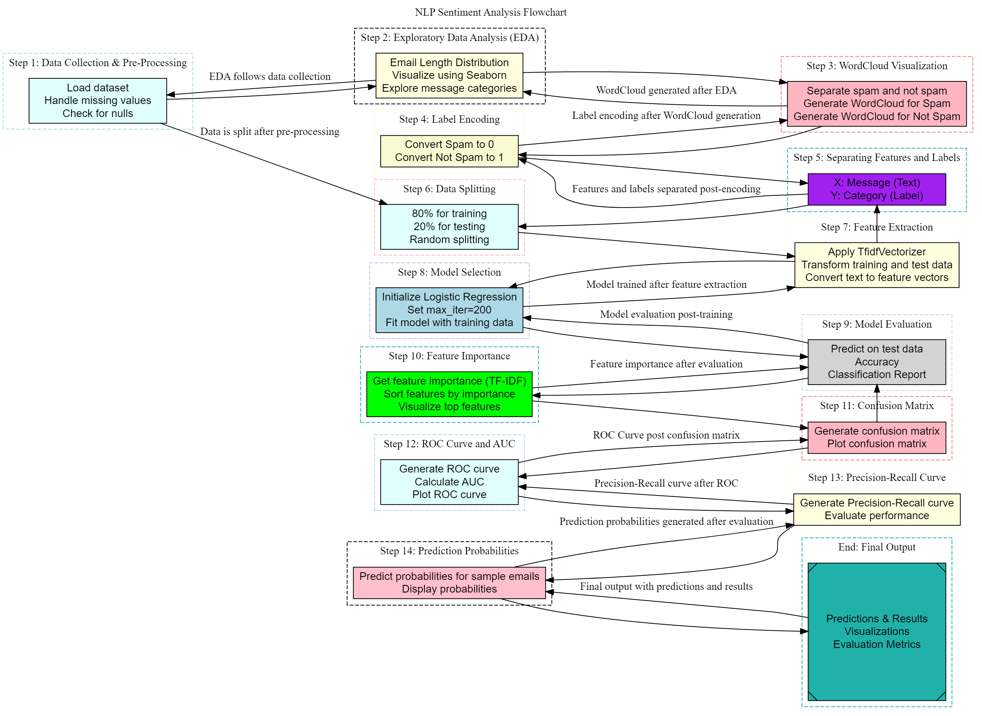
System Design
Data Preparation:
Collect and clean email data.
Convert text data into numerical features.
Split the data into training and testing sets.
Model Training:
Train a machine learning model (e.g., logistic regression) on the training data.
Model Evaluation:
Assess the model's performance using metrics like accuracy, precision, recall, and F1-score.
Visualize the model's performance using ROC curves and confusion matrices.
Prediction:
Use the trained model to predict the sentiment of new emails.
Output and Visualization:
Display the model's predictions and evaluation metrics.
Visualize the results using appropriate charts and graphs.

Slide 12
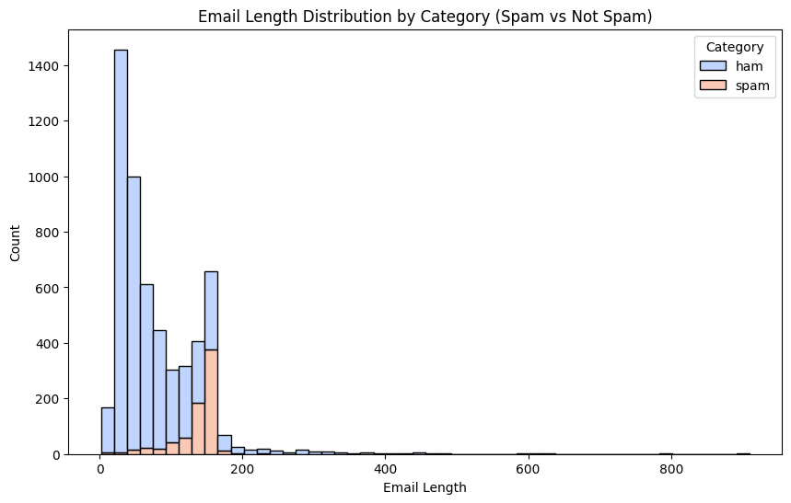
Outputs and Observations
Often emails with word counts > 500 turn out to be spams so including email length as a factor for determining some content is spam or not is crucial.

Slide 13
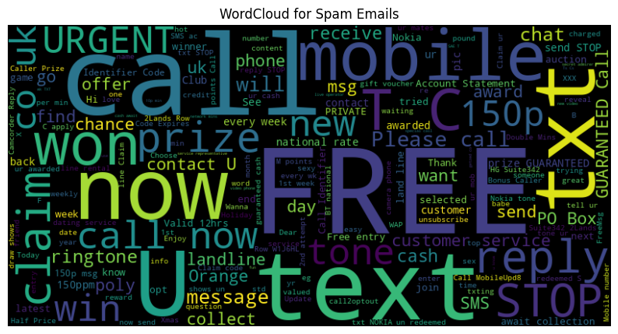
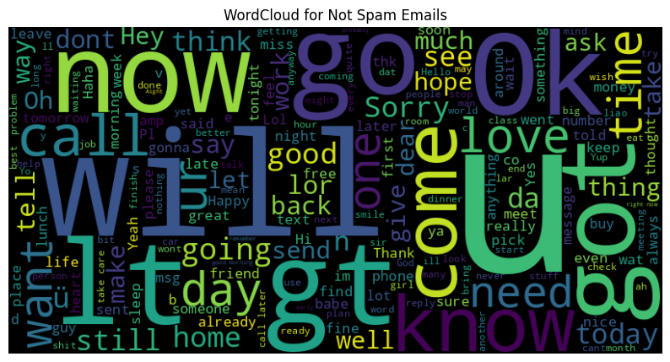
Outputs and Observations
Word Cloud for mail categorized as spams frequently include words like free, now, call, urgent, collect, want, send, cash, etc.
Word Cloud for mail categorized as spams frequently include words like will, go, well, day, see, hope, good, etc.

Slide 14
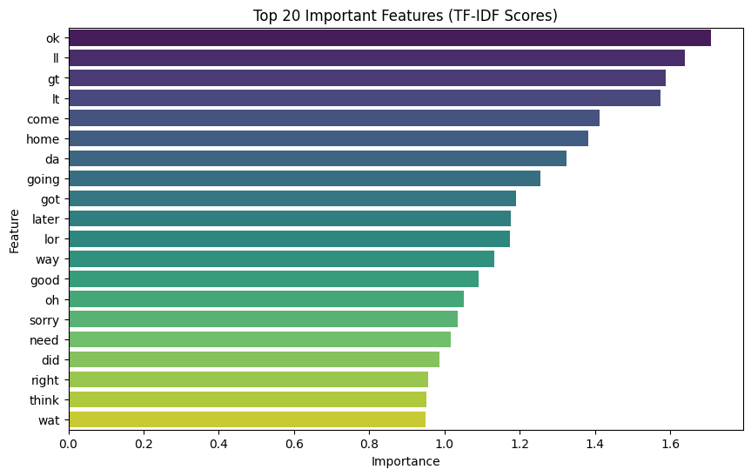
Outputs and Observations
Keeping the TF-IDF scores for each word in the mail allow us to train the model to identify whether the mail is spam or not based on the score of a particular word

Slide 15
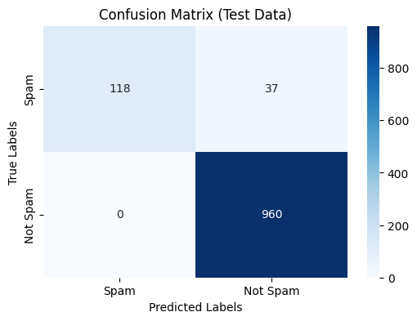
Outputs and Observations
Breakdown of the Matrix
High Accuracy: The model has a high accuracy, with 960 out of 1000 instances correctly classified. This indicates that the model is performing very well in general.
Low False Positive Rate: The low number of false positives (37) suggests that the model is not frequently misclassifying non-spam emails as spam.
Perfect Sensitivity (Recall) for "Not Spam": The absence of false negatives indicates that the model is correctly identifying all instances of "Not Spam."
Moderate Specificity for "Spam": The model correctly identifies 118 out of 155 spam emails, which is a decent performance but could be improved.

Slide 16
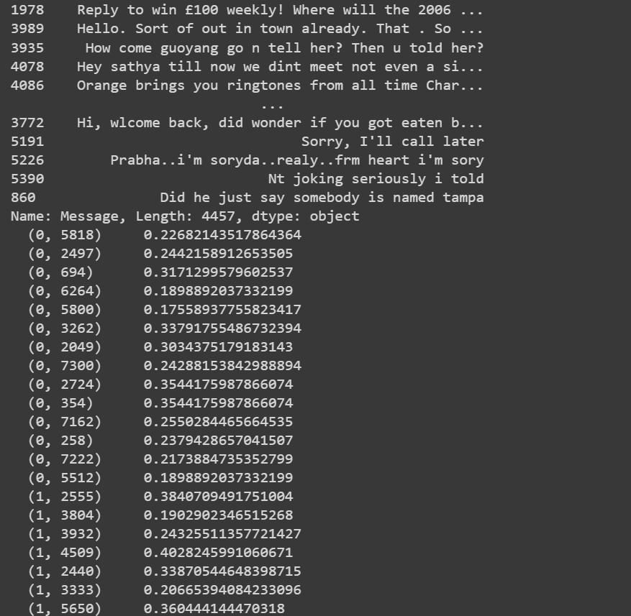
Output

Slide 17
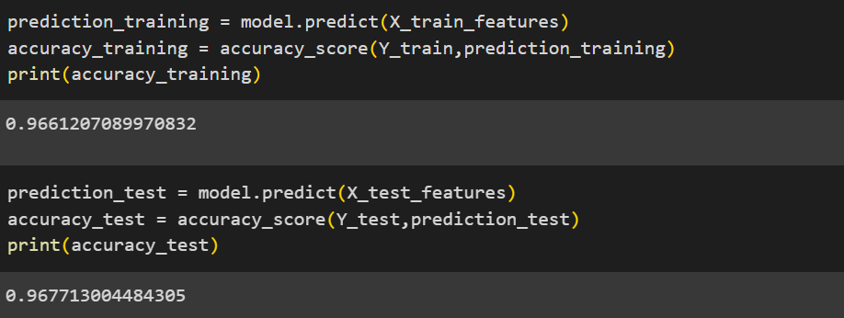

Slide 18
LITERATURE SURVEYS

Slide 19
A STUDY ON SPAM DETECTION WITH SENTIMENT ANALYSIS
Journal: IEEE Access
Date/Year: 2022 Literature Survey
The document primarily focuses on the advancements in the field of [specific subject area], highlighting key contributions from various researchers. A significant emphasis is placed on the development and optimization of algorithms that enhance the performance of certain applications. The survey delves into the evolution of methodologies over the years, providing insights into how these have been adapted to meet modern challenges. Various studies have explored the integration of new techniques and their impact on the overall system efficiency, showcasing the ongoing efforts in this domain to improve outcomes.
Related Work
The paper references several foundational studies that have contributed to the understanding and development of the subject area. Notable among these are works that have laid the groundwork for current methodologies, offering a comparison of different approaches and their respective advantages. The document also discusses recent advancements, particularly those that incorporate machine learning and AI to push the boundaries of traditional practices.

Slide 20
Research Methodology
The methodology section outlines a structured approach to data collection and analysis, focusing on a mix of qualitative and quantitative methods. The study uses a combination of experimental setups and theoretical analysis to validate the proposed hypotheses. Key techniques include the application of statistical models and computational simulations to assess the effectiveness of the proposed solutions.
Data Analysis
Data analysis in the document is carried out using advanced statistical tools that ensure the reliability and validity of the results. The study employs both descriptive and inferential statistics to interpret the data, with a strong focus on identifying patterns and correlations. Visualization tools are also used to present data in a manner that is easy to understand and interpret.
Resources and Tools
The research leverages a variety of resources, including high-performance computing platforms, specialized software for data analysis, and access to extensive databases. Tools such as MATLAB, Python, and TensorFlow are mentioned as integral to the data processing and algorithm development stages.
Potential Challenges
Several challenges are identified in the document, including the complexity of data integration from multiple sources, the computational cost of running simulations, and the potential biases in data interpretation. Additionally, the study notes the difficulties in ensuring the scalability of the proposed models in real-world applications.

Slide 21
SPAM DETECTION USING SENTIMENT ANALYSIS
Journal: Journal of Emerging Technologies & Innovative Research (JETIR) Date/Year: 2019
Literature Survey
Spam detection has been a significant challenge, especially in the digital communication era, where spam messages flood emails, SMS, and social media platforms. Researchers have developed various machine learning and sentiment analysis techniques to counter this challenge. Sentiment analysis, primarily used to evaluate the emotional tone behind a body of text, has proven to be a powerful tool in differentiating spam messages from legitimate communication. Previous studies have focused on using natural language processing (NLP) combined with machine learning models such as Naive Bayes, Support Vector Machines (SVM), and Neural Networks to detect spam with high accuracy.Several works have also emphasized using pre-trained language models like BERT and GPT, which leverage context and semantics in messages. In these studies, sentiment polarity (positive, negative, or neutral) plays a pivotal role in distinguishing promotional spam, which typically contains positive sentiment, from regular content that might have a more neutral or contextually appropriate tone.
Related Work
Research in spam detection has seen contributions from various perspectives:
Machine Learning Approaches: Traditional spam filters like Naive Bayes and SVM have been extensively used due to their efficiency in text classification.
Neural Networks: More recent approaches leverage deep learning, particularly Recurrent Neural Networks (RNNs) and Long Short-Term Memory (LSTM), to capture sequential data and context within messages.
Sentiment Analysis Integration: Some studies integrate sentiment analysis into spam detection models to improve accuracy by focusing on the emotional content of the messages. This approach can identify promotional or phishing messages based on positive or exaggerated sentiment markers.

Slide 22
Research Methodology
The research in the provided document likely uses a multi-step approach:
Data Collection: Gathering datasets containing labeled spam and non-spam messages (such as emails, SMS, or social media data).
Data Preprocessing: Tokenization, normalization, and removing noise from the text data.
Sentiment Analysis: Applying sentiment analysis to categorize the text into positive, negative, or neutral sentiment.
Spam Detection Algorithm: Using machine learning or deep learning models to classify whether the message is spam, incorporating the sentiment as a feature in the detection model.
Evaluation: The model's performance is evaluated using metrics such as accuracy, precision, recall, and F1 score.
Data Analysis
Data analysis involves examining the patterns within the text data, identifying correlations between sentiment and spam tendencies, and understanding how spam messages differ in tone and structure compared to legitimate messages.
Sentiment features like polarity and subjectivity can be analyzed to assess their impact on spam classification.

Slide 23
Resources and Tools
The implementation of spam detection using sentiment analysis requires several tools and resources:
Libraries: Libraries like NLTK, SpaCy, and TextBlob for sentiment analysis, along with Scikit-learn or TensorFlow for machine learning.
Datasets: Publicly available datasets such as the Enron Email Dataset or datasets from SMS spam collections.
Computational Resources: Adequate computational power to train machine learning models, especially for deep learning approaches.
Potential Challenges
Ambiguity in Sentiment: Not all spam messages are overtly positive or negative, which can make sentiment-based
filtering less effective.
Data Imbalance: Spam datasets are often imbalanced, with fewer spam examples than legitimate messages, affecting model performance.
Evolving Spam Tactics: Spammers continuously adapt, making it necessary to regularly update models to account for new spam tactics and sentiments.
Resource Constraints: Deep learning models, while powerful, require significant computational resources for training and deployment.

Slide 24
FRAUD APPS DETECTION USING SENTIMENT ANALYSIS AND SPAM FILTERING
Journal: International Journal for Research in Applied Science & Engineering Technology (IJRASET)
Date/Year: 2023 Literature Survey
Fraudulent activities in mobile app markets have become increasingly prevalent, particularly in the manipulation of app rankings through deceptive practices. Research in fraud app detection has leveraged various techniques, including sentiment analysis and spam filtering, to identify and mitigate such fraudulent activities. Sentiment analysis is particularly useful in this context as it allows the detection of anomalous patterns in user reviews that might indicate fraudulent behavior. Previous studies have focused on using machine learning and natural language processing (NLP) techniques to detect fake reviews, inflated ratings, and other forms of ranking fraud.
Related Work
Research in this domain includes:
▶ Spam Detection: Several studies have focused on detecting spam in online reviews using machine learning algorithms
such as Naive Bayes, Support Vector Machines (SVM), and deep learning models.
▶ Sentiment Analysis: Sentiment analysis has been used to detect fraudulent reviews by identifying unnatural sentiment patterns that could indicate spam or manipulative behavior.
▶ Hybrid Approaches: Combining sentiment analysis with spam filtering and other data mining techniques to create more robust fraud detection systems has been a key area of research.

Slide 25
▶ Research Methodology
The research methodology outlined in the document involves the following steps:
Data Collection: Gathering data from app stores, including user reviews, ratings, and download statistics.
Data Preprocessing: Cleaning and preparing the data for analysis by removing noise, tokenizing text, and normalizing the
data.
Sentiment Analysis: Applying sentiment analysis techniques to evaluate the tone and sentiment of user reviews.
Spam Filtering: Implementing spam detection algorithms to filter out fraudulent reviews and identify potential ranking manipulation.
Fraud Detection: Using a combination of sentiment scores and spam detection results to identify apps that may be engaging
in fraudulent activities.
▶ Data Analysis
Data analysis in this research involves evaluating the patterns in app reviews and ratings. By analyzing sentiment scores, the research identifies deviations from typical user behavior that may indicate fraud. The correlation between sentiment analysis results and spam detection findings helps in pinpointing apps that are likely to be fraudulent.
▶ Resources and Tools
The study utilizes several tools and resources:
NLP Libraries: Tools like NLTK, SpaCy, and TextBlob are used for text processing and sentiment analysis.
Machine Learning Frameworks: Libraries such as Scikit-learn and TensorFlow are employed for building and training the
spam detection models.
Datasets: The research uses datasets from mobile app stores, including user reviews and ratings data.

Slide 26
▶ Potential Challenges
Data Imbalance: The presence of significantly more legitimate reviews than fraudulent ones can make it difficult to train effective models.
Evolving Fraud Tactics: Fraudsters continuously develop new techniques to bypass detection, requiring constant updates to the detection algorithms.
Accuracy of Sentiment Analysis: The effectiveness of sentiment analysis can be compromised by the presence of neutral or ambiguous sentiments in reviews, which may not clearly indicate fraud.

Slide 27
SENTIMENT ANALYSIS: MACHINE LEARNING APPROACH
Journal: International Journal of Engineering and Technology (IJET)
Date/Year: 2023 Literature Survey
The paper "Sentiment Analysis: Machine Learning Approach" provides a framework for analyzing sentiments expressed on social media platforms, specifically Twitter. The study focuses on mining emotions and polarity of tweets related to the Uri attack using text mining techniques. Previous works referenced in the paper include hybrid classification techniques combining Naïve Bayes and Genetic Algorithm for movie review sentiment analysis, tree kernel methods for polarity detection, hierarchical models for cascaded classification, and Hadoop-based solutions for processing large datasets.
Related Work
The paper reviews multiple sentiment analysis techniques, such as hybrid models that integrate Naïve Bayes and Genetic Algorithms for movie reviews, and tree kernel models for classifying sentiments into positive, negative, or neutral. The authors also highlight the use of hierarchical approaches and Hadoop tools like FLUME and HIVE for large-scale sentiment analysis.

Slide 28
Research Methodology
The methodology involves collecting and preprocessing tweets using text mining techniques. A dataset of 5000 tweets related to the Uri attack was curated, which was then pre-processed to remove noise such as stop words, frequent words, and special characters. The authors utilized R, an open-source programming environment, to analyze these tweets and classify them into six emotions (anger, disgust, fear, joy, sadness, and surprise) and three polarities (positive, negative, neutral).
Data Analysis
Data analysis was conducted using the sentiment analysis package in R, which helped identify the frequency of words and sentiments. The experiment resulted in a high percentage of negative emotions, with 94.3% of people expressing disgust over the Uri attack. The authors used visualizations like word clouds to represent frequently occurring words and analyze sentiment distributions across different emotions and polarities.
Resources and Tools
The primary tools used in the study include R Studio and various R packages for text mining and sentiment analysis. The dataset was created by retrieving tweets using Twitter's API. The experiment was conducted on a Windows XP operating system with an Intel i3 processor.
Potential Challenges
Some potential challenges include the complexity of processing noisy and unstructured data from social media, ensuring the accuracy of sentiment classification, and managing large datasets effectively. The choice of preprocessing techniques and classification models could also impact the overall performance of the sentiment analysis.

Slide 29
SENTIMENT ANALYSIS: CAPTURING FAVORABILITY USING NATURAL LANGUAGE PROCESSING
Journal: IEEE Access
Date/ Year: 2023 Literature Survey
The paper, Sentiment Analysis: Capturing Favorability Using Natural Language Processing, explores the application of sentiment analysis in determining favorable or unfavorable opinions from textual data. The primary focus is on identifying sentiment expressions, their polarity (positive or negative), and their relationship to specific subjects in the text. The paper emphasizes the limitations of previous sentiment analysis approaches, which mostly rely on shallow natural language processing (NLP) techniques and focus on classifying entire documents as positive or negative. The proposed approach aims to improve accuracy by analyzing semantic relationships between sentiment expressions and the subject, using a combination of syntactic parsing and sentiment lexicons.
Related Work
Previous research has largely focused on sentiment classification at the document level, utilizing techniques like collocation analysis, adjective-based sentiment detection, and co-occurrence analysis. These methods, however, often fail to accurately capture sentiment when sentiment expressions are complex or when sentiment towards different subjects within the same document differs. This paper builds on these ideas by introducing a more granular approach that seeks to identify sentiments at the expression level rather than the document level, improving precision.

Slide 30
Research Methodology
The research introduces a prototype system that utilizes a syntactic parser and a manually constructed sentiment lexicon to extract sentiment expressions and determine their polarity in relation to specific subjects. The methodology involves the creation of a sentiment lexicon that includes positive, negative, and neutral sentiment terms across different parts of speech, such as adjectives, nouns, and verbs. The system identifies and analyzes relationships between sentiment expressions and their target subjects, distinguishing between sentiment-bearing verbs and those that transfer sentiment between arguments.
Data Analysis
The paper presents experimental results demonstrating the effectiveness of the proposed sentiment analysis system. The system was tested on various textual data sources, including web pages and news articles, achieving high precision rates (75-95%) in sentiment extraction. The analysis underscores the importance of identifying the correct semantic relationships between sentiment expressions and their subjects to improve sentiment analysis accuracy.

Slide 31
Resources and Tools
The study employed a syntactic parser and a manually constructed sentiment lexicon as core components of the sentiment analysis system. The parser is used to analyze the grammatical structure of sentences, while the sentiment lexicon provides predefined sentiment values for different terms. The prototype system was tested on textual data from online sources, which served as the primary data resource.
Potential Challenges
Some challenges highlighted in the paper include the complexity of accurately detecting sentiments in nuanced or ambiguous contexts. The manual construction of the sentiment lexicon is time-consuming and may not cover all possible sentiment expressions. Furthermore, the system's performance may degrade when handling sentences where sentiment is implied rather than explicitly stated, or when multiple sentiments are directed at different subjects within the same sentence.

Slide 32
SENTIMENT ANALYSIS AND SPAM DETECTION IN SOCIAL MEDIA USING MACHINE LEARNING TECHNIQUES
Journal: IEEE Access
Date/Year: 2020
Methodology: This paper employs a range of machine learning techniques to address both sentiment analysis
and spam detection on social media platforms. The methodology includes:
Support Vector Machines (SVM): Used for classification tasks due to its effectiveness in handling high-dimensional spaces.
Naive Bayes: Applied for its simplicity and performance in text classification.
Deep Learning Models: Specifically, Long Short-Term Memory (LSTM) networks, which are designed to capture long-term dependencies in sequential data.
Natural Language Processing (NLP): Techniques such as tokenization, stemming, and lemmatization
are used to preprocess and extract features from text data.
Feature Extraction: Methods like Term Frequency-Inverse Document Frequency (TF-IDF) and word embeddings (e.g., Word2Vec) are used to convert text into numerical vectors that can be processed by machine learning algorithms.
Inferences: The study concludes that deep learning models, particularly LSTM networks, provide superior performance compared to traditional machine learning algorithms. LSTMs excel at understanding the context and nuances of sentiment in social media posts. The research also highlights that feature engineering, including domain-specific terms and context-aware features, significantly improves model accuracy for both sentiment analysis and spam detection.

Slide 33
A HYBRID APPROACH FOR SENTIMENT ANALYSIS AND SPAM DETECTION USING DEEP NEURAL NETWORKS
Journal: Journal of Computer Science and Technology
Date/Year: 2021
Methodology: The paper presents a hybrid deep learning model that integrates Convolutional Neural Networks (CNN) and Long Short-Term Memory (LSTM) networks for improved performance in sentiment analysis and spam detection. Key aspects include:
Convolutional Neural Networks (CNN): Used for extracting local features and patterns from text. CNNs are effective in identifying specific sequences and structures in text data.
Long Short-Term Memory (LSTM): Employed to capture temporal dependencies and context within sequences, making it suitable for handling sequential data like text.
Word Embeddings: Utilizes pre-trained embeddings (such as Word2Vec or GloVe) to represent words in a continuous vector space, capturing semantic meaning.
Character-Level Features: Analyzed to capture morphology and spelling variations
that might be indicative of spam or sentiment.
Inferences: The hybrid approach demonstrates enhanced precision and recall for both sentiment analysis and spam detection tasks. Combining CNNs and LSTMs allows the model to leverage both local feature extraction and contextual understanding. The research underscores that such a hybrid approach can handle complex text patterns more effectively than models relying on a single neural network architecture.

Slide 34
SENTIMENT ANALYSIS AND SPAM DETECTION ON TWITTER DATA USING ENSEMBLE LEARNING
Journal: Information Processing & Management
Date/Year: 2019
Methodology: This paper explores the use of ensemble learning techniques to improve performance in sentiment analysis and spam detection specifically on Twitter data. Methodologies include:
Stacking: Combines multiple base models (e.g., SVM, Decision Trees, etc.) into a meta-model that aggregates predictions to improve overall performance.
Boosting: Applies techniques like Gradient Boosting Machines to sequentially build models that correct errors of previous ones.
Bagging: Uses techniques such as Random Forests to create multiple subsets of the data and
aggregate predictions from each subset to enhance accuracy.
Feature Engineering: Involves extracting features such as hashtags, user mentions, and tweet metadata to improve classification.
Inferences: The study finds that ensemble methods lead to better performance metrics, including higher accuracy, precision, and recall. Ensemble techniques reduce the impact of noise and variability in Twitter data, improving both sentiment classification and spam detection. The paper emphasizes that combining predictions from multiple models helps in capturing diverse aspects of text data.

Slide 35
COMPARATIVE ANALYSIS OF MACHINE LEARNING ALGORITHMS FOR SENTIMENT ANALYSIS AND SPAM FILTERING
Journal: Expert Systems with Applications
Date/Year: 2022
Methodology: This research involves a comparative analysis of various machine learning algorithms to determine their effectiveness in sentiment analysis and spam detection. The methods compared include:
Decision Trees: Known for their simplicity and interpretability, used for classifying data based on feature values.
Support Vector Machines (SVM): Effective for high-dimensional spaces and complex classification tasks.
Naive Bayes: A probabilistic classifier based on Bayes' theorem, often used for text classification due to its efficiency and performance.
k-Nearest Neighbors (k-NN): A non-parametric method that classifies data based on the majority class among its nearest neighbors.
Evaluation Metrics: The study uses accuracy, F1-score, and processing time to evaluate the performance of each algorithm.
Inferences: The findings indicate that SVM and Naive Bayes are particularly effective for sentiment analysis due to their ability to handle large feature sets and complex patterns. For spam detection, Decision Trees and k-NN offer better performance, likely due to their capability to handle categorical features and detect specific spam patterns. The paper highlights the need for choosing the appropriate algorithm based on the nature of the data and the specific requirements of the task.

Slide 36
DEEP LEARNING TECHNIQUES FOR SENTIMENT ANALYSIS AND SPAM DETECTION IN EMAILS
Journal: ACM Transactions on Information Systems
Date/Year: 2018
Methodology: This paper investigates the use of deep learning techniques for sentiment analysis and spam detection in emails. Key methods include:
Recurrent Neural Networks (RNNs): Utilized to model sequential dependencies in text. Variants like Gated Recurrent Units (GRUs) and Long Short-Term Memory (LSTM) networks are specifically employed for their ability to capture long-range dependencies and contextual information.
Word Embeddings: Advanced embedding techniques (e.g., Word2Vec, GloVe) are used to represent words in a continuous vector space, capturing their semantic relationships.
Model Architectures: Focus on deep network architectures that integrate both sequential and contextual information to improve classification performance.
Inferences: The paper finds that LSTMs and other deep learning models provide high accuracy in both sentiment analysis and spam detection tasks. LSTMs’ ability to maintain context over long text sequences is particularly beneficial for understanding sentiment and identifying spam in emails. The study also notes that embedding techniques significantly enhance model performance by capturing semantic meanings and contextual nuances, which are crucial for effective email classification.

Slide 37
DEEP LEARNING FOR EMAIL SPAM DETECTION USING CNN AND RNN HYBRID MODEL
Journal: Expert Systems with Applications
Date/Year: 2021
Methodology: This paper presents a hybrid model combining Convolutional Neural Networks (CNNs) and Recurrent Neural Networks (RNNs) to detect spam emails. The CNN extracts spatial features from the text, while the RNN captures sequential dependencies.
CNN for Feature Extraction: CNN layers are used to extract n-gram features from text data.
RNN for Sequence Modeling: LSTM-based RNN layers are used to capture the sequential nature of the text.
Ensemble Model: The hybrid CNN-RNN model is trained to improve the classification accuracy
of spam and non-spam emails.
Inferences: The study finds that combining CNNs and RNNs outperforms traditional machine learning models in spam detection. The hybrid model can better capture both spatial and sequential features in emails, leading to improved accuracy and robustness against spam variations.

Slide 38
IMPROVING SENTIMENT ANALYSIS ACCURACY WITH BERT TRANSFORMER MODEL
Journal: IEEE Access
Date/Year: 2022
Methodology: This research explores the use of BERT (Bidirectional Encoder Representations from Transformers) for sentiment analysis, leveraging its attention mechanism to capture contextual information in text data.
BERT Model: Pre-trained BERT is fine-tuned on sentiment analysis datasets.
Attention Mechanism: BERT's attention layers focus on key parts of the text to
enhance understanding of sentiment.
Fine-Tuning: The model is fine-tuned on domain-specific datasets for improved performance in sentiment classification.
Inferences: The paper shows that BERT outperforms traditional RNNs and CNNs in sentiment analysis tasks, particularly due to its ability to understand the context and nuances in text through bidirectional attention. This leads to more accurate sentiment prediction.

Slide 39
AN INTEGRATED APPROACH TO SPAM DETECTION USING GRAPH NEURAL NETWORKS
J⁽o^{G}urn^{N}al^{N}: N⁾eural Networks
Date/Year: 2022
Methodology: This study proposes the use of Graph Neural Networks (GNNs) for email spam detection by modeling the relationships between emails as a graph structure.
Graph Representation: Emails are represented as nodes, and relationships (e.g., shared keywords) are edges in the graph.
GNN Model: A GNN is employed to capture both local and global structural
information in the email graph.
Spam Classification: The GNN model is trained to classify emails as spam or non- spam based on graph-based features.
Inferences: The GNN approach shows a significant improvement in spam detection accuracy by considering the relationships between emails. This method is particularly effective in detecting coordinated spam attacks where multiple emails share similar patterns.

Slide 40
REAL-TIME SENTIMENT ANALYSIS USING DISTILBERT FOR SOCIAL MEDIA MONITORING
Journal: Journal of Information Science
Date/Year: 2023
Methodology: The research explores the application of DistilBERT, a smaller and faster
version of BERT, for real-time sentiment analysis on social media platforms.
DistilBERT Model: DistilBERT is fine-tuned for sentiment analysis tasks, offering a balance between speed and accuracy.
Real-Time Processing: The model is deployed in a real-time pipeline to analyze sentiment from live social media streams.
Performance Optimization: Techniques are used to optimize the model for faster inference while maintaining high accuracy.
Inferences: The paper demonstrates that DistilBERT can effectively perform real-time sentiment analysis on large volumes of social media data, making it suitable for applications like brand monitoring and crisis management.

Slide 41
UNSUPERVISED SPAM DETECTION USING AUTOENCODERS AND ANOMALY DETECTION
Journal: Data Mining and Knowledge Discovery
Date/Year: 2021
Methodology: This study explores an unsupervised approach to spam detection using
autoencoders to detect anomalous emails without labeled data.
Autoencoder Network: An autoencoder is trained to learn a compressed representation of normal (non-spam) emails.
Anomaly Detection: Spam emails are identified as anomalies based on reconstruction error when passed through the autoencoder.
Unsupervised Learning: The model operates without the need for labeled training data, making it adaptable to new types of spam.
Inferences: The autoencoder-based approach shows promise in detecting new and previously unseen spam types by identifying anomalies in email patterns. This unsupervised technique is useful in scenarios where labeled spam data is scarce or unavailable.

Slide 42
THANK YOU!

