Slide 1
Cognitive Robotics

Slide 2
Developmental Robot Design
Developmental robotics can be defined as “the interdisciplinary approach to the autonomous design of behavioral and cognitive capabilities in artificial agents (robots) that takes direct inspiration from the developmental principles and mechanisms observed in the natural cognitive systems of children.
Developmental robotics relies on a highly interdisciplinary effort of developmental psychology, neuroscience, and comparative psychology with robotics and artificial intelligence.

Slide 3
In particular, developmental sciences such as child psychology provide the empirical bases to identify the general developmental principles, mechanisms, models, and experimental protocols guiding the design of cognitive robots and their testing in situated developmental robotics experiments.
Given this close interaction, developmental psychology and developmental robotics can also mutually benefit from such a combined effort

Slide 4
Developmental robotics is based on the vision that a baby robot, using developmental principles and mechanisms regulating the real-time interaction between its body, brain, and environment, can autonomously acquire an increasingly complex set of sensorimotor and mental capabilities.
Thus, within the wider approach of cognitive robotics, developmental robotics specializes in its emphasis on the design of baby robots with an autonomous capability to acquire ever-more-complex skills.

Slide 5
Historically, the field of developmental robotics has also been known as “cognitive developmental robotics”, “autonomous mental development” and “epigenetic robotics”
Asada et al. (2001) proposed “cognitive developmental robotics” as a new paradigm for the design of humanoid robots.
“Physical embodiment” and “Social interaction” are introduced as key concepts of developmental robotics.

Slide 6
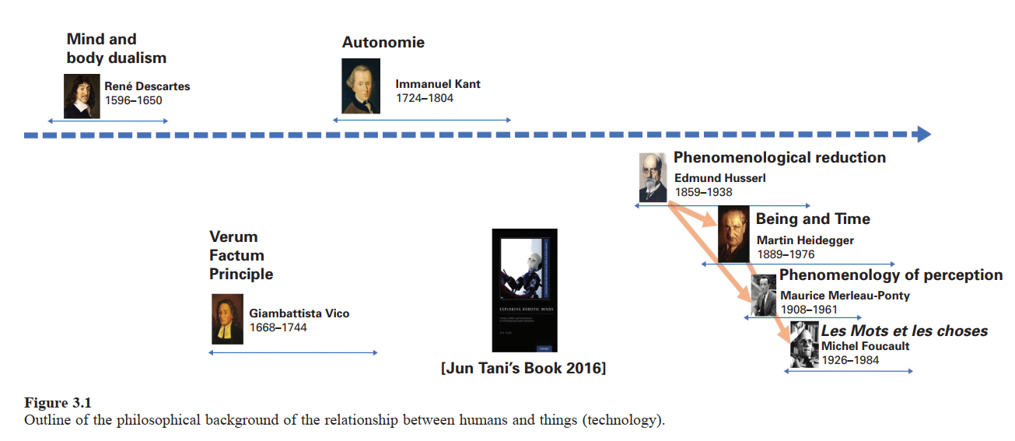

Slide 7
Asada (2019) has proposed a general outline of the theoretical and philosophical background of the relationship between consciousness, humans, and objects/technology at the origin of cognitive developmental robotics.
Descartes advanced mind-body dualism, establishing the relationship between mind and body or things, and laid the foundation for modern philosophy.
Then Vico opposed Cartesianism and all reductionism, asserting the verum factum principle that truth is verified only by creation or invention, not by observations, as proposed in Cartesianism.
Husserl, Heidegger, and Merlot-Ponty presented important concepts such as embodiment, interaction, and intersubjectivity and noted that the essence of reality is lost by discriminating between humans and objects

Slide 8
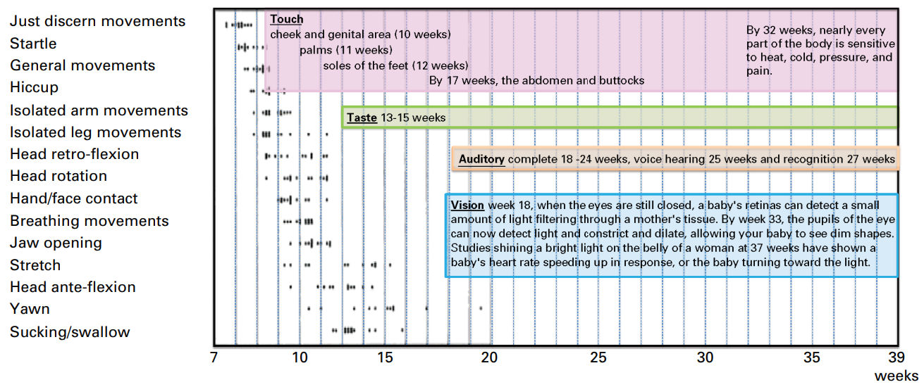
Development of Human Fetus and Infants

Slide 9
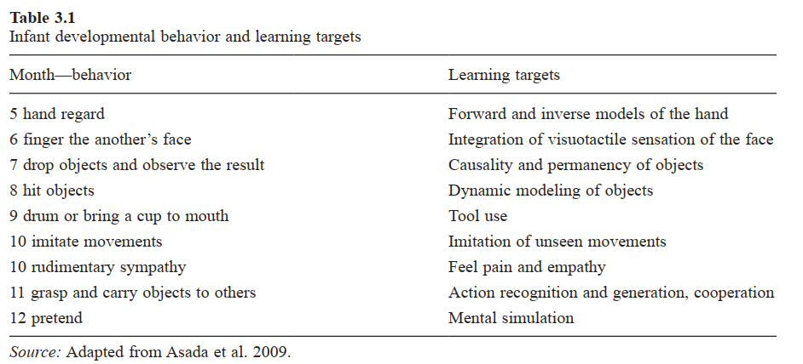

Slide 10
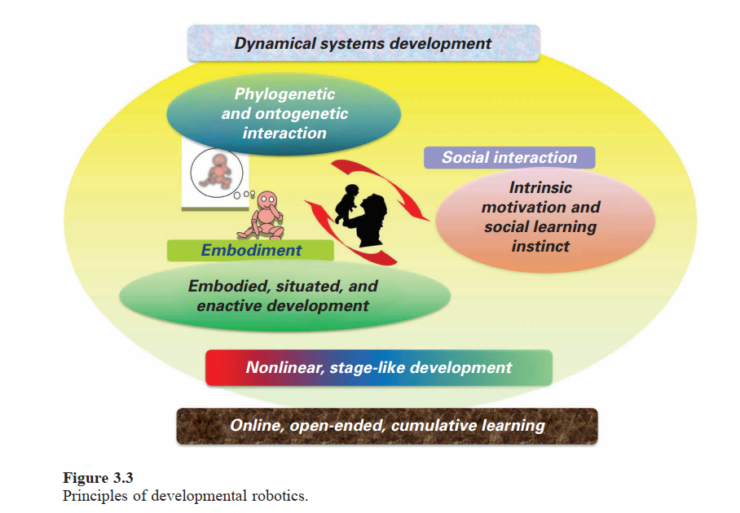
Six Principles of Developmental Robotics

Slide 11
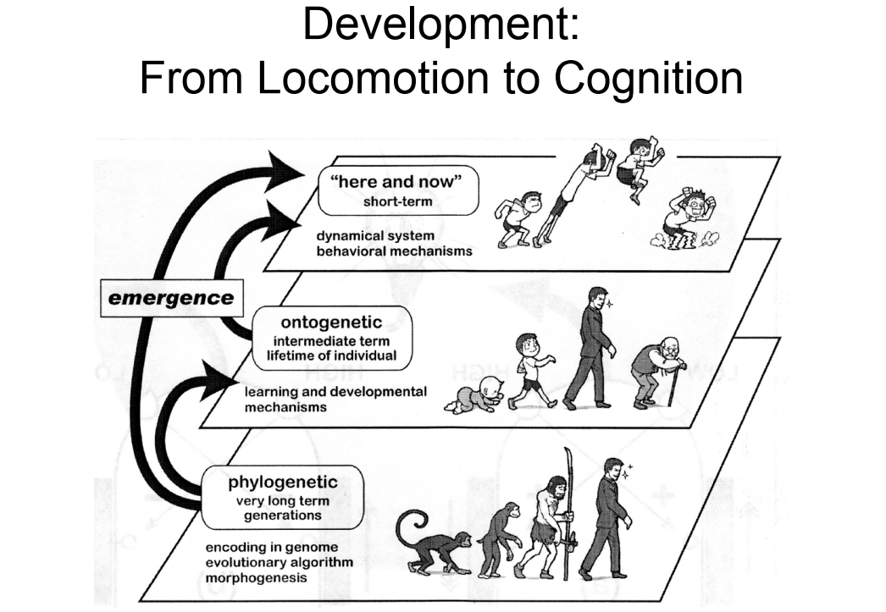

Slide 12
Dynamical Systems Development
In mathematics, a dynamical system is characterized by complex changes, over time, in the phase state that result from the self-organization of multifaceted interactions between the system’s variables.
The complex interaction of nonlinear phenomena results in the production of unpredictable states of the system, often referred to as emergent states.
One key concept in this theory is that of multicausality—for example, in the case when one behavior, such as crawling and walking, is determined by the simultaneous and dynamic consequences of various phenomena at the level of the brain, body, and environment.

Slide 13
Another key concept in the dynamical systems view of development is that of nested timescales.
That is, neural and embodiment phenomena act at different timescales and affect development in an intricate, dynamical way.
For example, the dynamics of the very fast timescale of neural activity (milliseconds) is nested within the dynamics of the other slower timescales, such as action-reaction time (seconds or hundreds of milliseconds), learning (after hours or days), and physical body growth (months).

Slide 14
Intrinsic Motivation and Social-Learning Instinct
Developmental robotics explores methods for designing intrinsically motivated agents and robots who can define their own goals and value systems.
Novelty-based approaches to intrinsic motivation study robots that learn about their environments by exploring and discovering unusual or unexpected features.
A useful mechanism for detecting novelty is habituation: the robot compares its current sensory state to past experiences, devoting its attention to situations that are unique or different.
Prediction-based approaches use knowledge-based intrinsic motivation to explicitly attempt to predict future states of the world.

Slide 15
Phylogenetic and Ontogenetic Interaction
Two different timescales must be considered in developmental robotics:
The ontogenetic phenomena of learning, over a timescale of hours or days, with maturational changes occurring for periods of months or years and
The phylogenetic phenomena of evolutionary changes.
Therefore, the additional implication of the interaction between ontogenetic and phylogenetic phenomena should be considered in developmental robotics models of development

Slide 16
Online, Open-Ended, Cumulative Learning
Human development is characterized by online, crossmodal, continuous, open-ended learning.
“Online” refers to the fact that learning happens while the child interacts with the environment and not in an off-line mode.
“Crossmodal” refers to the fact that different modalities and cognitive domains are acquired in parallel by the child and interact with each other.
“Continuous” and “open-ended” refers to the fact that learning and development do not start and stop at specific stages but rather are lifelong learning experiences

Slide 17
Current Scenario and Possibilities to work
Online learning is currently implemented in developmental robotics.
However, the application of crossmodal, cumulative, open-ended learning, which can lead to cognitive bootstrapping phenomena, has been investigated less frequently.
Most of the current models typically focus on the acquisition of only one task or modality, and few consider the parallel development, and interaction, between modalities and cognitive functions.
Thus, a truly online, crossmodal, cumulative, open-ended developmental robotics model remains a fundamental challenge for the field.

