Slide 1
Module 2
Model of Cognition
“Cognition” generally refers to the faculty of mental activities of human beings dealing with abstraction of information from the real world, their representation and storage in memory, as well as automatic recall
Perception- construction of higher level percepts from low level information or knowledge
Construction of mental imagery from real instances for subsequent usage in recognizing patterns or understanding complex scenes.
Sensing, reasoning, attention, recognition, learning, planning and task coordination, as well as the control
of activities of human beings
Cognitive model- manipulation of internal representation of the external world
Principle of functional decomposition- dividing the entire task into a few subtasks

Slide 2
Module 2
Model of Cognition
Sub tasks modules that together form a chain of information flow from the environment to the actuators, through sensing, planning and task coordination.
Difficult- perception, map building and world modeling
First robot (sonar or infrared sensors) was used to avoid obstacles that are too close and moving a little away or else standing still.
Subsumption architecture- higher levels subsumed the lower levels

Slide 3
Module 2
Various States of Cognition
Sensing and acquisition
Reasoning
Attention
Recognition
Learning
Planning
Action
Coordination
Transitions along with cognitive memory, i.e. LTM and STM

Slide 4
Module 2
Various States of Cognition
Acquisition cycle
Perception cycle
Learning and coordination cycle
Acquisition cycle consists of two states namely sensing and attention along with short term memory (STM) and long term memory (LTM)
Perception cycle consists of three states namely reasoning, attention and recognition along with LTM.
Learning and coordination cycle consists of LTM along with three states namely, learning, planning
and action.

Slide 5
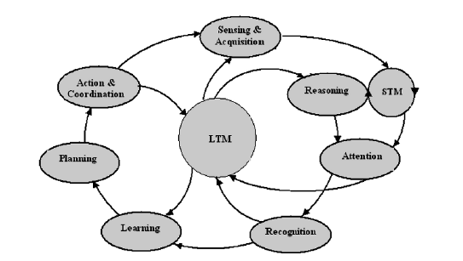
Module 2
Various States of Cognition

Slide 6
Module 2
Various States of Cognition
Sensing and acquisition:
Reception and transformation of signals into a measurable form
Preprocessing, extraction of features from the sensed data, along with stored knowledge in
LTM
Reasoning: high level knowledge from acquired information of relatively lower level and organizes it in structural form for efficient access. (commonsense reasoning, causal reasoning, non-monotonic reasoning, default reasoning, fuzzy reasoning, spatial and temporal reasoning, and meta-level reasoning)
Attention: Responsible for the processing of a certain part of the information more extensively, while the remaining part is neglected or suppressed
Recognition: Identifying a complex arrangement of sensory stimuli such as a letter of the alphabet or a human face from a complex scene. person recognizes a pattern or an object from a large scene, his sensory-organs process, transform and organize the raw data received by the sensory receptors.
(compares the acquired data from STM with the information stored earlier in LTM through appropriate reasoning for recognition of the sensed pattern)

Slide 7
Module 2
Various States of Cognition
Learning:
learning is a process that takes the sensory stimuli from the outside world in the form of examples and classifies these things without providing any explicit rules
Planning:
The state of planning engages itself to determine the steps of action involved in deriving the required goal state from known initial states of the problem.
Cognitive memory: STM, LTM (iconic memory and echoic memory= sensory memory)

Slide 8
Module 2
Cycles of Cognition
Acquisition cycle:
store the information temporarily in STM
compares the response of the STM with already acquired and permanently stored information in LTM.
The process of representation of the information for storage and retrieval from LTM (knowledge representation)
Perception cycle:
process that uses the previously stored knowledge in LTM to gather and interpret the stimuli registered by
the sensory organs through the acquisition cycle
Learning and coordination cycle:
Environment is perceived and stored in LTM in a suitable format (data structure), the autonomous system
utilizes various states namely learning, planning and action and coordination

Slide 9
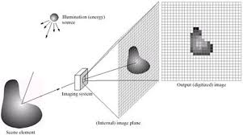
Module 2
Visual Perception

Slide 10
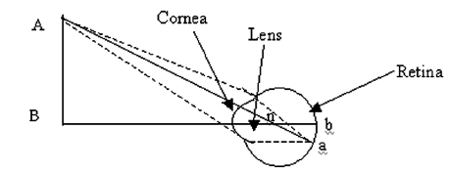
Module 2
Visual Perception
The wavelength of visible light ranges from approximately 390 nm to 720 nm. In the human eye, light is actually
refracted at the anterior surface of the cornea and at the anterior and posterior surface of the lens.

Slide 11
Module 2
Visual Perception
Rapidity, compactness and robustness.
Active perception is the study of perception strategies including sensor and signal processing cooperation, to achieve knowledge about the environment.
Both high level and low level image processing need to consider perceptual information in order to reduce uncertainty.

Slide 12
Module 2
Visual Recognition
The representation contains information about the shape and other properties such as color, dimensions and temporal information, including a label (name)
Type of representation, i.e. feature space, predicates, graph, etc.
• The number of representations per object, i.e. one 3D representation or multiple 2D representations from different viewing positions
• The number of classes for mapping into representations
• Inclusion of spatial relationships between objects and their component parts
• The amount and type of preprocessing given to the initial retinal image matching algorithm.

Slide 13
Module 2
Visual Recognition
Template based Matching
Retinal stimulation pattern projected by a shape is stored in LTM
(i) partial matches can give false results, for example comparing ‘O’ with ‘Q’;
(ii) any change in the distance, location or orientation of the input object in relation to the corresponding stored object will produce a different pattern;
(iii) any occlusion, shadow or other distortion of the input object may also produce inaccurate matching.
Template models are not useful at all if multiple objects are present in a scene, because the method is unable to determine which parts belong to which object.

Slide 14
Module 2
Visual Recognition
Feature-Based Model Matching
vertical and horizontal lines, curves and angles
Fourier Model
separates information about sharp edges and small details from other information pertaining to gross overall shape
Structural Model
structural description is stored in memory in the form of a data structure such as a list or tree or
graph of predicates.

Slide 15
Module 2
Machine Learning
A computer program is said to learn from experience E with respect to some class of tasks T and performance measure P, if its performance at tasks in T as measured by P improves with experience E
Task T: driving on public highways using vision sensors.
Performance measure P: average distance traveled before an error occurs as judged by a human observer.
Training experience E: a sequence of images and steering commands recorded while observing a human driver.
Choosing the training experience:
Type of training experience- Success and Failure
The training experience provides direct or indirect feedback regarding the choices made by the performance system
The degree to which the learner controls the sequence of training examples
How well it represents the distribution of examples over which the final system performance P must be measured

Slide 16
Module 2
Machine Learning
Choosing the target function:
To determine exactly what type of knowledge will be learned and how this will be used by the performance
program.
The process of learning the target function is often called the function approximation.
Choosing the representation of a target function:
A representation of the target function has to be described for the learning program to learn.
Accommodate a broad state of training data and function.
Choosing a function approximation algorithm:
In the case of robot navigation a set of sensory readings and robot movement forms a set of training patterns for learning.
The derivation of the training examples from the training experience available to the learner, the weights have to be adjusted to best fit these training examples.
That it involves searching every large space of possible hypotheses to determine one that
best fits the observed data and any prior knowledge held by the learner

Slide 17
Module 2
Machine Learning
Poorly understood domains where humans might not have required knowledge to develop effective algorithms, for example human face recognition from images;
• Domains where the program must dynamically adapt to changing conditions, for example controlling manufacturing process under changing supply stock;
• They are especially useful in data mining problems where large databases may contain valuable implicit regularities that can be discovered automatically.
Classification of Machine Learning:
Supervised learning, (ii) unsupervised learning and (iii) reinforcement learning.

Slide 18
Module 2
Machine Learning
Supervised learning:
Requires a trainer, who supplies the input–output training instances.
Un supervised learning
In the absence of trainers, the desired output for a given input instance is not known, and consequently the learner has to adapt its parameters autonomously
Reinforcement learning
learner does not explicitly know the input–output instances, but it receives some form of feedback from its environment. The feedback signals help the learner to decide whether its action on the environment is rewarding or punishable.

Slide 19
Module 2
Machine Learning
Soft Computing Tools and Robot Cognition
A collection of tools shared by artificial neural nets, fuzzy logic, genetic algorithms, belief calculus, and some aspects of inductive logic programming are known as soft computing tools.
Modeling Cognition Using ANN
The goal of cognitive modeling is the development of algorithms that require machines to perform cognitive tasks at which humans are presently better
cognitive system must be capable of
(i) sensing the external environment and storing it in the form of knowledge,
(ii) applying the knowledge stored to solve problems, and
(iii) Acquiring new knowledge through experience.
To perform this task the machine needs representation, reasoning and learning.

Slide 20
Module 2
Machine Learning
Machine learning may involve two different kinds of information processing
Inductive- generally patterns and rules are determined from raw data and experience
Deductive- general rules are used to determine specific facts
The development of knowledge bases is critical, and leveraging expert experience can be more effective than direct learning from data. This concept underlies the development of neural networks as cognitive models. Comparing neural networks with traditional cognitive models reveals differences in three aspects: level of explanation, style of processing, and representation of structure.

Slide 21
Module 2
Machine Learning
Level of Explanation:
Traditional machine intelligence focuses on symbolic representations and sequential processing of these representations.
Neural networks emphasize parallel distribution processing and neurobiological explanations of cognitive phenomena.
Style of Processing:
Traditional machine intelligence uses sequential processing, typical of computer programming.
Neural networks use parallel processing, providing flexibility and robustness, even with noisy or incomplete inputs.
Representation of Structure:
Traditional machine intelligence uses a language of thought for representation, which can be complex.
Neural networks emphasize connectionist models, integrating structure, adaptability, robustness, and uniformity in representation and inference.

Slide 22
Module 2
Machine Learning
Artificial Neural Networks (ANNs) adjust neuron weights during the adaptation cycle to reach equilibrium. They support both supervised and unsupervised learning.
Supervised learning with ANNs has applications in control, automation, robotics, and computer vision.
unsupervised learning is used in scheduling, knowledge acquisition, planning, and data conversion.

Slide 23
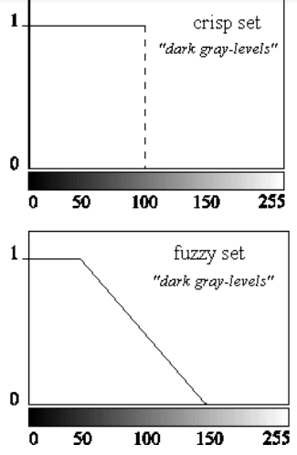
Module 2
Machine Learning- Fuzzy
Fuzzy logic deals with fuzzy sets and logical connectives for modeling the human-like reasoning problems of the real world.
It handles the concept of partial truth using a membership function
Instead of just black and white, the color belonging to a set has degree of whiteness & blackness

Slide 24
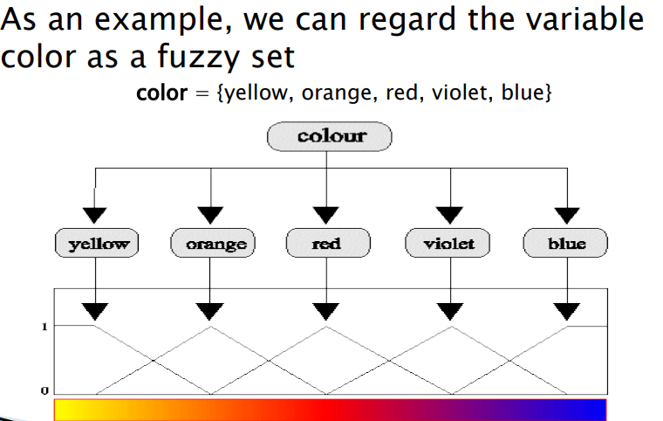

Slide 25
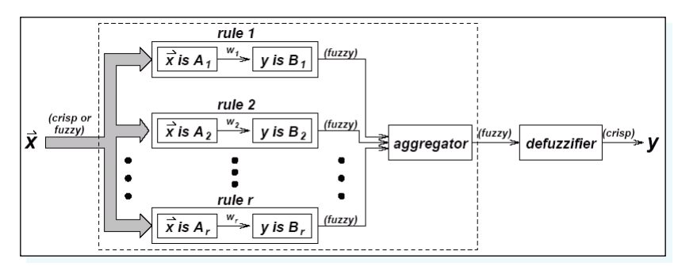
Module 2
Machine Learning- Fuzzy

Slide 26
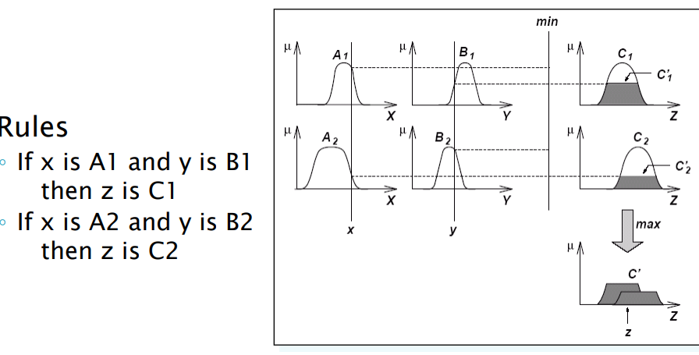
Module 2
Machine Learning- Fuzzy

Slide 27
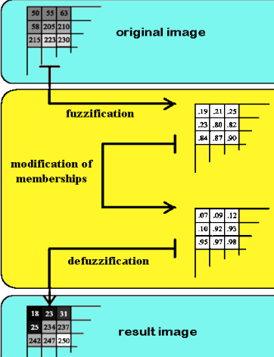
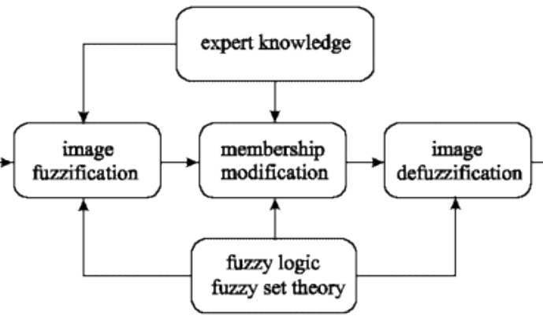
Module 2
Machine Learning- Fuzzy

Slide 28
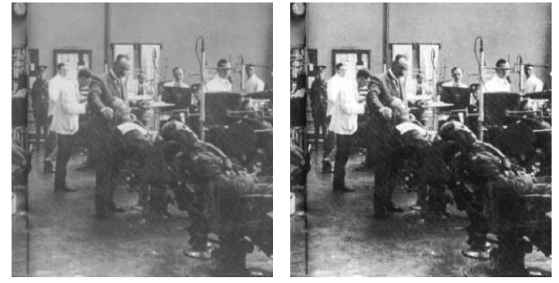
Module 2
Machine Learning- Fuzzy Image enhancement

Slide 29
Genetic Algorithms
(i) generation of a population (problem states represented by chromosomes)
(ii) selection of better candidate states from the generated population
(iii) genetic evolution through crossover followed by mutation.

Slide 30
Optimization Algorithms-PSO
Optimized Feature Integration and Minimized Search Space in Content Based Image Retrieval

Slide 31
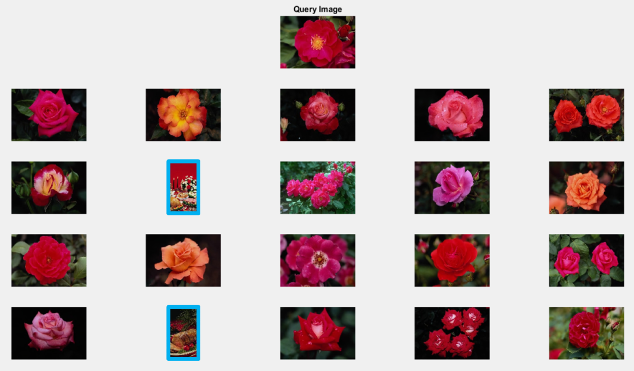
Optimization Algorithms-PSO

Slide 32
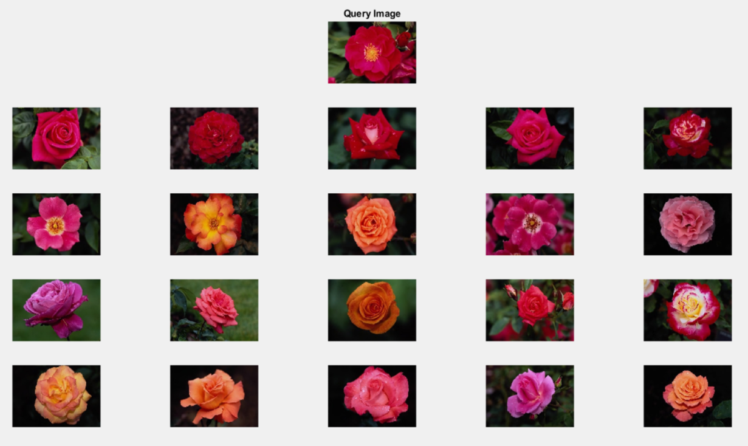
Optimization Algorithms-PSO

Slide 33

PSO details are given in the PSO PDF

