Slide 1
Digital Image
A representation of the original image by a discrete set of data points called pixels
Digital image processing is the study of representation and manipulation of pictorial information by a computer.
Important steps in a typical image processing system
Step 1: Image acquisition
Capturing visual data by an image sensor
Step 2: Digitalization; Quantization ; Compression
Convert data into discrete form; compress for efficient storage/transmission
Step 3: Image enhancement and restoration
Improving image quality (low contrast, blur noise)
Step 4: Image segmentation
Partition image into objects or constituent parts

Slide 2
Terminologies
Brightness is the perceived luminance
Contrast is determined by the difference in the color and brightness of the light reflected or emitted by an object
A hue refers to the gradation of color
Saturation refers to the intensity of a specific hue.
Dithering is the attempt by a computer program to approximate a color from a mixture of other colors when the required color is not available
Image resolution depends on two factors—optical resolution of the lens and spatial resolution. A useful way to define resolution is the smallest number of line pairs per unit distance.
Spatial resolution depends on two parameters—the number of pixels of the image and the number of bits necessary for adequate intensity resolution, referred to as the bit depth.
Bit depth The number of bits necessary to encode the pixel value is called bit depth. Bit depth is a power of two.

Slide 3
Digitization = Sampling + Quantization
Sampling = Image representation by a 2D matrix
Quantization = each matrix element represented by one of the finite set of discrete values
We apply Sampling and Quantization to the analog signals/image to convert them into digital form by arranging pixels in rows and columns.
Image Sampling
Converting an analog signal into discrete values.
Recording an analog signal at regular intervals of time.
We get a finite number of samples of an analog signal.
The number of samples gives us the number of pixels.
More samples will result in higher image quality
Image quantization
Quantization digitizes the amplitude of the sampled signal.
Quantization is done by rounding off the amplitude of each sample and then assigning a different value according to its amplitude.
Each value will represent a different color tone.

Slide 4
Sampling & Quantization
Resolution (the degree of detail) of an image depends on sample number and gray level number.
i.e. the more these parameters are increased, the closer the digitized array approximates the original image.
But storage & processing requirements increase rapidly as a function of N, M, and b
Different versions (images) of the same object can be generated through:
  Varying N, M numbers
  Varying b (number of bits) b = N x M x k
  Varying both
Quality of images increases as N & b increase
Sometimes, for fixed N, the quality improved by decreasing k (increased contrast)
For images with large amounts of detail, few gray levels are needed

Slide 5

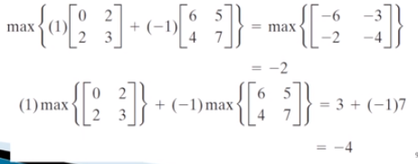
Linear Vs Non Linear operations
Consider the Maximum operations, to find the maximum value of the
pixels :
Max Operator
is
Not linear

Slide 6



Relationship between pixels
Consider the following image segment. Compute D4, D8 and Dm distances where V={0,1} and V = {1,2}
3 | 1 | 2 | 1
0 | 2 | 0 | 2
1 | 2 | 1 | 1
1 | 0 | 1 | 2
q(3,3)
Coordinates of p(x,y) = (0,0)
Coordinates of q(s,t) = (3,3)
D4= |x-s| + |y-t| = |0-3| + |0-3| = 3 + 3 = 6 units
D8 = max(|x-s|,|y-t|) = max(|0-3| , |0-3|) = max(3,3) = 3 units
p(0,0)
For V={0,1}
For calculating Dm
For V={1,2}
3 | 1 | 2 | 1
0 | 2 | 0 | 2
1 | 2 | 1 | 1
1 | 0 | 1 | 2
#Note: If you have option between 4 way and 8 way, always chose 4 way (i.e travel in straight line compared to diagonally)
3 | 1 | 2 | 1
0 | 2 | 0 | 2
1 | 2 | 1 | 1
1 | 0 | 1 | 2
Thus, Dm = 5 units
Thus, Dm = 6 units

Slide 7
Relationship between pixels
Consider the following image segment. Compute D4, D8 and Dm distances where V={0,1}
 | 0 | 1 | 2 | 3
0 | 0 | 1 | 1 | 1
1 | 1 | 0 | 0 | 1
2 | 1 | 1 | 1 | 1
3 | 1 | 1 | 1 | 1
Coordinates of p(x,y) = (3,0)
Coordinates of q(s,t) = (2,3)
D4= |x-s| + |y-t| = |3-2| + |0-3| = 1 + 3 = 4 units
D8 = max(|x-s|,|y-t|) = max(|3-2| + |0-3|) = max(1,3) = 3 units
q(2,3)
p(3,0)
 | 0 | 1 | 2 | 3
0 | 0 | 1 | 1 | 1
1 | 1 | 0 | 0 | 1
2 | 1 | 1 | 1 | 1
3 | 1 | 1 | 1 | 1
For V={0,1}
For calculating Dm
Thus, Dm = 4 units
#Note: If you have option between 4 way and 8 way, always chose 4 way (i.e travel in straight line compared to diagonally)

Slide 8
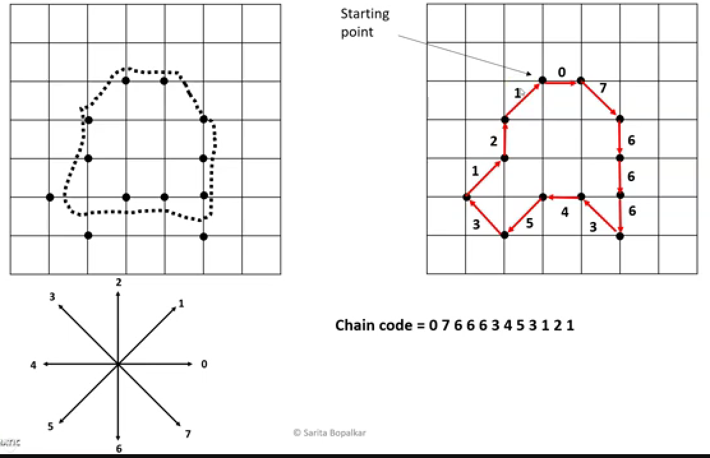
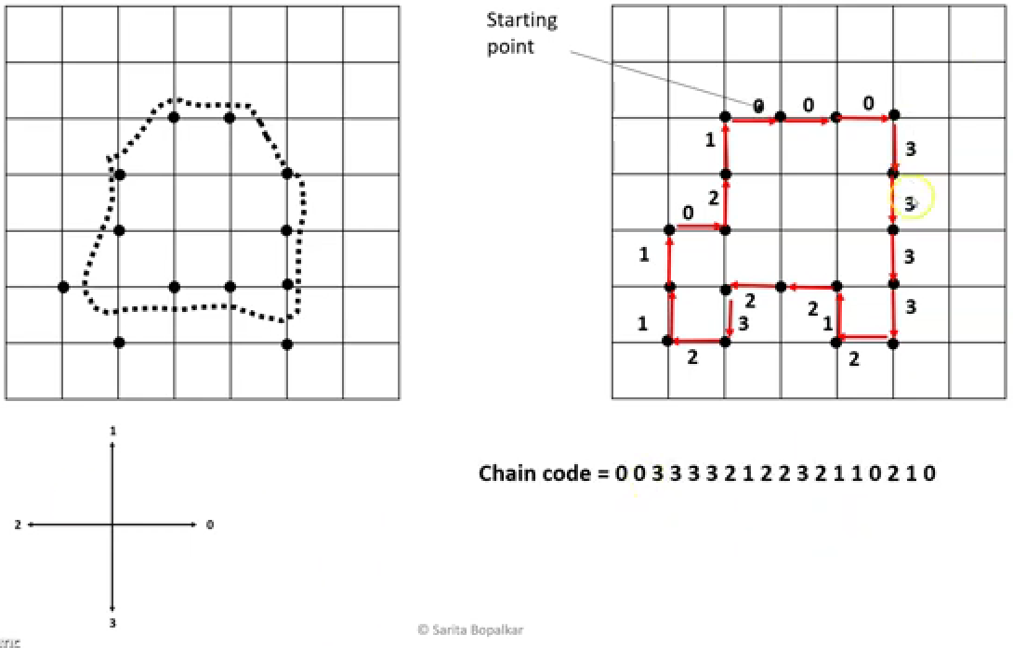

Adding extra point because we cant use diagonals

Slide 9
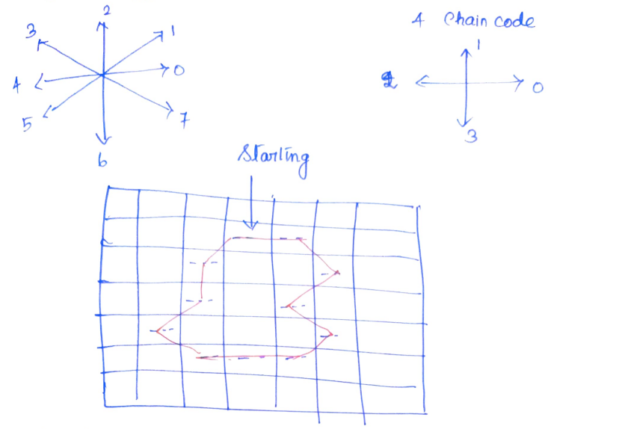
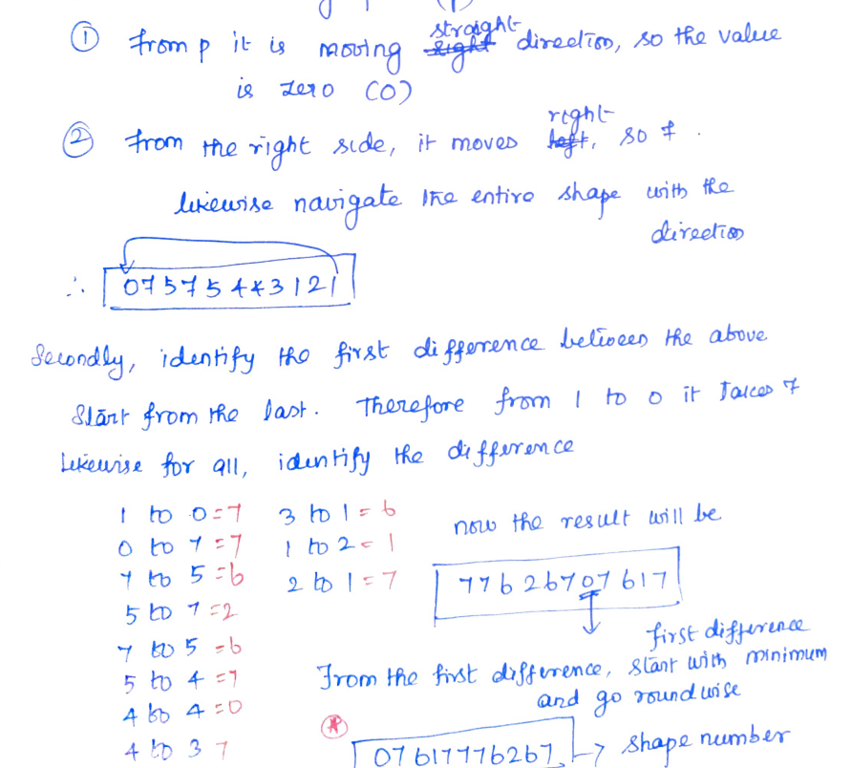
Chain Code and Shape Number

Slide 10
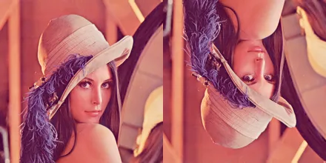
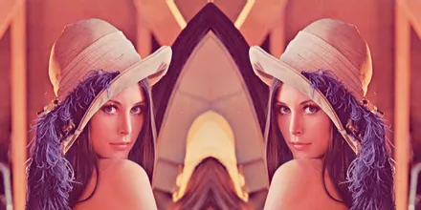
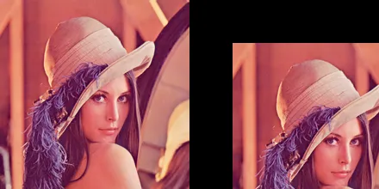
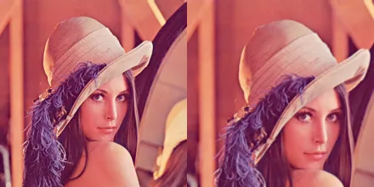
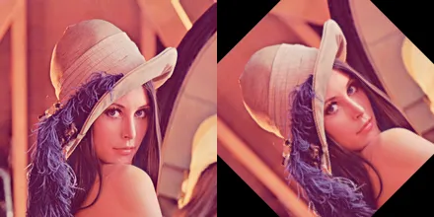
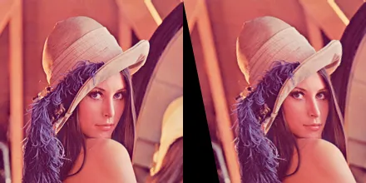
Geometric Transformations
Operation | Definition | Formula | Example
Horizontal Reflection | creating a mirror image along the horizontal axis. | f(x,y) = (h - x - 1, y)
Vertical Reflection | creating a mirror image along the vertical axis. | f(x,y) = (x, h - y - 1)
Translation | Shifting of an object within an image from one location to another. | x’ = x + ∆x y’ = y + ∆y
Scaling | involves resizing an image in the horizontal and/or vertical directions. | x’ = x * ∆x y’ = y * ∆y
Rotation | involves changing the orientation of an image by a specified angle around a given axis or point. | x’ = x cos (θ) – y sin (θ) y’ = x sin (θ) + y cos (θ)
Shearing | shearing involves shifting the pixel values of an image either horizontally or vertically | x’ = x + k.y , y’ = y x’ = x.y , y’ = y + k.y

