Slide 1
Artificial Neural Networks
Computational models inspired by the human brain:
  Algorithms that try to mimic the brain.
  Massively parallel, distributed system, made up of simple processing units (neurons)
  Synaptic connection strengths among neurons are used to store the acquired knowledge.
  Knowledge is acquired by the network from its environment through a learning process

Slide 2
History
late-1800's - Neural Networks appear as an analogy to biological systems
1960's and 70's – Simple neural networks appear
  Fall out of favor because the perceptron is not effective by itself, and there were no good algorithms for multilayer nets
1986 – Backpropagation algorithm appears
  Neural Networks have a resurgence in popularity
  More computationally expensive

Slide 3
Applications of ANNs
ANNs have been widely used in various domains for:
  Pattern recognition
  Function approximation
  Associative memory

Slide 4
Properties
Inputs are flexible
  any real values
  Highly correlated or independent
Target function may be discrete-valued, real-valued, or vectors of discrete or real values
  Outputs are real numbers between 0 and 1
Resistant to errors in the training data
Long training time
Fast evaluation
The function produced can be difficult for humans to interpret

Slide 5
When to consider neural networks
Input is high-dimensional discrete or raw-valued
Output is discrete or real-valued
Output is a vector of values
Possibly noisy data
Form of target function is unknown
Human readability of the result is not important
Examples:
Speech phoneme recognition
Image classification
Financial prediction

Slide 6
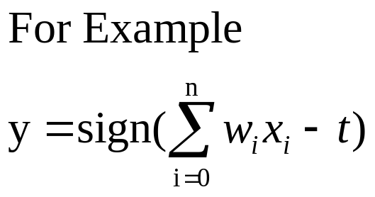
A Neuron (= a perceptron)
-
t
x₀
w₀
x₁
w₁
∑
f
output y
x_{n}
w_{n}
Input
vector x
weight
vector w
weighted
sum
Activation
function
The n-dimensional input vector x is mapped into variable y by means of the scalar product and a nonlinear function mapping

Slide 7
Perceptron
Basic unit in a neural network
Linear separator
Parts
  N inputs, x₁ ... x_{n}
  Weights for each input, w₁ ... w_{n}
  A bias input x₀ (constant) and associated weight w₀
  Weighted sum of inputs, y = w₀x₀ + w₁x₁ + ... + w_{n}x_{n}
  A threshold function or activation function,
    i.e 1 if y > t, -1 if y <= t

Slide 8
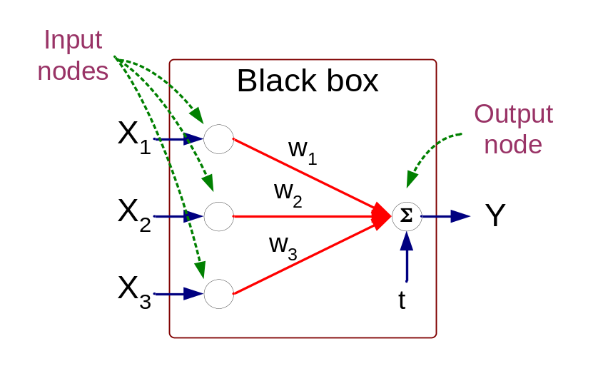
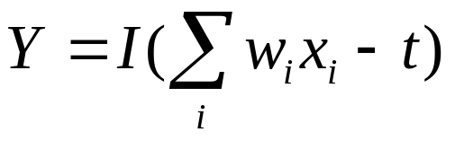
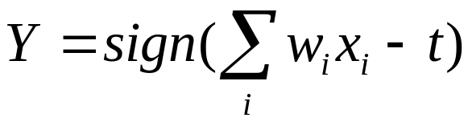
Artificial Neural Networks (ANN)
Model is an assembly of inter-connected nodes and weighted links
Output node sums up each of its input value according to the weights of its links
Compare output node against some threshold t
Perceptron Model
or

Slide 9
Types of connectivity
output units
Feedforward networks
  These compute a series of transformations
  Typically, the first layer is the input and the last layer is the output.
Recurrent networks
  These have directed cycles in their connection graph. They can have complicated dynamics.
  More biologically realistic.
hidden units
input units

Slide 10
Different Network Topologies
Single layer feed-forward networks
  Input layer projecting into the output layer
Single layer
network
Input Output
layer layer

Slide 11
Different Network Topologies
Multi-layer feed-forward networks
  One or more hidden layers. Input projects only from previous layers onto a layer.
2-layer or
1-hidden layer
fully connected
network
Input Hidden Output
layer layer layer

Slide 12
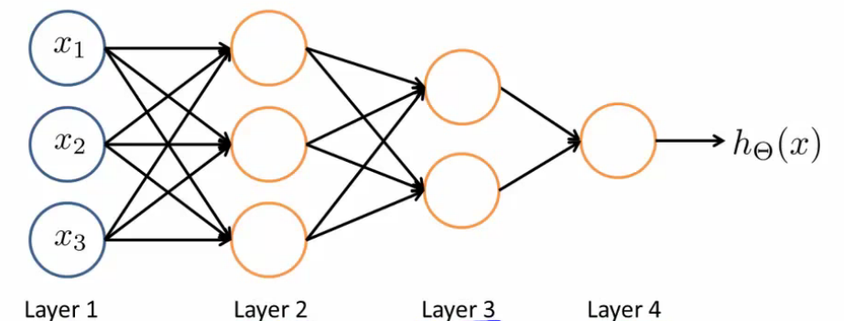
Different Network Topologies
Multi-layer feed-forward networks
Input Hidden Output
layer layers layer

Slide 13
Different Network Topologies
Recurrent networks
  A network with feedback, where some of its inputs are connected to some of its outputs (discrete time).
Recurrent
network
Input Output
layer layer

Slide 14
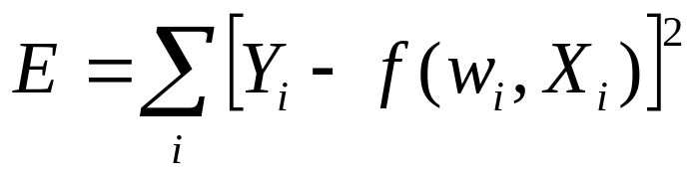
Algorithm for learning ANN
Initialize the weights (w₀, w₁, …, w_{k})
Adjust the weights in such a way that the output of ANN is consistent with class labels of training examples
  Error function:
  Find the weights w_{i}’s that minimize the above error function
    e.g., gradient descent, backpropagation algorithm

Slide 15
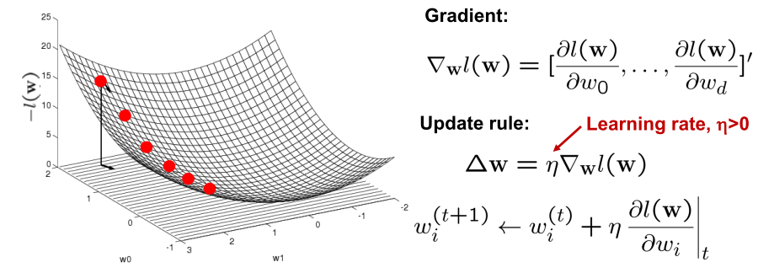
Optimizing concave/convex function
Maximum of a concave function = minimum of a convex function
Gradient ascent (concave) / Gradient descent (convex)
Gradient ascent rule

Slide 16
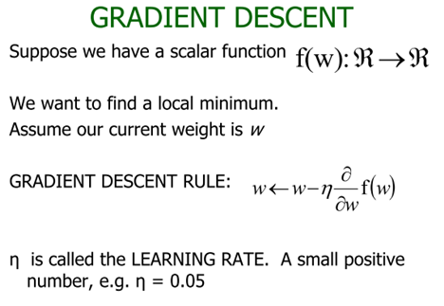


Slide 17
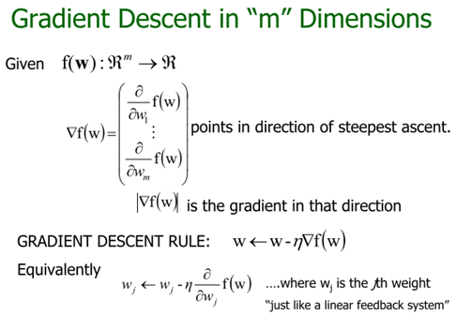

Slide 18
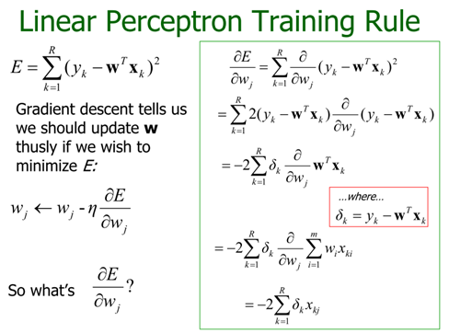

Slide 19
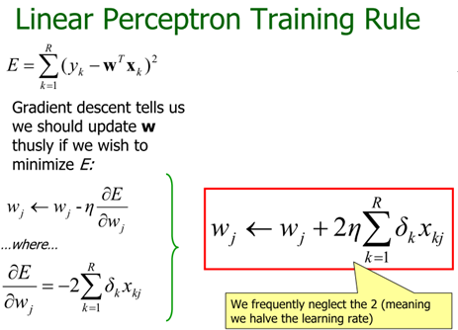

Slide 20
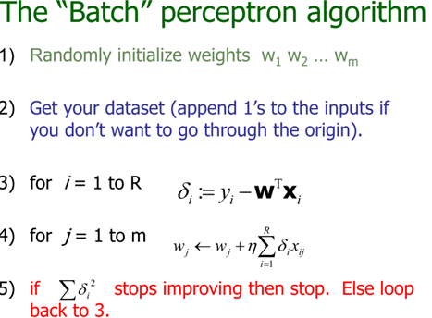

Slide 21
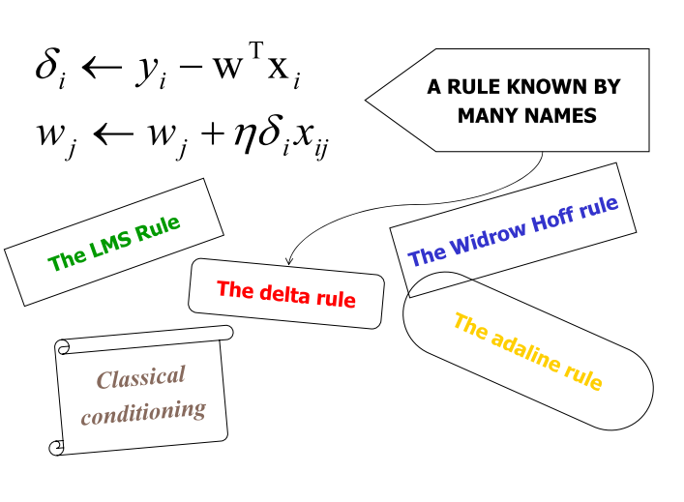

Slide 22
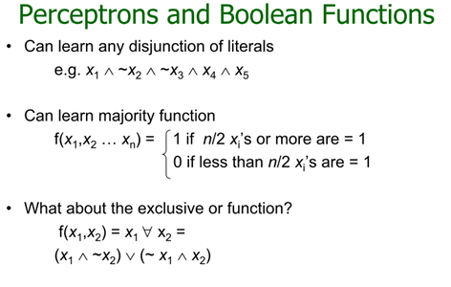

Slide 23
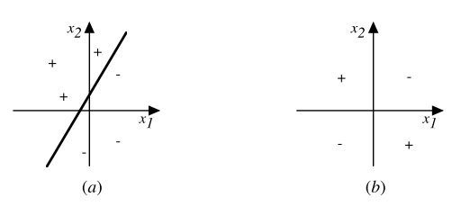
Decision surface of a perceptron
Decision surface is a hyperplane
  Can capture linearly separable classes
Non-linearly separable
  Use a network of them

Slide 24
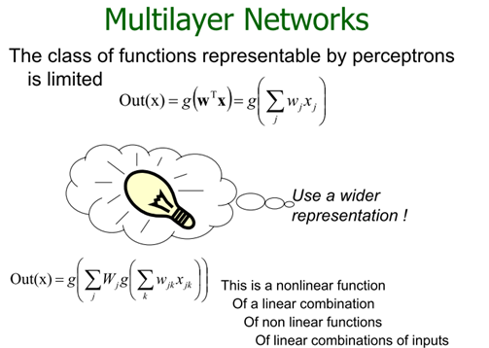

Slide 25
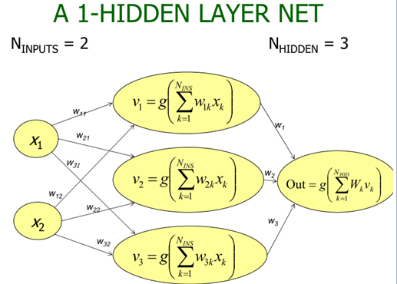

Slide 26
Multi-layer Networks
Linear units inappropriate
  No more expressive than a single layer
„ Introduce non-linearity
  Threshold not differentiable
„ Use sigmoid function

Slide 27
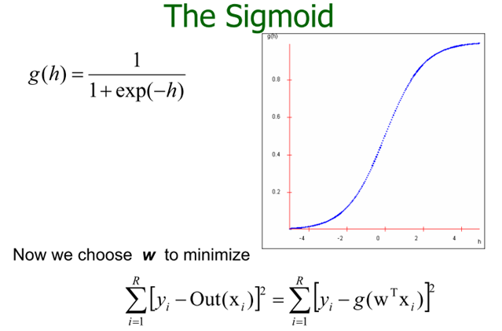

Slide 28
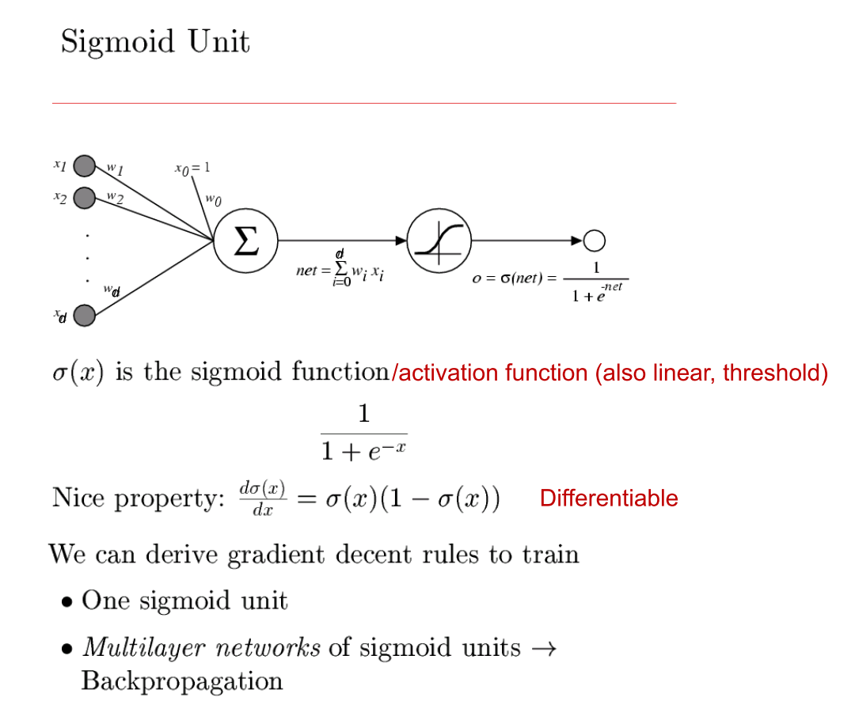

Slide 29
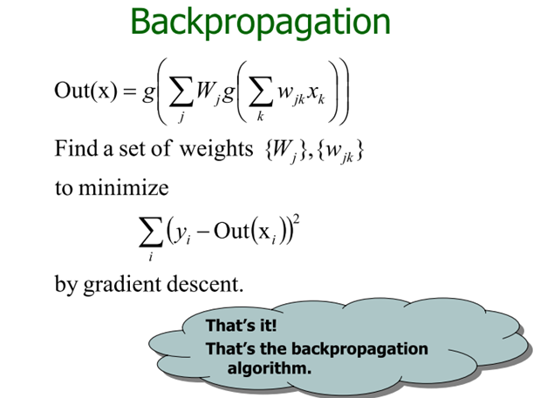

Slide 30
Backpropagation
Iteratively process a set of training tuples & compare the network's prediction with the actual known target value
For each training tuple, the weights are modified to minimize the mean squared error between the network's prediction and the actual target value
Modifications are made in the “backwards” direction: from the output layer, through each hidden layer down to the first hidden layer, hence “backpropagation”
Steps
  Initialize weights (to small random #s) and biases in the network
  Propagate the inputs forward (by applying activation function)
  Backpropagate the error (by updating weights and biases)
  Terminating condition (when error is very small, etc.)

Slide 31
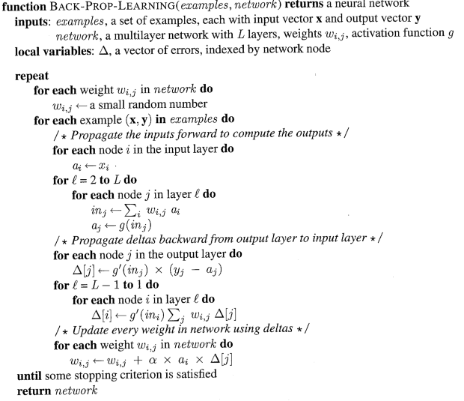

Slide 32
How A Multi-Layer Neural Network Works?
The inputs to the network correspond to the attributes measured for each training tuple
Inputs are fed simultaneously into the units making up the input layer
They are then weighted and fed simultaneously to a hidden layer
The number of hidden layers is arbitrary, although usually only one
The weighted outputs of the last hidden layer are input to units making up the output layer, which emits the network's prediction
The network is feed-forward in that none of the weights cycles back to an input unit or to an output unit of a previous layer
From a statistical point of view, networks perform nonlinear regression: Given enough hidden units and enough training samples, they can closely approximate any function

Slide 33
Defining a Network Topology
First decide the network topology: # of units in the input layer, # of hidden layers (if > 1), # of units in each hidden layer, and # of units in the output layer
Normalizing the input values for each attribute measured in the training tuples to [0.0—1.0]
One input unit per domain value, each initialized to 0
Output, if for classification and more than two classes, one output unit per class is used
Once a network has been trained and its accuracy is unacceptable, repeat the training process with a different network topology or a different set of initial weights

Slide 34
Backpropagation and Interpretability
Efficiency of backpropagation: Each epoch (one interation through the training set) takes O(|D| * w), with |D| tuples and w weights, but # of epochs can be exponential to n, the number of inputs, in the worst case
Rule extraction from networks: network pruning
  Simplify the network structure by removing weighted links that have the least effect on the trained network
  Then perform link, unit, or activation value clustering
  The set of input and activation values are studied to derive rules describing the relationship between the input and hidden unit layers
Sensitivity analysis: assess the impact that a given input variable has on a network output. The knowledge gained from this analysis can be represented in rules

Slide 35
Neural Network as a Classifier
Weakness
  Long training time
  Require a number of parameters typically best determined empirically, e.g., the network topology or “structure.”
  Poor interpretability: Difficult to interpret the symbolic meaning behind the learned weights and of “hidden units” in the network
Strength
  High tolerance to noisy data
  Ability to classify untrained patterns
  Well-suited for continuous-valued inputs and outputs
  Successful on a wide array of real-world data
  Algorithms are inherently parallel
  Techniques have recently been developed for the extraction of rules from trained neural networks

Slide 36
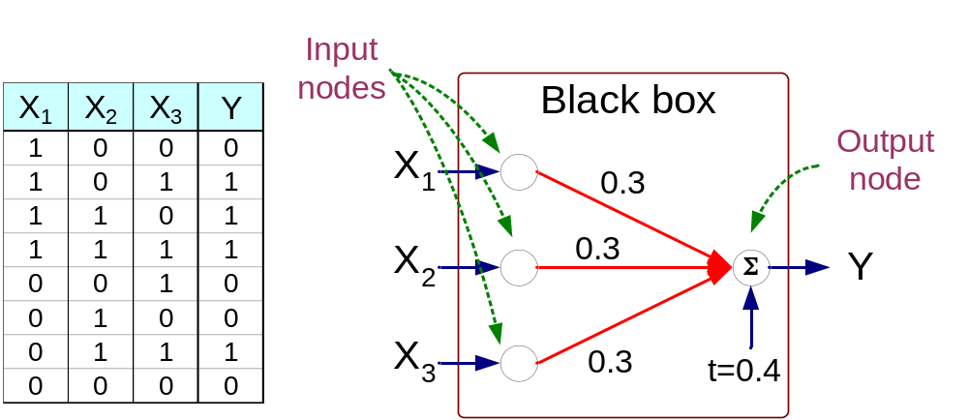
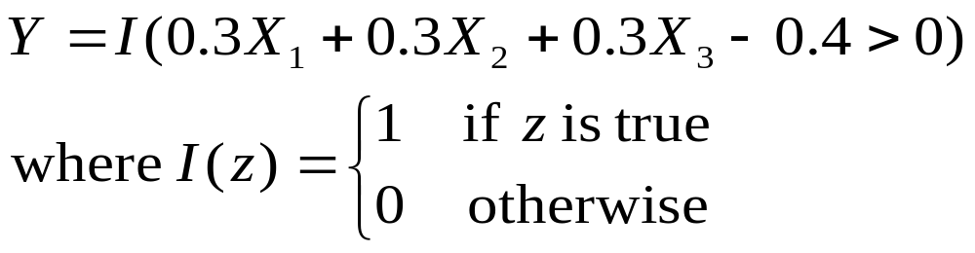
Artificial Neural Networks (ANN)

Slide 37
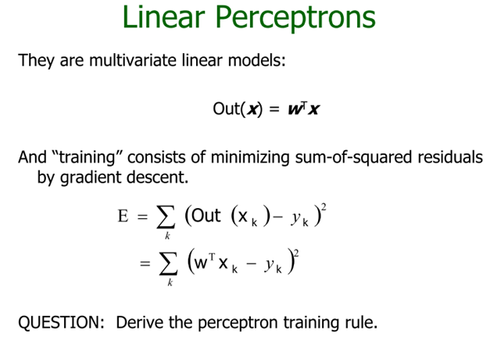
Learning Perceptrons

Slide 38
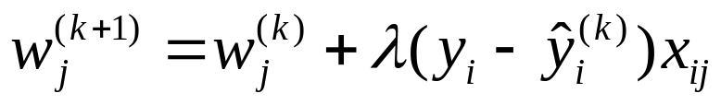
A Multi-Layer Feed-Forward Neural Network
Output vector
Output layer
Hidden layer
w_{ij}
Input layer
Input vector: X

Slide 39
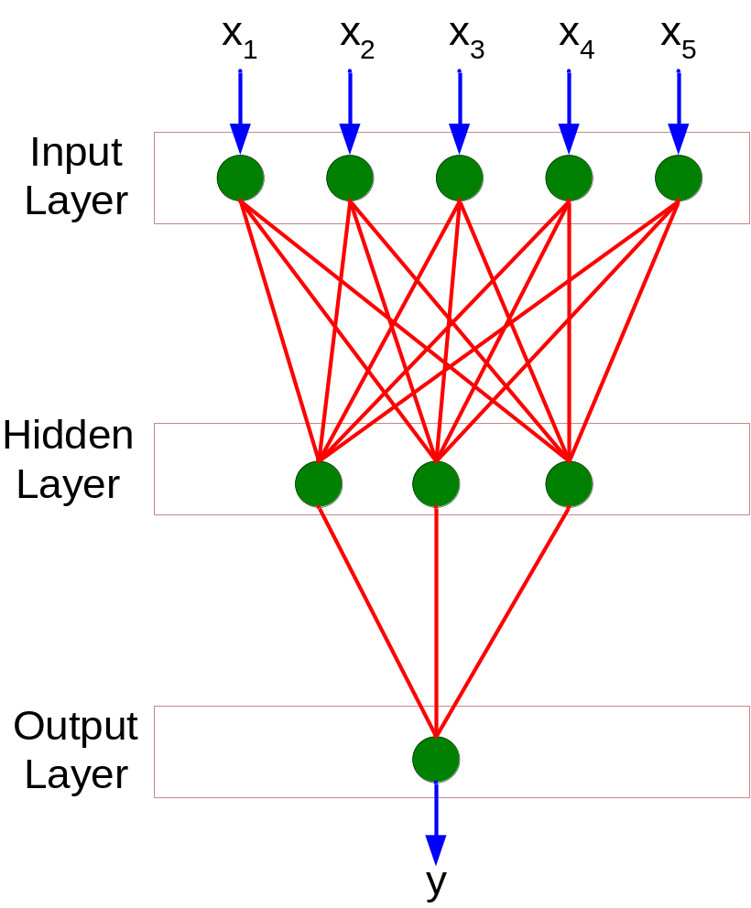
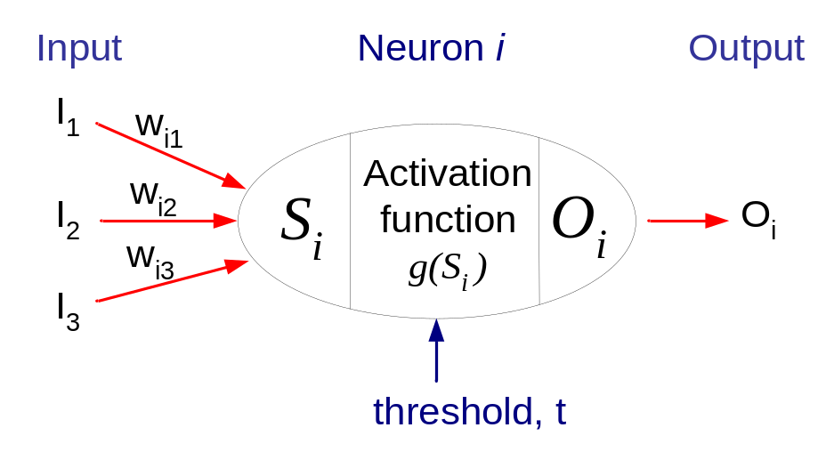
General Structure of ANN
Training ANN means learning the weights of the neurons

