Slide 1
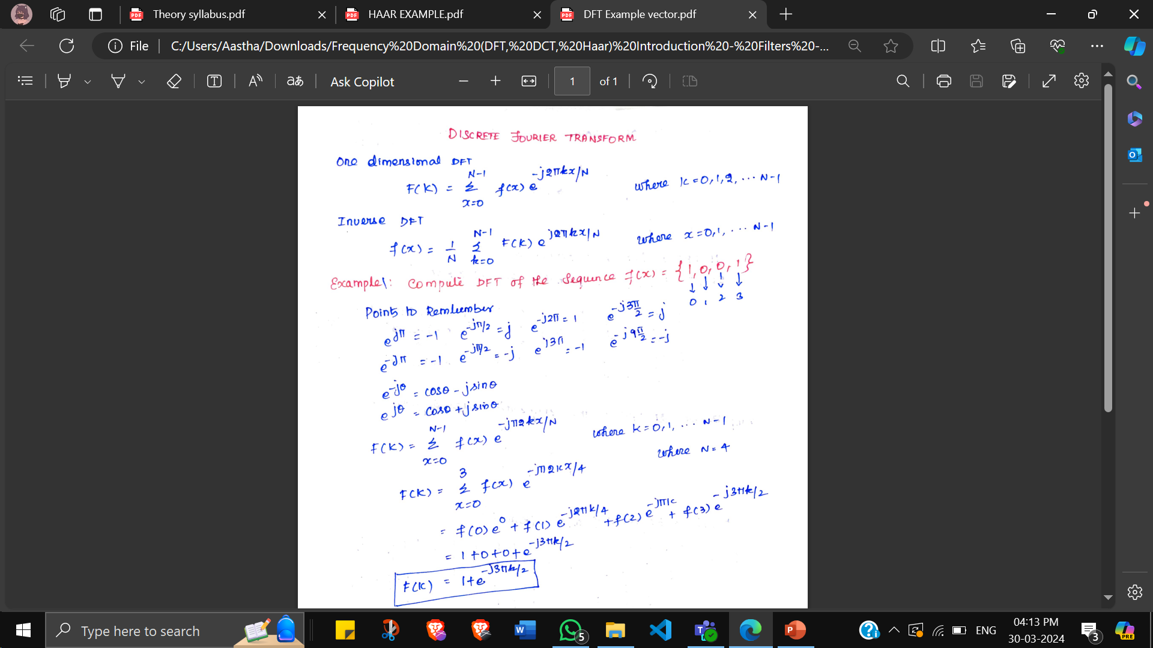
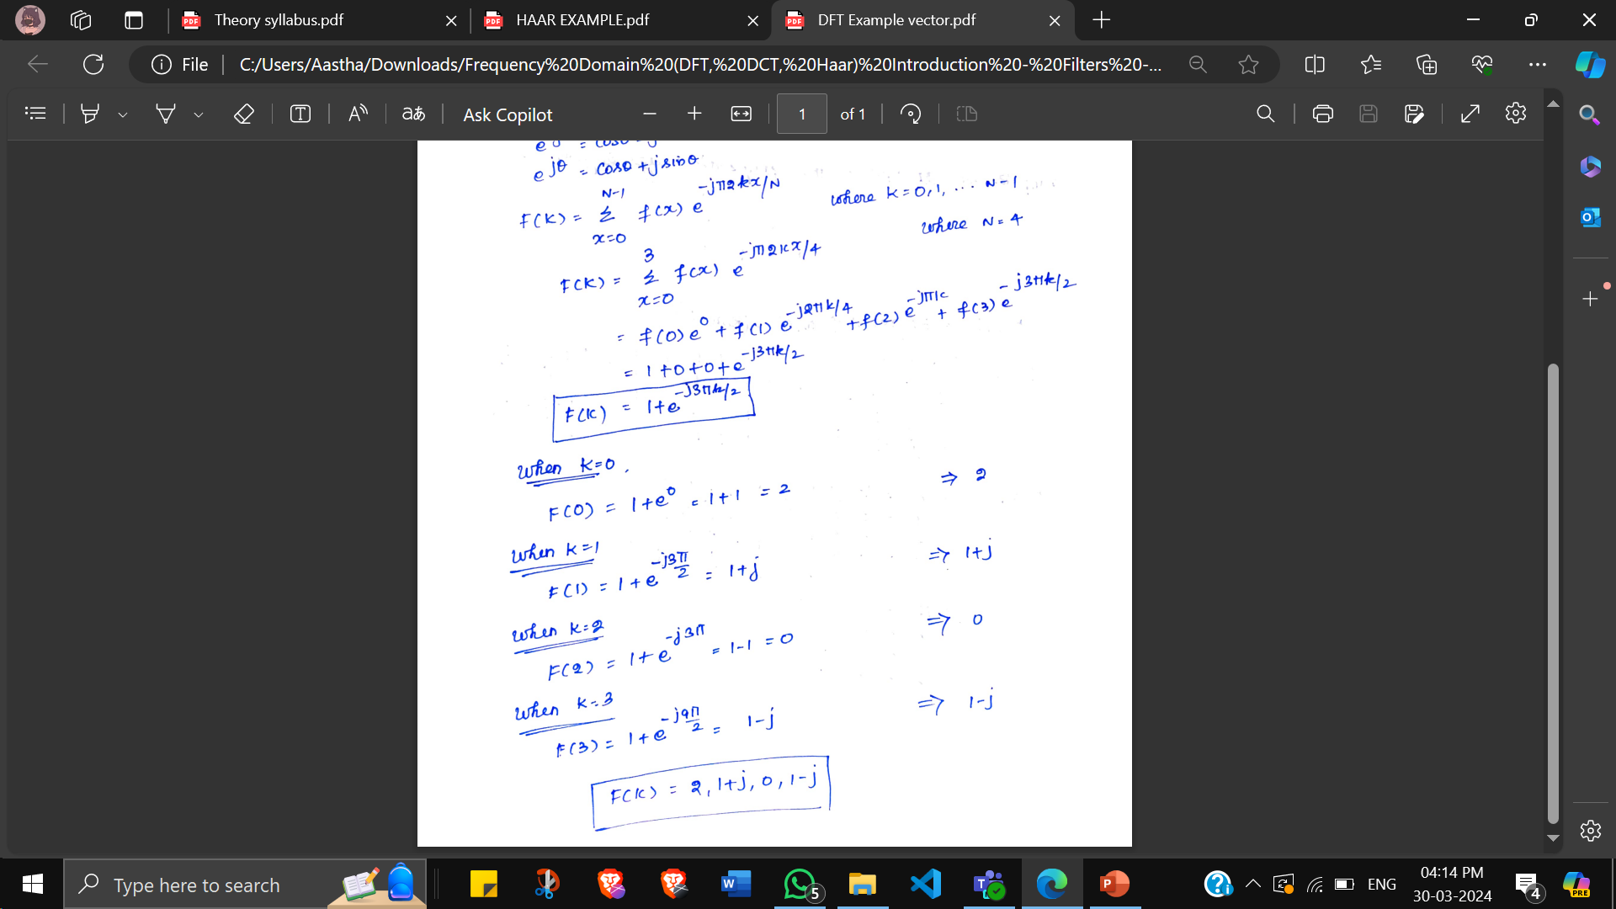
2D - The Discrete Fourier Transform (DFT) for Vectors
Spatial domain Freq. Domain
Freq. Domain Spatial domain

Slide 2
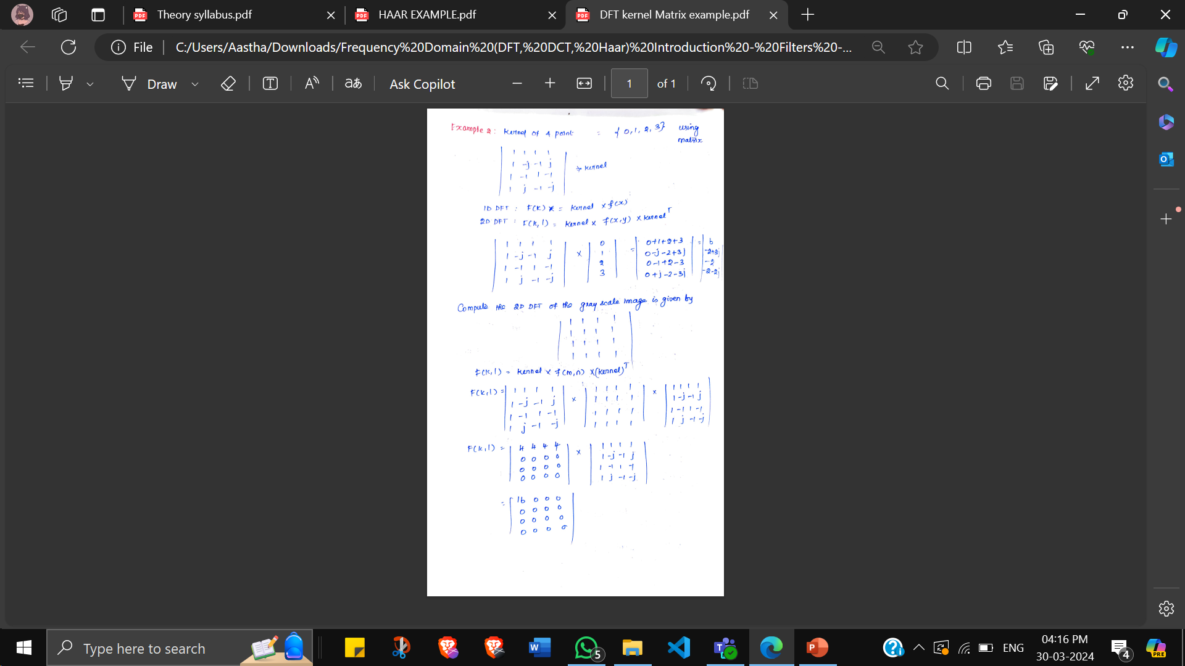
2D - The Discrete Fourier Transform (DFT) for Matrix

Slide 3
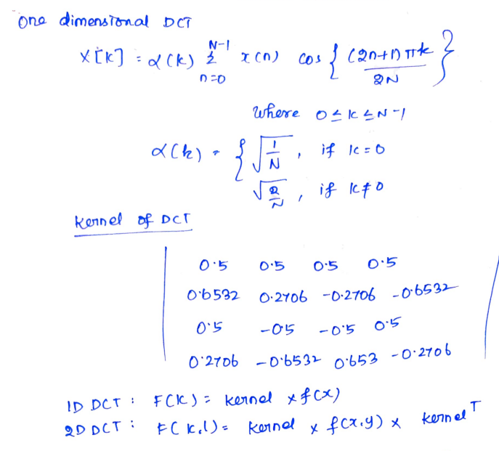
Discrete Cosine Transform (DCT)

Slide 4
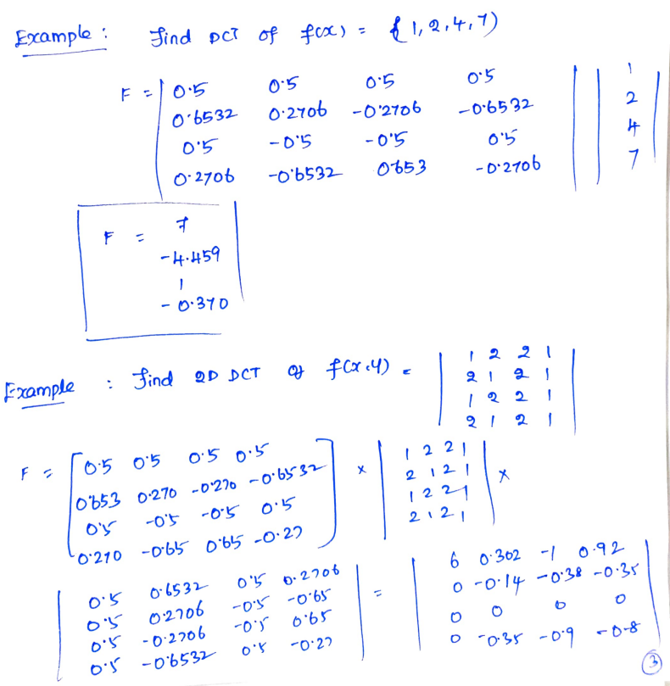

Slide 5
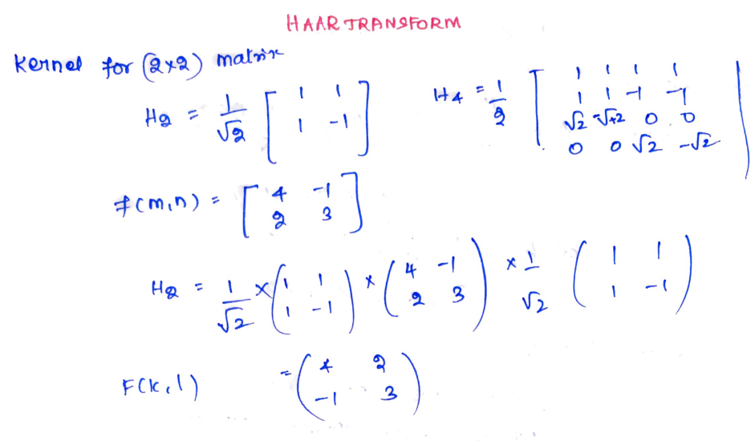
Wavelet Transform - Its is a waveform of effectively limited duration that has an average value a zero.

Slide 6
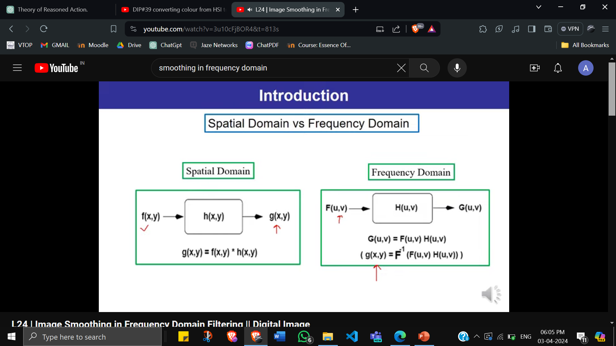
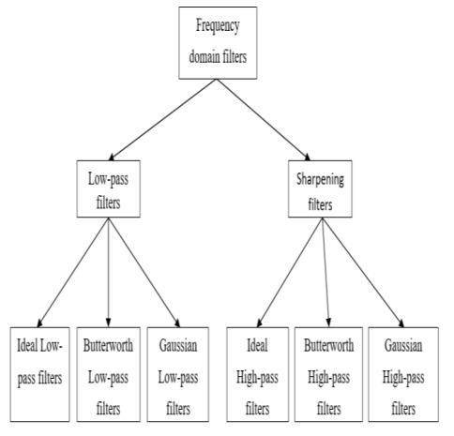
Smoothing Filters

Slide 7
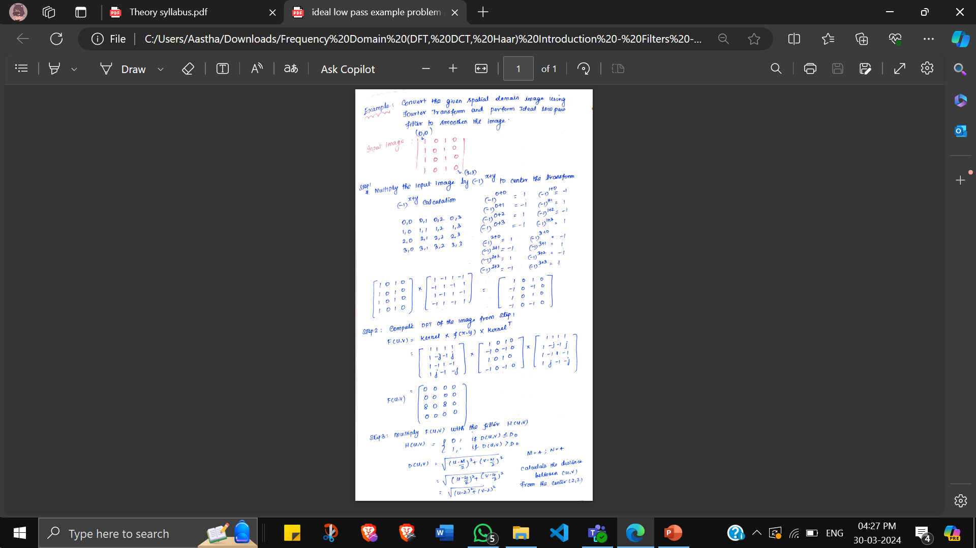
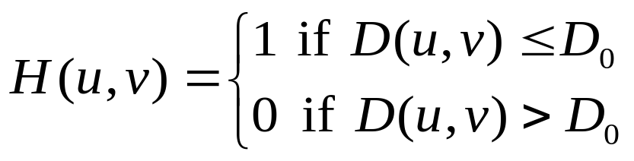
Ideal Low Pass Filter Numerical

Slide 8
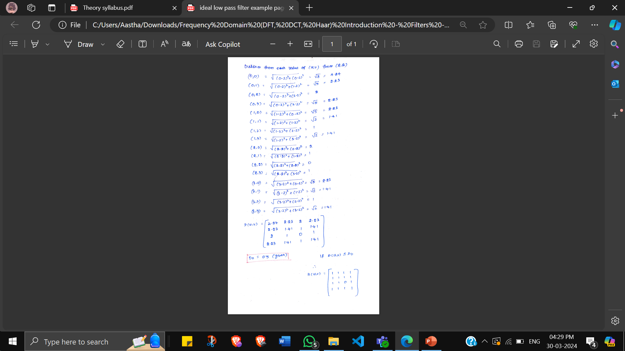

Slide 9
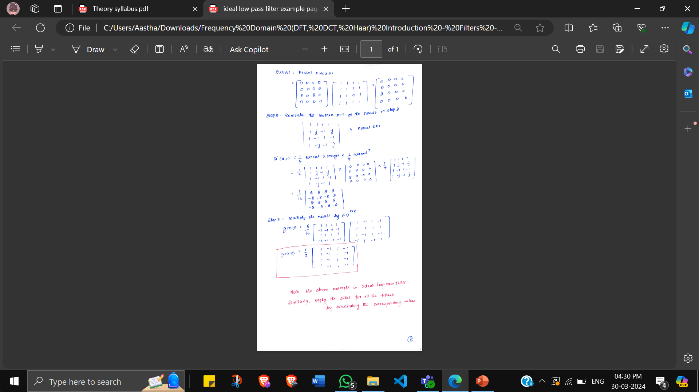

Slide 10
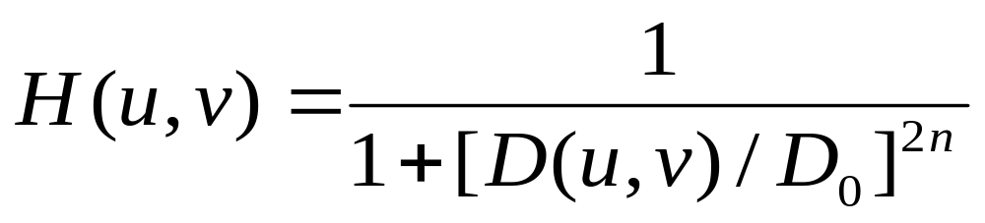
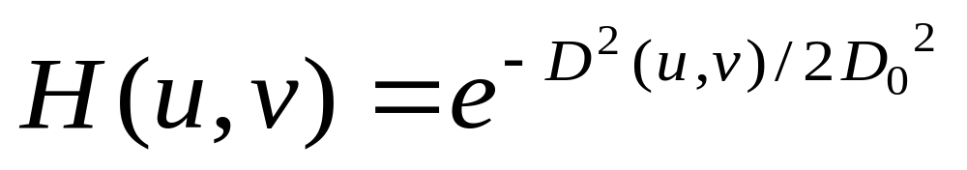
Butterworth Lowpass Filters
Useful in defining edges (both lowpass and high pass filters) and reduce ringing effect. If n increases, image becomes sharper but ringing increases.
Gaussian Lowpass Filters
Advantage – removes low freq. noise and ringing effect

Slide 11
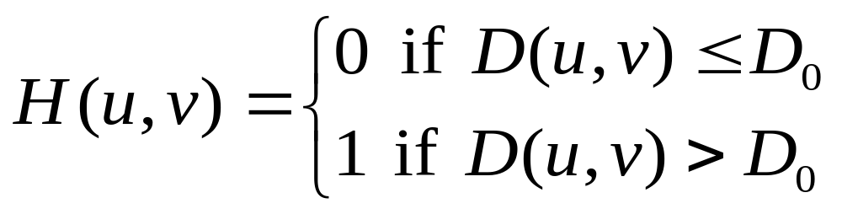
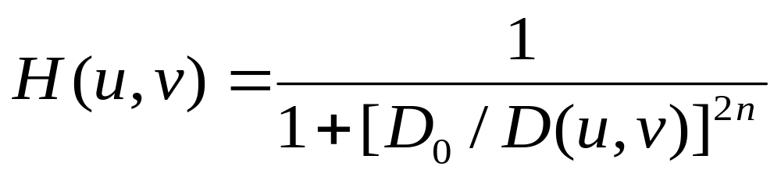
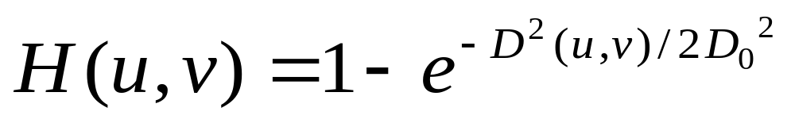
Ideal High Pass Filters
Disadvantage – blurred edges
Transition to higher frequencies is
Much smoother than Ideal HPS.
Results are much smoother and finer compared to IHPS and BHPS.
Butterworth High Pass Filters
Gaussian High Pass Filters

