Slide 1
Introduction to Monolithic Architecture and Microservices Architecture

Slide 2
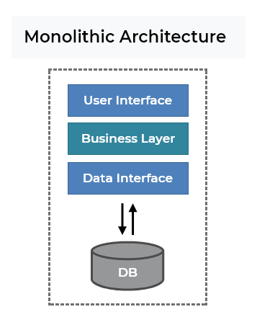
Monolithic and Microservices Architecture are two different approaches that can be used to create an application, and each approach has its pros and cons.
Monolithic Architecture
A Monolith is a software application that typically contains all the code in a single code base.
When working with .NET Core, for example, the whole application will be inside of a single solution file, and in a monolithic architecture, the application will connect into a single database.
This is a very common approach and generally almost all developers when started to code, work in this kind of architecture.
A monolith app is easier to implement and is much less complex than a microservices architecture. This is an example of a Monolithic Architecture:

Slide 3
Note that in this architecture you can also have many layers, but it will be everything inside the same solution and this application will connect to a single database.
Some advantages of a Monolithic Architecture are:
Simplicity — All the code is in a single solution. If you need to change something, all the code you need is in a single place. If you need to run the app locally, it’s only necessary to run a single application.
Easy to deploy — It’s easy to deploy because it’s only necessary to deploy a single project. Every time a new feature is added or a bug is fixed, it’s only necessary to deploy a single application.
Well known — Almost every developer already worked in a monolith application, so this makes it easier to find someone who can easily start to work on the project.
Easy to debug — It’s easy to debug a monolith because all the code is in a single solution. So when you need to debug, it’s only necessary to run the code and debug without doing extra configurations.
Easy to test — It’s easy to perform tests in a monolith application since everything is in a single app, so it’s not necessary to configure the communication between other applications, neither check if the other apps are running, and so on. You can also easily implement end-to-end testing by launching the app and testing the UI with some tool like Selenium.
Easy to monitoring — When a failure/bug occurs, it’s easier to identify where the problem happened, because the code is all in a single project.

Slide 4
Some disadvantages of a Monolithic Architecture
Can become too big and difficult to maintain — When the project starts, it’s easy to maintain, but through the years the application can become bigger, and this can be difficult to manage. A monolith application works really well for small or medium applications, but when the application is very big and complex, this can become a problem.
Can be difficult to work with big teams — Imagine a scenario where you have a monolith application, and there are many teams working in the same application. In this scenario, there are more space to some problem happens, because every team will be working in the same code, in the same project, this way increases the possibility of some conflicts happened when the code is merged in the repository, or also sometimes when one change is made by a team can affect something that the other team is working.
Scalability is not flexible — Monoliths can scale, but it’s only possible to scale the full application. If the application receives too many requests in only some specific part of the app, you can not scale only this part, it will be necessary to scale the whole application. Also, it’s not always possible to make use of horizontal scaling, it will be necessary to scale vertically and this is generally more expensive.
Restrict to the chosen technology — It’s difficult to switch the technologies in a monolith application, so generally, when a monolith is created, it will probably use the same technology for long years.

Slide 5
When should I use Monolithic Architecture?
A Monolithic architecture can be very handy in many scenarios as:
When you know that the application is not going to be so big
When you don’t know exactly how the application will be, for example, if the requirements are not well specified, or the domain is something new to you or to your team
When the team is small or is a new team and the domain is also something new

Slide 6
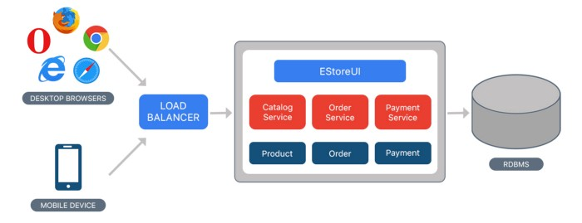
Example for Monolithic Approach
Consider an example of Ecommerce application, that authorizes customer, takes an order, check products inventory, authorize payment and ships ordered products.
This application consists of several components including e-Store User interface for customers (Store web view) along with some backend services to check products inventory, authorize and charge payments and shipping orders.

Slide 7
Benefits:
Simple to develop — At the beginning of a project it is much easier to go with Monolithic Architecture.
Simple to test. For example, you can implement end-to-end testing by simply launching the application and testing the UI with Selenium.
Simple to deploy. You have to copy the packaged application to a server.

Slide 8
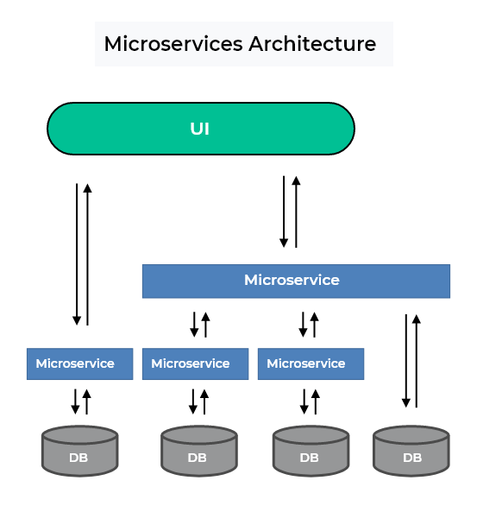
Microservice Architecture
In a microservice architecture, you split the application into small services, and these services are independent of each other (loosely coupled), they are technology agnostic(not sure) and each one has its own database.
This kind of architecture brings a lot of advantages, but also comes with many challenges and complexity. Working with microservices also demands more experience and seniority from the development team.
This is an example of a Microservices Architecture:
As shown in the image below, the UI connects with one or more microservices, and these microservices can communicate with each other by synchronous or asynchronous communication. Also each microservice has it’s own database.

Slide 9
Some advantages of a Microservice Architecture are:
Flexible scaling —Each microservice can be scaled independently of the other services. This way when a part of the application is receiving many requests, for example, it’s possible to scale only the specific microservice, instead of scale the whole application. Microservices are handy in cases where it’s necessary to have high availability of the application.
Deploy independently — Because microservices are loosely coupled (they are independent of each other), it’s possible to deploy only one microservice. This way it will not demands that the whole application stop working for a few moments because only a small part of the app will be updated/changed.
Eliminate the single point of failure — Splitting the application across many small services, eliminates the “single point of failure” in the app.
Reduces the risk of breaking the app — If a microservice breaks, it will not affect the rest of the application, it will only affect that single microservice, while the other parts of the app will continue working correctly.
Minimize downtime when a new version is released — When a new version of the microservice is released, the application will not stop working for a while, only the part which uses that specific microservices will be unavailable.

Slide 10
Can be easier updated — Since a microservice are not, in general, a big application, it’s easier to change something in the code or even update the framework which is used by the microservice.
Easier to work with multi teams — When working with many teams, each team can be responsible for a specific microservice, or for a group of microservices, separating the responsibility of each part of the project between the teams.
Easier to understand — A small application is in most of the time easier to understand than a bigger application.
Easier to expand — It’s easy to expand an application by creating new microservices.
Independently changeable — When something needs to be changed in a microservice, only the own microservice needs to change, and this will not affect the other microservices.
Can have different databases — It’s possible to choose a different database for each microservices. In one microservice a relational database can be the best option, and for other microservice, a NoSQL database fits better, and this is possible to achieve when working with microservice. Each team can define which database is the best option for the microservice.
Agility — With microservices it’s very easy to add something new and deploy a new version without having much impact on the whole app.

Slide 11
When should I use a Microservices Architecture?
A Microservices architecture can be handy in many scenarios as:
When you know that the application will grow a lot and will be really big
When you know about the domain of the software and the business rules, or the requirements are well specified and it’s possible to identify that will be a complex application
When the team is re-written an old application which is big and complex
When working with multiple teams and the domain is well known

Slide 12
Microservices Architecture
Consider the same example of the e-commerce application, which consists of several components/modules. Define each component/module as a separate loosely coupled service depending on the requirement, which may collaborate with each other based on the scenario. We can have following services for a complete application:

Slide 13
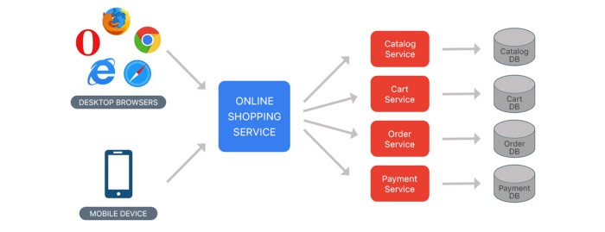

Slide 14
Authorization Service — Responsible for authorizing customer.
Order Service — takes an order and process it.
Catalog Service — Manage products and check products inventory.
Cart Service — Manage user cart, this service can utilize Catalog service as a data source.
Payment Service — Manage and Authorize payments.
Shipping Service — Ships ordered products.

Slide 15
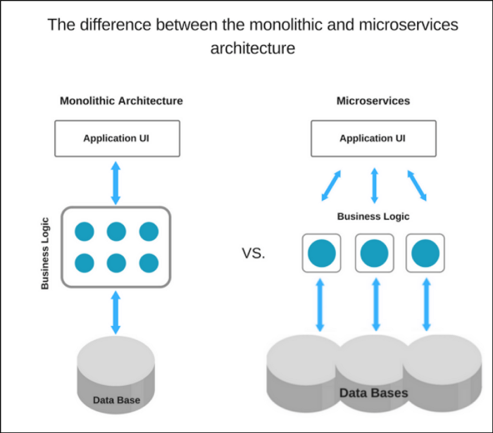

Slide 16


Slide 17
What is Monolithic Architecture?
The Monolithic Architecture is regarded as the conventional method of application development. An application in Monolithic architecture is developed as a single package. The development of a normal application starts with modular layered or hexagonal architecture. This architecture is made up of different types of layers as follows:
Presentation Layer: The Graphic User Interface layer handles the Hypertext Transfer Protocol (HTTP) requests using HTML or XML/JSON.
Business Logic Layer: The business logic of the application is present in this layer.
Database Access Layer: All the database accesses, including both SQL and NoSQL, of the applications, happens in this layer.
Application Integration Layer: All software integrations with other systems happen in this layer.
Even though Monolithic Architecture has a logical layered architecture, the final applications will be packaged into a single monolith and then deployed. Monolithic applications lack proper modularity, and it has only a single code base.

Slide 18
What is a Microservice Architecture?
On the other hand, Microservice architecture follows a modular approach to develop various applications.
A Microservice Architecture comprises a set of small, independent, and autonomous modules which does various services.
Every service should have the capability of independent implementation of its corresponding business units. Monolithic architecture is a single unit.
But the Microservice architecture has a group of small independent units, which collectively works as a single application.
The whole functionalities of an application are broken into separate and independent deployable modules that talk to each other by methods called Application Programming Interfaces (APIs).
Each of the services in a Microservices architecture can be independently scaled, deployed, and updated easily.
The Microservice architecture is loosely-coupled; each component is independent with respect to the other.
Multiple programming languages can be used for coding them. Also, they can use a different storage type for data storage.

Slide 19
Key Differences Between Microservice vs Monolithic
1. Commitment to Technology
Microservice:
The advantage of developing an application that follows Microservices architecture is that developers have a wide variety of options for various technologies like operating systems, frameworks, programming languages, etc., for building an application.
Continual commitment and dependency can be eliminated using a single stack of technology.
A better and a new stack of technology can be adopted whenever new services are built, or existing services are updated.
Dependencies of the development team on resources to build or to update services are eliminated.
Monolithic:
In Monolithic architecture, developers are forced to use only one technology, no matter whatever its limitations are.
For example, when your application’s framework is outdated, migration to a new, better framework will be very difficult and challenging.
In such situations, developers should rewrite the whole application in a different programming language and on a new framework, making it riskier and more time-consuming.

Slide 20
2. Isolation of Faults
Microservice: Even if there is an error in any of the processes, the rest of the processes will be unaffected and can be run as all the services are independent and isolated from each other.
Monolithic: On the contrary, in Monolithic architecture, any kind of misbehavior in any of the components may severely affect the working of the entire application.
3. Management of Code
Microservice:
On the other hand, Microservice has a divided codebase.(Codebase is the complete source code required to maintain application functionality)
Codebases in microservices are broken into multiple code units, which makes them easy to manage and update.
Monolithic:
Monolithic code base sizes are huge.
Due to the large size of monolithic codebases, it is very difficult for development teams for understanding and managing it properly.
This further leads to the slowing down of the development processes.

Slide 21
4. Developments and Deployments are Continuous
Microservice:
Development, deployment, operation, and scaling of every component of Microservices application are independent.
Any update in any services of the application will not affect any other services.
Also, there is no sharing of implementation or codebase between services.
This leads to the ease of continuous development and the deployment of complex and huge applications.
Monolithic:
Its codebases are large, and the components are interdependent.
This leads to the limitation of continuous deployment and development because a complete application must be redeployed to update any component.
It is risky and affects all the background tasks, and connected service functions are also impacted.

Slide 22
5. Scaling of Application
Microservice:
All the services of Microservices applications are built as different modules.
This leads to the team’s division to different work, which further helps them change and update production easily.
This makes the scaling of application easier.
Monolithic:
The scaling of monolithic architecture applications is a challenge to developers as it is a single package unit.
The developers can’t work on separate modules.
If it is possible, heavy coordination will be required during deployment and development.

Slide 23
Difference Between Microservices vs Monolithic
Microservice vs Monolithic is the comparison between two standard approaches or architecture for software design and development.
Microservice is a present trend in the software industry that utilized some of the latest technologies and programming languages for software development. Whereas monolithic is an industry-standard approach that is implemented for several years.
Microservice architecture based applications can be implemented with multiple programming languages as independent services.
Whereas the monolithic application is based upon a single programing language. Microservice is known for its change adaptability and scalability.
Whereas monolithic apps are less scalable and change requires rebuilding the whole application code and redeployment.

Slide 24
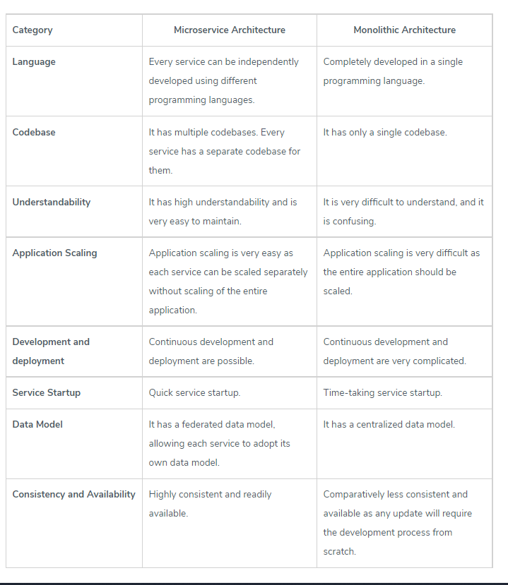
Microservice vs Monolithic Comparison Table

Slide 25
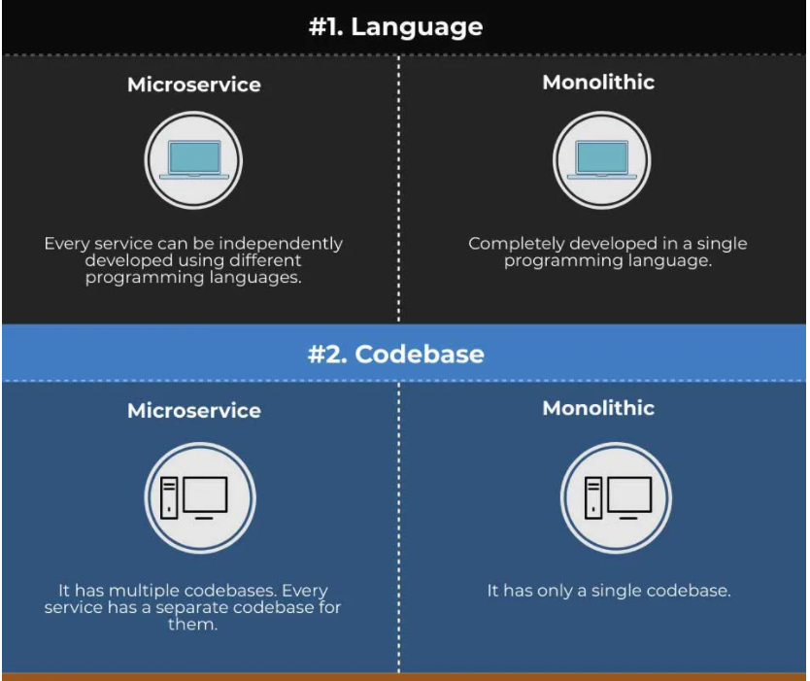

Slide 26
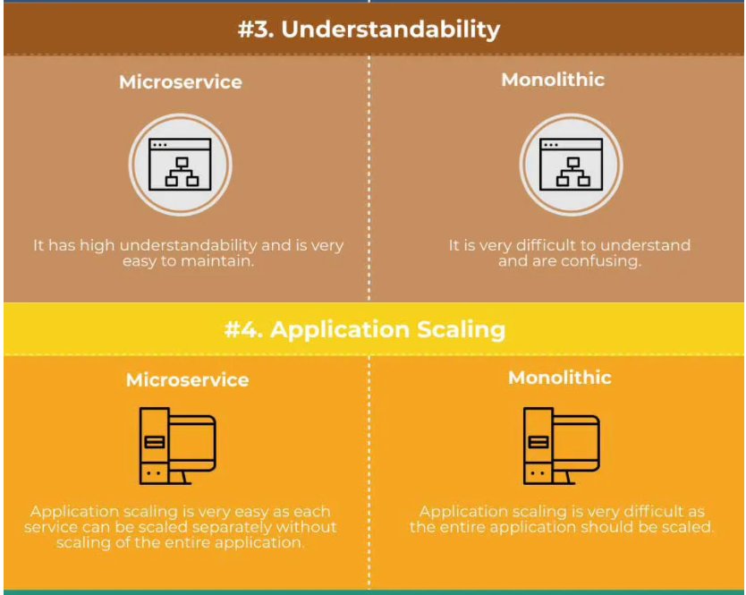

Slide 27
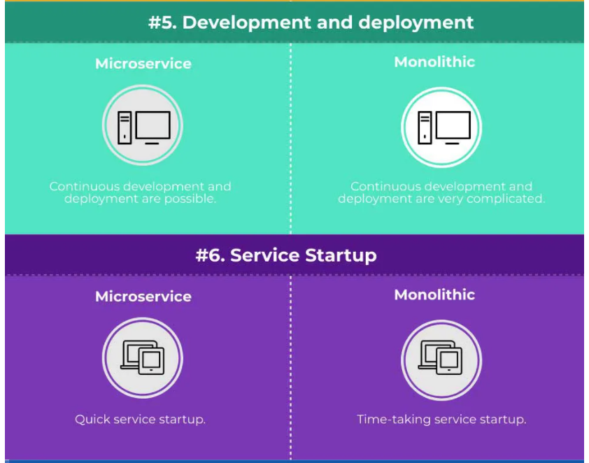

Slide 28
