Slide 1
Data tier

Slide 2
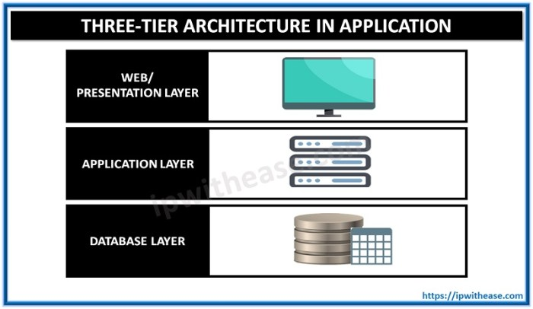

Slide 3
The Database Tier
The database tier is the base of a web database application.
Understanding system requirements, choosing database-tier software, designing databases, and building the tier are the first steps in successful web database application development.
In a three-tier architecture application, the database tier manages the data. The data management typically includes storage and retrieval of data, as well as managing updates, allowing simultaneous, or concurrent, access by more than one middle-tier process, providing security, ensuring the integrity of data, and providing support services such as data backup.
In many web database applications, these services are provided by a RDBMS system, and the data stored in a relational database .

Slide 4
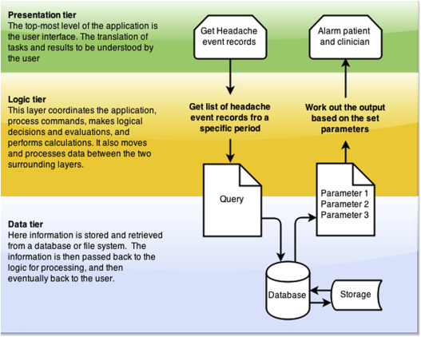

Slide 5
The data tier, sometimes called database tier,
data access tier or back-end, is where the information processed by the application is stored and managed. This can be a relational database management system such as PostgreSQL, MySQL, MariaDB, Oracle, DB2, Informix or Microsoft SQL Server, or in a NoSQL Database server such as Cassandra, CouchDB or MongoDB.
In a three-tier application, all communication goes through the application tier. The presentation tier and the data tier cannot communicate directly with one another.

