Slide 1
What is software architecture?
The software architecture of a system depicts the system’s organization or structure, and provides an explanation of how it behaves. A system represents the collection of components that accomplish a specific function or set of functions.
A series of architecture decisions and trade-offs impact quality, performance, maintainability, and overall success of the system. Failing to consider common problems and long-term consequences can put your system at risk.
There are multiple high-level architecture patterns and principles commonly used in modern systems. These are often referred to as architectural styles.
What is software design?
Software design is the process of conceptualizing the software requirements into software implementation. This is the initial phase within the software development life cycle (SDLC)—shifting the concentration from the problem to the solution.
When conceptualizing the software, the design process establishes a plan that takes the user requirements as challenges and works to identify optimum solutions. The plan should determine the best possible design for implementing the intended solution.
Software design includes all activities that aid in the transformation from requirement specification to implementation.

Slide 2
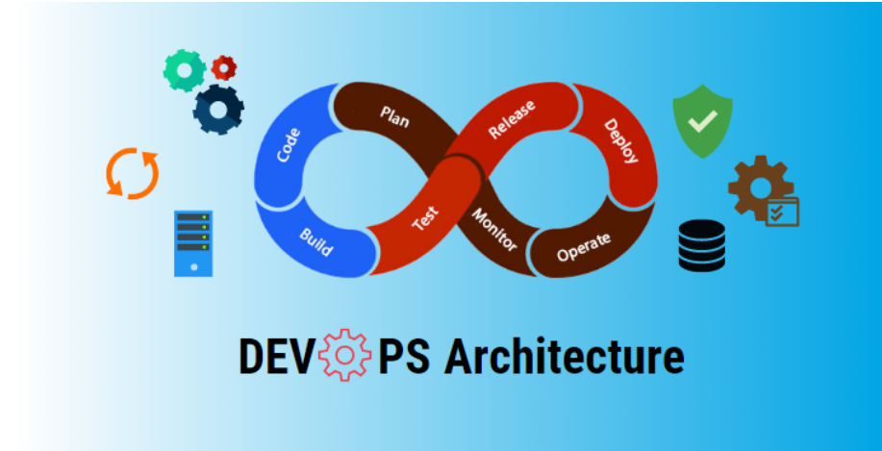

Slide 3
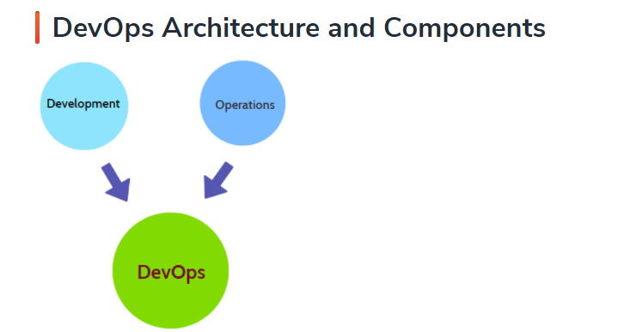
Introduction to DevOps Architecture
In Software Engineering, Development and Operations both play vital roles in order to deliver applications. The development comprises analyzing the requirements, designing, developing and testing of software components or frameworks.
The operation consists of administrative processes, services, and support for the software. When both Development and Operation are combined together to collaborate, DevOps architecture comes into the picture. Moreover, it can be gathered that DevOps architecture is the solution to mend the gap between Development and Operations teams so that the delivery can be faster with fewer issues.

Slide 4
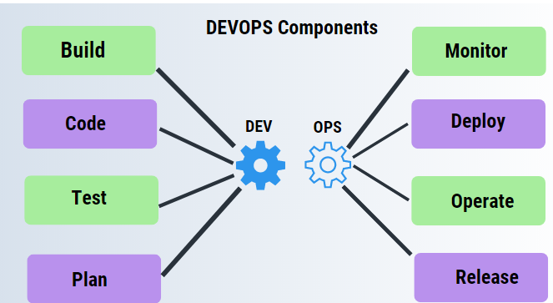
DevOps architecture is used for applications hosted on cloud platforms and large distributed applications. Agile Development is used here so that integration and delivery can be continuous.
When the Development and Operations team work separately from each other, it is time-consuming to design, test and deploy. Also if the teams are not in sync with each other, it may cause a delay in delivery. So DevOps enables the teams to amend their shortcomings and increase productivity.
Below are the various DevOps components

Slide 5
1.Build
Without DevOps, the cost of the consumption of resources was evaluated based on pre-defined individual usage with fixed hardware allocation. But with DevOps, the usage of cloud, sharing of resources comes into the picture and the build is dependent upon the user’s need which is a mechanism to control the usage of resources or capacity.
2. Code
Many good practices like widely used git enable the code to be used which ensures not only writing the code for business but also helps to track changes, getting notified about the reason behind the change and if necessary reverting to the original code developed. The code can be arranged properly in files and folders etc and they can be reused.
3. Test
The application will move to production after it is tested. In the case of Manual Testing, it consumes more time in testing and moving the code to production. The testing can be done by automation which decreases the time for testing so that the time to deploy the code to production can be reduced as automating the running of the scripts will remove many manual steps.
4. Plan
DevOps use agile methodology to plan the development. Unplanned work always reduces productivity. With the Development and Operations team in sync, it helps in organizing the work to plan accordingly so as to increase productivity.

Slide 6
5. Monitor
Continuous Monitoring is used to identify any risks of failure. It is also helpful in tracking the system accurately so that the health of the application also can be checked. The monitoring becomes easier with services where the log data may get monitored through many third-party tools.
6. Deploy
Most systems can support the scheduler for automated deployment. A cloud management platform enables users to capture accurate insights and view the optimization scenario, analytics on trends by the deployment of dashboards.
7. Operate
DevOps changes the way the traditional approach of developing and testing separately. The teams operate in a collaborative way where both the teams participate actively throughout the service lifecycle. The operations team interacts with developers and they come up with a monitoring plan which serves the IT and business requirements.
8. Release
Generally, deployment to an environment can be done by automation. But when the deployment is made to the production environment, it is done through manual triggering. Most of the processes involved in release management commonly specify to do the deployment in the production environment manually to lessen the impact on the customers.

Slide 7
Features of DevOps Architecture
1. Automation
Automation most effectively reduces the time consumption specifically during the testing and deployment phase. The productivity increases and releases are made quicker through automation with less issue as tests are executed more rigorously. This will lead to catching bugs sooner so that it can be fixed more easily. For continuous delivery, each code change is done through automated tests, through cloud-based services and builds. This promotes production using automated deploys.
2. Collaboration
The Development and Operations team collaborates together as DevOps team which improves the cultural model as the teams become more effective with their productivity which strengthens accountability and ownership. The teams share their responsibilities and work closely in sync which in turn makes the deployment to production faster.
3. Integration
Applications need to be integrated with other components in the environment. The integration phase is where the existing code is integrated with new functionality and then testing takes place. Continuous integration and testing enable continuous development. The frequency in the releases and micro-services lead to significant operational challenges. To overcome such challenges, continuous integration and delivery are implemented to deliver in a quicker, safer and reliable manner.
4. Configuration Management
This ensures that the application only interacts with the resources concerned with the environment in which it runs. The configuration files are created where the configuration external to the application is separated from the source code. The configuration file can be written while deployment or they can be loaded at the run time depending on the environment in which it is running.

Slide 8
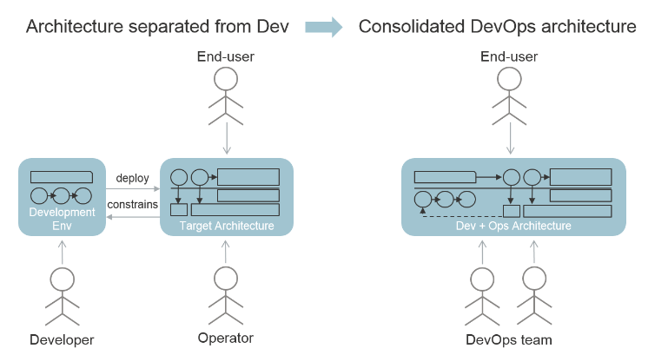
How DevOps impacts architecture

Slide 9
DevOps is an approach to IT that completely changes the traditional relationship between development, maintenance and operation of software.
The traditional separation between Dev and Ops brings with it a substantial amount of waste in terms of elapsed time and budget.
This waste is caused by differences in way of working, attitude and hand-over inefficiencies.
In DevOps, this waste is largely eliminated by making one team responsible for both Development and Operations of applications.
Supported by extensive automation (mostly by open source tooling) of testing and deployment, DevOps allows organizations like Facebook, Netflix and Google to deploy new releases into the Cloud on a daily basis. This is quite an improvement over the usual “once or twice a year” releases seen in traditional software products, and it gives organizations tremendous agility in reacting to market developments.

Slide 10
DevOps appears to be most successful in end-user facing (front-end) applications that run in public or private clouds and have a web-based user interface.
What is the architecture of DevOps?
In DevOps architecture, all necessary teams work simultaneously and cyclically providing a tracked feedback loop along the way. The DevOps project management approach is based on a foundation of achieving greater agility through communication and collaboration.
But how does DevOps impact the architecture of the software that is developed with it have found three ways in which DevOps influences architecture:
1.Architecting for deploy ability
Deploy ability is a non-functional requirement that addresses how reliably and easily software can be deployed from development into the production environment.
Architecting for deploy ability. Of all the quality attributes that a system may have, the one that is most directly related to DevOps is the ability to quickly deploy new releases into operation, with as much automation as possible.

Slide 11
How can you architect for deploy ability?
The more similar the environments, the simpler and more reliable it is to deploy the software.
Environmental differences can also affect the accuracy of testing: what worked in one environment may not work in a different one.
Unfortunately, it is not possible to eliminate all differences without eliminating all environments
Common unavoidable differences between environments include different servers, different hardware configurations, different databases, different URLs, and different security settings.

Slide 12
Development and Operations (DevOps) in the context of Continuous Deployment (CD) is an emerging software industry movement to bridge the gap between development and operations teams .
CD is defined as the ability to frequently and reliably put new releases into production, with as much automation as possible. It is argued that an architect should make a software system’s design as much simple and fine-grained as possible and try to remove those architectural elements that can be obstacle to deployment automation.
DevOps/CD practices necessitate an extensive use of infrastructure automation techniques, which can reduce the complexity of deployment and operations to a very large extent.
Adopting and supporting DevOps/CD involve a large number of challenges because organizational processes and tools may not be ready to support highly complex and challenging nature of DevOps/CD.

Slide 13
2.Architecting for systemic resilience
Resilience The ability of software or system to heal from unexpected events .
What is architecting resilience?
Architecting Resilience is IT-Systems that can avoid accidents and failures.
System resilience implies the capability to resist perturbances(Disturbance) and crises, to recover from emergencies and near-catastrophes(Sudden Damages), and the ability to adapt to a continually changing environment.
Architecting for systemic resilience. As the speed and scale of deployment increases, chances are that from time to time stuff (services, app, APIs) that your software depends on may not be available for a few minutes or hours.
Your software needs to be able to cope with this: the system as a whole needs to still be as available as possible.

Slide 14
Resilience is an outcome of a highly automated, well architected and well tested system, predicated on the following common characteristics: Adaptive — the ability to adapt to changing conditions. Self Healing — the ability to recover from failures autonomously.
Resilience is an outcome of a highly automated, well architected and well tested system, predicated on the following common characteristics:
Adaptive — the ability to adapt to changing conditions.
Self Healing — the ability to recover from failures autonomously.
Predictable — the ability to consistently define responses to failures. This is a prerequisite to support the automation necessary to be adaptive and self healing.
To achieve these characteristics, resilient systems require the following:
Investment — With respect to the labor and cost that is required to develop, test and deploy the resources and processes necessary for a resilient architecture. Infrastructure cost increases proportionally to the level of redundancy and data backup required.
Automation — This is essential for both development and software defined operations.
Monitoring — Monitoring in a continuous fashion is critical to enabling automated response and reliability.
Simplicity — In general, simpler architectures have less ways in which they can fail.

Slide 15
Consolidated development architecture. DevOps, it becomes almost impossible to see the development and operational environment as separate entities.
From an architectural point of view, the development and target environments form one system with three main categories of users: developers, operators and end-users.
One could even argue that that first two of those categories are the same in the DevOps philosophy. Many quality attributes affect all these user categories, and many architectural decisions have impact across the board as well. In DevOps, an architect (or “master builder”) does not design a target architecture after which an appropriate development toolset is selected:
the whole ensemble forms one consolidated solution, with one solution architecture that addresses the combined architectural concerns for development and operation.

Slide 16
The Software Architects are firmly rooted in development teams and Systems Architects have more interactions with operations, in a DevOps environment both roles will find themselves in discussions and design sessions with both development and operations disciplines.
In fact, they’re a lot more likely to find themselves working closer together than they would have before.
It’s in this sense that agile DevOps is such an effective way of working for dev and operations teams. We see it clearly in this example of Software and Systems Architects: it encourages collaboration thanks to a more fluid position for both roles, and more widely, for both teams.
Is DevOps a architecture?
In DevOps architecture, all necessary teams work simultaneously and cyclically providing a tracked feedback loop along the way. The DevOps project management approach is based on a foundation of achieving greater agility through communication and collaboration.

