Slide 1
The separation of concerns

Slide 2
The separation of concerns
The most important principle in Software Engineering is the Separation of Concerns (SoC):
The idea that a software system must be decomposed into parts that overlap in functionality as little as possible.
It is so central that it appears in many different forms in the evolution of all methodologies, programming languages and best practices.
Separation of concerns is a software architecture design pattern/principle for separating an application into distinct sections, so each section addresses a separate concern. At its essence, Separation of concerns is about order.
Separation of concerns is a design principle for separating a computer program into distinct sections, such that each section addresses a separate concern. For example the business logic of the application is a concern and the user interface is another concern.

Slide 3
The separation of concerns
In software engineering, Separation of Concerns refers to the delineation(explains) and correlation(connection) of software elements to achieve order within a system.
Through proper separation of concerns, complexity becomes manageable.
the principle of Separation of Concerns and to provide a set of foundational concepts to aid software engineers in the development of maintainable systems.
The Principle of Separation of Concerns
The Principle of Separation of Concerns states that system elements should have exclusivity and singularity of purpose.
That is to say, no element should share in the responsibilities of another or encompass unrelated responsibilities.
Separation of concerns is achieved by the establishment of boundaries.
Some examples of boundaries would include the use of methods, objects, components, and services to define core behavior within an application

Slide 4
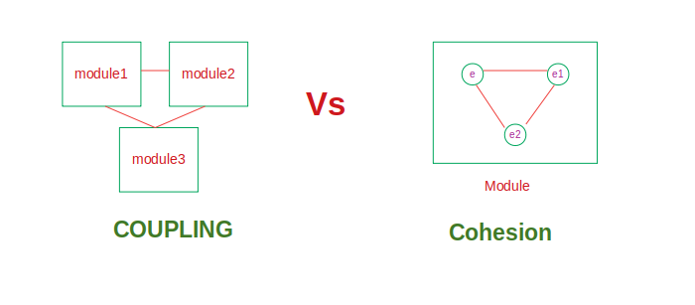
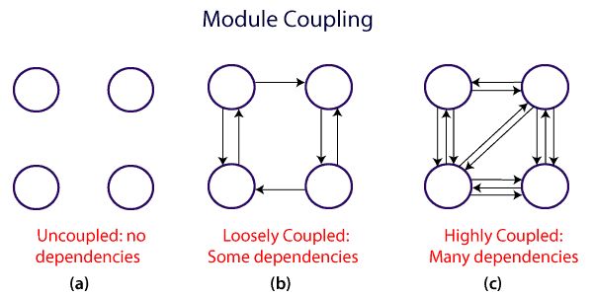
In the case of Object Oriented Programming (OOP), encapsulation and inheritance proved to be essential mechanisms to support new levels of modularity.
Finally, the separation of cross-cutting concerns is the most important motivation for the proponents of Aspect Oriented Programming (AOP).
Since the first software systems were implemented, it was understood that it was important for them to be modular. It is necessary to follow a methodology when decomposing a system into modules and this is generally done by focusing on the software quality metrics of coupling and cohesion,
Coupling: The degree of dependency between two modules. We always want low coupling.
Cohesion: The measure of how strongly-related is the set of functions performed by a module. We always want high cohesion.

Slide 5
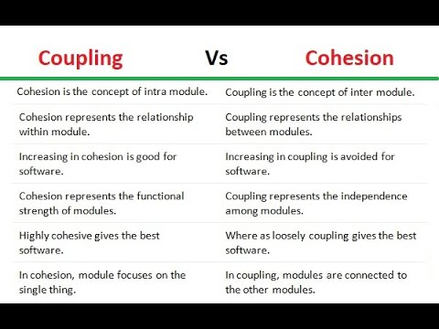
All methodologies try to reduce coupling and increase cohesion.

Slide 6
The Value of Separation of Concerns
Applying the principle of separation of concerns to software design can result in a number of outstanding benefits.
First, the lack of duplication and singularity of purpose of the individual components extract the overall system easier to maintain.
Second, the system as a whole becomes more stable as a byproduct of the increased maintainability.
Third, the strategies required to ensure each component only concerns itself with a single set of consistent responsibilities often result in natural extensibility points.
Forth, the decoupling which results from requiring components to focus on a single purpose leads to components which are more easily reused in other systems, or different contexts within the same system.
Fifth, the increase in maintainability and extensibility can have a major impact on the marketability and adoption rate of the system.

Slide 7
The principle of separation of concerns can also be of benefit when applied to business organizations.
The principle of separation of concerns can also improve problem resolution in enterprise wide systems.
When responsibilities are properly explained, problem identification becomes easier, resolution becomes faster, and personal accountability is increased.
Each of these areas in turn contributes to an improved quality control process.
Whether organizations of people or software systems are in view, applying the principle of separation of concerns can assistance in the management of complexity by eliminating unnecessary duplication and proper responsibility allocation.
In the next sections, various techniques will be discussed for achieving separation of concerns within application design.

Slide 8
Horizontal Separation
Vertical Separation
Aspect Separation
Dependency Direction
Horizontal Separation
Horizontal Separation of Concerns refers to the process of dividing an application into logical layers of functionally that fulfill the same role within the application.
One common division for graphical user interface applications is the separation of processes into the layers of Presentation, Business, and Resource Access. These categories encompass the main types of concerns for most application needs, and represent an organization of concerns which minimizes the level of dependencies within an application. Figure 1 depicts a typical three-layered application:

Slide 9
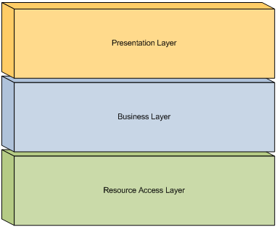

Slide 10
The Presentation Layer encompasses processes and components related to an application’s user interface.
This includes components which define the visual display of an application, and may include advanced design concepts such as controllers, presenters, or a presentation model. The primary goal of the Presentation Layer is to encapsulate all user interface concerns in order to allow the application domain to be varied independently.
The Presentation Layer should include all components and processes exclusively related to the visual display needs of an application, and should exclude all other components and processes. This allows other layers within the application to vary independently from its display concerns.
The Business Layer encompasses processes and components related to the application domain. This includes components which define the object model, govern business logic, and control the workflow of the system.
The business layer may be represented through specialized components which represent the workflow, business processes, and entities used within the application, or through a traditional object-oriented domain model which encapsulates both data and behavior.
The Resource Access Layer encompasses processes and components related to the access of external information. This includes components which interface with a local data store or remote service. The
goal of the Resource Access Layer is to provide a layer of abstraction around the details specific to data access.

Slide 11
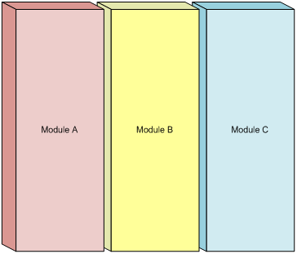
Vertical Separation
Vertical Separation of Concerns refers to the process of dividing an application into modules of functionality that relate to the same feature or sub-system within an application.
Vertical separation divides the features of an application holistically, associating any interface, business, and resource access concerns within a single boundary. Figure 3 depicts an application separated into three modules:

Slide 12
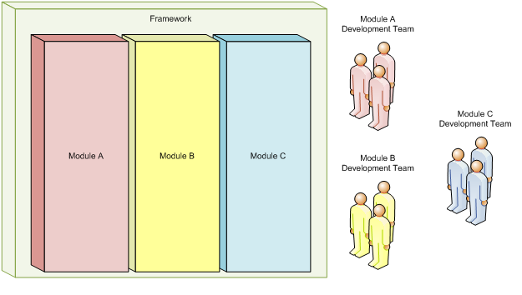
Separating the features of an application into modules clarifies the responsibly and dependencies of each feature which can aid in testing and overall maintenance. Boundaries may be defined logically to aid in organization, or physically to enable independent development and maintenance.
Logical boundaries imply the existence of modularity, though the methods used to denote separation may have no bearing on the actual deployment or runtime behavior of an application. This can be useful for improving the maintainability of an application as well easing any future efforts for physically separating features.
Physical boundaries are generally used in the context of developing add-ins or composite applications, and can enable features to be managed by disparate development teams. Applications supporting add-in modules often employ techniques such as auto-discovery, or initializing modules based on an external configuration source.

Slide 13
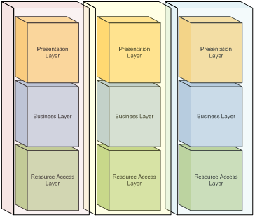
For example, each module may itself be designed using layers to describe the role of components within the module. Figure 6 depicts an application using both horizontal and vertical separation of concerns strategies:

Slide 14
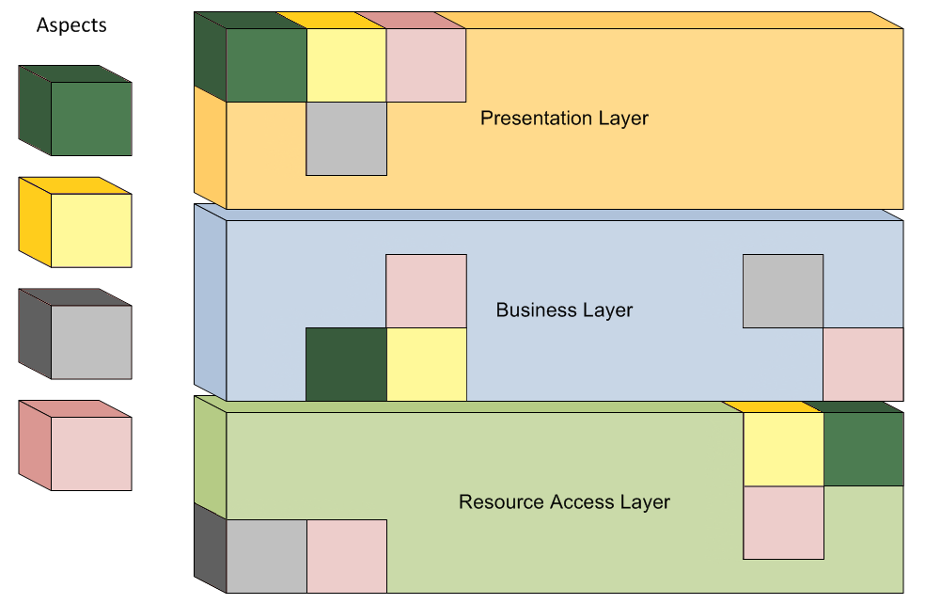
Aspect Separation
Aspect Separation of Concerns, better known as Aspect-Oriented Programming, refers to the process of segregating an application’s cross-cutting concerns from its core concerns.
Cross-cutting concerns, or aspects, are concerns which are interspersed across multiple boundaries within an application. Logging is one example of an activity performed across many system components.

Slide 15
Cross-cutting concerns can be difficult to maintain due to their widespread placement throughout an application. Their mixture with core concerns also adds complexity, rendering the application more difficult to maintain. By separating these concerns, both core concerns and cross-cutting concerns are made easier to manage.
Aspect separation differs from other separation techniques in that it relies on a pre-processing, compile time, or run-time fusion of cross-cutting concerns with the application.
Dependency Direction
concept of dependency direction is the common relationship between a business component and a utility component. Consider a system which provides an order inquiry process which requires that frequently requested data be cached for greater efficiency. To facilitate the caching of order inquiries, a caching utility component may be developed to separate the concerns of caching from the rest of the order inquiry process.
Because the function of caching is a more generic behavior than an order inquiry process, the caching component has the higher potential for reuse among the two. Therefore, the best dependency direction in this case would be from the business component to the utility component.

Slide 16
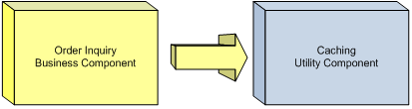

Slide 17
Data Concerns
principle of Separation of Concerns to data involves properly modeling information managed by a system. While the aspects of data modeling apply to both object-oriented and database design
For example, given a system which sells products to customers, an object which defines the product should not contain customer related information. This is because products are not inherently concerned with who may be purchasing the product. A better approach would be the creation of a conceptual order object which composes both customer and product information. This enables the product object to be reused by other processes in the future which may not be concerned with customer information.
When organizing behavior, the following goals should be sought:
* Eliminate the duplication of functionality. * Restrict the scope of work to a maintainable size. * Restrict the scope of work to the description of the containing boundary. * Restrict the scope of work to the inherent behavior of the containing boundary. * Minimize external dependencies. * Maximize the potential for reuse.

