Slide 1
INTRODUCTION TO DATA SCIENCE
UNIT-I

Slide 2
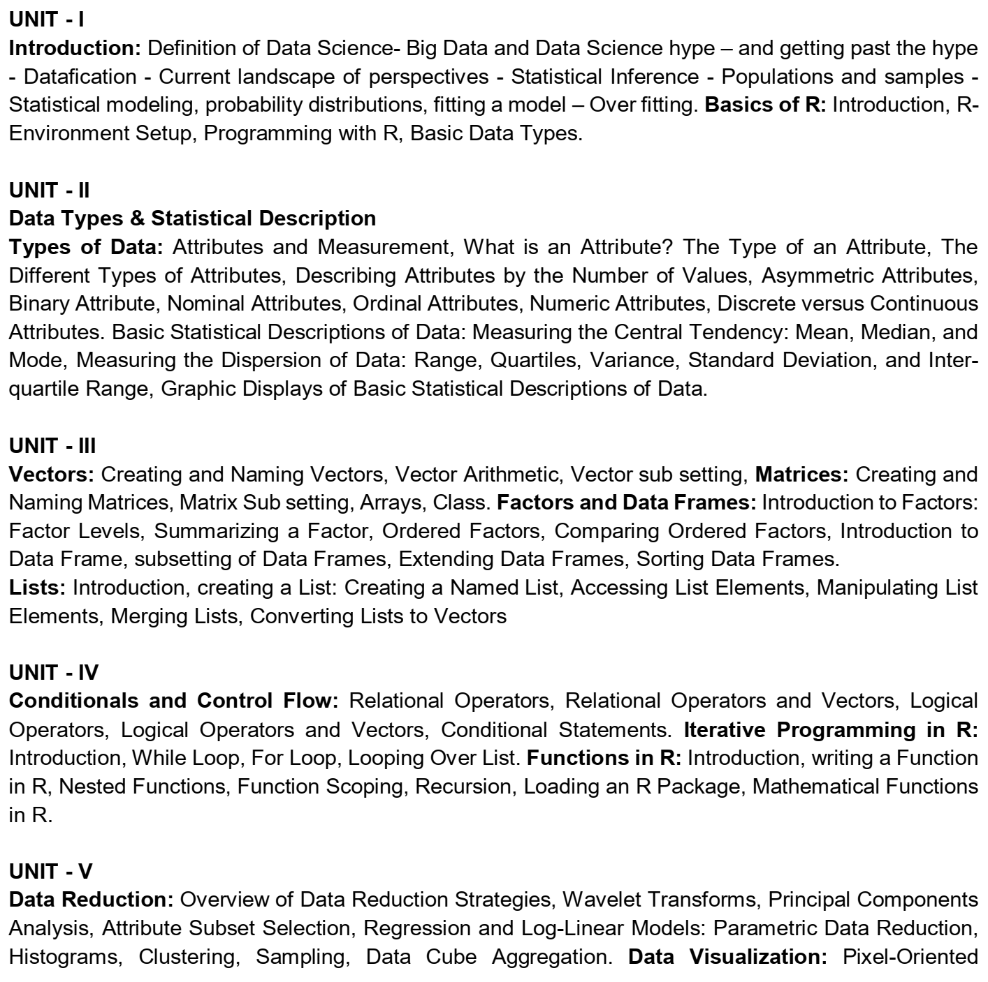

Slide 3
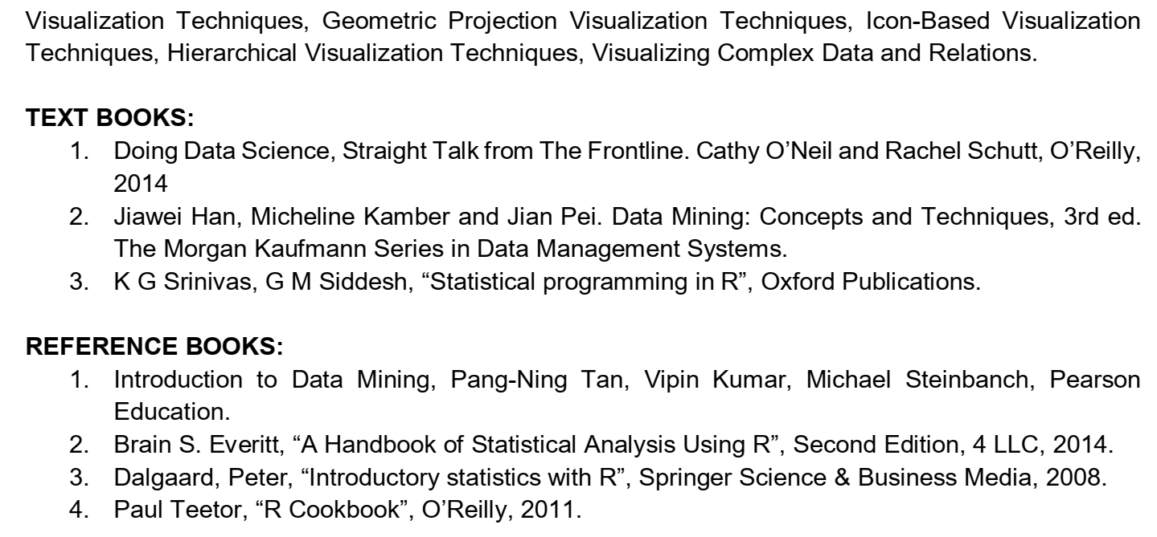

Slide 4
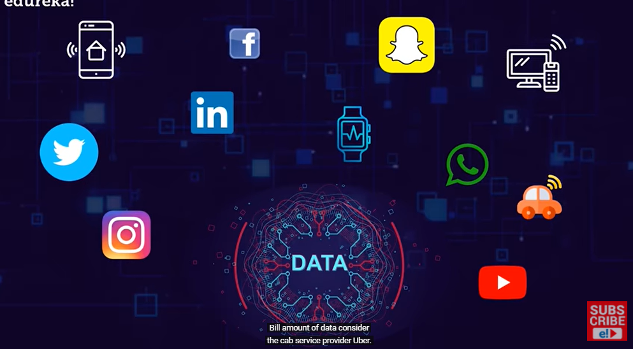
Applications of Data Science
Various Sources of Data

Slide 5
What is Data? What is Information? What is Knowledge? What is Intelligence?
Data: The raw facts/set of records/Any real world business fact
Types of Data
Structured data: The data is in some format
Ex: RDBMS Table
Unstructured data: Data is not in structure
Ex: Media and Entertainment, Surveillance data, Geo spatial data, Audio, Weather data etc
Semi-structured data: Combination of both structured and un-structured
Ex: All markup languages like HTML,XML etc
Information: The meaning of data/what you understand by reading data
Knowledge: Skills acquired through experience or education; the theoretical or practical understanding of a subject give knowledge
Intelligence: The ability to solve a new problem using existing knowledge is known as Intelligence.

Slide 6
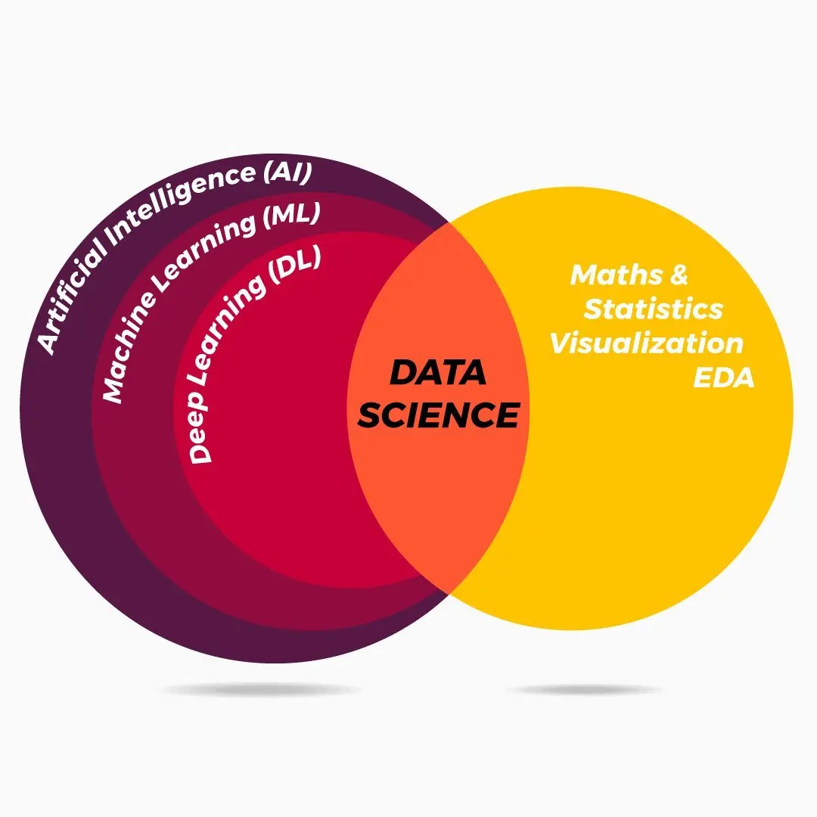
RELATIONSHIP BETWEEN AI, MACHINE LEARNING, DEEP LEARNING & DATA SCIENCE?

Slide 7
What is Data Science?
Past Few year, lot of hype in the media about “data science” and “Big Data.” Today, Data rules the world. This has resulted in a huge demand for Data Scientists.
A Data Scientist helps companies with data-driven decisions, to make their business better.
Data science is a field that deals with unstructured, structured data, and semi-structured data.
Data science is the combination of: statistics, mathematics, programming, and problem-solving;

Slide 8
DATA SCIENCE PROCESS
What is the role of the Data Scientist Job
Define Business Problem
Data Acquisition/Data Collection
Data Representation
Exploratory Data Analysis
Data Modelling
Visualization and Communication
Deployment and Maintains

Slide 9
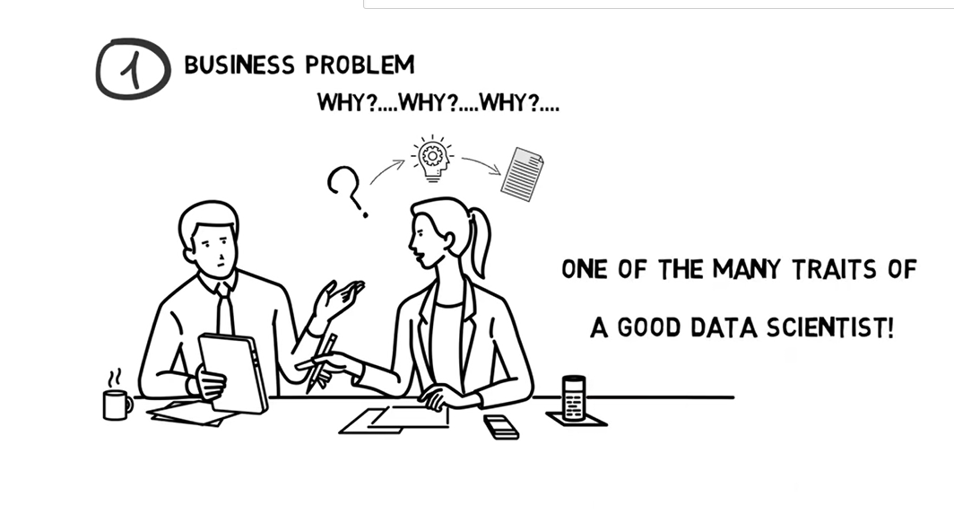

Slide 10
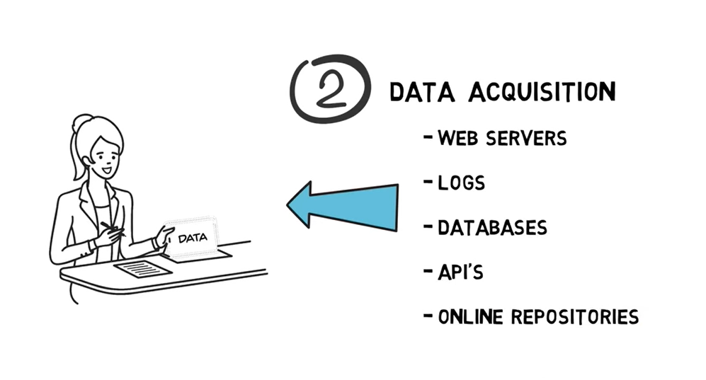

Slide 11
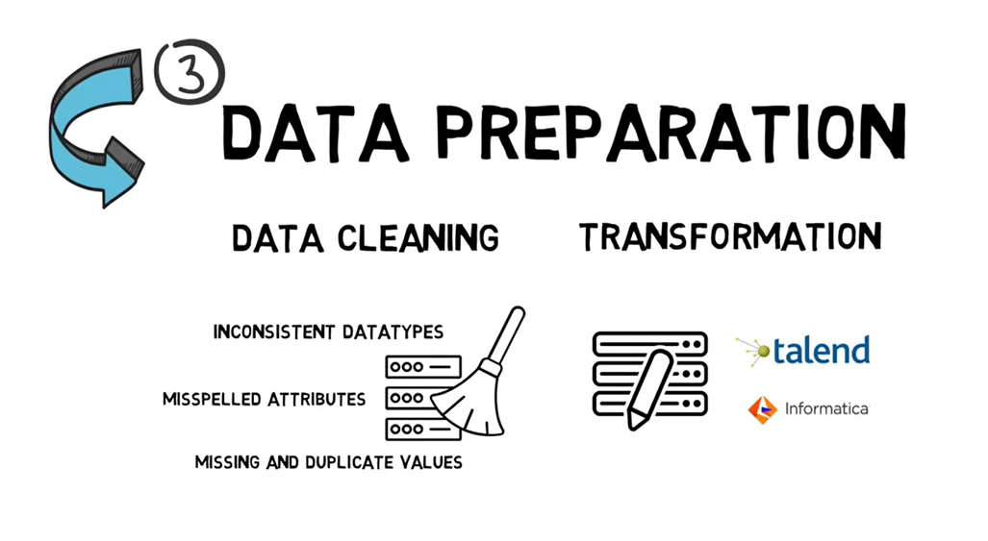

Slide 12
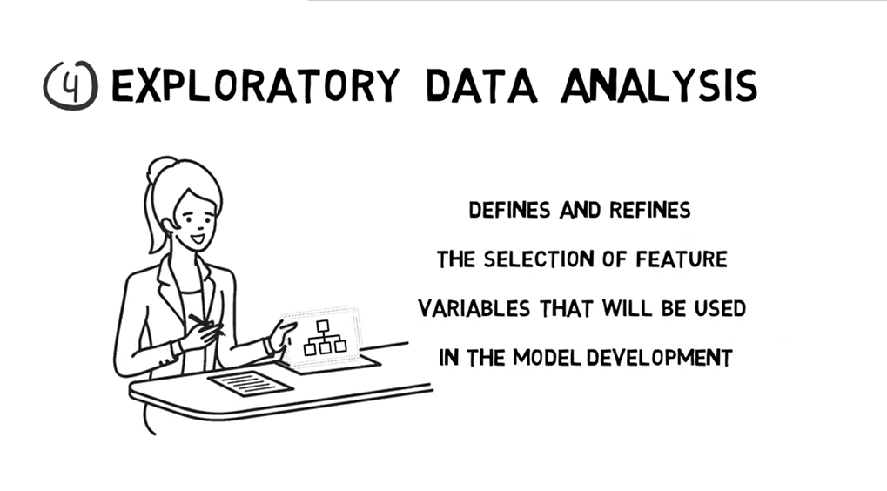

Slide 13
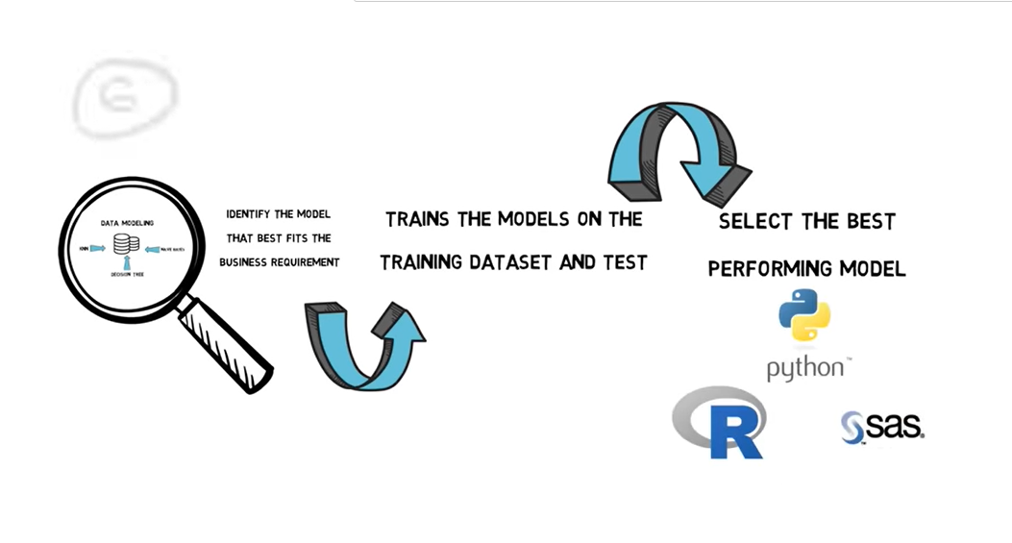
Data Modeling

Slide 14
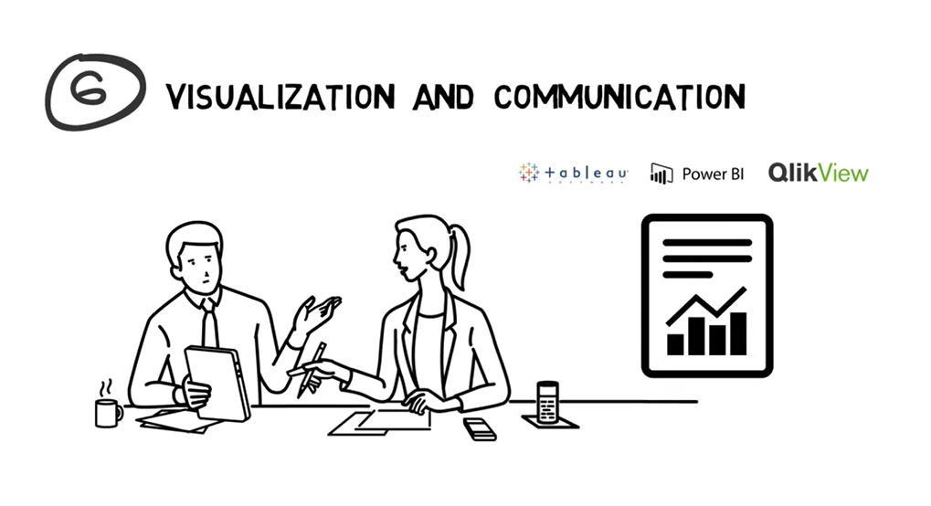

Slide 15
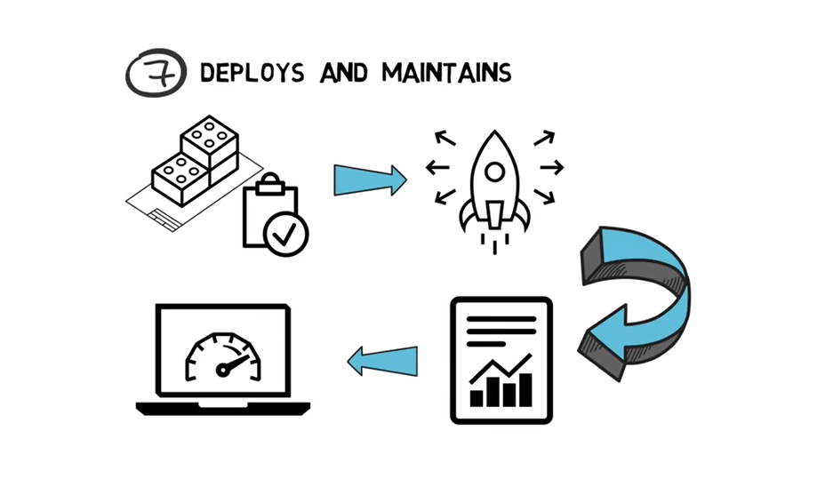

Slide 16
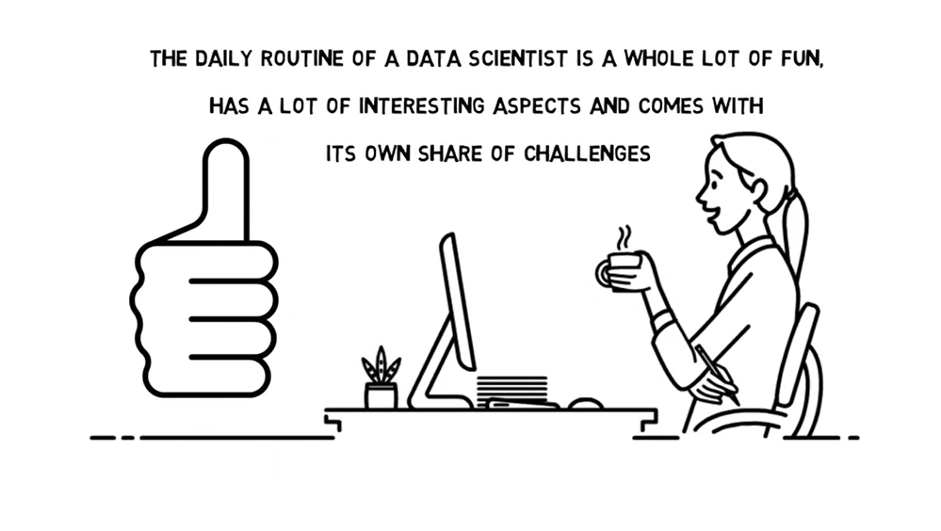

Slide 17
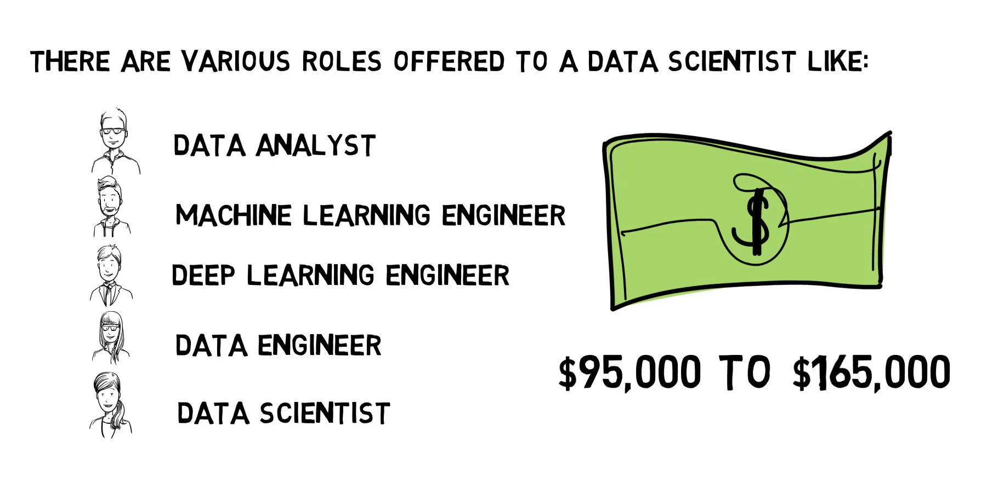

Slide 18
