Slide 1
Wolfram Mathematica
By Bot Team

Slide 2

Not Quite A Bot...
Mathematica is a mathematical computational program started by Stephen Wolfram.
Uses Wolfram Language (can be difficult to master)
Includes numerous libraries.
Not free :(
There is a trial version, though.

Slide 3
Features
Matrix and data manipulation
Animation
Tools for solving combinatoric problems
Image processing
Parallel programming
Text mining
Creating and deploying cloud-based services
Calculus
Tools for solving systems of equations, diophantine equations, ordinary differential equations, partial differential equations, differential algebraic equations, delay differential equations, stochastic differential equations, and recurrence relations.

Slide 4
Features (cont.)
Elementary functions
Special functions
Multivariate statistics
Signal processing (wavelet analysis)
Finite element analysis including mesh generation
Number theory
Group theory
Data mining
Import and export filters for data files
Tools for connecting to DLL, SQL, Java, C++, HTTP based systems
And many more...

Slide 5
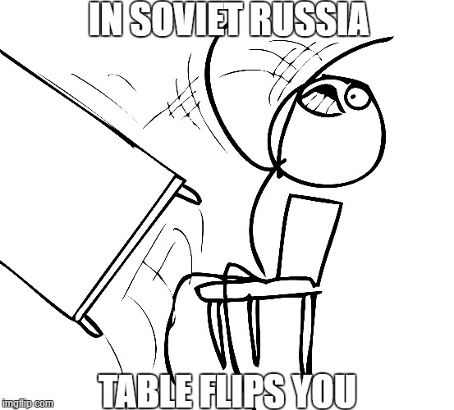

Slide 6
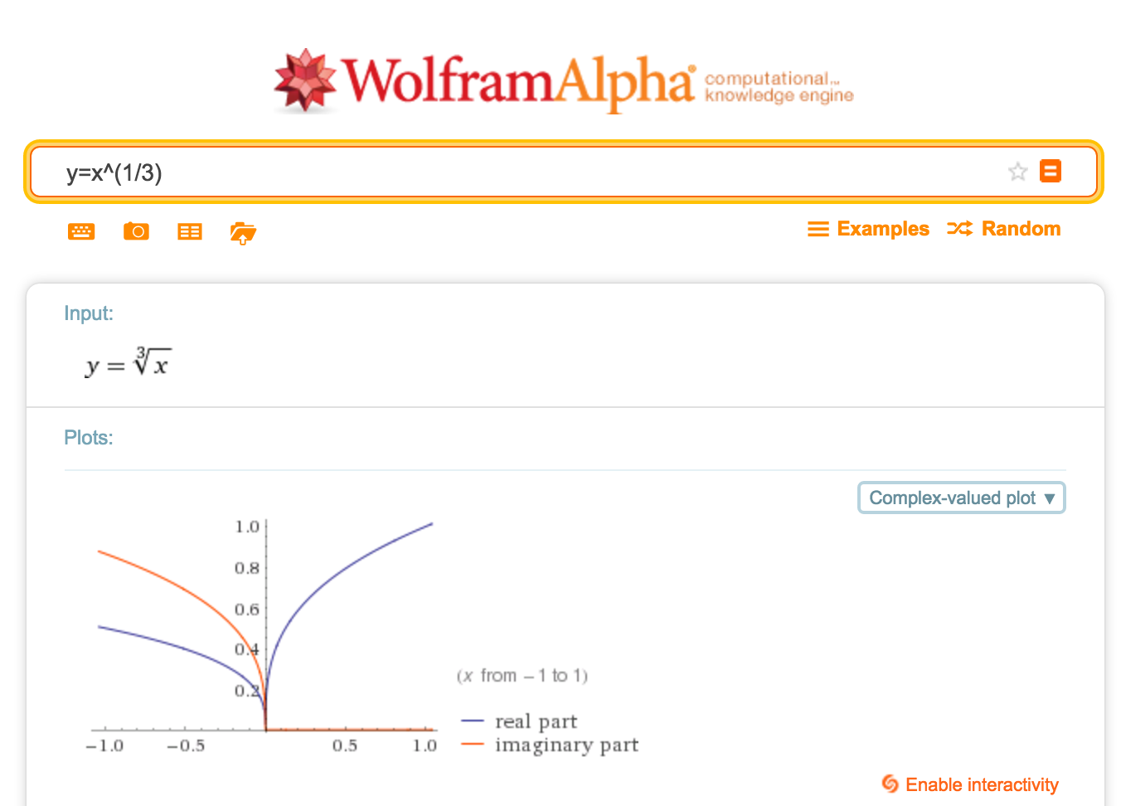
Wolfram Alpha...

Slide 7
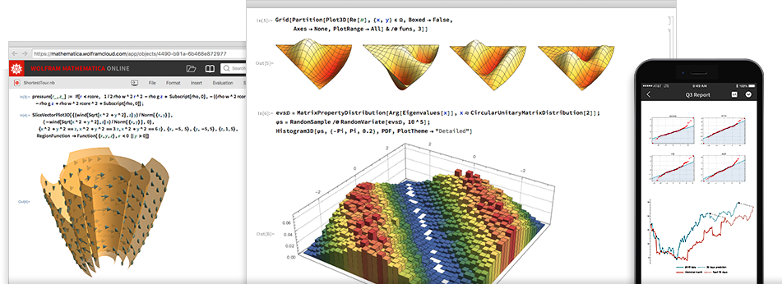
Wolfram Mathematica:
Desktop:
Online:
Mobile:

Slide 8
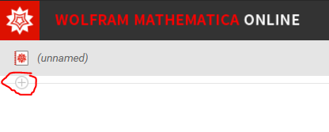
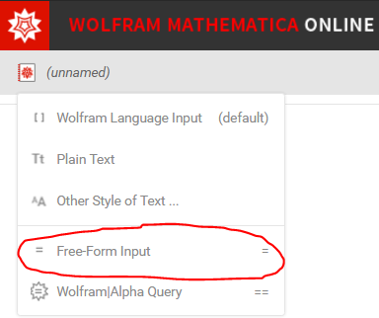
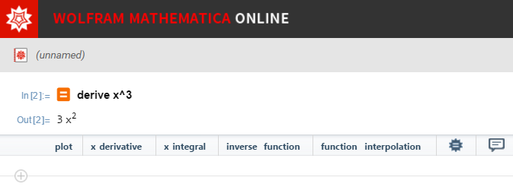
The Basics
You can use Mathematica without knowing the Wolfram Language:
Free-from input:
Click the “plus sign”, select Free-Form Input. This allows you to input commands like you do with Wolfram Alpha.

Slide 9
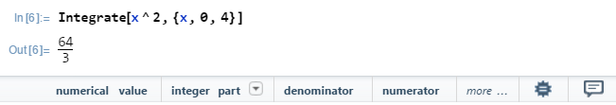

The Language
Tells Mathematica what you really want to do
Rules:
Command names have capital letters
Square brackets surround arguments
Curly braces for lists and ranges
Shift + enter to evaluate input (just the enter key would create newline)
example:

Slide 10
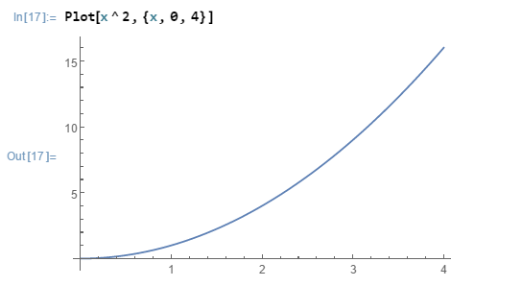
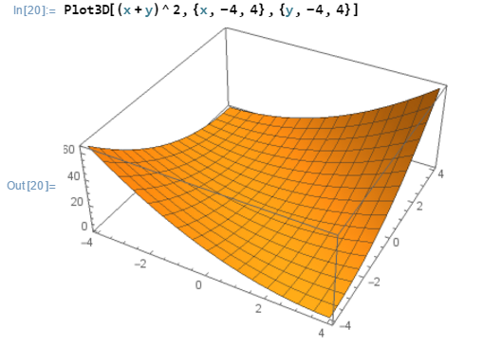
Graphing
Taking the integration from the previous slide, we simply replace Integrate with Plot:
Plotting in 3D is similar:

Slide 11
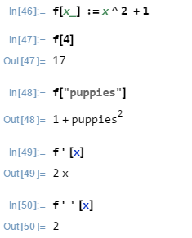
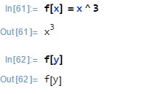

Creating Functions
Example:
f is the function name
IMPORTANT: The _ means x can represent any variable (like “puppies”). Without it:
:= means delayed evaluation while = means immediate evaluation (shows output).
Example:

Slide 12
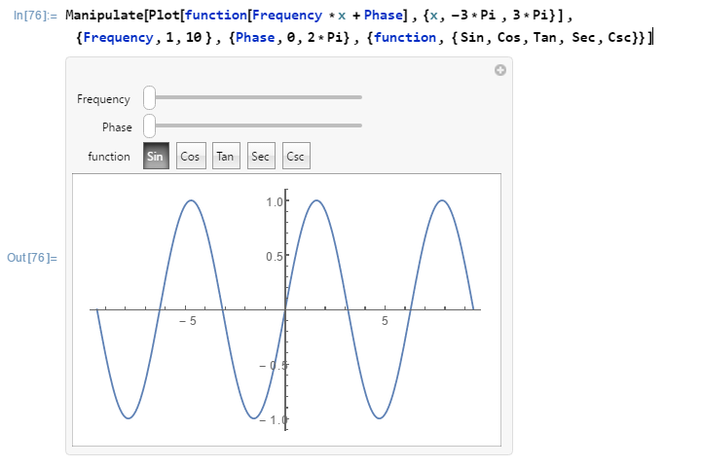
Interactive Graphs
Manipulate allows for interactive manipulation of values.
Values of Frequency and Phase are defined in ranges in { }
function choices are defined in a list: {Sin, Cos, Tan, Sec, Csc}

Slide 13
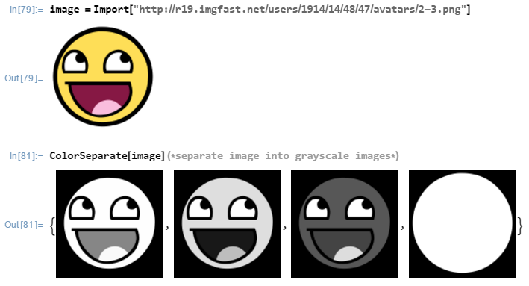
Importing Data
It is easy to import files. Syntax: Import["file"]
Files can be images, table formats ( .csv, .xls, etc.), or matrix formats ( .mat, .mtx ).
Image example:

Slide 14
Thank You!
Sources:
https://reference.wolfram.com/language/
http://www.wolfram.com/language/fast-introduction-for-programmers/en/
http://www.slate.com/articles/technology/bitwise/2014/03/stephen_wolfram_s_new_programming_language_can_he_make_the_world_computable.html

