Slide 1

CSE 163
Stock Market Movement Prediction
Byungsu Jung, Seoyoung Park

Slide 2



Question Summary
Predict stock market price movement based on top 25 News headlines for each day
Implement different machine learning models to evaluate which feature extraction showed highest prediction

Slide 3
Process
1. Data Preparation
2. Vectorize
Tf-idf & N-gram
3. Choose
Best N-gram
6. Hyper-parameter
Tuning
4. Logistic
Regression
5. Random
Forest

Slide 4





7. Random-Search
9. Neural
Network
8. Grid-Search

Slide 5
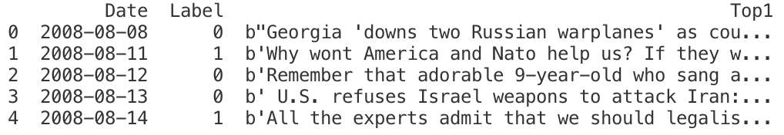



#Data #Kaggle #Date #Label #Headlines #Top1~Top25

Slide 6
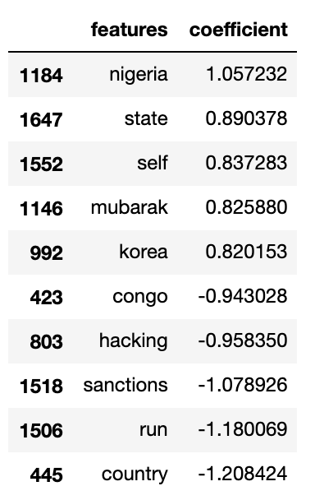
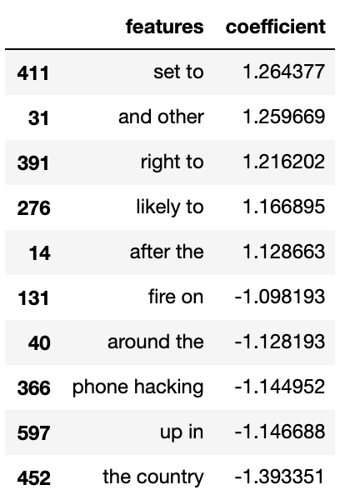
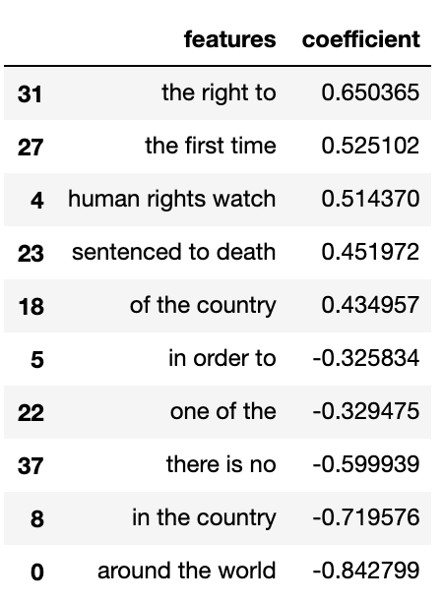
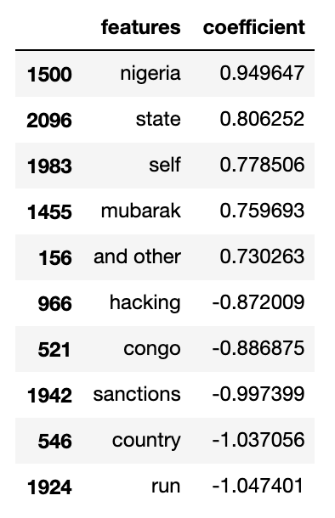
Uni-gram
Bi-gram
Tri-gram
All(1-3 words)
Accuracy:0.46965
Accuracy:0.57255
Accuracy:0.52770
Accuracy:0.51715
#N-gram #Features #Top5_Positive #Top5_Negative

Slide 7
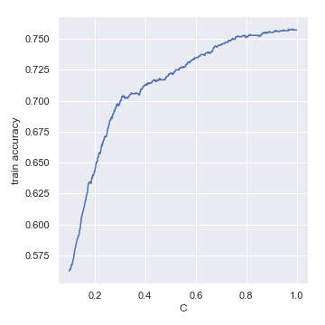
#Logistic_Regression #Train_Accuracy

Slide 8
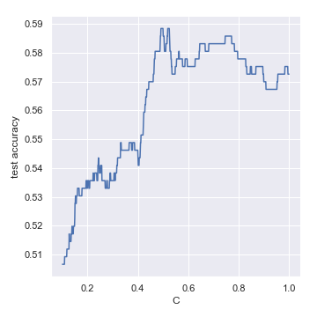
#Logistic_Regression #Test_Accuracy
Best C = 0.491, Best_acc: 0.588

Slide 9
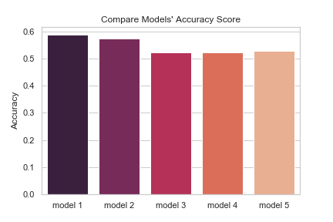
model 1: Logistic Regression (with Test set)
model 2: Logistic Regression (with Validation set)
model 3: Base RandomForest
model 4: RandomForest using RandomSearch
model 5: RandomForest using GridSearch
#Compare_Accuracy

Slide 10
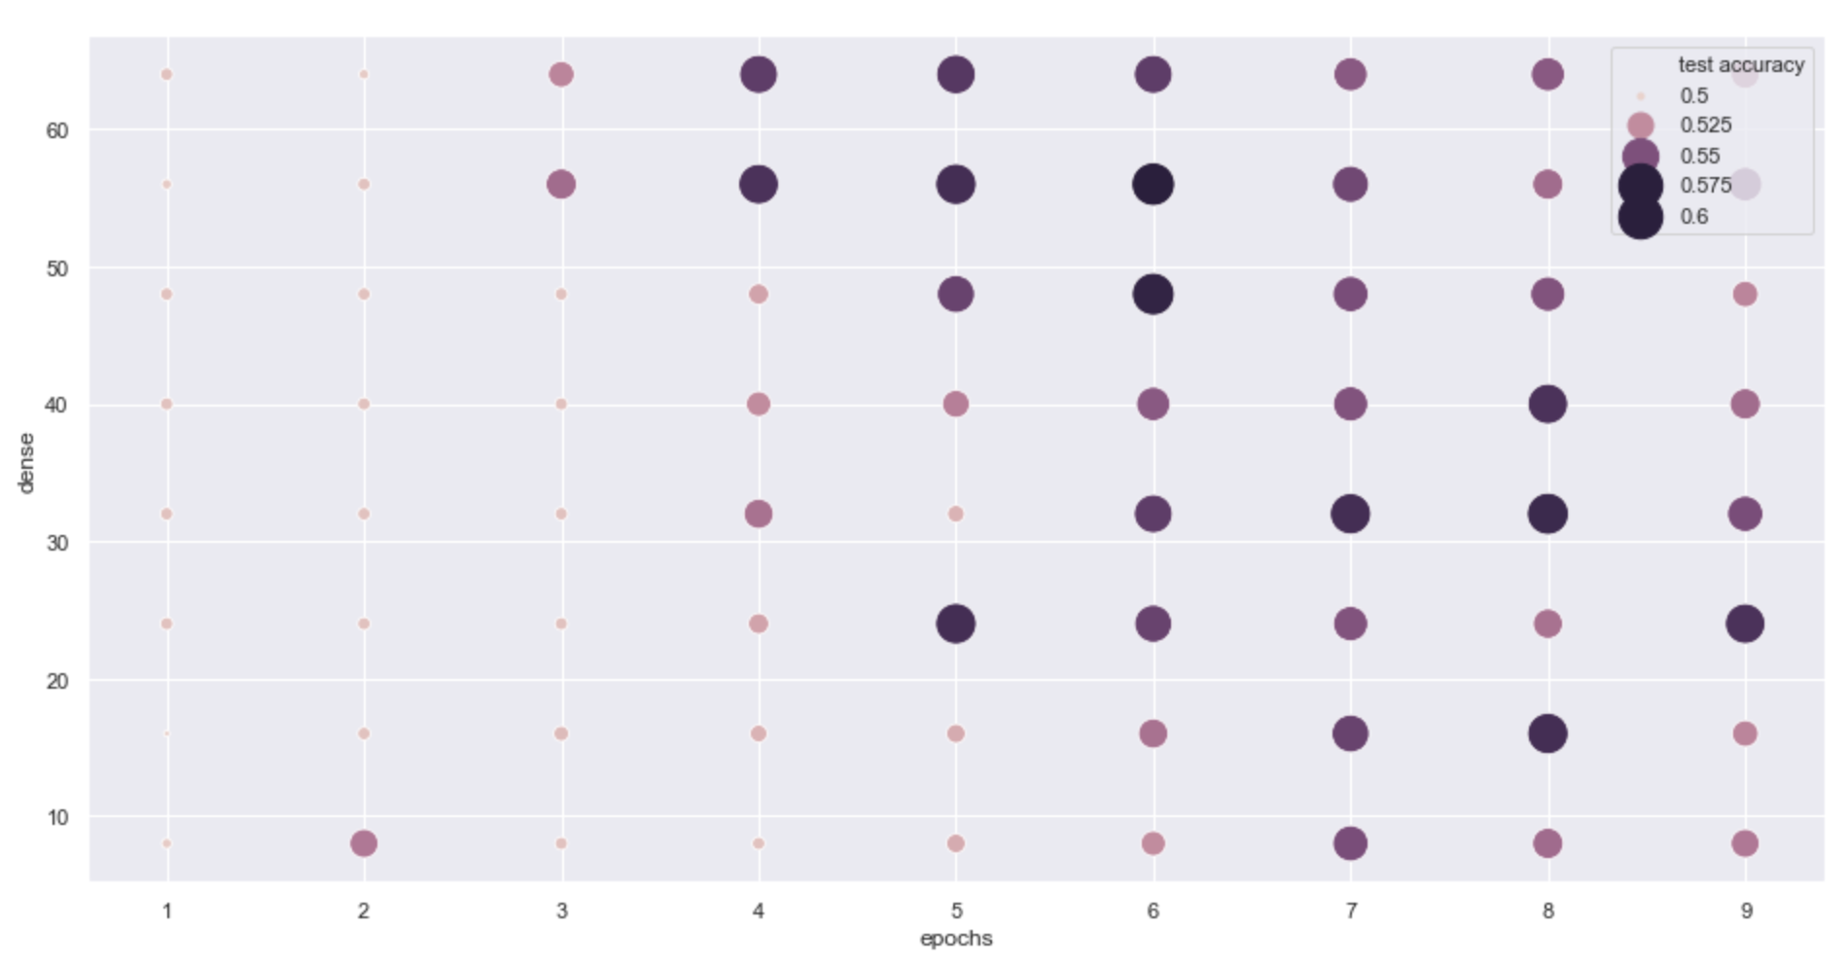
#Neural_Network #Tensorflow
Best Test Accuracy = 0.575198

Slide 11

Thank you

Slide 12

Thank you

